Slide 1
Nuclear rockets

Slide 2
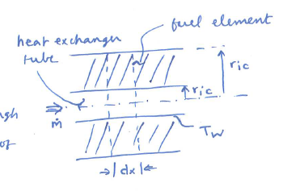

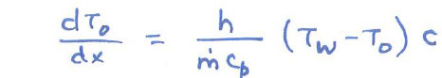
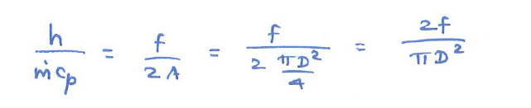
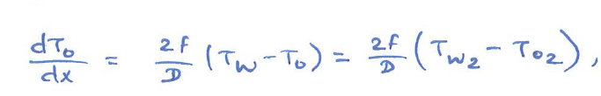
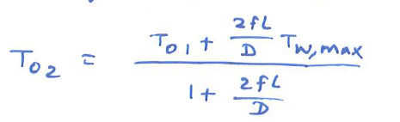
Nuclear heated rocket
the power density of the nuclear reactor
outer radius of the heat exchanger tube
inner radius of the heat exchanger tube
heat transfer coefficient
heat exchanger tube's perimeter
wall temperature
The Reynold's analogy between skin friction and hear transfer:
entry
exit

Slide 3
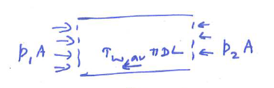
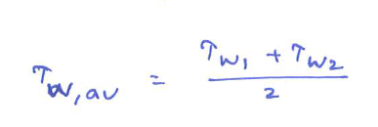


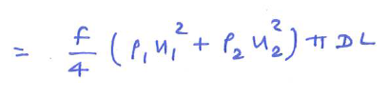

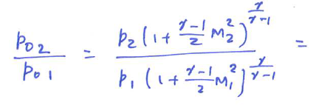
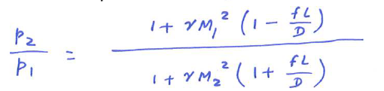
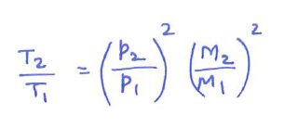
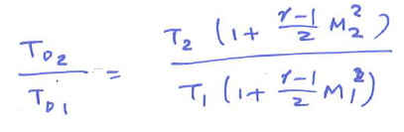

Pressure-drop in heat exchanger:
Average shear stress across the heat exchanger:
Shear force across the exchanger:
Momentum equation:

