Slide 1
Sections 1 – 4

Slide 2
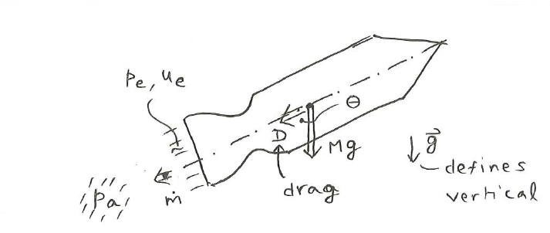







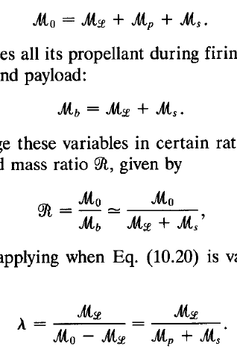



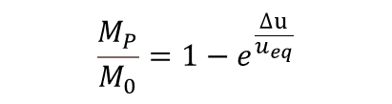
Thrust:
Section1 :
Equivalent exhaust velocity
Specific impulse:
Acceleration:
Velocity Rise:
Impulsive Velocity Rise:
Burnout mass:
$${M_{S}=M_{eng}+M}_{tank}$$
$$\frac{M_{P}}{M_{0}}=1−e^{\frac{∆u}{u_{eq}}}$$

Slide 3

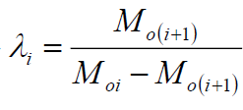
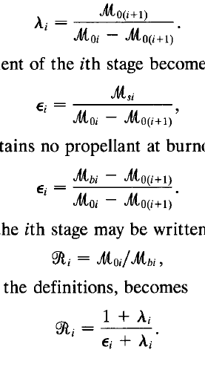
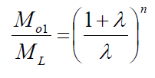

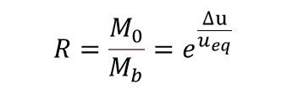



Multi-Stage Rockets:
Payload ratio:
Structural Coefficient:
$ε=\frac{M_{S}}{M_{P}+M_{S}}$
$$R=\frac{M_{0}}{M_{b}}{=e}^{\frac{∆u}{u_{eq}}}$$
Mass ratio:
$$M_{oi}=M_{oi+1}+M_{si}+M_{pi}$$
$$M_{bi}=M_{oi+1}+M_{si}$$
Payload ratio of the ith stage:
Structural coefficient of the ith stage:
Mass ratio of the ith stage:
$$R_{i}=\frac{M_{oi}}{M_{bi}}$$
Overall mass ratio:

Slide 4
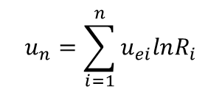
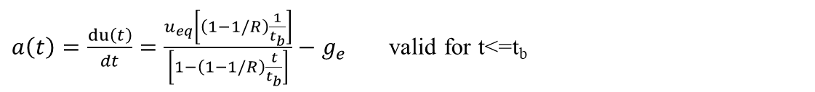

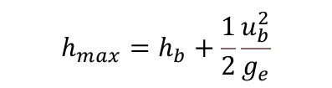

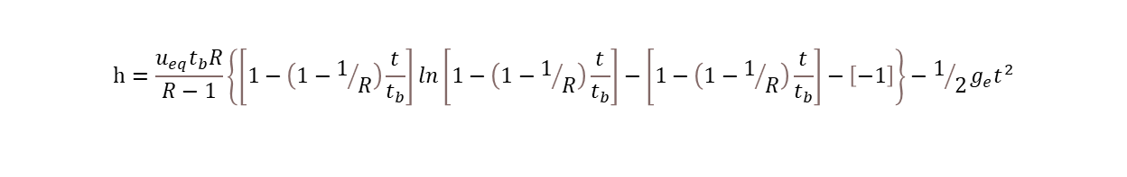

Section2 :
$$u_{b}=u_{eq}\ln{R}−g_{e}t_{b}$$
$$h_{b}=\int_{0}^{t_{b}}{u\left(t\right)dt={−u}_{eq}t_{b}\frac{lnR}{R−1}+u_{eq}t_{b}−1/2g_{e}t_{b}^{2}}$$
Velocity at burnout
Altitude at burnout
Altitude for ${t<t}_{b}$
$$h=\frac{u_{eq}t_{b}R}{R−1}\left\{\left[1−\left(1−1/R\right)\frac{t}{t_{b}}\right]ln\left[1−\left(1−1/R\right)\frac{t}{t_{b}}\right]−\left[1−\left(1−1/R\right)\frac{t}{t_{b}}\right]−\left[−1\right]\right\}−1/2g_{e}t^{2}$$
$$h_{max}=h_{b}+\frac{1}{2}\frac{u_{b}^{2}}{g_{e}}$$
Maximum Altitude
$a\left(t\right)=\frac{du\left(t\right)}{dt}=\frac{u_{eq}\left[\left(1−1/R\right)\frac{1}{t_{b}}\right]}{\left[1−\left(1−1/R\right)\frac{t}{t_{b}}\right]}−g_{e}$ valid for t<=t_{b}
Rocket’s acceleration
$$u_{n}=\sum_{i=1}^{n}{u_{ei}lnR_{i}}$$
n-stage Rockets:
$${∆u}_{i}=u_{eq}lnR_{i}$$
The stage velocity increment
The payload terminal velocity
$$u_{n}=u_{e}\ln\left(\prod_{i=1}^{n}{R_{i}}\right)=nu_{e}ln\frac{1+λ}{ε+λ}$$
The exhaust velocities are all the same:
$$\frac{u_{n}}{u_{e}}=nln\left\{\frac{{(\frac{M_{01}}{M_{L}})}^{1/n}}{ε\left[{\left(\frac{M_{01}}{M_{L}}\right)}^{1/n}−1\right]+1}\right\}$$
$\lim_{n→∞}{u_{n}}=u_{e}\lim_{n→∞}\left\{−nln\left[ε+\frac{1−ε}{{(\frac{M_{01}}{M_{L}})}^{1/n}}\right]\right\}$= $u_{e}\left(1−ε\right)ln⁡(\frac{M_{01}}{M_{L}})$
Similar stages:

Slide 5


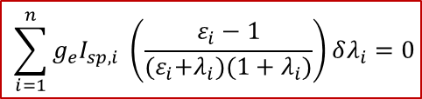



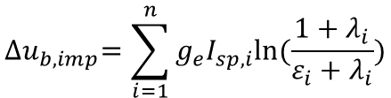


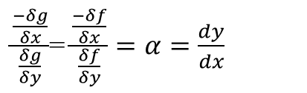
Optimization of multistage Rocket
Lagrange multiplier
$\frac{δh}{δx}=\frac{δf}{δx}+α\frac{δg}{δx}$=0.0
$\frac{\frac{−δg}{δx}}{\frac{δg}{δy}}$= $\frac{\frac{−δf}{δx}}{\frac{δf}{δy}}=α=\frac{dy}{dx}$
$\frac{δh}{δη}=g$=0.0
$$h\left(x,y,α\right)=f\left(x,y\right)+αg(x,y)$$
$\frac{δh}{δy}=\frac{δf}{δy}+α\frac{δg}{δy}$=0.0
$$\sum_{i=1}^{n}{g_{e}I_{sp,i} \left(\frac{ε_{i}−1}{{(ε}_{i}+λ_{i})(1+λ_{i})}\right)δλ_{i}=0}$$
$δ\left[{∆u}_{b,imp}\right]$=0
A
$$\sum_{i=1}^{n}{\frac{1}{λ_{i}(1+λ_{i})}δλ_{i}=0}$$
$δ\left[\frac{M_{L}}{M_{O1}}\right]$=0
B
Lagrange multiplier
$$B+αA=0 ( to get minima λ_{i})$$
$\frac{1}{λ_{i}(1+λ_{i})}+{αg}_{e}I_{sp,i}\frac{ε_{i}−1}{{(ε}_{i}+λ_{i})(1+λ_{i})}$=0
$$λ_{i}=\frac{ε_{i}}{{αg}_{e}I_{sp,i}\left(1−ε_{i}\right)−1}$$
Here $λ_{i}$ is independent :
C
D
$$e={\prod_{i=1}^{n}{\left[\frac{1}{ε_{i}}−\frac{1}{ε_{i}{αg}_{e}I_{sp,i}}\right]}}^{\frac{g_{e}I_{sp,i}}{{∆u}_{b,imp}}}$$
$${∆u}_{b,imp}=\sum_{i=1}^{n}{g_{e}I_{sp,i}ln⁡(\frac{1+λ_{i}}{ε_{i}+λ_{i}})}$$
α is obtain from ${∆u}_{b,imp}:$

Slide 6




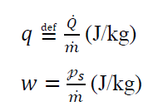



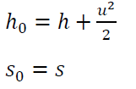



Section3 :
Continuity equation
Momentum equation
Energy equation (I law)
II Law
impulse function
heat addition into the control volume
work done by the control volume per unit time
heat transfer per unit area per unit time
a reversible, adiabatic process (isentropic process), 𝑠2=𝑠1.
diabatic process, 𝑄̇=𝓆̇=0, and 𝑠2≥𝑠1
Stagnation state (u = 0)

Slide 7
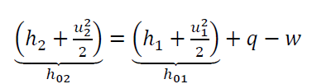













I law:
II Law:
Relation in isentropic flow
An ideal gas
$c_{p}$=$\frac{γR}{γ−1}=\frac{γ\overline{R}}{γ−1\overline{M}}$
Mach number
Mass flow rate

Slide 8
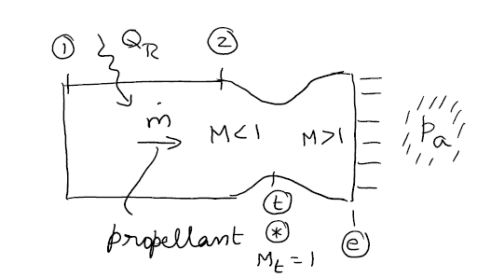






Characteristic Velocity:
Section4 :
Thrust Coefficient:
Ι law across combustion:
Ι law across nozzle:
$\dot{m}c_{p}T_{01}+\dot{m}Q_{R}=\dot{m}c_{p}T_{02}$ ${ T}_{02}=T_{01}+\frac{Q_{R}}{c_{p}}$
$T_{02}$= $T_{01}+\frac{\overline{Q_{R}}}{c_{p}\overline{M}}$
$P_{02}$= $P_{01}$
$h_{0e}$= $h_{02}+q−w$
Mach number at the nozzle exit :
Nozzle area ratio :
The jet pressure at nozzle exit :
$\frac{P_{02}}{P_{e}}$ ${=(1+\frac{γ−1}{2}M_{e}^{2})}^{\frac{γ}{γ−1}}$
For isentropic nozzle:
$P_{02}$= $P_{0e}{ T}_{02}\text{= }T_{0e}$

Slide 9



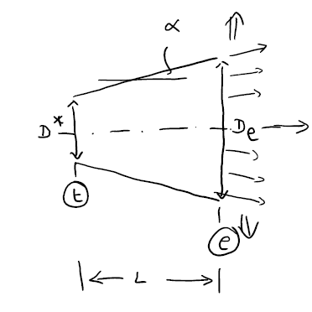
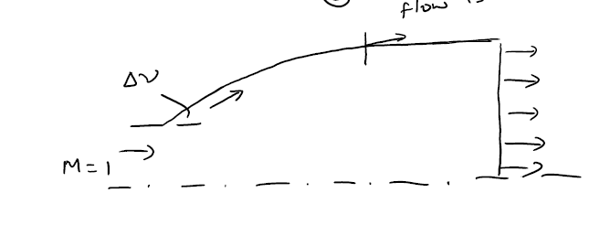


For the ideal rocket thrust chamber model:
Conical
Perfect nozzle:
$\frac{D_{e}}{2}$=$\frac{D^{∗}}{2}+L tanα$
Diverging section nozzle shapes:
Divergence loss
Effect of back pressure:
Underexpanded jet:
$$P_{e}>P_{a}$$
$$P_{e}<P_{a}$$
Overexpanded jet:

