Slide 1
Section 2-Rocket Performance

Slide 2
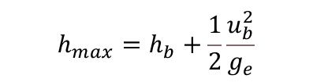

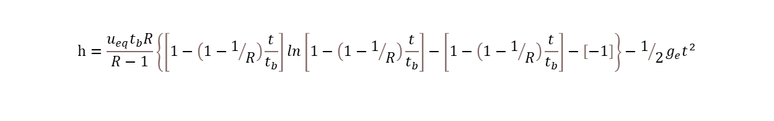
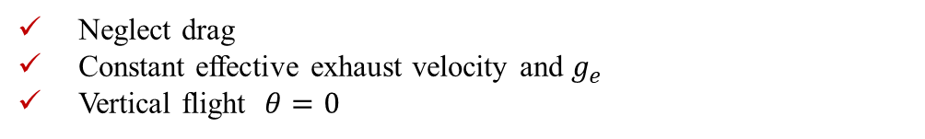


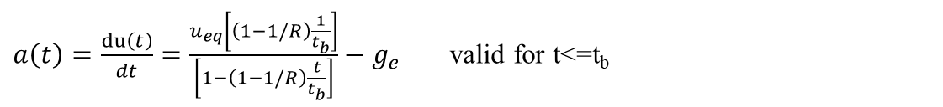
Sounding Rocket Altitude Equation:
Neglect drag
Constant effective exhaust velocity and $g_{e}$
Vertical flight $θ=0$
$$h_{b}=\int_{0}^{t_{b}}{u\left(t\right)dt}$$
Altitude at burnout
Velocity at burnout
$u\left(t\right)=−u_{eq}\ln{\frac{M\left(t\right)}{M_{0}}}−g_{e}t$
$$u_{b}=u_{eq}\ln{R}−g_{e}t_{b}$$
$$M\left(t\right)=M_{0}−\dot{m}∗t=M_{0}−\frac{M_{0}−M_{b}}{t_{b}}t$$
$$u\left(t\right)=−u_{eq}\ln\left[1−\left(1−1/R\right)\frac{t}{t_{b}}\right]−g_{e}t$$
for t$≤$t_{b}
constant fuel burn rate
$$h_{b}=\int_{0}^{t_{b}}{\left\{−u_{eq}ln\left[1−\left(1−1/R\right)\frac{t}{t_{b}}\right]−g_{e}t\right\}dt}$$
$$h_{b}={−u}_{eq}t_{b}\frac{lnR}{R−1}+u_{eq}t_{b}−1/2g_{e}t_{b}^{2}$$
Altitude at burnout
Altitude for ${t<t}_{b}$
$$h=\frac{u_{eq}t_{b}R}{R−1}\left\{\left[1−\left(1−1/R\right)\frac{t}{t_{b}}\right]ln\left[1−\left(1−1/R\right)\frac{t}{t_{b}}\right]−\left[1−\left(1−1/R\right)\frac{t}{t_{b}}\right]−\left[−1\right]\right\}−1/2g_{e}t^{2}$$
$$h_{max}=h_{b}+\frac{1}{2}\frac{u_{b}^{2}}{g_{e}}$$
Maximum Altitude
$a\left(t\right)=\frac{du\left(t\right)}{dt}=\frac{u_{eq}\left[\left(1−1/R\right)\frac{1}{t_{b}}\right]}{\left[1−\left(1−1/R\right)\frac{t}{t_{b}}\right]}−g_{e}$ valid for t<=t_{b}
Rocket’s acceleration

Slide 3


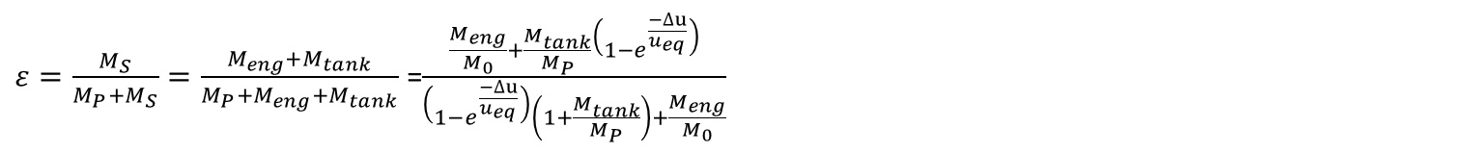


Chemical Rockets:
Single-stage Rockets:
$$R=\frac{M_{0}}{M_{O}−M_{P}}=\frac{M_{0}}{M_{b}}=\frac{M_{0}}{M_{S}+M_{L}}{=e}^{\frac{∆u}{u_{eq}}}$$
$$\frac{M_{P}}{M_{0}}=1−e^{\frac{∆u}{u_{eq}}}$$
Mass Ratio:
$${M_{S}=M_{eng}+M}_{tank}$$
$$\frac{M_{L}}{M_{0}}=1−\frac{M_{eng}}{M_{0}}−\frac{M_{tank}}{M_{P}}\frac{M_{P}}{M_{0}}−\frac{M_{P}}{M_{0}}$$
Structural mass:
$${M_{L}=M}_{0}−\left(M_{eng}+M_{tank}\right)−M_{P}$$
$$\frac{M_{L}}{M_{0}}=1−\frac{M_{eng}}{M_{0}}−\left(1+\frac{M_{tank}}{M_{P}}\right)\left(1−e^{\frac{−∆u}{u_{eq}}}\right)$$
$ε=\frac{M_{S}}{M_{P}+M_{S}}=\frac{M_{eng}+M_{tank}}{M_{P}+M_{eng}+M_{tank}}$ =$\frac{\frac{M_{eng}}{M_{0}}+\frac{M_{tank}}{M_{P}}\left(1−e^{\frac{−∆u}{u_{eq}}}\right)}{\left(1−e^{\frac{−∆u}{u_{eq}}}\right)\left(1+\frac{M_{tank}}{M_{P}}\right)+\frac{M_{eng}}{M_{0}}}$
Structural Coefficient:

Slide 4




n-stage Rockets:
The stage velocity increment :
$${∆u}_{i}=u_{eq}lnR_{i}$$
$$u_{n}=\sum_{i=1}^{n}{u_{ei}lnR_{i}}$$
The payload terminal velocity :
$$u_{n}=u_{e}\ln\left(\prod_{i=1}^{n}{R_{i}}\right)=nu_{e}ln\frac{1+λ}{ε+λ}$$
The exhaust velocities are all the same:
$$\frac{M_{01}}{M_{L}}={\left(\frac{1+λ}{λ}\right)}^{n}$$
$$\frac{u_{n}}{u_{e}}=nln\left\{\frac{{(\frac{M_{01}}{M_{L}})}^{1/n}}{ε\left[{\left(\frac{M_{01}}{M_{L}}\right)}^{1/n}−1\right]+1}\right\}$$
$$\lim_{n→∞}{u_{n}}=u_{e}\lim_{n→∞}\left\{−nln\left[ε+\frac{1−ε}{{(\frac{M_{01}}{M_{L}})}^{1/n}}\right]\right\}$$
$$\lim_{n→∞}{u_{n}}=u_{e}\left(1−ε\right)ln⁡(\frac{M_{01}}{M_{L}})$$
Similar stages:

Slide 5


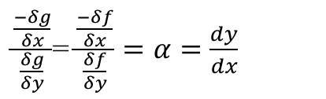
Lagrange multiplier
Let $z= f(x,y)$for Maxima or minima: $dz=0.0$
$\frac{δf}{δx}dx+\frac{δf}{δy}$ dy=0.0
dx and dy are independent and not zero.
Let g(x,y)=0 a curve in xy plane:
Points on the curve $g=0.0$at which is stationary $g=0 dg=0.0$
$\frac{δg}{δx}dx+\frac{δg}{δy}$ dy=0.0
$\frac{δf}{δx}+α\frac{δf}{δy}$ =0.0
$\frac{\frac{−δg}{δx}}{\frac{δg}{δy}}$= $\frac{\frac{−δf}{δx}}{\frac{δf}{δy}}=α=\frac{dy}{dx}$
$\frac{δg}{δx}+α\frac{δg}{δy}$ =0.0
$$h\left(x,y,α\right)=f\left(x,y\right)+αg(x,y)$$
$\frac{δh}{δx}=\frac{δf}{δx}+α\frac{δg}{δx}$=0.0
$\frac{δh}{δη}=g$=0.0
$\frac{δh}{δy}=\frac{δf}{δy}+α\frac{δg}{δy}$=0.0

Slide 6
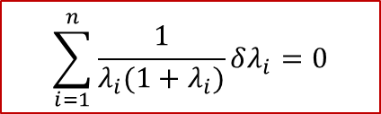
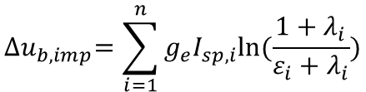


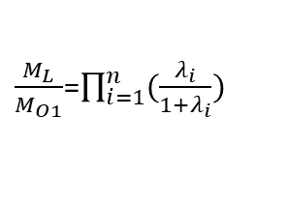

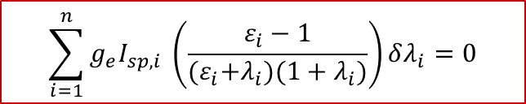


Optimization of multistage Rocket
$${∆u}_{b,imp}=\sum_{i=1}^{n}{g_{e}I_{sp,i}ln⁡(\frac{1+λ_{i}}{ε_{i}+λ_{i}})}$$
$$\sum_{i=1}^{n}{g_{e}I_{sp,i} \left(\frac{ε_{i}−1}{{(ε}_{i}+λ_{i})(1+λ_{i})}\right)δλ_{i}=0}$$
$δ\left[{∆u}_{b,imp}\right]$=0
A
For maximation of $\frac{M_{L}}{M_{O1}}$
$\frac{M_{L}}{M_{O1}}$=$\prod_{i=1}^{n}{(\frac{λ_{i}}{1+λ_{i}})}$
$$\sum_{i=1}^{n}{\frac{1}{λ_{i}(1+λ_{i})}δλ_{i}=0}$$
$δ\left[\frac{M_{L}}{M_{O1}}\right]$=0
B
If we use Lagrange multiplier for A and B then:
$$B+αA=0 ( to get minima λ_{i})$$
Here $λ_{i}$ is independent :
$\frac{1}{λ_{i}(1+λ_{i})}+{αg}_{e}I_{sp,i}\frac{ε_{i}−1}{{(ε}_{i}+λ_{i})(1+λ_{i})}$=0
C
$$λ_{i}=\frac{ε_{i}}{{αg}_{e}I_{sp,i}\left(1−ε_{i}\right)−1}$$
D

Slide 7
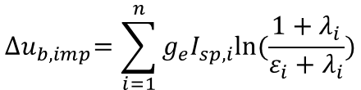




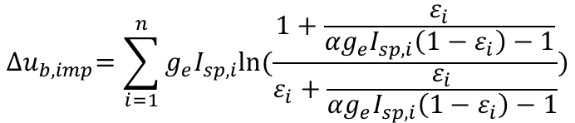

$${∆u}_{b,imp}=\sum_{i=1}^{n}{g_{e}I_{sp,i}ln⁡(\frac{1+λ_{i}}{ε_{i}+λ_{i}})}$$
Replacing $λ_{i}$
α is obtain from ${∆u}_{b,imp}:$
$${∆u}_{b,imp}=\sum_{i=1}^{n}{g_{e}I_{sp,i}ln⁡(\frac{1+\frac{ε_{i}}{{αg}_{e}I_{sp,i}\left(1−ε_{i}\right)−1}}{ε_{i}+\frac{ε_{i}}{{αg}_{e}I_{sp,i}\left(1−ε_{i}\right)−1}})}$$
/ ${∆u}_{b,imp}$
$$1=\sum_{i=1}^{n}{\frac{g_{e}I_{sp,i}}{{∆u}_{b,imp}}ln⁡(\frac{1+\frac{ε_{i}}{{αg}_{e}I_{sp,i}\left(1−ε_{i}\right)−1}}{ε_{i}+\frac{ε_{i}}{{αg}_{e}I_{sp,i}\left(1−ε_{i}\right)−1}})}$$
$$e=e^{\sum_{i=1}^{n}{{ln⁡(\frac{1+\frac{ε_{i}}{{αg}_{e}I_{sp,i}\left(1−ε_{i}\right)−1}}{ε_{i}+\frac{ε_{i}}{{αg}_{e}I_{sp,i}\left(1−ε_{i}\right)−1}})}^{\left[\frac{g_{e}I_{sp,i}}{{∆u}_{b,imp}}\right]}}}$$
$$e={\prod_{i=1}^{n}{\left[\frac{1}{ε_{i}}−\frac{1}{ε_{i}{αg}_{e}I_{sp,i}}\right]}}^{\frac{g_{e}I_{sp,i}}{{∆u}_{b,imp}}}$$
e
$\left[{\frac{1}{ε_{1}}−\frac{1}{ε_{1}{αg}_{e}I_{sp,1}}}^{\frac{g_{e}I_{sp,1}}{{∆u}_{b,imp}}}\right]$ $\left[{\frac{1}{ε_{2}}−\frac{1}{ε_{2}{αg}_{e}I_{sp,2}}}^{\frac{g_{e}I_{sp,2}}{{∆u}_{b,imp}}}\right]$……….. $\left[{\frac{1}{ε_{n}}−\frac{1}{ε_{n}{αg}_{e}I_{sp,n}}}^{\frac{g_{e}I_{sp,n}}{{∆u}_{b,imp}}}\right]$=e=2.718

