Slide 1
Module 2 :A review of thermodynamics and gas dyanmics

Slide 2




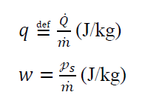



General 1-D, steady flow of a perfect gas:
Continuity equation
Momentum equation
Energy equation (I law)
II Law
impulse function
heat addition into the control volume
work done by the control volume per unit time
heat transfer per unit area per unit time
a reversible, adiabatic process (isentropic process), 𝑠2=𝑠1.
diabatic process, 𝑄̇=𝓆̇ not equal to zero, and 𝑠2≥𝑠1

Slide 3

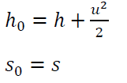


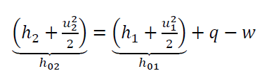






Stagnation state (u = 0)
Adiabatically
Reversibly
Without work
I and II laws
Calorically Perfect Gas (CPG)
I law:
II Law:
Relation between stagnation pressure ratio and stagnation temperature ratio in isentropic flow
Relation between pressure ratio and temperature ratio in isentropic flow

Slide 4






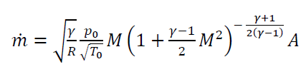

Mach number
local speed of sound
An ideal gas
Mass flow rate in terms of stagnation values and Mach number
Substituting 𝑇,P

Slide 5
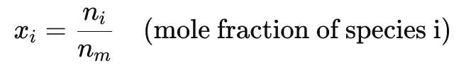
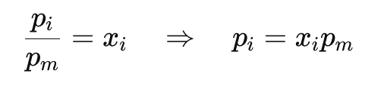
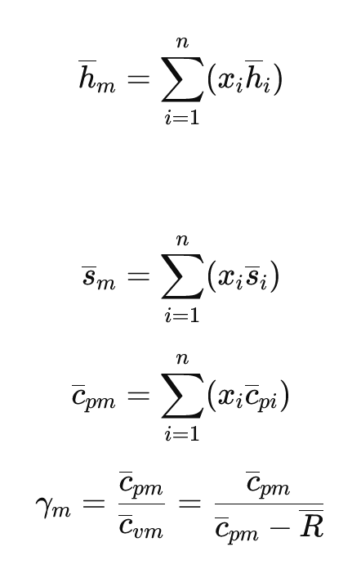
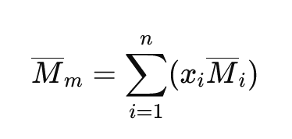
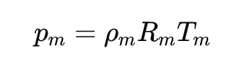
Gas Mixture

Slide 6
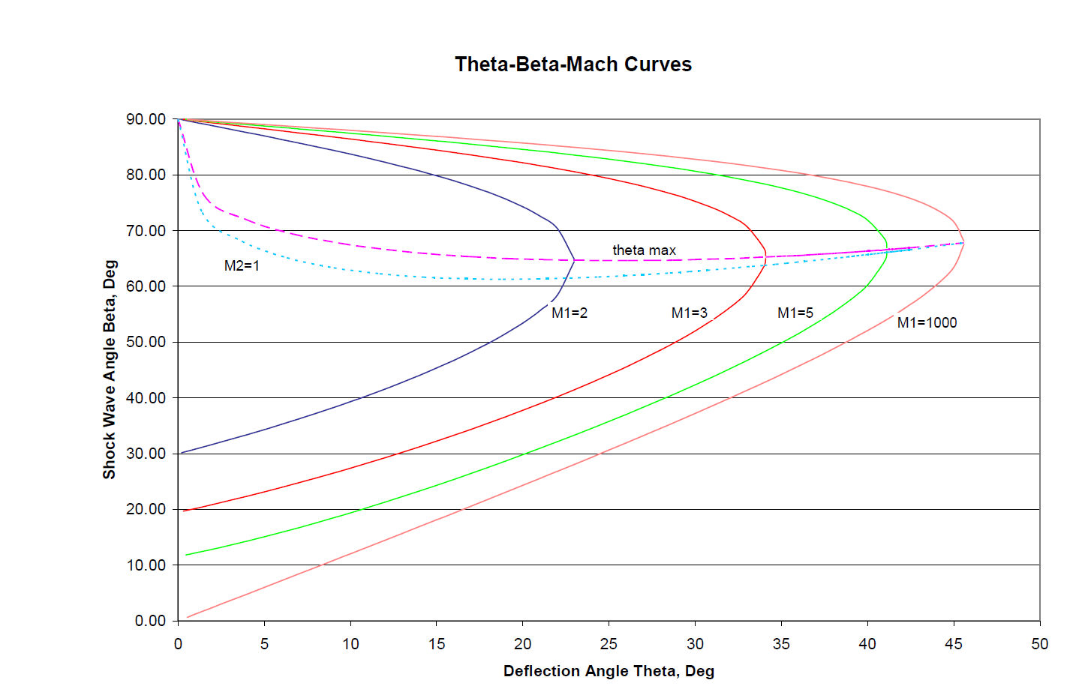
Oblique Shocks

