Slide 1
Section 6 – EQUILIBRIUM COMBUSTION THERMODYNAMICS;
CHEMICAL REACTIONS

Slide 2

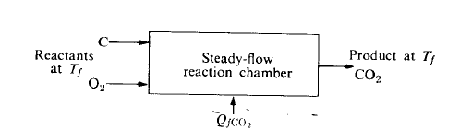




Composition and temperature of the exhaust products of a constant-pressure adiabatic combustion process.
Chemical Transformation
Csolid + O2 gas→ CO2 gas. Heat of formation of carbon dioxide (-393.522 kJ/gmol) at 298 K:
reactant
products
heat of interaction:
A steady-flow process (experimental): heat transfer is equal to the change in enthalpy. (No shaft work)
Complex reactions:
number of moles of reactant i
heat of formation per mole

Slide 3
Stoichiometric Ratio
In combustion, the stoichiometric ratio refers to the exact air-to-fuel ratio needed for complete combustion.
At this ratio, all the fuel burns completely with the available oxygen, leaving no excess fuel or oxygen.
The products of a stoichiometric combustion reaction typically include carbon dioxide (CO₂) and water (H₂O), without any unburnt fuel or residual oxygen.
The stoichiometric air-to-fuel ratio is critical because it ensures that the reaction uses the optimal amount of air to burn the fuel completely.

Slide 4


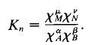

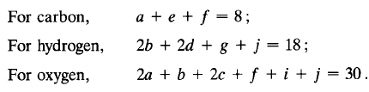
Chemical equilibrium:
Stoichiometric combination of A and B react to form products M and N:
small number
Equilibrium constant for the mixture in term of partial pressures:
Based on mole fractions :
Gibbs-Dalton law,
Composition of Products:
combustion of a particular nonstoichiometric mixture of octane and oxygen at low temperature:
At high temperatures:
Atom balances yield:
six more independent equations are required.

Slide 5
Reactions Close to Stoichiometry (Rocket combustors , Ramjet combustors, Piston engines, Welding torches)
Cannot easily predict the final composition of the burnt gases
Complex molecules like H₂O tend to break down into simpler ones such as O, H ,OH
Iteration procedure to Determine the temperature and other properties of the gas products :
Identify the possible molecular species in the products, classify them into major and minor.
Neglect at first the “minor” species, obtain the “major” species concentration and an approximate temperature.
Write chemical reactions which would produce one “minor” species at a time from only “major” ones.
Calculate their equilibrium constants at the approximate temperature of step (2),
Use the equilibrium laws to calculate the concentrations of the “minors”.
Correct the “majors” concentration, and do a new enthalpy balance to obtain an improved temperature.
Iterate back to step (3) until convergence is obtained

Slide 6
NASA CEA
There are several computational tools and codes available that can perform the iterative process for determining the temperature and concentrations of the gas products in equilibrium reactions.
Here are some popular software tools and approaches:
1. NASA CEA (Chemical Equilibrium with Applications)
Description: NASA CEA is a well-established software for calculating chemical equilibrium compositions and thermodynamic properties of products from combustion and other chemical processes.
Capabilities: It can perform equilibrium calculations for major and minor species, determine concentrations, and iterate until convergence.
How to Use: You can input your reactants, conditions (like pressure and temperature), and the program will compute equilibrium states.
Language: NASA CEA is standalone software but can be integrated into Python or MATLAB for automation.
Download Link: NASA CEA

