Slide 1
Section 7: Liquid propellant rocket engines
Ehsan Roohi

Slide 2
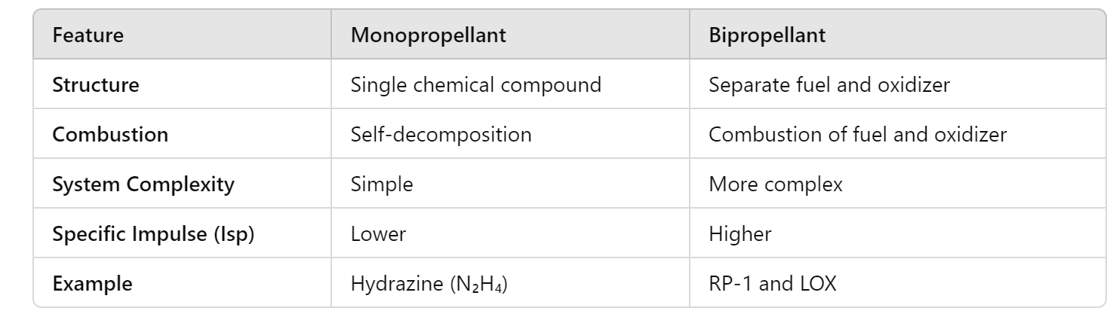
Monopropellants (N2H4)
Liquid propellants
Bipropellant (O2-H2)
Desirable propellant Properties:
Low Freezing Point
High Specific Gravity
Stability
Heat Transfer Properties: High specific heat, high thermal conductivity, and high boiling or decomposition temperature for propellants used for cooling
Pumping Properties. A low vapor pressure
Temperature variation: The temperature variation of the physical properties
of the liquid propellant should be small.(Similar for fuel and oxidizer)
Readily ignite.
Falcon - SpaceX

Slide 3

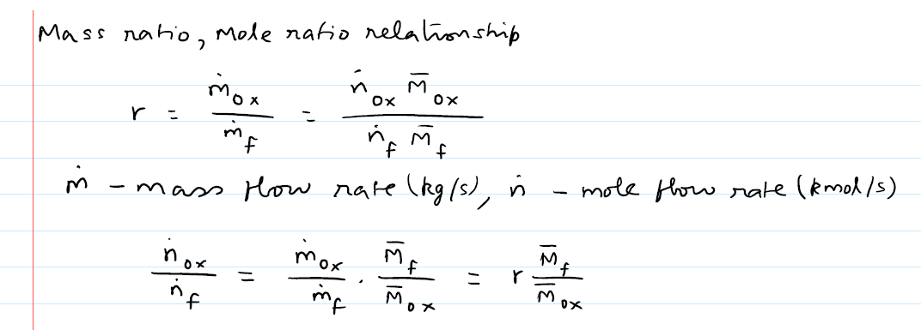
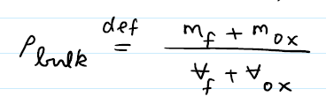
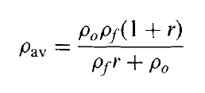
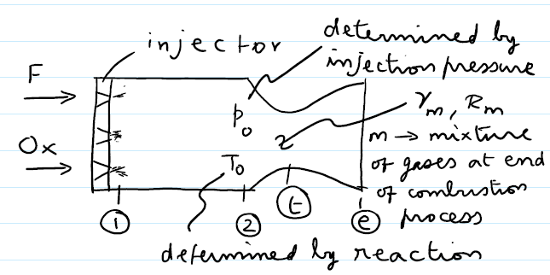
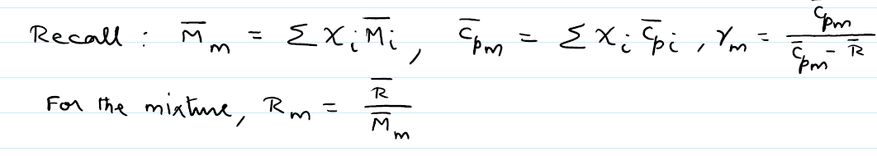
Mass ratio: the ratio of the oxidizer mass flow rate and the fuel mass flow
Mole flow rate (k mole/s) :
Average bulk density:
Liquid propellant rocket engine thrust:
chamber requires propellant feed at high pressure.
Unlike in the SRM, there is no increase in P0 in the combustion chamber.

Slide 4
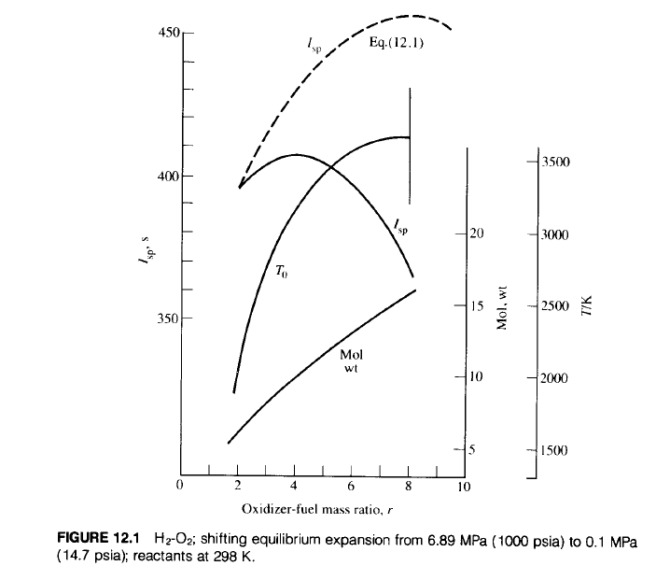
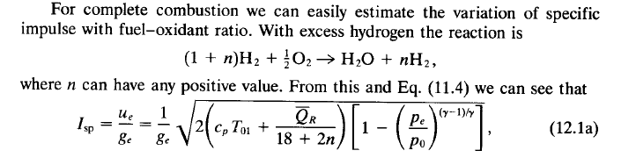







The variation of specific impulse with fuel-oxidant ratio for complete combustion:
With excess hydrogen
M_bar=18+2n
r=8 Stoichiometric ratio
It gives the higher I_{sp}
$$u_{e}=\sqrt{2\frac{γ_{m}\overline{R}}{γ_{m}−1{\overline{M}}_{m}}(T_{0e}−T_{e})}$$
M₂ from Nozzle Contraction ratio:
Combustion pressure loss:

Slide 5
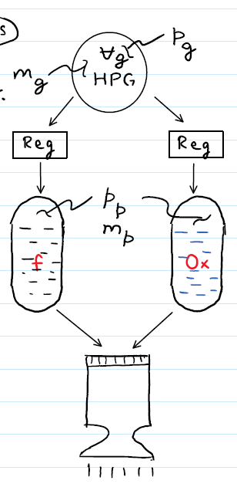

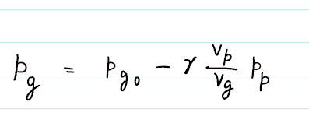
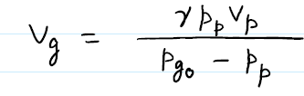
LPRE propellant feed systems
Gas pressure feed system:
conservation of energy (gas energy after and before propellant expulsion)
Adiabatic process
an ideal gas,
a negligibly small initial mass of gas in the piping and the propellant tank.
final high pressure gas energy
Initial high pressure gas energy
Work by high pressure gas energy
Ideal gas

Slide 6
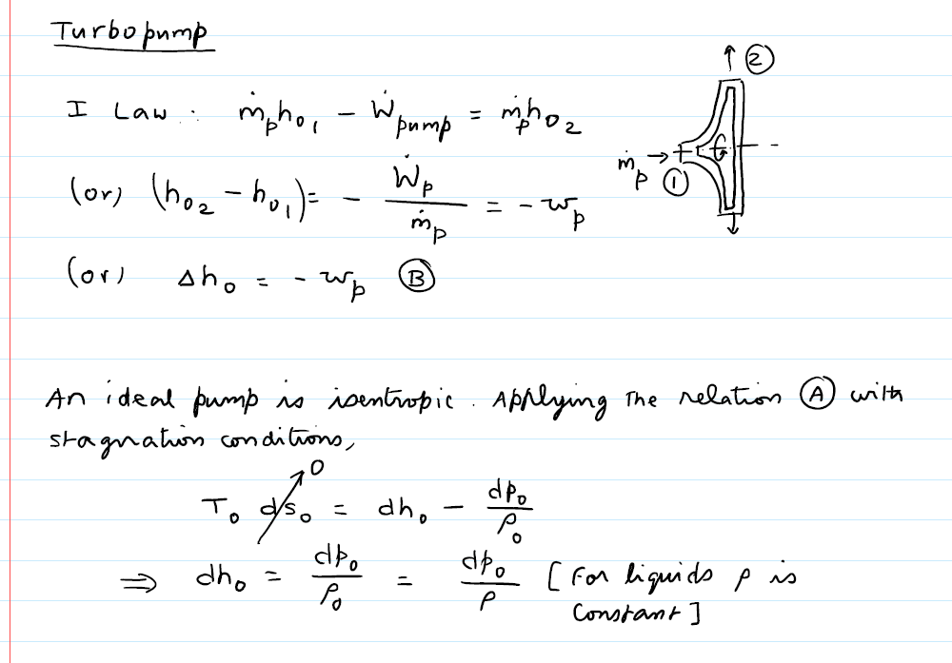
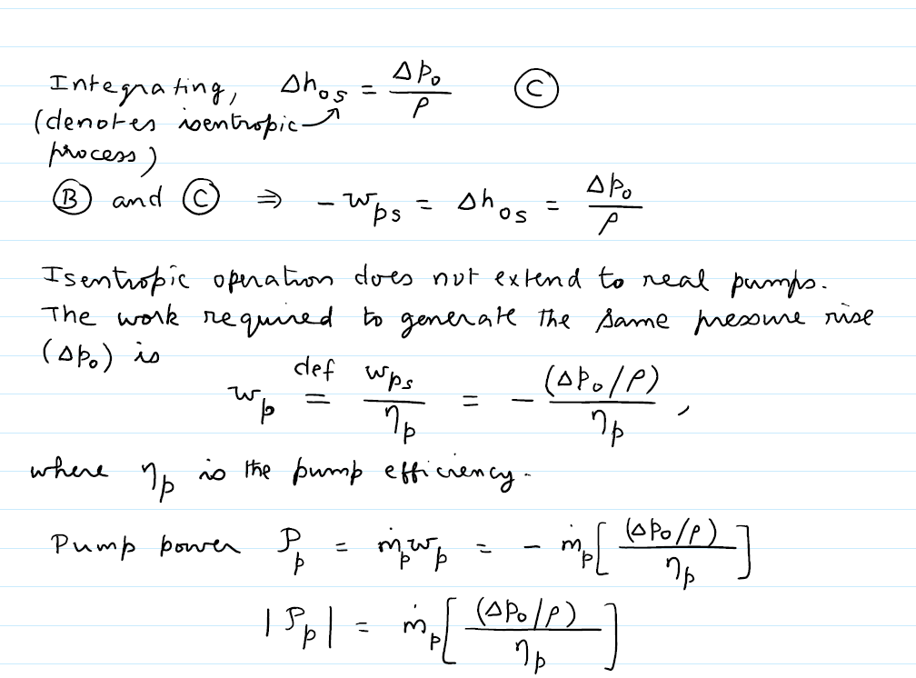
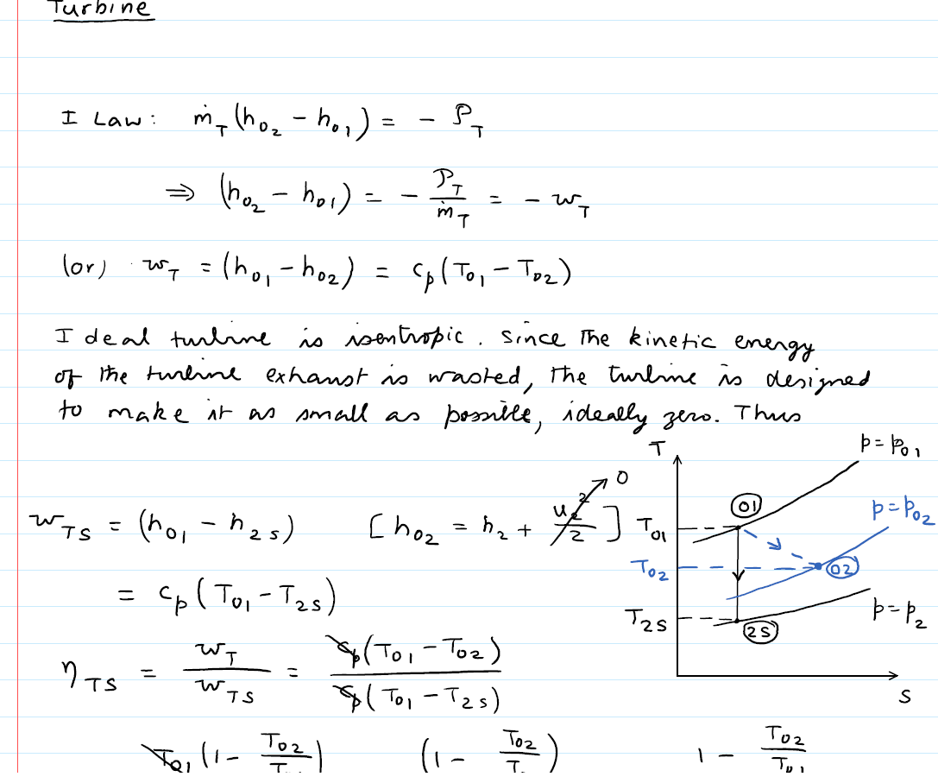
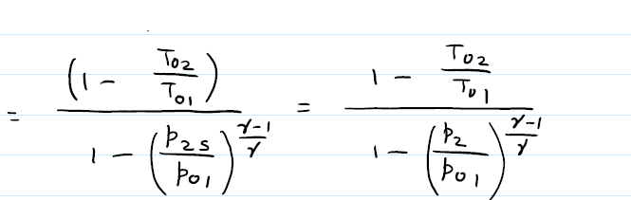
Pump feed system:
Ideal pump: (isentropic)
The work required to generate the same pressure ratio in real pump:
Pump efficiency
Pump power:
Turbine :
Ideal turbine: (isentropic)
turbine efficiency

Slide 7
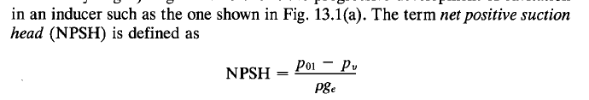
Cavitation
Formation of vapor bubbles where the fluid static pressure declines to levels below the fluid's vapor pressure.
The flow rate to significantly decline
Erosion of pump surfaces by the collapse bubbles in higher pressure regions (important in reusable engines)
Pressure head on head : $\frac{P}{P_{g}}$
The associated head is known as the net positive suction head :(NPSH):
stagnation pressure of the fluid at the entrance
the fluid vapor pressure.
A value for NPSH exists below which pump head declines dramatically: required suction head [(NPSH)_{R}]
To avoid cavitation-related performance problems, the available NPSH [(NPSH)_{A}] should be kept more than that required [(NPSH)_{R}]

