Slide 1
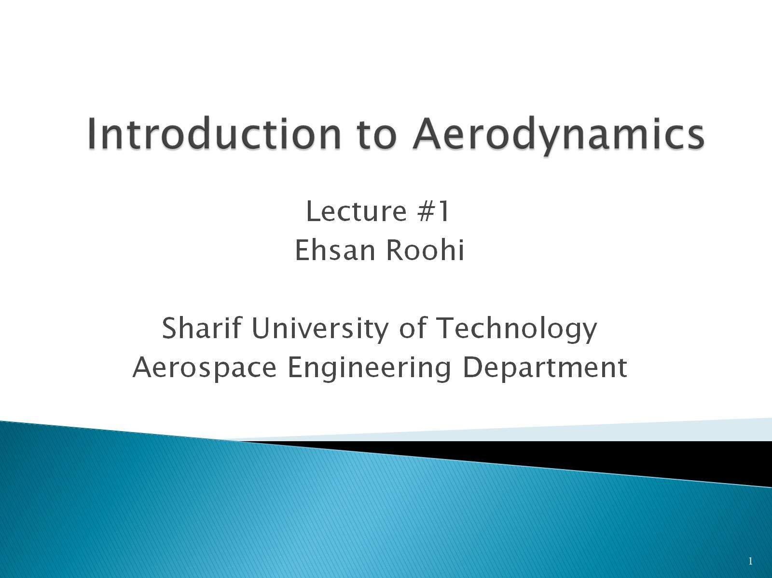
Introduction to Aerodynamics

Slide 2
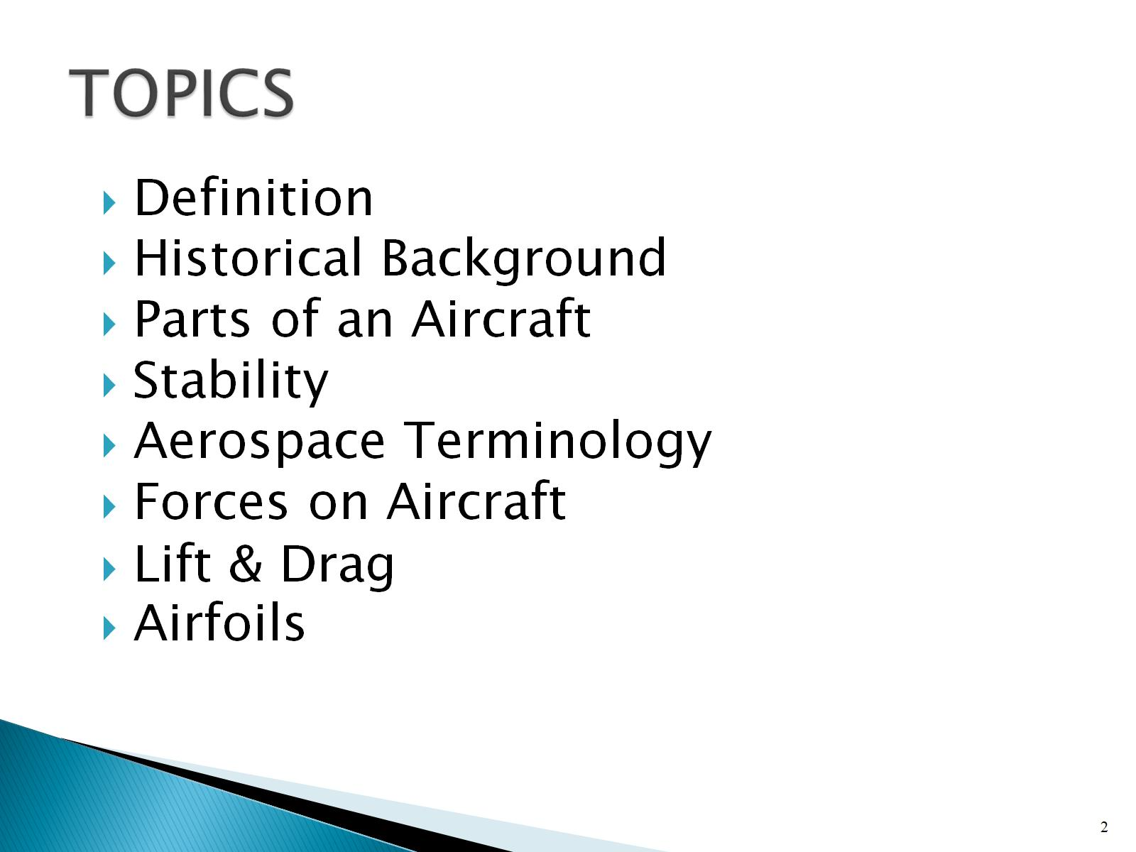
TOPICS

Slide 3
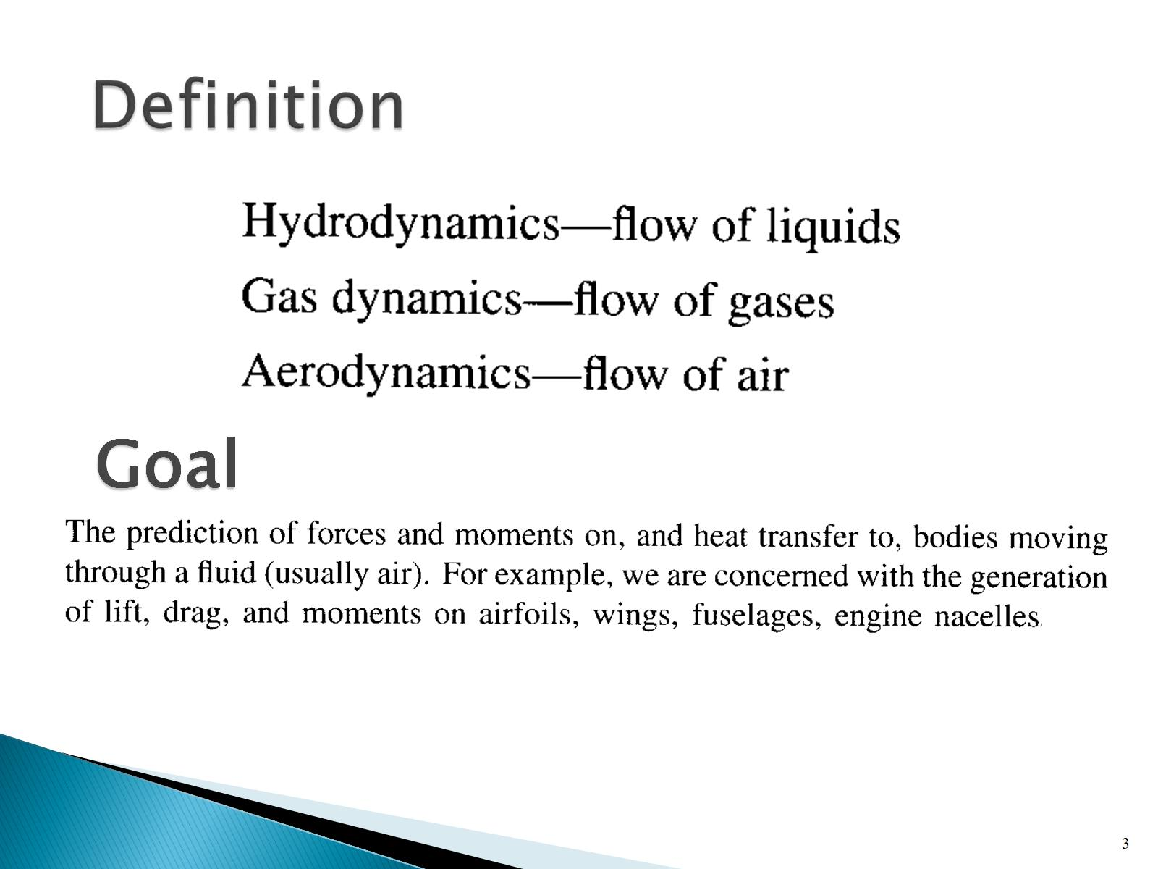
Definition

Slide 4
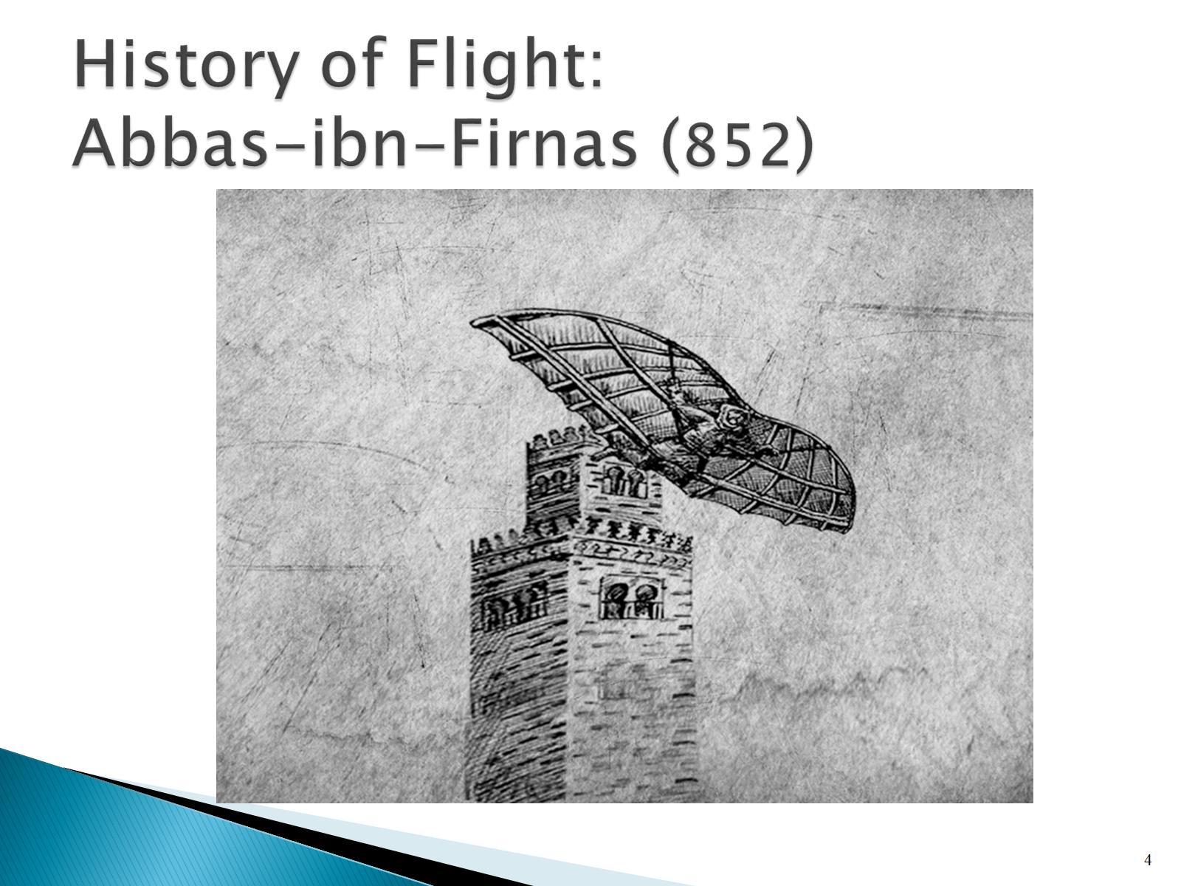
History of Flight:
Abbas-ibn-Firnas (852)

Slide 5
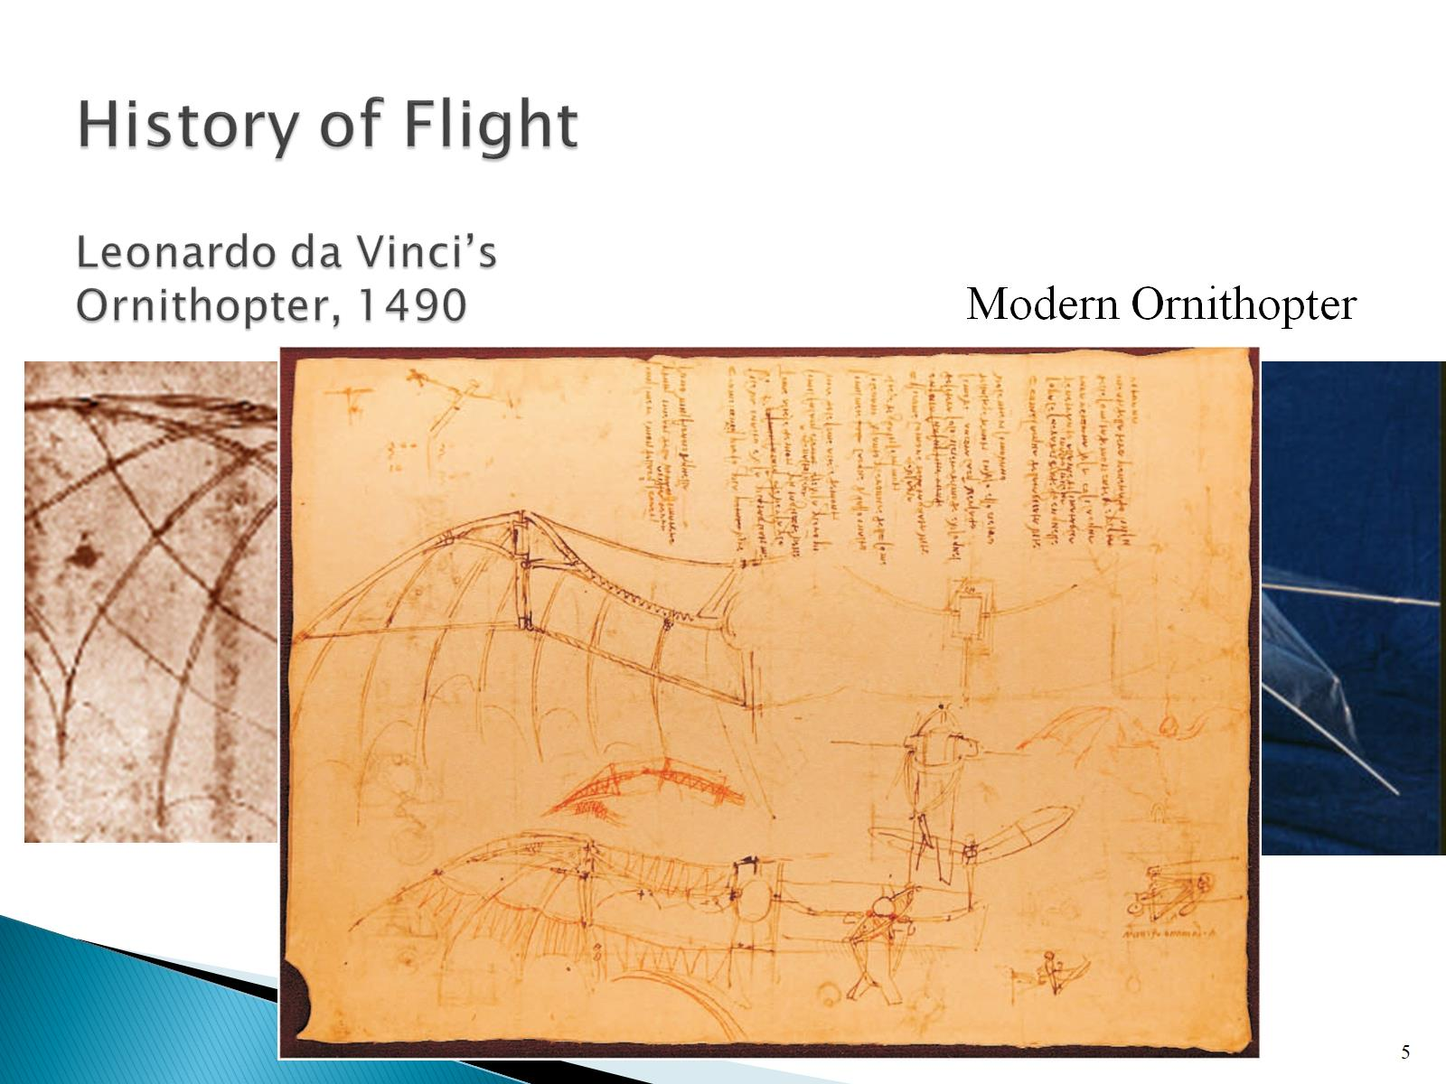
History of Flight
Leonardo da Vinci’s Ornithopter, 1490

Slide 6
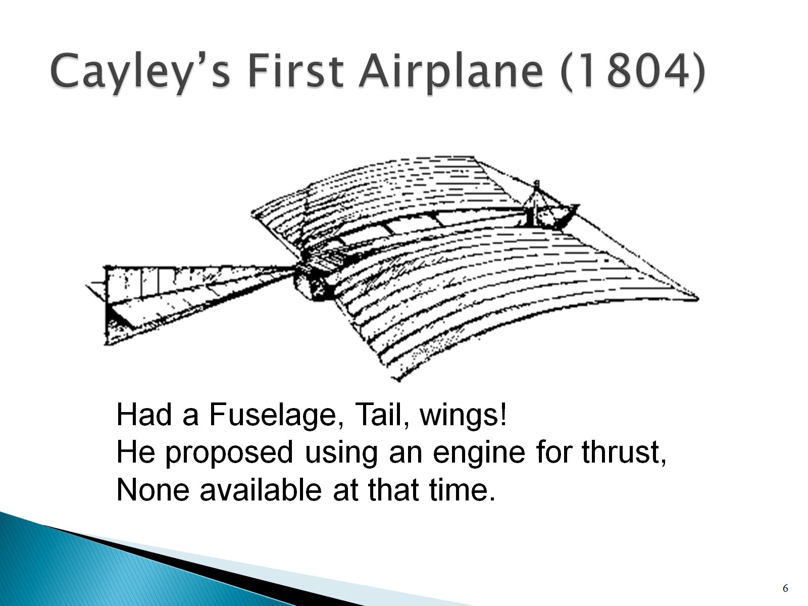
Cayley’s First Airplane (1804)

Slide 7
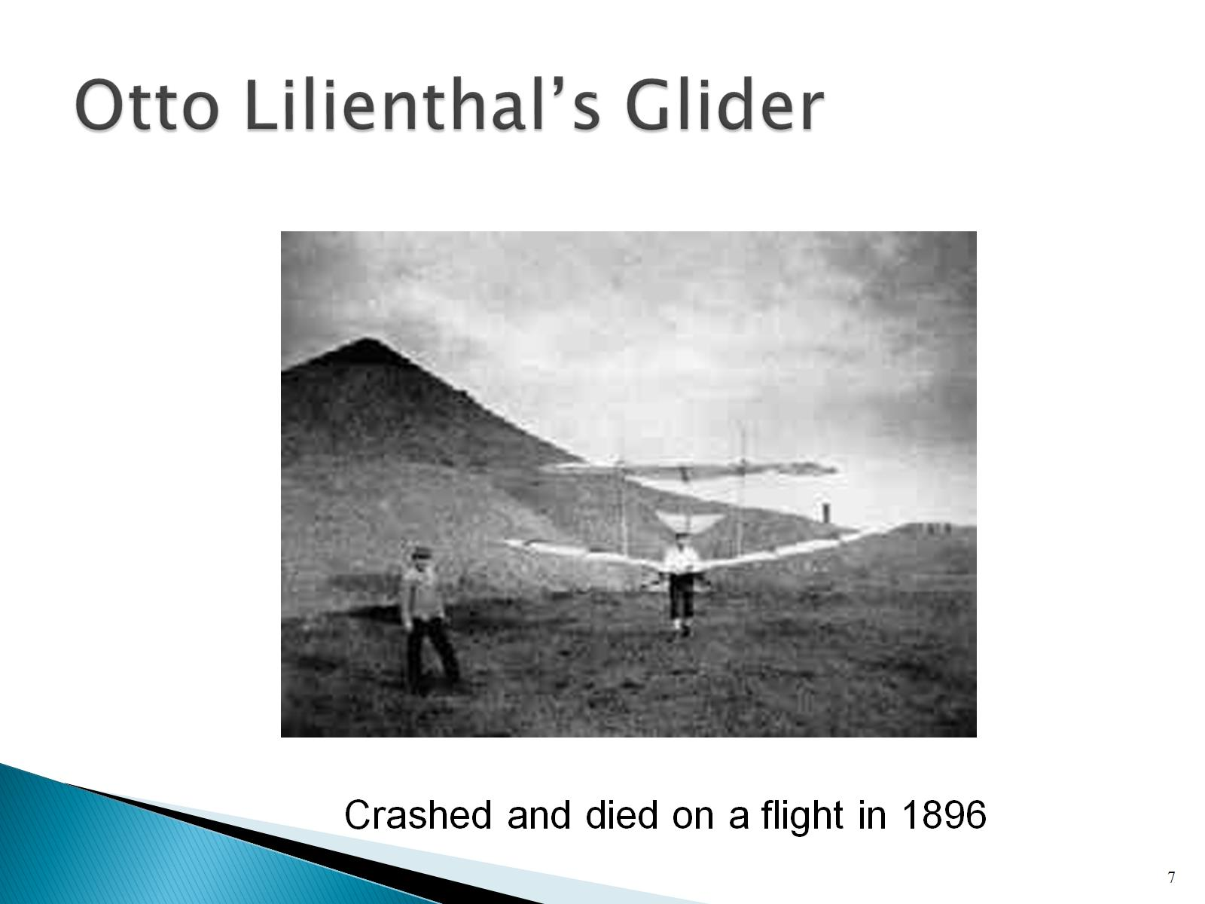
Otto Lilienthal’s Glider

Slide 8
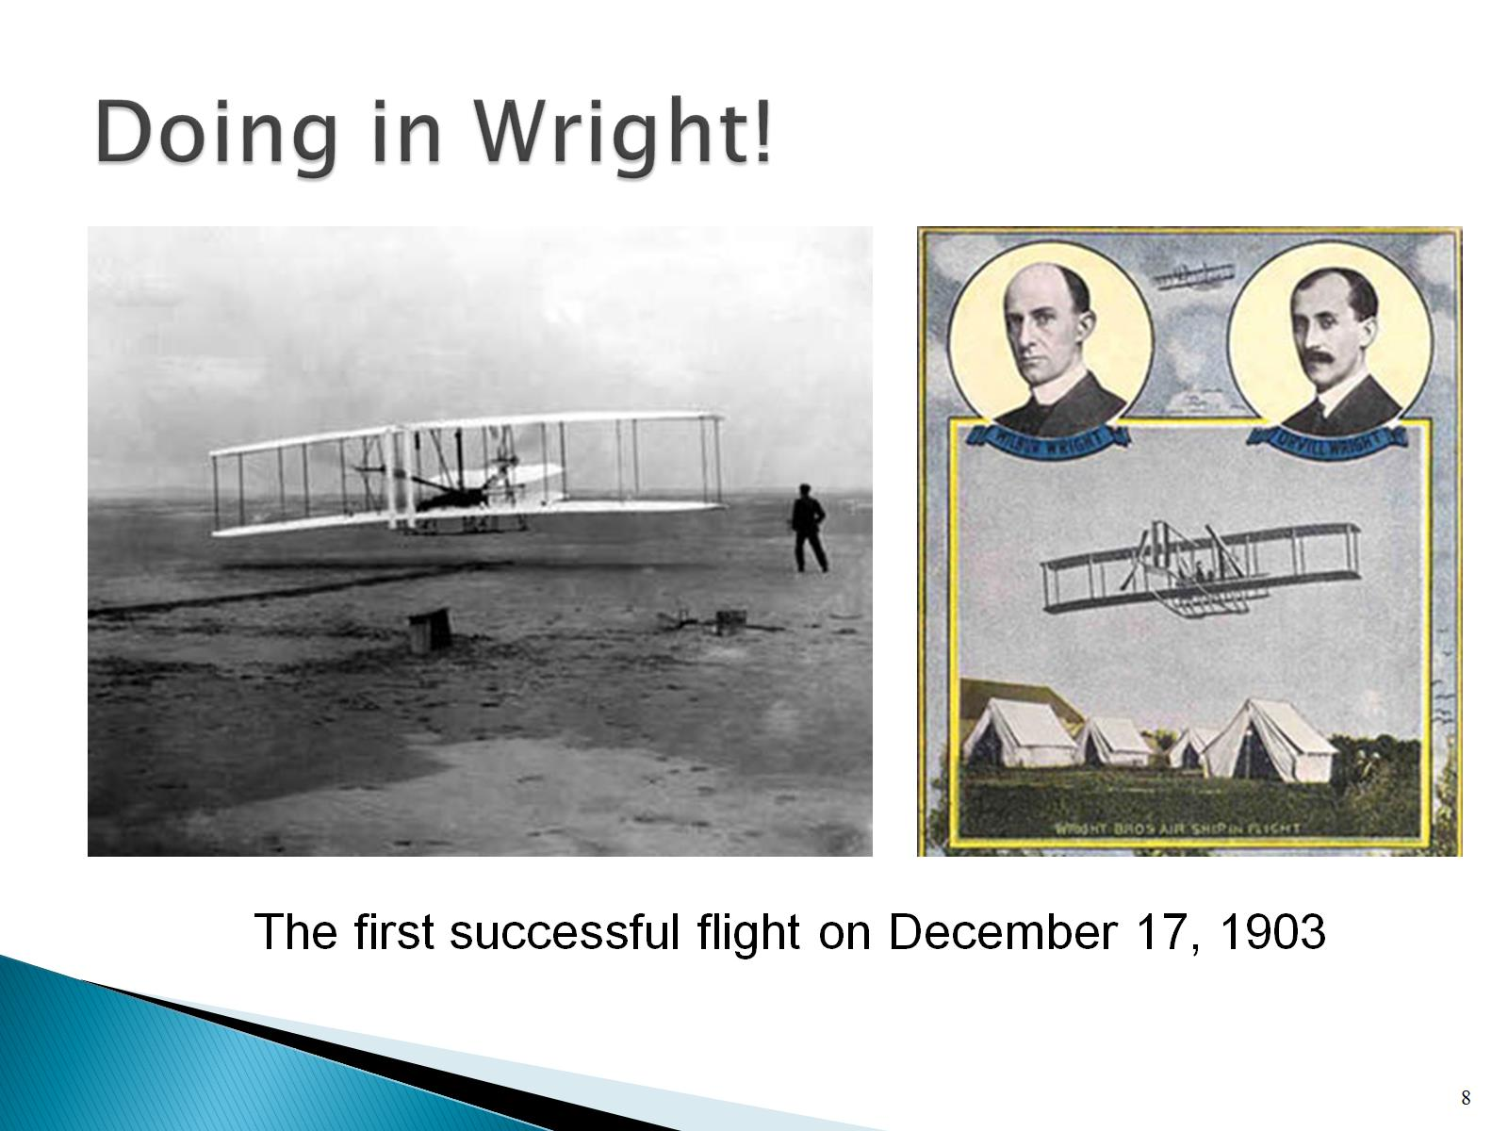
Doing in Wright!

Slide 9
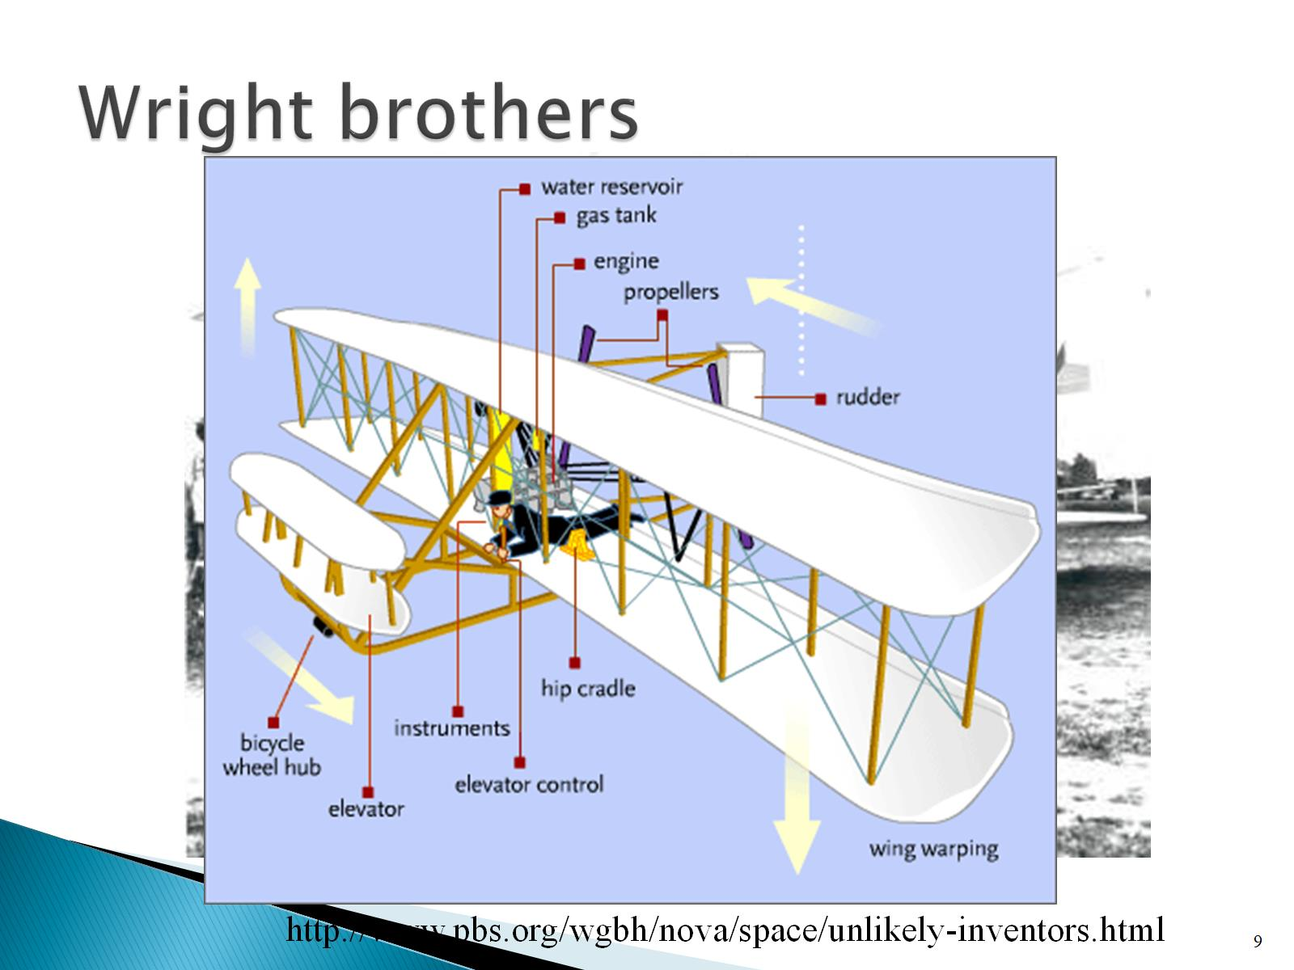
Wright brothers

Slide 10
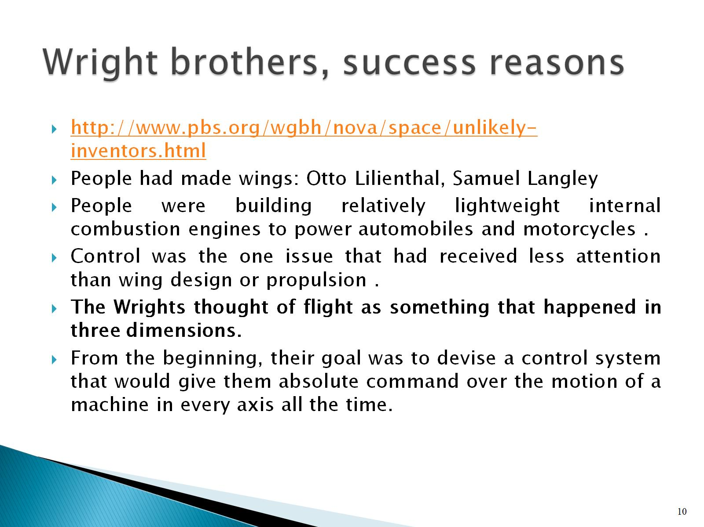
Wright brothers, success reasons

Slide 11
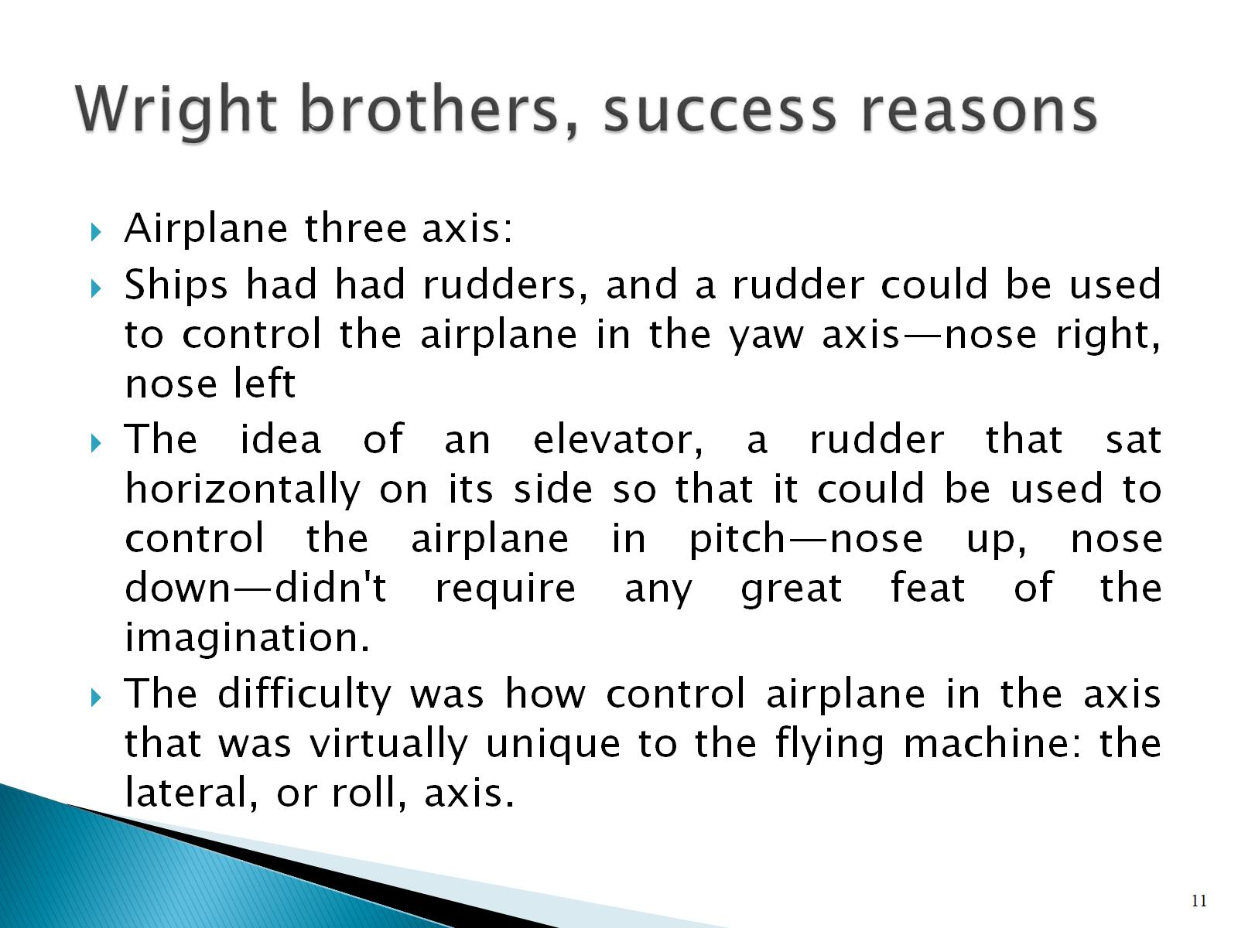
Wright brothers, success reasons

Slide 12
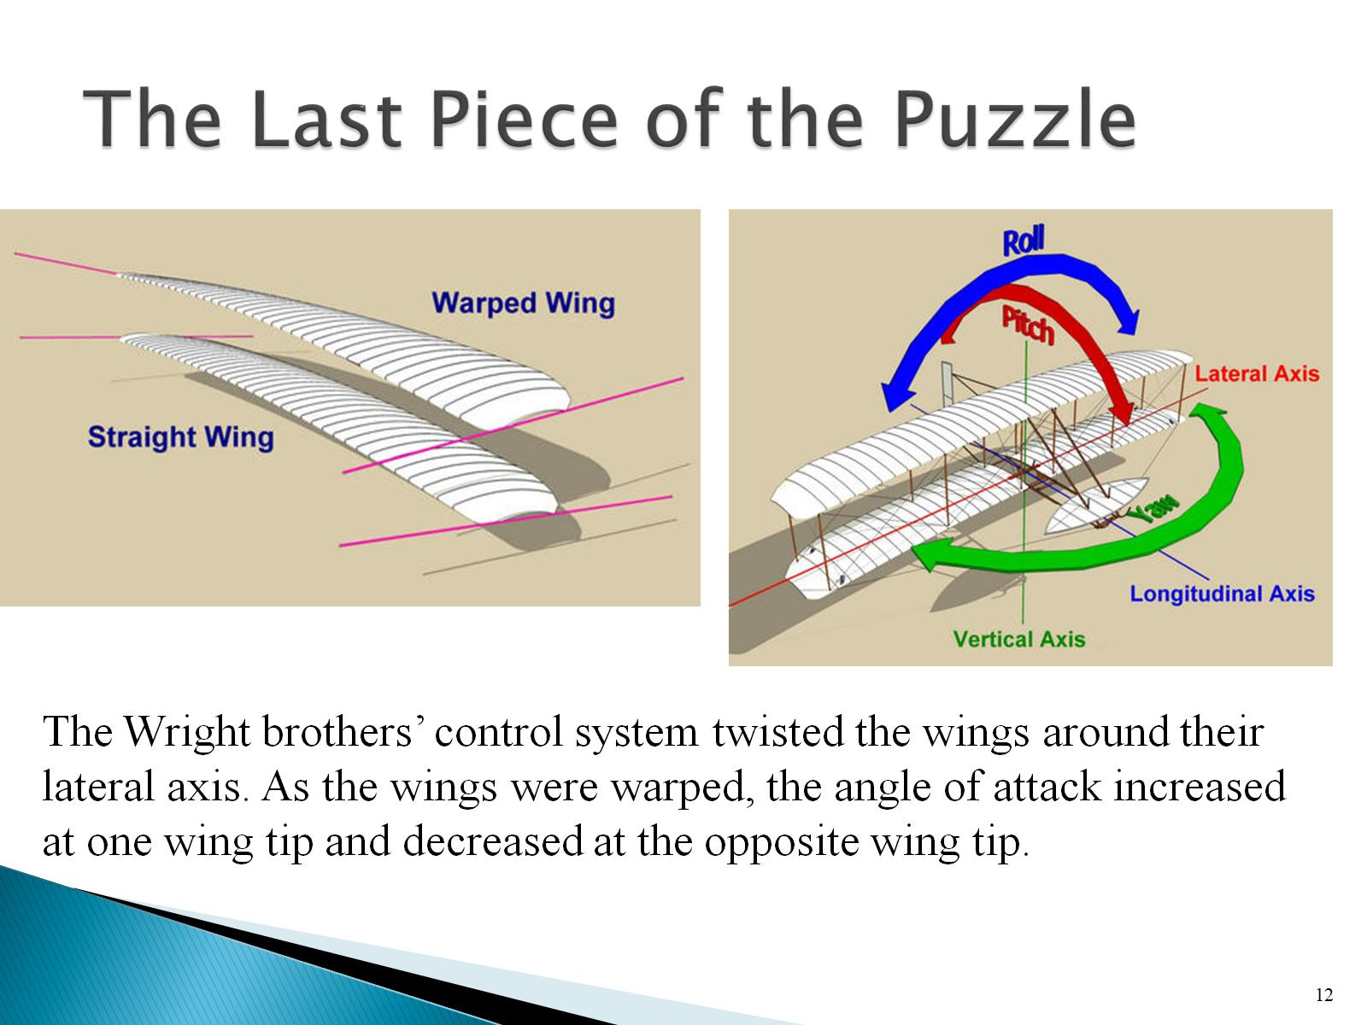
The Last Piece of the Puzzle

Slide 13
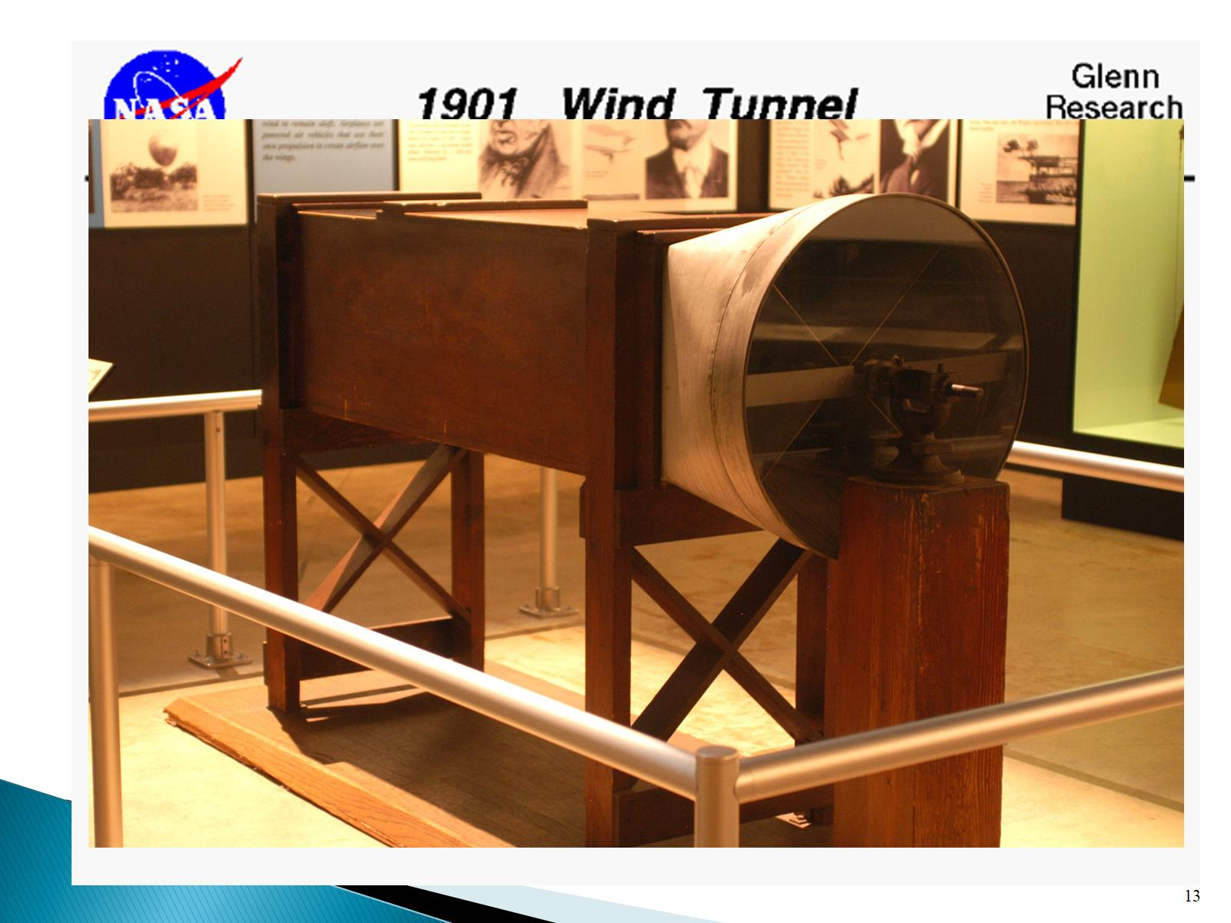

Slide 14
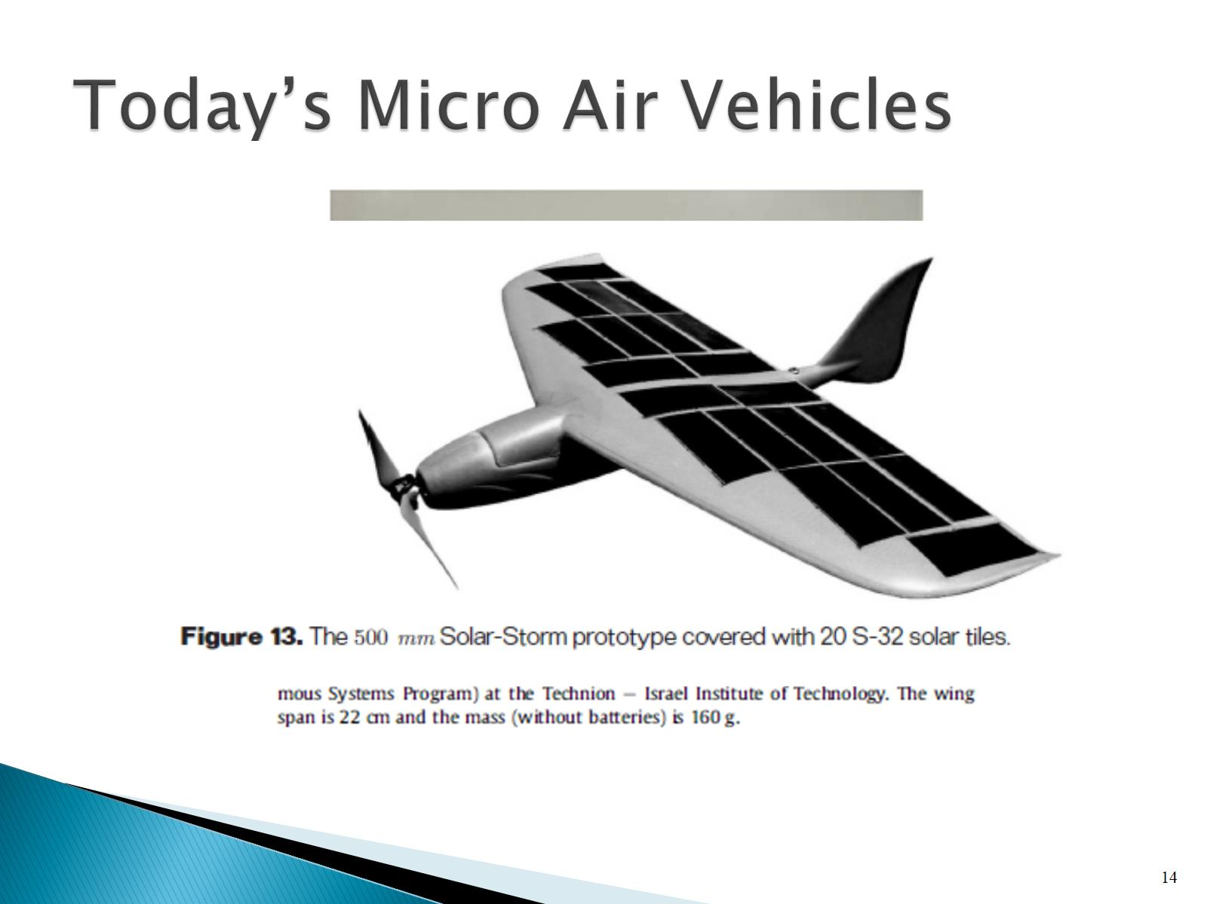
Today’s Micro Air Vehicles

Slide 15
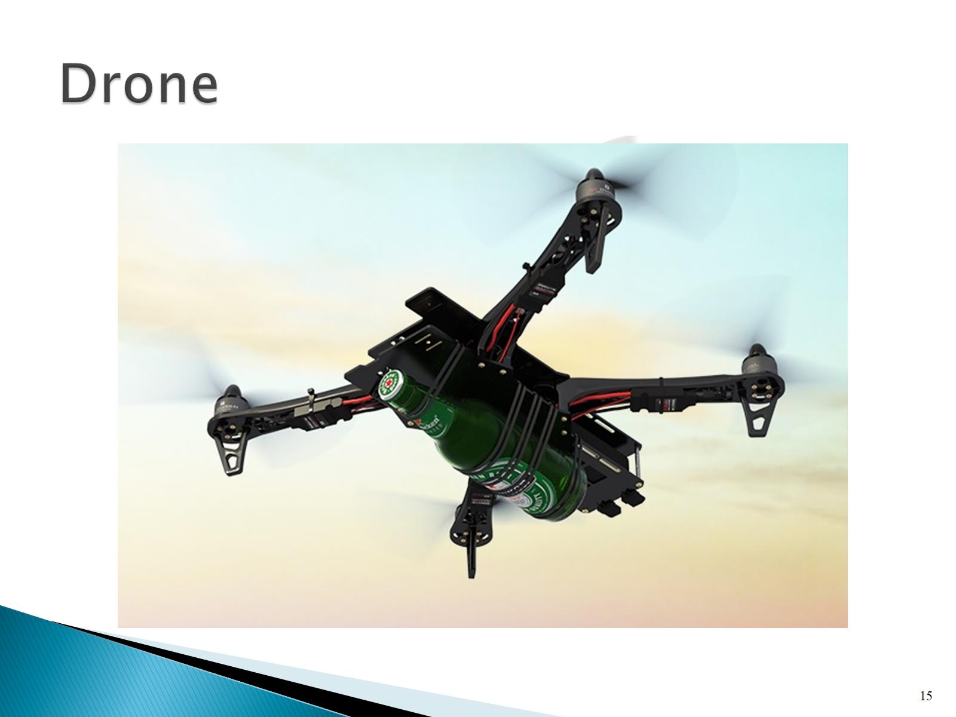
Drone

Slide 16
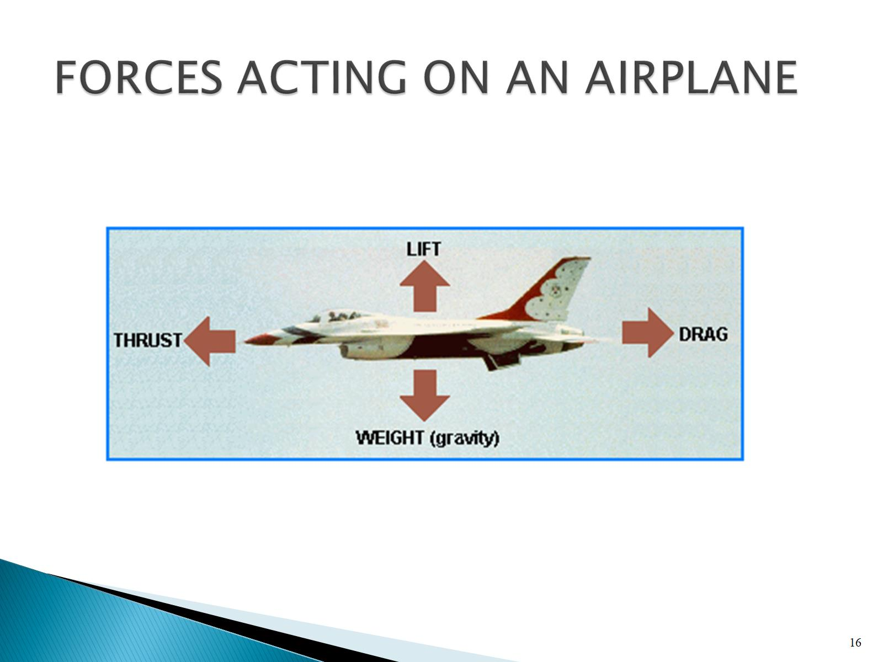
FORCES ACTING ON AN AIRPLANE

Slide 17
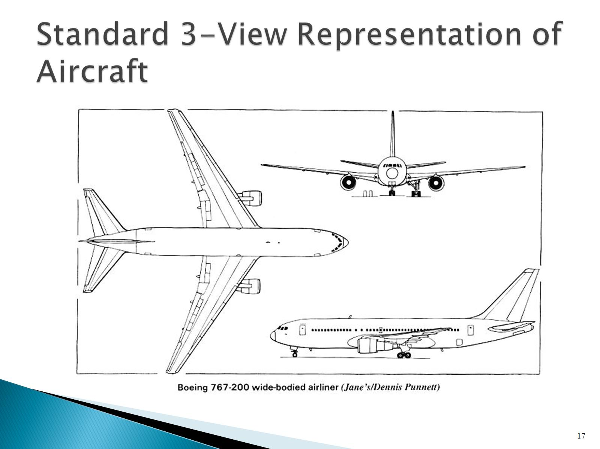
Standard 3-View Representation of Aircraft

Slide 18
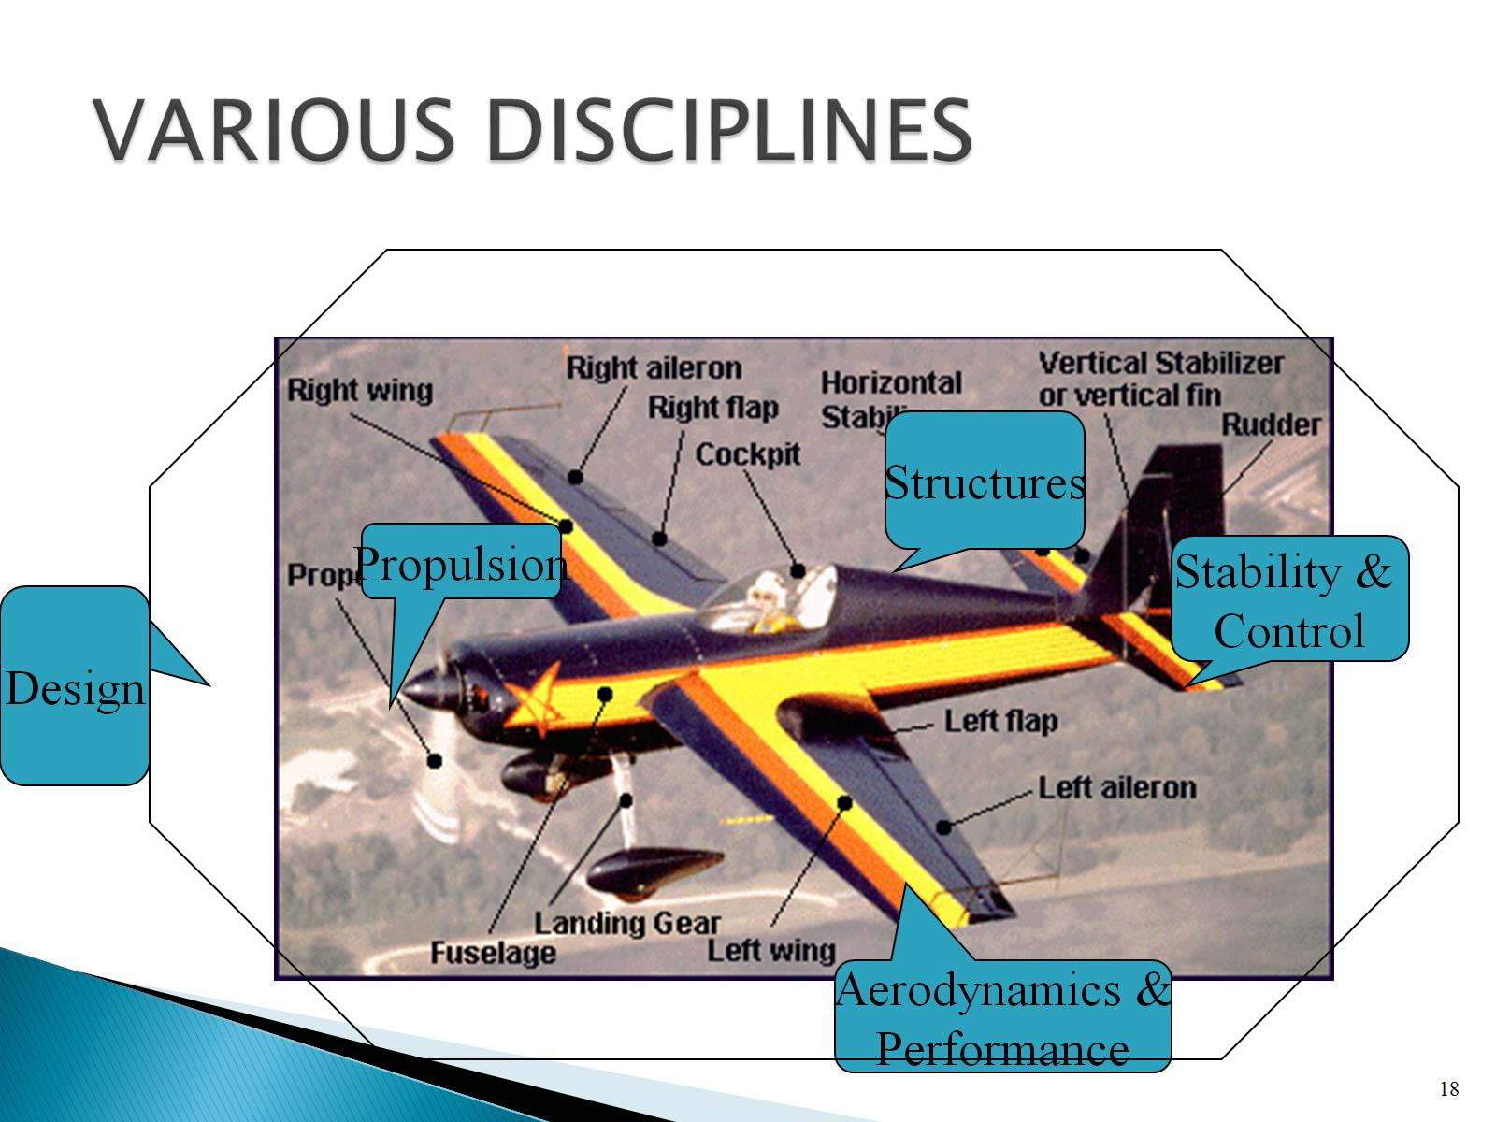
VARIOUS DISCIPLINES

Slide 19
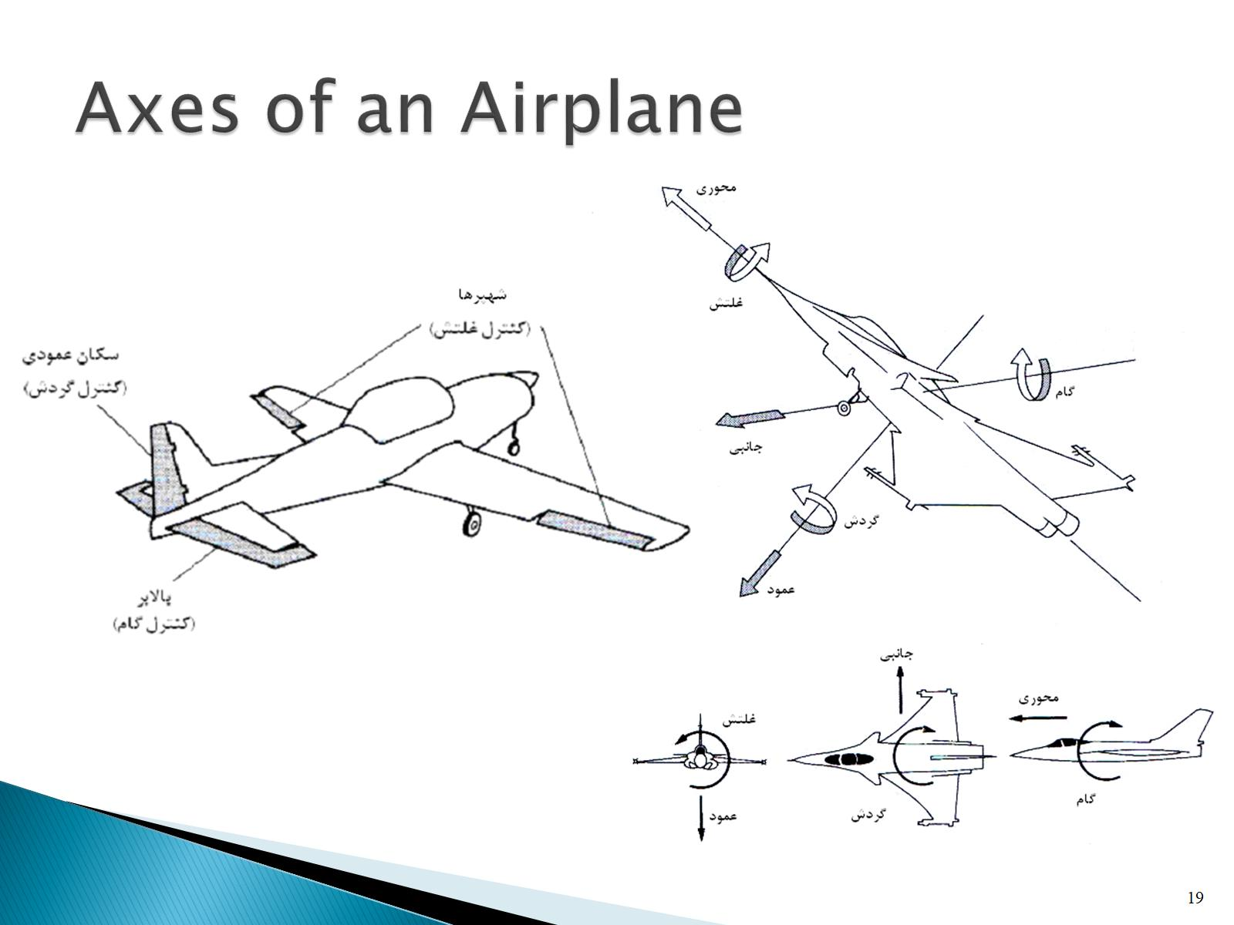
Axes of an Airplane

Slide 20
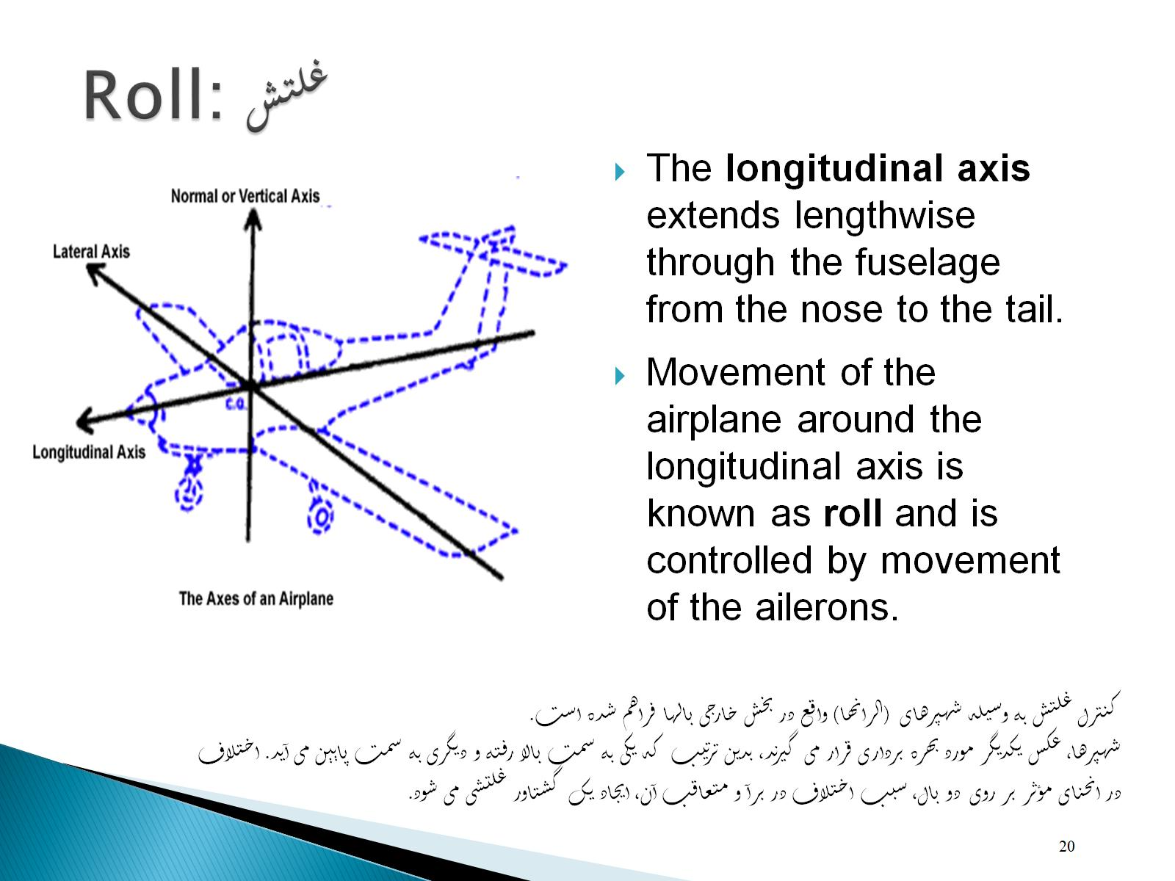
Roll: غلتش

Slide 21
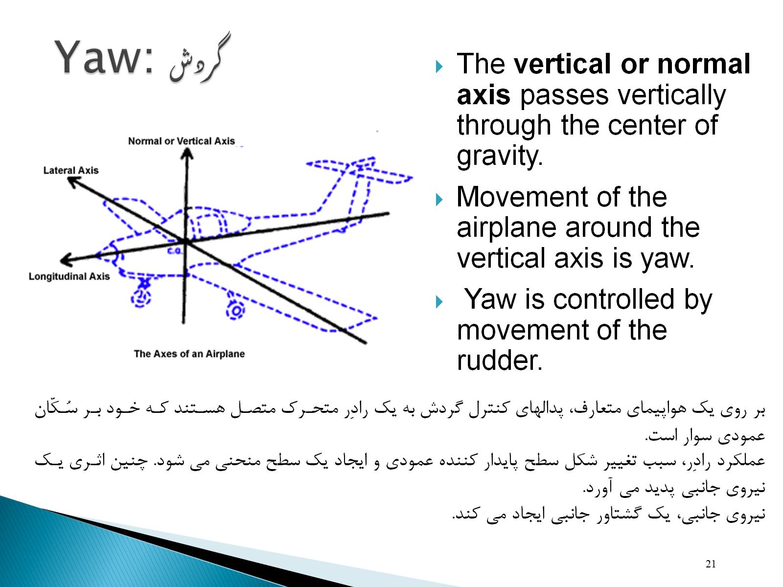
Yaw: گردش

Slide 22
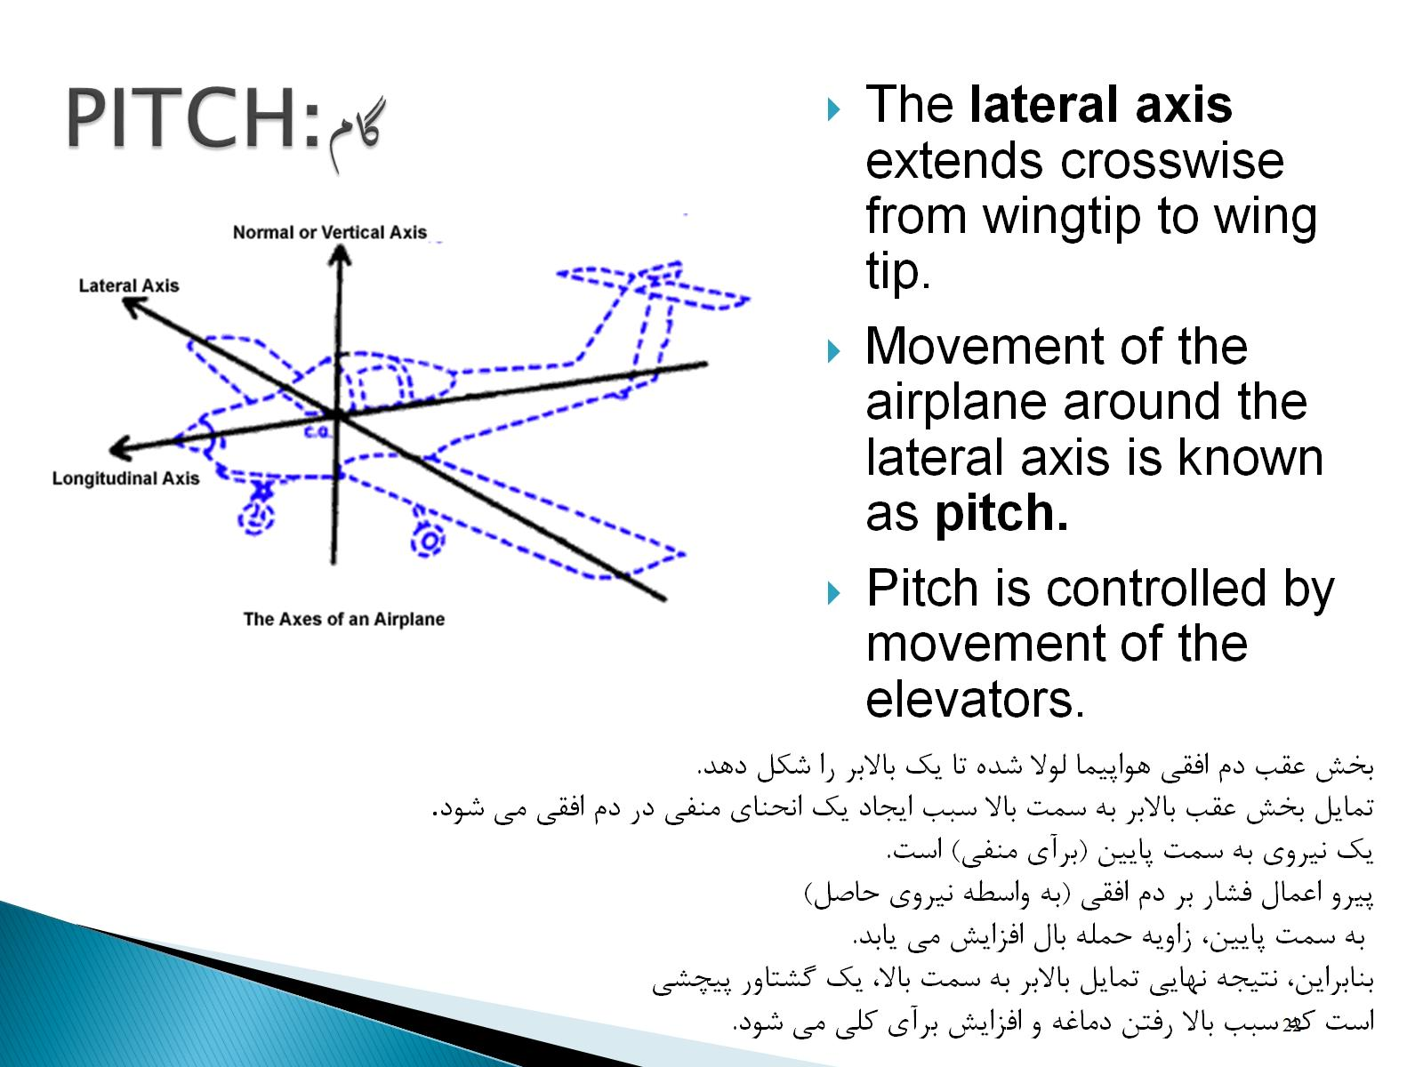
PITCHگام:

Slide 23
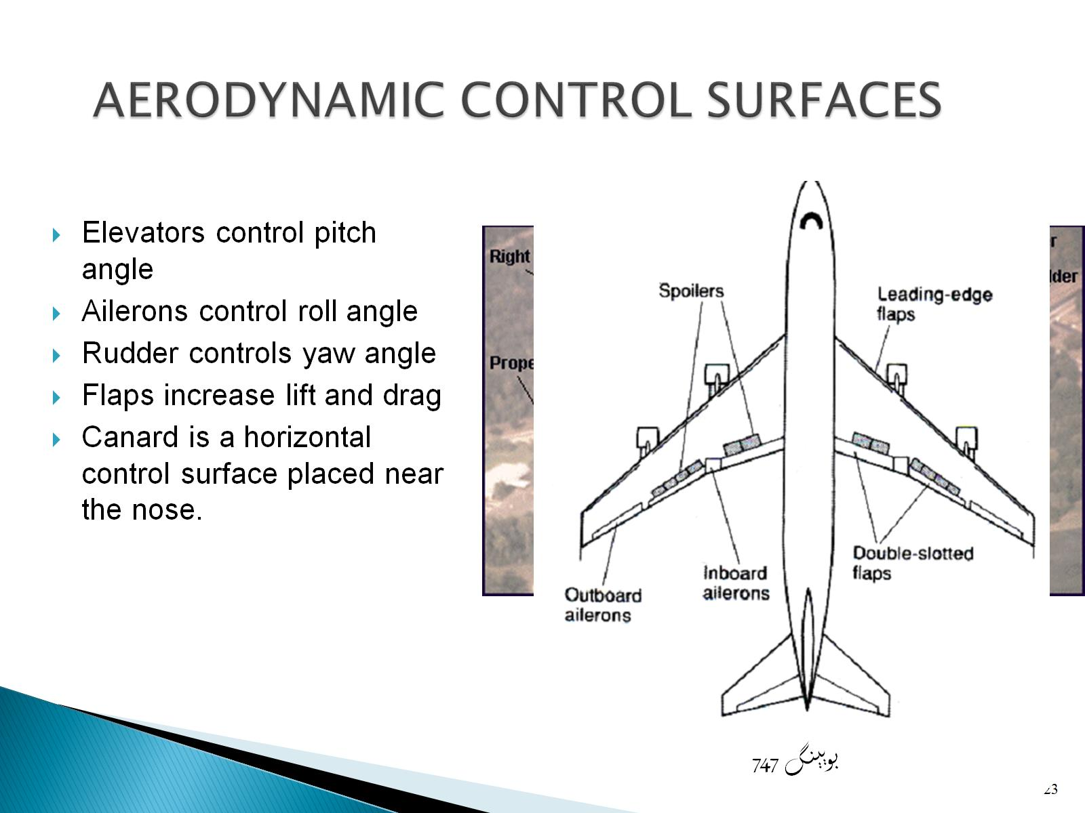
AERODYNAMIC CONTROL SURFACES

Slide 24
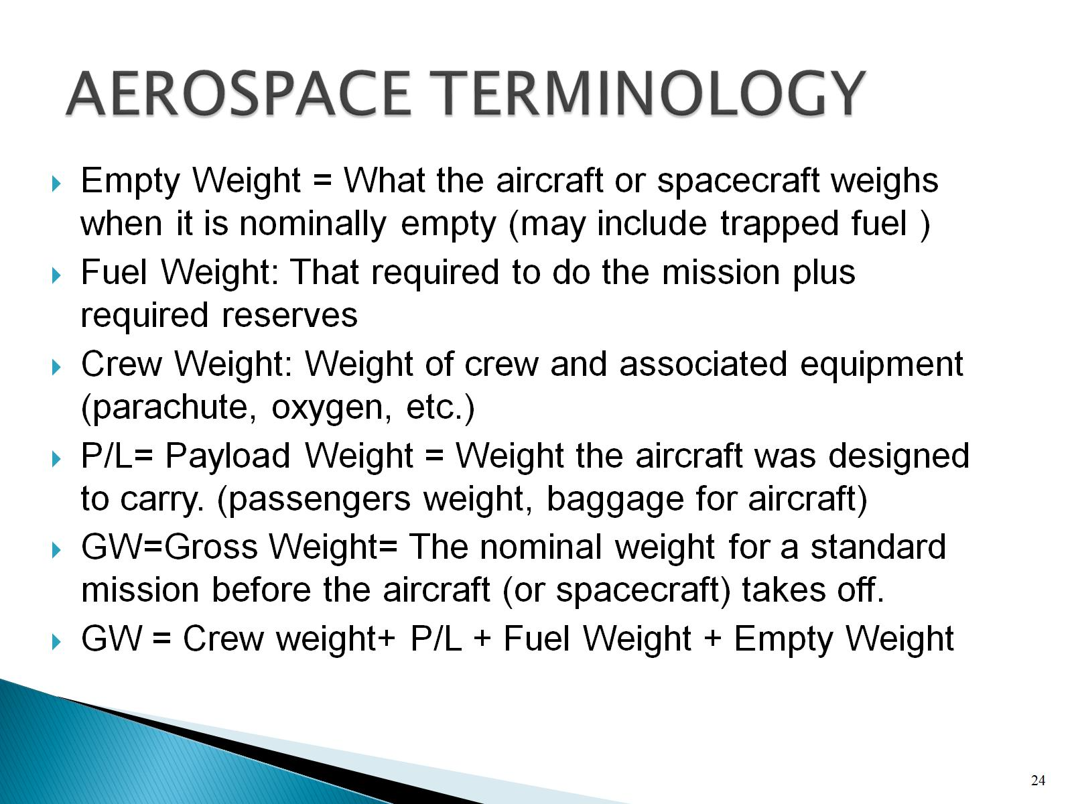
AEROSPACE TERMINOLOGY

Slide 25
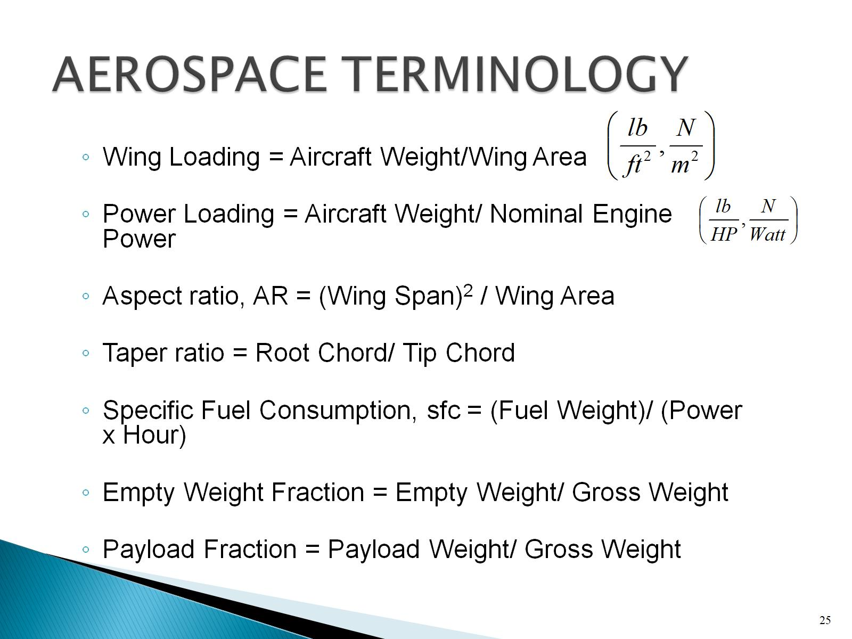
AEROSPACE TERMINOLOGY

Slide 26
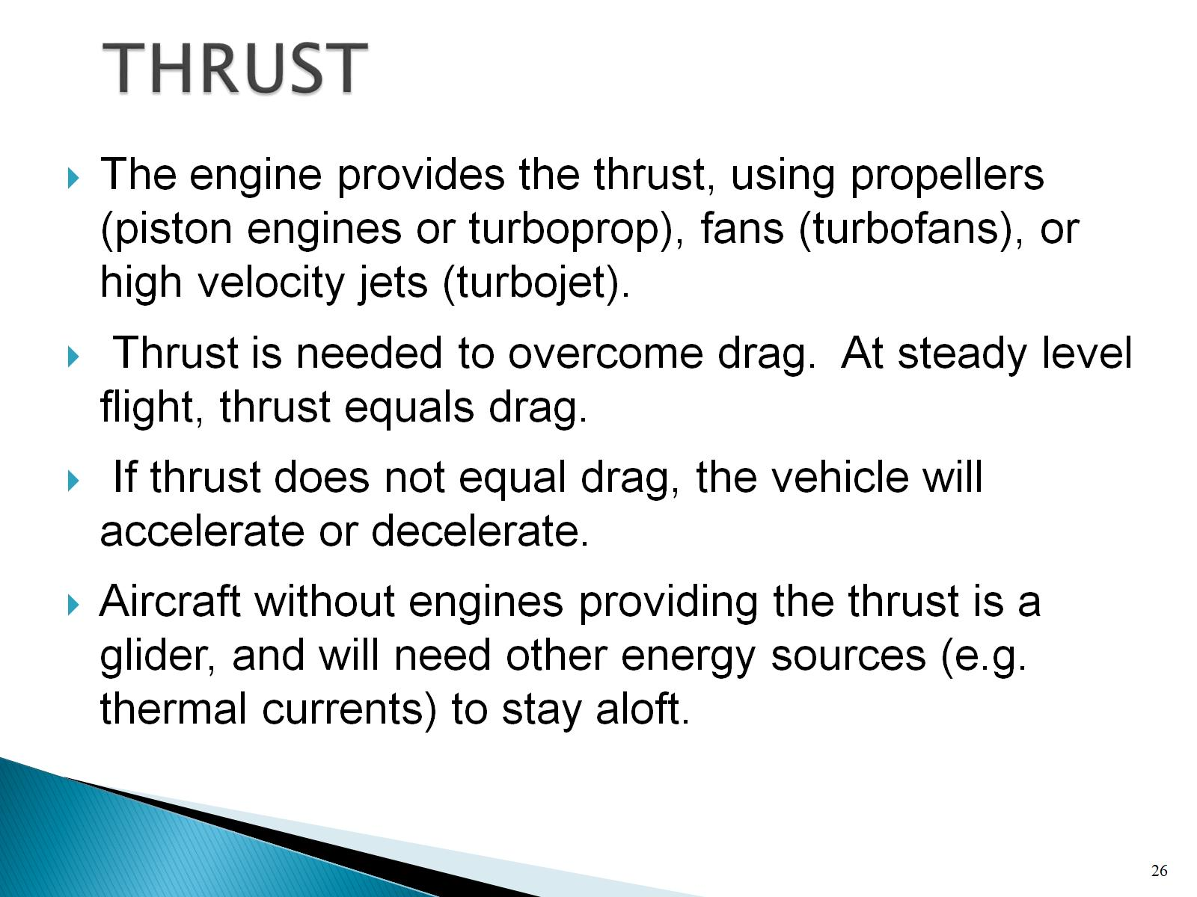
THRUST

Slide 27
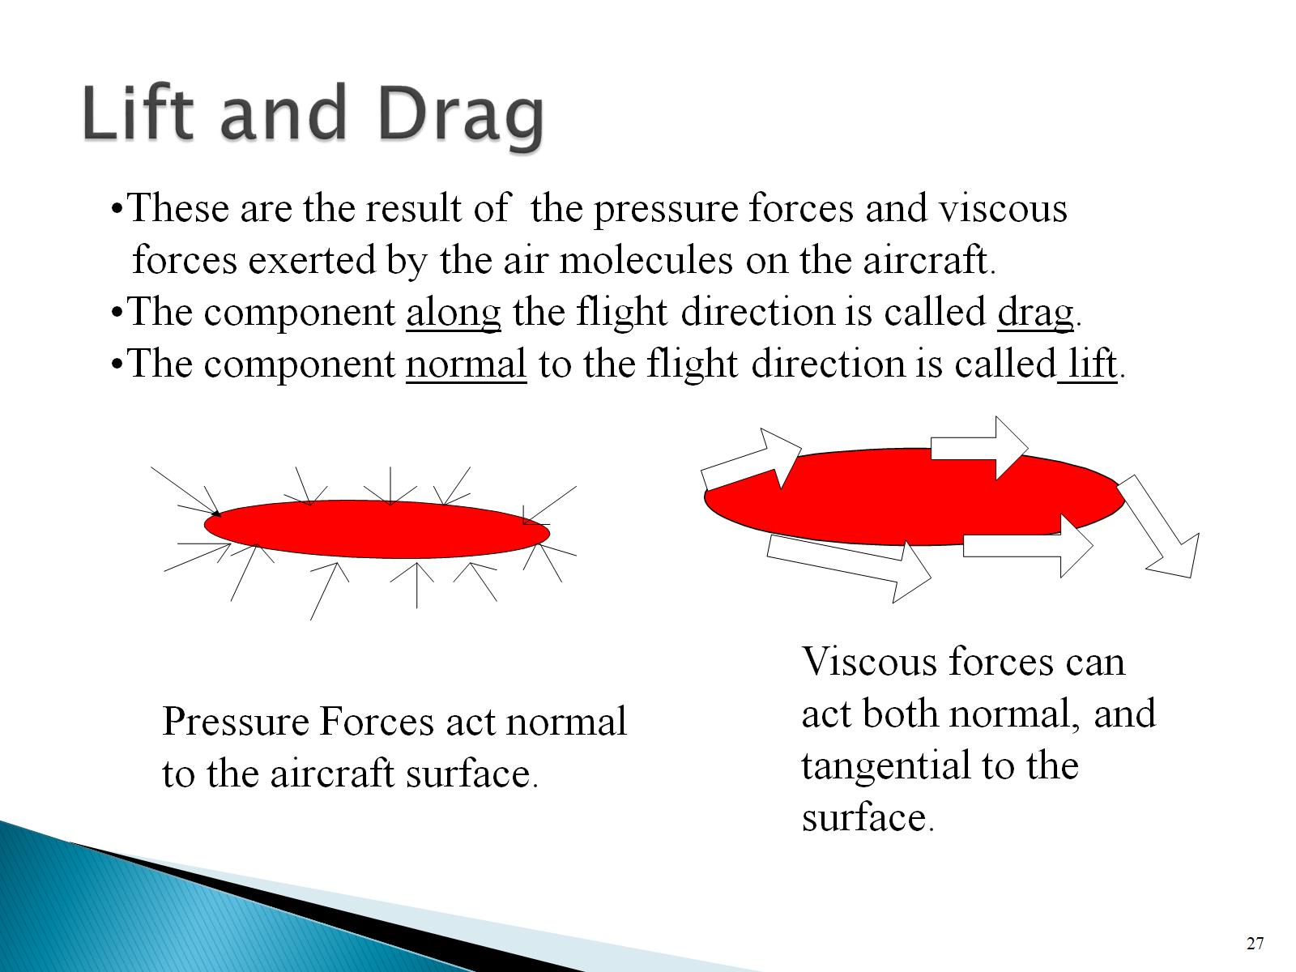
Lift and Drag

Slide 28
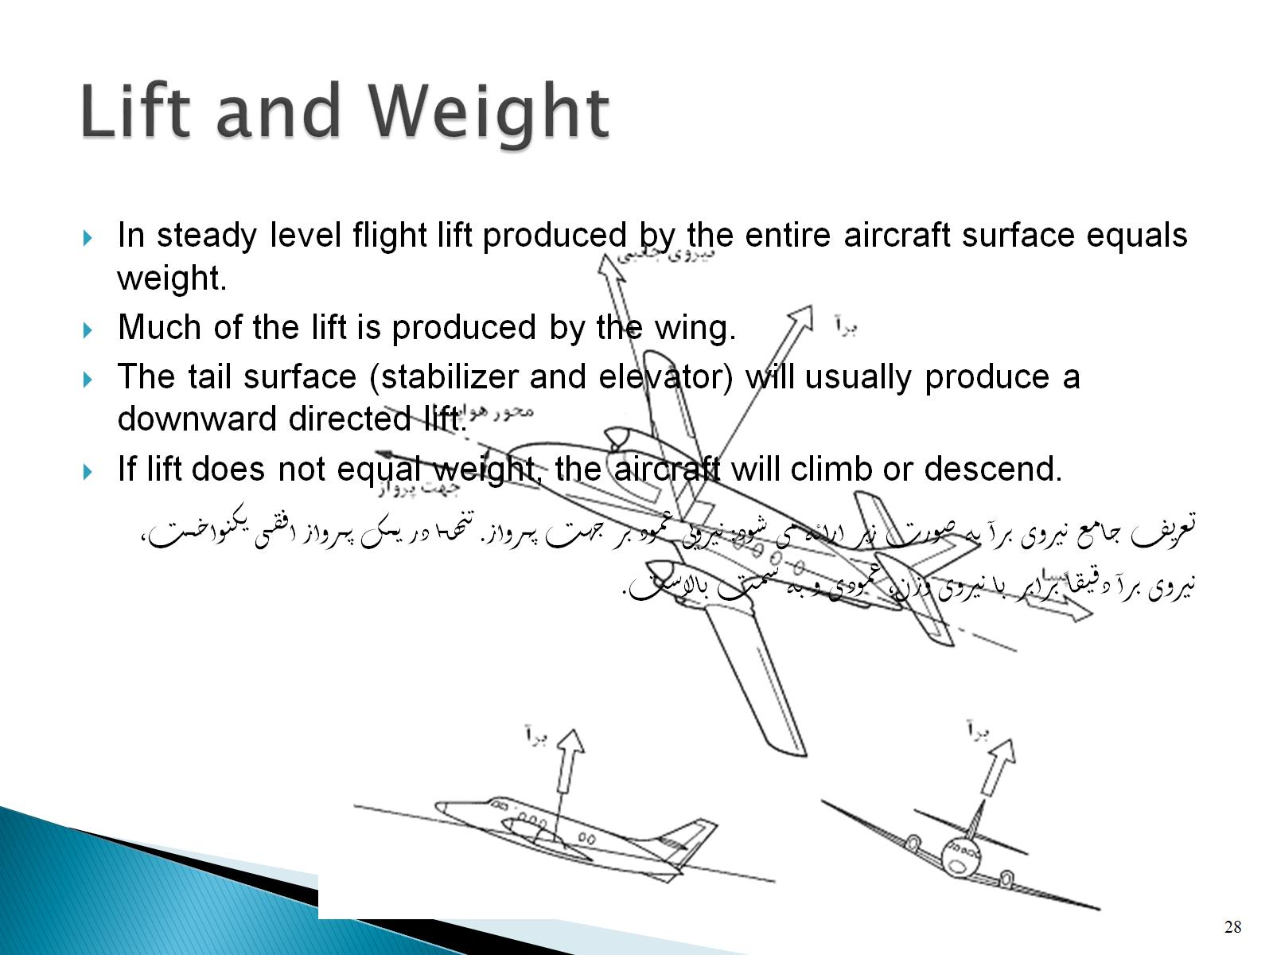
Lift and Weight

Slide 29
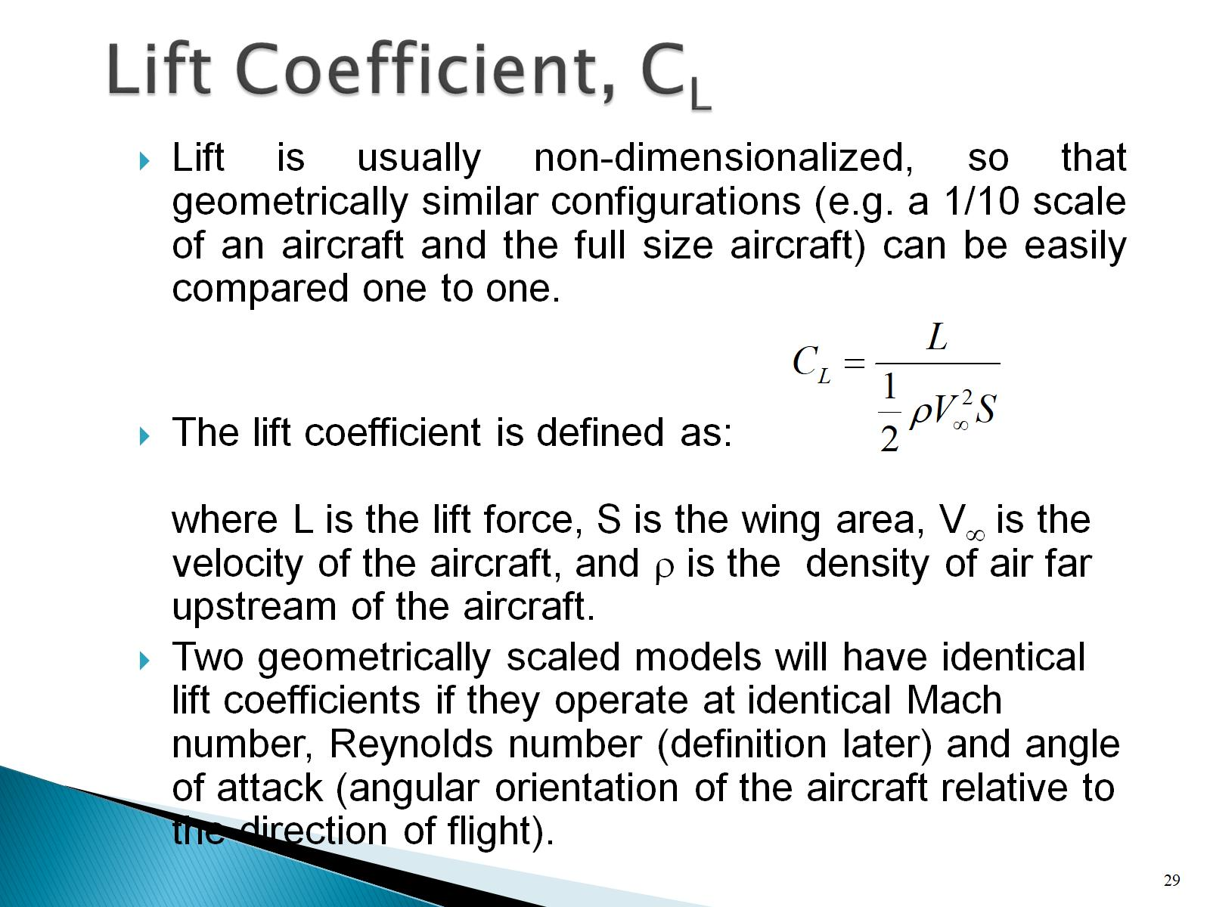
Lift Coefficient, C_{L}

Slide 30
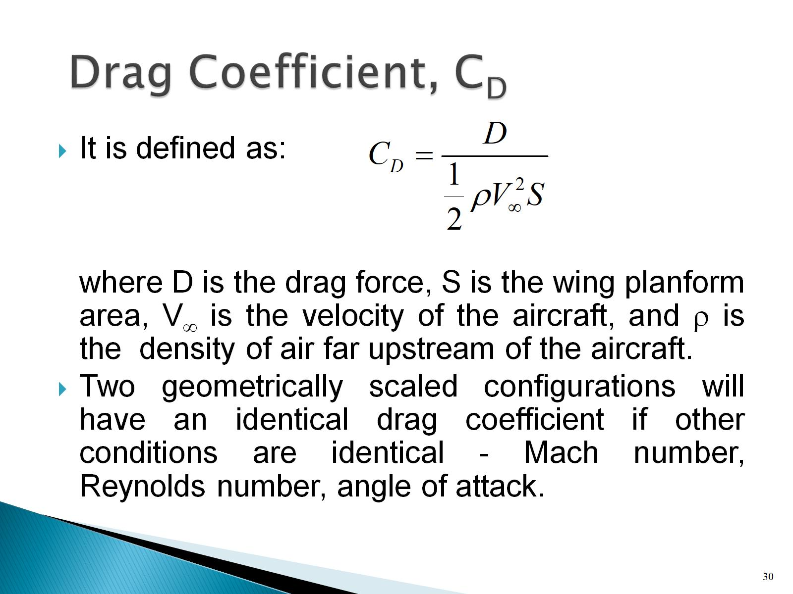
Drag Coefficient, C_{D}

Slide 31
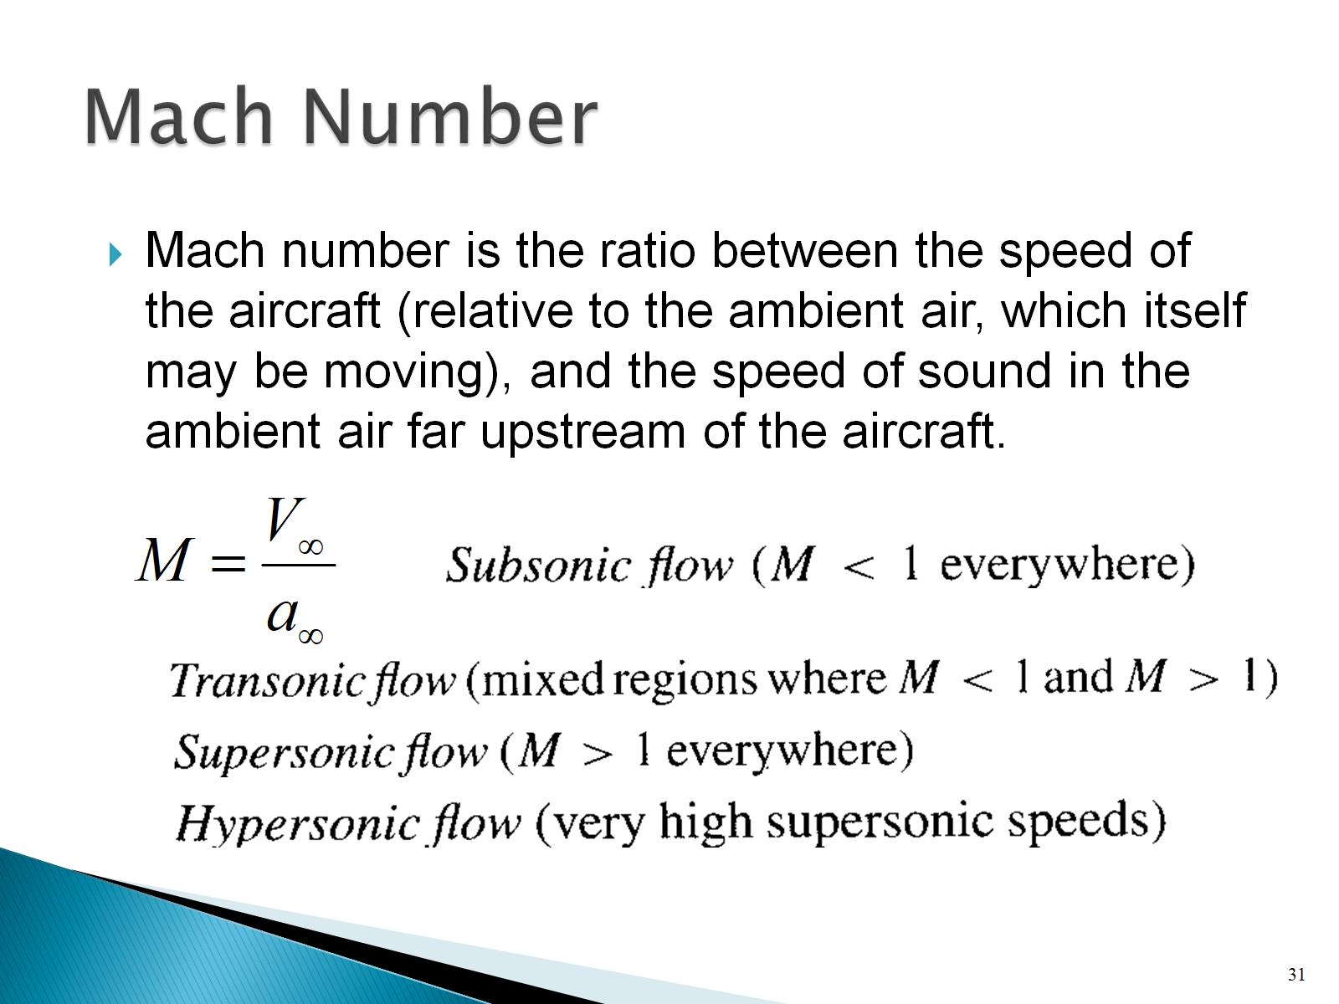
Mach Number

Slide 32
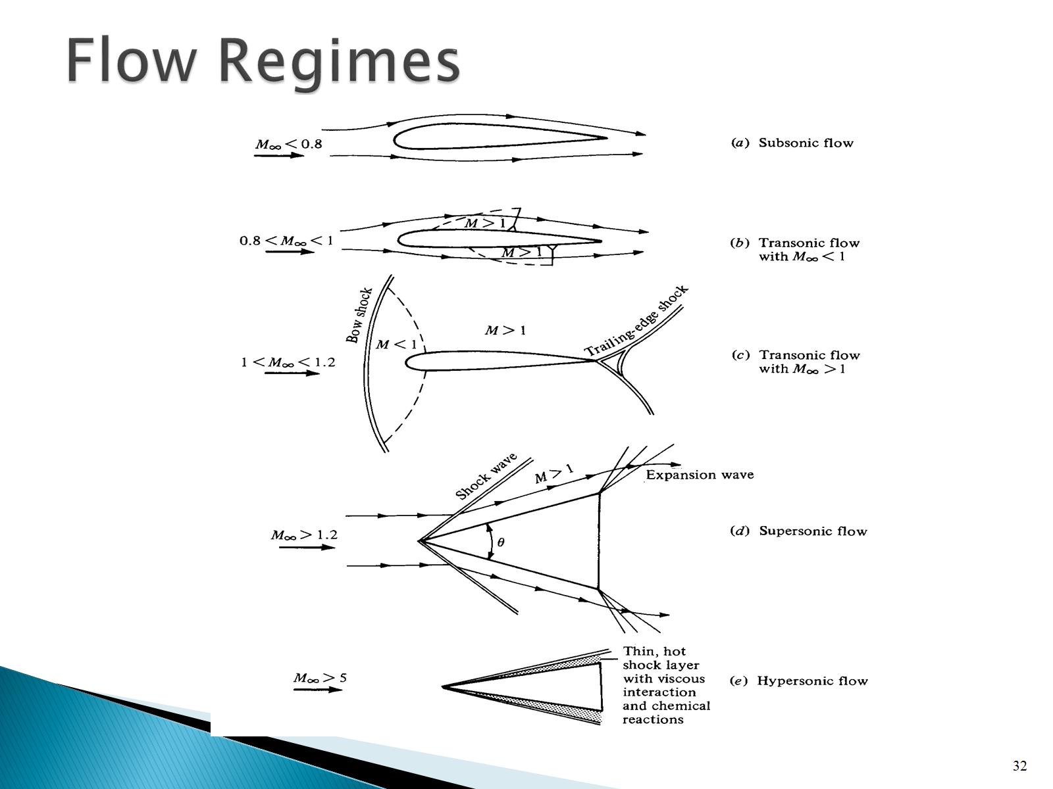
Flow Regimes

Slide 33
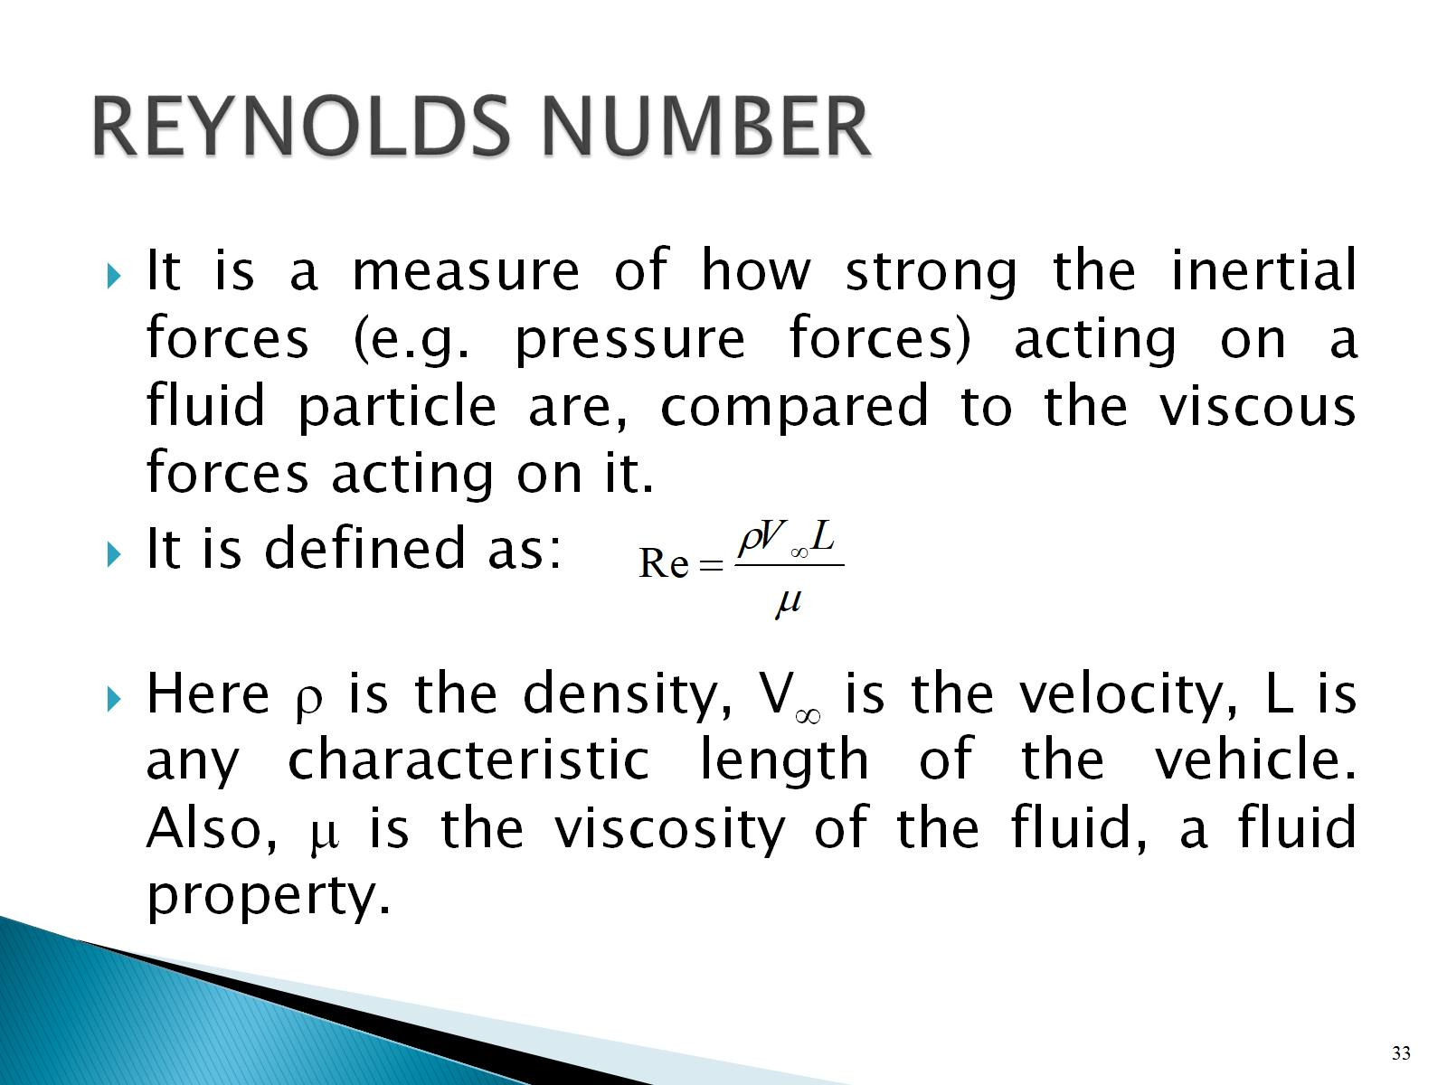
REYNOLDS NUMBER

Slide 34
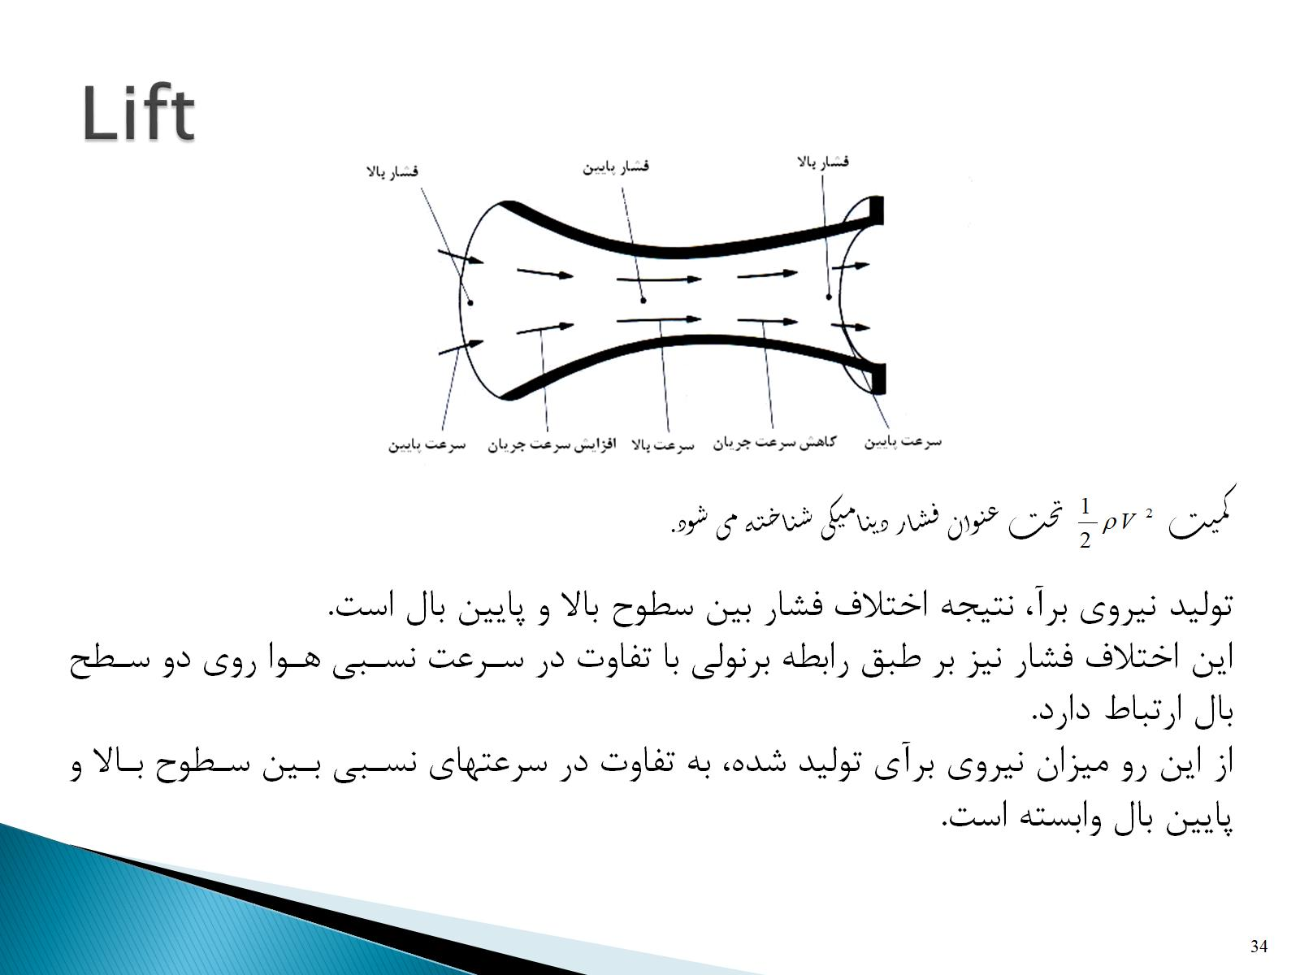
Lift

Slide 35
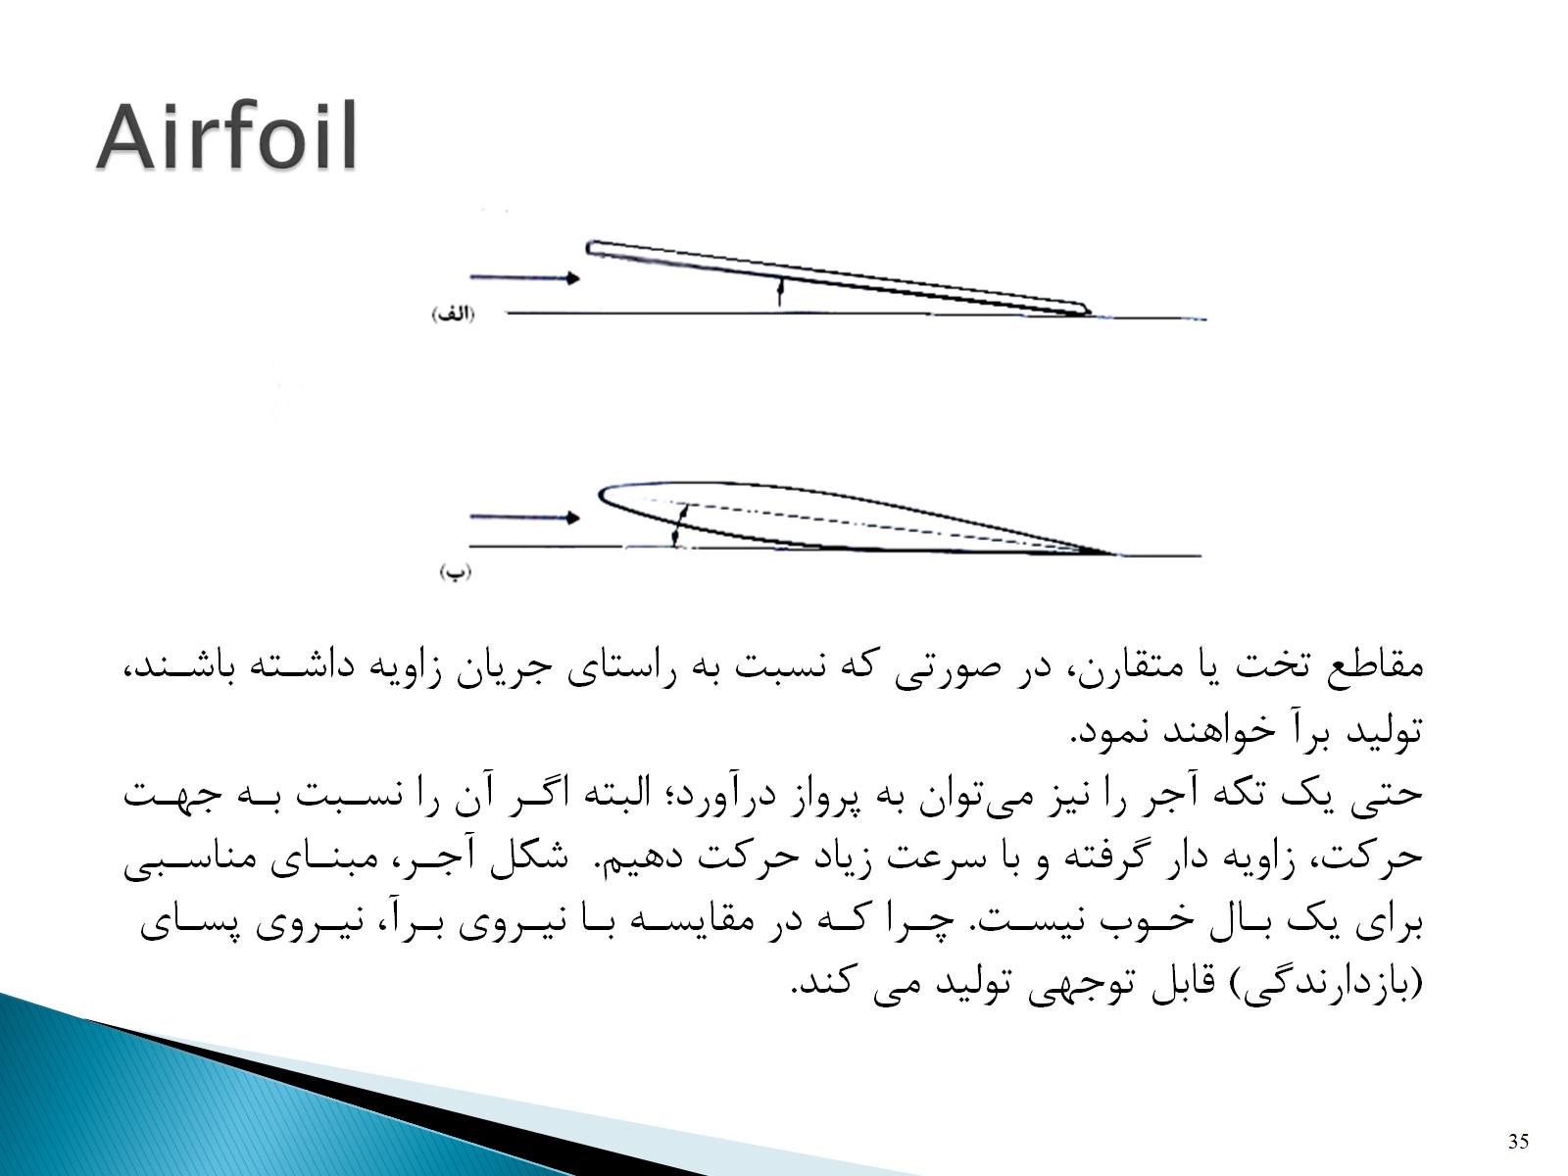
Airfoil

Slide 36
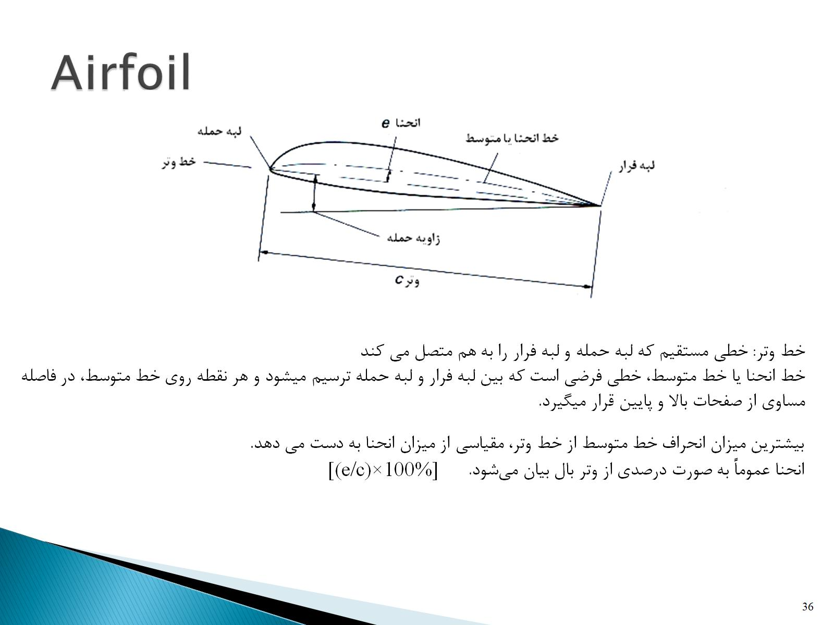
Airfoil

Slide 37
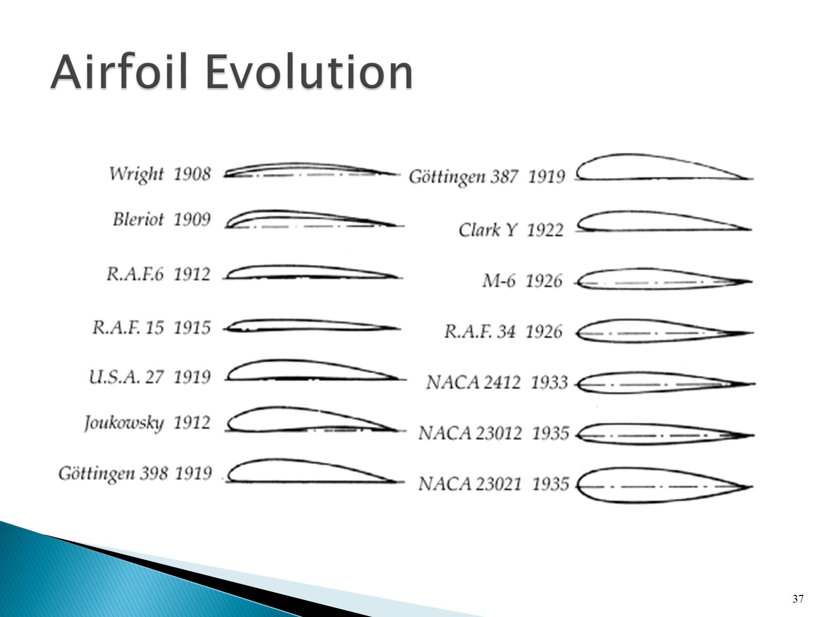
Airfoil Evolution

Slide 38
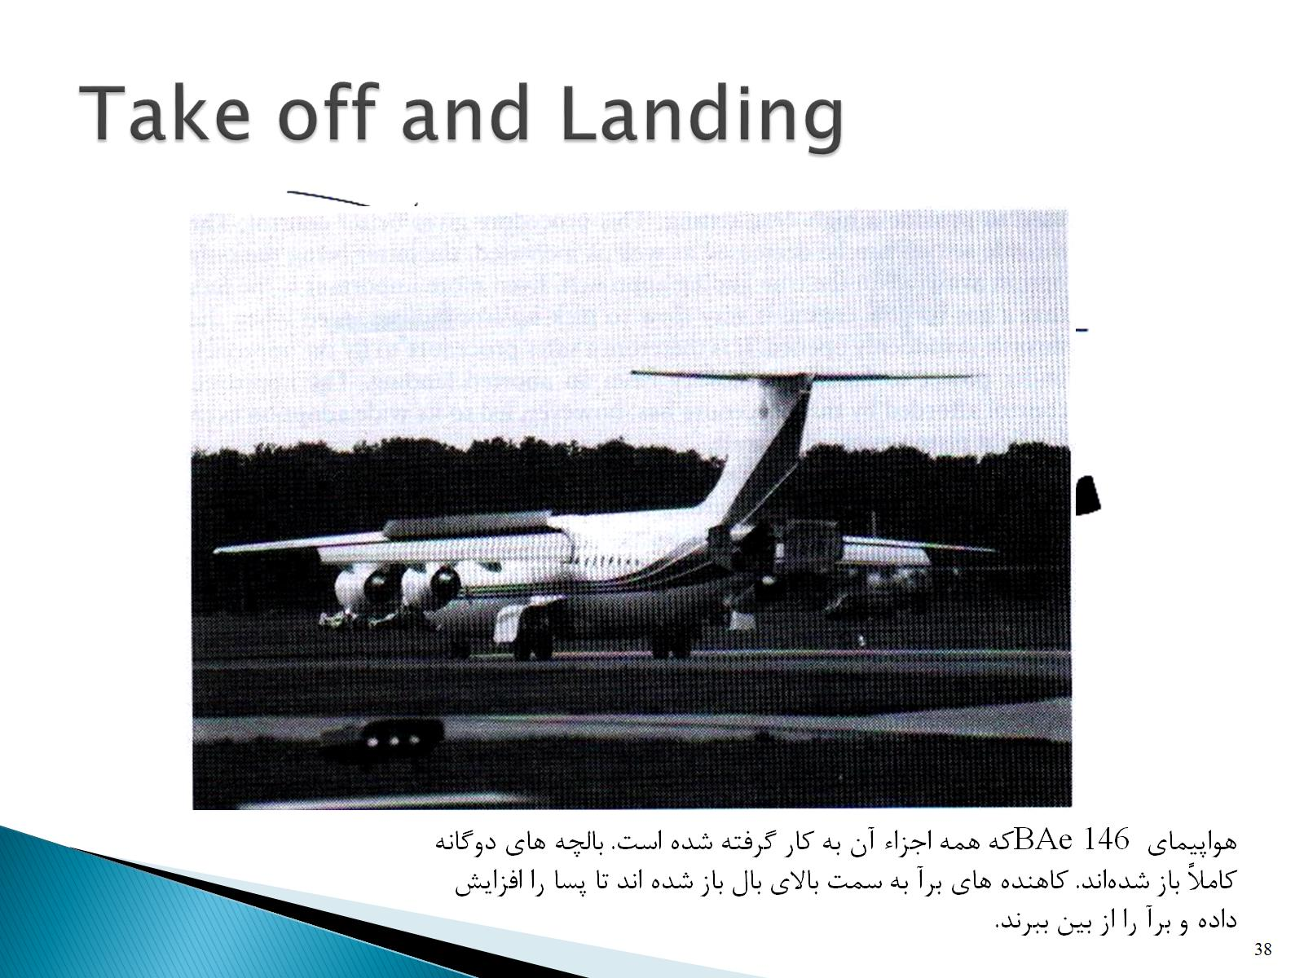
Take off and Landing

