Slide 1

Lecture #10
Ehsan Roohi
Sharif University of Technology
Aerospace Engineering Department

Slide 2

Review of Gas Dynamics
H-K Diagram
Normal shock wave
Flow with heat addition
Flow with friction
References:
  Chapter 2 of Mattingly
  Chapter 3 of Modern Compressible Flow, by: Anderson

Slide 3

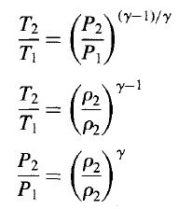
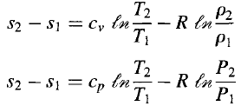
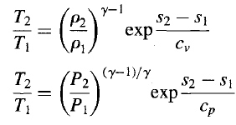
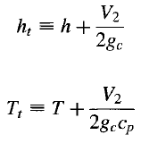
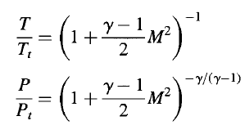
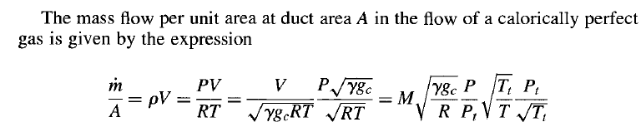
Read Example 2.1, 2.3, 2.4, Thermo 1-2
Isentropic

Slide 4

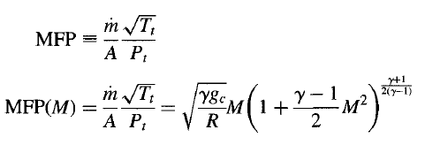









M=1

Slide 5


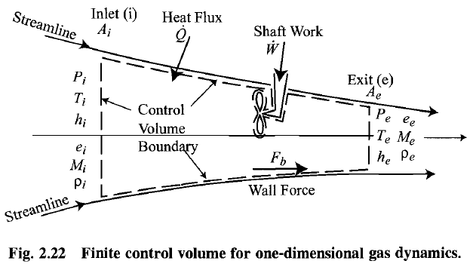







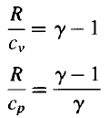



constant total enthalpy line

Slide 6




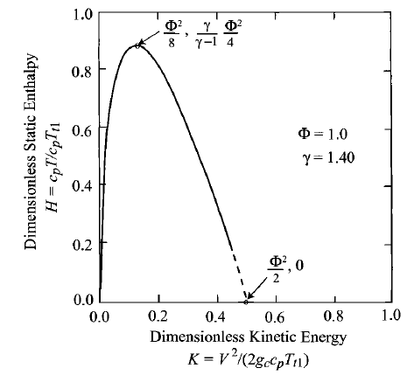


constant stream thrust flow
Stream thrust function
dimensionless stream thrust function for axial flow

Slide 7



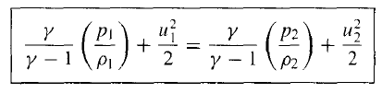

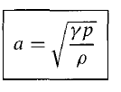

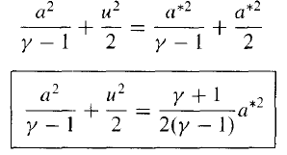
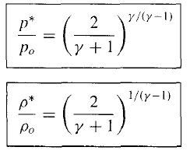


Slide 8
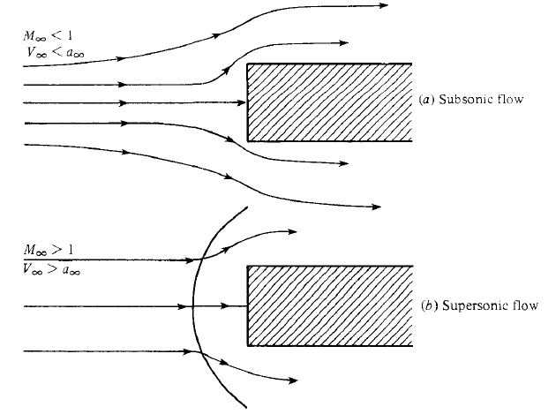
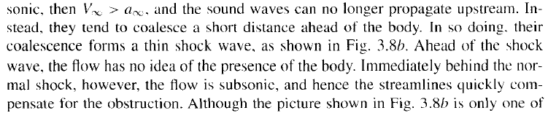
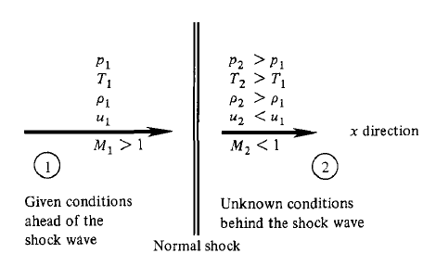
Normal shock waves are discontinuities in one-dimensional, constant through flow area, axial flows that are subject to the three constraints of constant mass flow, constant energy, and constant stream thrust.

Slide 9




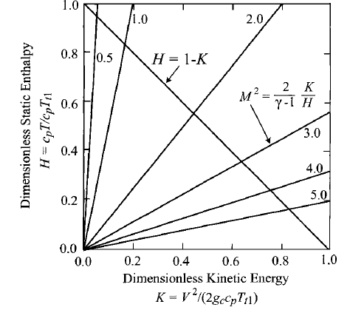
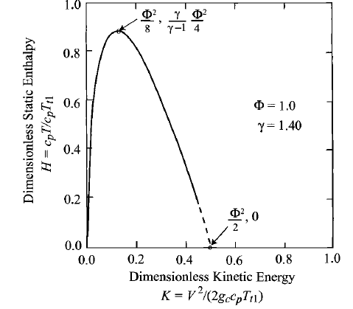
constant stream thrust flow
constant total enthalpy line
simultaneous solution

Slide 10


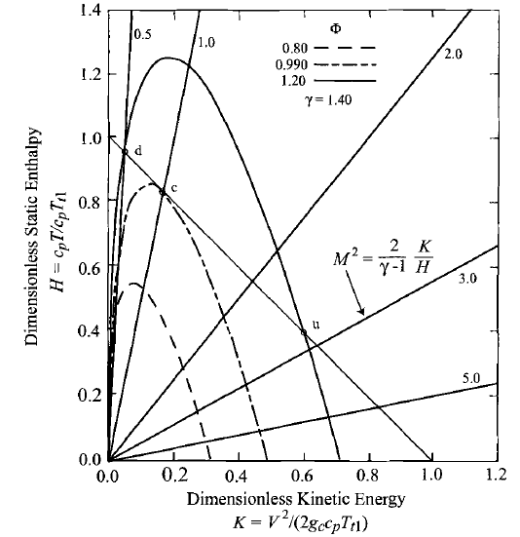



straight lines emanating from the origin of Fig. 2.25 are lines of constant Mach number
Next, it can be seen from the geometry of this diagram that there is only one value of φ for which the constant stream thrust function line is tangent to the constant energy line at point c and for which there is one solution (rather than two or zero).
M <1
M >1

Slide 11


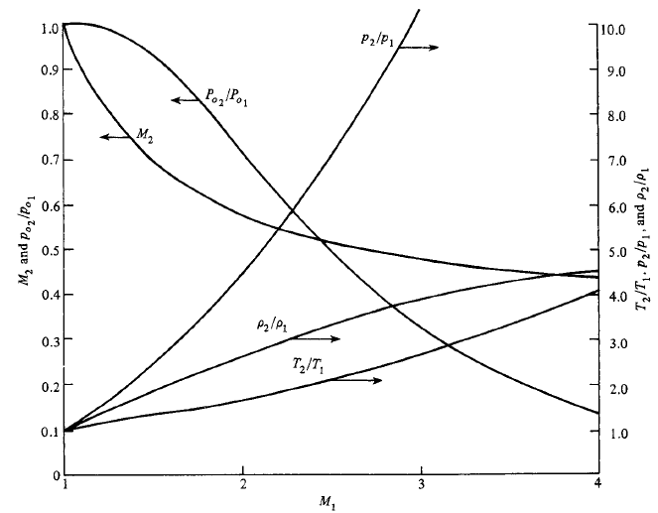
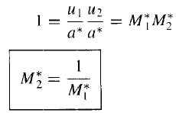




Slide 12

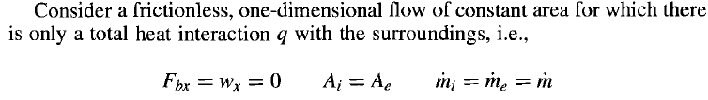









Slide 13

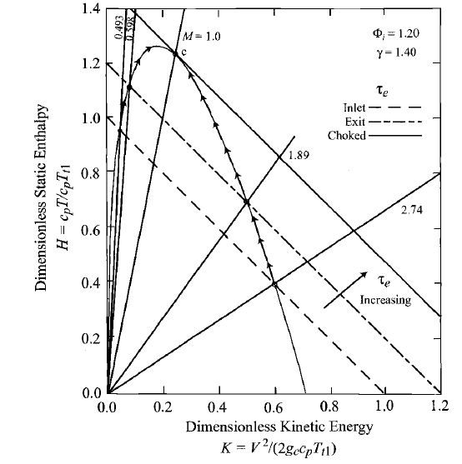


heating the flow
drives it toward an exit Mach number of 1 regardless of whether it was initially
subsonic or supersonic.
in the typical example of Fig. 2.25, a τ of 1.20
reduces the supersonic branch Mach number from an inlet value of 2.74 to an
exit value of 1.89, and increases the subsonic branch Mach number from 0.493
to 0.598.

Slide 14

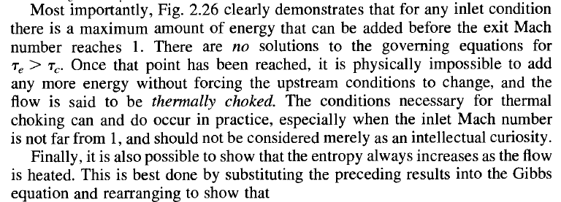


Read 3.8 of Anderson

Slide 15

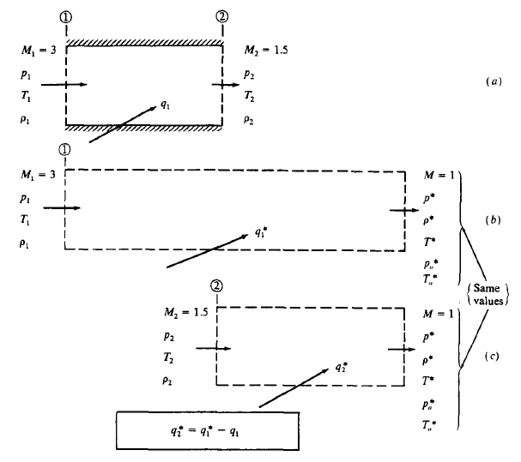
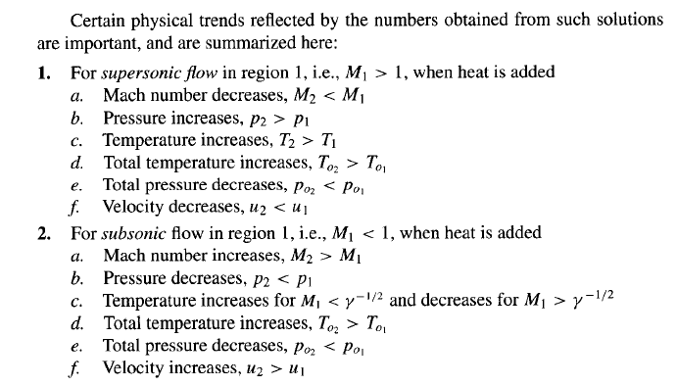

Slide 16

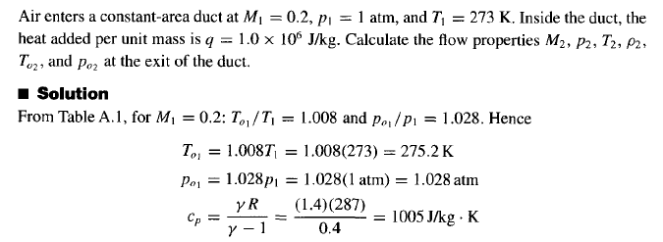
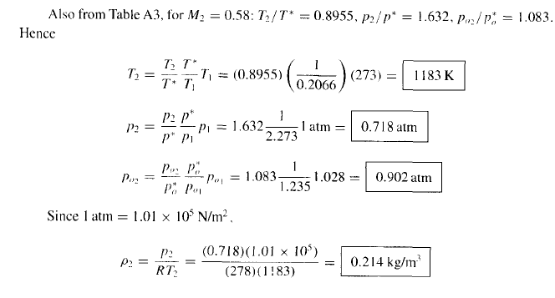

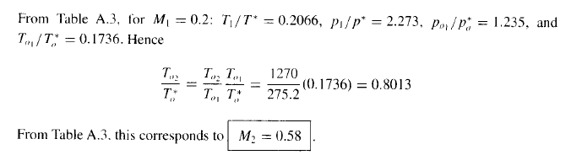

Slide 17

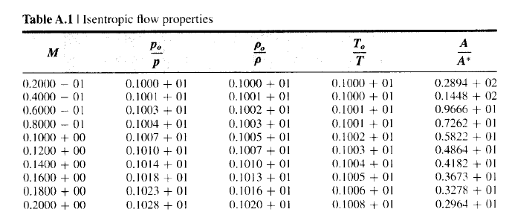
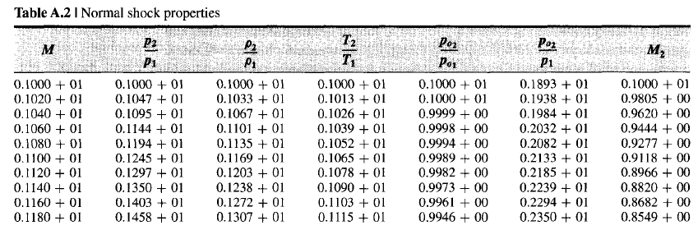

Slide 18
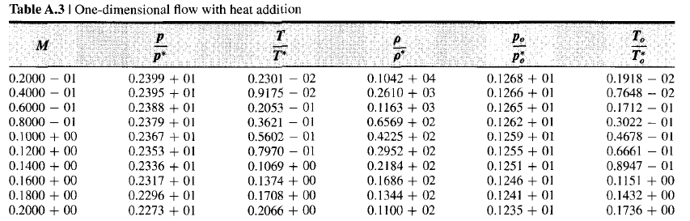
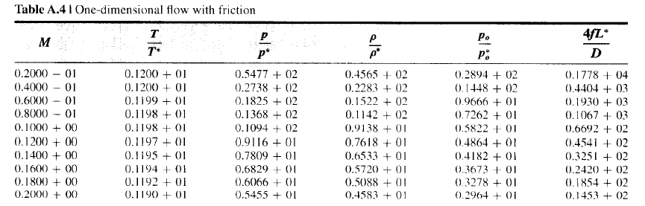

Slide 19









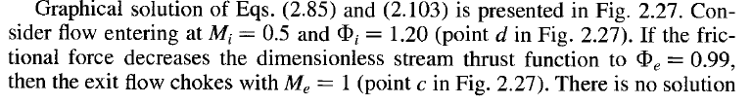


Slide 20


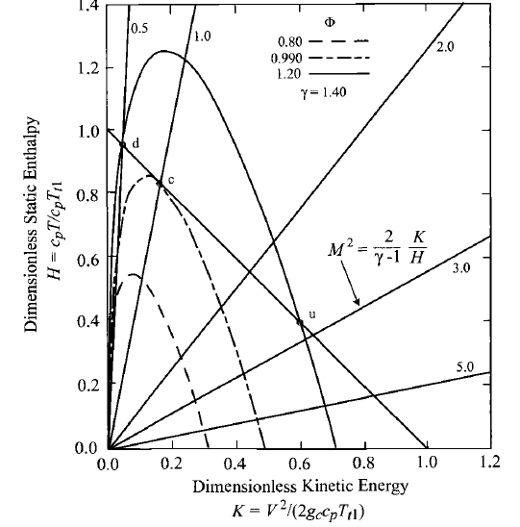
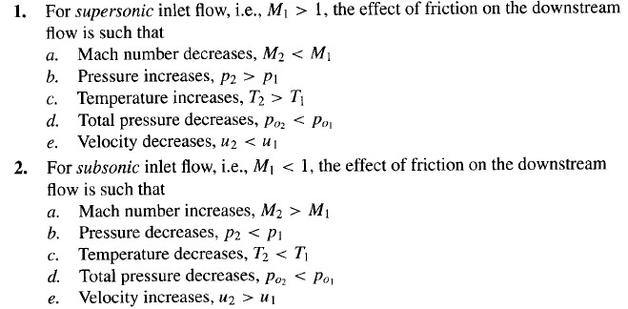

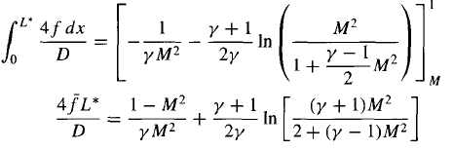

Slide 21

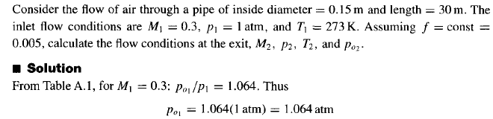
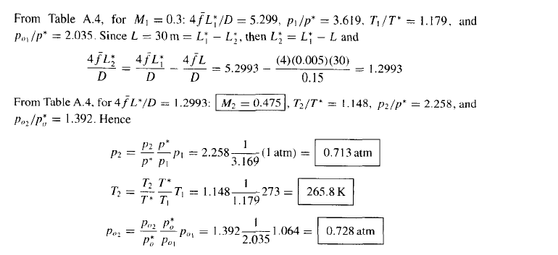

Slide 22

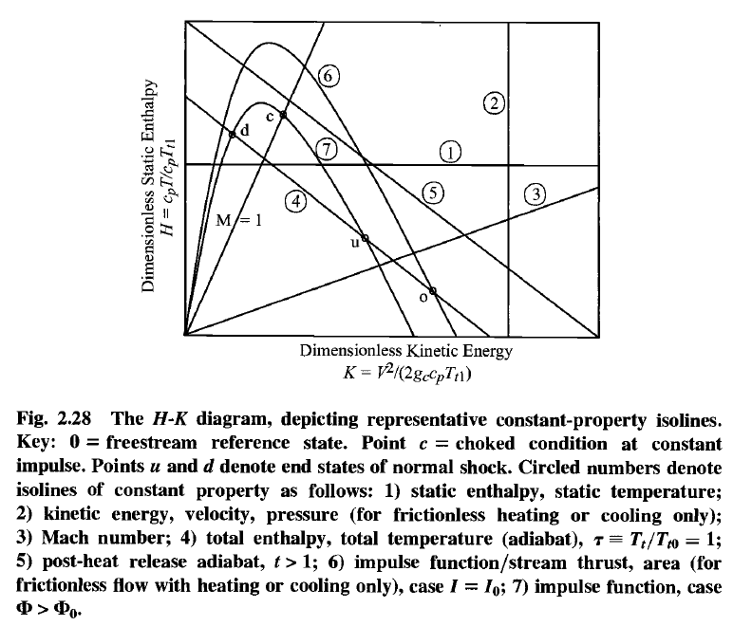
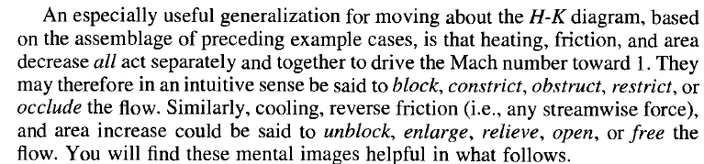
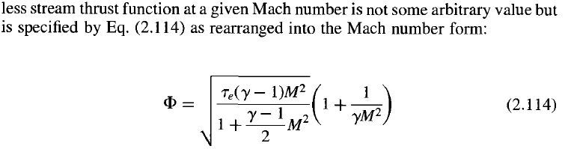

Slide 23
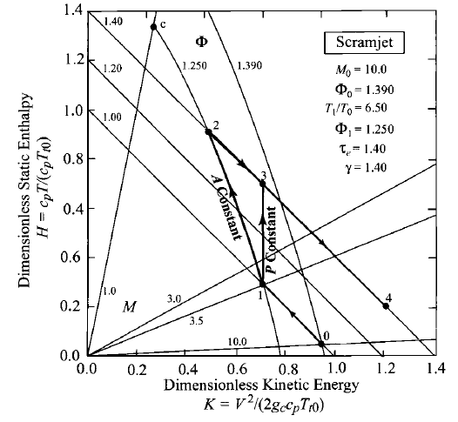
scramjet that is powering a vehicle at a freestream Mach number of 10.0, where φ0 = 1.390.
The air is decelerated
and compressed from the freestream condition (point 0) to the burner entry condition
(point 1) by means of a combination of isentropic compression and oblique
shock waves.
The purposes of this compression are to provide a large enough static temperature ratio T1/To for satisfactory thermodynamic cycle efficiency and to produce high
enough values of P1 and T1 to support complete and stable combustion in the burner. The burner entry M1 = 3.340
remains supersonic
Example

Slide 24
The air is then heated in a combustion process that releases the chemical
energy of the fuel. The heating is represented in this type of analysis by an increasing total temperature, in this example case by a factor of 1.40. The
precise path of this process depends on the philosophy of the burner design,
and two of many possible different types are depicted in Fig. 2.29. The first, joining point 1 to point 2, is frictionless, constant area heating, which is a Rayleigh line having qbl = 1.250. The second, joining point 1 to point 3, is frictionless, constant pressure heating, which is found in Problem 2.49d also to be a
line of constant velocity. There is clearly no danger of reaching point c and thermal choking for either combustor in this scenario.
Example

Slide 25
The heated air is then accelerated and expanded from a burner exit condition such as point 2 or 3 to the freestream static pressure at point 4. Because there are total pressure losses in the scramjet, the Mach number at point 4 can never be
quite as large as the freestream Mach number, but it can be large enough that the kinetic energy and velocity at point 4 exceed that of point 0, which means that the scramjet produces net thrust. As a corollary, the total pressure losses and therefore the precise location of point 4 also depend on the type of burner design. Nevertheless, the H-K diagram makes it clear that the potential thermodynamic performance is greater for constant area heating than for constant velocity
heating because each increment of heat is added at a higher temperature
in the former case.
Example

Slide 26
HW’s: in two weeks
Chapter 1 (Mattingly):
5, 7, 14, 16
Chapter 3 (Anderson):
9, 12, 16

