Slide 1

Lecture #12
Ehsan Roohi
Sharif University of Technology
Aerospace Engineering Department

Slide 2

We already read:
Chapters 1 & 2 from Mattingly,
Chaps 3 & 4 from MCF by Anderson,
This session:
Chapter 4:
  4.4 Gas Turbine Engine Components, p:244
  Brayton Cycle
  Chapter 5:
  Ideal Cycle design
  Ideal ramjet design

Slide 3

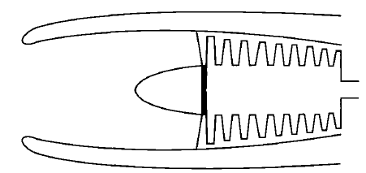
inlet, compressor, combustor, turbine, nozzle
Inlet
An inlet reduces the entering air velocity to a level suitable for the compressor.
The design and operation of the inlet depend on whether the air entering the duct is subsonic or supersonic.
Subsonic inlet:
The subsonic inlet can be a divergent duct, as shown

Slide 4

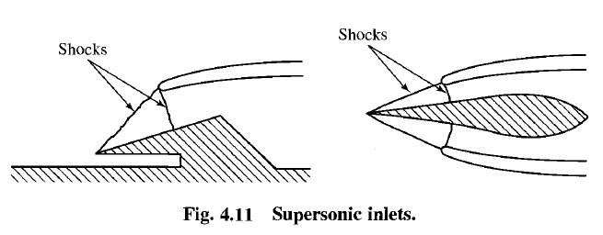
Because shock waves will occur in supersonic flow, the geometry of supersonic inlets is designed to obtain the most efficient compression.
If the velocity is reduced from a supersonic speed to a subsonic speed with one normal shock wave, compression process is inefficient.
If several oblique shock waves are employed to reduce the velocity, the compression process is more efficient.

Slide 5

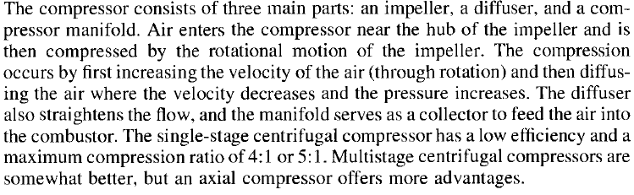
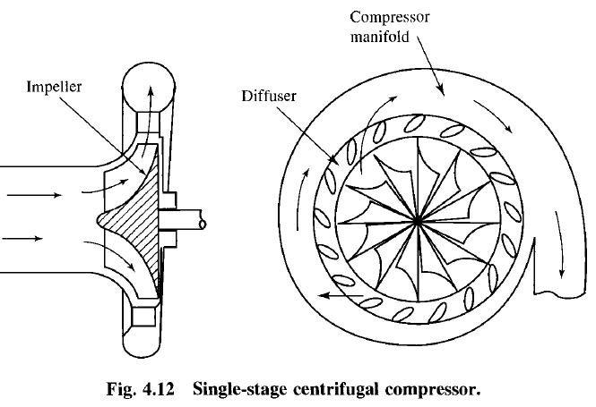

Slide 6
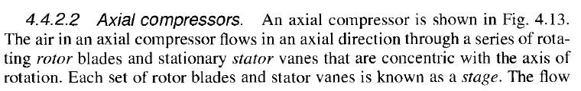
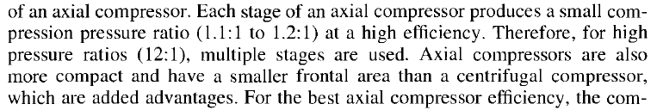
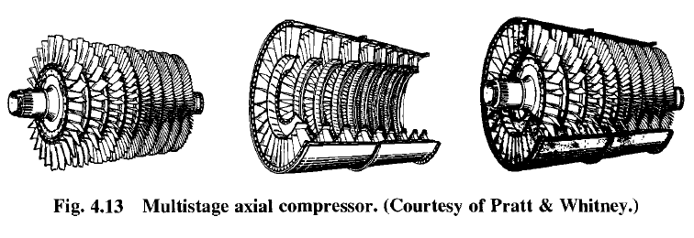

Slide 7
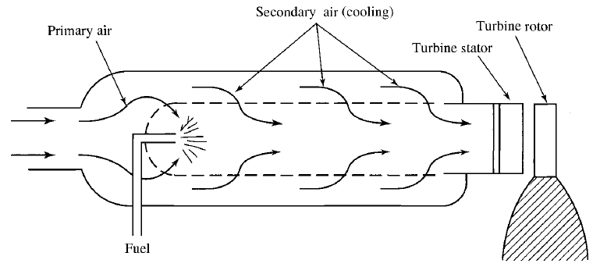
The combustor is designed to burn a mixture of fuel and air and to deliver the resulting gases to the turbine at a uniform temperature. The gas temperature must not exceed the allowable structural temperature of the turbine.

Slide 8

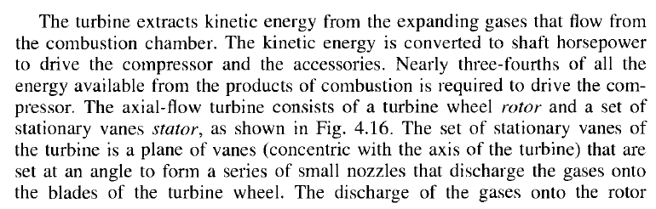
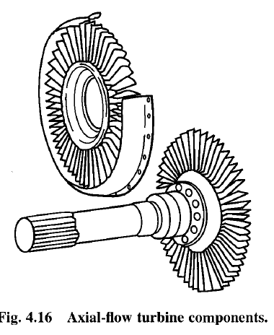
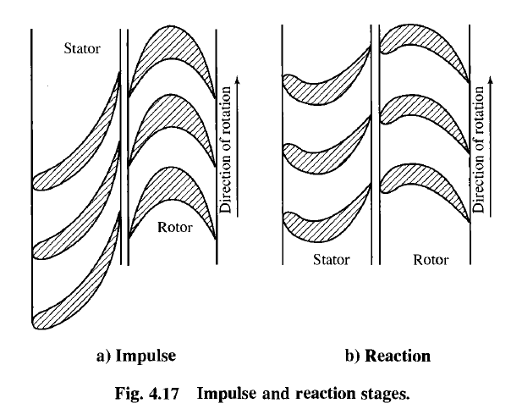

Slide 9

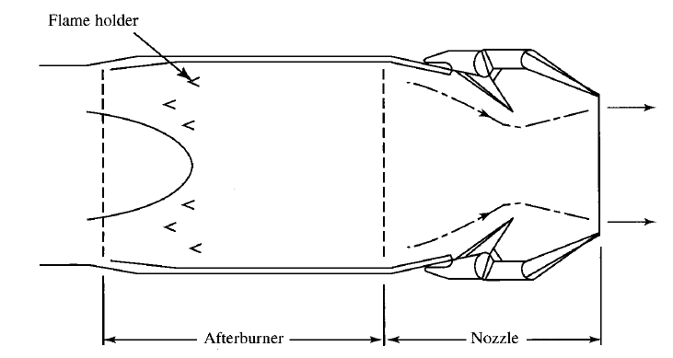
The purpose of the exhaust nozzle is to increase the velocity of the exhaust gas before discharge from the nozzle and to collect and straighten gas flow from the turbine.

Slide 10

When water is injected into the inlet of the compressor, the mass flow rate increases and a higher combustion chamber pressure results
The higher pressure and the increase in mass flow combine to increase the thrust.
Afterburning
The afterburner consists of the duct section, fuel injectors, and flame holders.
It is possible to have afterburning because, in the main burner section, the combustion products are air-rich.
The effect of the afterburning operation is to raise the temperature of the exhaust gases that, when exhausted through the nozzle, will reach a higher exit velocity

Slide 11

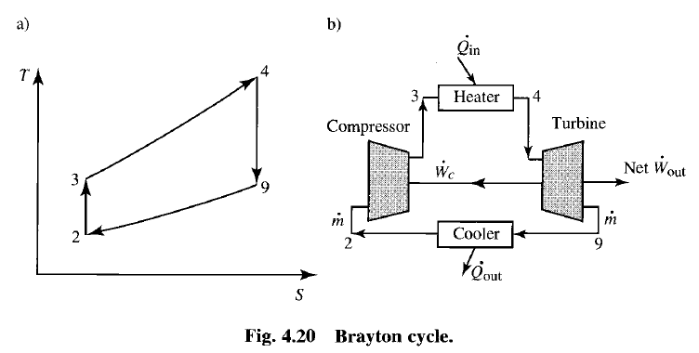
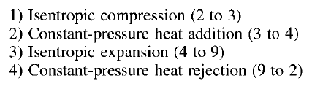
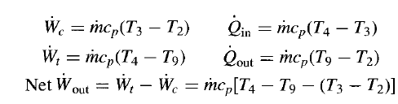


Slide 12
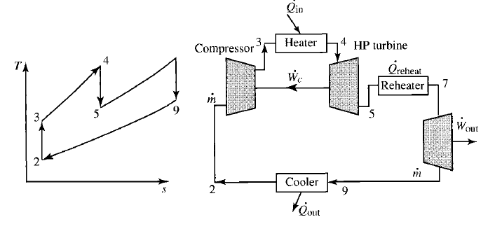
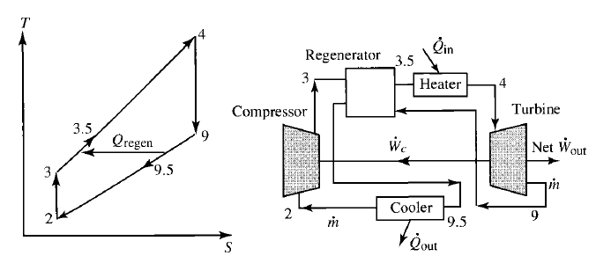

Two Turbines
Reheat
Regenerator

Slide 13



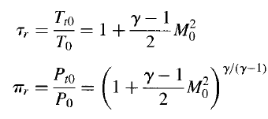

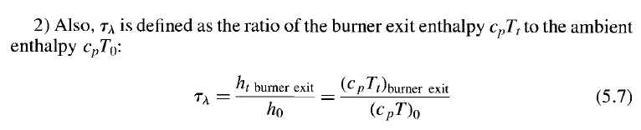
Parametric cycle analysis determines the performance of engines at different conditions
ratio of total pressures across a component by π, d for diffuser (inlet), c for compressor, b for burner, t for turbine, n for nozzle

Slide 14

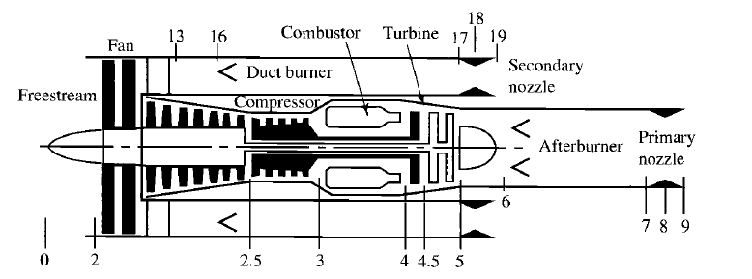
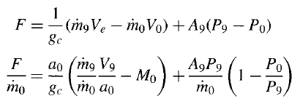
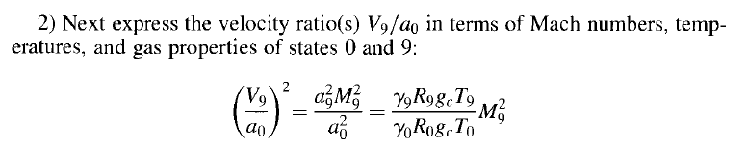
1) Thrust

Slide 15
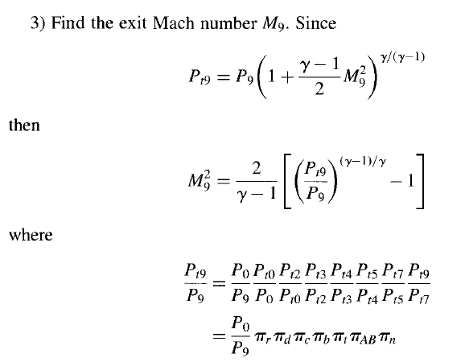
Free stream, diffuser , compressor, burner, turbine, after burner, nozzle

Slide 16

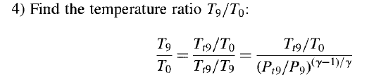
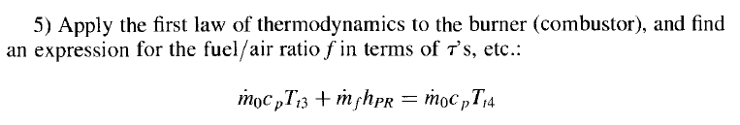
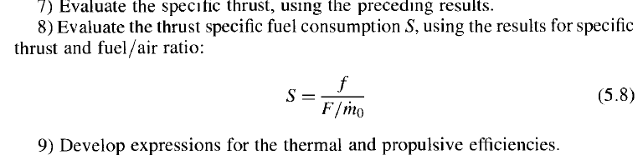

Slide 17
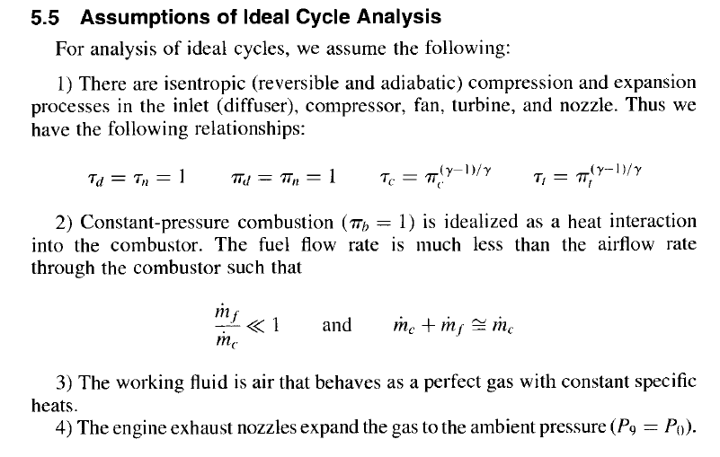

Slide 18

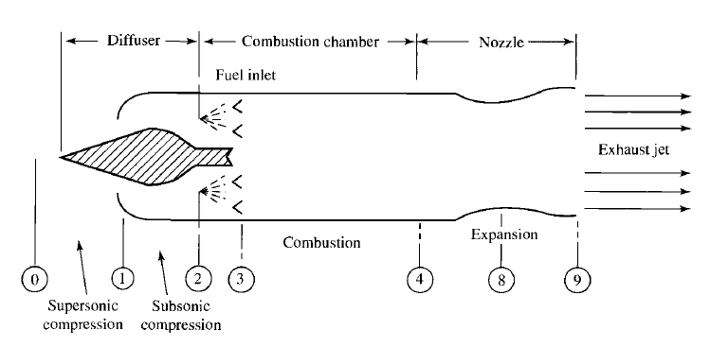
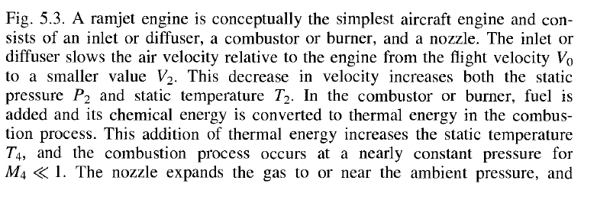

Slide 19
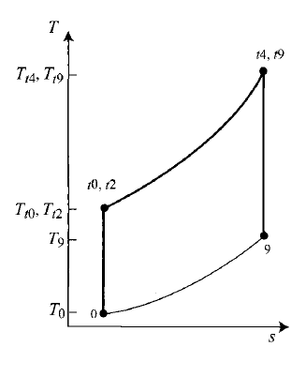

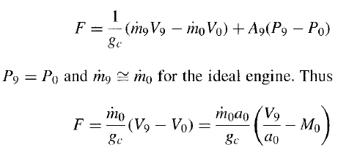


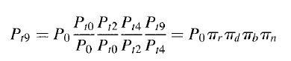
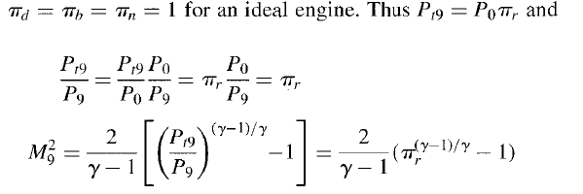


1
2
3

Slide 20








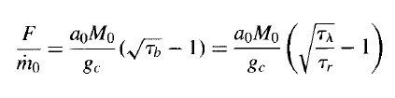




4
5: Combustions
7
9

Slide 21

Until Final exam date
Chapter 4: 10
Chapter 5: 1
We will cover ideal turbojet and turbofan design next week.

