Slide 1

Lecture #9
Ehsan Roohi
Sharif University of Technology
Aerospace Engineering Department

Slide 2

Propulsion
Operational Envelopes, Standard Atmosphere
Air-breathing Engines
Aircraft Performance
Rocket Engines

Slide 3

Reference: Element of Propulsion- Gas turbine and rockets, By: Mattingly
We read:
Introduction to aircraft and rocket propulsion
(Chapter 1),
Review of fundamentals (Chapter 2),
Analysis and performance of air-breathing propulsion systems (Chapter 4),

Slide 4


Propel :"to drive, or cause to move, forward or onward. '‘
Study of propulsion includes the study of the propelling force, the motion caused, and the bodies involved.
Propulsion involves an object to be propelled plus one or more additional bodies, called propellant.
Methods devised to produce a thrust force for the
propulsion are based on the principle of jet propulsion
(the momentum change of a fluid by the propulsion system).
The fluid may be the gas used by the engine itself
(turbojet),
it may be a fluid available in the surrounding
(air used by a propeller),
or it may be stored in the vehicle and carried by it during the
flight (e.g., rocket).

Slide 5
Jet propulsion systems can be subdivided into two broad categories: air-breathing and non-air-breathing.
Airbreathing propulsion systems include the reciprocating, turbojet, turbofan, ramjet, turboprop, and turboshaft engines.
Non-airbreathing engines include rocket motors, nuclear propulsion systems, and electric propulsion systems.
1) Basic concepts and one-dimensional gas dynamics,
2) Analysis and performance of airbreathing propulsion systems,
3) Analysis of gas turbine engine components.

Slide 6

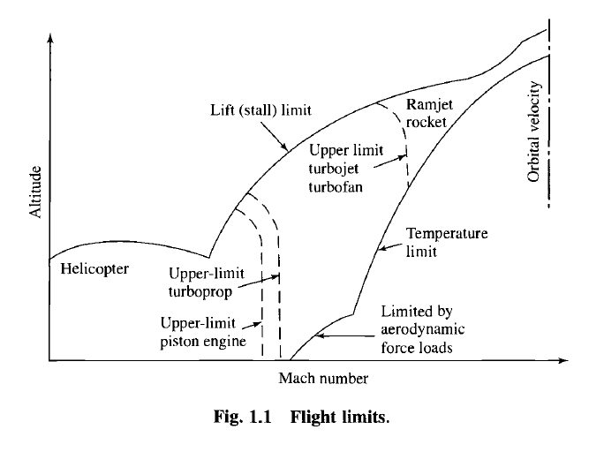
Each engine type will operate only within a certain range of altitudes and Mach numbers (velocities).
the approximate velocity and altitude limits, or corridor of flight, within which airlift vehicles can operate. The corridor is
bounded by a lift limit, a temperature limit, and an aerodynamic force limit.

Slide 7

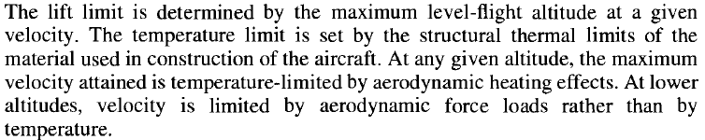
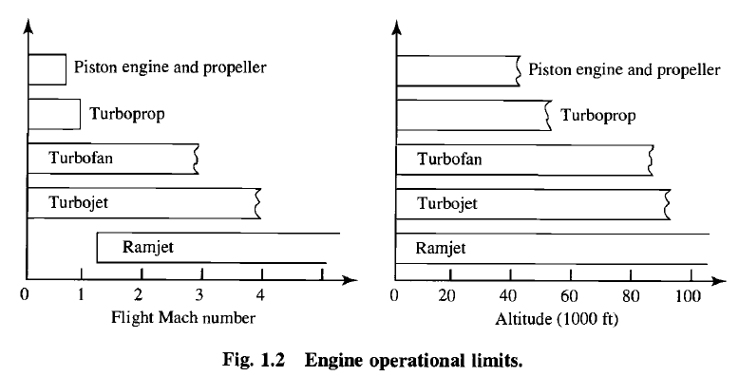

Slide 8

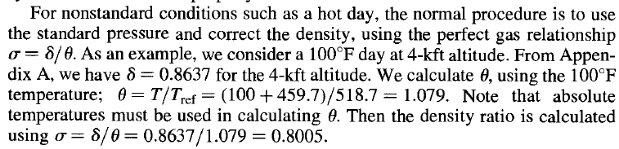
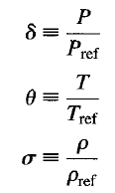
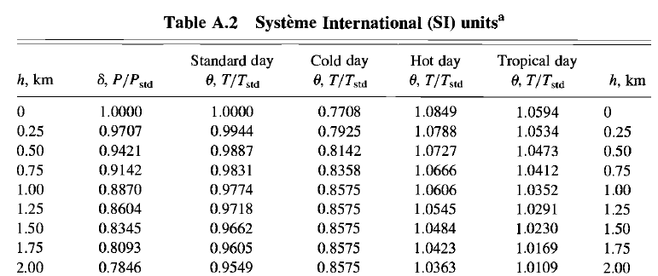

Slide 9

The turbojet, turbofan, turboprop, turboshaft, and ramjet engine systems are discussed.
The discussion of these engines is in the context of providing thrust for aircraft.
The "heart" of a gas turbine type of engine is the gas generator.
The compressor, combustor, and turbine are the major components of the gas generator which is common to the turbojet, turbofan, turboprop, and turboshaft engines.
The purpose of a gas generator is to supply high-temperature and high-pressure gas.

Slide 10

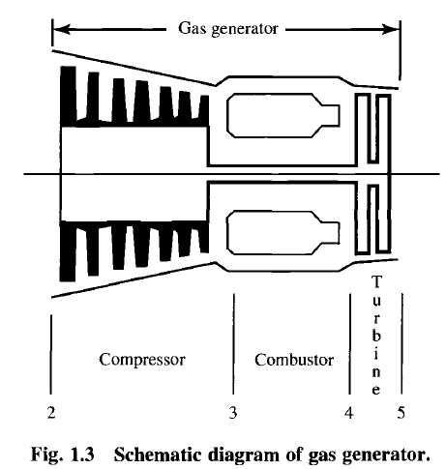
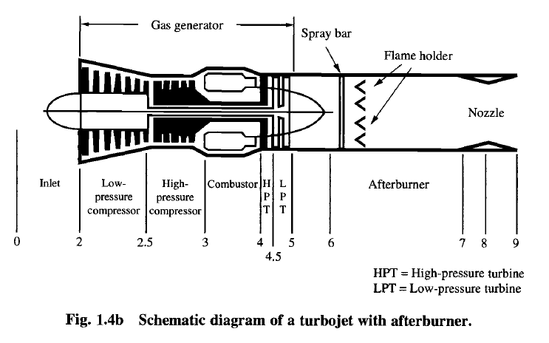
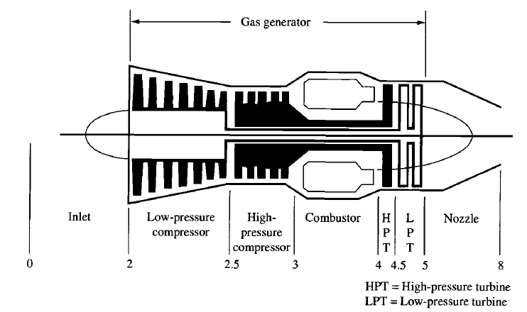
By adding an inlet and a nozzle to the gas generator, a turbojet engine can be constructed.

Slide 11

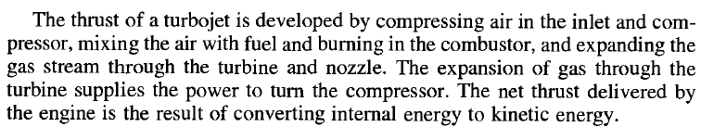
In the compressor, pressure and temperature increase as a result of work.
The temperature of the gas is further increased by burning fuel in the combustor.
In the turbine section, energy is being removed from the gas stream and converted to shaft power.
he energy is removed by an expansion process that results in a decrease of temperature and pressure.
In the nozzle, the gas stream is further expanded to produce a high exit kinetic energy.

Slide 12
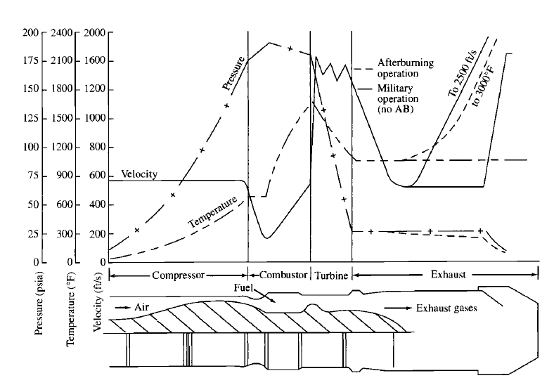
After Burner

Slide 13

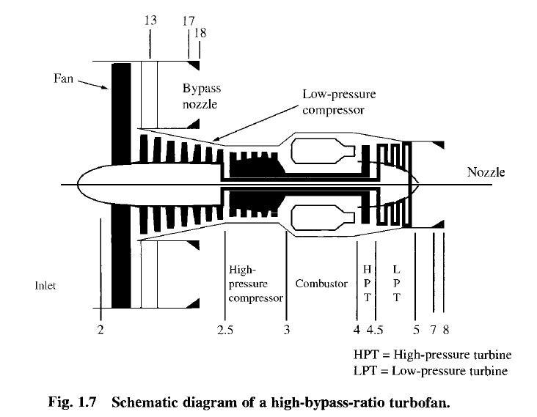
The turbofan engine consists of an inlet, fan, gas generator, and nozzle.
The fan increases the propellant mass flow rate

Slide 14

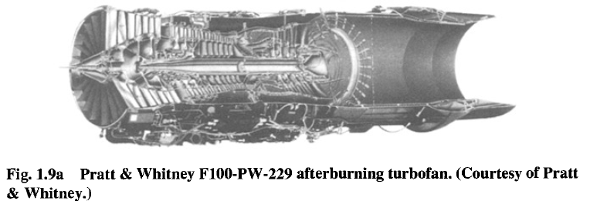
In the turbofan, a portion of the turbine work is used to supply power to the fan.
The thrust specific fuel consumption (TSFC, or fuel mass flow
rate per unit thrust) is lower for turbofans and indicates a more economical operation.
The turbofan also accelerates a larger mass of air to a lower velocity than a turbojet for a higher propulsive efficiency.

Slide 15

A gas generator that drives a propeller is a turboprop engine. The expansion of gas through the turbine supplies the energy required to turn the propeller
The turboshaft engine is similar to the turboprop except that power is supplied to a shaft rather than a propeller.
The limitations and advantages of the turboprop are those of the propeller.
For low-speed flight and short-field takeoff, the propeller has a performance advantage.
At speeds approaching the speed of sound, compressibility effects set
in and the propeller loses its aerodynamic efficiency.
Because of the rotation of the propeller, the propeller tip approach the speed of sound before the vehicle approaches it.

Slide 16
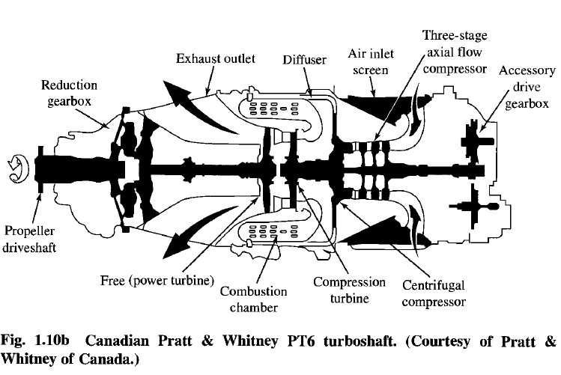

Slide 17

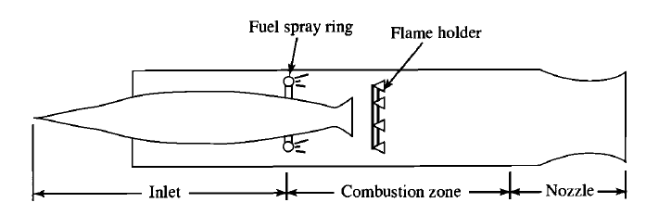
The ramjet consists of an inlet, a combustion zone, and a nozzle.
The ramjet does not have the compressor and turbine as the turbojet does. Air enters the inlet where it is compressed and then enters the combustion zone where it is mixed with the fuel and burned. The hot gases are then expelled through the
nozzle, developing thrust. The operation of the ramjet depends on the inlet to decelerate the incoming air to raise the pressure in the combustion zone.

Slide 18
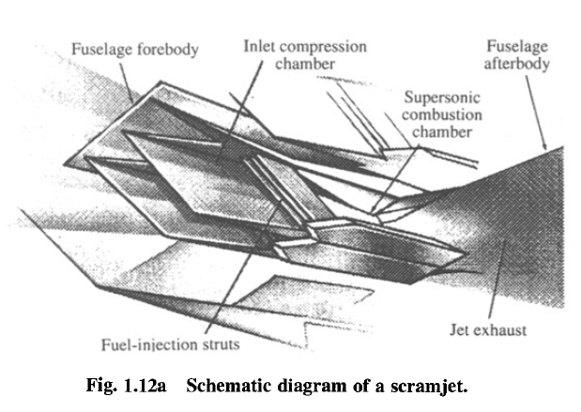
In the past few years, research and development have been done on a ramjet that has the combustion process taking place at supersonic velocities.
By using a supersonic combustion process, the temperature rise and pressure loss due to deceleration in the inlet can be reduced. This ramjet with supersonic combustion is known as the scramjet (supersonic combustion ramjet).

Slide 19


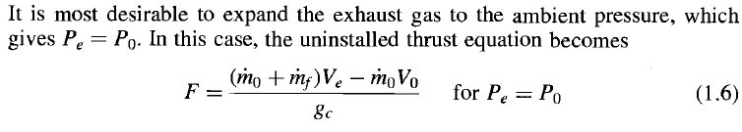
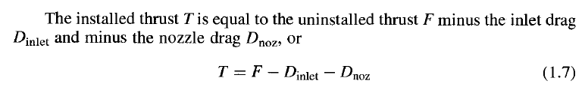
Engine Performance Parameters
the uninstalled thrust F of a jet engine (single inlet
and single exhaust)

Slide 20
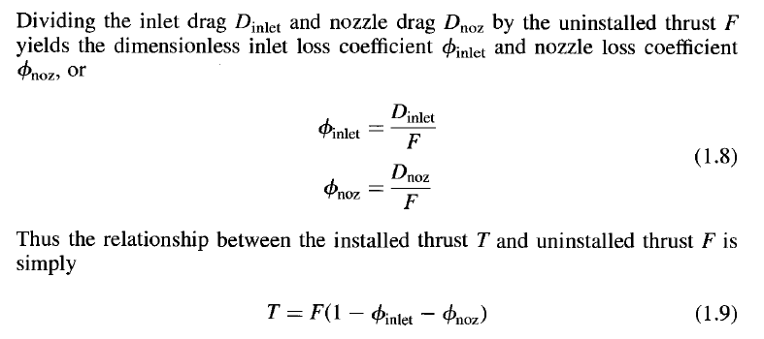
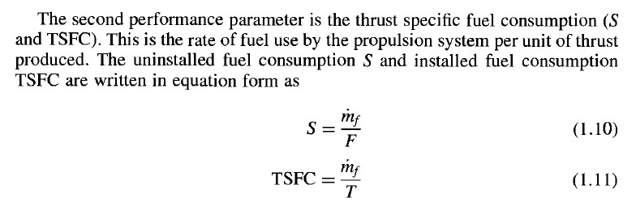
Engine Performance Parameters

Slide 21

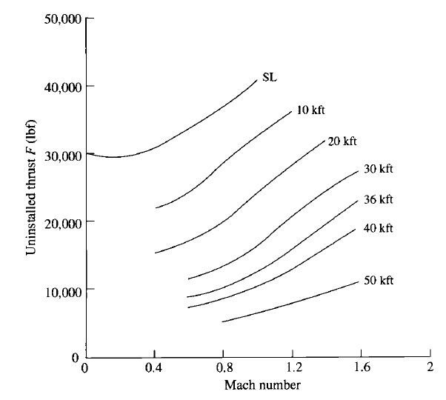
Engine Performance Parameters
thrust F decreases with altitude
and the fuel consumption
S also decreases with
altitude until 36 kft (the
start of the isothermal
layer of the atmosphere).
Also note that the fuel
consumption increases
with Mach number and
that the thrust varies
considerably with the Mach number.
Drag decreases with h

Slide 22
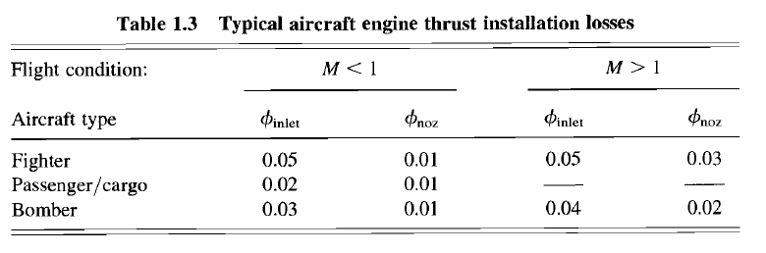

Engine Performance Parameters
Thermal efficiency is defined as the net rate of organized energy
(shaft power or kinetic energy) out of the engine divided by the rate of thermal energy available from the fuel.
The fuel's available thermal energy is equal to the mass flow rate of the fuel rnf times the fuel lower-heating value hpR.
Thermal efficiency can be written in equation form as

Slide 23

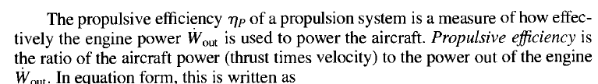

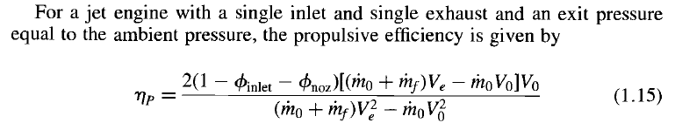
Engine Performance Parameters
The power out of a jet engine with a single inlet and single exhaust (e.g., turbojet engine) is given by
Inlet velocity

Slide 24
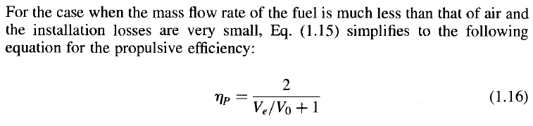
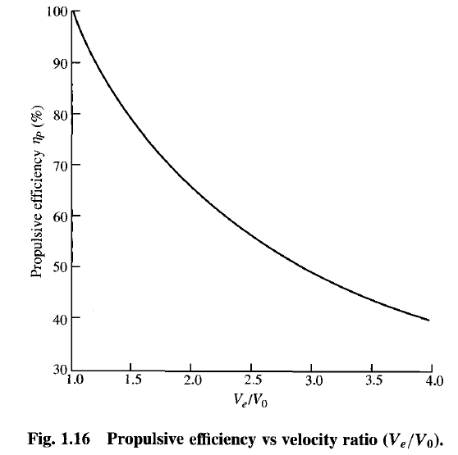
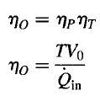




Engine Performance Parameters
The thermal and propulsive efficiencies can be combined to give the overall efficiency of a propulsion system.

Slide 25



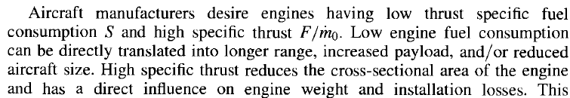
Engine Performance Parameters
Specific Thrust vs Fuel Consumption
For a jet engine with a single inlet and single exhaust and exit pressure equal to ambient pressure, when the mass flow rate of the fuel is much less than that of air and the installation losses are very small, the specific thrust F/m can be written as

Slide 26
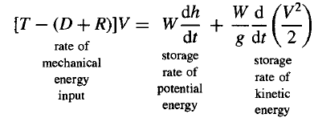





Aircraft Performance
the installed propulsive thrust T, aerodynamic drag D, and other resistive forces R act in the same direction as the velocity V,
Power Eq.
Note that the total resistive force D + R is the sum of the drag of the clean aircraft D and any additional drags R associated with such proturberances as landing gear, external stores, or drag chutes.
sum of the potential and kinetic energy terms

Slide 27
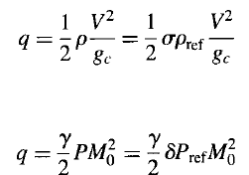
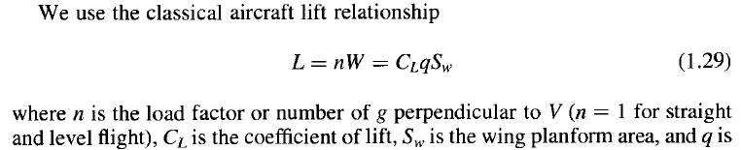

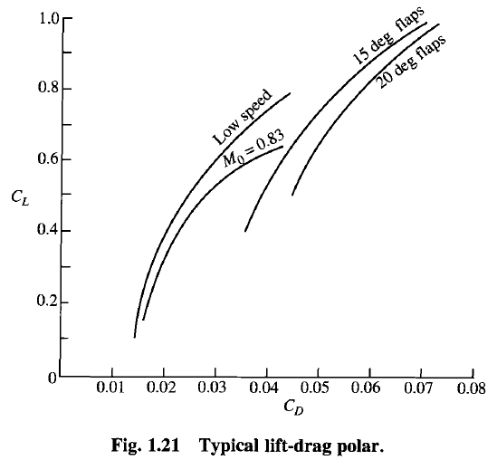
Lift and Drag
Where δ and σ are the dimensionless pressure and density ratios
where the coefficients K1, K2, and CDO are typically functions of flight Mach
number and wing configuration (flap position, etc.).

Slide 28
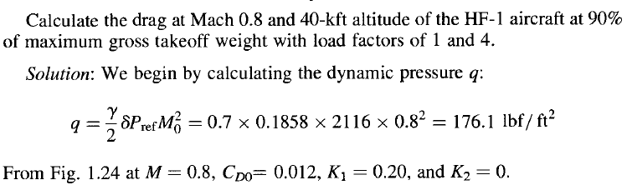
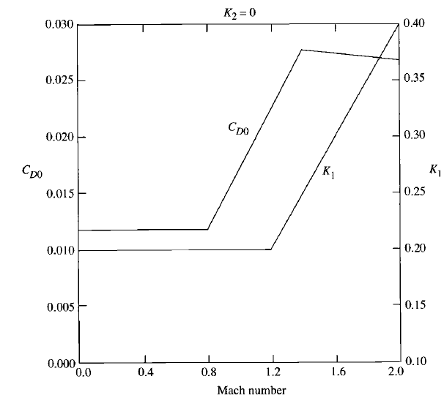
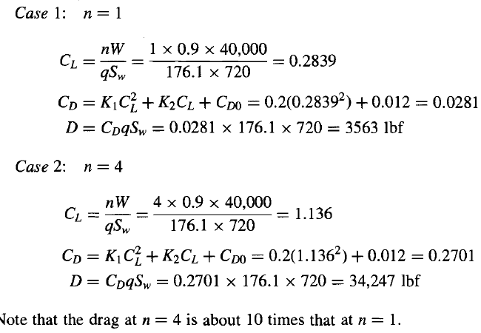
Example

Slide 29
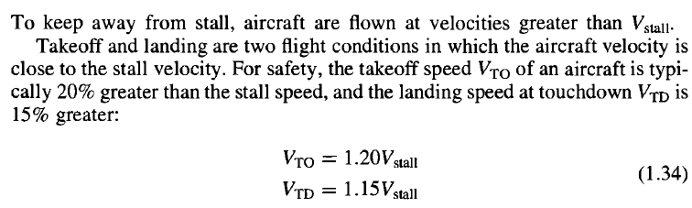
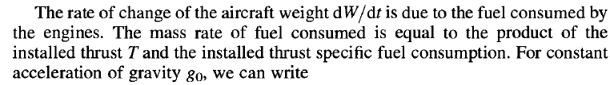





Definitions
Endurance. For level un-accelerated flight, thrust equals drag
(T = D) and lift equals weight (L = W).

Slide 30


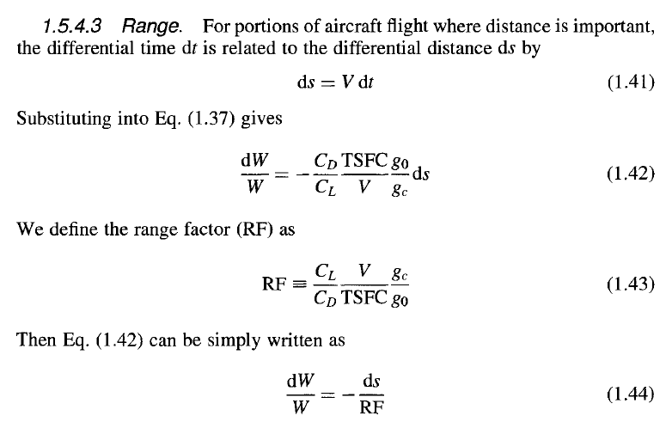
Definitions

Slide 31
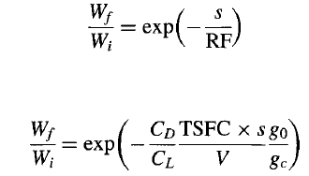
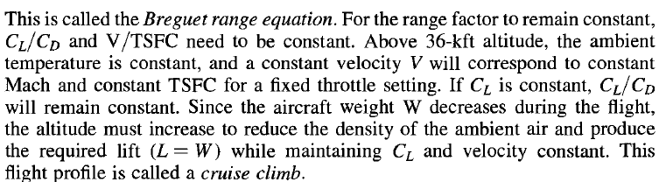
Definitions

Slide 32
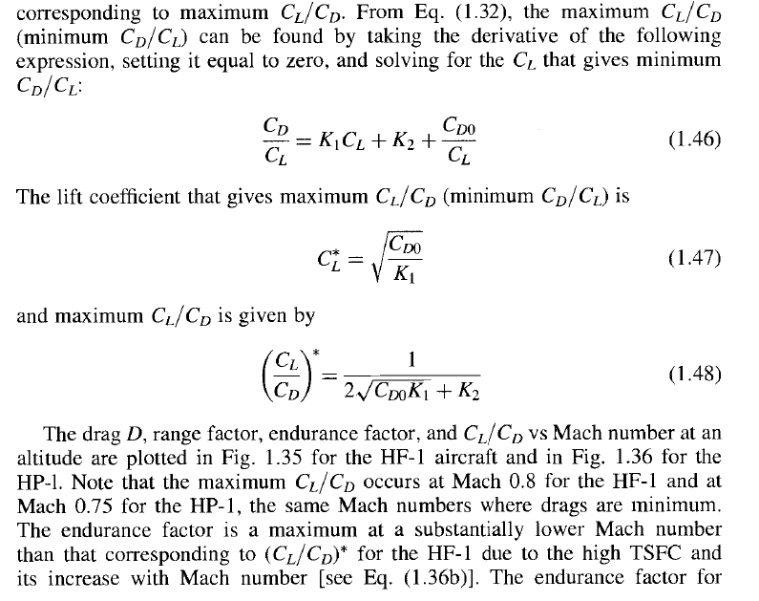
Definitions

Slide 33
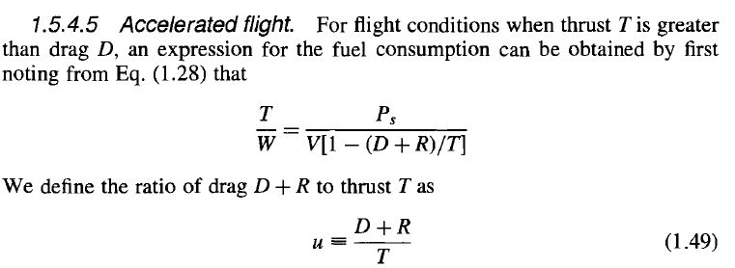
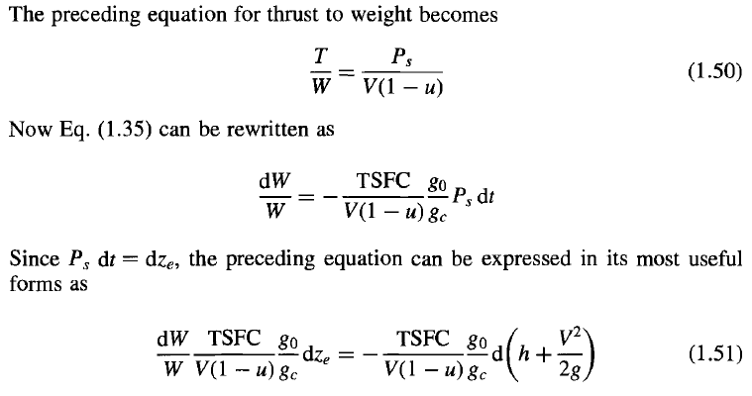
Definitions

Slide 34
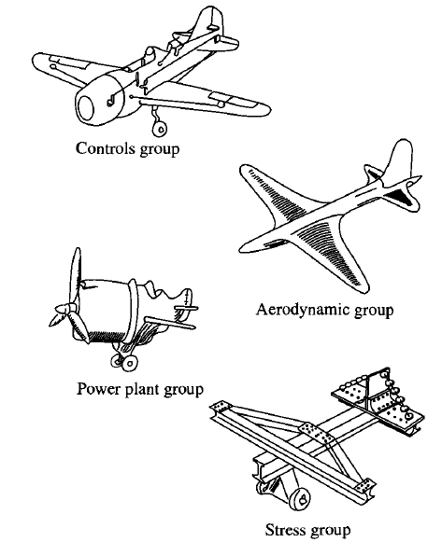
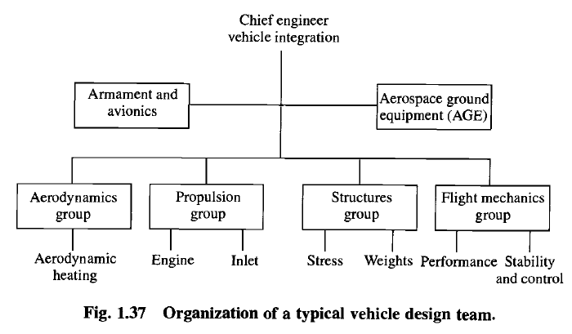
Aircraft Design

Slide 35
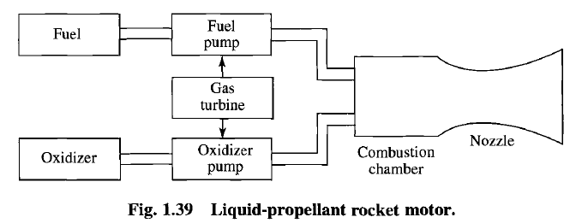
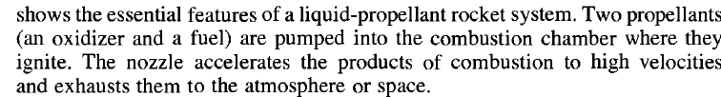
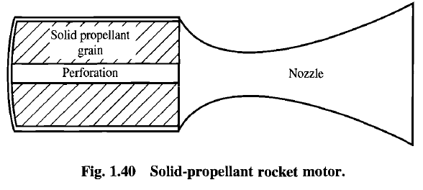
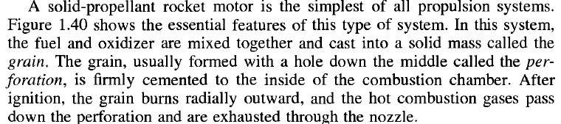
Rocket Engines

Slide 36
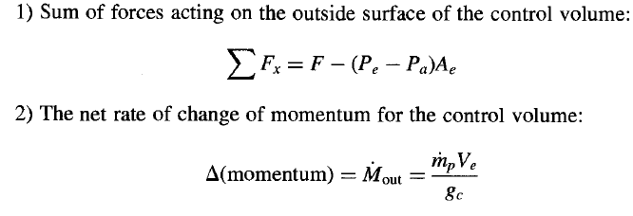




Rocket Thrust

Slide 37
HW’s
Read Pages 6-41 (acrobat pages), “FOREWORD”
Find softwares at aircraft engine designe.com

