Slide 1

Lecture: Airfoils/Wings
Ehsan Roohi
Department of Engineering
Ferdowsi University of Mashhad

Slide 2


Note: Dp is pressure Drag and can be calculated easily.
The NACA 4 digit and 5 digit airfoils were created by superimposing a simple mean line shape with a thickness distribution that was obtained by fitting a couple of popular airfoils of the time:
y = ±(t/0.2) * (.2969*x^{0.5} - .126*x - .3537*x² + .2843*x³ - .1015*x⁴)
The camberline of 4-digit sections was defined as a parabola from the leading edge to the position of maximum camber, then another parabola back to the trailing edge.

Slide 3

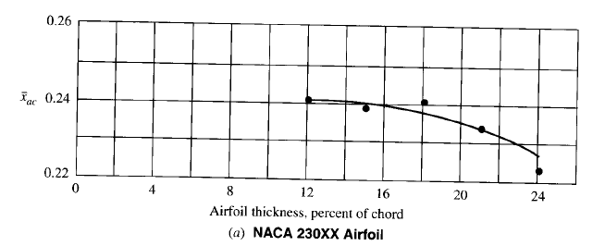
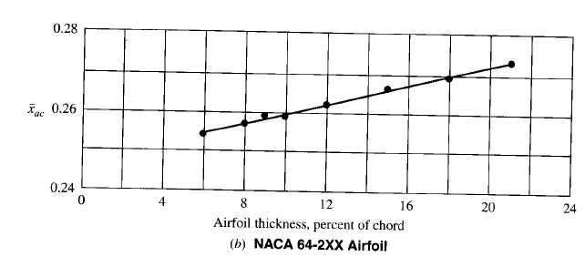

Slide 4



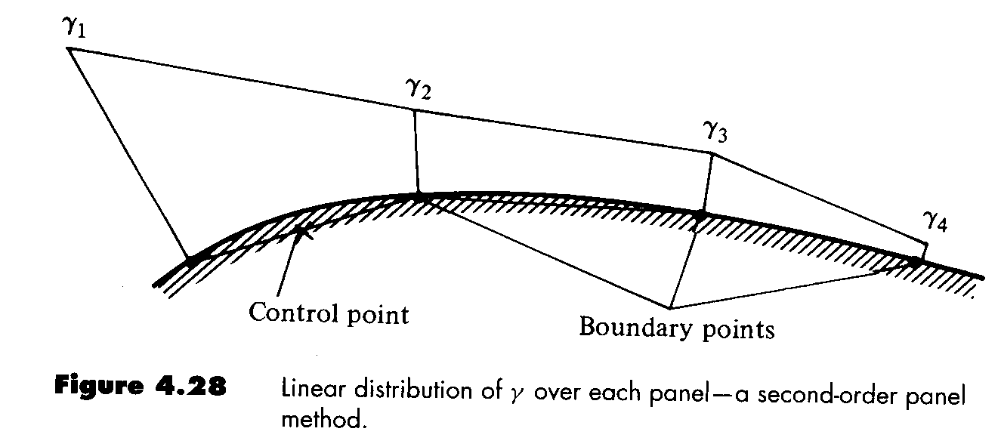
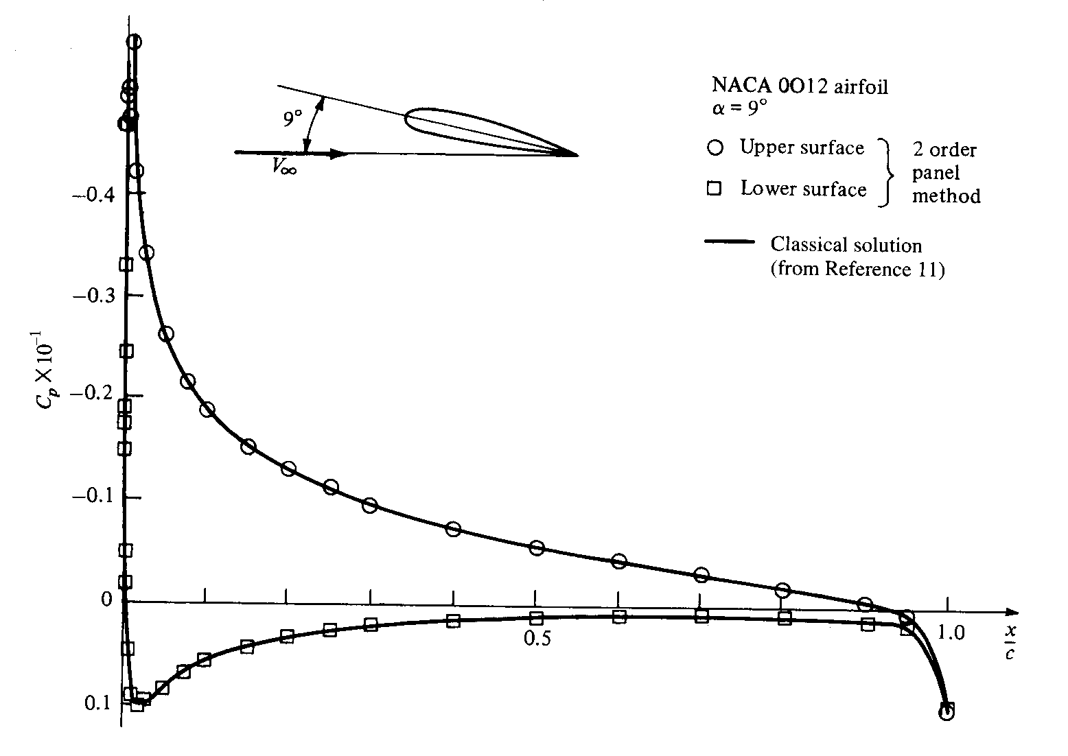

Slide 5

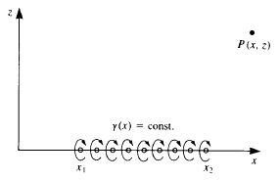
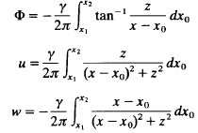




θ
z-z0
ds

Slide 6




Slide 7

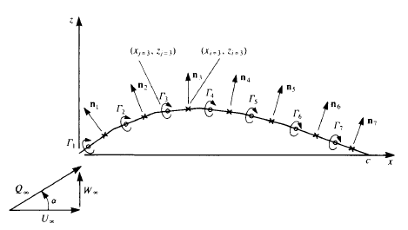

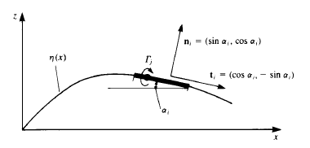


Slide 8


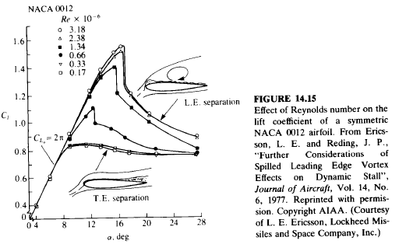
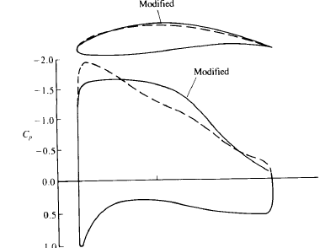

Slide 9

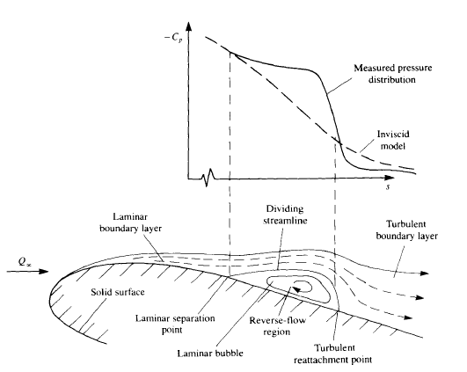


Slide 10




Slide 11


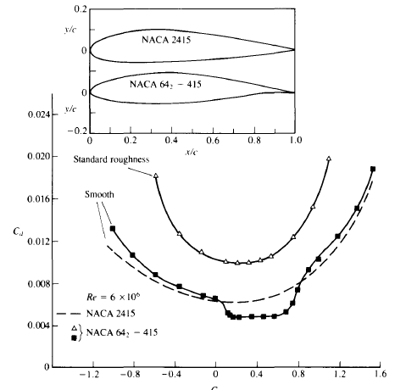
Turbulent
Laminar

Slide 12


Turbulent
Laminar

Slide 13


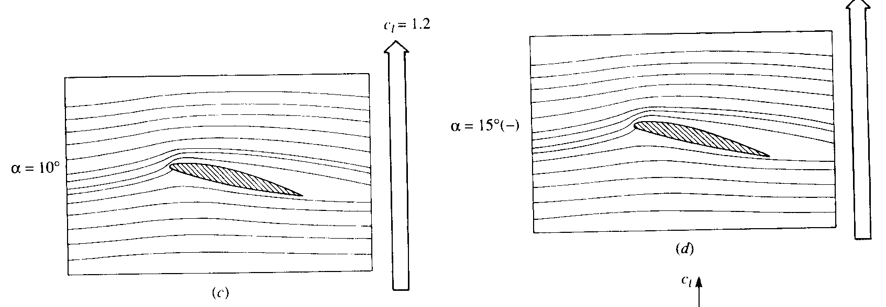
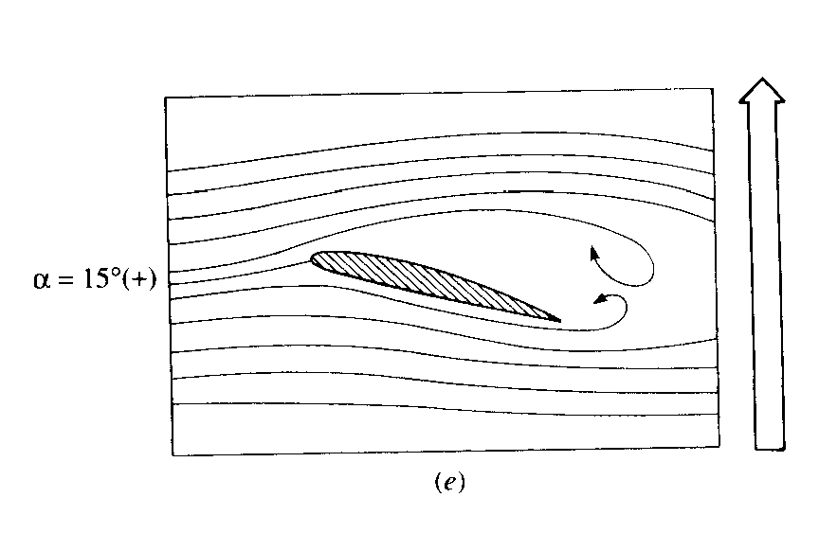

Slide 14



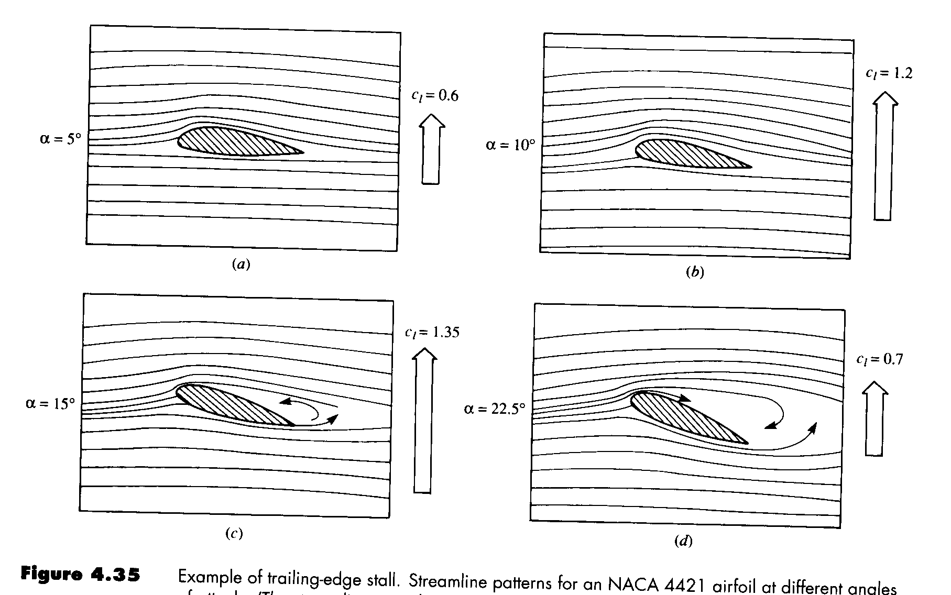

Slide 15

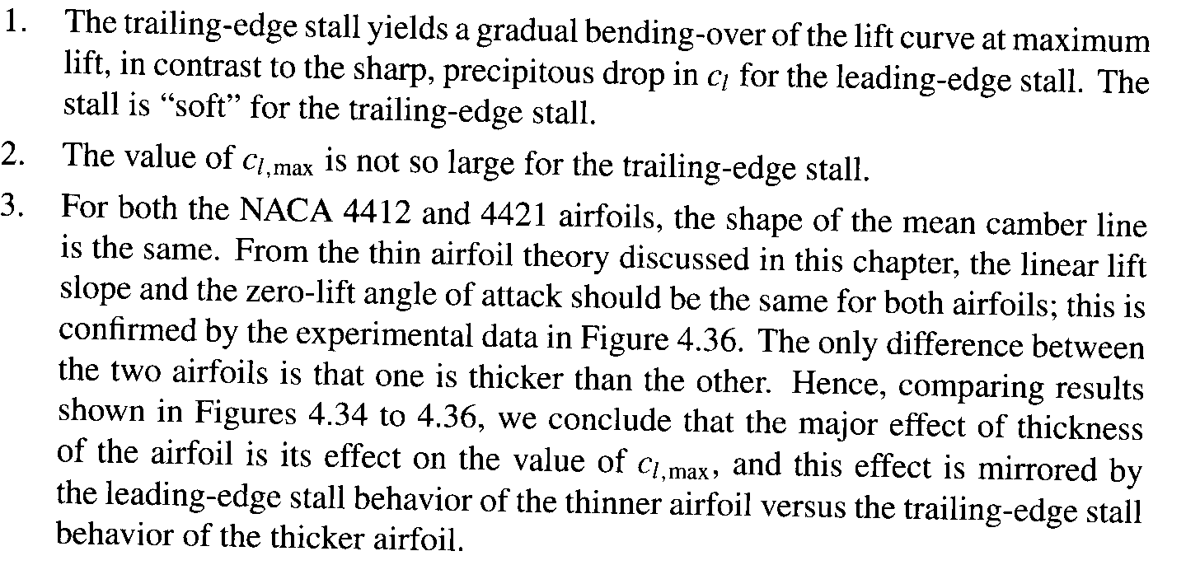
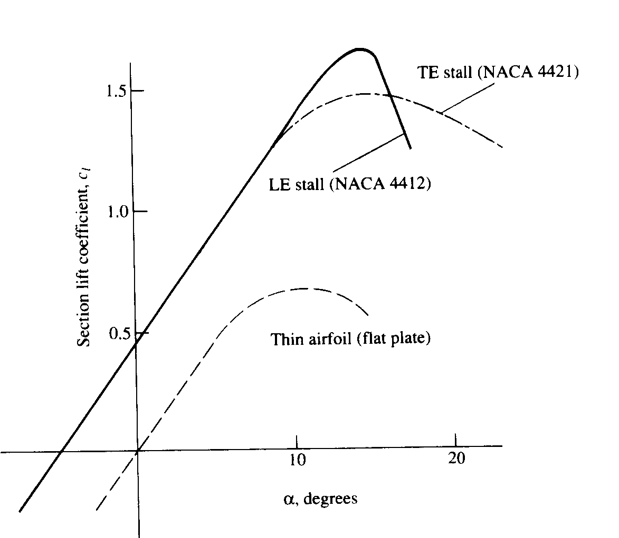

Slide 16

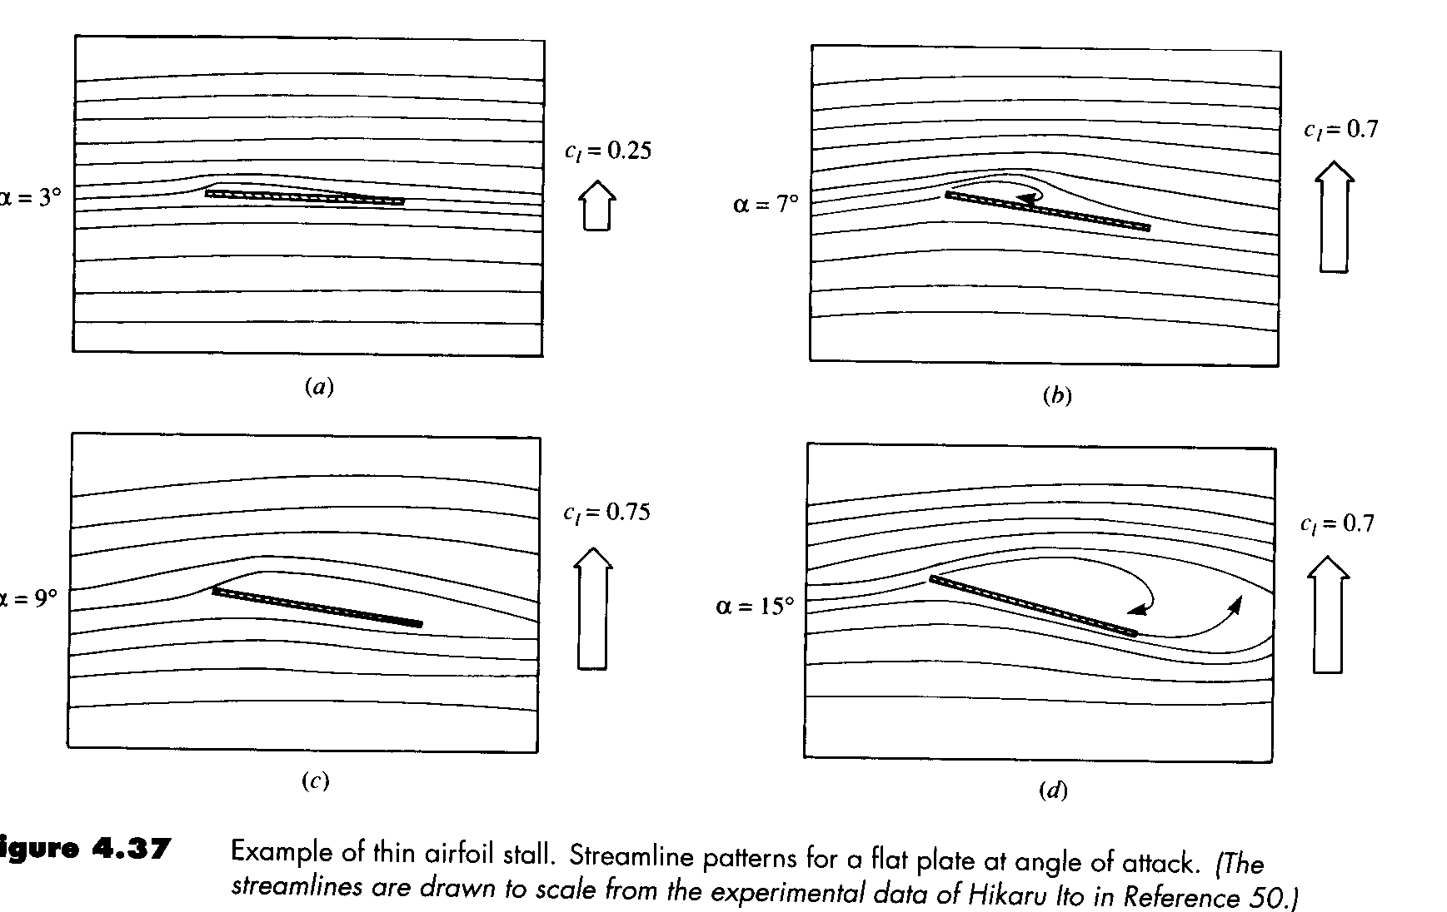
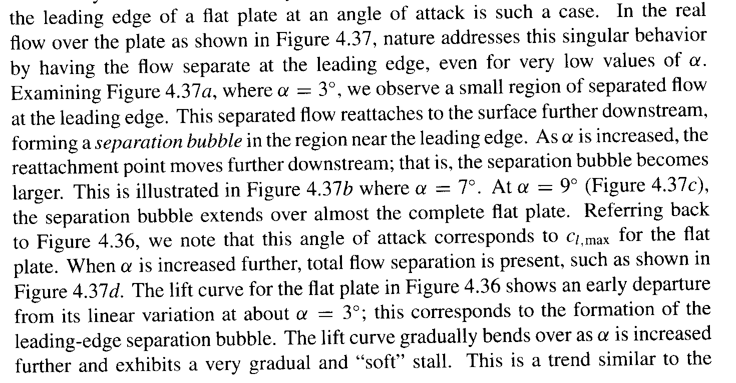

Slide 17


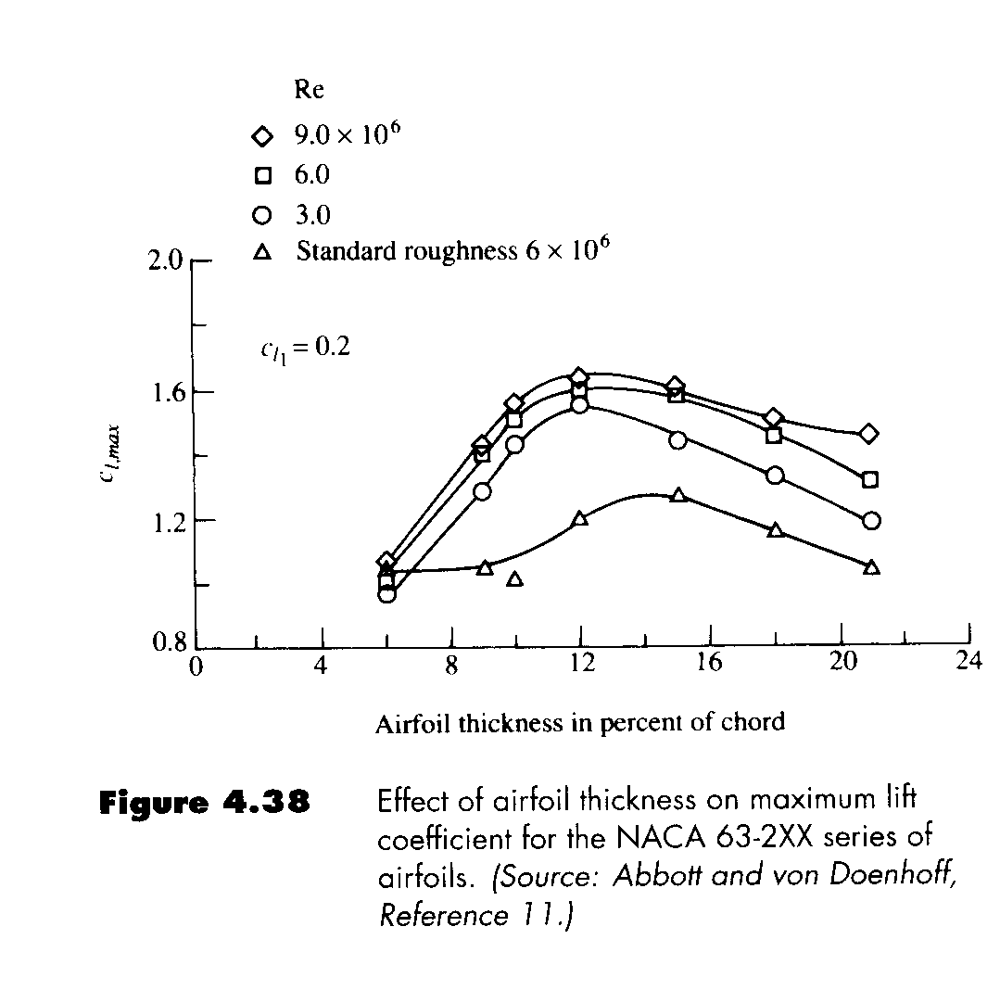

Slide 18

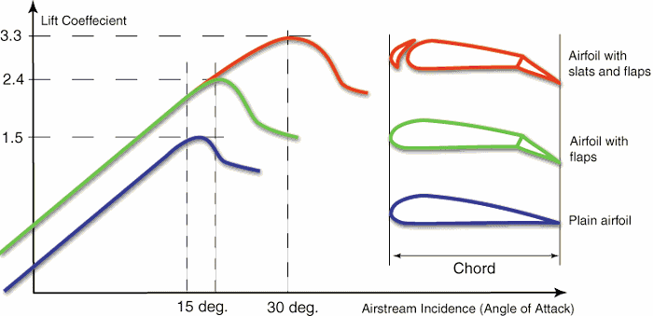
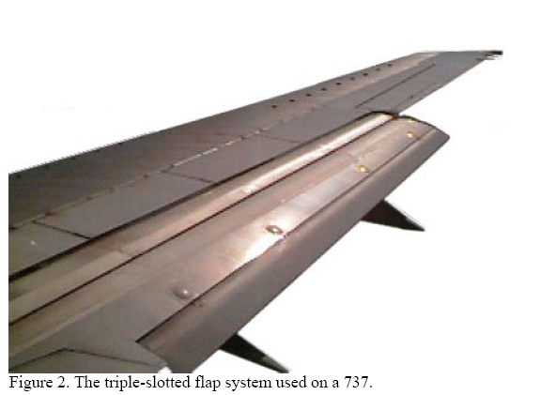
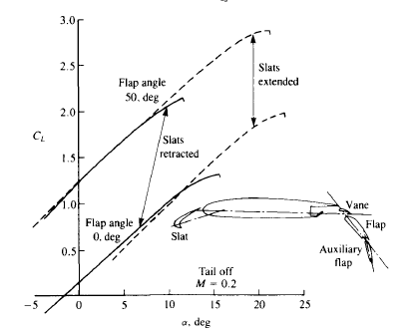

Slide 19


Leading edge slats prevent the stall up to approximately 30 degrees angle of attack by picking up a lot of air from below, accelerating the air in the funnel shaped slot, and blowing this fast air tangentially on the upper wing surface through the much smaller slot.
This "pulls" the air around the leading edge, thus preventing the stall up to a much higher angle of incidence and lift coefficient.
The disadvantage is higher drag.
High lift is needed only when flying slowly (take-off, initial climb, and final approach and landing) the temptation for the designer is to use a retractable device which closes at higher speeds to reduce drag.

Slide 20

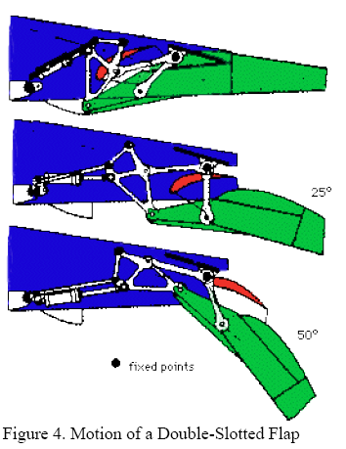
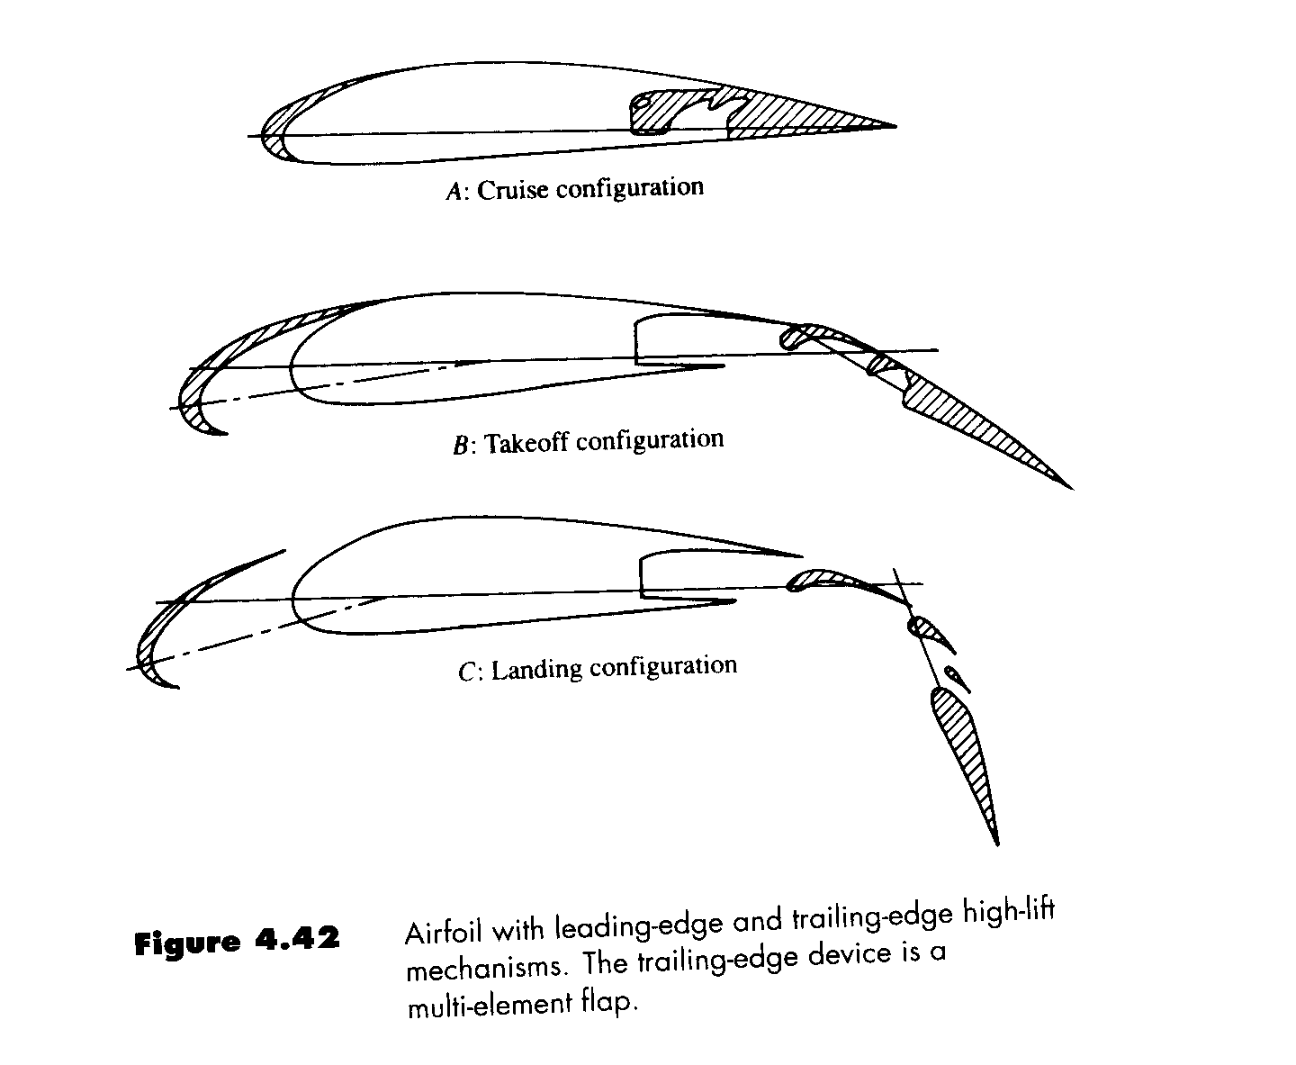
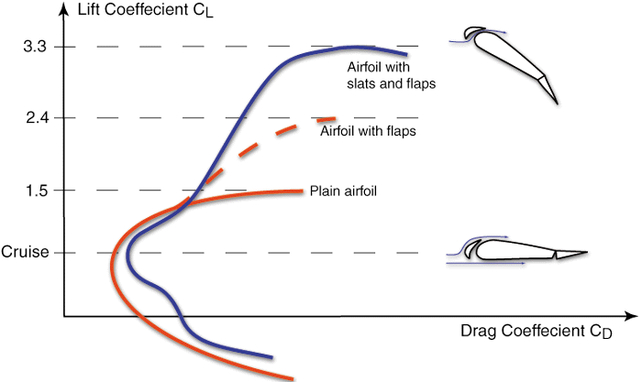
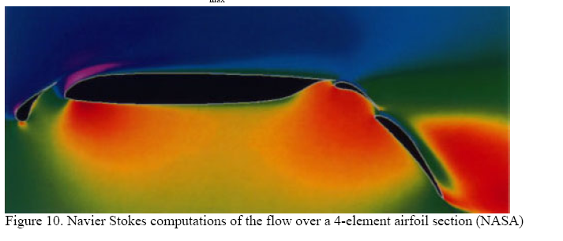

Slide 21
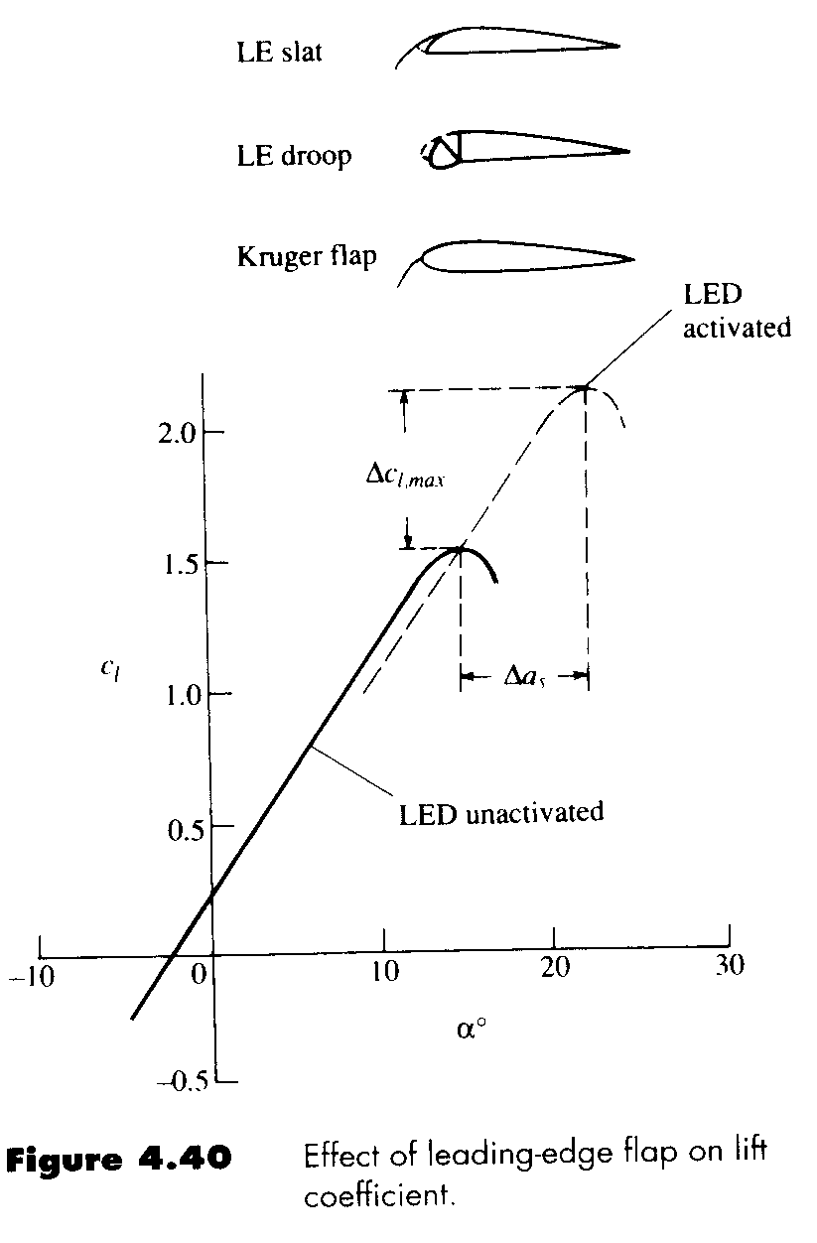
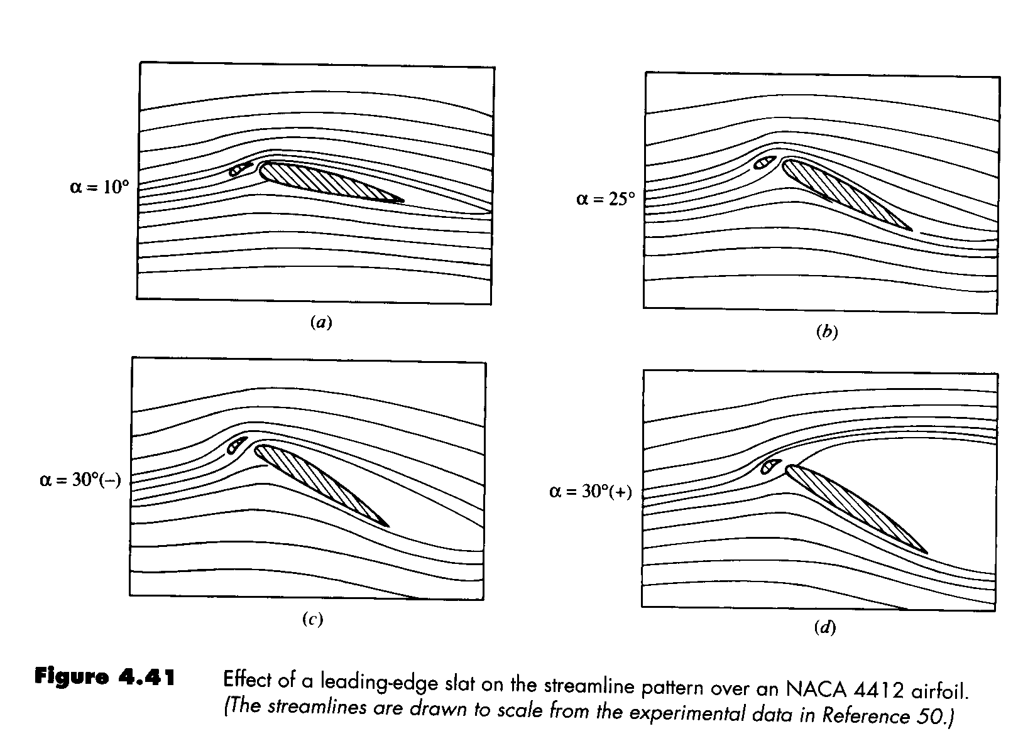


Slide 22

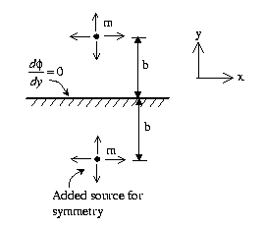
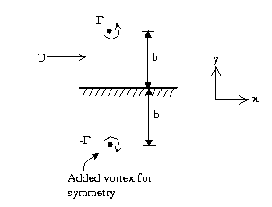


Read how to calculate lift from Kutthe and Chow

Slide 23


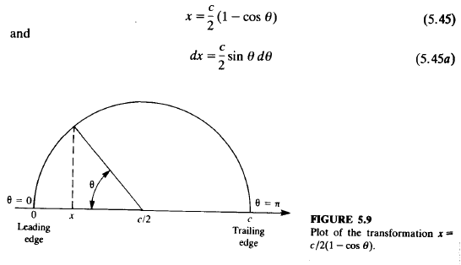



Slide 24

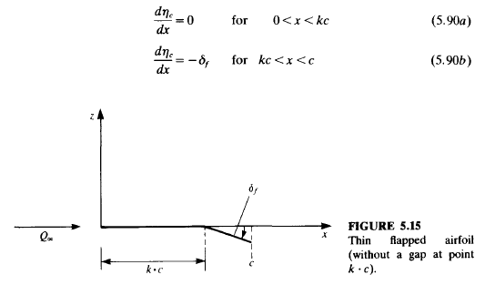

Slide 25
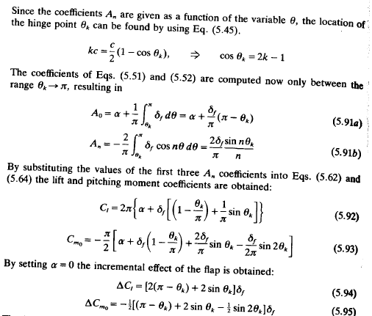


2kc-1

Slide 26

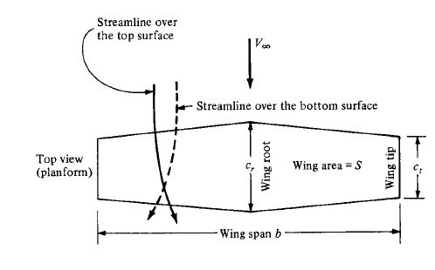
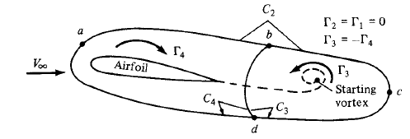
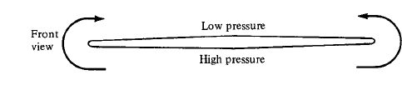

Slide 27

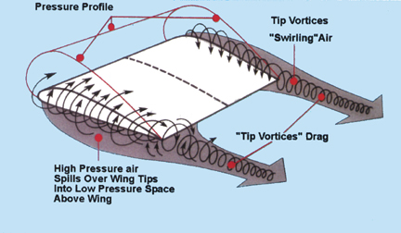

Slide 28
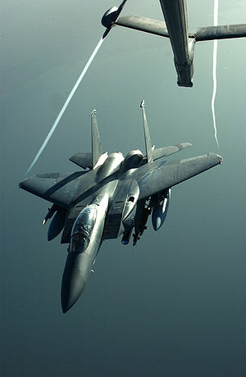


Slide 29

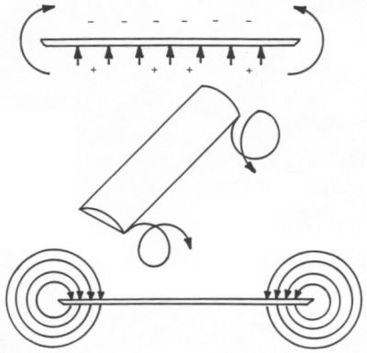
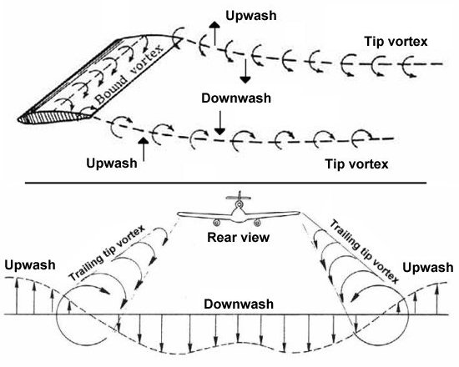

Slide 30

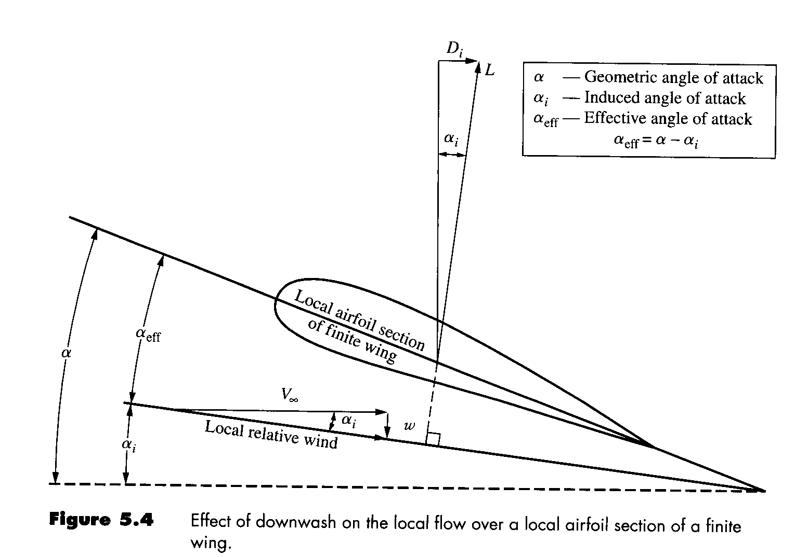

Slide 31

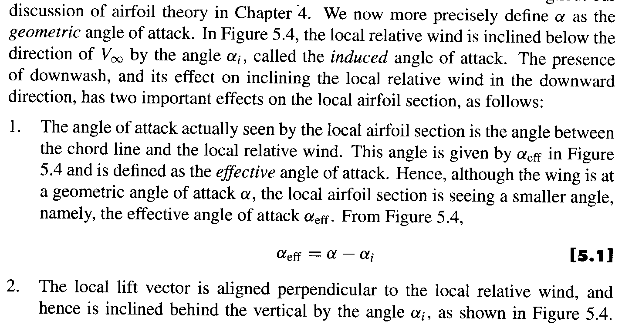



Slide 32
