Slide 1
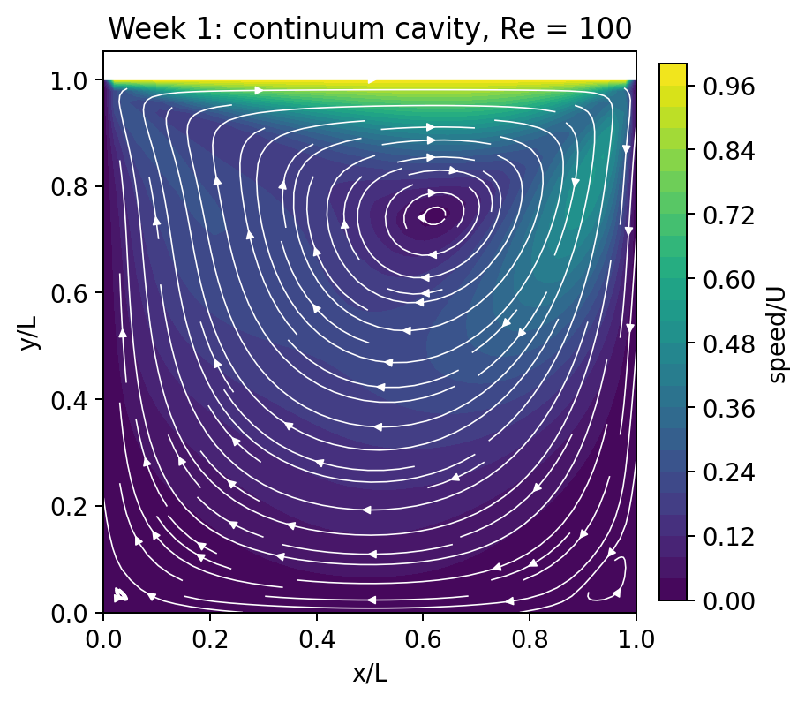
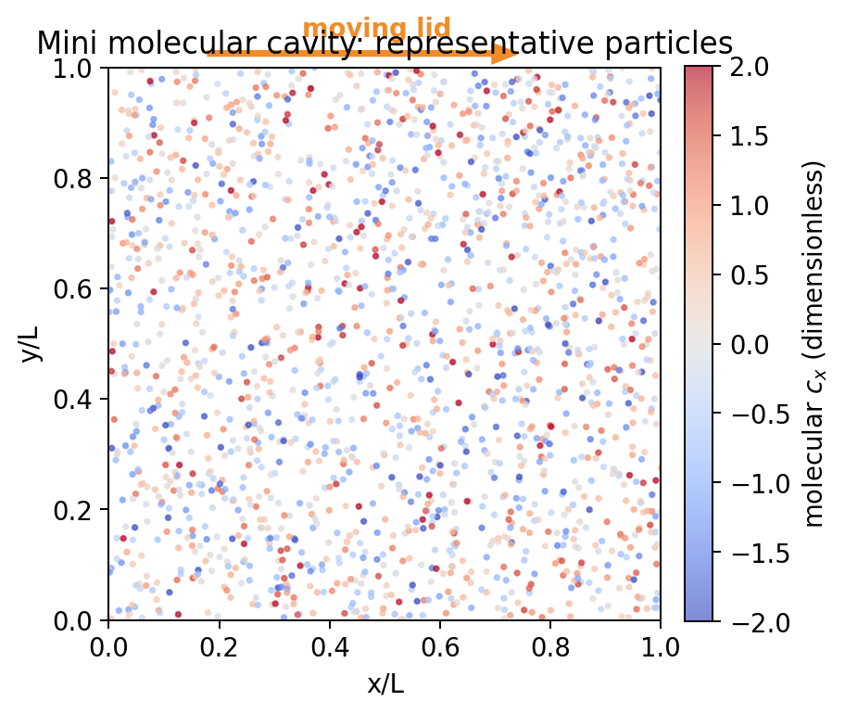
AI in Fluid Dynamics
Week 3
From Continuum Cavity
to Molecular Cavity
Kinetic theory, Boltzmann equation, DSMC sampling, and data quality for machine learning
Week 1: continuum field
Week 3: molecular samples
same geometry
different description
Physics -> solver -> validated data -> AI surrogate
Instructor: Ehsan Roohi | M&I-ENG 690A

Slide 2
The course story continues
COURSE STORY
Week 3 is not a separate kinetic-theory detour; it creates the data that later AI models will learn.
Week 1
Week 2
Week 3
Week 4
Continuum cavity
Neural-network basics
Molecular cavity + DSMC
Surrogate from validated data
Central question
How do we turn physically meaningful molecular simulations into trustworthy training data - without letting statistical noise or numerical bias become “ground truth”?
The geometry is continuous across the course; the modeling description and validation questions become richer.

Slide 3
Learning outcomes
OVERVIEW
1
Interpret a molecular velocity distribution and a Maxwellian equilibrium.
2
Recover density, bulk velocity, temperature, pressure, and heat flux from particles.
3
Explain the Boltzmann equation and why DSMC is used.
4
Trace the DSMC cycle: move, walls, cells, collisions, sampling.
5
Quantify statistical noise and connect data quality to ML validation.
By the end of the week, students should see DSMC output as a statistical dataset with physics, metadata, and uncertainty.

Slide 4
Same cavity, different modeling language
PHYSICS BRIDGE
What changes?
State
u, v, p on a grid
particle positions + molecular velocities
Wall model
no-slip / prescribed T
stochastic gas-surface reflection
Control
Reynolds number
Knudsen number
Output
smooth deterministic field
noisy sampled field
Validation
residual + Ghia benchmark
statistics + DSMC criteria + paper data
Continuum
Molecular / kinetic
The Week-3 question is not “which picture looks nicer?” It is “which model is valid in this regime, and how trustworthy are its samples?”

Slide 5
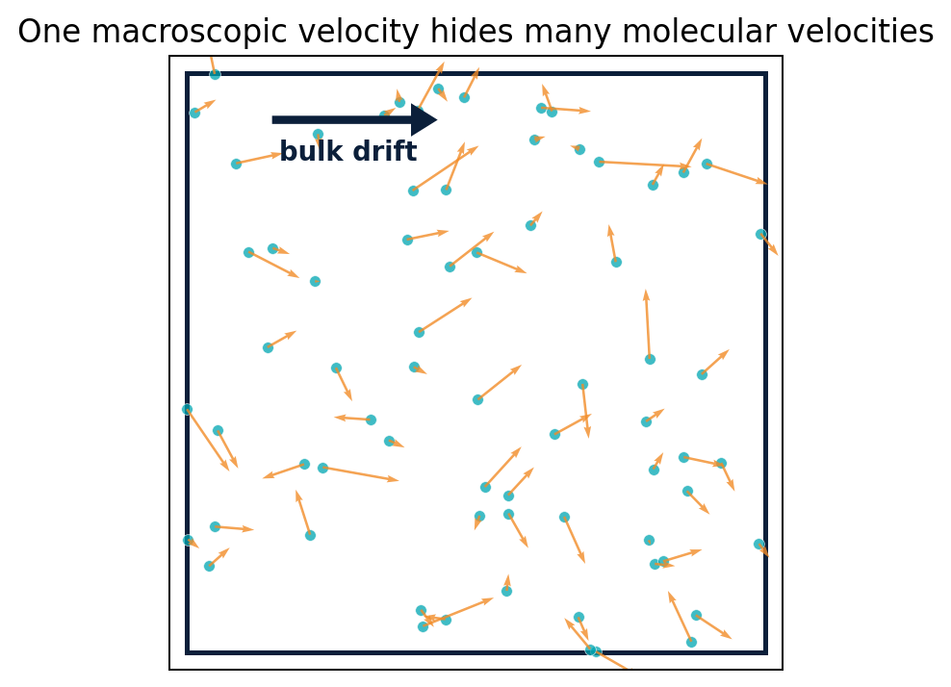
A macroscopic velocity hides many molecular velocities
KINETIC VIEW
Molecular velocity, c
The instantaneous velocity of one molecule. It contains organized motion plus thermal fluctuation.
Bulk velocity, U
The average molecular velocity in a small region and time window.
Thermal fluctuation, c - U
The random part used to define temperature, stress, and heat flux.
A low-speed gas flow can have a small U even though individual molecules move hundreds of meters per second.

Slide 6

The distribution function is the kinetic state variable
KINETIC THEORY
Phase space: physical cells + velocity space
What does f describe?
How molecular populations are distributed over physical position x, molecular velocity c, and time t.
physical space x
molecular velocity space c
One continuum value U(x) is replaced by an entire local distribution over c.
Kinetic theory keeps information that is compressed away when we store only density, velocity, and temperature.

Slide 7
Fluid variables are moments of the distribution
KINETIC THEORY
Density
Velocity
Temperature
n = integral f dc
How many molecules?
U = <c>
What is the average motion?
T proportional to <|c-U|^2>
How strong are thermal fluctuations?
Pressure
Heat flux
p = n k_B T at equilibrium
How large is isotropic normal stress?
q proportional to <|c-U|^2(c-U)>
How is thermal energy transported?
DSMC does not output a smooth field directly. It outputs particle histories; macroscopic fields are estimators built from those histories.

Slide 8
Maxwellian equilibrium: the reference distribution
KINETIC THEORY
Center
Set by the bulk velocity U.
Width
Equilibrium does not mean “molecules stop moving”
Set by temperature and molecular mass.
It means the velocity statistics have a specific form and there is no unresolved directional imbalance in the local rest frame.
Amplitude
Set by number density n.
Near walls, shocks, or strong gradients, the local distribution can depart from a Maxwellian even when density, U, and T look smooth.

Slide 9
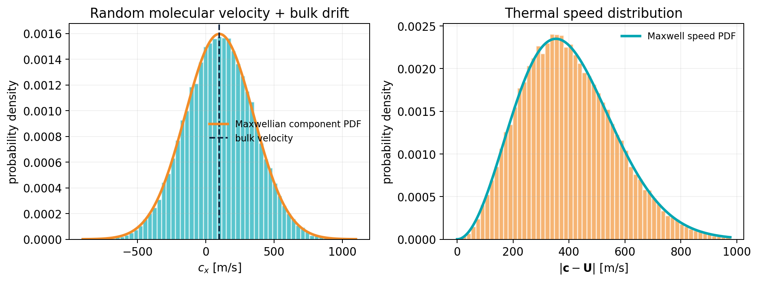
Sampling a Maxwellian: what the notebook will do
LAB 1
Given
Argon, T = 300 K, and a prescribed bulk drift.
Generate
Three Gaussian velocity components for each particle.
Recover
Sample U, T, p, and q from finite particle moments.
The histogram is not the result to memorize; the connection between distribution parameters and macroscopic moments is the learning goal.

Slide 10
Finite-particle estimates are random variables
SAMPLING
Bulk velocity estimator
One possible finite sample
Average all molecular velocities in the sample.
quantity
imposed
estimated
interpretation
Ux
100 m/s
near 100
mean drift
Temperature estimator
Uy, Uz
0
small nonzero
finite-sample fluctuation
Average fluctuation energy after subtracting the sampled bulk velocity.
T
300 K
near 300
thermal variance
q
0 at equilibrium
small nonzero
higher-order noise
Heat-flux estimator
Average a higher-order, signed thermal-energy flux. It is especially noisy.
A correct estimator can still be noisy; repeated samples produce a distribution of estimates.

Slide 11
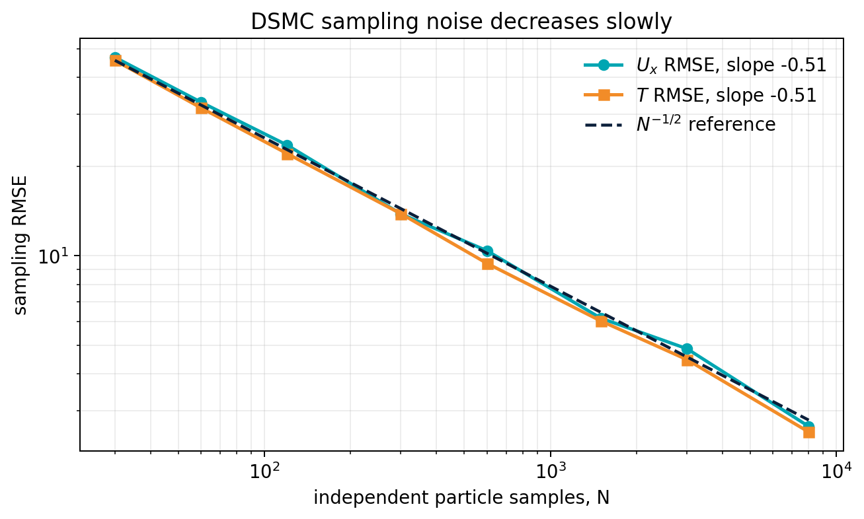
Statistical error falls approximately as 1/sqrt(N)
SAMPLING
Core scaling
10x smaller standard error needs about 100x more independent samples.
Low-speed difficulty
The thermal molecular speed may be much larger than the small bulk-flow signal.
ML consequence
Noise creates a label-error floor that a network cannot eliminate by architecture alone.
The raw number of stored samples is not always the effective number of independent samples.

Slide 12
Effective sample size is more than particle count
SAMPLING
Particles per cell
Number of cells
Sampling duration
More simultaneous observations
Spatial resolution and local count
More time observations after transients
Sampling correlation
Repeated random seeds
Reduces independent information
Estimates run-to-run uncertainty
Long averaging helps only after the transient has decayed and only when the samples add new information.

Slide 13
Noise is not the only data-quality problem
SAMPLING
Variance / statistical noise
Bias / numerical or model error
Reduced by more particles, longer averaging, multiple seeds, and appropriate estimators.
Visible symptom: rough fields and seed-to-seed scatter.
Caused by cells that are too large, time steps that are too large, incorrect boundaries, an unsuitable collision model, or unresolved gradients.
Averaging does not remove it.
A smooth, converged average can still be systematically wrong. Independence and validation remain essential.

Slide 14
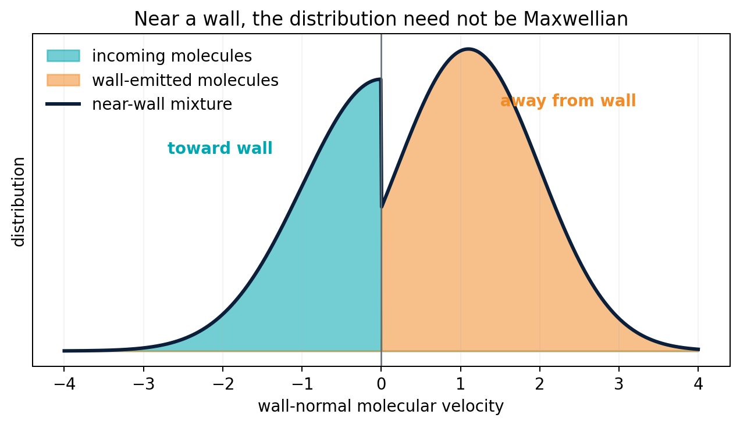
Near a wall, the distribution need not be Maxwellian
NON-EQUILIBRIUM
Incoming population
Carries information from the gas toward the wall.
Outgoing population
Carries the wall temperature, velocity, and reflection model.
Macroscopic signatures
Velocity slip, temperature jump, Knudsen layers, and anisotropic stress/heat flux.
Wall conditions are not a minor implementation detail; they directly shape the kinetic distribution and therefore the training data.

Slide 15
The Boltzmann equation: transport plus collisions
BOLTZMANN
Why we care
The equation contains the complete kinetic state, and its moments recover continuum quantities.
But direct solution is expensive - especially for many parameter cases needed by AI.
Left side: transport
Right side: collisions
Molecules move through physical space and, if forces exist, through velocity space.
The nonlinear collision operator redistributes molecular velocities while preserving collision invariants.
DSMC is a stochastic particle method designed to reproduce the Boltzmann dynamics of dilute gases.

Slide 16
Why the Boltzmann equation is difficult to solve directly
BOLTZMANN
High dimension
Nonlinear collision integral
Boundary physics
3 physical + 3 velocity coordinates + time
Pre- and post-collision states are coupled
Diffuse/specular reflection and accommodation
Multi-scale structure
Large parametric cost
AI opportunity
Bulk flow, Knudsen layers, shocks, corners
Many Kn, wall, geometry, and gas cases for design
Learn mappings only after solver data are validated
The high cost of repeated kinetic solutions motivates surrogates; the high complexity also makes extrapolation dangerous.

Slide 17
DSMC separates molecular movement and collisions
DSMC
Transport substep
Collision substep
Particles move ballistically during a short time interval. Wall crossings are processed with a gas-surface model.
Pairs are selected locally inside cells and their velocities are updated stochastically.
repeat for many time steps
The time step must be short enough that the split transport/collision picture remains accurate.

Slide 18
The DSMC cycle
DSMC ALGORITHM
1
2
3
4
5
6
Initialize
Move
Walls
Index cells
Collide
Sample
x, c, species, weight
x <- x + c dt
reflect / re-emit
local collision neighborhoods
select pairs + update c
average particle moments
Continue until transients decay and the desired statistical precision is reached
The Week-3 notebook exposes every stage; the later Project-1 code adds VHS, NTC, GPU acceleration, validation, and independence studies.

Slide 19
Step 1 - initialize representative particles
DSMC ALGORITHM
Positions
Usually sampled throughout the physical domain according to the initial density.
Velocities
Sampled from a Maxwellian or another prescribed distribution.
Statistical weight
One simulated particle represents many real molecules.
DSMC tracks representative particles, not every physical molecule.

Slide 20
Step 2 - move particles and apply wall physics
DSMC ALGORITHM
moving diffuse lid
Ballistic move
Update positions with the current molecular velocity during dt.
Diffuse reflection
Re-emitted velocity is sampled from the wall temperature and wall velocity.
Kinetic consequence
The top lid injects tangential momentum; stationary walls remove or redistribute it.
Gas-surface interaction parameters are physics inputs and should later be retained as ML features or metadata.

Slide 21
Step 3 - collision cells enforce locality
DSMC ALGORITHM
Cell-size criterion
Cells should generally resolve the mean free path and important gradients.
Why it matters
If a cell is too large, particles that are far apart may be treated as collision partners, creating nonlocal bias.
candidate pairs are local
At low Kn, resolving the small mean free path makes DSMC expensive - one reason AI acceleration is attractive.

Slide 22
Step 4 - stochastic collisions preserve invariants
DSMC ALGORITHM
Before collision
After accepted collision
v1
v2
pair momentum conserved
pair kinetic energy conserved
randomized relative direction
The Week-3 teaching model uses a simplified local elastic-pair rule; Project 1 uses VHS collision rates and No-Time-Counter selection.

Slide 23
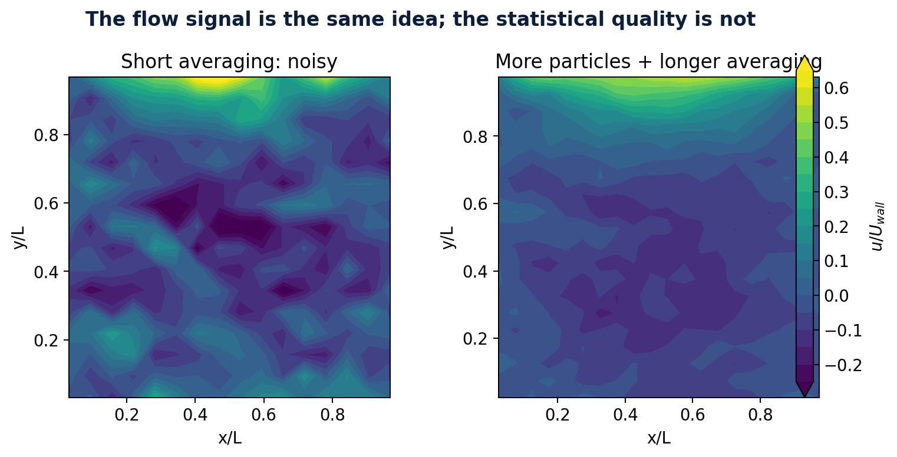
Step 5 - sample, average, and attach uncertainty
DSMC ALGORITHM
Instantaneous field
Very noisy because each cell has a finite particle population.
Time-averaged field
Lower variance after transients, if samples add independent information.
Dataset record
Store mean values plus PPC, number of samples, seed, grid, dt, and model settings.
Never hide unsmoothed data or omit the sampling settings used to produce a “clean” contour.

Slide 24
DSMC accuracy criteria become AI data-quality criteria
DATA QUALITY
Cell size
Time step
Particles/cell
Resolve mean free path and gradients
Diagnostic: dx/lambda
Resolve collision and transport time scales
Diagnostic: dt/tau
Control local estimator variance
Diagnostic: PPC
Transient
Sampling
Seeds
Do not average the startup response
Diagnostic: sample_start
Use a sufficient averaging window
Diagnostic: N samples
Measure stochastic repeatability
Diagnostic: seed spread
A polished neural-network prediction cannot be more trustworthy than the simulation data and metadata used to train it.

Slide 25
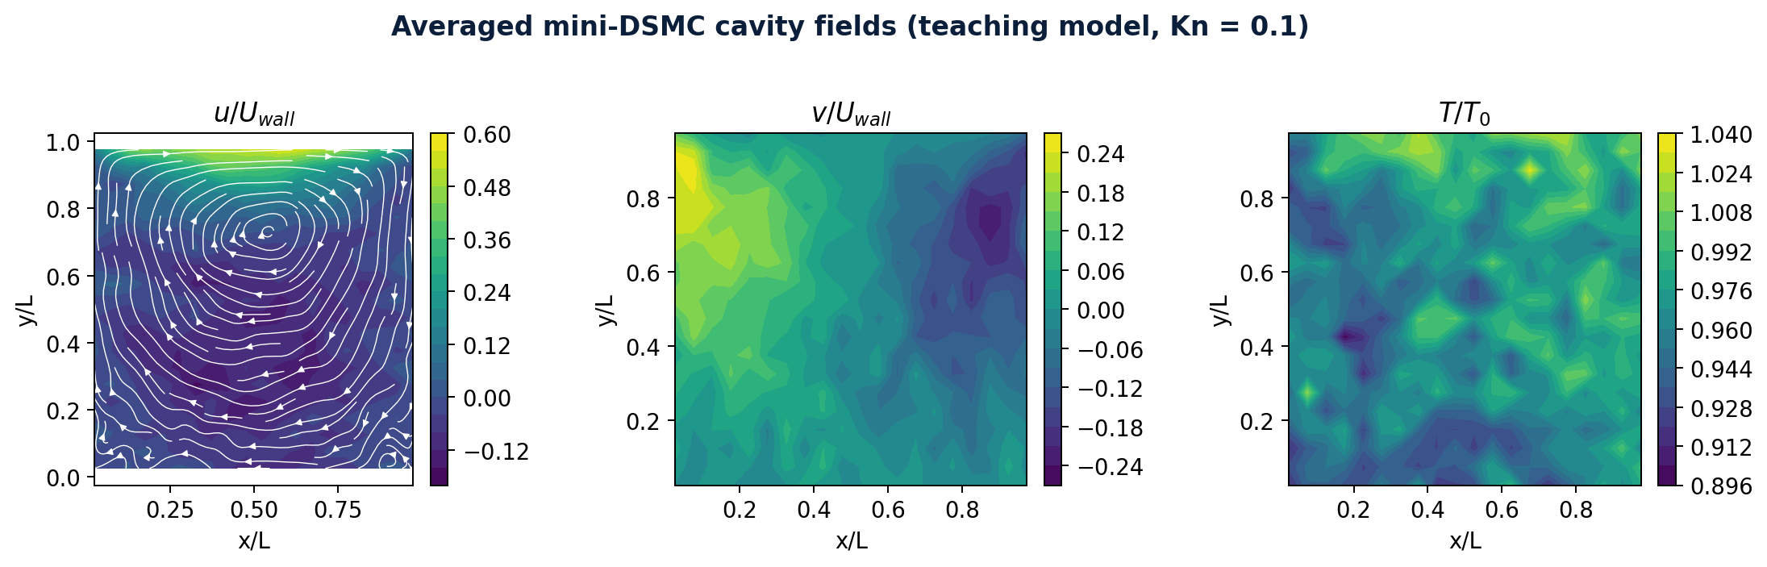
Revisit the cavity: Week 1 and Week 3 side by side
CAVITY STORY
Continuum CFD: smooth deterministic field
Mini molecular model: averaged but noisy field
Same lid-driven mechanism, but molecular wall slip, stochastic sampling, and kinetic validity now enter the interpretation.

Slide 26
What should a rarefied molecular cavity reveal?
CAVITY PHYSICS
Velocity slip
Temperature jump
Gas adjacent to the moving lid does not exactly match the wall speed.
Gas temperature next to a wall can differ from wall temperature.
Primary recirculation
Corner non-equilibrium
Lid momentum is transferred through collisions and wall interactions.
Incoming and wall-emitted populations can be strongly different.
Kn-dependent structure
Statistical noise
Vortex location, slip, and thermal fields change with rarefaction.
Small signals require particles, time averaging, and repeatability checks.
A plausible vortex picture is not sufficient validation; students must separate physical trend, sampling noise, and model limitations.

Slide 27
Week 3 uses a mini cavity - deliberately
LAB 2
Required this week
Reserved for Project 1
• Run a fast CPU teaching model
• Trace move, walls, cells, collisions, sampling
• Compare short and better averaging
• Export one ML-ready table
• Explain limitations honestly
• GPU VHS + NTC solver
• Paper validation
• Grid, PPC, dt, and sampling independence
• Multiple Kn cases
• Vortex-Kn trends and final dataset
This scope keeps Week 3 conceptually strong without turning one weekly exercise into the full research project.

Slide 28
A DSMC field becomes a supervised-learning table
AI BRIDGE
One row = one grid location in one validated case
Pointwise surrogate
log10 Kn
Uwall/c_th
x/L
y/L
rho/rho0
u/Uwall
v/Uwall
T/T0
Inputs: log Kn, wall conditions, x/L, y/L. Outputs: rho, u, v, T.
-1.0
0.38
0.025
0.025
1.02
-0.04
0.01
0.98
-1.0
0.38
0.075
0.025
1.01
-0.03
0.02
0.99
Case-level surrogate
Inputs: Kn and wall parameters. Outputs: vortex center or integrated quantities.
...
...
...
...
...
...
...
...
features / coordinates
targets
Metadata
Grid, PPC, dt, sample count, seed, collision model, wall model, uncertainty.
Do not let the ML table erase the numerical provenance of each target value.

Slide 29
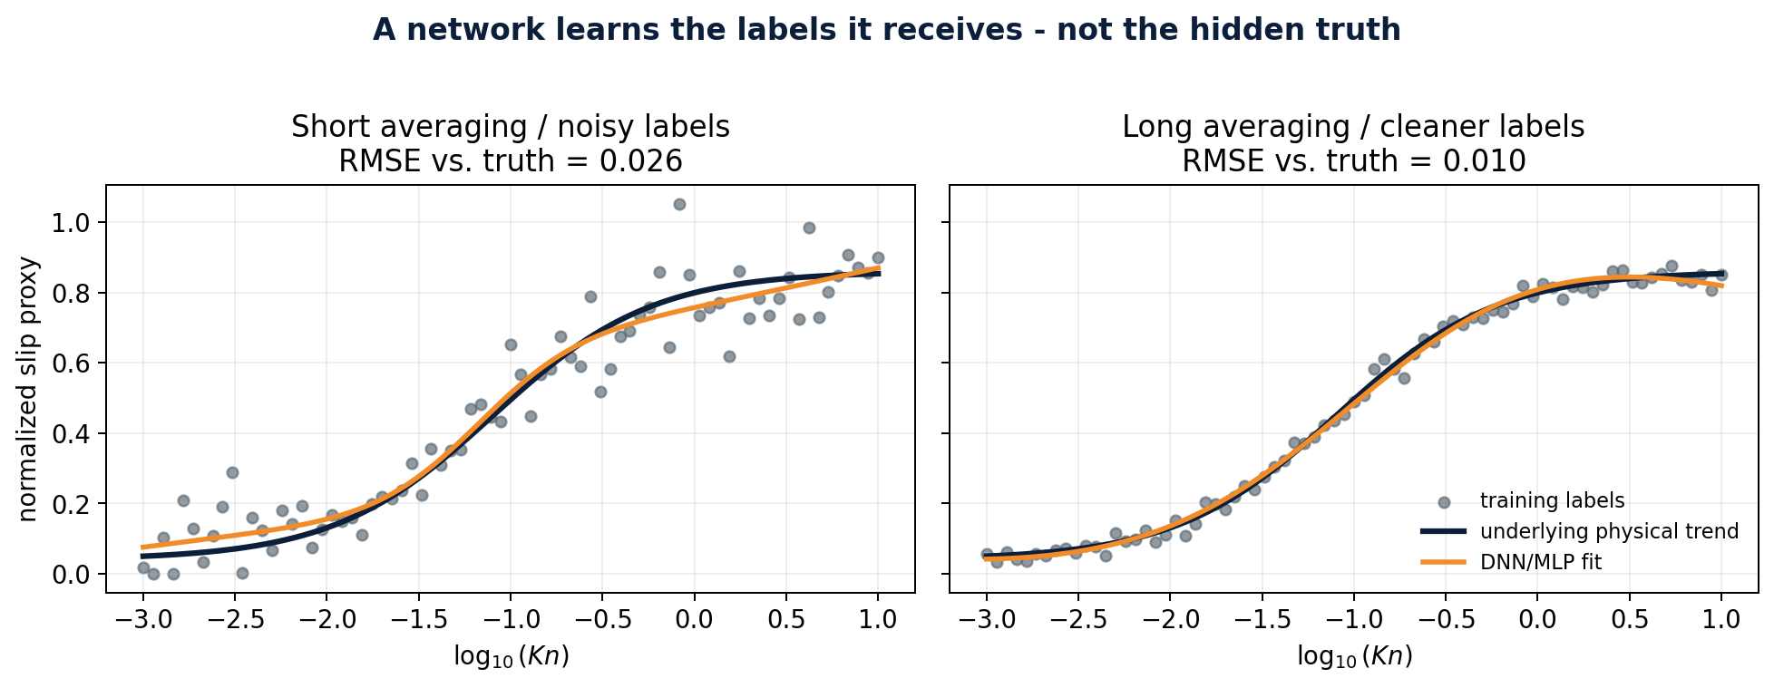
A network learns the labels it receives - not hidden truth
AI + NOISE
Training loss
Measures agreement with the supplied labels.
Source-data error
Can be statistical noise or numerical bias that the loss never sees.
Correct response
Improve/quantify the data and validate by cases, regimes, and physics.
A smooth neural curve is not evidence that the DSMC labels were converged.

Slide 30
How to validate an ML surrogate trained on DSMC data
AI VALIDATION
Case-wise split
Regime-wise error
Hold out entire Kn or wall-condition cases, not random points from the same field.
Report performance separately in slip, transition, and high-Kn regimes.
Wall-region checks
Seed repeatability
Evaluate slip, jump, and near-wall errors, not only global RMSE.
Compare predictions with DSMC seed-to-seed uncertainty.
Physical checks
Extrapolation test
Positivity, symmetry, conservation trends, sensible wall behavior.
Deliberately evaluate outside the training Kn range and state failure.
Randomly splitting grid points from one field can produce severe leakage and falsely optimistic test error.

Slide 31
Week 3 is the on-ramp to Project 1
ROADMAP
Week 3 Lab 1
Week 3 Lab 2
Project 1A
Project 1B
Project 1C
Later AI
Maxwellian moments + noise scaling
Mini cavity + ML-ready table
GPU preflight + baseline DSMC
Paper validation + independence
Multi-Kn dataset + vortex trend
DNN, GPR, DeepONet / operator surrogate
The full project philosophy remains: physics -> DSMC solver -> validation -> independence -> dataset -> AI surrogate.

Slide 32
Week 3 submission: exactly three files
ASSIGNMENT
1
Lastname_Firstname_Week3_Lab1.ipynb
Completed Maxwellian, noise, and ML-label notebook with visible outputs.
2
Lastname_Firstname_Week3_Lab2.ipynb
Completed mini-cavity notebook with visible outputs and exported dataset.
3
Lastname_Firstname_Week3_Report.pdf
One report containing every written answer, requested table, figure, and interpretation.
Incomplete submission
Notebook only = incomplete. PDF only = incomplete. Written answers belong in the PDF; code and outputs remain in the notebooks.

Slide 33
What students will do this week
ASSIGNMENT
Lab 1 - Maxwellian, noise, ML
Lab 2 - Mini molecular cavity
1. Sample argon velocities
2. Estimate U, T, p, and q
3. Repeat at several particle counts
4. Fit the error slope
5. Train the same small MLP on noisy and cleaner labels
6. Explain why low loss is not data validation
1. Generate the DSMC flowchart
2. Verify collision conservation
3. Run a quick case
4. Run a better-sampled case
5. Compare fields and centerline profiles
6. Export an ML-ready table
7. State what the mini model cannot prove
The notebooks are scaffolded and CPU-friendly; the intellectual work is interpretation, data-quality reasoning, and clear reporting.

Slide 34
Week 3 summary
SUMMARY
1
Kinetic state
A distribution of molecular velocities, not only a few macroscopic fields.
2
DSMC
A stochastic approximation to dilute-gas kinetic dynamics using move, wall, cell, collision, and sampling steps.
3
Data quality
Statistical noise decreases slowly; numerical bias needs separate independence checks.
4
Cavity story
The same geometry now exposes slip, jump, wall non-equilibrium, and noisy sampling.
5
AI message
Validate the solver and uncertainty before asking a network to learn the data.
Exit question
What information can be lost when a noisy molecular distribution is reduced to a single averaged field - and then compressed again into an ML model?

