Slide 1
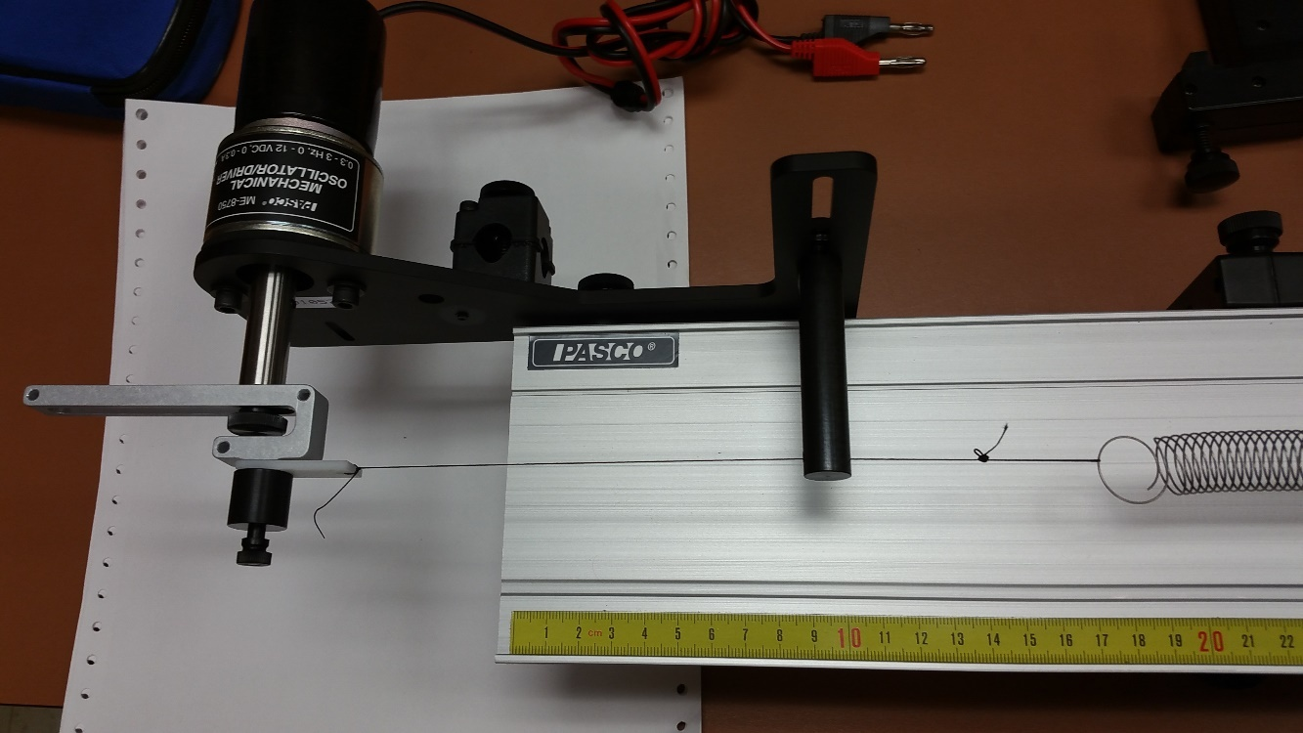
MIE 402 | ME LAB II
1
Forced vibration | Lab 5
Repeated motor motion can excite a structural resonance.
Measure impact decay, periodic response and displacement amplification.
MIE 402 · Prof. Ehsan Roohi · Fall 2026
Notes:
Theory Nov 9; lab sections Nov 17–20. Begin with the rotating motor and ask what happens when its speed approaches a structural frequency. Photo: prior-course Lab 5 apparatus.

Slide 2
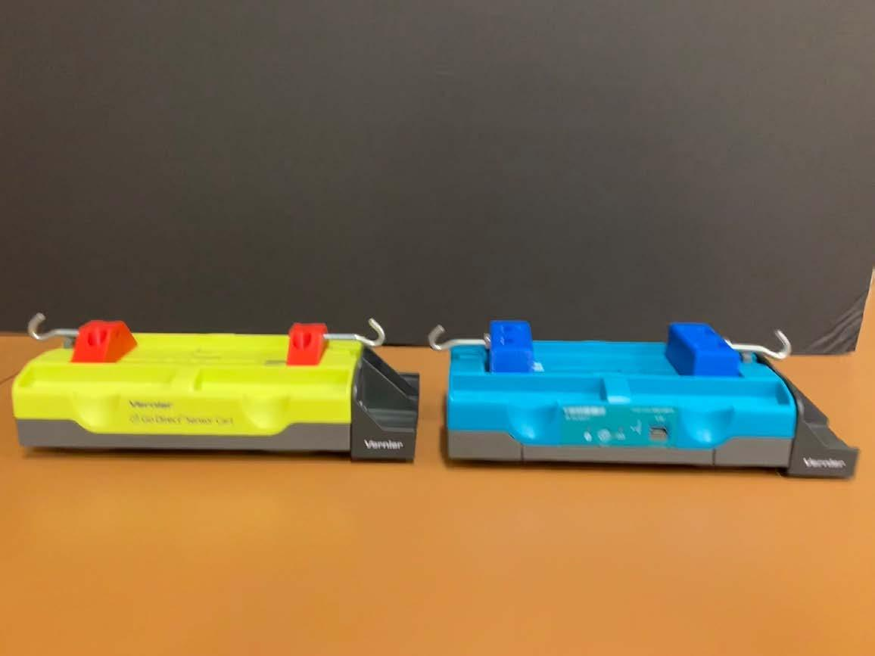
MIE 402 | ME LAB II
2
Engineering applications
Pump and motor supports: repeated loading can amplify vibration.
Precision stages: vibration limits positioning accuracy and settling.
This cart test identifies which drive speeds cause large motion.
Notes:
0–3 min. The laboratory is a linear vibration model, not a full vehicle suspension. Discuss fatigue and motion quality without claiming the cart duplicates every industrial load path. Photo: course apparatus.

Slide 3
MIE 402 | ME LAB II
3
What the apparatus measures
The motor moves one spring end; the cart encoder measures cart position.
Two springs provide restoring force. Magnets provide eddy-current braking.
The tachometer measures drive speed; supply voltage only controls the motor.
Notes:
3–5 min. Point out the motor, linkage, driven spring, track and cart. An encoder infers displacement from rolling wheel rotation; slipping invalidates that measurement. Source: LAB5_MIE402, tasks 3–4.

Slide 4
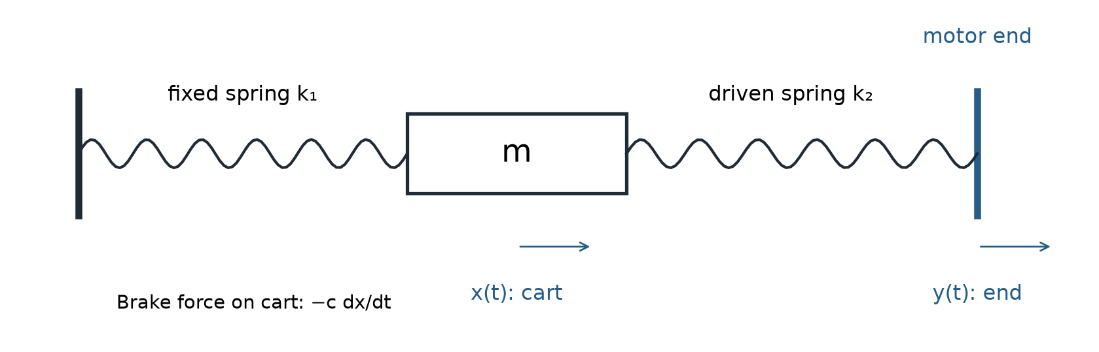
MIE 402 | ME LAB II
4
Coordinates and measured parameters
x(t): cart displacement; y(t): driven-end displacement, both positive right [m].
m: total moving mass [kg]; k₁, k₂: spring stiffness [N/m].
c: equivalent braking coefficient [N s/m], acting against the stationary track.
Notes:
5–7 min. Both coordinates are changes from static equilibrium. The fixed outer spring end stays still. The right end is driven. The model assumes taut linear springs and a viscous approximation to losses.

Slide 5
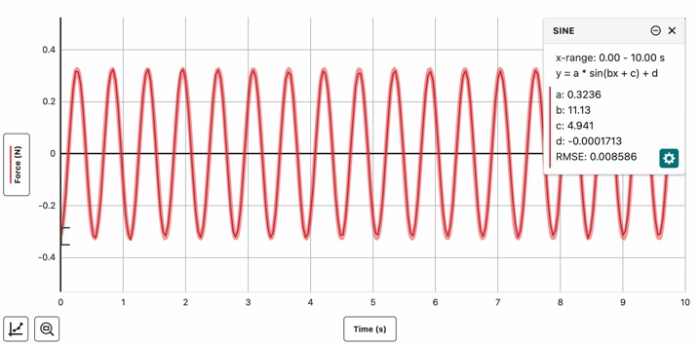
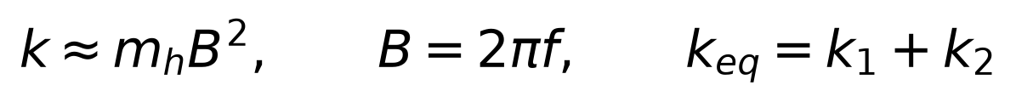
MIE 402 | ME LAB II
5
Spring and mass measurements
Weigh the cart, added hex rods and mounted dampers.
For a hanging calibration mass mₕ, fit A sin(Bt + phase) + offset.
B is angular frequency [rad/s]; convert Hz before calculating stiffness.
Notes:
7–9 min. This uses light damping and a negligible spring-mass correction. If a reliable decay rate alpha is measured, k=m_h(B²+alpha²). Reuse the same labeled springs’ Lab 4 calibrations. Do not insert nominal stiffness as a measurement.

Slide 6
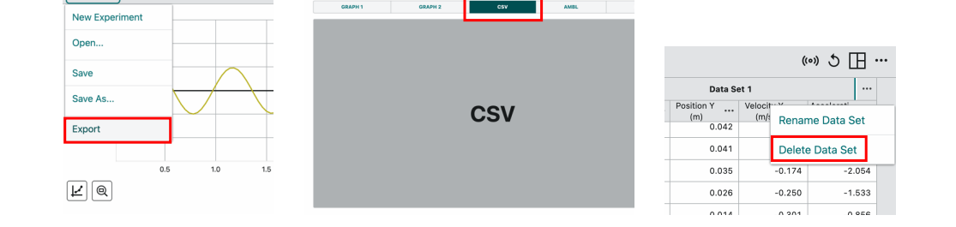
MIE 402 | ME LAB II
6
Vernier Graphical Analysis
Connect the cart serial number and choose Position versus Time.
Set meters, collection rate at or below 25 Hz, and zero at equilibrium.
Collect before excitation. Export one continuous run as CSV; keep the raw file.
Notes:
9–11 min. The image is from the prior course handout; menu appearance may vary by installed version. Use Sensor Data Collection, connect, Done, choose collection settings and sensor zero. For spring calibration connect the force sensor, not the cart position channel.

Slide 7
MIE 402 | ME LAB II
7
A short tap starts the cart moving
Motor off. Keep both outer spring ends stationary and remove the magnetic dampers. Let the cart rest at equilibrium.
Start recording. Give the cart body one brief, gentle horizontal tap with your fingers, then remove your hand immediately.
Keep the wheels rolling and travel small. Avoid the end stops, spring slack and repeated contact. Analyze after your hand leaves.
Notes:
The contact is the student’s fingers against the cart body. There is no intended collision between two carts or with an end stop. A tap approximates an impulse only when contact is short compared with an oscillation period. The encoder need not resolve the contact-force history.

Slide 8
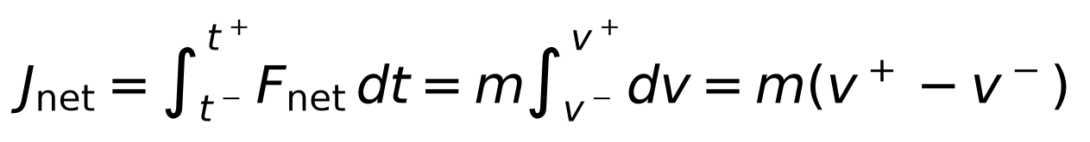
MIE 402 | ME LAB II
8
The impulse–momentum relation comes from Newton’s law
Let t⁻ and t⁺ bracket the short contact. The cart velocities immediately before and after it are v⁻ and v⁺ [m/s].
Integrate the net force: acceleration is dv/dt, so its time integral is the change in velocity. Constant mass m stays outside the integral.
The net impulse Jnet has units N s = kg m/s. Divide by m only when calculating the velocity change.
Notes:
This is exact for constant mass. For the hand impulse, m Δv = Jhand − integral(c xdot + k_eq x)dt. If the tap is sufficiently short and motion remains small, the spring and damping impulses are small and Jhand is approximately m Δv. Do not equate an impulse to a velocity without dividing by mass.

Slide 9
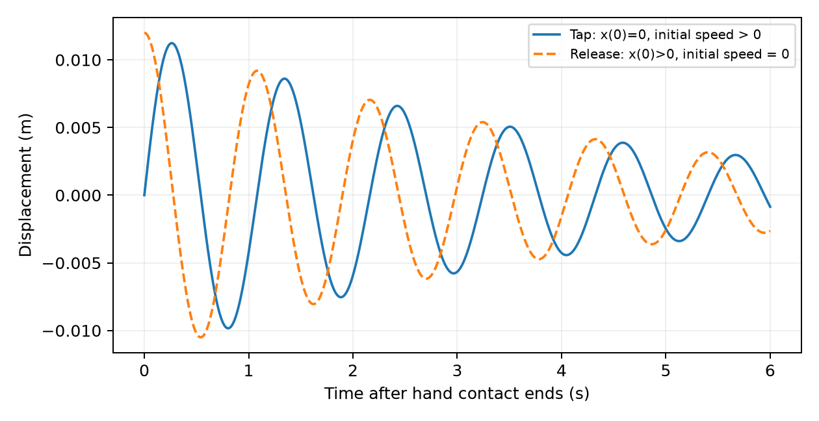
MIE 402 | ME LAB II
9
A tap and a pull-and-release set different initial conditions
Tap near equilibrium: position changes little during contact, but the cart gains velocity.
Pull-and-release: hold displacement x₀, then release without pushing. Initial velocity is nearly zero.
Both then follow the same free-decay equation. Initial conditions change the waveform.
Illustrative free decays with the same mass, stiffness and damping
Notes:
Time zero is the end of hand contact. The short-tap position approximation does not imply that a finite-duration tap produces exactly zero displacement. The illustrated curves use the same m, k and c and have similar displacement scale to compare initial slopes.

Slide 10
MIE 402 | ME LAB II
10
Frequencies and decay rate in the free-response model
Equivalent stiffness is the sum of the two spring stiffnesses. Total moving mass includes every mounted attachment.
The decay rate α [s⁻¹] controls the exponential envelope. Natural and damped angular frequencies have units rad/s.
Subscript n means undamped natural frequency. Subscript d means the frequency of an underdamped free oscillation.
Notes:
The underdamped model requires alpha < omega_n. Convert either angular frequency to Hz by dividing by 2 pi. Do not substitute drive frequency for either natural frequency.

Slide 11
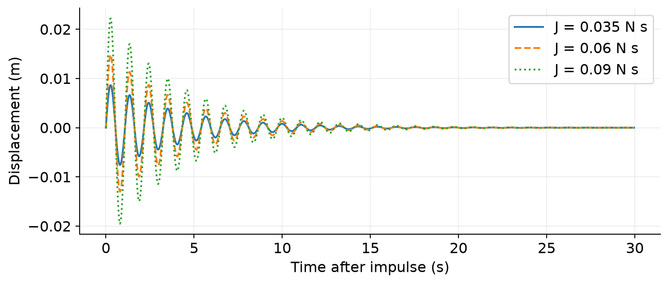
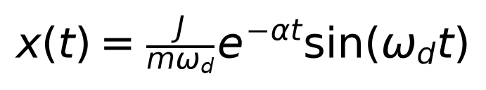
MIE 402 | ME LAB II
11
Impulse response follows the free-decay model
For a short tap from equilibrium, the impulse sets initial speed approximately J/m.
The solution starts with nearly zero displacement and the tap-induced velocity.
Larger J increases amplitude. Fixed mass, stiffness and damping give the same frequency and decay rate.
Illustrative model; not laboratory data
Notes:
13–15 min. Derive by applying x(0)=0 and xdot(0+)=J/m to exp(-alpha t)(A cos wd t+B sin wd t). The fitted laboratory interval may start later and uses both sine/cosine terms. Source: prior theory notes and Newton’s law.

Slide 12
MIE 402 | ME LAB II
12
Three gentle taps check the effect of excitation level
Record three separate runs: light, medium and slightly stronger gentle taps in the same direction. Start each run from rest near equilibrium.
Keep mass, springs and damper configuration unchanged. Change only the tap level and keep all motion within the linear working range.
Compare displacement amplitudes, fitted frequencies and decay rates. A large frequency change suggests a changed setup or nonlinearity.
Notes:
Tap strength is a qualitative label, not a calibrated force or impulse. We do not measure J with the position encoder. Do not report numerical impulses or normalize a response by an assumed J. Save Impulse_1.csv, Impulse_2.csv and Impulse_3.csv.

Slide 13
MIE 402 | ME LAB II
13
How Lab 5 builds on Lab 4
Lab 4: pull and release without pushing. Vary mass, magnetic damping and spring pair to identify their effects on free decay.
Lab 5 impulse tests: keep the setup fixed and vary the brief tap. Check how excitation level affects amplitude and frequency.
Lab 5 motor tests: keep applying a periodic input and vary its frequency. Measure amplification and compare with the forced-response theory.
Notes:
These are different experimental questions, not different free-motion laws. Tap tests could also be performed in Lab 4, but its prescribed seven-case matrix varies system parameters. The impulse tests provide a bridge to the periodically forced experiment. Reuse measured spring stiffnesses only for the same labeled springs.

Slide 14
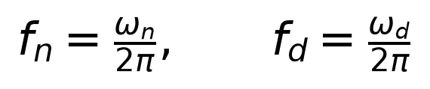
MIE 402 | ME LAB II
14
What an impulse spectrum tells us
The time record reveals period and decay. The FFT is a frequency cross-check.
A finite decaying record spreads spectral energy; do not infer damping from peak height.
The fitted damped frequency and model natural frequency are distinct. Their difference is small for light damping.
Notes:
15–17 min. Define fn and fd in Hz. Finite-window FFT peaks need not exactly equal fd or fn; damping, record length and bin spacing matter. Use consistent windows and show three spectra together. No claim of exactly equal FFT and time-fit frequency is needed.

Slide 15
MIE 402 | ME LAB II
15
Forces from the moving spring end
x(t) is cart displacement. y(t) is the motor-end displacement. Both are horizontal coordinates, positive to the right [m].
The driven spring changes length by y − x, so its force on the cart is k₂(y − x). The fixed spring contributes −k₁x.
Sum the two spring forces and the braking force, then collect the terms in x.
Notes:
The letter y labels a second horizontal position; it does not mean a vertical degree of freedom. Displacements are measured from the equilibrium positions. The motor prescribes y(t). It is an input, so we do not add a second equation of motion for a free moving mass at that endpoint. Static spring preloads cancel when using equilibrium coordinates.

Slide 16
MIE 402 | ME LAB II
16
Why there is no derivative of y in this model
The magnetic brake reacts against the stationary track. Relative brake velocity is therefore the cart velocity.
Only the driven spring connects the cart to the moving endpoint. Its force depends on relative displacement.
A damper between the cart and moving endpoint would add a term proportional to the endpoint velocity. That is a different attachment.
Notes:
Compare attachment points before selecting a textbook base-excitation formula. For a hypothetical single damper attached to the moving end, collecting forces would give m xddot+c xdot+(k1+k2)x=k2 y+c ydot. Our track-brake apparatus has no c ydot input. This difference also changes the transfer-function numerator from k2 to k2+i c omega. Do not use that alternative numerator for this apparatus.

Slide 17
MIE 402 | ME LAB II
17
Prescribed input and settled output
The motor prescribes y(t) = Y cos(ωt). Y is the input peak amplitude [m]; ω = 2πf is drive angular frequency [rad/s].
A linear system in steady harmonic motion responds at the same drive frequency. Its amplitude and phase can differ.
X is cart peak amplitude [m]. φ is the output phase lag relative to input [rad]. We will solve for X and φ.
Notes:
The subscript ss means steady state. The initial transient has not yet been included. Y and X are peak amplitudes, not peak-to-peak ranges. A phase lag means a displacement maximum occurs later than the corresponding input maximum. The assumed single sinusoid requires approximately stable motor speed and sinusoidal endpoint travel.

Slide 18
MIE 402 | ME LAB II
18
Differentiate the assumed response
The first time derivative shifts cosine to negative sine and multiplies the amplitude by ω.
A second derivative returns cosine with a factor −ω². Acceleration therefore opposes displacement.
Insert these derivatives into the force-balance equation from the preceding slides.
Notes:
This gives (k1+k2-m omega²)X cos(omega t-phi) - c omega X sin(omega t-phi) = k2 Y cos(omega t). Show this intermediate substitution on the board. It reveals the stiffness-minus-inertia term and the velocity-dependent term, instead of jumping directly to a complex transfer function.

Slide 19
MIE 402 | ME LAB II
19
Why we expand the shifted sine and cosine
After substitution, the left side contains shifted functions with phase φ, but the input is written as cos(ωt).
Set a = ωt in the identities below. They rewrite both sides using the same two time functions: cos(ωt) and sin(ωt).
This separates the unknown amplitude and phase from time, so we can solve algebraic equations.
Notes:
Here a=omega t. After defining D=k1+k2−m omega², substitution gives D X cos(omega t−phi) − c omega X sin(omega t−phi)=k2 Y cos(omega t). Expand both shifted functions because both stiffness/inertia and damping contribute to the cosine and sine coefficients.

Slide 20
MIE 402 | ME LAB II
20
Why both coefficient equations must hold
Define D = k₁ + k₂ − mω² [N/m]. After expansion, the left side is A cos(ωt) + B sin(ωt).
The right side is k₂Y cos(ωt) + 0 sin(ωt). Equality must hold throughout every cycle, not just at one instant.
At ωt = 0, A must equal k₂Y. At ωt = π/2, B must equal zero. These give the two equations below.
Notes:
Use cos(a-b)=cos a cos b+sin a sin b, and sin(a-b)=sin a cos b-cos a sin b. These two identities produce the displayed equations. Because cosine and sine are independent functions, equality for every time requires matching both coefficients. This is a derivation using real trigonometry; complex notation is optional.

Slide 21
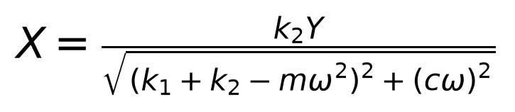
MIE 402 | ME LAB II
21
The displacement amplitude depends on input travel
Square the two coefficient equations and add them. The cross terms cancel and cos²φ + sin²φ = 1.
The result is X²[D² + (cω)²] = (k₂Y)². Take the positive square root to obtain the cart peak amplitude X [m].
Y remains in this amplitude formula. At fixed mass, stiffness, damping and drive frequency, doubling input travel doubles X.
Notes:
This directly addresses the apparent disappearance of y: the time-dependent input was specified as a cosine, and its amplitude Y cancels in a normalized output/input ratio. It has not been removed from the equation of motion. If Y doubles with parameters and drive frequency fixed, X doubles within the linear regime.

Slide 22
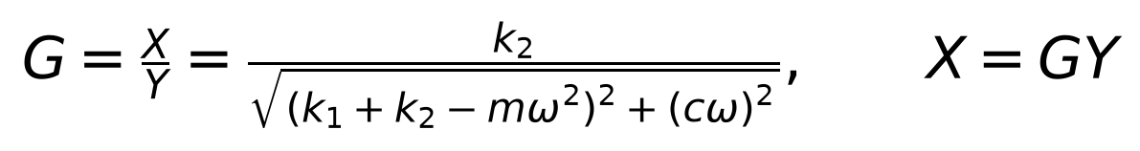
MIE 402 | ME LAB II
22
A ratio removes the chosen input amplitude
Define gain G = X/Y [dimensionless]. Divide both sides of the amplitude formula by the nonzero input amplitude Y.
Example: if G = 1.5, an input peak travel Y = 10 mm predicts X = 15 mm. With Y = 20 mm, X becomes 30 mm.
The gain stays 1.5 in both cases. The physical motion still depends on Y. This normalization lets us compare different runs.
Notes:
The numbers are illustrative, not apparatus data. This amplitude scaling holds only in the linear regime, while springs remain taut and model parameters remain approximately constant. Y cancels only in the dimensionless ratio, not from the physical forcing.

Slide 23
MIE 402 | ME LAB II
23
The tangent of phase comes from the sine equation
The zero-sine-coefficient equation is D X sinφ − cω X cosφ = 0. Move the damping term to the other side.
For X ≠ 0, D ≠ 0 and cosφ ≠ 0, division gives tanφ = cω/D. The inverse tangent therefore helps recover φ.
A plain arctangent loses the quadrant. When D < 0, positive damping requires a lag between π/2 and π, not a negative lag.
Notes:
At D=0 do not divide by D. The coefficient equations give cos phi=0 and, for positive k2 Y and damping, sin phi positive. Therefore phi=pi/2. For positive drive frequency and damping, select phi in [0,pi].

Slide 24
MIE 402 | ME LAB II
24
atan2 selects the physically correct phase lag
Use atan2(cω, D): its two signed arguments retain the quadrant. In MATLAB, atan2 returns radians.
For D > 0 the lag is between 0 and π/2. At D = 0 it is π/2. For D < 0 it lies between π/2 and π.
Example: cω = 1 and D = −1 give φ = 135°, whereas atan(−1) gives −45°. Record input and output together to measure this lag.
Notes:
At low omega, D is positive and damping gives a small positive lag. At D=0 the phase is pi/2. Above that point D becomes negative so a simple arctan(c omega/D) gives the wrong quadrant. The lab normally measures motor rpm and input travel without a synchronized y(t) channel. In that workflow, compare amplitude and gain. The plotted model waveform is phase-aligned to the output and is not a phase-validation experiment.

Slide 25
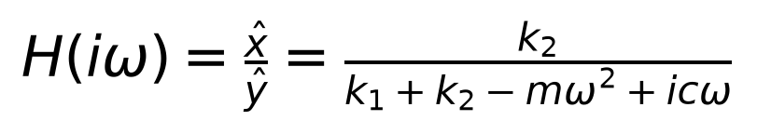
MIE 402 | ME LAB II
25
Complex amplitudes give the same result
Define i² = −1. A sinusoid can be written as the real part of a complex amplitude times exp(iωt).
Differentiation then multiplies the complex amplitude by iω, and a second derivative multiplies it by −ω².
The complex ratio H contains both gain and phase: its magnitude is X/Y and its argument is the negative of the lag.
Notes:
A hat denotes a complex displacement amplitude [m], including its phase relative to a common clock. Substitute both complex representations into the original ODE, cancel the common exponential and divide by the input amplitude. This is an alternative compact representation of the real trigonometric derivation, not an additional physical assumption. H is dimensionless. The input Y cancels because H is a normalized ratio.

Slide 26
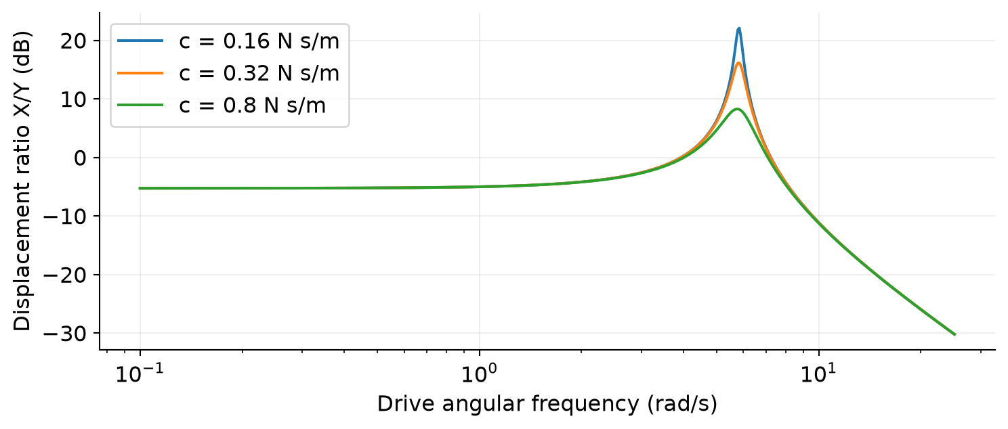
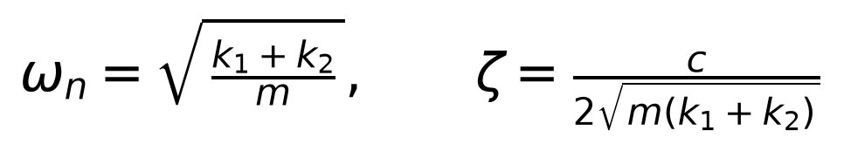
MIE 402 | ME LAB II
26
Low-frequency and resonance limits
At low drive frequency, the gain approaches k₂/(k₁ + k₂). Both springs share the endpoint displacement.
Near resonance, inertia partly cancels restoring stiffness. Damping limits the amplitude. The maximum shifts below the natural frequency when damping is nonzero.
ζ is the dimensionless damping ratio. At high drive frequency the cart inertia reduces the displacement ratio.
Illustrative model; not laboratory data
Notes:
24–27 min. The amplitude maximum is at ωr=ωn sqrt(1-2ζ²) when ζ<1/sqrt(2), so it is not exactly ωn with damping. The ratio is not generally unity at zero frequency. Do not ask students to dwell at the peak; gather safe points on both sides. Derive the low-frequency limit by setting omega=0 in the gain formula. For equal springs the limit is 1/2, not 1. At high omega, X/Y approaches k2/(m omega²). Distinguish the natural frequency, damped decay frequency and gain-peak frequency.

Slide 27
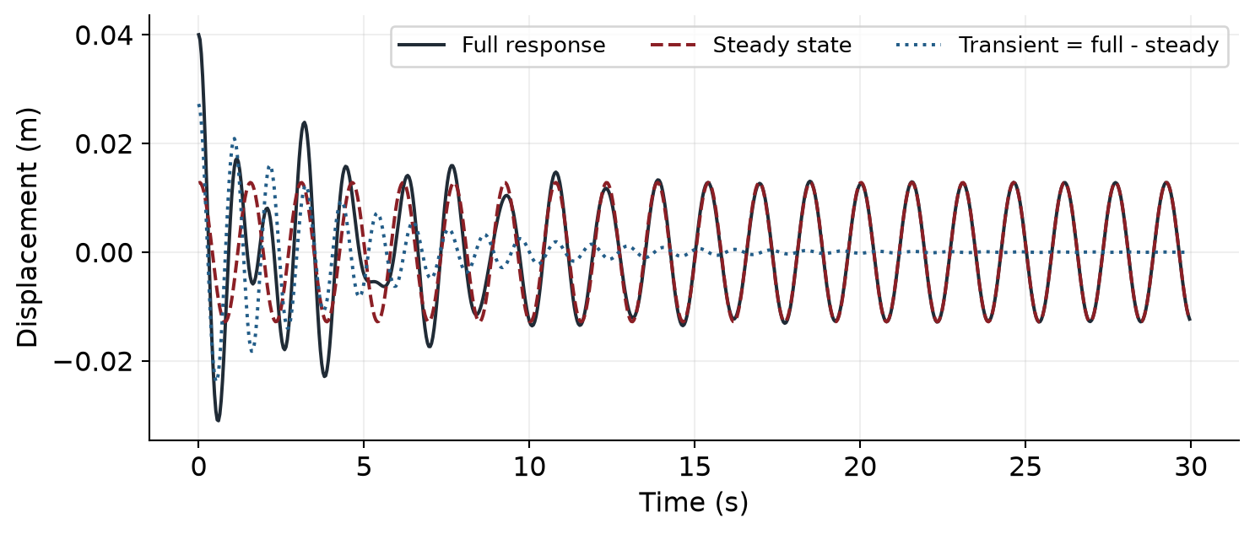
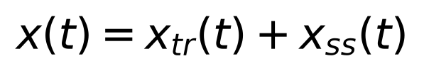
MIE 402 | ME LAB II
27
The full response includes startup motion
The steady response solves the forced equation; a transient solves the same equation with zero right-hand side.
Their sum satisfies the full equation. The initial position and velocity determine the transient coefficients.
With positive damping, the transient decays and only the forced sinusoid remains. Select that settled interval for the gain comparison.
Illustrative model; not laboratory data
Notes:
27–29 min. The steady response solves the forced equation. Their sum must satisfy initial position and velocity; this determines the transient coefficients. Ask students to identify which curve would disappear after several damping time constants. The motor must be stable for a single-frequency fit to be meaningful.

Slide 28
MIE 402 | ME LAB II
28
How initial conditions determine the transient
Use the decay rate and damped natural frequency defined earlier. The transient contains a decaying sine and cosine.
A and B are transient displacement coefficients [m]. Set them so the total response matches the initial position and velocity.
Changing release conditions changes A and B. It does not change the final harmonic gain for fixed system parameters and drive.
Notes:
If the clock begins at the initial condition, A=x(0)-X cos phi and B=[xdot(0)-omega X sin phi+alpha A]/omega_d. The velocity of the steady component at zero is +omega X sin phi. This solution assumes an underdamped linear system with constant parameters and a sinusoidal input whose phase is zero at the chosen origin.

Slide 29
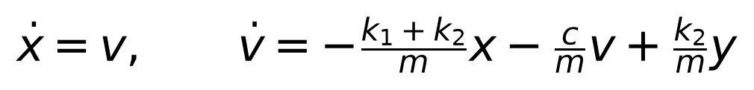
MIE 402 | ME LAB II
29
Transfer function and state equations agree
A force-input transfer function gives displacement per force [m/N]. Here the effective input force is k₂y.
Multiplying the force-input transfer function by k₂ gives the displacement ratio H [dimensionless].
Set velocity v = dx/dt [m/s]. Dividing Newton’s law by m gives the second state equation below.
Notes:
29–31 min. H(s)=k2/(m s²+c s+k1+k2). Define s as the Laplace variable, units 1/s. The force-input version in last year’s prelab has numerator 1; it describes X/F in m/N. Multiplying by k2 converts driven-end displacement to effective force and gives X/Y, dimensionless. No Control System Toolbox is needed for the supplied numerical simulation.

Slide 30
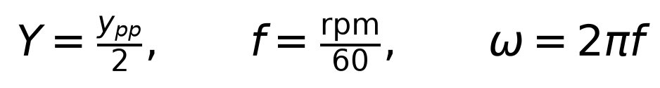
MIE 402 | ME LAB II
30
Measure input travel and motor speed
Measure actual endpoint peak-to-peak travel, typically 2–3 cm, then divide by 2.
Use the tachometer for each run. One revolution corresponds to one drive cycle.
Record the drive amplitude again when the pin setting or endpoint travel changes.
Notes:
31–33 min. Example: ypp=0.024 m gives Y=0.012 m. A 72 rpm setting gives 1.2 Hz and 7.54 rad/s. For direct-hook calibration stop the motor before changing the linkage, retain the opposing spring and ask the GTA to check travel. Do not confuse input travel with cart output travel.

Slide 31
MIE 402 | ME LAB II
31
A useful sweep covers both sides of resonance
Use 3–5 safe frequencies below and 3–5 above the expected resonance.
Allow startup to decay; record at least five settled cycles, preferably ten.
Keep the springs taut and travel safe. Stop if oscillations become excessive.
Illustrative prediction used to plan test points
Notes:
33–35 min. The handout supply range is 2–11 V; ask the GTA to supervise near resonance. At least five measured points are a before-leaving quick check, not an instruction to skip the rest of the sweep. Do not interpolate across resonance and present the result as measured data.

Slide 32
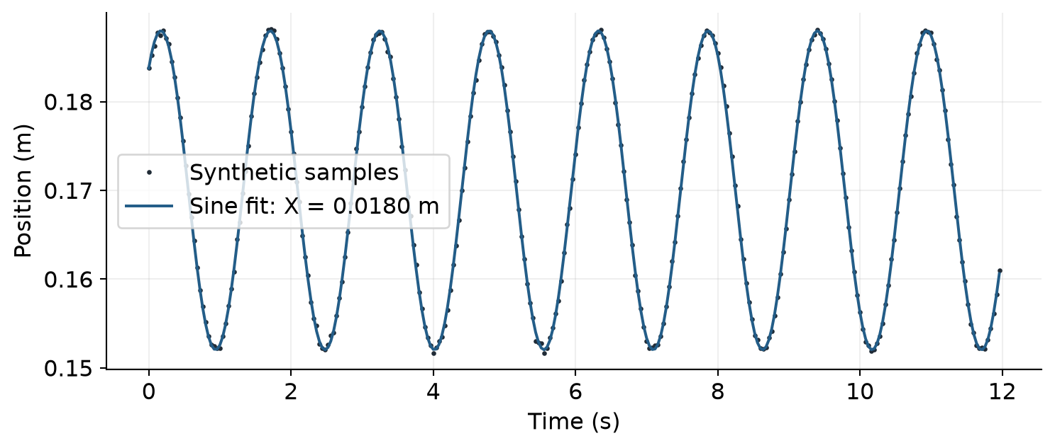
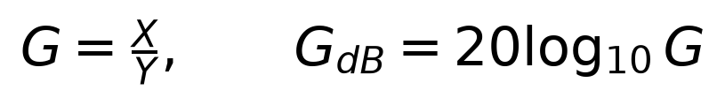
MIE 402 | ME LAB II
32
Fit amplitude at the measured drive frequency
Fit x(t) = offset + slow drift + a cos(ωt) + b sin(ωt).
The frequency comes from the tachometer; the code solves for a and b by linear least squares.
The peak amplitude is X = √(a² + b²). Inspect the fit against the data.
Synthetic example of measured-point and fit display
Notes:
35–37 min. Define a and b as fitted displacement coefficients [m], G as dimensionless amplitude ratio, and GdB as its decibel value. This avoids a nonlinear sine-fit convergence failure. A trend term captures modest offset drift but does not establish steady state: compare amplitudes in both halves and inspect residuals.

Slide 33
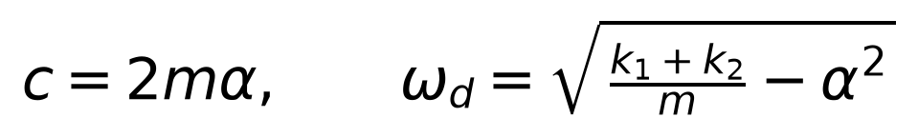
MIE 402 | ME LAB II
33
Choose damping for the tested configuration
Magnetic dampers change both damping and moving mass.
With the drive off and both ends stationary, record a free decay in the forced-test configuration.
Analyze that decay for c. Use it with the matching mass in the harmonic prediction.
Notes:
37–39 min. This is system identification, not an independently known damping constant. Report that c was obtained from free decay. The no-magnet impulse runs cannot supply c for a cart with added magnets. Reuse Lab 4 c only if mass, springs and damper configuration truly match.

Slide 34
MIE 402 | ME LAB II
34
Test 1: measurements and setup
Weigh the cart, hex rods and all moving attachments. Record the spring IDs and each calibrated stiffness from Lab 4.
Level the track. Keep both springs taut near equilibrium. Set up the stationary ends for impulse runs with magnetic dampers removed.
In Vernier Graphical Analysis, connect the correct cart, select position in meters, set up to 25 Hz and zero at equilibrium. Start collection before each tap.
Notes:
Maintain a run log with filename, total moving mass, spring IDs, k1, k2 and damper count. Reweigh whenever mounted hardware changes.

Slide 35
MIE 402 | ME LAB II
35
Test 2: three impulse runs
Let the cart rest at equilibrium. Give one short horizontal tap, remove your hand and record several clean decay cycles.
Repeat from rest at three gentle tap levels without changing the hardware. Save one raw CSV per run.
Use MATLAB mode 1 and select data after contact ends. Compare the three time traces, decay fits and frequency spectra.
Notes:
Keep wheels rolling and avoid end-stop contact. In the report compare amplitudes and frequencies, not numerical impulses unless an independent contact-force measurement exists.

Slide 36
MIE 402 | ME LAB II
36
Test 3: harmonic-input calibration
Install 1–2 magnetic dampers and reweigh. With both ends stationary and motor off, record a free decay to identify the matching damping coefficient.
With the GTA, measure motor-end peak-to-peak travel at low speed using the guide’s calibration setup or a ruler. Input amplitude Y is half that travel.
Stop the motor before reconnecting the driven spring. Measure actual rpm with the tachometer: one revolution gives one input cycle.
Notes:
The original guide calls for approximately 2–3 cm peak-to-peak motion, but use the actual measured travel. Supply voltage controls motor speed; it does not measure frequency. Obtain c from the same mass and brake configuration.

Slide 37
MIE 402 | ME LAB II
37
Test 4: frequency sweep and result checks
With the GTA, increase motor speed gradually. Aim for 3–5 safe frequencies below and 3–5 above predicted resonance. Avoid dwelling at the peak.
At each speed, let the transient decay. Record at least five settled cycles, preferably ten or more. Save raw CSV, rpm and input travel.
Use MATLAB mode 2. Compare measured amplitude and X/Y with theory. Show the GTA one impulse fit, one harmonic fit and the frequency-response points before leaving.
Notes:
Use a settled interval after startup. Stop if travel becomes excessive, wheels slip or a spring goes slack. Do not invent a resonance measurement. A first-half/second-half amplitude change above 10% triggers a code warning. Bring all raw files and the parameter log into the combined Labs 4 + 5 report.

Slide 38
MIE 402 | ME LAB II
38
MATLAB workflow
Open Run_Lab5_Forced_Response.m. Enter measured mass, both stiffnesses and matching damping.
Select CSV/Excel files, a settled time interval and position units. Enter measured motor rpm and input peak-to-peak travel.
Each run exports measured data, its sine fit and the analytical amplitude comparison. The sweep figure compares measured gain with theory.
Notes:
39–42 min. Helpers must stay in the same folder. The launcher takes no input arguments. No extra preliminary figure is created. Students read time boundaries from the original Vernier record. Results are saved beside data in Lab5_Results; the script prints the exact path.

Slide 39
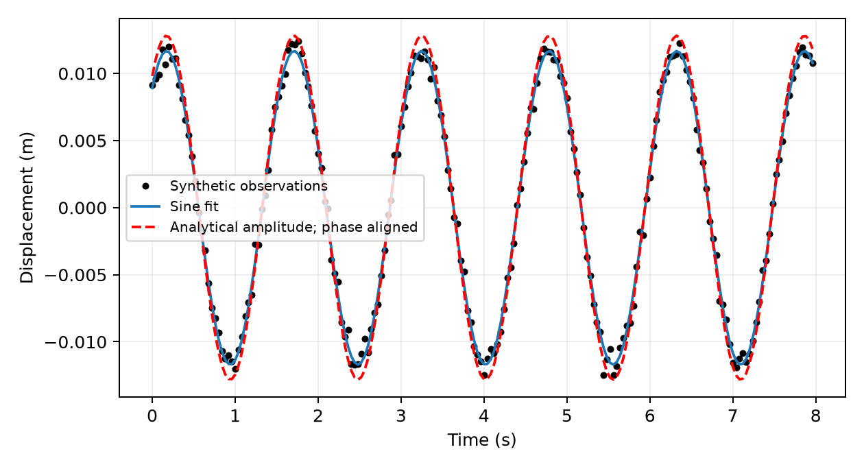
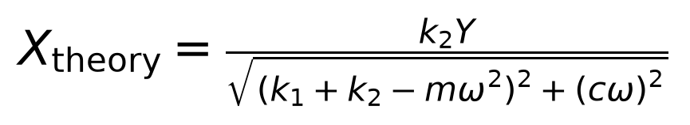
MIE 402 | ME LAB II
39
What the code compares with theory
The blue sine fit estimates the measured amplitude X. The red dashed curve uses amplitude predicted from m, k₁, k₂, c, Y and drive frequency.
Its phase is aligned to the output for display. That comparison tests amplitude; it does not measure input/output phase.
Read measured X, predicted X and percent difference in the summary. Compare X/Y across drive frequencies.
Synthetic example: fit and analytical amplitude are different quantities
Notes:
All plots on this explanatory slide use synthetic signals. The experimental code uses the group’s own parameters. The fixed-amplitude red curve is not a second best fit to the output amplitude. Only its display phase and equilibrium offset come from the output. For impulse runs, the existing analytical decay uses measured mass and stiffness and identified damping. That is not an independent validation of the damping estimate.

Slide 40
MIE 402 | ME LAB II
40
Figures for the combined Labs 4 + 5 report
Three impulse time histories and spectra: compare frequency and amplitude.
Representative harmonic record: identify startup and the settled interval.
Measured displacement ratios overlaid on theory using your measured parameters.
Illustrative theory only; add your own measured points
Notes:
42–45 min. Use an Abstract, Introduction, Methods, Results, Discussion and Conclusion following the course template. Keep free and forced results distinct, then connect them in discussion. Include a short parameter/results table and export figures, not screenshots. The theoretical line must not be passed off as experimental data. The shared Labs 4 and 5 report is due Monday November 23 at 11:59 PM. The red curve in a single harmonic record is phase-aligned for amplitude comparison; validate phase only with a synchronized input measurement.

Slide 41
MIE 402 | ME LAB II
41
Check before leaving the laboratory
Show one impulse trace and spectrum, one settled sine fit and at least five sweep points to the GTA.
Confirm time units, meters, kilograms, peak versus peak-to-peak, and rpm conversion.
Copy the raw files and parameter log to every group member.
Notes:
45–48 min. Data-quality check: an amplitude change greater than 10% between halves flags possible unsettled behavior; inspect rather than accepting automatically. Explain friction, slack or changing motor speed when theory disagrees. A frequency-response peak does not imply an unstable linear system if c remains positive.

Slide 42
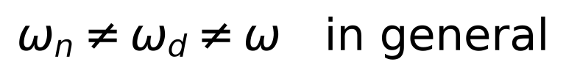
MIE 402 | ME LAB II
42
Three frequencies to distinguish
Natural frequency: set by mass and the two spring stiffnesses.
Damped transient frequency: appears in decay after release or impact.
Drive frequency: remains in the settled forced oscillation.
Notes:
48–50 min. Ask: if motor speed changes and mass/springs do not, which frequency changes? Which motion disappears with time? Then ask what parameter is missing if students did not measure input travel: they cannot calculate X/Y. Sources for this lecture: prior MIE 402 Lab 5 manual and theory/experiment notes, plus Newton’s law derivations shown here. All generated model figures are labeled illustrative.

