Slide 1
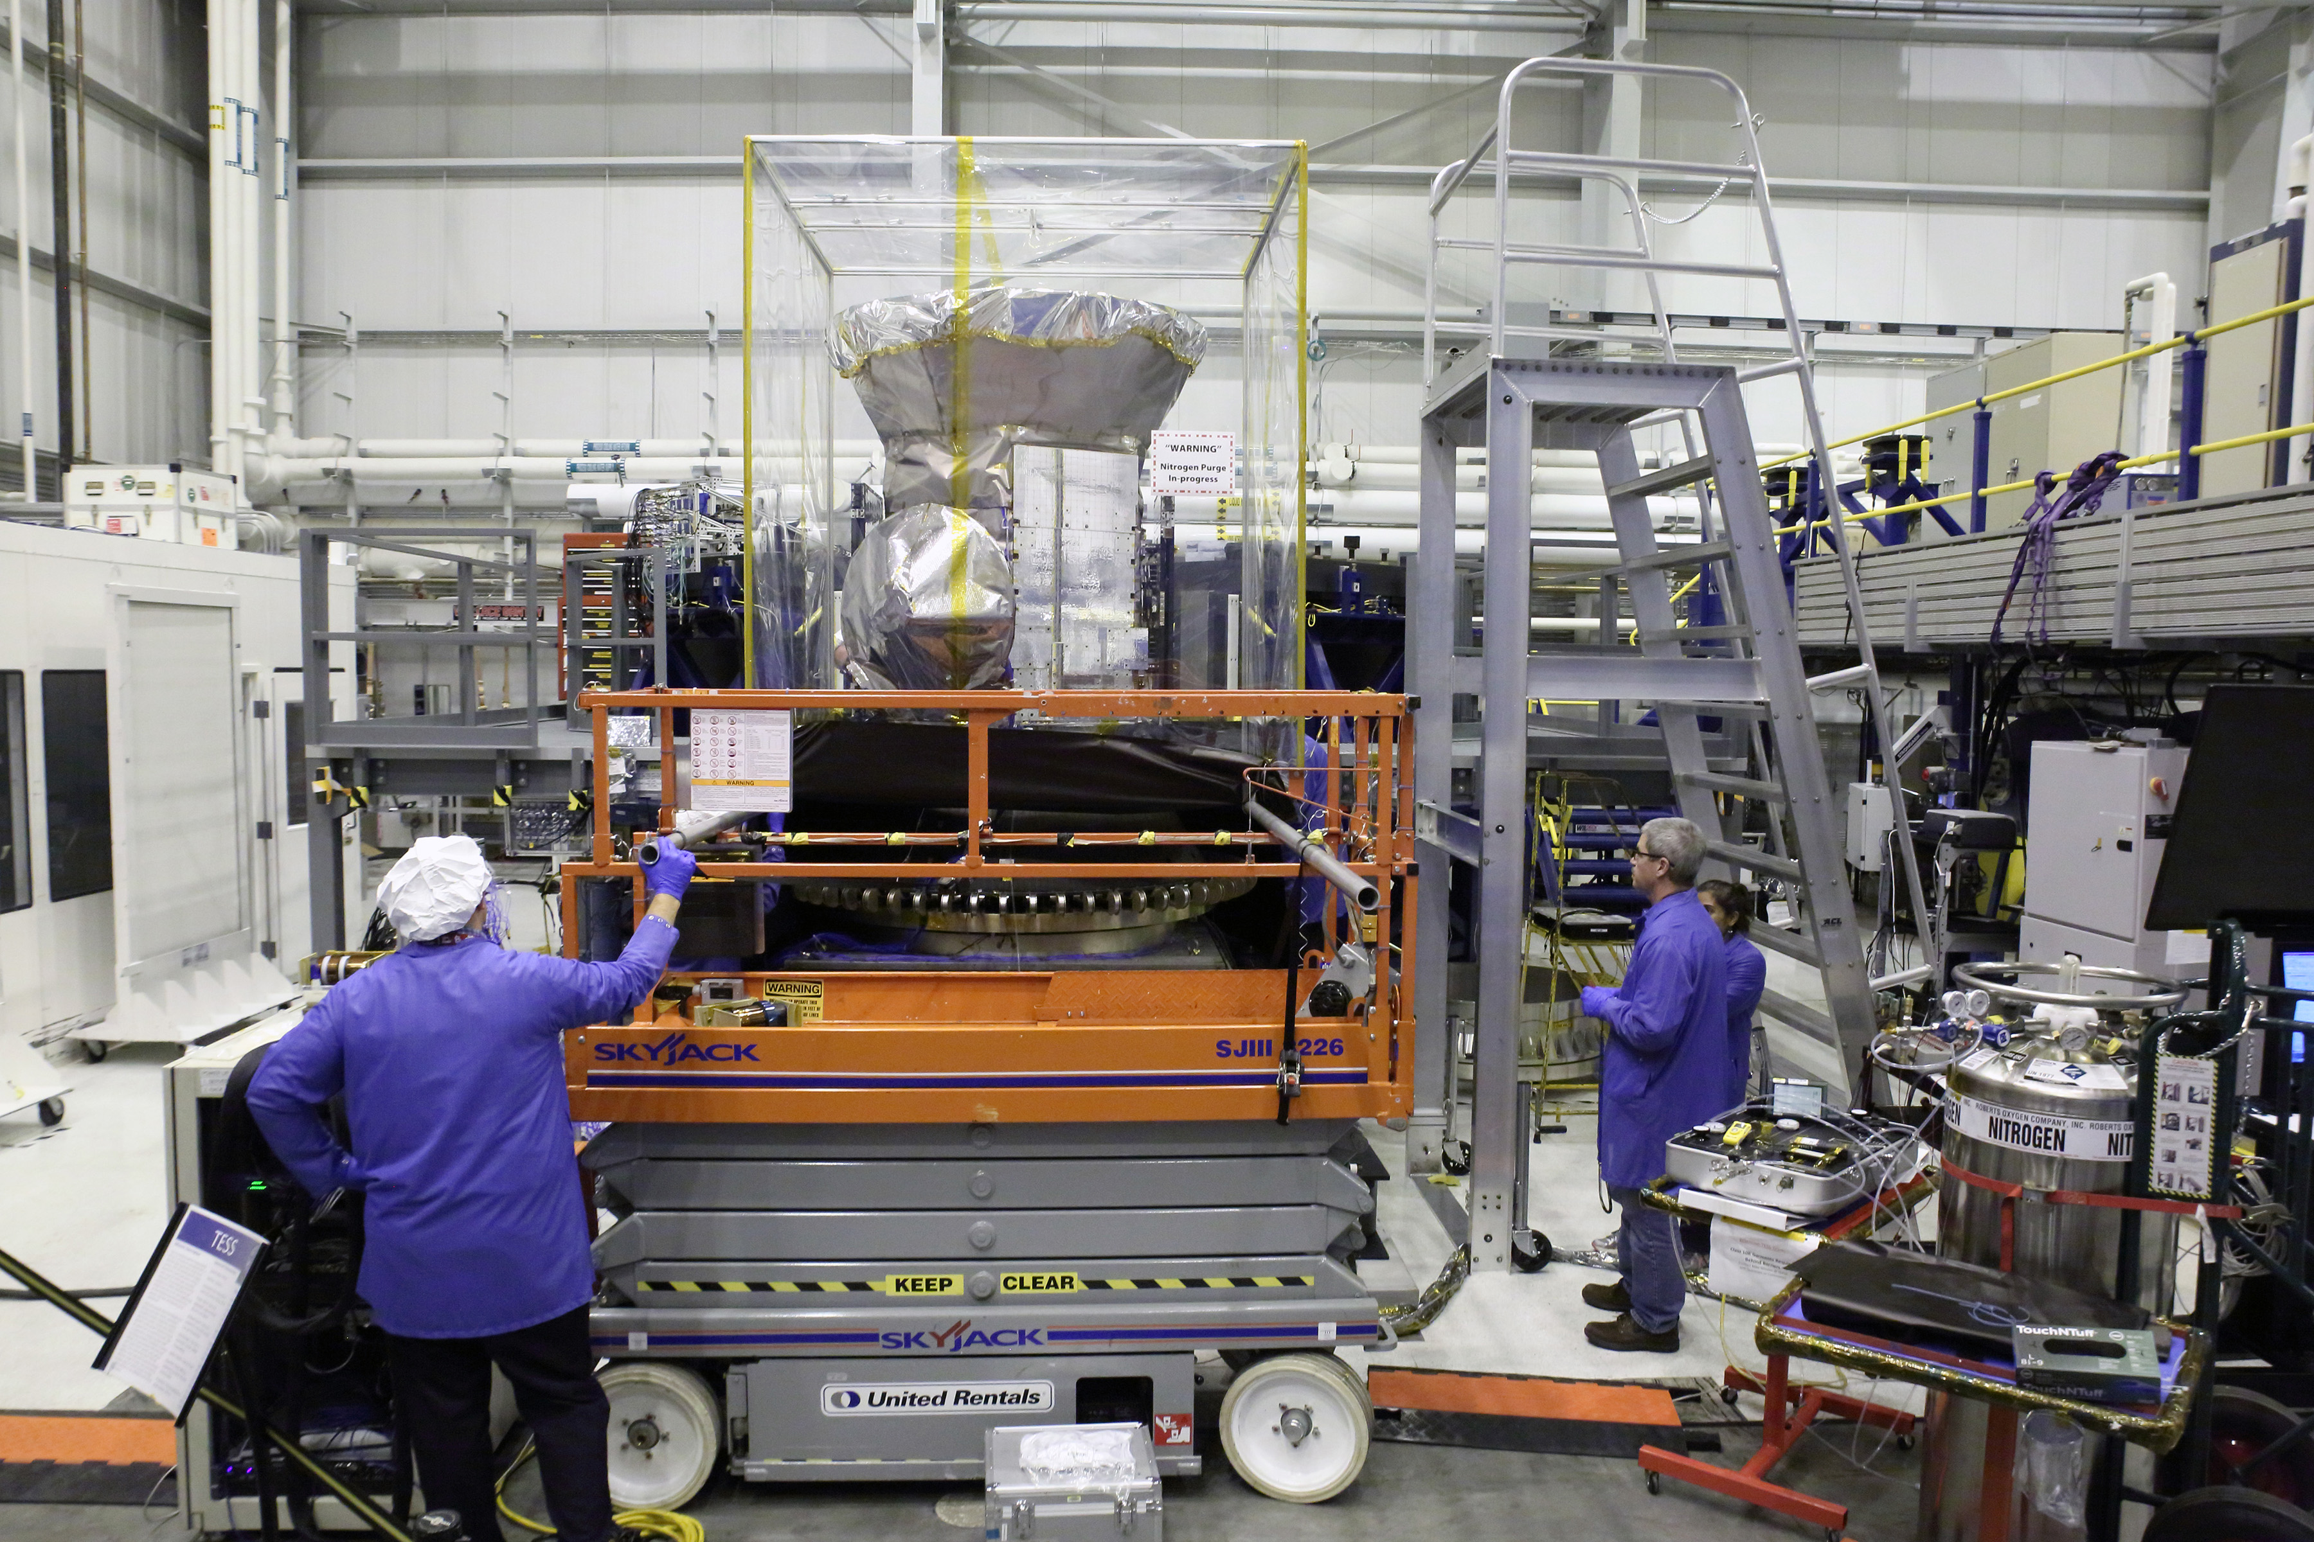
MIE 402 · ME LAB II
Lab 4: free vibration of a 1‑DOF system
From a sensor-cart record to mass, stiffness, natural frequency, and damping
Fall 2026 · Lab 4 theory · October 19
A small cart teaches the same identification logic used in full-scale vibration testing.
NASA/GSFC image · TESS vibration test

Slide 2
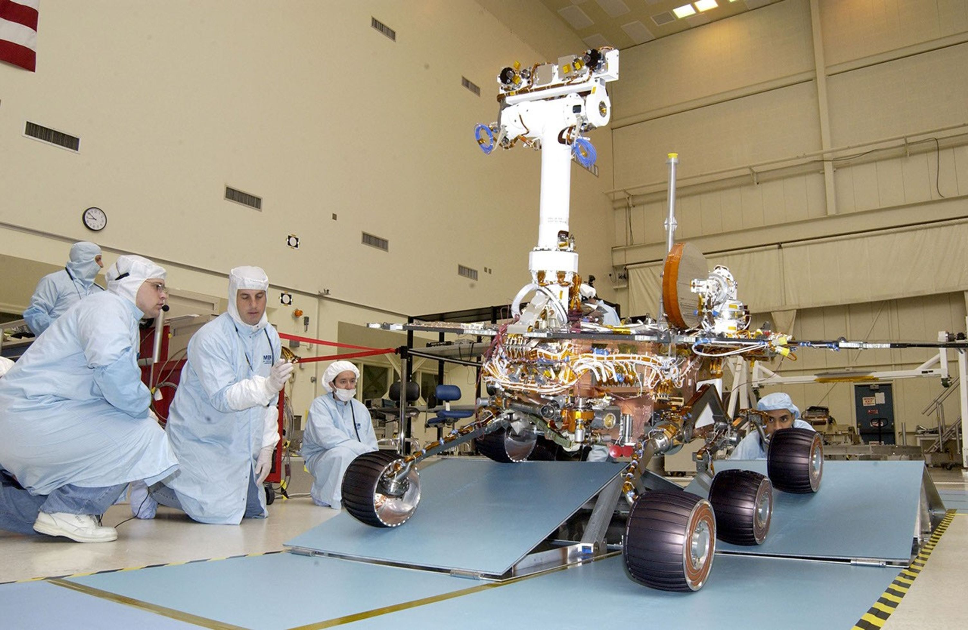
MIE 402 | APPLICATION FIRST
0–3 min
Why this experiment matters
Vehicle suspension
Spacecraft qualification
A bump excites the system. Frequency and decay tell engineers whether the suspension will settle safely.
Modal and vibration tests identify resonances before launch loads expose a weak design.
Lab 4 uses the same measurement logic at a smaller scale: disturb, record the free response, identify frequency and damping, then compare with the model.
2

Slide 3
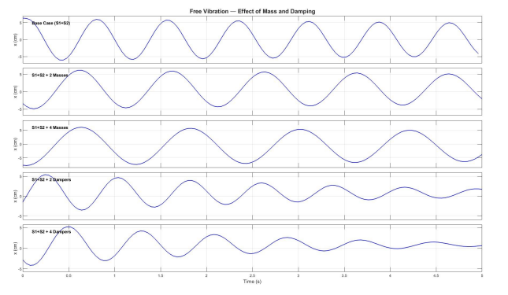
MIE 402 | APPLICATION FIRST
3–5 min
The laboratory question and the evidence
One record contains two independent clues
Peak spacing
sets the oscillation period and damped natural frequency.
Peak decay
sets the logarithmic decrement and damping ratio.
The seven cases change mass, damping, or spring pair one at a time so the cause of each change remains visible.
Representative anonymized class data · Spring 2026
The engineering question: which physical change moved the frequency, and which change shortened the ring-down?
3

Slide 4
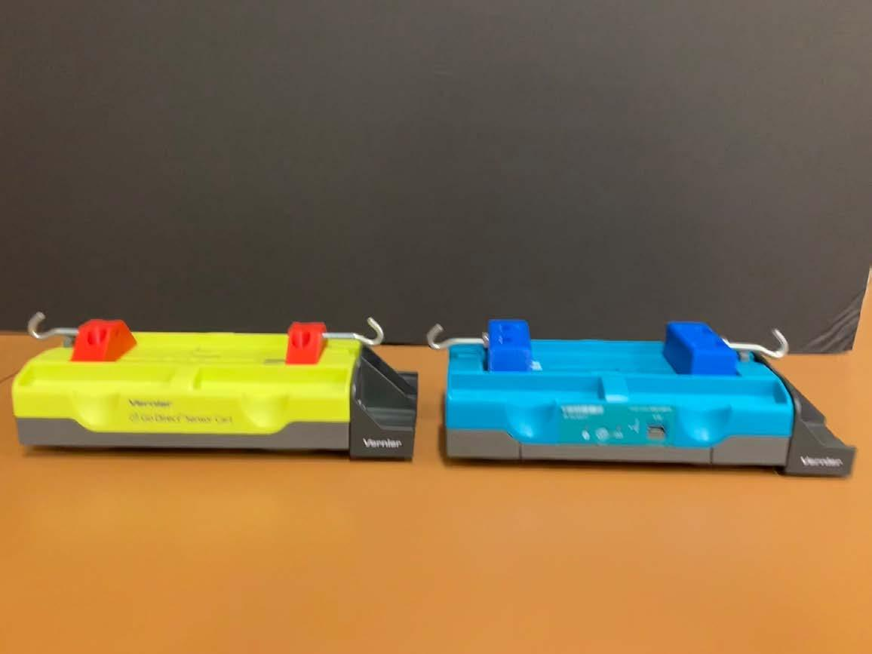
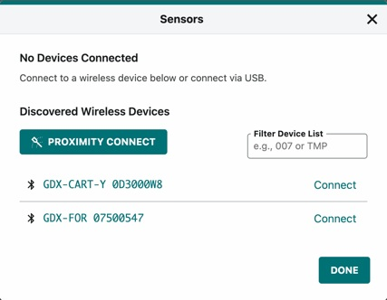
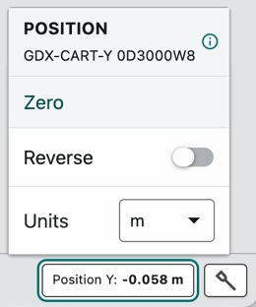
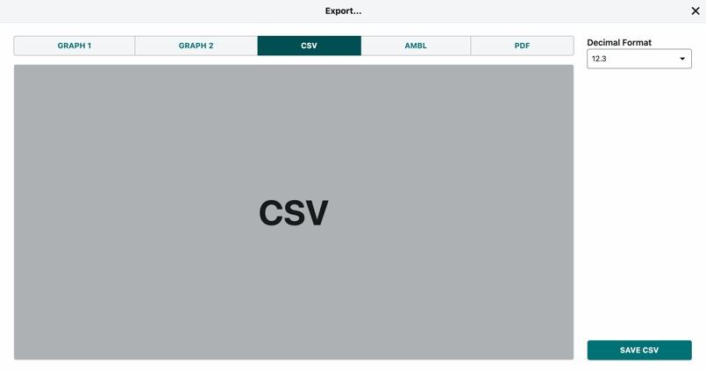
MIE 402 | MEASUREMENT CHAIN
5–7 min
The apparatus records position, not “damping”
1 wheel encoder records x(t)
2 Graphical Analysis stores time and position
3 CSV carries the raw evidence into MATLAB
The sensor never reports “damping.” Students infer damping from how the measured peaks decrease.
4

Slide 5
MIE 402 | MODEL
7–9 min
The hardware becomes a spring–mass–damper model
x(t)
↔
k
m ẍ + c ẋ + k x = 0
mass m
•
x(t): cart displacement from equilibrium [m]
•
m: total moving mass [kg]
•
c: viscous-equivalent damping coefficient [N·s/m]
damper c
•
k: equivalent stiffness of both springs [N/m]
5

Slide 6
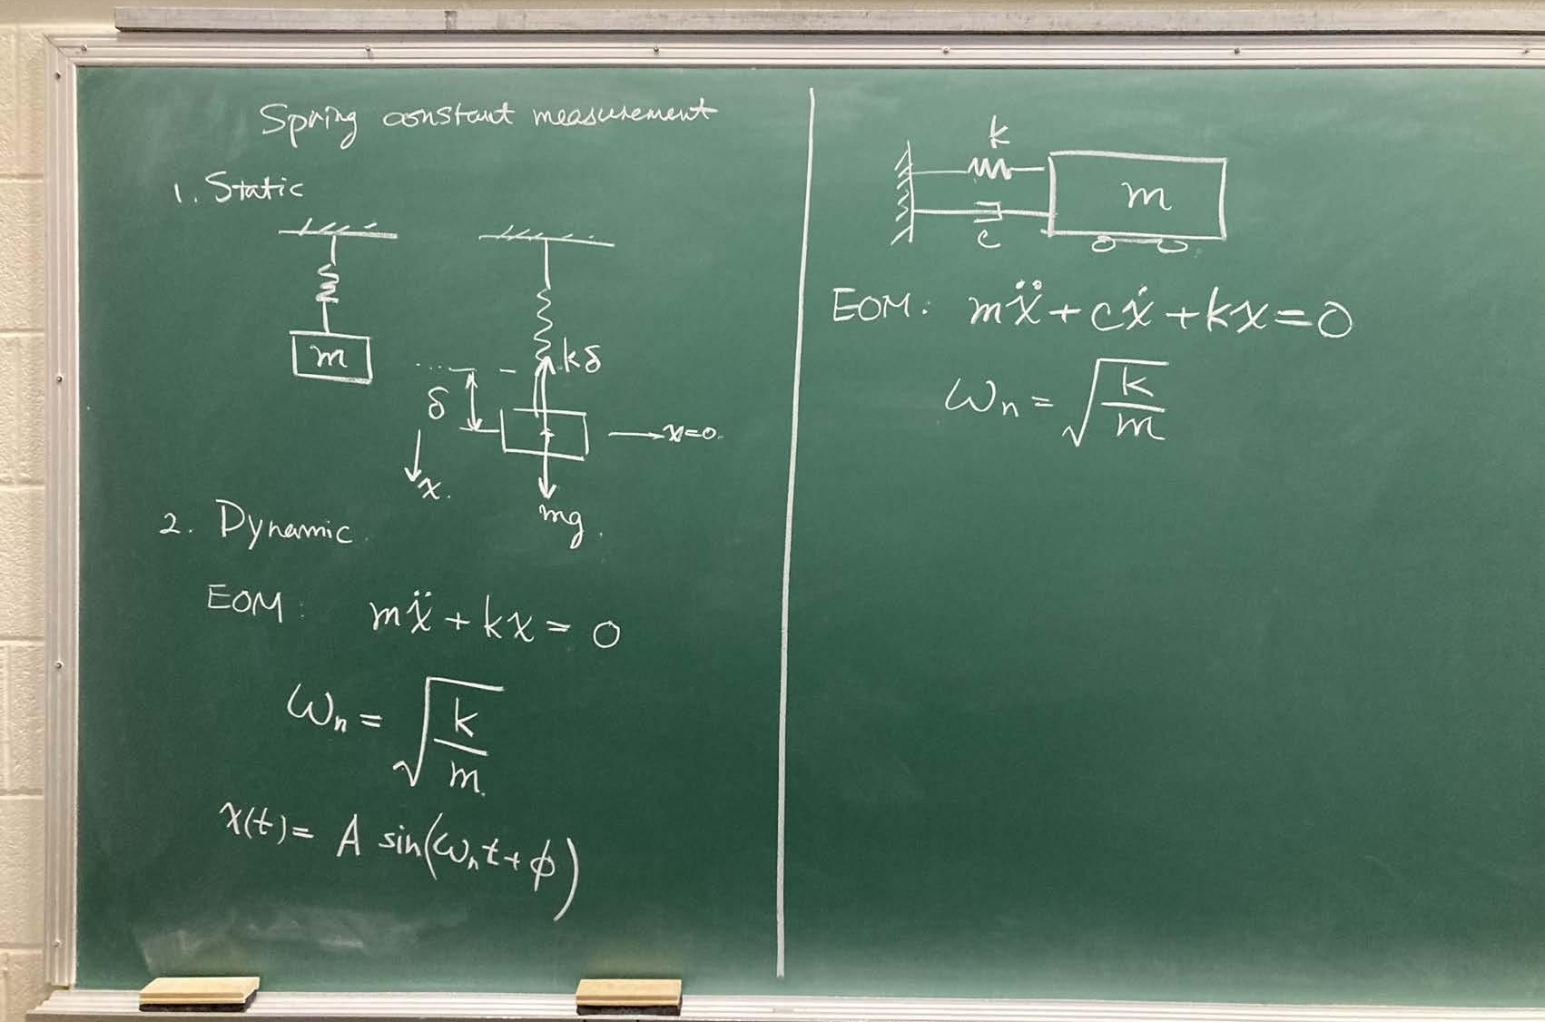
MIE 402 | NEWTON’S SECOND LAW
9–11 min
A free-body diagram gives the equation of motion
Start from forces, then simplify
Fₛ = −kx
Spring force
Fd = −c ẋ
Damping force
m ẍ + c ẋ + kx = 0
The equation describes motion after release, when no external input remains.
Prior MIE 402 classroom derivation
6

Slide 7
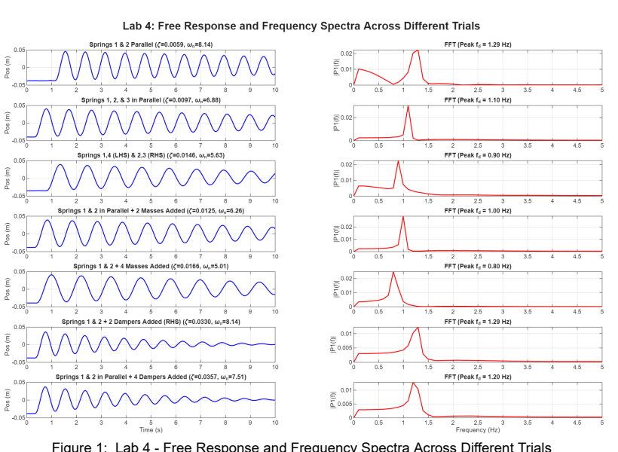
MIE 402 | PHYSICAL MEANING
11–13 min
Each parameter changes a different feature of the record
Mass m
More moving mass stretches the period. The FFT peak shifts left.
Stiffness k
A stiffer spring pair shortens the period. The FFT peak shifts right.
Damping c
More eddy-current damping reduces peak height faster. Frequency changes only slightly.
Representative anonymized class result · Spring 2026
7

Slide 8
MIE 402 | UNDAMPED MODEL
13–15 min
Without damping, the cart exchanges energy forever
m ẍ + kx = 0
ωₙ = √(k/m) [rad/s]
x(t) = A cos(ωₙt − φ)
fₙ = ωₙ/(2π) [Hz]
ωₙ is the undamped natural angular frequency. fₙ counts cycles per second. A and φ come from the initial displacement and velocity.
Dimensional check: k/m has units s⁻², so √(k/m) has units rad/s.
8

Slide 9
MIE 402 | PREDICTION
15–16.5 min
Natural frequency is a property of the system
Double the mass
Double the stiffness
Double m and k
fₙ becomes 1/√2 = 0.707 times the original
fₙ becomes √2 = 1.414 times the original
fₙ stays unchanged
fₙ ∝ √k and fₙ ∝ 1/√m
9

Slide 10
MIE 402 | ENERGY
16.5–18 min
Energy explains the repeated motion
E(t) = ½m ẋ² + ½k x²
turning point
equilibrium
x = ±A
x = 0
spring energy maximum
speed = 0
spring energy minimum
speed maximum
With c = 0, total mechanical energy stays constant. Real damping removes energy on every cycle.
10

Slide 11
MIE 402 | DAMPING
18–20 min
Damping removes energy fastest when the cart moves fastest
•
The damping force reverses when velocity reverses.
F_d = −c ẋ
•
The damper does no work at a turning point because ẋ = 0.
P_d = F_d ẋ = −c ẋ²
•
The magnitude of energy loss is largest near equilibrium, where speed is largest.
•
The magnetic dampers approximate viscous damping over the operating range.
We model several loss mechanisms with one equivalent coefficient c. The model is useful only if the measured envelope resembles an exponential.
11

Slide 12
MIE 402 | STANDARD FORM
20–22 min
Damping ratio classifies the response
ẍ + 2ζωₙ ẋ + ωₙ² x = 0
ζ = c / (2√km)
0 < ζ < 1
ζ = 1
ζ > 1
underdamped
critical
overdamped
oscillates and decays
fastest nonoscillatory return
slow nonoscillatory return
12

Slide 13
MIE 402 | RESPONSE MODEL
22–24 min
Lab 4 operates in the underdamped regime
x(t) = A exp(−ζωₙt) cos(ωd t − φ)
ωd = ωₙ√(1 − ζ²)
•
A: response amplitude set by the initial conditions [m]
•
φ: phase set by initial displacement and velocity [rad]
•
ωd: damped natural angular frequency [rad/s]
•
exp(−ζωₙt): exponential envelope that controls decay
13

Slide 14
MIE 402 | DECAY
24–26 min
The peaks trace an exponential envelope
envelope = ±A exp(−ζωₙt)
Peak spacing gives the period.
Peak-height reduction gives damping.
Use peaks with the same sign, or use absolute peak magnitudes consistently.
14

Slide 15
MIE 402 | DAMPING FROM PEAKS
26–28 min
Logarithmic decrement turns decay into a ratio
δ = (1/N) ln(|xᵢ| / |xᵢ₊ₙ|)
ζ = δ / √(4π² + δ²)
•
x_i and x_(i+N) are peak amplitudes of the same sign.
•
N is the number of complete cycles between the selected peaks.
•
Using several cycles reduces sensitivity to cursor placement and noise.
•
A line fit to ln|peak| versus time provides a stronger check.
15

Slide 16
MIE 402 | FREQUENCY FROM TIME DATA
28–30 min
Peak timing gives damped and undamped frequency
Td = (tᵢ₊ₙ − tᵢ)/N
fd = 1/Td
ωd = 2πfd
ωₙ = ωd / √(1 − ζ²)
For light damping, f_d and fₙ are close, but they are not identical. Report which one you measured and which one you calculated.
16

Slide 17
MIE 402 | FREQUENCY DOMAIN
30–32 min
The FFT finds the frequency that best matches the record
largest spectral peak
fₚₑₐₖ ≈ fd
The cart repeats most strongly at its damped natural frequency, so the correlation with that sinusoid becomes largest.
17

Slide 18
MIE 402 | CROSS-CHECK
32–33.5 min
Time-domain and FFT estimates must agree
peak spacing
FFT peak
model fit
f_d,time
f_peak
f_d, ζ
direct and intuitive
fast visual check
uses the entire record
If the estimates disagree, inspect sampling, drift, peak selection, units, and whether the record contains more than one motion.
18

Slide 19
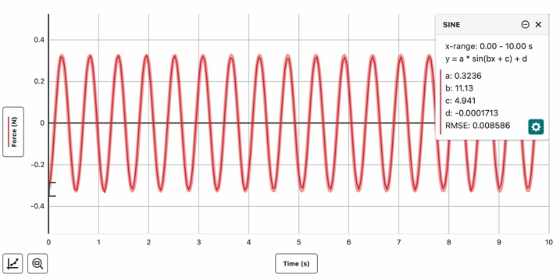
MIE 402 | SPRING CALIBRATION
33.5–36 min
Spring stiffness comes from a separate free-vibration test
k ≈ mₕ (2π fₛ)²
What the fit reports
•
a: force amplitude
•
b: angular frequency in rad/s
•
c: phase
•
d: force offset
Use b directly: k ≈ mₕ b². Include every moving attachment in mₕ.
Actual Graphical Analysis fit from a prior MIE 402 setup
19

Slide 20
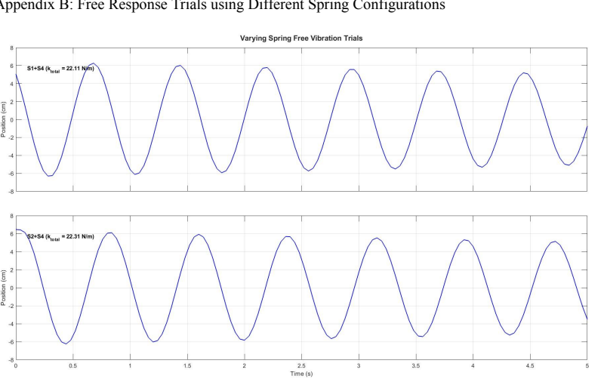
MIE 402 | EQUIVALENT STIFFNESS
36–38 min
Two springs act together on the cart
A small displacement stretches one spring and compresses the other. Both forces oppose the displacement.
k = kL + kR
fₙ = (1/2π) √(k/m)
The prior runs at left show similar but measurably different periods for two spring combinations.
Representative anonymized class data · Spring 2026
20

Slide 21
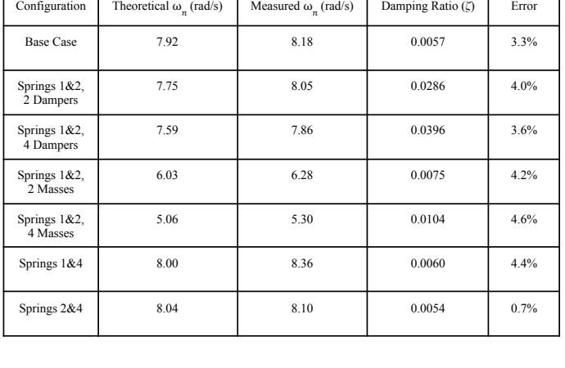
MIE 402 | PRIOR CLASS EVIDENCE
38–40 min
What a complete seven-case data set can show
Results from a prior section
Mass cases
5.30–6.28 rad/s
Base case
8.18 rad/s
Spring cases
8.10–8.36 rad/s
Damper cases
ζ rose to 0.0396
The useful result is the trend and the theory–experiment comparison, not a single “correct” number.
21

Slide 22
MIE 402 | GRAPHICAL ANALYSIS
40–42 min
Collection settings must preserve the motion
sample rate
≤ 25 Hz
record length
until nearly at rest
enough samples per cycle
captures the decay envelope
initial displacement
measure and record
position zero
set before each run
release without a push
prevents avoidable offsets
22

Slide 23
MIE 402 | COLLECTION WORKFLOW
42–44 min
A reliable run follows the same sequence every time
1
Level track and confirm clear travel
2
Pair the cart by serial number
3
Zero position at equilibrium
4
Displace a measured distance
5
Click Collect, then release without push
6
Record until motion nearly stops
7
Export CSV with a descriptive file name
8
Plot immediately and repeat if needed
23

Slide 24
MIE 402 | DATA ANALYSIS
44–46 min
The analysis code produces four pieces of evidence
1
2
3
4
clean x(t)
peak table
decay estimate
frequency check
remove offset and inspect drift
times, amplitudes, and cycle spacing
δ, ζ, and fitted envelope
time-domain f_d and FFT peak
Keep raw CSV files unchanged. The code writes figures and a summary table to a separate results folder.
24

Slide 25
MIE 402 | TROUBLESHOOTING
46–48 min
Quality checks catch most bad runs before students leave
Accept the run when…
Repeat the run when…
•
several complete cycles
•
push at release
•
smooth exponential-like envelope
•
spring goes slack or overstretches
•
cart remains on track
•
cart or cable rubs
•
no clipped or missing samples
•
track not level
•
metadata matches file name
•
wrong mass or spring recorded
Fully analyze one case and show the result to the GTA before leaving.
25

Slide 26
MIE 402 | PRE-LAB
48–49 min
Pre‑Lab 4 prepares the decisions made at the bench
•
Identify the industrial role of free-response testing.
•
Calculate ωₙ, ζ, and ω_d for a new spring–mass–damper case.
•
Predict how mass, stiffness, and damping change the record.
•
Run provided code for an analytical response and a numerical solution.
•
Use provided peak-analysis code to estimate damping and frequency.
•
Submit one Word or PDF file with answers and required figures before your own Lab 4 section begins.
No Python or MATLAB programming is required. Students run supplied code, interpret outputs, and explain the physics.
26

Slide 27
MIE 402 | REPORT BRIDGE
49–50 min
Lab 4 evidence feeds the combined Labs 4–5 report
Model
Method
Results
Discussion
define m, k_eq, c, ωₙ, ζ, and assumptions
describe calibration, cases, sampling, and release
time traces, spectra, parameter table, uncertainties
compare trends with theory and diagnose deviations
The central claim should answer: do the measured changes in natural frequency and damping follow the spring–mass–damper model?
27

