Slide 1
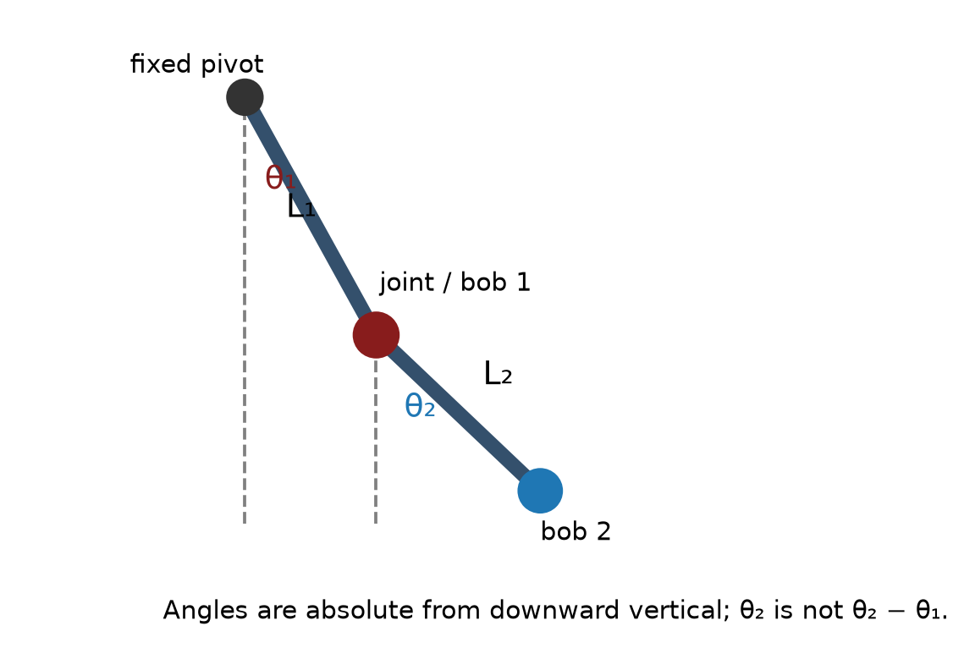
MIE 402 | ME LAB II
0–2 min
Double pendulum: from video to physics
• Lecture 04 · Monday, October 5, 2026
• Lab 3 takes place October 19–23; October 12 has no class or lab.
• Today: understand the device, predict motion, prepare measurements and analysis.
1

Slide 2
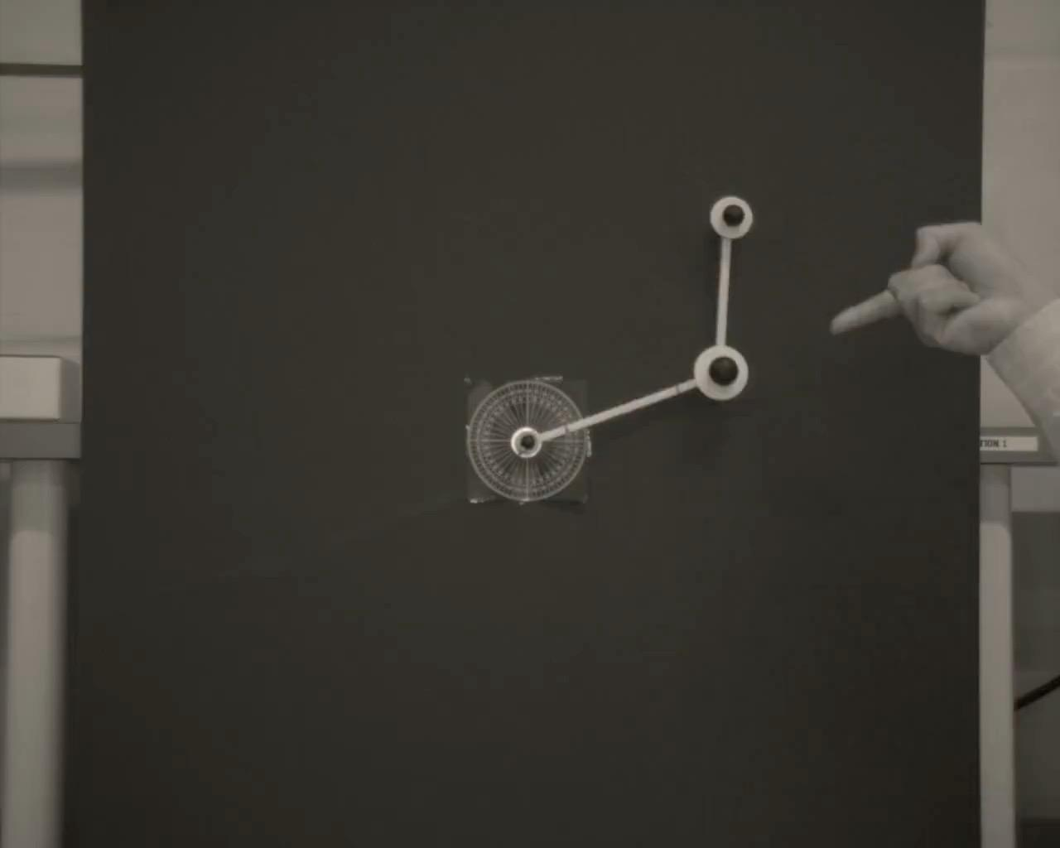
MIE 402 | ME LAB II
2–4 min
What will students actually do?
• Build and measure a two-link pendulum; record four or more useful releases.
• Track two moving bob centers with the high-speed camera and MATLAB app.
• Convert saved coordinates to two angles; compare traces and spectra with a model.
• Keep raw MP4, MAT, masses, lengths, settings, and a trial log.
2

Slide 3
MIE 402 | ME LAB II
4–6 min
The two links and two angles
• Upper link: fixed pivot to joint/bob 1; lower link: joint to bob 2.
• θ₁ and θ₂ are each measured from the downward vertical, positive to the right.
• θ₂ is the absolute orientation of link 2; θ₂ − θ₁ is its relative angle.
• Measure pivot-to-joint L₁ and joint-to-bob-center L₂.
3

Slide 4
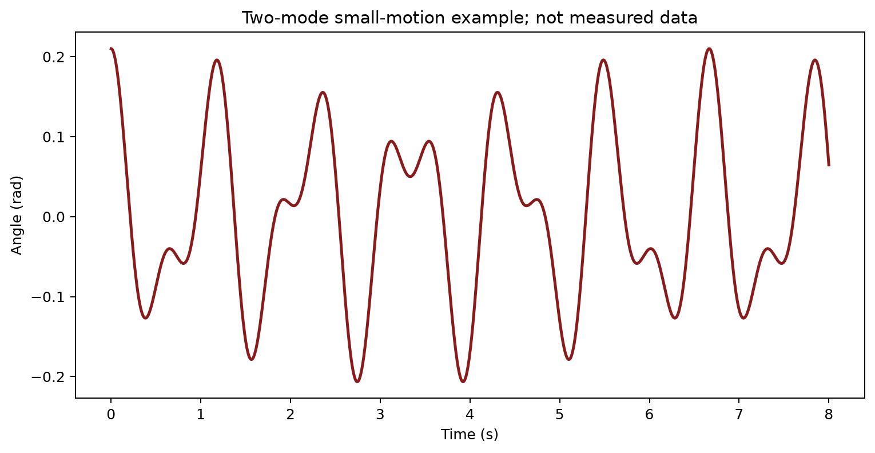
MIE 402 | ME LAB II
6–8 min
One pendulum versus two
• Lab 2 had one angle and one principal oscillation frequency.
• Lab 3 has two angles: motion of one link changes the other.
• Energy transfers between the links; even small motion can contain two normal modes.
• At large amplitudes the sine and angle-difference terms make the motion nonlinear.
4

Slide 5
MIE 402 | ME LAB II
8–10 min
The physical model we will test
• m₁,m₂: upper/lower uniform bar masses; M₁,M₂: lumped joint/lower-bob masses.
• L₁,L₂: pivot-to-joint and joint-to-lower-bob-center distances.
• Assume planar rigid links, frictionless pivots, and release from rest for baseline.
• Measured masses and lengths replace last year’s illustrative numbers.
5

Slide 6
MIE 402 | ME LAB II
10–12 min
Where the restoring torque comes from
• Gravity acts at each bar’s center and at each bob/hardware mass.
• For a displaced angle θ, the horizontal lever arm is distance × sin θ.
• Bar centers lie at L₁/2 and L₂/2 for uniform bars.
• Potential energy rises as each mass moves above its hanging position.
6

Slide 7
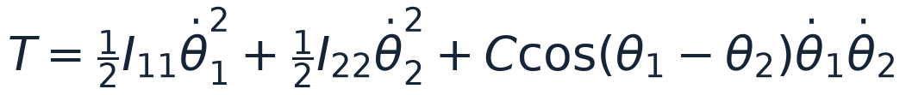

MIE 402 | ME LAB II
12–15 min
Energy of the double pendulum
7

Slide 8

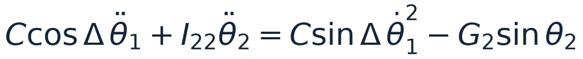
MIE 402 | ME LAB II
15–18 min
Equations used by the supplied simulation
The coupled accelerations are solved together at each time step:
MATLAB solves this 2×2 system inside ode45; students do not write an ODE solver.
8

Slide 9
MIE 402 | ME LAB II
18–20 min
Why the coupling terms matter
• The off-diagonal C cosΔ couples both angular accelerations.
• The sinΔ × angular-speed-squared terms vary as the geometry changes.
• Setting both bar masses to zero gives the ideal point-mass limit.
• A real bar has mass: leaving it out can shift predicted timing.
9

Slide 10
MIE 402 | ME LAB II
20–22 min
Small motion: two normal modes
• For small angles, sinθ ≈ θ and cos(θ₁−θ₂) ≈ 1.
• The linearized model is M₀ q¨ + Kq = 0, with q=[θ₁,θ₂]ᵀ.
• In one mode links move mostly together; in the other they move mainly oppositely.
• The two frequencies depend on measured masses and lengths.
10

Slide 11
MIE 402 | ME LAB II
22–24 min
Large motion and initial conditions
• At large angles, the small-angle approximation is no longer reliable.
• Two nearly identical starts may separate over time as coupling changes.
• A short finite trace shows sensitivity; it does not by itself prove chaos.
• Release without a push; document both initial angles and whether initial speeds are near zero.
11

Slide 12
MIE 402 | ME LAB II
24–26 min
Design the four required trials
• A: small nonzero, roughly aligned links, released from rest.
• B–D: at least three larger initial-angle combinations.
• Include one pair with similar but distinct starting angles to compare sensitivity.
• Record actual θ₁(0), θ₂(0), masses, lengths, frame rate, and file names.
12

Slide 13
MIE 402 | ME LAB II
26–28 min
What the high-speed camera records
• The camera stores images, not angles or angular velocities.
• Use black background, bright bobs, sharp focus, and full-motion framing.
• Set 1280×1024 and nominal 1000 capture frames/s, then record actual setting.
• Saved MP4 playback frame rate may differ from capture frame rate.
13

Slide 14
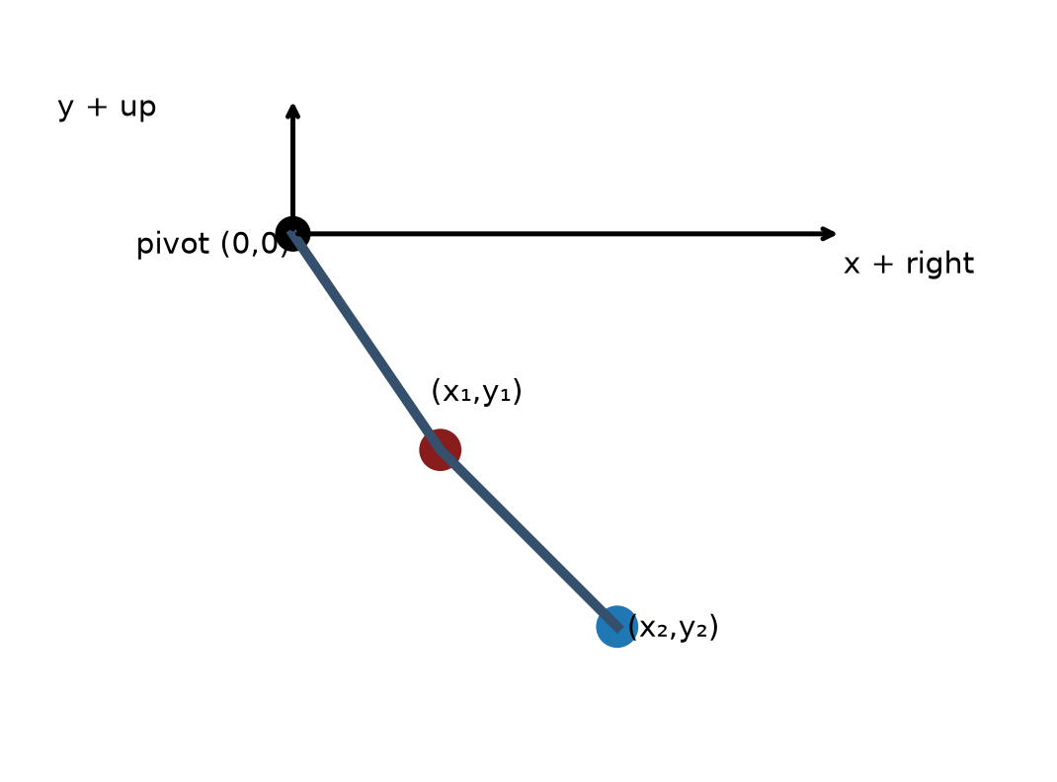
MIE 402 | ME LAB II
28–30 min
From video to two trajectories
• Select Double Pendulum in Pendulum Motion Analyzer V4.
• Enter capture frame rate and known calibration distance between black marks.
• Locate fixed pivot and centers of both bobs in first frame.
• Quick Review first; rerun setup if >10% are missing, then analyze all frames.
14

Slide 15
MIE 402 | ME LAB II
30–32 min
What the MAT file contains
• ExpData: time [s], x₁ [mm], y₁ [mm], x₂ [mm], y₂ [mm].
• App coordinates are relative to pivot: x is right-positive, y is up-positive.
• The lower-link vector is (x₂−x₁, y₂−y₁).
• Inspect one saved file before leaving; preserve the raw MP4 as well.
15

Slide 16
MIE 402 | ME LAB II
32–34 min
Convert tracked positions to angles
From the app’s pivot-relative, right-positive and up-positive coordinates:
Both angles should be near zero when both links hang down. Check one known frame and sign before processing all trials.
16

Slide 17
MIE 402 | ME LAB II
34–36 min
Velocity and frequency: what can we trust?
• Angular velocity is the slope of the angle trace; missing points and jitter can amplify noise.
• FFT displays frequencies present in a finite record; subtract the mean first.
• A coupled pendulum need not have a single “pendulum frequency.”
• Use spectra to compare dominant components; inspect time traces and record duration too.
17

Slide 18
MIE 402 | ME LAB II
36–39 min
Compare measured and simulated motion
• Use measured masses, lengths, initial angles, and approximate initial speeds.
• Overlay θ₁(t) and θ₂(t) for each trial; compare early timing and shape.
• For large-angle trials, focus on short-time agreement and qualitative behavior.
• Explain discrepancies: release push, calibration, friction, air drag, out-of-plane motion.
18

Slide 19
MIE 402 | ME LAB II
39–41 min
What model omits
• The required baseline model has no damping. Real pivots and moving links lose energy.
• Amplitude decay is observable, but one recording cannot isolate air drag from pivot friction.
• Joint hardware is treated as a lumped mass; real bars and hardware are not perfectly uniform.
• Do not tune damping to make one plot look good without documenting a new model.
19

Slide 20
MIE 402 | ME LAB II
41–43 min
Pre-Lab 3: different from last year
• No student coding: run supplied Colab cells and answer in Word/PDF.
• Compare a low-angle release with two near-identical large-angle starts.
• Predict which trace is simpler; quantify divergence and inspect both angle spectra.
• Explain why model mismatch does not automatically mean a tracking error.
20

Slide 21
MIE 402 | ME LAB II
43–46 min
In the lab: a practical sequence
• 1 Measure parts; log which hardware belongs to which link/bob.
• 2 Set camera, calibrate, frame, focus, and record four releases.
• 3 Save MP4; in app select Double Pendulum and Quick Review.
• 4 Analyze full video, save MAT, make trial plots; show one complete set to GTA.
21

Slide 22
MIE 402 | ME LAB II
46–48 min
Before leaving: evidence checklist
• Four trial labels with measured initial conditions.
• Masses and lengths with units; capture fps and calibration distance.
• Raw MP4 and ExpData MAT for each trial.
• For one trial: two angle traces, two angular-velocity traces, and spectra checked with GTA.
22

Slide 23
MIE 402 | ME LAB II
48–50 min
Question for discussion
• If θ₁ and θ₂ start almost equal, must they remain equal?
• What extra observation distinguishes a bad tracking trace from real coupling?
• Which parameter in the model changes if you add washers to the lower bob?
• Use the pre-lab to test your answer before Lab 3.
23

