Slide 1

MIE 402 | ME LAB II
0-2 min
Lab 2: measuring a single pendulum
From high-speed video to a defensible model comparison
Physical model, finite-angle behavior, camera measurement, tracking, and Pre-Lab 2.

Slide 2
MIE 402 | ME LAB II
2-4 min
What you will do in Lab 2
Release pendulum from rest at three angle ranges.
Record motion with high-speed camera.
Track bob and convert x(t), y(t) into theta(t).
Compare period and frequency with model.

Slide 3
MIE 402 | ME LAB II
4-6 min
Physical system and coordinate
M: bob and attached hardware mass
m: uniform bar mass
l: pivot-to-bob-center distance
theta(t): angle from downward vertical
omega(t) = dtheta/dt; every release begins with omega(0) = 0.

Slide 4
MIE 402 | ME LAB II
6-8 min
Ideal point-mass pendulum
M l^2 theta_double_dot = -M g l sin(theta)
theta_double_dot + (g/l) sin(theta) = 0
Gravity drives the bob toward theta = 0.
The sine term makes exact motion nonlinear.
M cancels only because this ideal model treats the bar as massless.

Slide 5
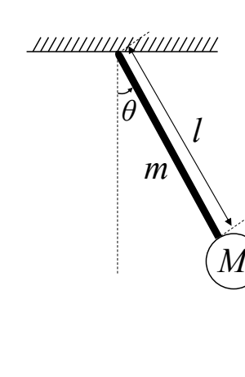
MIE 402 | ME LAB II
8-11 min
The bar mass changes the model
Moment of inertia about the pivot
I = M l^2 + m l^2 / 3
Gravity torque
tau_g = -(M g l + m g l / 2) sin(theta)
The bob acts at l. The uniform bar acts through its center of mass at l/2.

Slide 6
MIE 402 | ME LAB II
11-13 min
Compound-pendulum equation
(M l^2 + m l^2/3) theta_double_dot + (M g l + m g l/2) sin(theta) = 0
Small angle: omega_n^2 = g(M + m/2) / [l(M + m/3)]
Measure M, m, and l for the apparatus.
sqrt(g/l) applies only when bar mass is negligible.
Mass distribution changes inertia and gravity torque by different amounts.

Slide 7
MIE 402 | ME LAB II
13-15 min
Why large initial angle changes period
At large angle, sin(theta) differs from theta.
Exact restoring torque is weaker than the linear model predicts at the same angle.
Finite-angle motion takes longer to complete a cycle.
Use the nonlinear equation from Pre-Lab 2 for all three releases.

Slide 8
MIE 402 | ME LAB II
15-17 min
Energy during a swing
E = 1/2 (M l^2 + m l^2/3) omega^2 + (M g l + m g l/2)(1 - cos(theta))
At release theta is largest and omega = 0.
Near the bottom theta = 0 and speed is largest.
Air drag and pivot friction cause measured amplitude and energy to decrease.

Slide 9
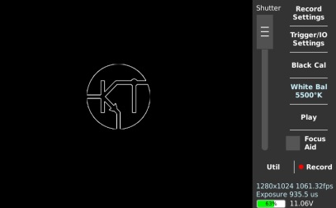
MIE 402 | ME LAB II
17-19 min
What the camera actually measures
Camera stores frames, not angle directly.
Every frame contains pivot and bob positions.
Useful record needs full motion in frame, sharp contrast, and visible bob center.
Frame rate becomes time spacing of measurement.

Slide 10
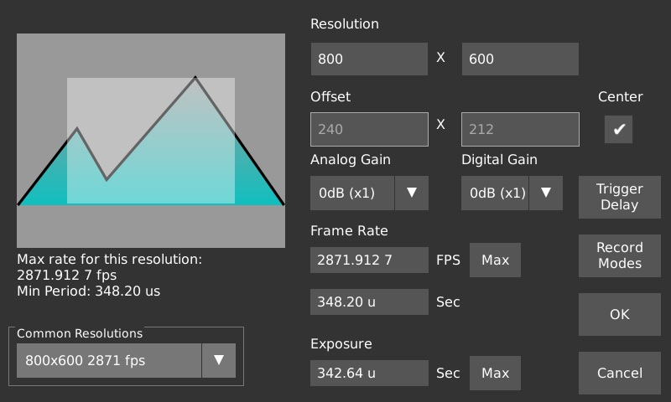
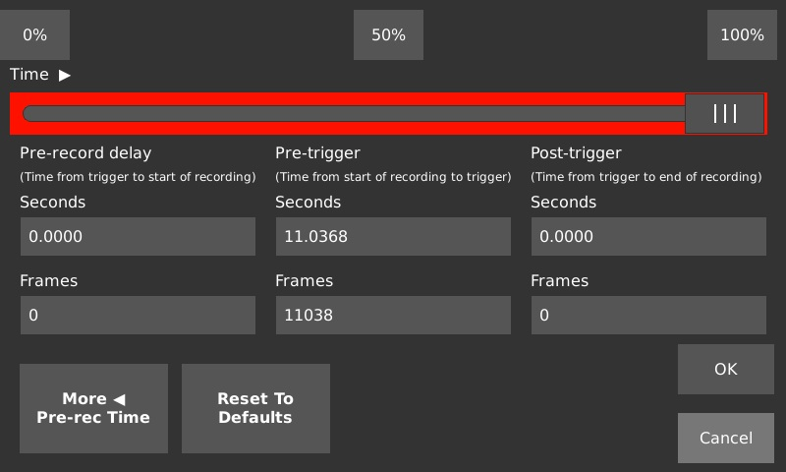
MIE 402 | ME LAB II
19-21 min
Camera settings and useful video
Record actual frame rate.
Use trigger delay that includes release and cycles.
Test framing before experiment.
Smooth video does not prove accurate tracking.

Slide 11
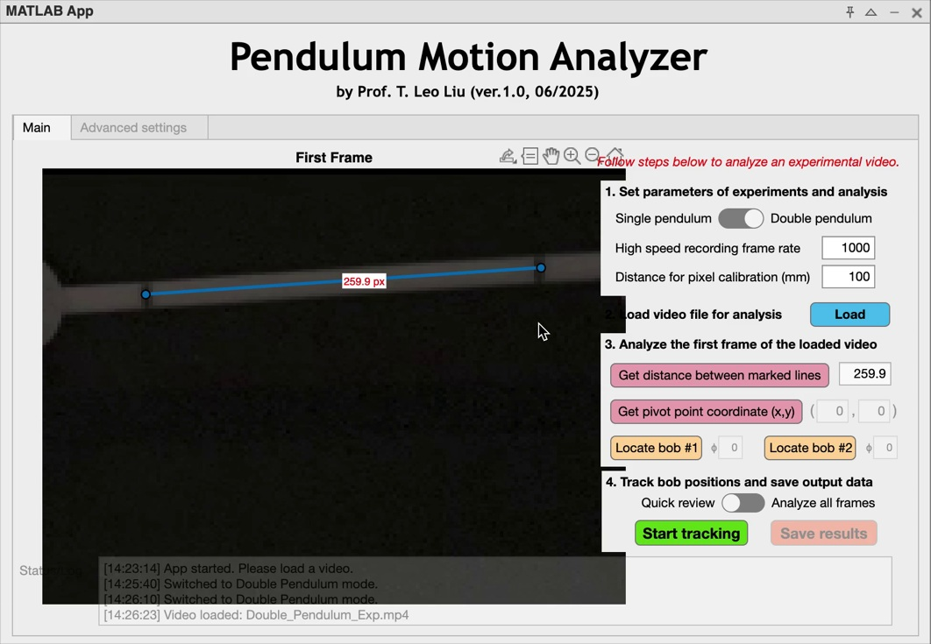
MIE 402 | ME LAB II
21-23 min
From pixels to coordinates
Calibration marks have known separation, normally 100 mm.
Calibration gives pixel-to-millimeter scale.
Do not move camera or change zoom after calibration.
App saves time and bob coordinates.

Slide 12
MIE 402 | ME LAB II
23-25 min
From coordinates to a signed angle
theta(t) = atan2( xb - xp, yb - yp )
For image coordinates, x points right and y points down.
The formula gives theta = 0 when the bob is directly below the pivot.
Verify zero and sign using one known frame before batch analysis.
Use radians for modeling and derivatives.

Slide 13
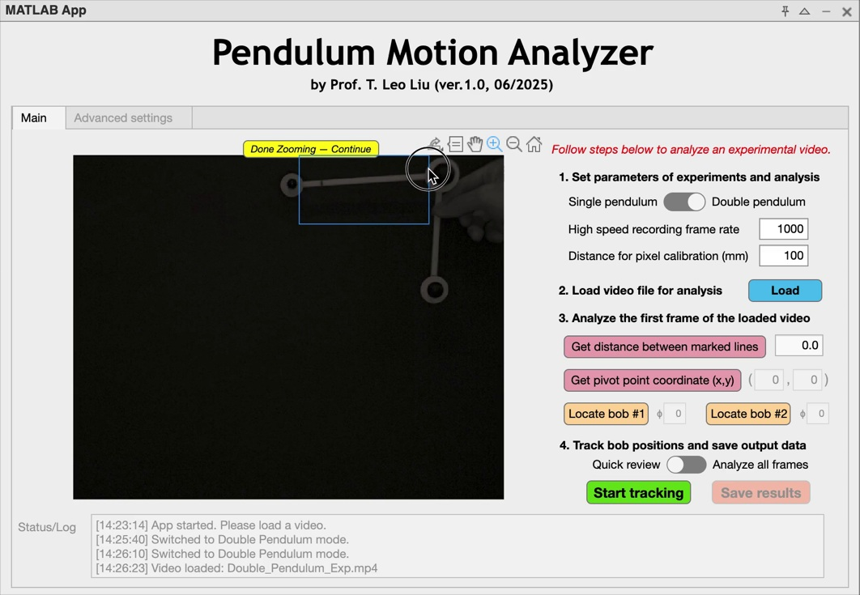
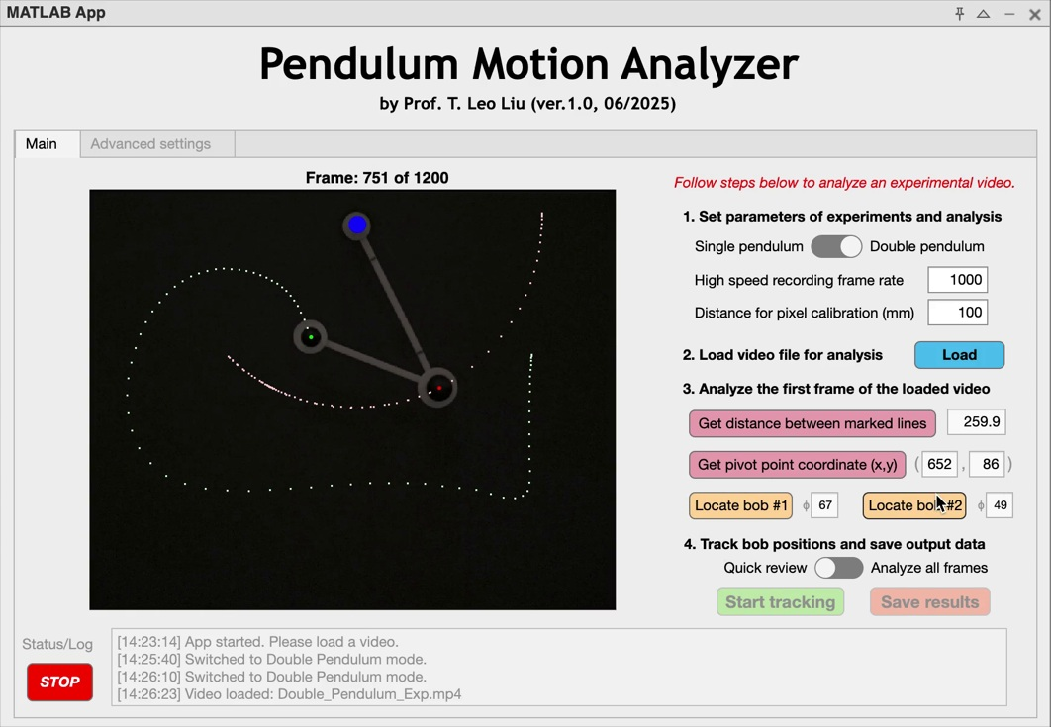
MIE 402 | ME LAB II
25-28 min
Tracking workflow in MATLAB
Select Single pendulum.
Enter actual camera frame rate.
Calibrate, select pivot and bob, then Quick Review.
Run Analyze All Frames only after marker follows bob.

Slide 14
MIE 402 | ME LAB II
28-30 min
Why frame rate belongs in report
At 1000 frames/s: Nyquist frequency = 500 Hz
For l = 0.82 m, one cycle contains roughly 1800 frames.
The rate greatly exceeds the Nyquist minimum for the pendulum.
Wrong frame rate gives wrong time, frequency, and angular velocity.

Slide 15
MIE 402 | ME LAB II
30-32 min
Angular velocity and noise
omega(t) = d theta(t) / dt
Differentiation magnifies frame-to-frame error.
Inspect theta(t) before interpreting omega(t).
State smoothing method and show it does not hide tracking problems.
Maximum speed occurs near the bottom.

Slide 16
MIE 402 | ME LAB II
32-34 min
Period from time history and spectrum
Time domain: measure several cycles between same-direction peaks.
Frequency domain: remove mean, compute FFT, identify dominant peak.
Bin spacing Delta f = 1/T_record.
Time-domain period and spectral frequency should agree within resolution.
f = number of cycles / elapsed time
Delta f = 1/T_record

Slide 17
MIE 402 | ME LAB II
34-36 min
Lab 2 trial matrix
Trial A: theta0 below 10 degrees. Closest test of small-angle theory.
Trial B: theta0 from 10 to 90 degrees. Observe period change.
Trial C: theta0 from 90 to 180 degrees. Expect strong nonlinearity; keep bob in frame.
All releases start from rest. Record theta0 from protractor.

Slide 18
MIE 402 | ME LAB II
36-38 min
Data quality before accepting video
Bob remains in frame.
Bob edge and center are visible without glare.
Pivot and calibration marks are visible.
Release begins from rest.
Quick Review follows bob for nearly all frames.
Notes include file name, angle, frame rate, and calibration distance.

Slide 19
MIE 402 | ME LAB II
38-41 min
Pre-Lab 2: what you submit
One Word or PDF before laboratory section.
Task 1: compare point-mass and compound-pendulum frequencies.
Task 2: predict behavior before running the supplied simulation.
Task 3: estimate periods and explain finite-angle behavior.
Tasks 4-6: explain coordinates, frame rate, and the laboratory plan.

Slide 20
MIE 402 | ME LAB II
41-44 min
Evidence for combined Lab 2 and 3 report
Schematic: pivot, l, M, m, theta, and positive direction.
Table: measured parameters and analytical, nonlinear, time-domain, and FFT frequencies.
Plots: theta(t), omega(t), and spectra with units.
Discussion: separate model limitations from measurement errors.

Slide 21
MIE 402 | ME LAB II
44-47 min
In-class prediction
For the same apparatus, which release has the longest period?
A. 8 degrees
B. 35 degrees
C. 105 degrees
Explain using the exact sine restoring torque.

Slide 22
MIE 402 | ME LAB II
47-49 min
Before leaving laboratory
Save and back up every video and MAT output.
Verify tracking for every trial.
Record initial angle, frame rate, calibration distance, l, M, m, and file names.
Check one theta(t) plot and one spectrum with the GTA.

Slide 23
MIE 402 | ME LAB II
49-50 min
Key ideas for Lab 2
The real apparatus is a compound pendulum because the bar has mass.
Initial angle changes the nonlinear period.
Camera coordinates require calibration, a fixed pivot, and a verified sign convention.
Compare analytical theory, nonlinear simulation, time history, and spectrum.

