Slide 1
MIE 402 | MECHANICAL ENGINEERING LABORATORY II
Orientation and
report writing
MEASURE
MODEL
COMPARE
Fall 2026 · Prof. Ehsan Roohi September 9, 2026
Notes:
TIME: 0–1 minutes (1 minutes)
Welcome students. Today prepares you to collect useful evidence and write the four reports required this semester. Ask: If two groups report different frequencies for the same apparatus, what information would help you decide whether either result is trustworthy? Take two brief answers. Explain that the session includes a tour of all six experiments, a detailed report walkthrough, and a short exercise. The report template and syllabus are available on the course site.
SOURCE: Syllabus_MIE402_Fall26_6Labs.pdf and supplied Lecture 01
Report instructions: Template for MIE 402 Report.docx. Teaching examples labeled illustrative use invented values.

Slide 2
MIE 402 | ME LAB II
Experimental evidence and engineering judgment
01
02
03
04
OBSERVE
→
MEASURE
→
COMPARE
→
COMMUNICATE
See the physical behavior worth explaining
Acquire data with a deliberate measurement system
Test data against theory and models
Write a report another engineer can trust
The goal is not merely to collect numbers. The goal is to make a claim that the data support.
2
Notes:
TIME: 1–1.5 minutes (0.5 minutes)
Connect the four stages to the opening question. A believable number needs a measurement method, units, a model with stated assumptions, and an estimate of what might change the conclusion. The report is the record of that reasoning.
SOURCE: Syllabus_MIE402_Fall26_6Labs.pdf and supplied Lecture 01
Report instructions: Template for MIE 402 Report.docx. Teaching examples labeled illustrative use invented values.

Slide 3
MIE 402 | ME LAB II
Today’s 50-minute session
01
0–8 min: course organization and workflow
02
8–23 min: experiments, apparatus, and analysis
03
23–42 min: report writing and comparison
04
42–48 min: policies and report exercise
05
48–50 min: first dates and preparation
3
Notes:
TIME: 1.5–2 minutes (0.5 minutes)
Preview the timing. The six experiment introductions explain the apparatus, main data-collection steps, expected analysis, and report evidence. Detailed operating procedures and pre-lab requirements come with each experiment. Reserve the exercise time so students practice the distinction between reporting an observation and explaining it.
SOURCE: Syllabus_MIE402_Fall26_6Labs.pdf and supplied Lecture 01
Report instructions: Template for MIE 402 Report.docx. Teaching examples labeled illustrative use invented values.

Slide 4
MIE 402 | ME LAB II
People, places, and weekly rhythm
COURSE TEAM
WEEKLY RHYTHM
Prof. Ehsan Roohi
Yuyuan Zhang
Nazila Emamdoost
MON
Theory • 12:20–1:10 PM
Hasbrouck Laboratory 134
TUE–FRI
Laboratory sections
Gunness Laboratory 5
FRI
Office hours • 12:20–1:10 PM
Gunness Laboratory 1
Check Canvas for your assigned section, GTA, and any section-specific updates.
4
Notes:
TIME: 2–4 minutes (2 minutes)
Introduce the two GTAs, Yuyuan Zhang and Nazila Emamdoost. Ask students to check their own section and GTA in Canvas. September 9 is a one-time Wednesday orientation. Regular theory meetings are on Mondays. There is no regular Wednesday theory meeting. Explain the difference between the 50-minute theory meeting and the scheduled laboratory section. General questions belong in lecture, individual questions in office hours, and email is appropriate when those options are not practical.
SOURCE: Syllabus_MIE402_Fall26_6Labs.pdf and supplied Lecture 01
Report instructions: Template for MIE 402 Report.docx. Teaching examples labeled illustrative use invented values.

Slide 5
MIE 402 | ME LAB II
Course grading
100%
Preparation + reports + participation
The combined reports reward synthesis across related experiments.
5
Notes:
TIME: 4–6 minutes (2 minutes)
Reports account for 75% of the course grade, six pre-labs account for 20%, and participation accounts for 5%. There are four report submissions, not six separate reports. Each combined report should connect its two experiments. Distinguish these course weights from the report rubric: the rubric allocates ten equally weighted criteria within each report. Pre-labs prepare the theory and analysis needed for a productive lab session. Report dates are tentative and Canvas carries updates.
SOURCE: Syllabus_MIE402_Fall26_6Labs.pdf and supplied Lecture 01
Report instructions: Template for MIE 402 Report.docx. Teaching examples labeled illustrative use invented values.

Slide 6
MIE 402 | ME LAB II
The laboratory workflow
PRE-LAB
LAB
ANALYSIS
REPORT
Build the theory and analysis tools before arriving
→
Acquire data, check quality, and document the method
→
Process data, quantify uncertainty, compare cases
→
Make a clear claim and support it with evidence
Pre-labs are due before your own laboratory section begins.
6
Notes:
TIME: 6–7 minutes (1 minutes)
Walk through a concrete example: before the pendulum lab, establish the equation and expected period. During the lab, record the initial angle, geometry, frame rate, and motion. Afterward, keep raw data unchanged and use a traceable analysis to generate the report figures. Check at least one data set before leaving the laboratory so a missing file or poor recording does not become a report-writing problem.
SOURCE: Syllabus_MIE402_Fall26_6Labs.pdf and supplied Lecture 01
Report instructions: Template for MIE 402 Report.docx. Teaching examples labeled illustrative use invented values.

Slide 7
MIE 402 | ME LAB II
Six experiments and four reports
Lab | Experiment | Primary focus | Report
1 | Dynamic data sampling | Sampling, aliasing, spectra | Lab 1
2 | Single pendulum | Dynamic response, model–data | Labs 2+3
3 | Double pendulum | Coupled and nonlinear motion | Labs 2+3
4 | 1-DOF free response | Natural frequency, damping | Labs 4+5
5 | 1-DOF forced response | Resonance, frequency response | Labs 4+5
6 | Radiometer | Movement measurement | Lab 6
7
Notes:
TIME: 7–8 minutes (1 minutes)
Use the Fall 2026 numbering. Lab 6 is the radiometer. Older course files use Lab 6 for a different apparatus, so direct students to the current Canvas release. The sequence begins with the reliability of measurements, continues through simple and coupled dynamics, and ends with rotation driven by thermal effects. The next twelve slides describe the measurement question and report evidence for each experiment.
SOURCE: Syllabus_MIE402_Fall26_6Labs.pdf and supplied Lecture 01
Report instructions: Template for MIE 402 Report.docx. Teaching examples labeled illustrative use invented values.

Slide 8
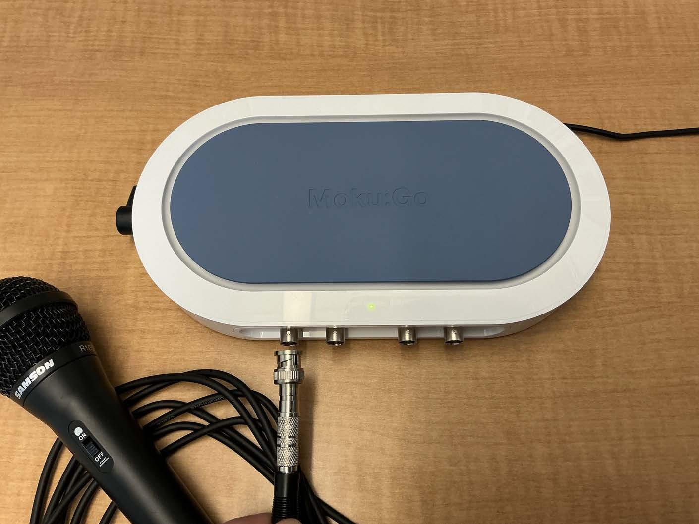
MIE 402 | ME LAB II
Lab 1: Recording sound
The question
How often must we measure a sound to record its frequency correctly?
The equipment
The microphone turns sound into voltage. Moku:Go records that voltage as numbers.
What you do
Record several sounds. For a steady tone, repeat the recording at different sampling rates.
Moku:Go data logger connected to a microphone
8
Notes:
TIME: 8–9.25 minutes (1.25 minutes)
Point to the microphone and its cable in the photo. Sound is a changing pressure; the microphone turns that change into a changing voltage. The logger stores voltage values at regular times. Sampling rate means the number of stored measurements per second. Frequency means the number of sound cycles per second. These are different quantities, although both can be expressed per second. Students record at least three sounds and at least one second of data per recording. Use a tone with a known frequency to demonstrate the sampling-rate ratios in the procedure: 100f, 10f, 3f, 1.4f, and 1f. A finger snap contains many frequencies, so it is a useful comparison but does not have one steady tone frequency. Ask: If we measure a rapidly changing signal only occasionally, what information might we miss?
SOURCE: LAB1_MIE402.pdf; photo: Lecture Notes/4_Lab1_Exp.pdf, page 10
Report instructions: Template for MIE 402 Report.docx. Teaching examples labeled illustrative use invented values.

Slide 9
MIE 402 | ME LAB II
Lab 1: A recording can show the wrong frequency
Two useful plots
A waveform shows voltage versus time. A frequency spectrum shows which frequencies are present; MATLAB can calculate it with an FFT.
What to look for
With too few samples per cycle, the signal can appear to have a lower frequency. This is called aliasing.
What goes in the report
Compare recordings with their actual sampling rates and durations. Explain which settings gave a reliable frequency estimate.
Saving as MAT makes the measurements easy to load in MATLAB. Changing the file format does not fix a poor recording.
9
Notes:
TIME: 9.25–10.5 minutes (1.25 minutes)
Use this simple example: a 100 Hz tone completes 100 cycles in one second. At 1000 samples/s, there are ten measurements per cycle. At 150 samples/s, the recorded values can instead look like a 50 Hz signal. These are illustrative numbers, not results from this apparatus. Save or convert the data to MAT, load the measurements, and plot voltage against time. If playback is available, play each recording using its actual sampling rate. A poorly sampled tone may sound different because the stored values describe the wrong frequency. Do not call every audible difference aliasing: using the wrong playback rate also changes pitch. A longer recording helps distinguish close frequencies in the spectrum, but it does not repair sampling that was too slow. The ideal minimum rate is more than twice the highest frequency we want to represent; real measurements may need filtering and a larger margin. Ask: Would recording for longer fix an inadequate sample rate? No.
SOURCE: LAB1_MIE402.pdf
Report instructions: Template for MIE 402 Report.docx. Teaching examples labeled illustrative use invented values.

Slide 10
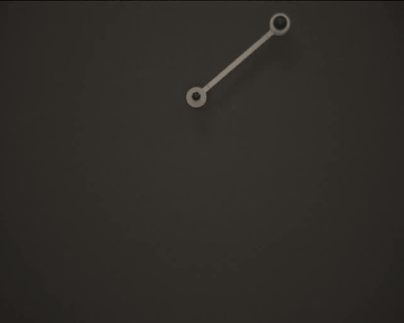
MIE 402 | ME LAB II
Lab 2: One pendulum
The question
Does a pendulum take the same time to swing when we release it from a larger angle?
The equipment
A pendulum, a high-speed camera, lighting, and a length reference. The camera records the moving rod.
What you do
Release it without pushing. Record small, medium, and large starting angles. Track its position in MATLAB.
Single pendulum recorded by the high-speed camera
10
Notes:
TIME: 10.5–11.75 minutes (1.25 minutes)
Explain period first: it is the time for one complete back-and-forth swing. The camera records images at known time intervals. The tracking app follows the moving end of the pendulum, then uses the pivot location to calculate angle. A scale reference converts pixels into distances where needed. The supplied procedure uses a high-speed camera setting of 1000 frames/s and releases below 10 degrees, between 10 and 90 degrees, and between 90 and 180 degrees. Read the actual capture rate from the recording; a slow-motion playback rate is different. Keep the background dark and the pendulum in focus. Record the initial angle and release without an extra push. The source photo shows the pendulum itself; the camera and light are additional parts of the measurement setup. Ask students to predict what a larger release angle will do to the period.
SOURCE: LAB2_MIE402.pdf; photo: LAB2_MIE402.pdf, page 4
Report instructions: Template for MIE 402 Report.docx. Teaching examples labeled illustrative use invented values.

Slide 11
MIE 402 | ME LAB II
Lab 2: Comparing the swing with a model
The measurements
Plot angle versus time. Measure the period over several swings and check whether the swing size decreases.
The model
The small-angle model simplifies the equation of motion. Compare it with the full model as the release angle increases.
What goes in the report
Overlay measured and predicted angles. Compare their periods and explain how the starting angle changes the agreement.
Use the same starting angle, angle direction, and time origin in the measurement and simulation.
11
Notes:
TIME: 11.75–13 minutes (1.25 minutes)
Show how the period comes from a plot: choose a clear peak and a later peak, measure the elapsed time, then divide by the number of complete cycles between them. For example, ten cycles in eight seconds would give a period of 0.8 s; these are invented teaching values. The small-angle approximation replaces sin(theta) by theta when the angle is expressed in radians. At larger angles that shortcut becomes less accurate, and the ideal pendulum period increases. The real rod has distributed mass, so use the physical pendulum inertia and center-of-mass distance rather than treating its full mass as a point at the end. The report should also include the required angular-velocity and frequency plots. Keep any filtering or differentiation method in the analysis description because tracking noise can become larger in velocity. If the swing size decreases, discuss friction and air resistance. Inspect tracking early; an incorrect pivot or camera rate can spoil every later calculation.
SOURCE: LAB2_MIE402.pdf
Report instructions: Template for MIE 402 Report.docx. Teaching examples labeled illustrative use invented values.

Slide 12
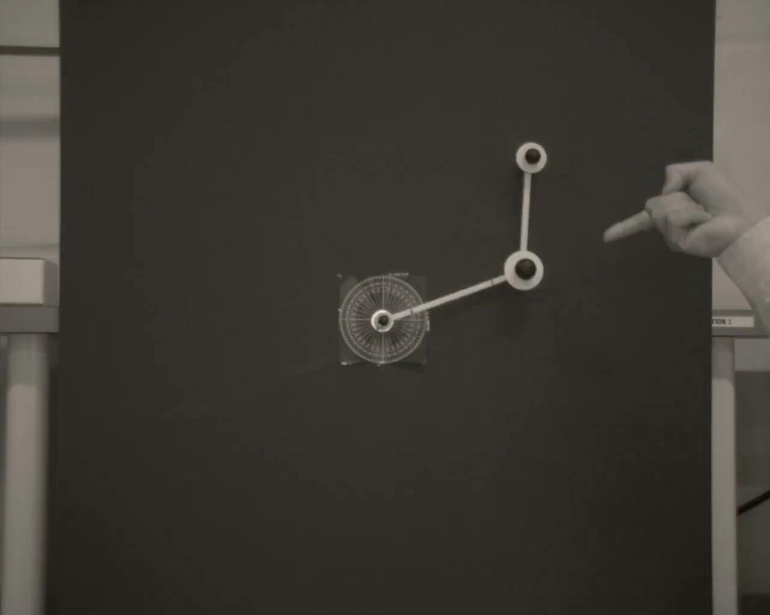
MIE 402 | ME LAB II
Lab 3: Two connected pendulums
The question
How does adding a second moving link change the motion and our ability to predict it?
The equipment
Two connected links, a high-speed camera, and a tracking app that follows both moving joints.
What you do
Record one small-angle case and at least three large-angle cases. Write down both starting angles before each release.
Two-link pendulum during release
12
Notes:
TIME: 13–14.25 minutes (1.25 minutes)
Point out the fixed pivot, the middle joint, and the lower moving end in the photo. The first link moves the pivot of the second link, so each link influences the other. This is what coupled motion means. Track both moving points and record both initial angles; one starting angle is not enough to describe the release. The procedure includes one small-angle, approximately collinear release and at least three large-angle cases. Keep the motion in the plane viewed by the camera. Define the angle of the lower link from the line connecting the middle joint to the lower end; measuring that line from the fixed top pivot would give the wrong angle. Ask: What additional measurements do we need now that there are two links?
SOURCE: LAB3_MIE402.pdf; photo: Lecture Notes/9_Lab3_Exp.pdf, page 7
Report instructions: Template for MIE 402 Report.docx. Teaching examples labeled illustrative use invented values.

Slide 13
MIE 402 | ME LAB II
Lab 3: Two angle records to explain
The measurements
Plot each link’s angle versus time. Notice how the two links speed up, slow down, and influence one another.
The comparison
Start the simulation with the measured angles. Compare both links over the same time interval.
What goes in the report
Show where the predictions agree and where they separate from the measurements. Check release conditions and tracking before explaining the difference.
A small difference at release can grow during large motion. An irregular-looking trajectory alone does not prove chaos.
13
Notes:
TIME: 14.25–15.5 minutes (1.25 minutes)
With a single pendulum we follow one angle; now we follow two angles and solve their equations together. Small motions can show more than one characteristic frequency. Large motions can be much more sensitive to the starting state. Explain sensitivity in plain language: two releases that look almost identical can later produce noticeably different positions. That observation does not by itself prove that the apparatus is chaotic. First check both initial angles, any accidental push, frame timing, and whether the tracking app followed the correct objects. Friction and uncertain mass properties can also affect the comparison. Include the required angular velocities and spectra, but choose figures that answer a clear question. In the combined Labs 2 and 3 report, explain what the second link changes rather than simply joining two unrelated documents.
SOURCE: LAB3_MIE402.pdf
Report instructions: Template for MIE 402 Report.docx. Teaching examples labeled illustrative use invented values.

Slide 14
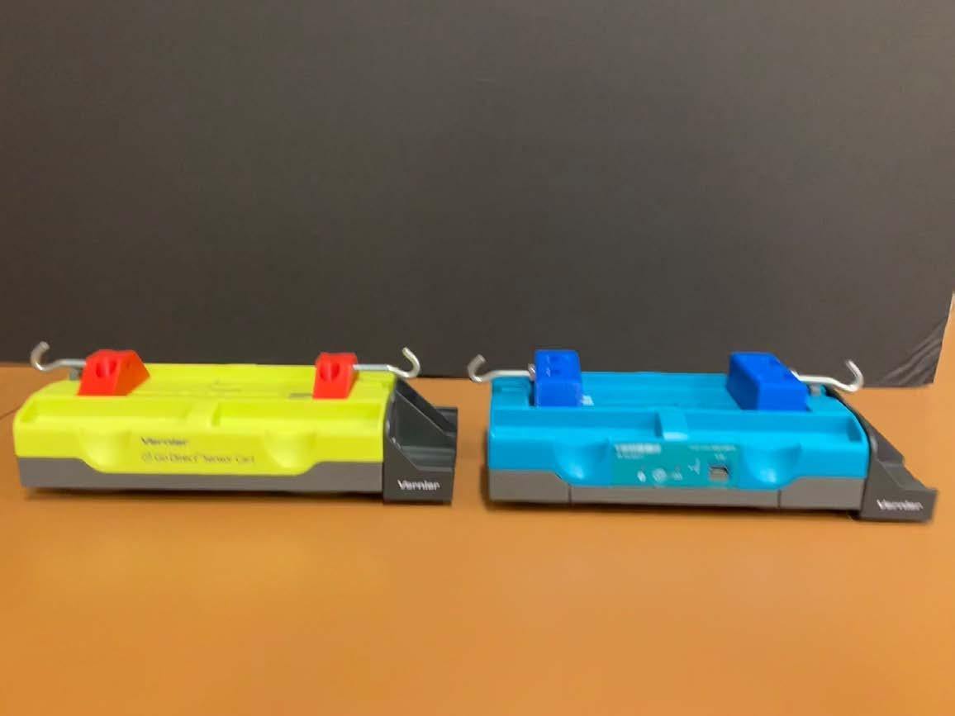
MIE 402 | ME LAB II
Lab 4: A cart released between springs
The question
What controls how fast the cart moves back and forth, and how quickly that motion dies away?
The equipment
A cart on a track, springs, added masses, and magnetic brakes. A sensor records the cart position.
What you do
Measure mass and spring stiffness. Pull the cart away from rest and let go. Repeat after changing one setting at a time.
Vernier carts with added masses
14
Notes:
TIME: 15.5–16.75 minutes (1.25 minutes)
The photo shows the Vernier carts and added masses used in the course. In this experiment the cart sits on a track between springs. It moves along one direction, so we call it a system with one degree of freedom. Free response means that after the release we stop driving it; the stored spring energy starts the motion. The magnetic brakes reduce the motion without a pad rubbing on the cart. Damping is the process by which the motion dies away as energy is lost. Measure the actual mass and spring stiffness rather than assuming the nominal values are exact. Zero position at equilibrium and keep the initial pull small enough for the specified setup. The procedure uses at least seven cases: a base case, two mass changes, two damping changes, and two spring changes. Ask students to predict which change will make the motion slower.
SOURCE: LAB4_MIE402.pdf; photo: Lecture Notes/13_Lab4_Exp.pdf, page 8
Report instructions: Template for MIE 402 Report.docx. Teaching examples labeled illustrative use invented values.

Slide 15
MIE 402 | ME LAB II
Lab 4: Swing time and fading motion
Two features of the plot
Peak spacing gives the period. The decrease in peak height shows how quickly the motion dies away.
Expected trends
More mass usually gives slower motion. Stiffer springs give faster motion. More damping makes the peaks decrease faster.
What goes in the report
Compare the cases using measured frequency and damping. State exactly what changed and connect each trend to the model.
Keep other settings fixed when making a comparison. Include the mass of added brake parts in the total moving mass.
15
Notes:
TIME: 16.75–18 minutes (1.25 minutes)
Sketch the meaning verbally: the distance between two successive positive peaks along the time axis is one period. The heights of those peaks decrease as the cart loses energy. Frequency is the number of cycles per second, the reciprocal of the period. Estimate damping from how the peak heights decrease, using the method taught with this lab. For a fixed mass, greater effective stiffness raises the natural frequency. For a fixed stiffness, greater mass lowers it. The simple relation is natural angular frequency equals the square root of effective stiffness divided by mass. If springs act on both sides of the cart, include both contributions. Magnetic brake parts can add mass as well as damping, so the report must account for both changes. Use the assigned sampling settings, no more than 25 Hz in the supplied procedure, and inspect the exported CSV. The combined Labs 4 and 5 report can use these parameter estimates to help predict driven motion, provided the configuration is comparable.
SOURCE: LAB4_MIE402.pdf
Report instructions: Template for MIE 402 Report.docx. Teaching examples labeled illustrative use invented values.

Slide 16
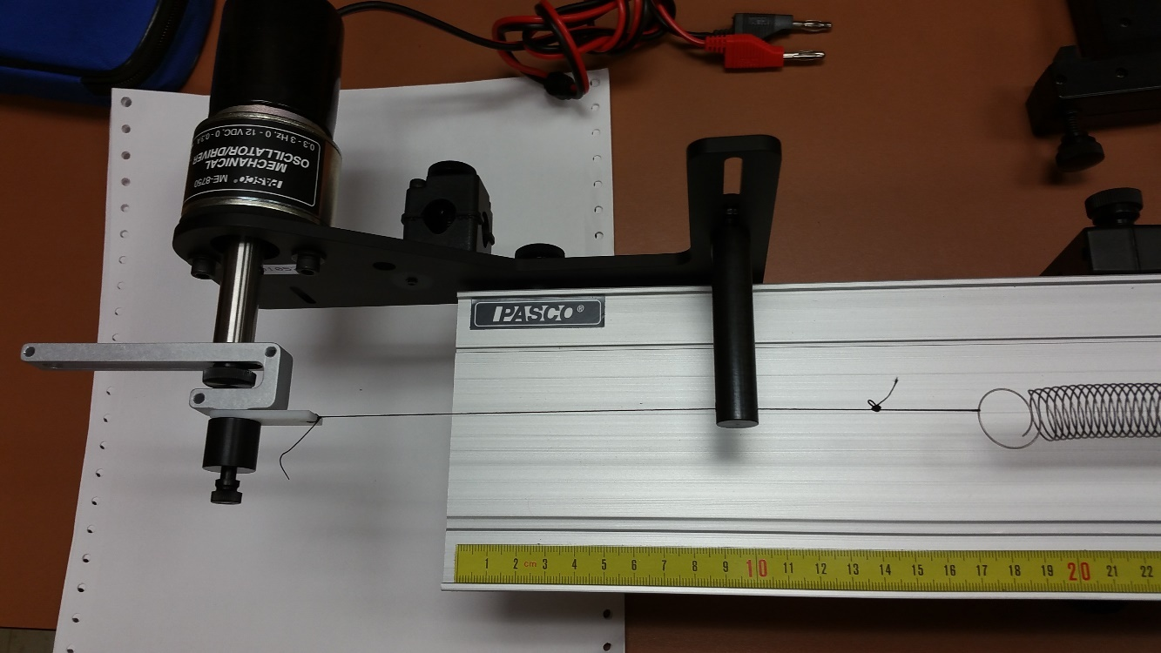
MIE 402 | ME LAB II
Lab 5: A cart driven by a motor
The question
Why can the cart move much farther at some driving speeds than at others?
The equipment
A motor moves one spring end back and forth. The cart records position; a tachometer measures motor speed.
What you do
Compare three brief pushes. Then drive the cart at several speeds below and above its strongest response.
Motor and spring drive from an earlier course setup
16
Notes:
TIME: 18–19.25 minutes (1.25 minutes)
The photograph shows the motor and spring drive from the earlier course materials. It illustrates the drive mechanism; follow the current Vernier procedure for the cart and data-acquisition details. The experiment first compares three impulse strengths without magnetic brakes. An impulse is a brief push; the cart then moves freely. In the second part, a motor continues moving one spring end, repeatedly supplying energy. That sustained input makes this a forced response. Use the assigned magnetic brakes for the driven tests. The tachometer measures revolutions per minute, which gives the driving frequency after conversion. Explain resonance as the range of driving frequencies where the cart response becomes large. Avoid running there for a long time. Ask: How is this different from pulling the cart once and letting go?
SOURCE: LAB5_MIE402.pdf; photo: Yahya's Files/402 files/05. Lab 3 1 DOF Vibrations.pptx, ppt/media/image39.jpeg
Report instructions: Template for MIE 402 Report.docx. Teaching examples labeled illustrative use invented values.

Slide 17
MIE 402 | ME LAB II
Lab 5: Response at different driving speeds
After each speed change
Wait until the motion settles into a repeating pattern. Measure the spring-end motion and the cart motion.
The main graph
Plot cart amplitude divided by input amplitude against driving frequency. A peak indicates resonance.
What goes in the report
Compare the measured curve with the model. Explain how mass, spring stiffness, and damping affect the response.
Amplitude means the distance from the middle position to a peak. Keep peak and peak-to-peak measurements consistent.
17
Notes:
TIME: 19.25–20.5 minutes (1.25 minutes)
After changing speed, the initial motion may mix with the driven motion. Wait approximately one to two minutes as directed, then use the steady repeating portion. Record several frequencies below resonance and several above it; the procedure asks for three to five on each side. Measure input amplitude at each frequency because a constant motor setting does not guarantee the same spring-end motion. Gain means output amplitude divided by input amplitude. For an illustrative input amplitude of 1 cm and cart amplitude of 3 cm, gain is 3. The required Bode magnitude plot may express this as 20 log10(gain), in decibels. The source manual does not require a phase plot for this activity. This apparatus moves a spring end, so the input is a displacement. Use the corresponding model with k2 times the input displacement on the right-hand side, and k1+k2 as total stiffness. Do not use an applied-force transfer function without accounting for that distinction. Include three impulse records as well as the driven-response curve in the combined report.
SOURCE: LAB5_MIE402.pdf
Report instructions: Template for MIE 402 Report.docx. Teaching examples labeled illustrative use invented values.

Slide 18
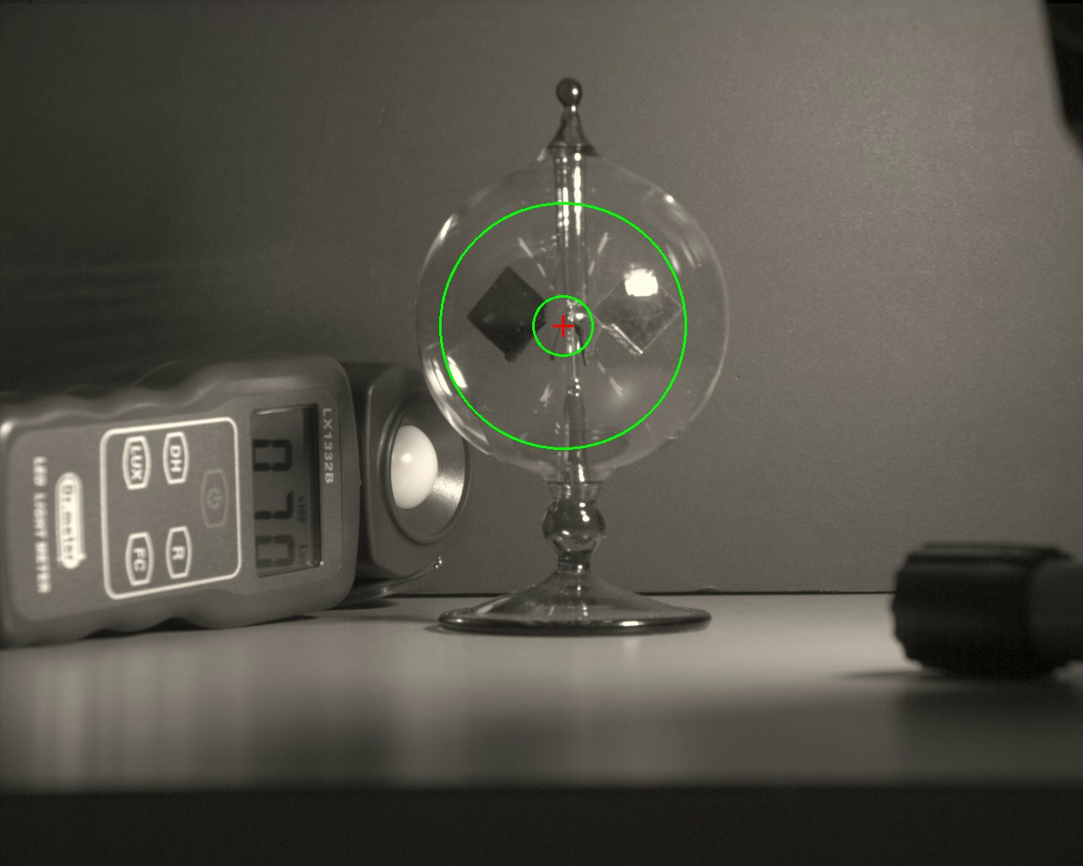
MIE 402 | ME LAB II
Lab 6: A radiometer under light
The question
How fast do the vanes turn under the light, and does that speed change as the device warms?
The equipment
A glass radiometer, LED light, light meter, fixed camera, and dark background.
What you do
Keep the setup still. Record a clear 60–90 second video and note light level, distance, and whether the device is already warm.
Radiometer and light meter; green rings mark the tracking region
18
Notes:
TIME: 20.5–21.75 minutes (1.25 minutes)
Point out the vanes inside the glass bulb and the nearby light meter. The two sides of each vane absorb light differently and reach different temperatures. The low-pressure gas inside interacts with these temperature differences and helps drive rotation. It is not simply ordinary light pressure pushing the vanes. The green rings in this saved test image identify the region used by the tracking program; students should check that it covers the vanes. Begin near the recommended 15 cm light distance and follow the released limits. Keep the camera, lamp, and bulb fixed. Place the dark background behind the bulb without touching it. Record one clear trial first; make additional comparisons only when permitted by the instructions. The source image is an actual saved test image, not a diagram of the full setup.
SOURCE: Radiometer Test/Crookes_Radiometer_Laboratory_Module__Rarefied_Gas_Transport__Light_Driven_Rotation__and_Video_Based_RPM_Measurement.pdf; photo: Radiometer Test/first_frame_with_tracking_annulus.png
Report instructions: Template for MIE 402 Report.docx. Teaching examples labeled illustrative use invented values.

Slide 19
MIE 402 | ME LAB II
Lab 6: Rotation speed from video
The measurement
The program follows the vanes and adds up their rotation angle. The slope of angle versus time gives average speed.
The useful comparison
Compare the early and late parts of the same recording. Check whether the rotation speeds up, slows down, or stays nearly steady.
What goes in the report
Report speed in revolutions per minute (RPM), show the angle plot, and explain how lighting, warming, and tracking affect the result.
Compare the same time window in each trial. Lux measures visible light level; it does not directly measure the heat absorbed.
19
Notes:
TIME: 21.75–23 minutes (1.25 minutes)
Define RPM in plain language: the number of full turns in one minute. For example, ten turns in twenty seconds would be thirty RPM; this is an invented teaching example. The program estimates small changes in vane position between frames and adds them together, producing a cumulative angle that can grow beyond one turn. A steeper angle-versus-time line means faster rotation. Fit the line over a stated interval to estimate average speed, and inspect shorter early and late intervals to detect a speed change. Do not interpret every frame-to-frame spike as real acceleration because reflections or tracking errors can produce spikes. Check the marked region and the tracking overlay against the actual vanes. Record whether the device had cooled before a new trial. A change in lux is useful context, but lux is weighted for human vision and does not tell us the absorbed heat directly. The report should distinguish measured trends from possible thermal explanations.
SOURCE: Radiometer Test/Crookes_Radiometer_Laboratory_Module__Rarefied_Gas_Transport__Light_Driven_Rotation__and_Video_Based_RPM_Measurement.pdf
Report instructions: Template for MIE 402 Report.docx. Teaching examples labeled illustrative use invented values.

Slide 20
MIE 402 | ME LAB II
The structure of a laboratory report
REQUIRED SECTIONS
WHAT THE READER SHOULD FIND
Abstract
1. Introduction
2. Method
3. Results
4. Comparison
5. Discussion
6. Conclusions
References • Appendices
• A clear purpose and relevant theory
• A reproducible method
• Readable figures with units and labels
• Direct comparison with theory or a model
• A discussion of discrepancies and limitations
• Conclusions supported by the presented data
Meaningful results matter more than a polished page with weak analysis.
20
Notes:
TIME: 23–24.5 minutes (1.5 minutes)
Open the actual report template or point students to its download link. Explain the reader: someone with relevant undergraduate background who was not present during the experiment. The report must answer what you studied, how you measured it, what happened, how it compares with a prediction, and what the comparison means. References are required, including the lecture notes at minimum. An appendix is optional and cannot replace evidence needed for the main conclusion. Explain the difference between the report outline and the grading rubric: having each section earns only one of the ten rubric categories.
SOURCE: Syllabus_MIE402_Fall26_6Labs.pdf and supplied Lecture 01
Report instructions: Template for MIE 402 Report.docx. Teaching examples labeled illustrative use invented values.

Slide 21
MIE 402 | ME LAB II
Report length and section purpose
Section | Template allocation | Main purpose
Abstract | Maximum 10 lines | Purpose, method, key finding, implication
Introduction | 1 page | Theory, experiment, and testable objective
Method | 1 page | Enough detail to reproduce the measurement
Results | 3 pages including figures | Observed behavior and processed measurements
Comparison | 1 page | Prediction and experiment on the same basis
Discussion | 1 page | Discrepancies, uncertainty, and limitations
Conclusions | 1 page | Quantitative answer and the main lesson
References and optional appendices have no stated page limit. Follow any assignment-specific limit on Canvas.
21
Notes:
TIME: 24.5–26 minutes (1.5 minutes)
The template provides section-level allocations, including a maximum of ten lines for the abstract. The numbered main sections total eight pages, with three of those pages reserved for results and figures. Do not announce an invented overall page limit that includes the cover and references. Do not assume a combined report doubles the allocation. Follow the stated limit for each assignment. These lengths encourage selection: include the evidence needed for the claim, rather than every plot generated. Remind students to put group members in alphabetical order by last name as directed by the cover template.
SOURCE: Template for MIE 402 Report.docx
Report instructions: Template for MIE 402 Report.docx. Teaching examples labeled illustrative use invented values.

Slide 22
MIE 402 | ME LAB II
Introduction and method
Introduction
Explain what you want to test, why it matters, and which equation predicts the result. Define every symbol.
Method
Describe the equipment, calibration, recording settings, and what you changed between trials.
Data processing
Explain how you turned the raw measurements into your final numbers and plots. Another group should be able to repeat the steps.
Example objective: test how release angle changes agreement with the small-angle pendulum model.
22
Notes:
TIME: 26–27.5 minutes (1.5 minutes)
An introduction should establish the experiment and the relevant theory without copying a textbook chapter. For a pendulum, identify the angle convention, inertia, geometry, and the approximation under test. The method should describe what the group actually did. Include sensor or camera settings and calibration, not every button pressed. Show how measured quantities become the reported quantity: pixels become position, position becomes angle, and peak times become period. State how many runs you made and what changed between them. If you filtered data, explain the filter and its possible effect. Keep original data and scripts so every final figure has a traceable origin.
SOURCE: Template for MIE 402 Report.docx
Report instructions: Template for MIE 402 Report.docx. Teaching examples labeled illustrative use invented values.

Slide 23
MIE 402 | ME LAB II
An abstract with a clear numerical result
Purpose and method
We tested a small-angle pendulum prediction using angle histories from video.
Key result
The measured frequency was 1.47 Hz, compared with a predicted 1.50 Hz, a 2.0% difference.
Meaning and limit
The agreement supports the model for this case. The discrepancy requires an uncertainty assessment.
Illustrative wording and invented teaching values. An actual abstract must use your own results. Maximum 10 lines.
23
Notes:
TIME: 27.5–29 minutes (1.5 minutes)
Read the three parts aloud and identify the role of each. A useful abstract tells the reader the purpose, what was done, the most important numerical result, and the implication. It should be written after the analysis and conclusions so the numbers agree across the report. The values here are invented for teaching, not a result from this course apparatus. A two-percent difference by itself does not prove agreement within uncertainty. If your actual report supports an uncertainty statement, include it precisely. Avoid an abstract that only lists activities, such as saying that a pendulum was released and graphs were plotted.
SOURCE: Template for MIE 402 Report.docx
Report instructions: Template for MIE 402 Report.docx. Teaching examples labeled illustrative use invented values.

Slide 24
MIE 402 | ME LAB II
Results: what the measurements show
Observation
Describe the measured trend. Give the important values and their units.
Evidence
Use a figure or table that answers the question. State the test conditions and identify repeated trials.
Origin of each curve
Label measurements and simulations clearly. Explain any processing that changes the measured values.
Example observation: successive positive displacement peaks decrease over time.
24
Notes:
TIME: 29–30 minutes (1 minutes)
Results present what happened. A plot of a simulated trajectory alone cannot stand in for the measured response of a physical experiment. Identify processing without hiding its effect. Explain the trend and point to the relevant figure rather than saying only that the results are shown below. Save causal explanations for the Discussion, while keeping enough context for the reader to understand each measurement.
SOURCE: Template for MIE 402 Report.docx
Report instructions: Template for MIE 402 Report.docx. Teaching examples labeled illustrative use invented values.

Slide 25
MIE 402 | ME LAB II
Readable, exported figures
DO
AVOID
• Export high-resolution PNG, EPS, or PDF
• Label axes and include units
• Use legends that identify each data set
• Group related cases when comparison improves the analysis
• Screenshots of MATLAB or Python figure windows
• Tiny labels and unreadable legends
• Decorative plots that do not answer a question
• Separate figures when one comparison plot is clearer
A figure should still make sense when viewed without the surrounding paragraph.
25
Notes:
TIME: 30–31 minutes (1 minutes)
Use the syllabus export rule when preparing the final report. The older template mentions copying a figure, but the final result must still be a clean, readable figure without application-window chrome. A figure needs context: the apparatus or case, acquisition settings where relevant, and the distinction between experiment and prediction. Color alone may be insufficient, so combine color with markers or line styles. Verify quality in the PDF because a figure that looks fine in the editor can become tiny or rasterized on export.
SOURCE: Syllabus_MIE402_Fall26_6Labs.pdf and supplied Lecture 01
Report instructions: Template for MIE 402 Report.docx. Teaching examples labeled illustrative use invented values.

Slide 26
MIE 402 | ME LAB II
A figure that supports a comparison
Figure 1. Illustrative angle histories: undamped model and synthetic decaying signal, 5° initial angle, 50 samples/s.
26
Notes:
TIME: 31–33 minutes (2 minutes)
This is a deliberately simplified teaching figure using synthetic data. Both series use the same time origin and angle convention. The model is 5 cos(2 pi 1.50 t) degrees. The synthetic signal is 5 exp(-0.45 t) cos(2 pi 1.47 t) degrees, sampled at 50 Hz. Ask students to identify one observed difference before proposing a cause. The decaying envelope is visible, and a slight phase drift grows over time. The caption states the conditions, the axes include units, and the legend identifies both series. A good figure supports a specific statement. It does not, by itself, establish why a discrepancy occurred.
SOURCE: Syllabus_MIE402_Fall26_6Labs.pdf and supplied Lecture 01
Report instructions: Template for MIE 402 Report.docx. Teaching examples labeled illustrative use invented values.

Slide 27
MIE 402 | ME LAB II
Comparison: a fair test of the model
Same conditions
Use the same units, starting conditions, and time origin. State the model parameters.
Useful numbers
Compare a relevant quantity, such as period, frequency, or amplitude. Also show the curves together when useful.
Where parameters came from
State which values you measured, assumed, or adjusted to match the data. Test adjusted values on another trial when possible.
Relative discrepancy = | measured − predicted | / | predicted | × 100%
Use an appropriate absolute or scaled metric when the predicted value is zero or very small.
27
Notes:
TIME: 33–34.5 minutes (1.5 minutes)
Return to the 1.47 Hz versus 1.50 Hz example. The absolute difference is 0.03 Hz and the relative discrepancy is two percent using the predicted value as the reference. A single number can miss a time-dependent mismatch, so also inspect an overlay or residual where appropriate. Do not repeatedly shift a simulation or tune parameters without reporting that choice. If damping was estimated from the same decay record used for the comparison, describe the result as a fitted-model agreement. An independent trial or a different response can test how well the fitted parameters generalize. The equations belong in the Introduction and the solution procedure and parameter values belong in the Comparison.
SOURCE: Template for MIE 402 Report.docx
Report instructions: Template for MIE 402 Report.docx. Teaching examples labeled illustrative use invented values.

Slide 28
MIE 402 | ME LAB II
How close is close enough?
Limits of the measurements
A camera time setting, ruler scale, or tracking position can be slightly wrong. Repeated trials can also give different results.
Limits of the model
Mass or spring stiffness may be uncertain. A simple model may leave out friction or large-angle effects.
A supported conclusion
A 2% difference alone does not tell us whether the agreement is good. Compare it with the size of the measurement and model uncertainties.
Period = elapsed time / number of complete cycles
Timing several cycles reduces the effect of choosing one peak slightly early or late.
28
Notes:
TIME: 34.5–36 minutes (1.5 minutes)
Ask whether a two-percent discrepancy is acceptable. The answer depends on the measurement and model uncertainty and the intended use. If two independent standard uncertainties were 0.02 Hz each, their combined standard uncertainty would be sqrt(0.02 squared plus 0.02 squared), about 0.028 Hz. The 0.03 Hz discrepancy would be about 1.1 combined standard uncertainties. This is a classroom illustration, not a formal acceptance criterion. A plus/minus value must state whether it is instrument resolution, run-to-run standard deviation, uncertainty of a mean, or a confidence interval. Timing several cycles can reduce the relative effect of endpoint timing error, but it does not remove a biased clock or incorrect length calibration.
SOURCE: Syllabus_MIE402_Fall26_6Labs.pdf and supplied Lecture 01
Report instructions: Template for MIE 402 Report.docx. Teaching examples labeled illustrative use invented values.

Slide 29
MIE 402 | ME LAB II
Discussion: explanations tied to evidence
What you observed
The measured swing gets smaller over time, while the model keeps the same swing size.
A possible explanation
Friction or air resistance could remove energy. This plot alone does not tell us how much each one contributes.
A useful check
Compare how quickly the motion fades in different setups. Test whether adding damping improves the prediction.
Replace “human error” with a specific mechanism, its expected effect, and a way to check it.
29
Notes:
TIME: 36–38 minutes (2 minutes)
Explain why this paragraph is stronger than saying the experiment differed because of human error. It describes a visible feature, proposes a mechanism consistent with that feature, and identifies a further check. Plausibility is not proof. Students should explain the direction and scale of an effect where possible. A wrong frame rate changes time and frequency estimates. A length-calibration error changes positions or inferred model parameters. A delayed time origin changes phase. Random tracking scatter has a different signature from systematic drift. Discuss whether the evidence supports the model over the tested range and where that conclusion stops.
SOURCE: Template for MIE 402 Report.docx
Report instructions: Template for MIE 402 Report.docx. Teaching examples labeled illustrative use invented values.

Slide 30
MIE 402 | ME LAB II
Conclusions, references, and appendices
Conclusions
Answer the objective with the key numerical result, supported limitation, and a useful improvement.
References
Cite sources where used. Include the lecture notes at minimum and list every cited source.
Appendices
Add supporting calculations or extra data only when needed. Keep essential evidence in the main text.
30
Notes:
TIME: 38–39 minutes (1 minutes)
A conclusion should agree with the abstract and the figures. Do not introduce new results for the first time here. Mention what the experiment established within its tested range and what a repeat experiment should improve. The reference list is required, and the report needs in-text citations that connect borrowed equations, methods, or images to their sources. Appendices have no stated page limit but should be selective. The reader should be able to follow and evaluate the main argument without opening them.
SOURCE: Template for MIE 402 Report.docx
Report instructions: Template for MIE 402 Report.docx. Teaching examples labeled illustrative use invented values.

Slide 31
MIE 402 | ME LAB II
Combined reports connect related experiments
Labs 2 and 3
Compare one angle with two coupled angles. Discuss model assumptions, initial conditions, and the limits of prediction.
Labs 4 and 5
Relate free-response frequency and damping to the forced response. Account for configuration changes.
Organization
Use one abstract and conclusion, with experiment-specific subsections and an explicit synthesis.
Suggested organization within the required template. Do not assume the page allowance doubles.
31
Notes:
TIME: 39–40 minutes (1 minutes)
Students often produce a combined report by joining two independent documents. A more useful structure has one common objective and conclusion, with clearly labeled subsections for the experiment-specific methods and results. For the pendulums, compare what coupling and larger motions do to model agreement. For the cart experiments, test whether parameters estimated from a free decay help explain the forced response. The comparison is valid only when students account for any changed spring arrangement, damping, or mass. The assignment-specific page limit still controls.
SOURCE: Syllabus_MIE402_Fall26_6Labs.pdf and supplied Lecture 01
Report instructions: Template for MIE 402 Report.docx. Teaching examples labeled illustrative use invented values.

Slide 32
MIE 402 | ME LAB II
The report rubric: ten equal criteria
Each criterion is 10% of the report grade | What to check
Complete sections / overall aesthetic | Required organization and consistent formatting
Clear figures / abstract | Readable evidence and a concise, quantitative summary
Data analysis / introducing the theory | Traceable processing and defined governing equations
Introducing the experiment / comparison with theory | Physical context and a fair model-data comparison
Discussion / meaningful results | Evidence-based interpretation and an answer to the objective
This table groups the ten original rubric criteria into pairs. Each individual criterion remains worth 10%.
32
Notes:
TIME: 40–42 minutes (2 minutes)
Read the rubric as ten separate ten-percent items, even though this slide groups them into five rows. Completing all section headings accounts for only ten percent of a report. Formatting and figure quality matter, but so do the abstract, analysis, theory, experiment description, comparison, discussion, and meaningful results. Ask students to choose the weakest category in a report that has beautiful figures but no explanation of how frequency was estimated. The answer should include data analysis and potentially meaningful results. Use the rubric as a review checklist, not an invitation to repeat the same material in several sections.
SOURCE: Syllabus_MIE402_Fall26_6Labs.pdf
Report instructions: Template for MIE 402 Report.docx. Teaching examples labeled illustrative use invented values.

Slide 33
MIE 402 | ME LAB II
Submission and integrity policies
DEADLINES
INTEGRITY
Normally posted Monday before the laboratory. Due before your own section; no late pre-labs.
Reports lose 25% for each day or partial day late.
Discuss approaches, but do not copy solutions or share MATLAB, Python, or Simulink files.
MAKE-UPS
VERIFICATION
Require instructor/GTA availability, space, and the correct equipment setup.
Any pre-lab or report may include a brief oral check of your understanding.
Notify the instructor during the first two weeks about approved conflicts or accommodation needs.
33
Notes:
TIME: 42–43 minutes (1 minutes)
State the policy as written in the syllabus without inventing an additional penalty or AI rule. Any pre-lab or report may include a brief oral verification. Students should be able to explain their model, processing choices, and conclusions. Make-ups require instructor or GTA availability and the correct equipment. Notify the instructor within the first two weeks about approved schedule conflicts or accommodation needs. Canvas is the submission system and the place for section-specific updates. Emphasize that one release date applies to all sections, while each student submits before their own Tuesday-through-Friday meeting. Tuesday students therefore submit first. Earlier sections collect their data sooner and have more time before the common report deadline.
SOURCE: Syllabus_MIE402_Fall26_6Labs.pdf and supplied Lecture 01
Report instructions: Template for MIE 402 Report.docx. Teaching examples labeled illustrative use invented values.

Slide 34
MIE 402 | ME LAB II
Three-minute report exercise
Draft sentence
“The frequency was 1.47. Theory was 1.50. The error was small because of human error.”
Work with a neighbor
Add units, calculate the discrepancy, and separate the observation from its interpretation.
Then decide
What information is missing before you can judge agreement? Suggest one check that would help.
Invented teaching values. No submission is required for this in-class discussion.
34
Notes:
TIME: 43–46 minutes (3 minutes)
Give students 45 seconds to work individually, 75 seconds to compare with a neighbor, and 60 seconds to share. Keep the debrief on the following slide hidden until they finish. Ask for one rewritten sentence, one missing uncertainty item, and one targeted check. Circulate or pause so the room actually has working time. If students finish early, ask whether agreement is independent when the model frequency was fitted to the same measured record. The objective is to practice a defensible claim, not to find a predetermined explanation for the discrepancy.
SOURCE: Syllabus_MIE402_Fall26_6Labs.pdf and supplied Lecture 01
Report instructions: Template for MIE 402 Report.docx. Teaching examples labeled illustrative use invented values.

Slide 35
MIE 402 | ME LAB II
Exercise debrief
Results and comparison
The measured frequency was 1.47 Hz and the predicted frequency was 1.50 Hz. Their difference was 0.03 Hz, or 2.0% of the prediction.
Discussion
This discrepancy alone does not establish acceptable agreement. Timing and model-parameter uncertainties are needed.
Useful next check
Verify the time calibration and repeat the frequency estimate using a stated interval and method.
Other specific, evidence-based checks can also be valid.
35
Notes:
TIME: 46–48 minutes (2 minutes)
Invite a student to read their sentence, then compare it with the example. Emphasize that two percent is a calculated discrepancy, not a universal pass criterion. A valid discussion separates what the data demonstrate from possible explanations. A check should target a mechanism that could change the result. For example, confirming the camera frame rate tests a timing-scale error. Repeating the estimate on several intervals tests stability of the estimate. These are more useful than a promise to be more careful. If time permits, ask which portions belong in Results, Comparison, and Discussion.
SOURCE: Syllabus_MIE402_Fall26_6Labs.pdf and supplied Lecture 01
Report instructions: Template for MIE 402 Report.docx. Teaching examples labeled illustrative use invented values.

Slide 36
MIE 402 | ME LAB II
The first dates
SEP 9
SEP 14
SEP 21–25
OCT 5
Orientation
Measurement fundamentals
Lab 1
Lab 1 report
Course workflow and expectations
How to design and interpret measurements
Theory Monday; pre-lab due before your section
Submit on Canvas by 11:59 PM
There is no laboratory in Weeks 1–2.
36
Notes:
TIME: 48–49 minutes (1 minutes)
Point to the current syllabus and remind students that the schedule is tentative. There is no laboratory during the first two weeks. The first laboratory week is September 21 through 25. The Lab 1 report is due October 5 at 11:59 PM. The other report dates in the syllabus are November 2 for Labs 2 and 3, December 7 for Labs 4 and 5, and December 14 for Lab 6. The syllabus places the December 7 due-date text in a November row, so read the explicit date and follow Canvas updates.
SOURCE: Syllabus_MIE402_Fall26_6Labs.pdf and supplied Lecture 01
Report instructions: Template for MIE 402 Report.docx. Teaching examples labeled illustrative use invented values.

Slide 37
MIE 402 | ME LAB II
Preparation for Lab 1
BEFORE WEEK 3
• Confirm your laboratory section and GTA on Canvas
• Install or update MATLAB and Simulink
• Open the Lab 1 instructions and Pre-lab 1
• Know where and when your section meets
• Bring a way to save your experimental data
ONE QUESTION
What would make you trust an experimental result?
Questions & discussion
37
Notes:
TIME: 49–50 minutes (1 minutes)
Close with one student answer to the opening trust question. A complete answer can mention the sampling rate, record duration, calibration, analysis method, model assumptions, and uncertainty. Ask students to locate the syllabus and report template before the next meeting. Remind them that public course materials are on GitHub and submissions, deadlines updates, and grades stay in Canvas. Leave any remaining seconds for a practical question about the first laboratory. Remind students that Pre-lab 1 is normally posted on Canvas on Monday before the Lab 1 week and is due before their own section begins.
SOURCE: Syllabus_MIE402_Fall26_6Labs.pdf and supplied Lecture 01
Report instructions: Template for MIE 402 Report.docx. Teaching examples labeled illustrative use invented values.

