Slide 1
Accuracy Prediction model

Slide 2
Lost_info(L_i) → Accuracy_drop(i)
Lost_info(L_j) → Accuracy_drop(j)
Lost_info(L_i,L_j) → ?

Slide 3
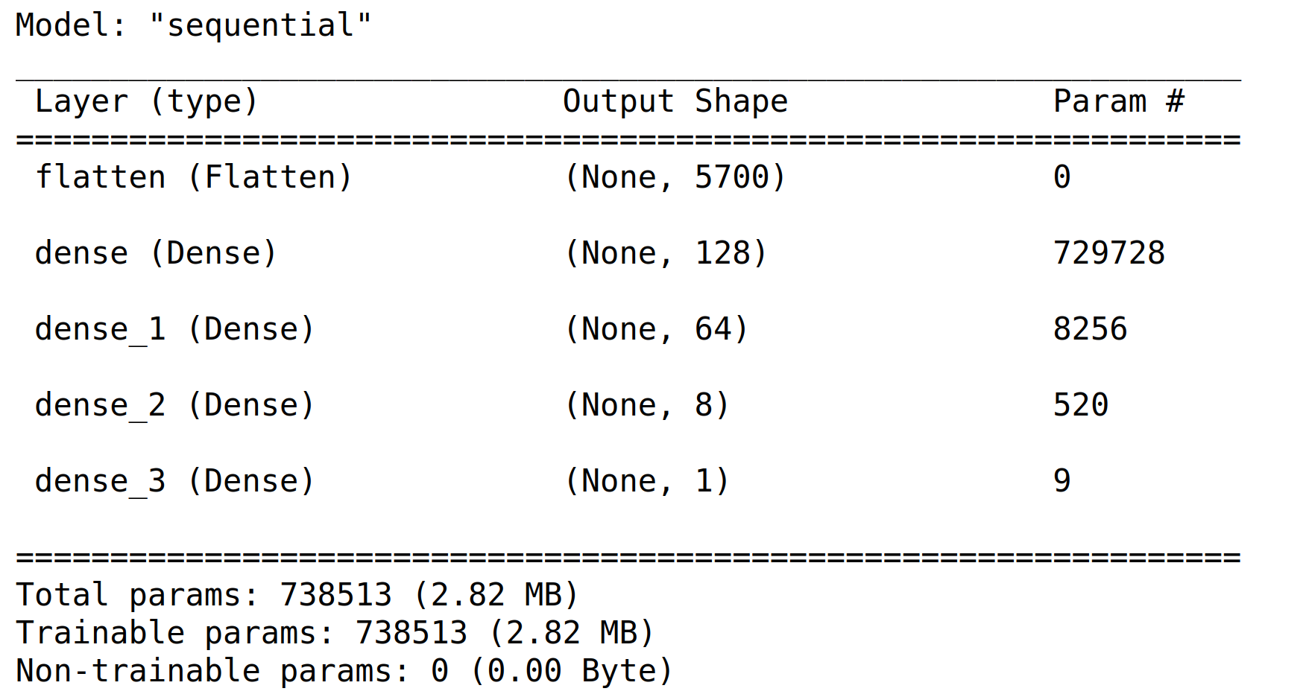
Accuracy Prediction Model

Slide 4
DataSet | Total | Train(85%) | Test(15%)
D_1_Layer | 75 | 75 | 0
D_2_Layers | 2775 | 2775 | 0
D_3_Layers (random subset) | 11884 | 10101 | 1783
D_Random | 6329 | 5380 | 949
D_Total | 21063 | 18331 | 2732

Slide 5
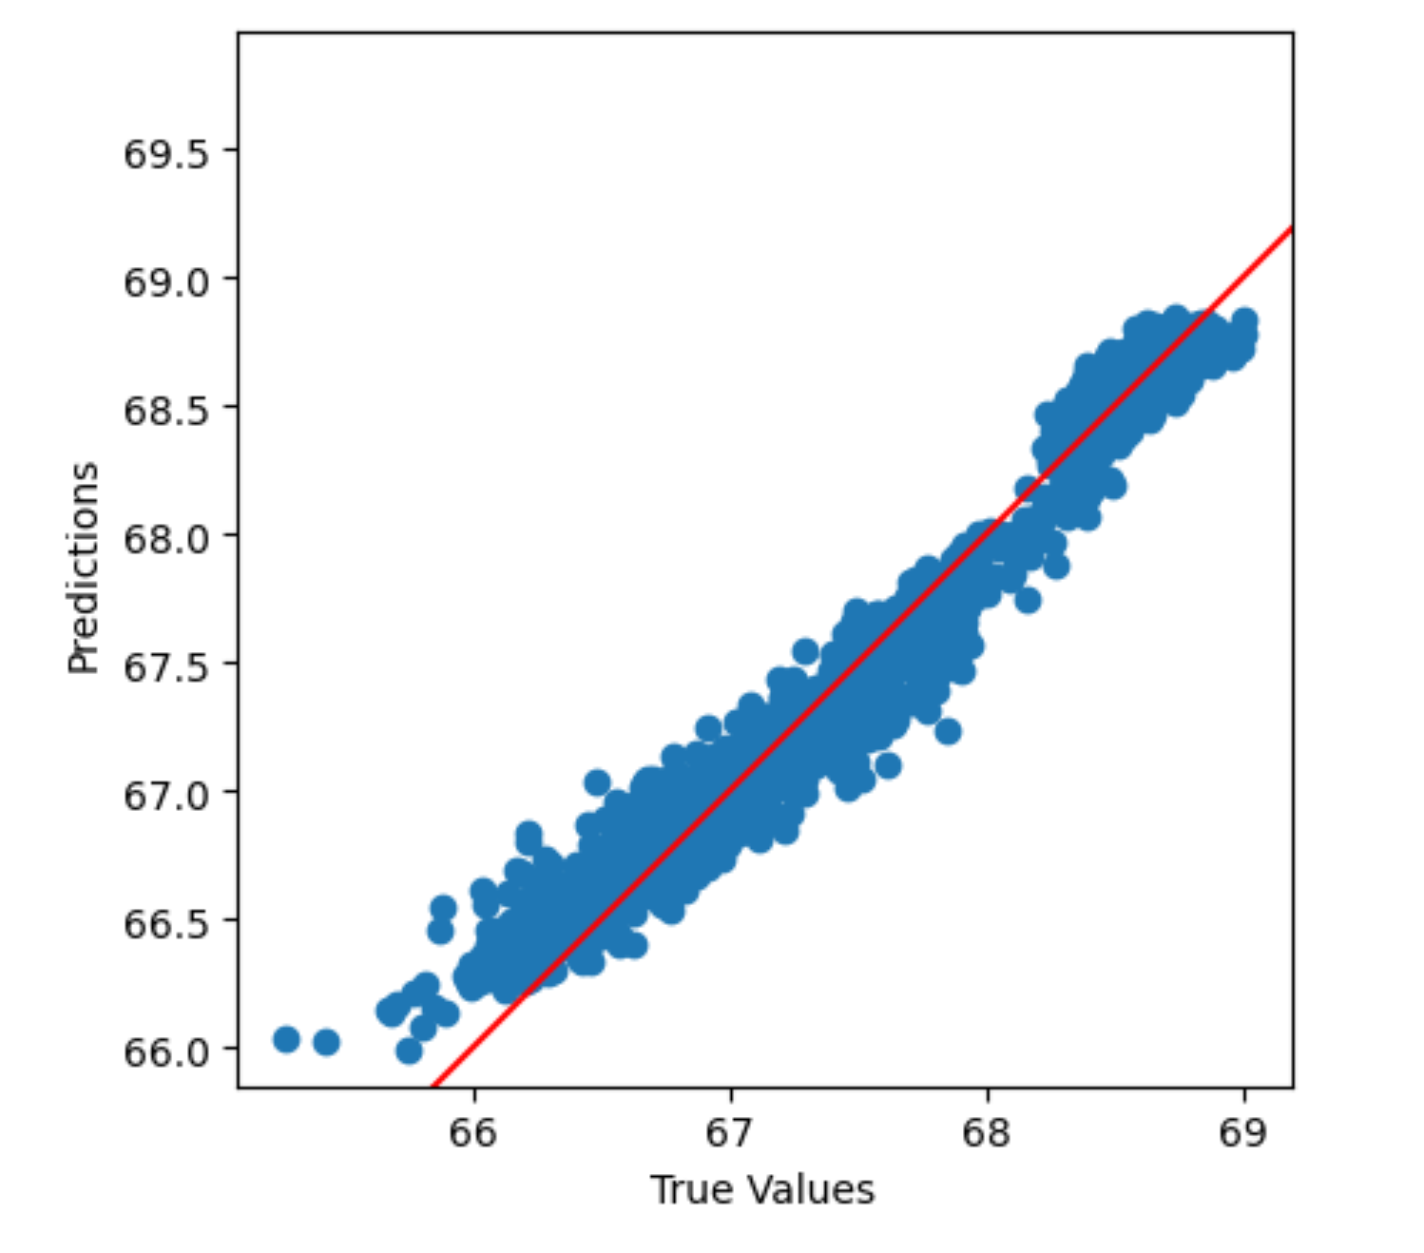

Slide 6
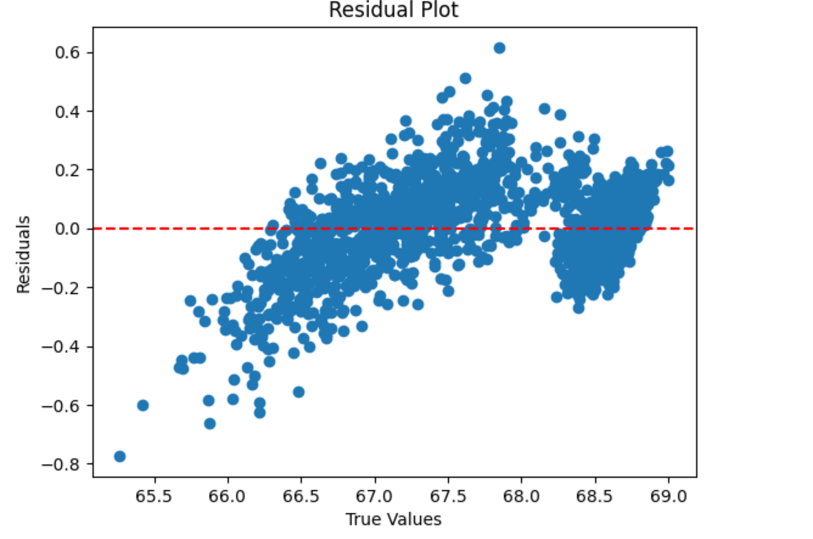

Slide 7
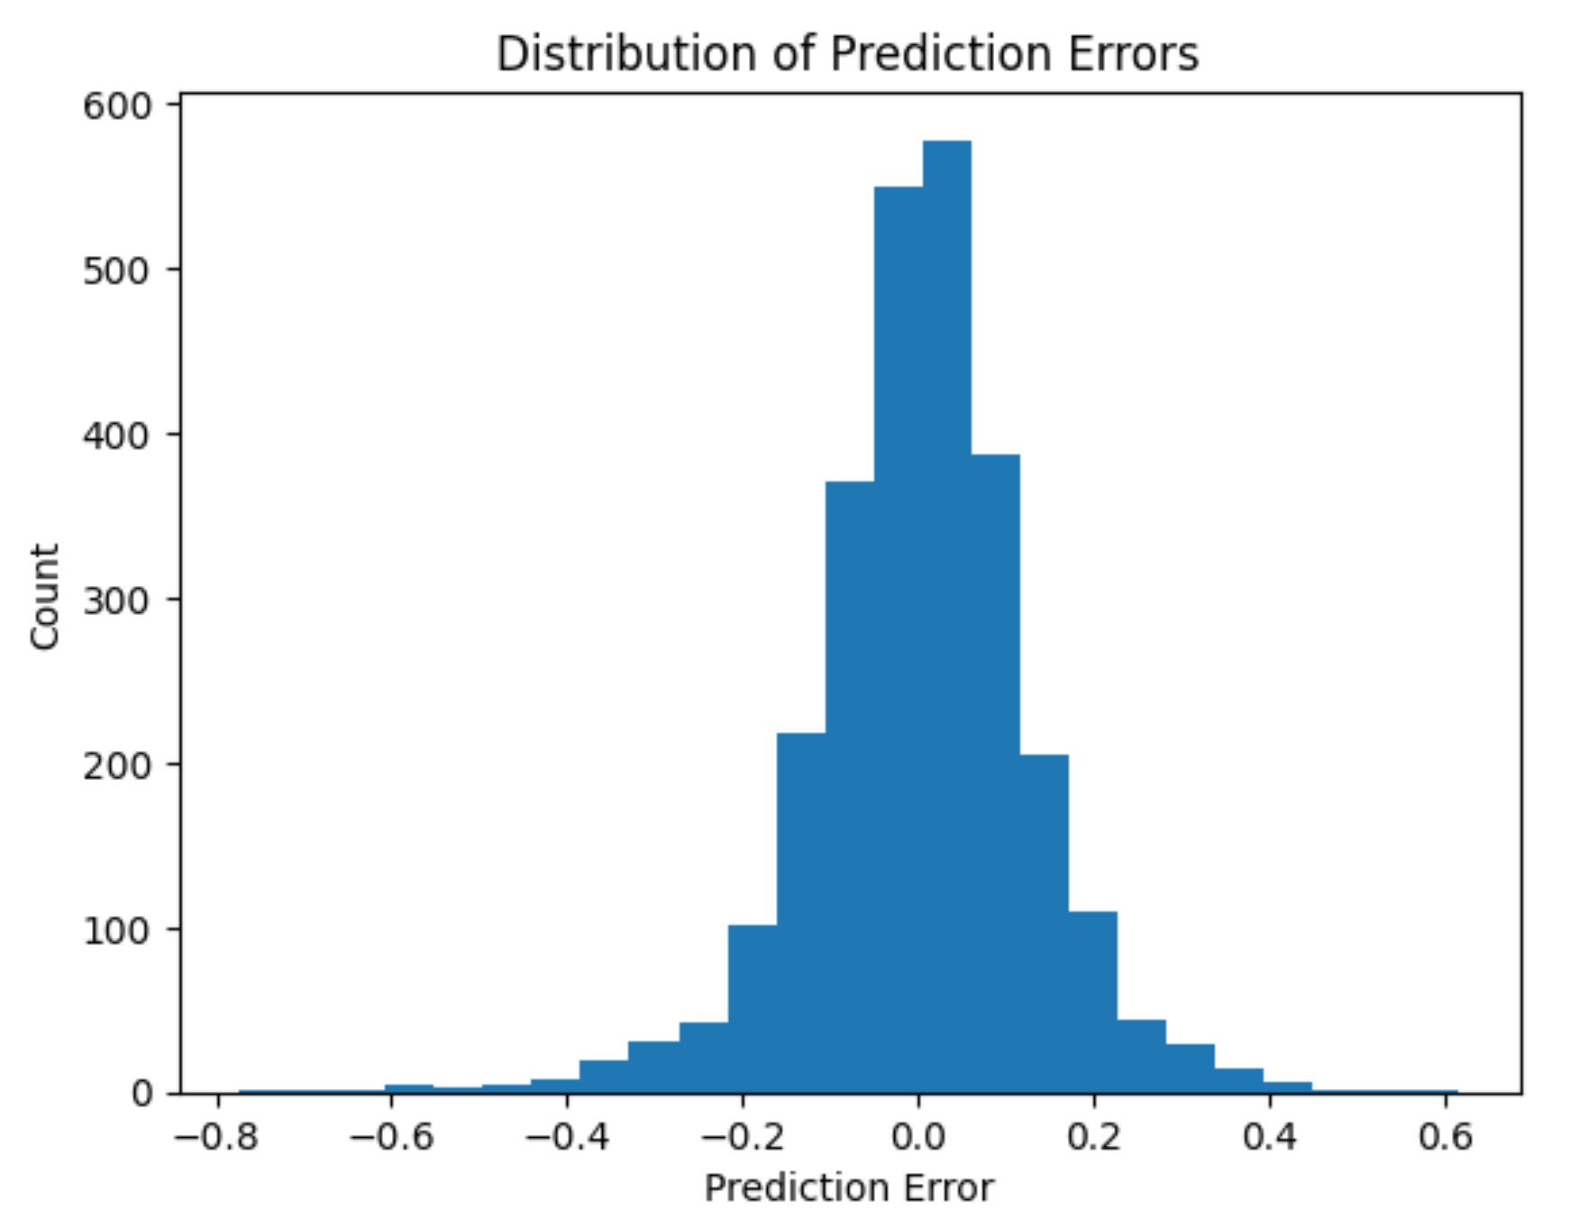

Slide 8
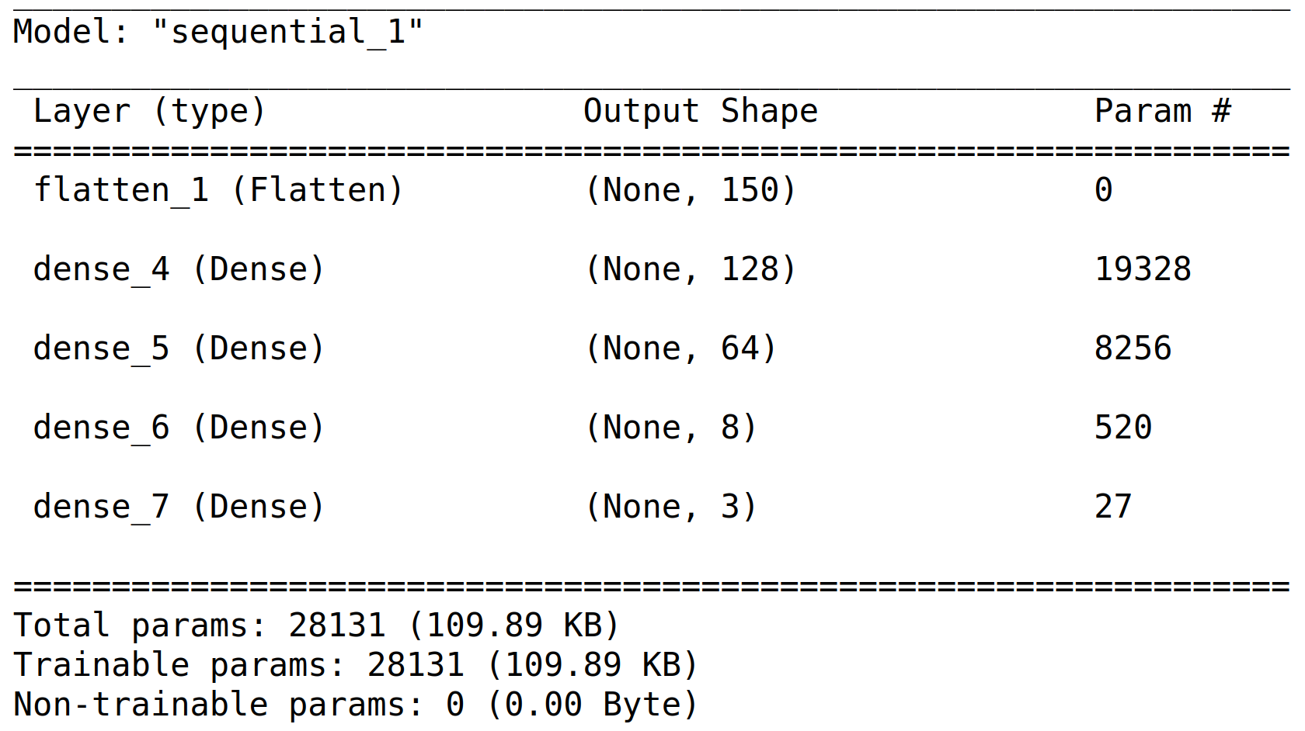
Comparison Model

Slide 9
DataSet | Total | Train(85%) | Test(15%)
D_1,2 | C(2850,2)=4.06 M | 4.06 M | 0
D_3 | 70.6 M | 51.0 M | 1.6 M
D_mc | 20 M | 14.5 M | 0.45 M
D_all | 221.8 M | 168 M | 3.7 M

Slide 10
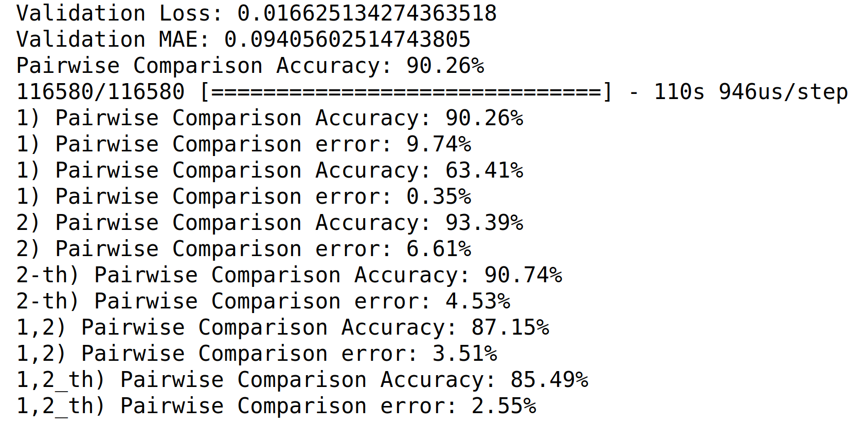
Loss function is MSE
th_1=0.2, th_2=0.8

