Slide 1
ONNX in EDDL
Lab 0: ECVL + EDDL environment
Winter School 24/01/2022

Slide 2
Contents
What is ONNX?
4
Operators support
6
EDDL ONNX API
8
Model Zoo
12
Resources
16

Slide 3
What is ONNX?

Slide 4
What is ONNX?
Open Neural Network Exchange
Open format to represent ML models
Defined by a set of Operators to build computational graphs
Uses Protocol Buffers as the mechanism to serialize the models
Key benefits
Frameworks interoperability
Inference hardware optimizations

Slide 5
Operators support

Slide 6
Operators support
EDDL coverage of the ONNX operators
We do not support the full ONNX operators set
All the main layers of the EDDL are supported. The exceptions are:
Data transformations: Most of them are not in ONNX standard (Coverage list)
The ones supported are Pad and Scale
Data augmentation layers: Not in ONNX standard (Coverage list)
Noise layers: Not in ONNX standard (Coverage list)
Complete layers coverage list in eddl_progress.md

Slide 7
EDDL ONNX API

Slide 8
EDDL ONNX API
Functionalities of the ONNX module in EDDL
Export/import your EDDL models
Import pretrained models from our model Zoo
Import models from other libraries*
*Remember that not all the operators are supported. Errors may appear

Slide 9
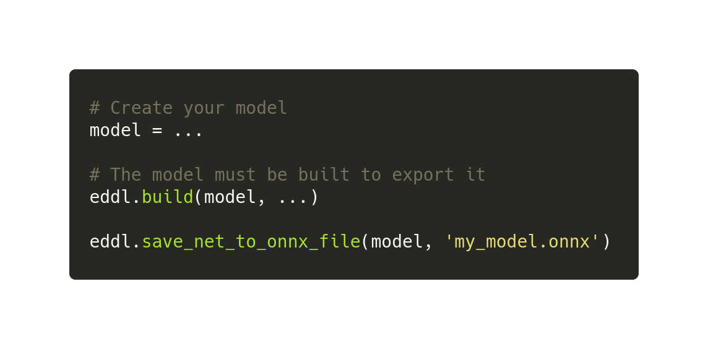
EDDL ONNX API
Export example

Slide 10
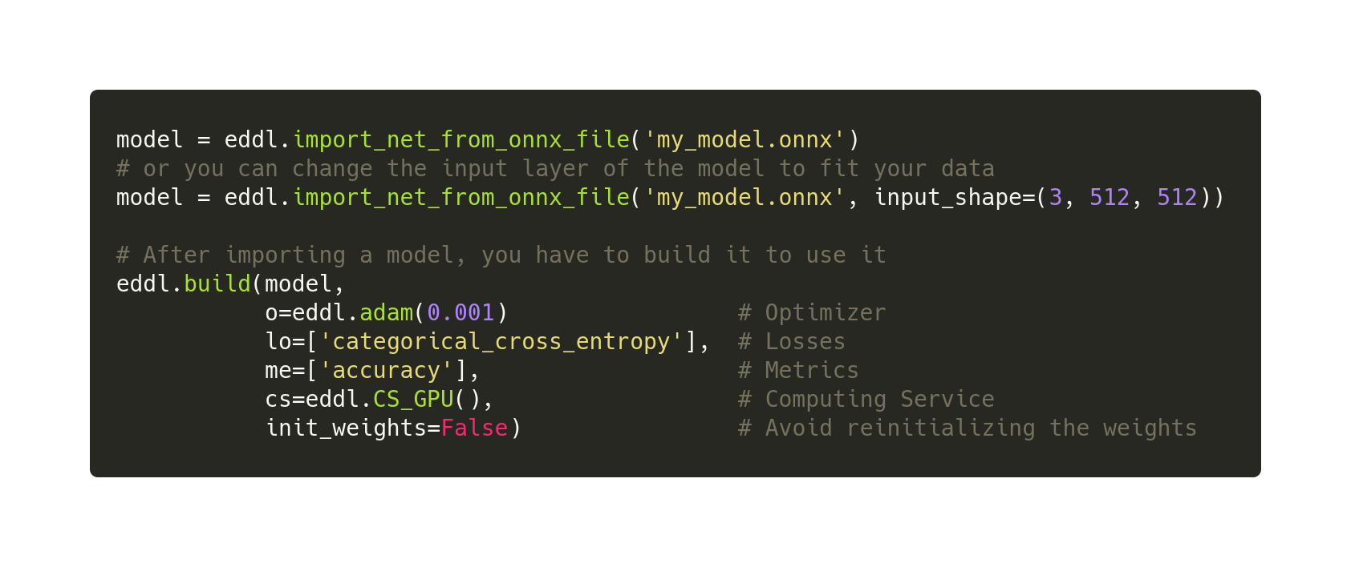
EDDL ONNX API
Import example

Slide 11
Model Zoo

Slide 12
Model Zoo
Models included
One of the main advantages of ONNX in the EDDL is to import pretrained models for transfer learning
We currently support some popular topologies for image classification (pretrained with ImageNet):
VGG: The 16 and 19 variants, with and without BatchNormalization
ResNet: 18, 34, 50, 101 and 152 variants
DenseNet-121
You can check them in the documentation here

Slide 13
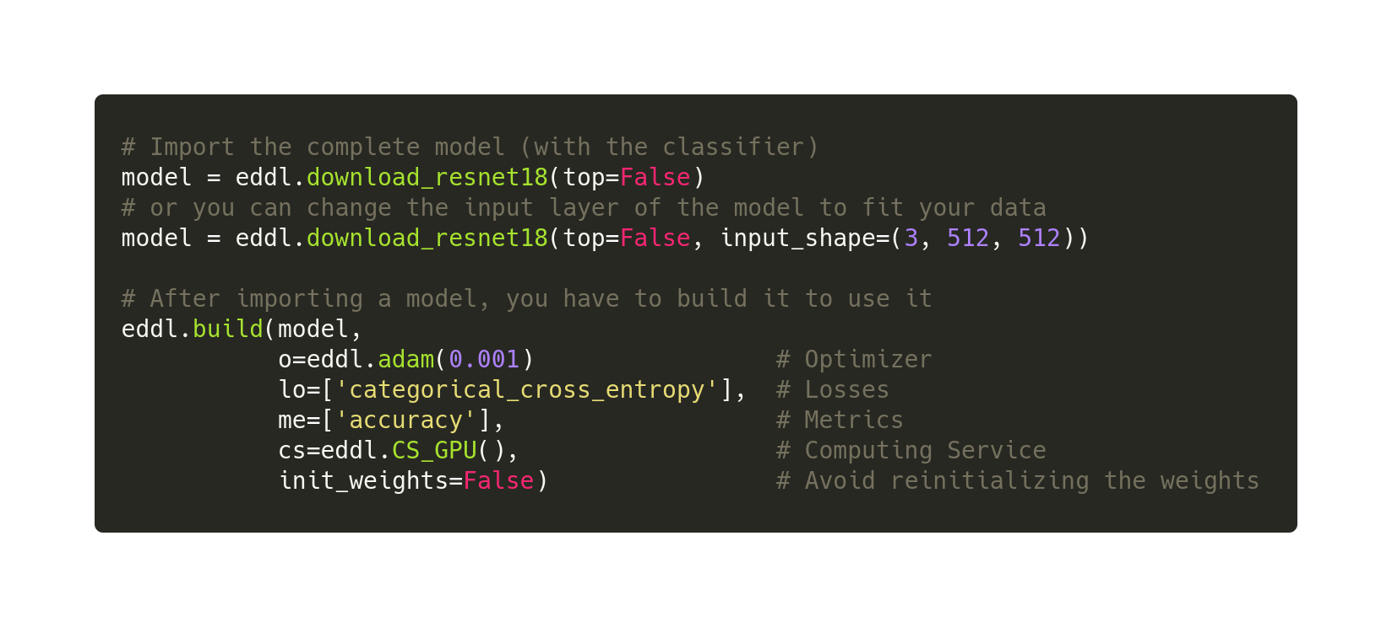
Model Zoo
Full model import example

Slide 14
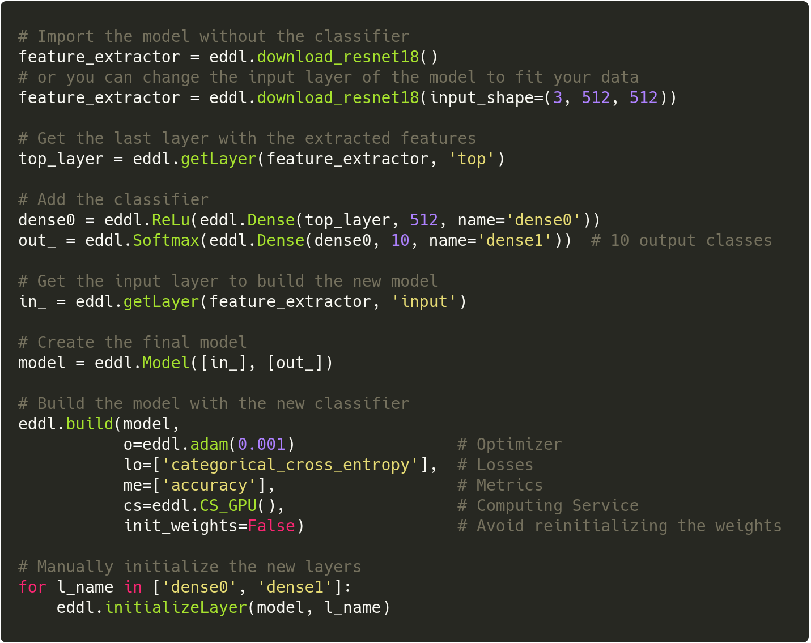
Model Zoo
Feature extractor import example

Slide 15
Resources

Slide 16
Resources
Additional links with useful information
EDDL ONNX documentation
https://deephealthproject.github.io/eddl/model/onnx.html#
Netron
ONNX models visualizer (web app here)
ONNX Simplifier
Tool to avoid some importing errors (github here)

Slide 17
Thank you!
Álvaro López Chilet
allochi@prhlt.upv.es

