Slide 1
Use Case 13
Lab 3: Epileptic Seizure Detection
Winter School 25/01/2022

Slide 2
Contents
Epilepsy Detection
3
Dataset
7
Recurrent approach
13
Convolutional approach
23
Conclusions
29
Resources
31

Slide 3
Epilepsy Detection

Slide 4

Epilepsy Detection
Introduction
Epilepsy
Neurological disorder characterized by recurrent seizures
Episodes of involuntary movement
Around 50 million people diagnosed in the world
Electroencephalogram (EEG)
Recording the electrical activity of the brain
Electrodes located on the scalp
Continuous signal composed of different channels

Slide 5
Epilepsy Detection
Brain stages
Interictal
Normal activity.
Pre-ictal
Strange brain activity, usually before an actual seizure.
Ictal
Period while a patient is suffering a seizure.
Post-Ictal
The patient is recovering from a seizure.

Slide 6

Epilepsy Detection
Brain Stages
General cycle of stages
Automatic seizure detection task (not prediction few minutes before seizures)
High variability between subjects
Patient-Dependent classifiers
Class 0
Class 1
Interictal + Pre-ictal + Post-ictal
Ictal
Notes:
High variability: Normal activity for one patient could be abnormal for another one -> The high variability makes the task difficult -> Patient-Dependent approach: One classifier per patient.

Slide 7
Dataset

Slide 8
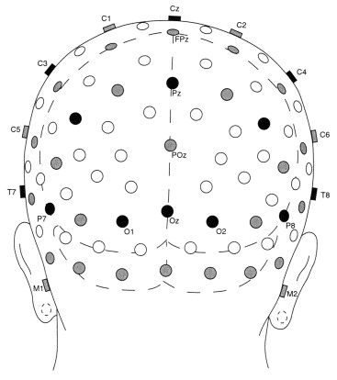
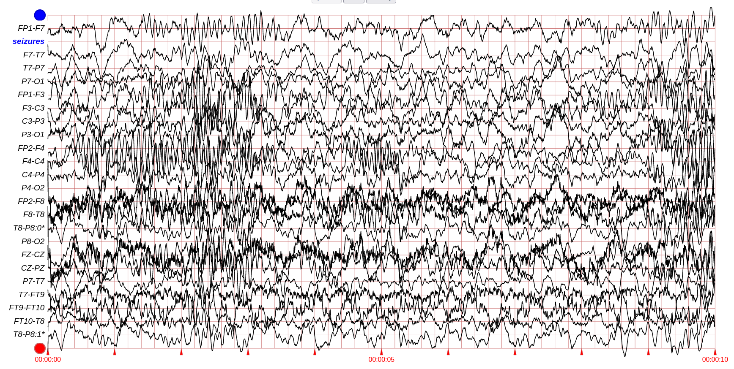
Dataset
Data description
CHB-MIT Scalp EEG Database from Physionet
EEG recordings from 24 pediatric subjects
Data in EDF (European Data Format)
Sessions are between 24 and 48 hours long, split in several files
Most files are 1 hour long, others are longer (up to four hours)
Electrodes located on the scalp (10-20 system standard)
23 channels, related to pairs of electrodes
Acquired at 256 Hz
Manual Labelling: Starting and Ending times of seizures

Slide 9
Dataset
Data description
Notes:
Here we can see a 10 seconds extract of a signal from the dataset. At the left side, we can observe the labels for the channels. As you can see, each channel refers to two electrodes.

Slide 10
Dataset
Data preparation, cleaning and selection
Preparation preprocess (Data cleaning process done by Winter-School team):
Read signals from EDF format
Homogenize signals to have each channel in the same position
Store the data in a Python dictionary (containing signals and seizure information)
Serialize the object in Pickle to save it (.pbz2 files)
We provide a subset of the original dataset already cleaned
clean_signals/
chb01/
chb03/
chb05/
…

Slide 11
Dataset
Splits
Train
Validation
Test
65 %
15 %
20 %
Splits not in chronological order
31,2 hours
7,2 hours
9,6 hours
A whole session of 48 hours

Slide 12
Dataset
Class imbalance
Seizures normally last few seconds, so there is a high class imbalance.
Patient id | # files without seizures | # files with seizures | # interictal hours | # ictal hours
chb01 | 35 | 7 | 40,43 | 0,12
chb03 | 31 | 7 | 37,89 | 0,11
chb05 | 34 | 5 | 38,85 | 0,16
chb08 | 15 | 5 | 19,75 | 0,26
chb12 | 11 | 10 | 20,41 | 0,28
chb14 | 19 | 7 | 25,95 | 0,05
chb15 | 25 | 14 | 38,46 | 0,55
chb24 | 10 | 12 | 21,15 | 0,14
Total | 180 | 67 | 242,89 | 1,67

Slide 13
Recurrent Approach

Slide 14
Recurrent Approach
Introduction
Recurrent Neural Networks
LSTM / GRU layers
Data Loader
Post inference process
Metrics
Neural Network Metrics
Post inference Metrics
Results

Slide 15
Recurrent Approach
RNN topologies based on LSTM and GRU layers
Recurrent Layer
Input shape: (19, 256)
(256,)
(256,)
Dense Layer
Output Layer
0 - Interictal
1 - Ictal
(timesteps = 19, data_dim = 256)
256 units
1 unit
256 units
In the first example provided we are using 19 timesteps of one-second-long sliding windows, that is why the input shape is (19, 256). Because each one of the 23 channels is processed independently.

Slide 16
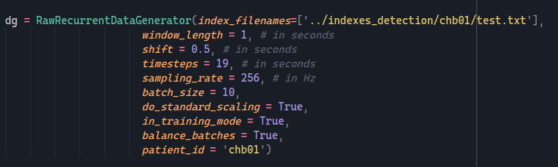
Recurrent Approach
Data Loader
Data Loader Sequence Parameters
window_length (in seconds)
shift (in seconds)
timesteps

Slide 17
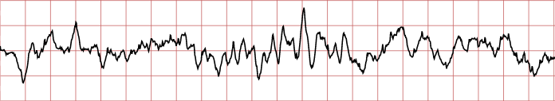
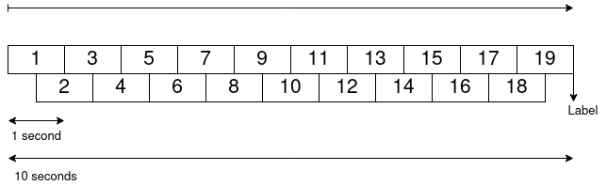
Recurrent Approach
Data Loader - Example
Example of sequence generation
window_length = 1 second
shift = 0.5 seconds
timesteps = 19
(19, 256)
When using all the 23 channels
(19, 256) x 23

Slide 18
Recurrent Approach
Data Loader - Example
Training Mode
Input shape: (19, 256)
RNN
Model
0 - Interictal
(19, 256) x 23
We independently pass each channel through the net
1 - Ictal
Inference Mode
RNN
Model
Classification by consensus
RNN
Model
RNN
Model
0 - Interictal
RNN
Model
RNN
Model
RNN
Model
RNN
Model
Input Tensor
256
1 - Ictal
x 23
x 23
19

Slide 19
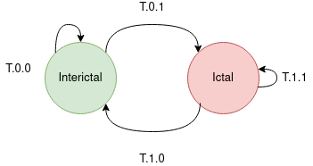
Recurrent Approach
Post inference process
Post inference function to act as a detector
Analyses the consecutive outputs
Raises alarms when it detects a seizure
Detection threshold
Ground Truth
... 0 0 0 0 0 0 0 0 0 1 1 1 1 1 1 1 1 1 1 0 0 0 0 0 0 0 0 0 0 0 0 0 ...
... 0 0 0 0 1 0 0 0 0 1 1 1 1 1 1 1 0 1 1 0 0 0 0 0 1 1 0 1 0 0 0 0 ...
Prediction
Post-Inference window
Inference window length
If the proportion of ones inside the post-inference window while being in the Interictal state is greater than alpha_pos, it makes the transition from Interictal to Ictal: T.0.1
If the proportion of ones inside the post-inference window while being in the Ictal state is lower than alpha_neg, it makes the transition from Ictal to Interctal: T.1.0

Slide 20
Recurrent Approach
Metrics
Classifier Metrics
Post Inference process Metrics
Accuracy
Macro F1-score
Balanced Accuracy
Post-inference window accuracy
Percentage of detected seizures
Average Latency (in seconds)
False Alarms per hour
Metrics at two levels
Channel independent
Ensemble: all 23 channels combined

Slide 21
Recurrent Approach
Results
Experiment configuration
Window Length (s) | Shift (s) | Timesteps | Model | Optimizer | Initial LR | Epochs
1 | 0,5 | 19 | GRU | Adam | 0,0001 | 10
Post-Inference Parameters
Post-Inference Window Length (in timesteps) | Alpha_pos | Alpha_neg | Detection Threshold (s)
20 | 0,4 | 0,4 | 20

Slide 22
Recurrent Approach
 | Test |  |  |  |  |  | Post-Inference Process with Test subset
 | Channel Independent |  |  | Combined channels |  |  | Acc | # Seizures | Detected seizures | Latency (s) | False Alarms per Hour | Hours
Patient | Acc | F1-Score | Balanced Acc | Acc | F1-score | Balanced Acc
chb01 | 99,75% | 0,8828 | 86,34% | 99,93% | 0,9667 | 94,45% | 99,90% | 2 | 100,00% | 11,75 | 0,00 | 9,62
chb03 | 99,62% | 0,6117 | 57,53% | 99,64% | 0,4991 | 50,00% | 99,64% | 2 | 0,00% | - | 0,00 | 8,97
chb05 | 99,75% | 0,8553 | 87,35% | 99,90% | 0,9335 | 88,46% | 99,87% | 1 | 0,00% | - | 0,13 | 7,98
chb08 | 97,60% | 0,7215 | 83,11% | 99,49% | 0,9054 | 87,71% | 99,49% | 1 | 100,00% | 18,00 | 0,80 | 4,99
chb12 | 95,26% | 0,5774 | 63,09% | 97,63% | 0,6018 | 58,85% | 97,53% | 11 | 54,55% | 13,92 | 2,67 | 5,98
chb14 | 99,76% | 0,5856 | 58,21% | 99,85% | 0,5252 | 51,32% | 99,85% | 2 | 0,00% | - | 0,00 | 6,98
chb15 | 96,70% | 0,6383 | 67,83% | 97,86% | 0,6363 | 61,32% | 97,71% | 7 | 28,57% | 11,75 | 1,89 | 8,98
chb24 | 99,34% | 0,7385 | 69,23% | 99,49% | 0,7586 | 67,56% | 99,44% | 4 | 100,00% | 11,50 | 0,16 | 6,28
Results

Slide 23
Convolutional Approach

Slide 24
Convolutional Approach
Introduction
Time Delay Convolutional Neural Networks
Post Inference Process
Metrics
Neural Network Metrics
Post inference Metrics
Results

Slide 25
Convolutional Approach
Time Delay Convolutional Neural Networks
Kernel_size = (128, 23), strides = (64, 1) --> 500 ms long window shifted every 250 ms
Input shape: (2560, 23)

Slide 26
Convolutional Approach
Models available in the pipeline
"conv1"
Post Inference Process
Metrics
Neural Network Metrics
Post inference Metrics
The same as in the recurrent approach

Slide 27
Convolutional Approach
Results
Experiment configuration
Window Length (s) | Shift (s) | Model | Optimizer | Initial LR | Epochs
10 | 0,25 | Conv1 | Adam | 0,00001 | 10
Post-Inference Parameters
Post-Inference Window Length (in timesteps) | Alpha_pos | Alpha_neg | Detection Threshold (s)
20 | 0,4 | 0,4 | 20

Slide 28
Convolutional Approach
 | Test |  |  | Post-Inference Process with Test subset
Patient | Acc | F1-score | Balanced Acc | Acc | # Seizures | Detected seizures | Latency (s) | False Alarms per Hour | Hours
chb01 | 99,72% | 0,8940 | 96,15% | 99,69% | 2 | 100,00% | 9,00 | 0,73 | 9,62
chb03 | 99,62% | 0,8086 | 91,86% | 99,56% | 2 | 100,00% | 2,88 | 1,78 | 8,98
chb05 | 99,66% | 0,8330 | 92,07% | 99,59% | 1 | 0,00% | - | 1,76 | 7,98
chb08 | 99,2% | 0,8477 | 81,74% | 99,19% | 1 | 100,00% | 16,75 | 1,80 | 4,99
chb12 | 96,73% | 0,5530 | 55,63% | 96,51% | 11 | 45,45% | 15,90 | 7,52 | 5,98
chb14 | 98,83% | 0,4971 | 49,49% | 98,71% | 2 | 0,00% | - | 4,01 | 6,98
chb15 | 97,63% | 0,7848 | 94,28% | 97,52% | 7 | 57,14% | 10,44 | 3,01 | 8,98
chb24 | 99,22% | 0,6435 | 60,05% | 99,23% | 4 | 75,00% | 9,25 | 0,96 | 6,28
Results

Slide 29
Conclusions

Slide 30
Conclusions
Conclusions of the results
We did not find an ideal model that works well with every patient
In general, slightly better accuracy with the convolutional approach
In some cases, the recurrent approach has more latency but less false alarms, and the convolutional approach has lower latency but more false alarms per hour.

Slide 31
Resources

Slide 32
Resources
Original Dataset
CHB-MIT Scalp EEG Database
Prepared Dataset
clean_signals.zip (7.6 GB) Option 1 Option 2
Pipeline Repository
UC13_pipeline

Slide 33
Thank you!
Javier Martínez Bernia
jamarbe2@prhlt.upv.es

