Slide 1
EDDL
Lab 0: ECVL + EDDL environment
Winter School 24/01/2022

Slide 2
Contents
What is EDDL?
4
Deep-Learning features
6
Tensor features
8
Supported architectures
10
Installation
12
Documentation
14
Resources
16

Slide 3
What is EDDL?

Slide 4
What is EDDL?
European Distributed Deep Learning Library
Open-source library that provides two high-level features:
Distributed Deep Learning
Tensor computation
API for C++ and Python
Key benefits
Hardware transparency support for CPU, GPU and FPGA
Support for Clusters, Clouds and containerized platforms
Framework interoperability

Slide 5
Deep-learning features

Slide 6
Deep-learning features
Layers supported
All the main deep-learning operations are supported (See here):
Core layers: Dense, Dropout, Select, Concat, Broadcasting,…
Activations: ReLU, Softmax, Sigmoid,…
Convolutions & Poolings: conv, pool, upsampling, transposed,… (1d, 2d, 3d)
Recurrent: RNN, LSTM, GRU
Normalization: BatchNorm, LayerNorm, GroupNorm,…
Tensor operators: Max, Min, Sum, Mean, Equal,…
Data transformation & Augmentation*: Crop, Rotate, Flip, Pad, Cutout,…
Notes:
CUDA support for data augmentation in the EDDL, complementary with ECVL

Slide 7
Tensor features

Slide 8
Tensor features
Operations supported
All the main tensor operations are supported (See here):
Array creation: ones, zeros, arange, linespace, randn, clone,…
Array manipulation: reshape, permute, un/squeeze, concat, stack, tile, broadcast…
Image manipulation: Crop, Scale, Rotate, Pad, Flip,… (+ randoms)
Indexing routines: nonzero, where, select, permute, expand,…
Input/Output: load, save, load_partial,…
Linear Algebra: Interpolate, Norm, Trace,
Logical functions: all, any, isclose, isinf, logical_and, logical_or,…
Mathematical functions: abs, cos, clamp, log, add, mult, max, min,…

Slide 9
Supported architectures

Slide 10
Supported architectures
Working models
Image classification: AlexNet, ResNet, GoogLeNet, DenseNet,…
Object Detection: YOLO, RetinaNet,…
Object Segmentation: U-Nets, DUC,…
Encoder-Decoder: Machine translation, Image Captioning, Sentiment,…
Generative Adversarial Networks

Slide 11
Installation

Slide 12
Installation
EDDL
Operating system: Windows, MacOS and Linux
Hardware acceleration: CPU, GPU (cuda native/cuDNN), FPGA and COMPSs
Installation:
Source: cmake
Image: Docker
Package management: conda*, brew and pip
*It will be seen in detail in the next lab session
Notes:
Overview. Lab later.

Slide 13
Documentation

Slide 14
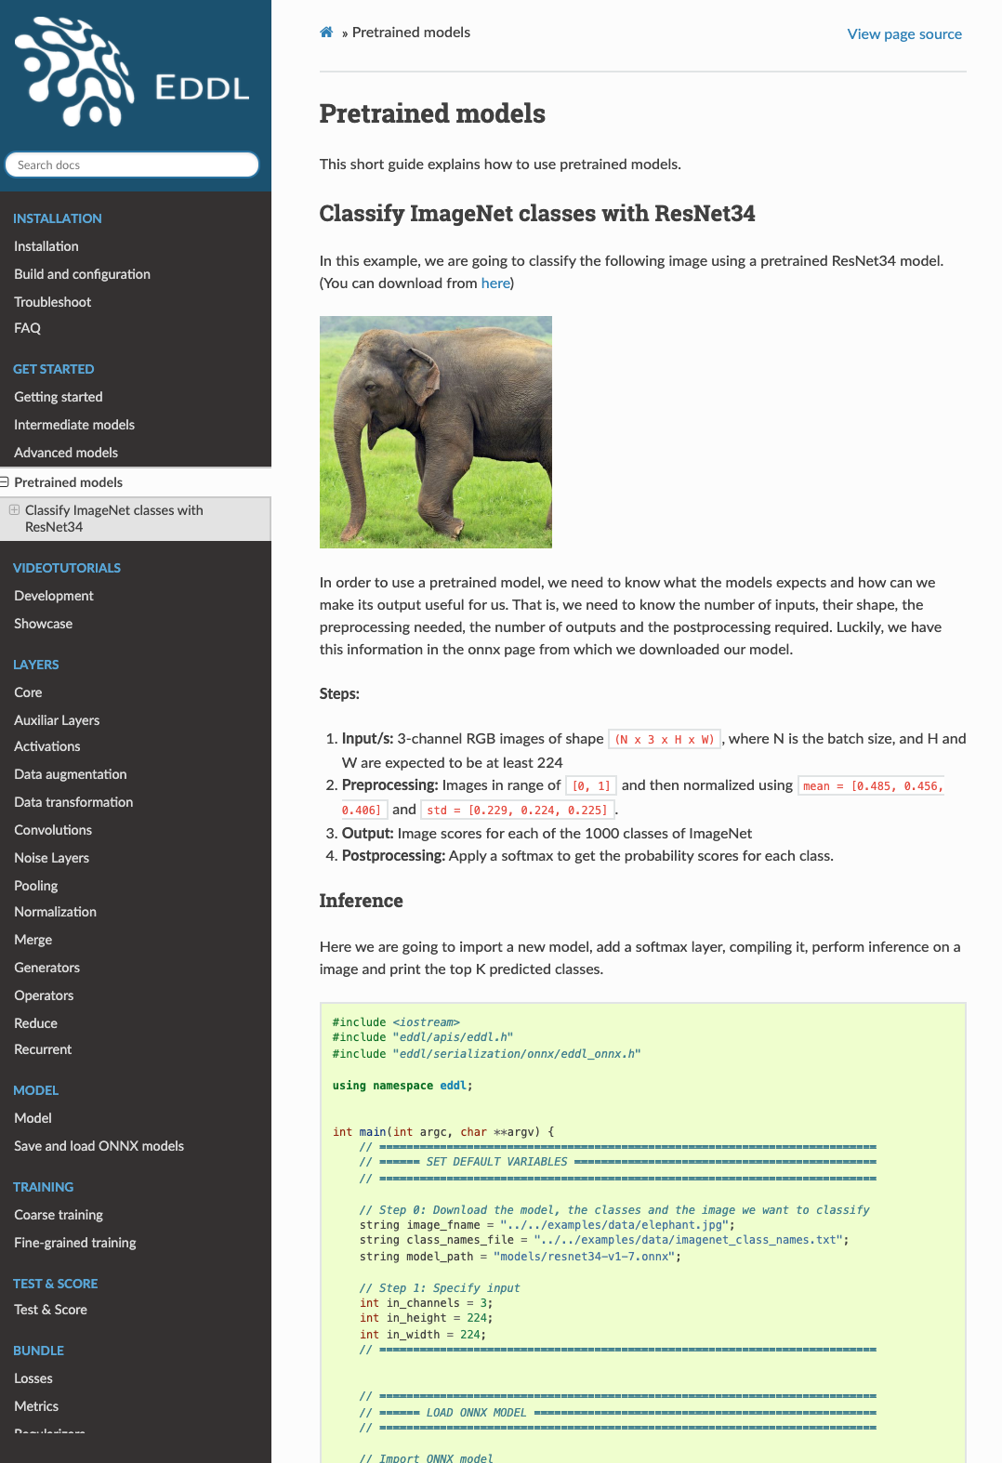
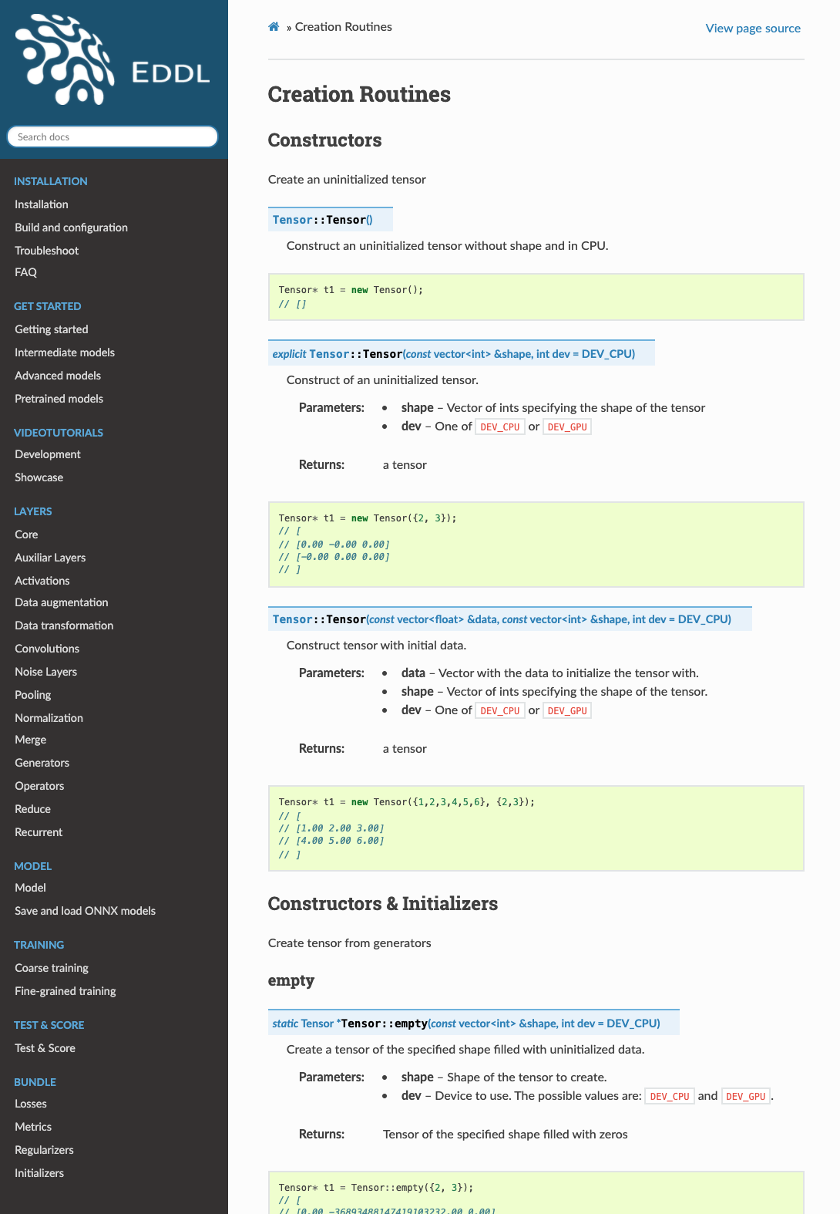
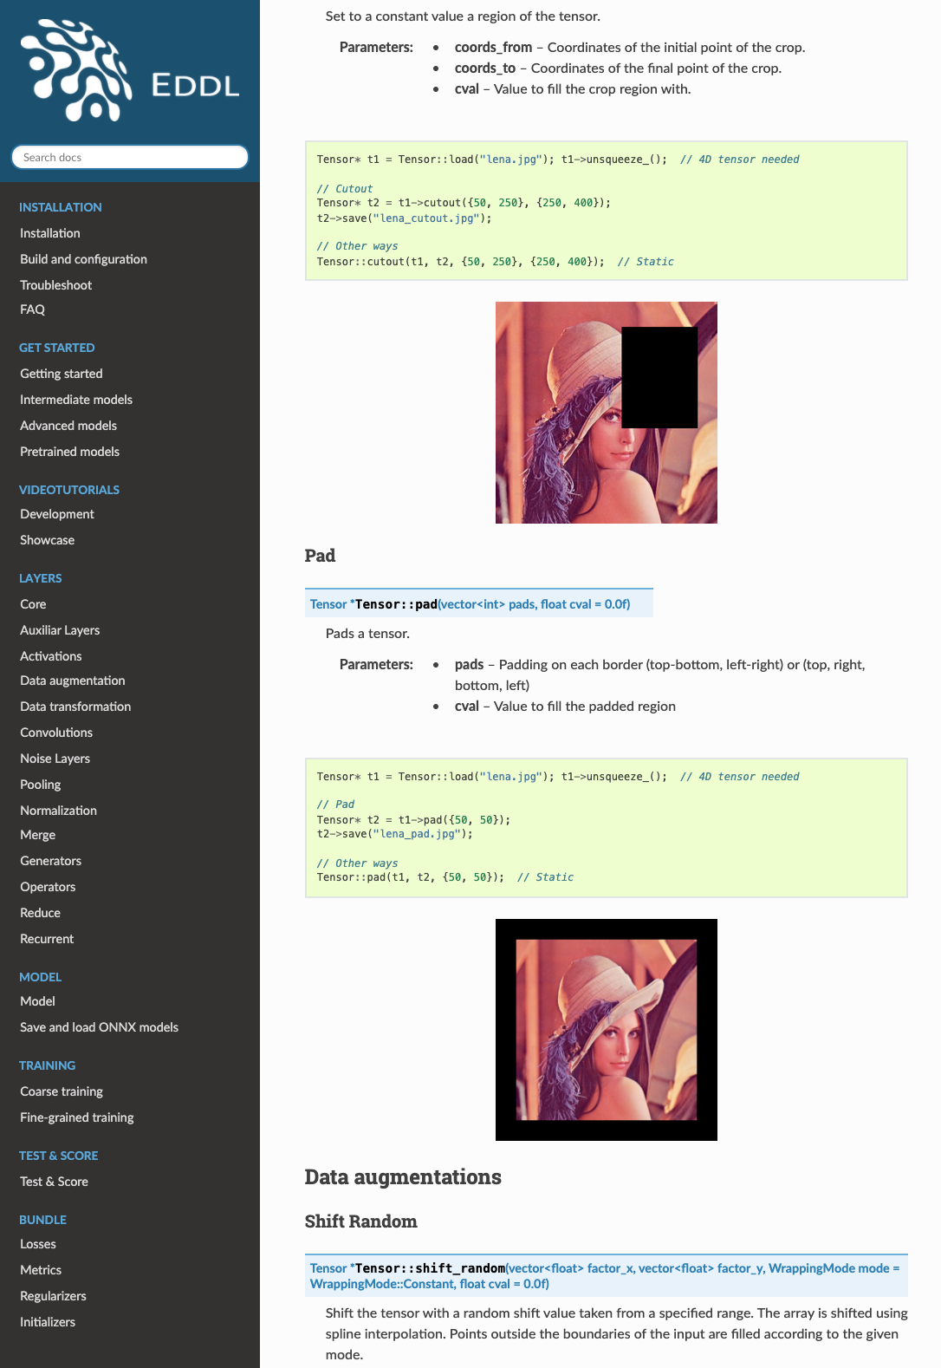
Documentation
EDDL

Slide 15
Resources

Slide 16
Resources
Additional links with useful information
EDDL documentation
https://deephealthproject.github.io/eddl/index.html
GitHub
https://github.com/deephealthproject/eddl
Progress
https://github.com/deephealthproject/eddl/blob/master/docs/markdown/eddl_progress.md

Slide 17
Thank you!
Salva Carrión
salcarpo@prhlt.upv.es

