Slide 1
Our store
C# Project

Slide 2
Project Manager:
Eng. Ahmed Mamdouh
Members of Team:
Shaza Emam Ehsan Ahmed
Sohila EzzElarab Doaa Mahmoud

Slide 3
Outline
Project Description
ERD
UML Diagrams
UI Project pages

Slide 4
Project Description
System of stores .
the purpose of system to store our categories, each category has a lot of products, each product has special data like (Name , BarCode, Price, ….etc.).
When admin use system can he add(Delete) different store in certain location, then add(Delete) categories to certain store, and store products to this category.
Also he can add customers and suppliers .
The admin can make reports in more details to show all processes done.

Slide 5
Project Description
Each customer can buy any product in our store in available quantity.
Each Supplier can supply our store with products.

Slide 6
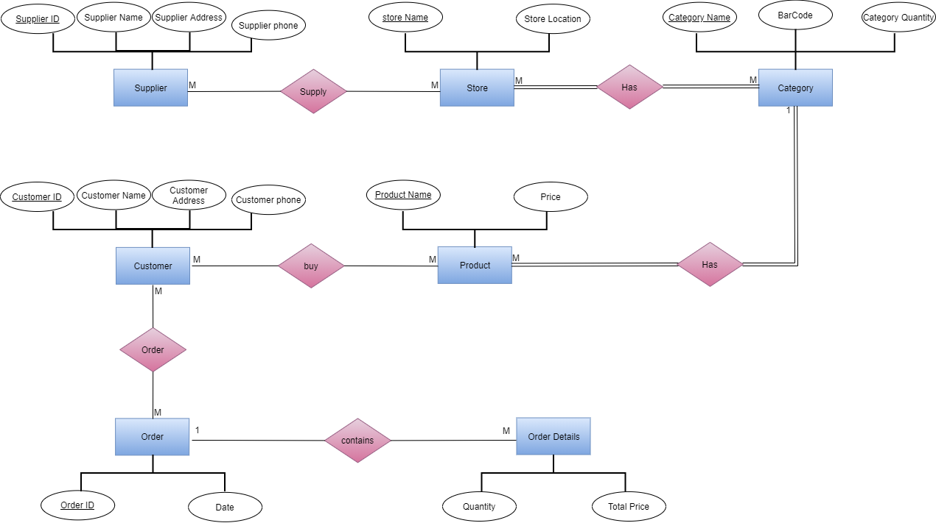
ERD

Slide 7
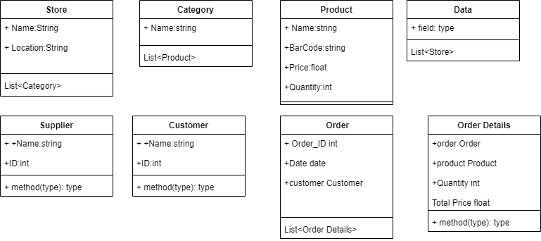
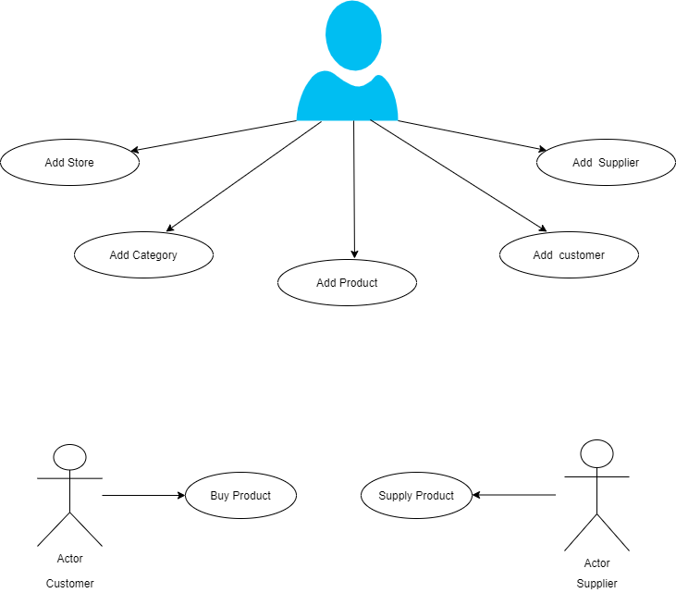
UML Diagrams

Slide 8
Thank You

