Slide 1

Serverless computing
with Azure Functions V2

Slide 2



Ehsan Amini Senior Technical Engineer ehsan.amini@outlook.com
https://github.com/EhsanAminii
@dorhost

Slide 3



Slide 4
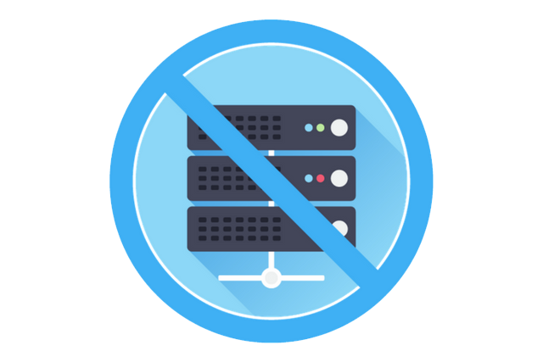
Serverless?
On-demand CPU | On-demand RAM | Pay by usage
Notes:
Warum serverless?

Slide 5
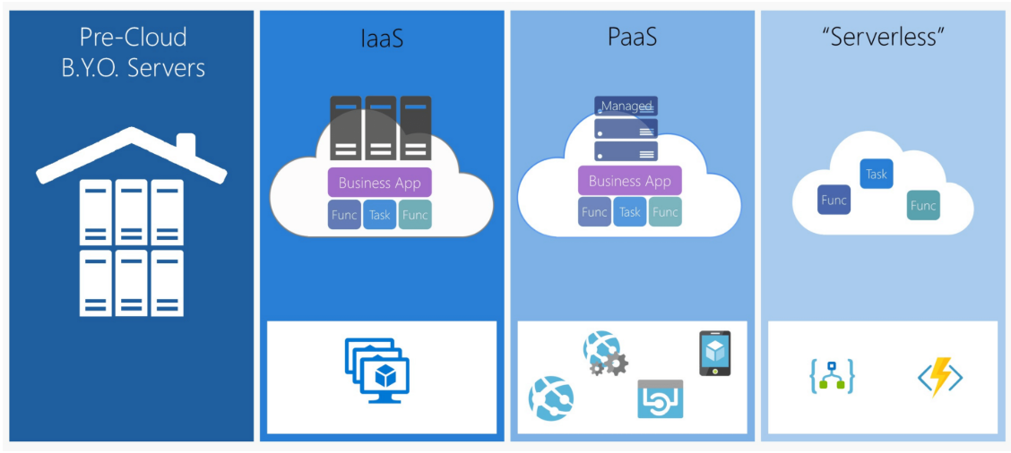
Notes:
Platforms
Service models

Slide 6

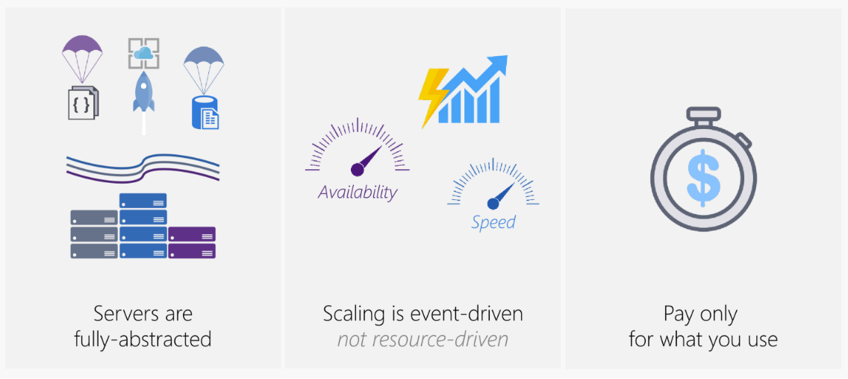
So, what really is Serverless?
Notes:
Serverless platform

Slide 7
A Serverless solution is one that costs you nothing to run if nobody is using it, excluding data storage.
@paulJohnson
Notes:
Warum serverless?

Slide 8


Azure Functions (FaaS)
Serverless compute service
Language of your choice
On demand scale
Micro billing $
Fully managed by azure
Processing data (Images, …)
Integrating systems
IOT solutions

Slide 9
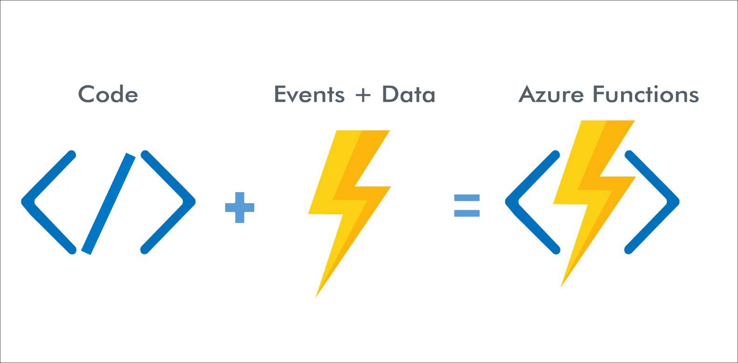
How Azure Functions Works

Slide 10
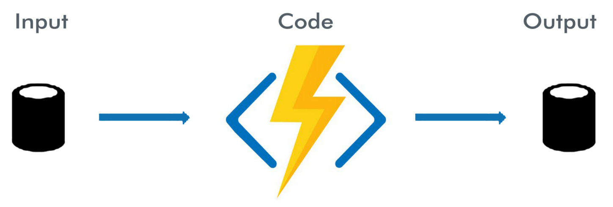
How Azure Functions Works

Slide 11
Azure Functions V1 vs V2
Functions V1
.net framework 4.x
Predefined trigger
Functions V2
.net core
Performance
Better scaling
Breaking Change

Slide 12
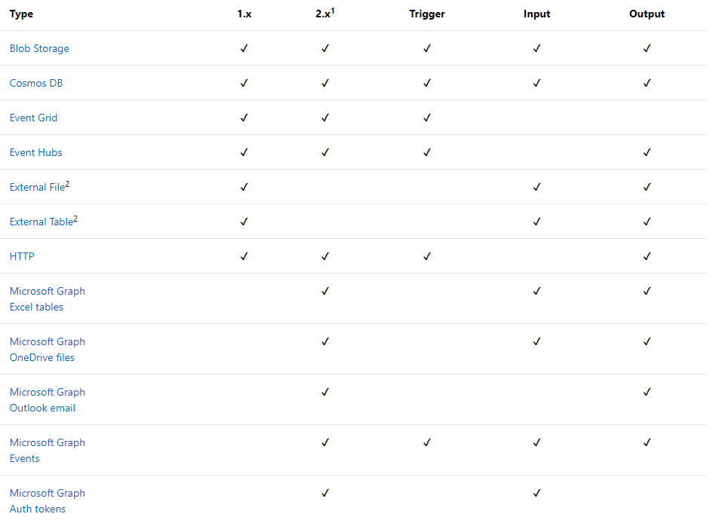
Azure Functions triggers and bindings
HTTPTrigger
TimerTrigger
CosmosDBTrigger
BlobTrigger
QueueTrigger
EventGridTrigger
EventHubTrigger
ServiceBusQueueTrigger
ServiceBusTopicTrigger

Slide 13
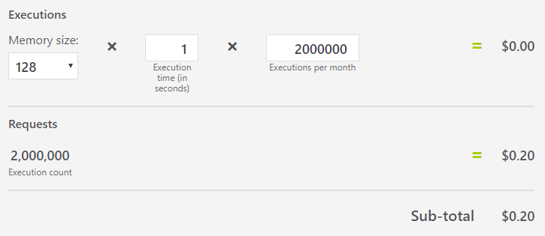
Azure functions Hosting
Consumption plan
Dynamics instances (scale out)
Pay only by running
Max running time up to 10 min
App Service plan
dedicated App Service plan
Always running
Long running time (more than 10 min)
Fix costs
No auto scale

Slide 14
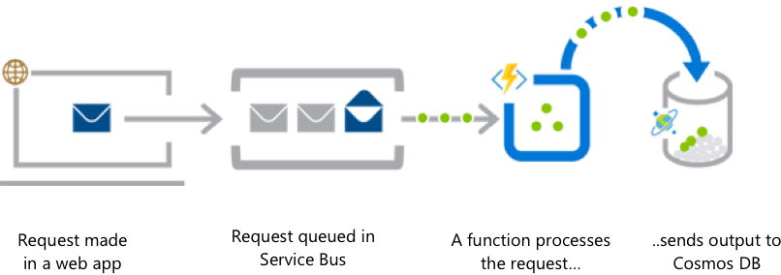
What you can do with Functions
Web application backends

Slide 15
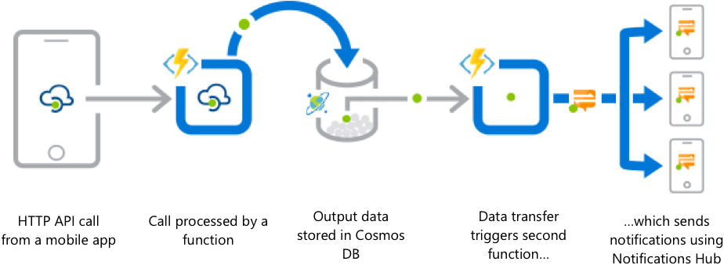
What you can do with Functions
Mobile application backends

Slide 16
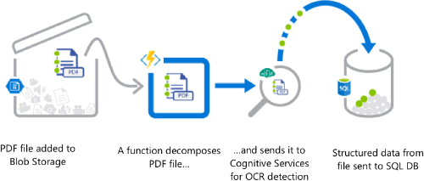
What you can do with Functions
Real-time file processing

Slide 17
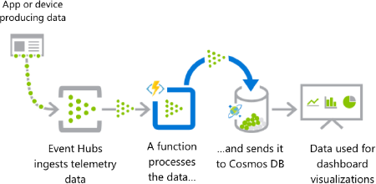
What you can do with Functions
Real-time stream processing

Slide 18
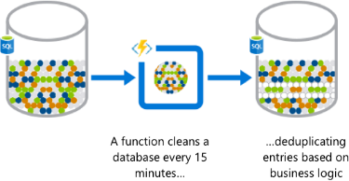
What you can do with Functions
Automation of scheduled tasks

Slide 19
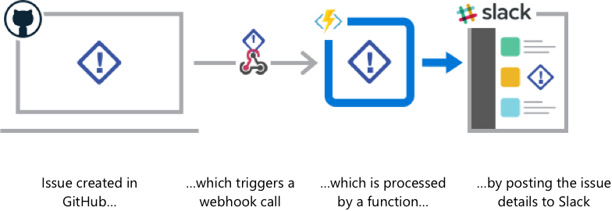
What you can do with Functions
Extending SaaS applications

Slide 20
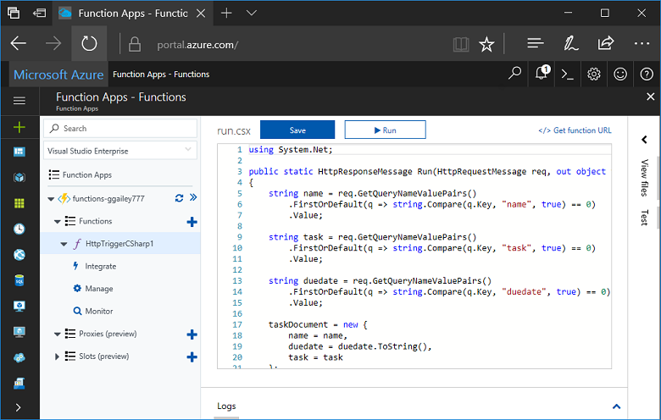
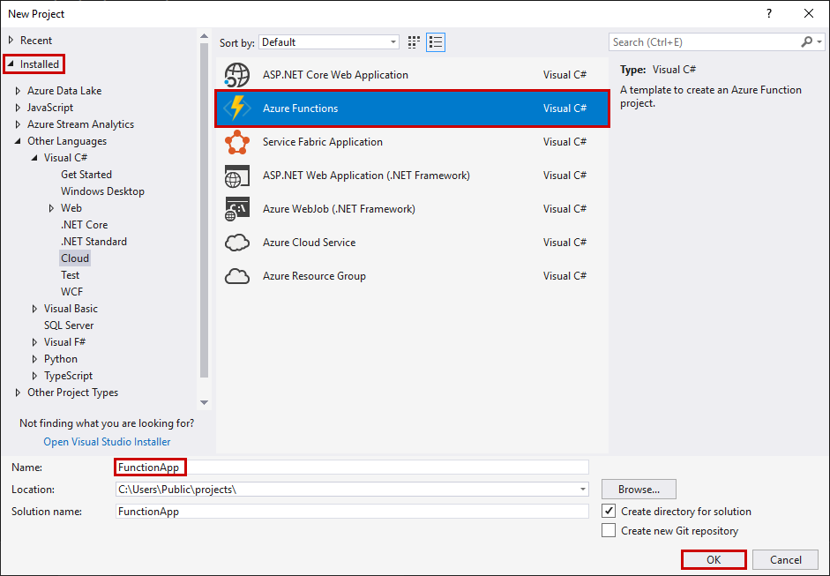
How to create a function app?
Azure portal
Visual Studio / code

Slide 21


Slide 22

Testing/ debuging
Test in Azure Portal
Test with a browser
Test with Postman
Test a blob trigger by using Storage Explorer
Test with a timer trigger
Test a function with code

Slide 23
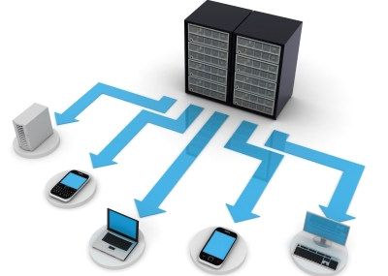
Deployment
Continuous integration BitBucket, Dropbox, GitHub, and Azure DevOps.
Zip deployment Azure CLI, REST APIs, PowerShell
package file
Automate resource deployment

Slide 24
Simple Scenario
{ "ParentTotal":0, "Amount":1
}

Slide 25


