Slide 1
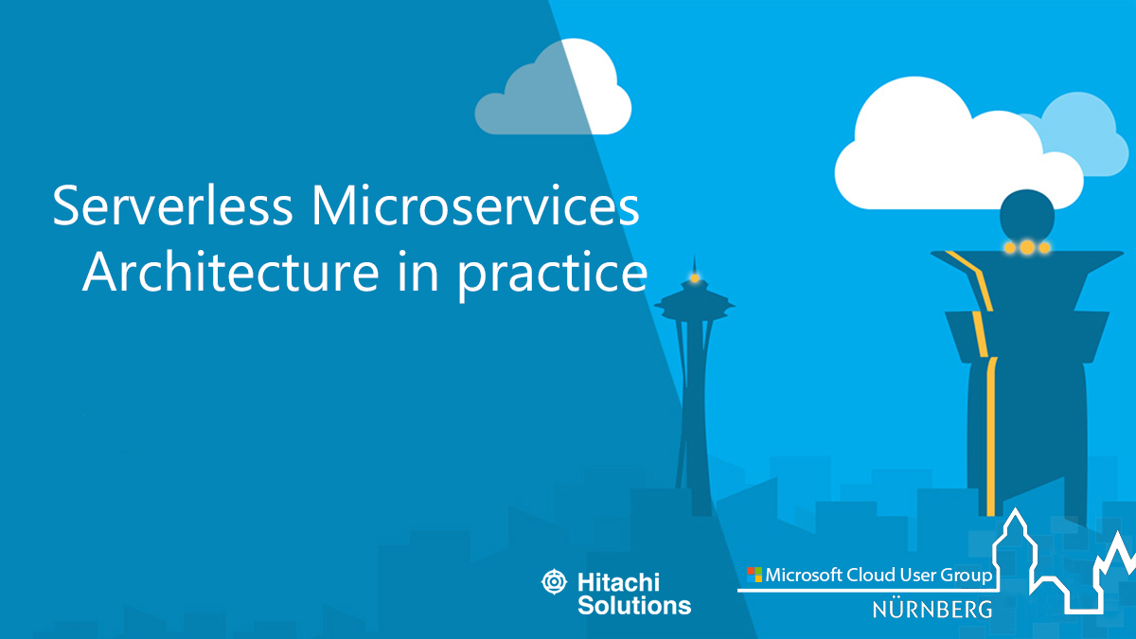

Slide 2



Ehsan Amini Senior Technical Engineer ehsan.amini@outlook.com
https://github.com/EhsanAminii
@ehsannamini

Slide 3

Nuremberg office Bayreuther Straße 1 90409 Nürnberg Deutschland
DE Telephone +49 (0)911 2778 80

Slide 4
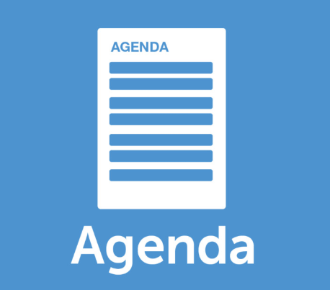
Introduction
Understanding Microservice Architecture
Why?
Serverless microservices?
Best practices
Monolithic architecture
Notes:
Platforms
Service models

Slide 5
Before cloud
What hardware should be installed?
How is physical access to the machine secured?
Does the data center require an Uninterruptible Power Supply (UPS)?
Where are storage backups sent?
Should there be redundant power?
Notes:
A set of requirements that enables one application to talk with another application

Slide 6
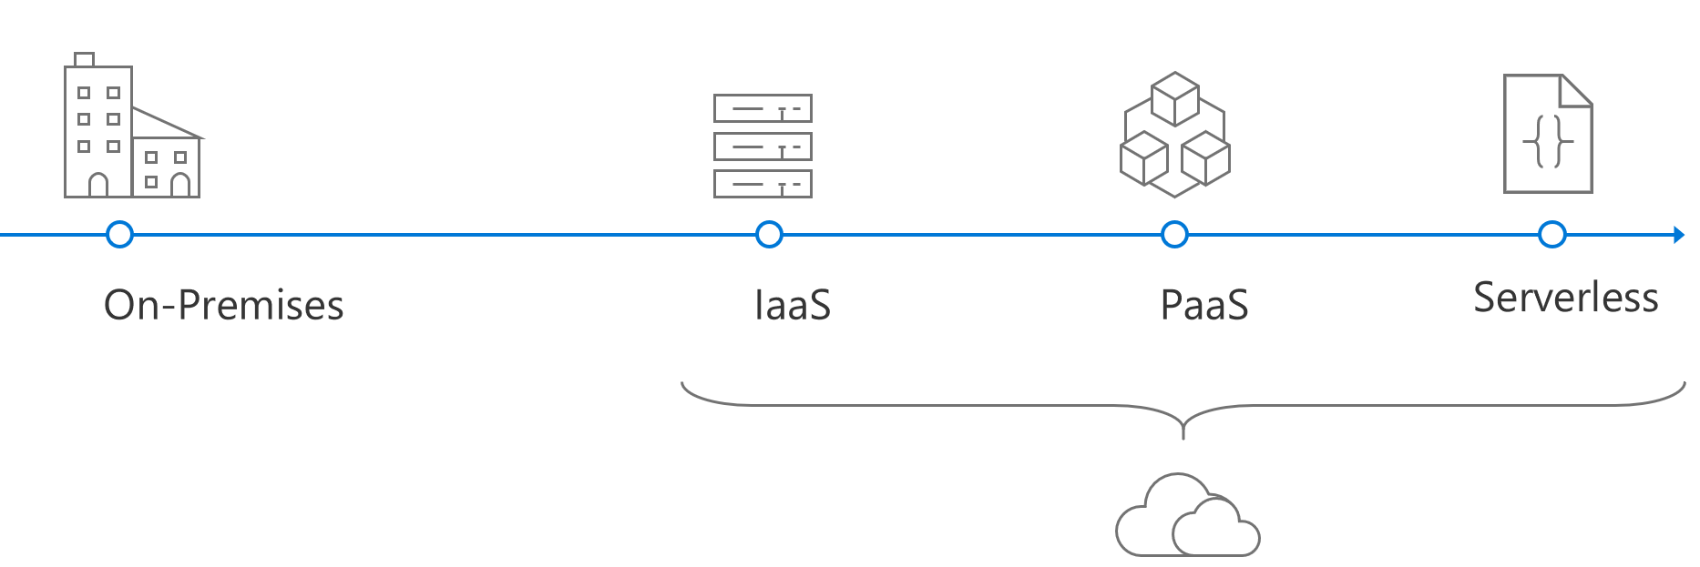
Evolution of cloud platforms
Notes:
A set of requirements that enables one application to talk with another application

Slide 7
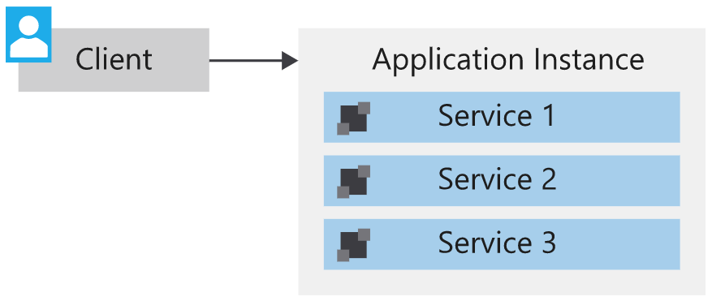
Monolithic Architecture
All components are co located within a single unit
single runtime instance of the application
Suitable Solutions for small Applikation
Difficult to scale services independently
Complex to develop and manage deployments
Slows releases and new feature implementation.
Tied to a single technology stack
Data schema updates can be increasingly difficult.
Notes:
A set of requirements that enables one application to talk with another application

Slide 8
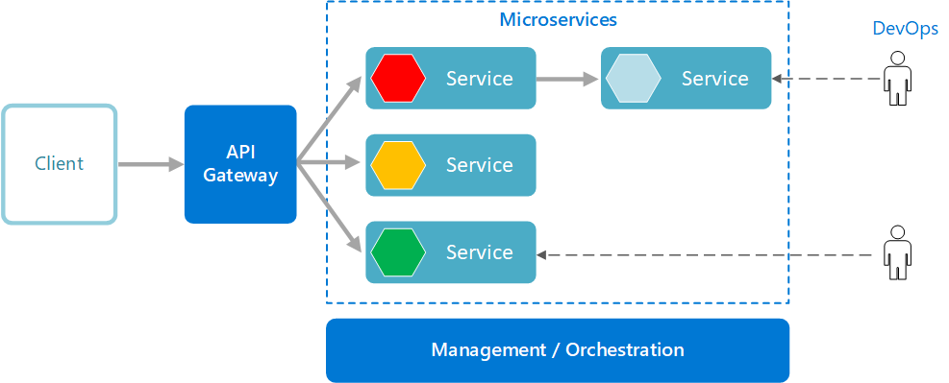
Microservice Architecture
Software Architecture style
Small, independent and loosely coupled modules
Communicate with each other using well-defined API contracts
Small enough to implement a single business capability.
Separate codebase
Different technology stack, library or framework
Notes:
A set of requirements that enables one application to talk with another application

Slide 9
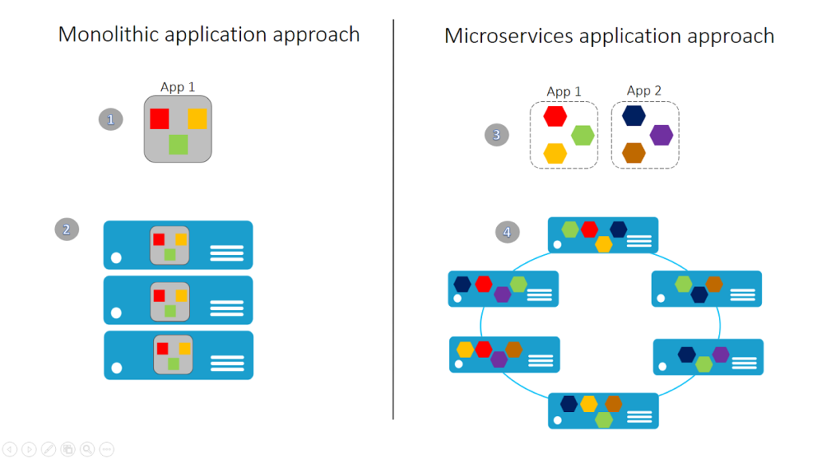
Monolithic vs Microservices Architecture
Notes:
A set of requirements that enables one application to talk with another application

Slide 10

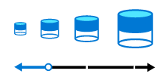


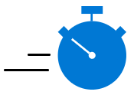
Microservice Architecture Benefits
Agility deliver value faster, Build services independently, easy to manage bug fixes, Independently deploy
Small, focused teams small enough for single feature team
Small code base Minimizing dependency, easy to add feature, take care of just one task
Mix of Technologies use the best approach, different language, best fits to the team
Fault isolation isolate point of failure, improve security and reliability
Data Isolation Scalability Independent services can be scaled
Data Storage / duplicate data easy to perform Schema Updates
Notes:
A set of requirements that enables one application to talk with another application

Slide 11
Challenges
Complexity
Development and testing
Network congestion and latency
Data consistency
Management
Versioning
Notes:
A set of requirements that enables one application to talk with another application

Slide 12
When choose a microservices architecture?
Large applications that require a high release velocity
Complex applications that need to be highly scalable
Applications with rich domains or many subdomains
An organization that consists of small development teams
Notes:
A set of requirements that enables one application to talk with another application

Slide 13
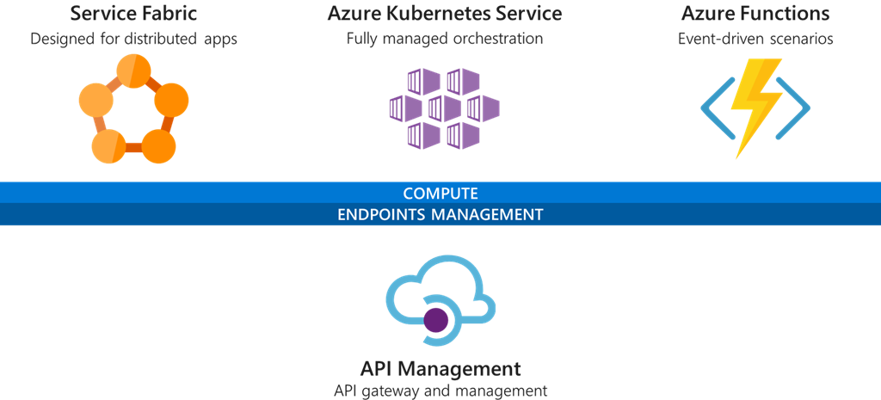
Microsoft Microservices patterns

Slide 14
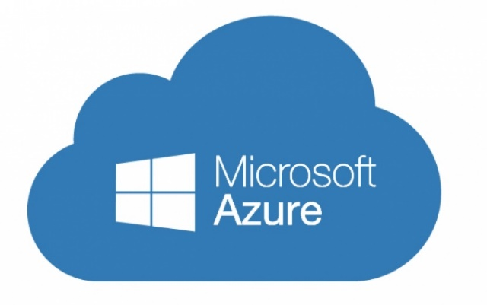

Azure Functions (FaaS)
Serverless compute service
Language of your choice
On demand scale
Micro billing $
Fully managed by azure
Processing data (Images, …)
Integrating systems
IOT solutions

Slide 15
Azure Functions = FaaS++
Integrated Programming model [Built-in trigger and bindings]
Enhanced development experience [Code, test, monitor and debug locally or web-based interface]
Hosting options flexibility [run locally, container, cloud service, …]

Slide 16
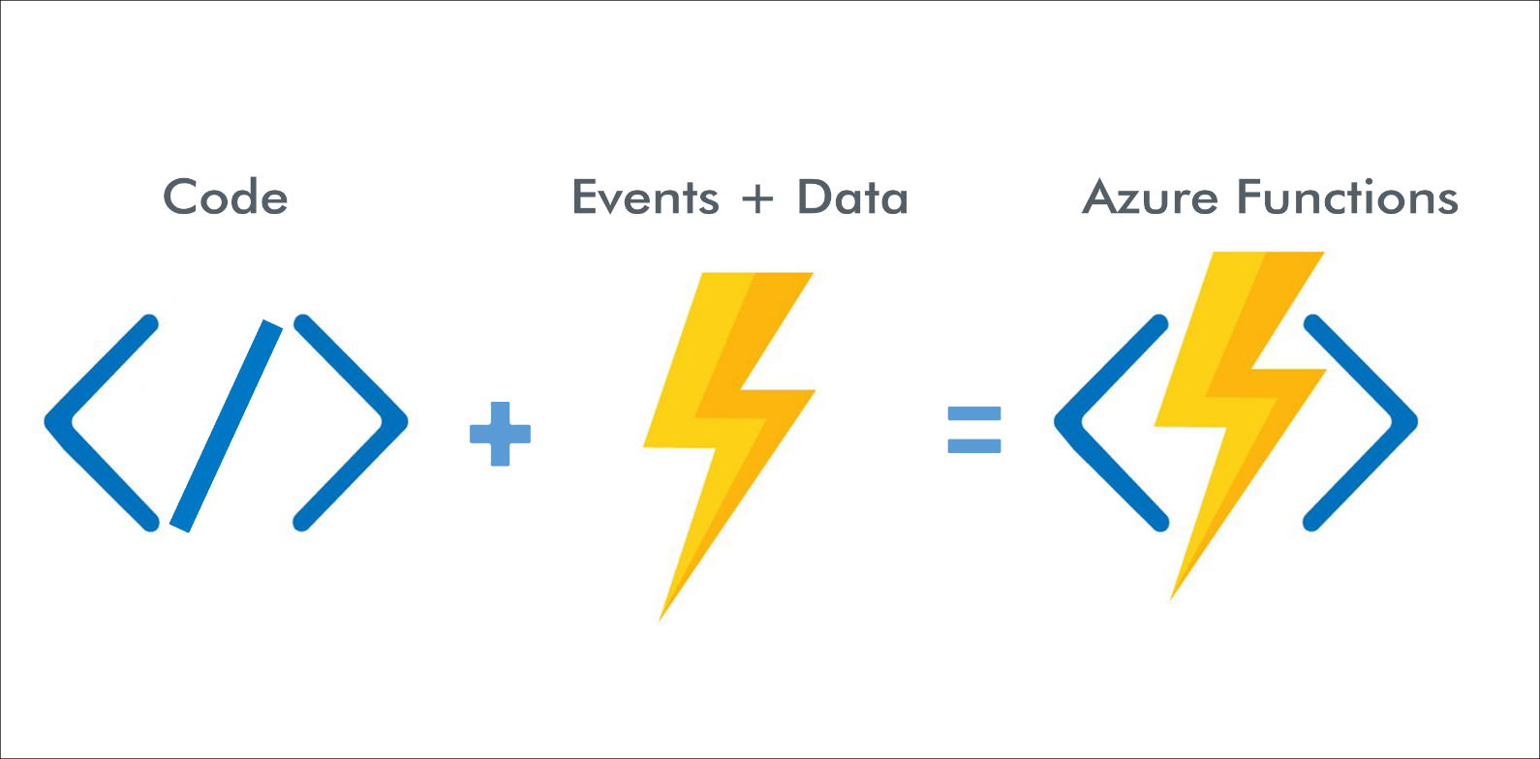
How Azure Functions Works?

Slide 17
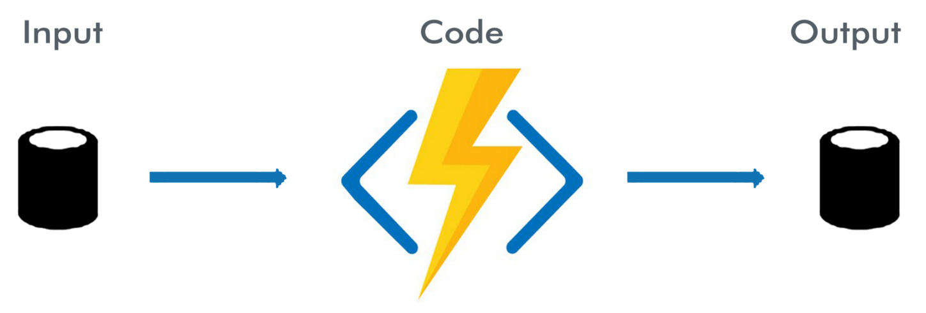
How Azure Functions Works?

Slide 18
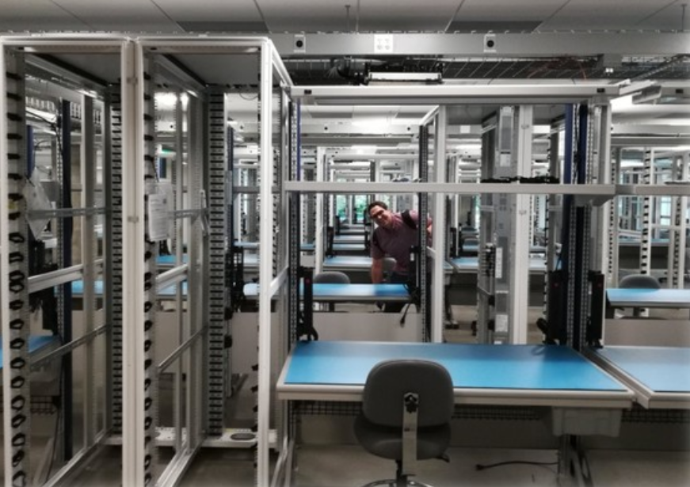
Serverless != no server
Notes:
A set of requirements that enables one application to talk with another application

Slide 19



Azure serverless for event-driven apps
Auto-scale based on workload
No infrastructure management
No wasted resources
Hosting options
Multiple languages
Development environments
Shorter time to market
Fully-managed services
End-to-end dev experince
Notes:
A set of requirements that enables one application to talk with another application

Slide 20
Why FaaS as the center of microservices?
Problem of traditional microservices
Event-driven solution
Scaling of compute resources
Operations dependency
Pay per hosting nodes
Services discovery and managing services integration
Automatic scaling based on workload
No infrastructure management
Pay per execution
Event-based programming model (trigger + binding)
Notes:
A set of requirements that enables one application to talk with another application

Slide 21
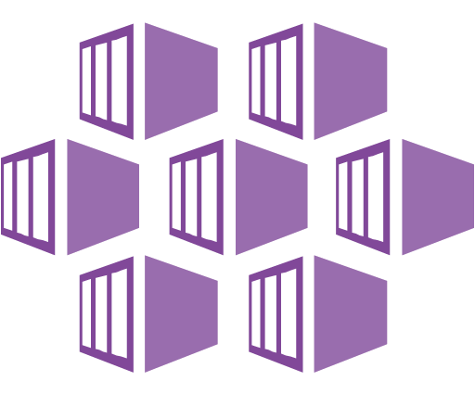
Azure compute option for microservices
Service Orchestrator (manage services running on dedicated nodes [VMs])
Serverless Architecture (using function as a service [FaaS])
An orchestrator handles tasks related to deploying and managing a set of services. These tasks include placing services on nodes, monitoring the health of services, restarting unhealthy services, load balancing network traffic across service instances, service discovery, scaling the number of instances of a service, and applying configuration updates.
With a Serverless Architecture, you don't manage the VMs or the virtual network infrastructure. Instead, you deploy code and the hosting service handles putting that code onto a VM and executing it.
Notes:
A set of requirements that enables one application to talk with another application

Slide 22
Orchestrator or serverless?
Manageability
Flexibility and control
Portability
Application integration
Cost
Scalability
Notes:
A set of requirements that enables one application to talk with another application

Slide 23


Slide 24
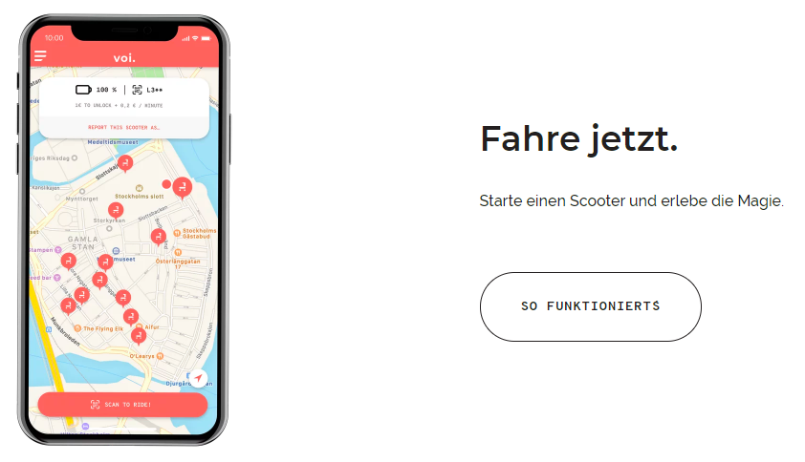

Scooter App
Notes:
For example, perhaps you want to access all Twitter tweets that mention the #epicodus hashtag.

Slide 25
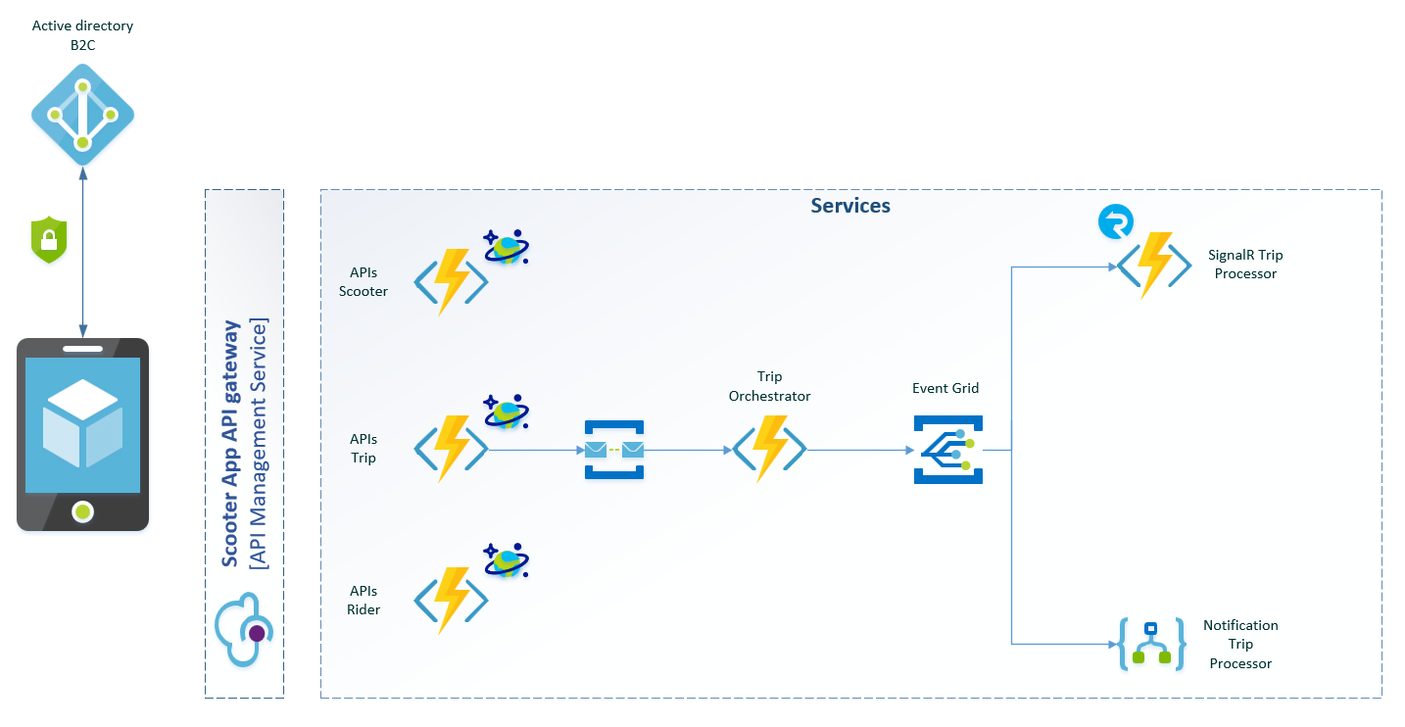

Slide 27


