Slide 1

Ehsan Amini @ehsannamini
Azure API Management for Serverless workloads

Slide 2



Ehsan Amini Senior Technical Engineer ehsan.amini@outlook.com
https://github.com/EhsanAminii
@ehsannamini

Slide 3

Nuremberg office Deutschherrnstrasse 15-19 90429 Nuremberg Germany
DE Telephone +49 (0)911 277 88 0

Slide 4

Introduction to API
Azure API Management
Scenario 1 demo
Pricing details
Security and policies
Scenario 2 demo
Versioning
New developer portal (preview)
Notes:
Platforms
Service models

Slide 5
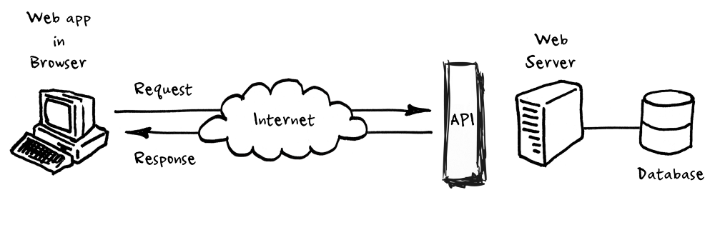
Web API?
Application Programming Interface
Allow applications to communicate with one another
A publicly available web-based API that returns data, likely in JSON or XML
Notes:
A set of requirements that enables one application to talk with another application

Slide 6
But why would we need an API?
Access to data with standatd communication
Keep data up to date
Notes:
For example, perhaps you want to access all Twitter tweets that mention the #epicodus hashtag.

Slide 7
Who need to use/create API?
Applications [web, component]
Organizations [ extern, intern, social media, Smart Cities]
Person [personal, socials]

Slide 8
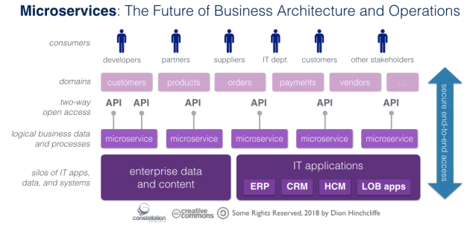
Digital transformation run on APIs

Slide 9

What is API Management?
Development Engagement
Analytics
Policy Enforcement
Authentication and authorization
Notes:
API Management enables both developers and architects to manage the key stages of an API as it designed, published and shared with its consumer base. Key aspects of security, documentation, API growth and other important requirements can all be managed with API Management.

Slide 10
Azure API Management Service
turnkey cloud hosted and fully managed solution to enable publishing APIs to external and internal customers.

Slide 11

Azure API Management Service
Manage all your APIs in one place
Secure and optimize your APIs
Gain insights into your APIs
Connect to back-end services anywhere

Slide 12
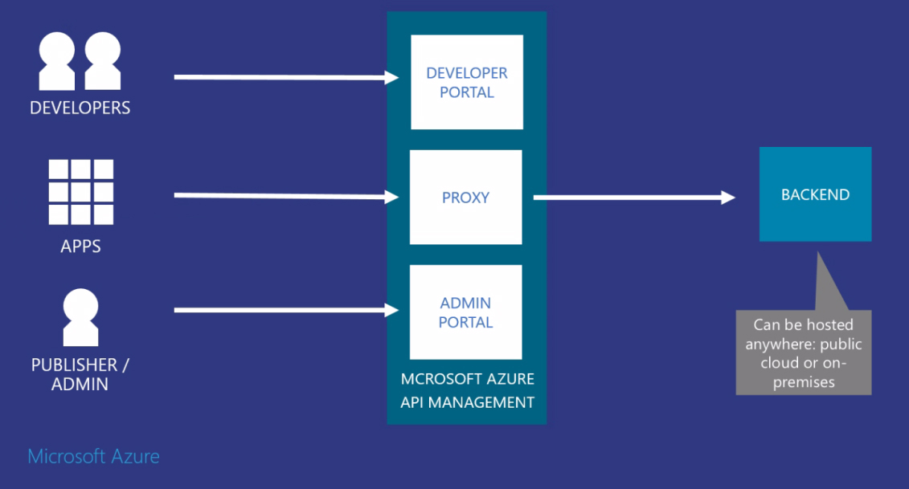
A hub for enterprise APIs

Slide 13
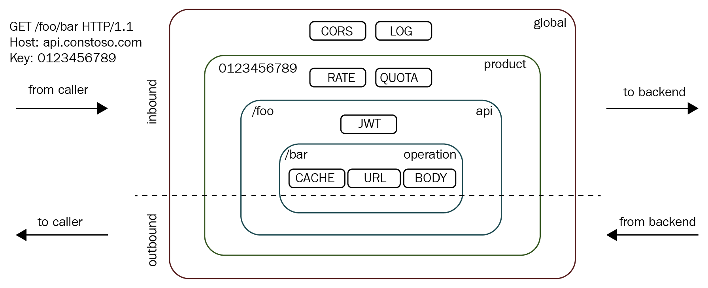
Scopes

Slide 14
Scenario 1

Slide 15


Slide 16
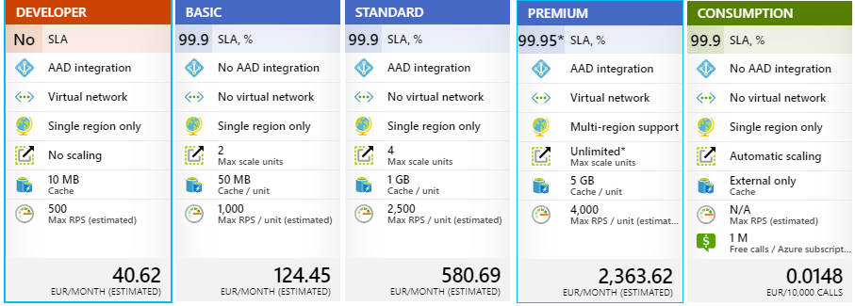
Pricing detail

Slide 17
Policies
Simple XML document
collection of Statements that are executed sequentially on the request or response of an API
change the behavior of the API through configuration
applied to inbound request and outbound response.
consumer
policy
Manage API
conversion from XML to JSON
call rate limiting

Slide 18
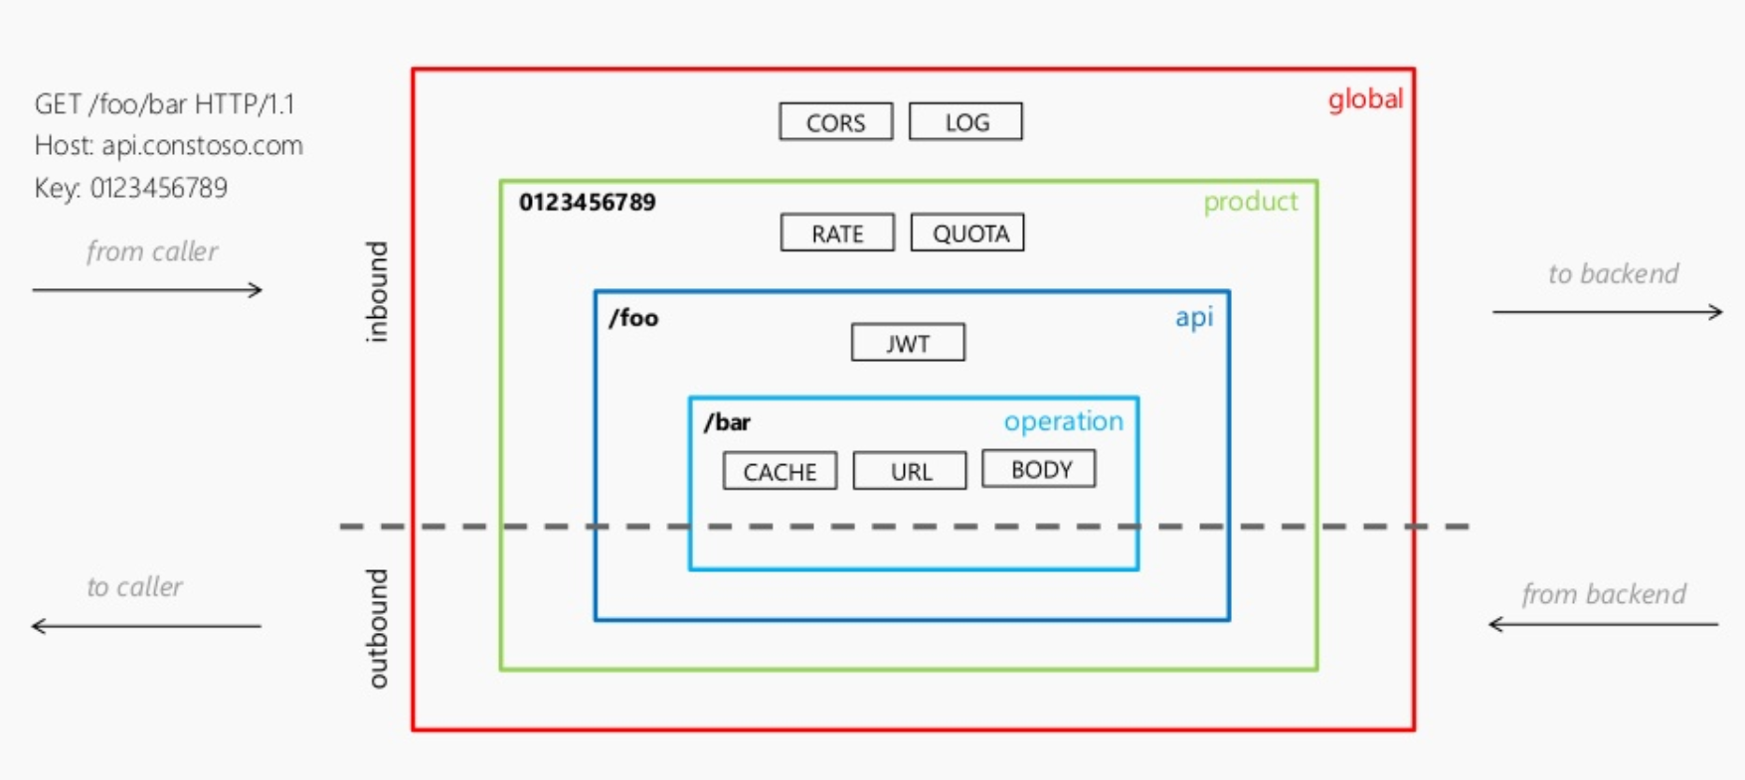
Policy scopes

Slide 19
Scenario 2

Slide 21
Security and protection
Subscription
OAuth2.0
Client certificates
IP whitelisting

Slide 22
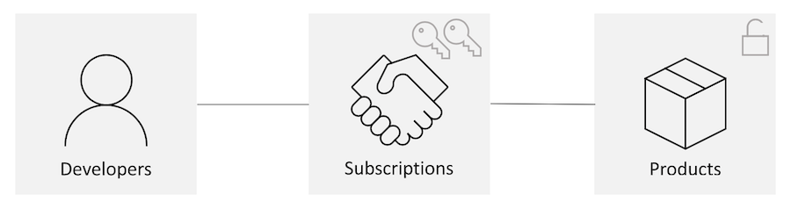
What are subscriptions?
common way for API consumers to get access to APIs published
Scopes: product, all APIs, or an individual API.

Slide 24
What are Versions & Revisions?
Versions:
Publish multiple versions of your API at the same time
Use path/query string or header to differentiate between versions.
Use any string value you wish to identify your version (a number, a date, a name).
Show your API versions grouped together on the developer portal.
Revisions:
Safely make changes to your API Management API definitions & policies, without disturbing your production API
Try out changes before publishing them.
Document the changes you make, so your developers can understand what is new.
Rollback if you find issues.

Slide 26
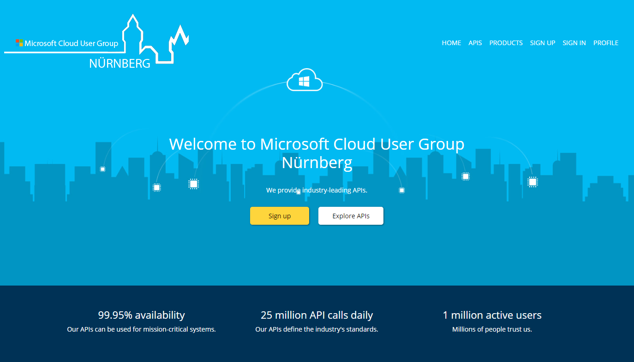
New developer portal (preview)

Slide 28


