Slide 1

Serverless computing
with Azure Functions V2

Slide 2



Ehsan Amini Senior Technical Engineer ehsan.amini@outlook.com
https://github.com/EhsanAminii
@dorhost

Slide 3



Slide 4
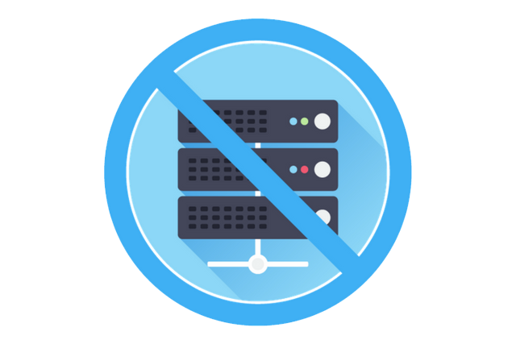
Serverless?
On-demand CPU | On-demand RAM | Pay by usage
Notes:
Warum serverless?

Slide 5
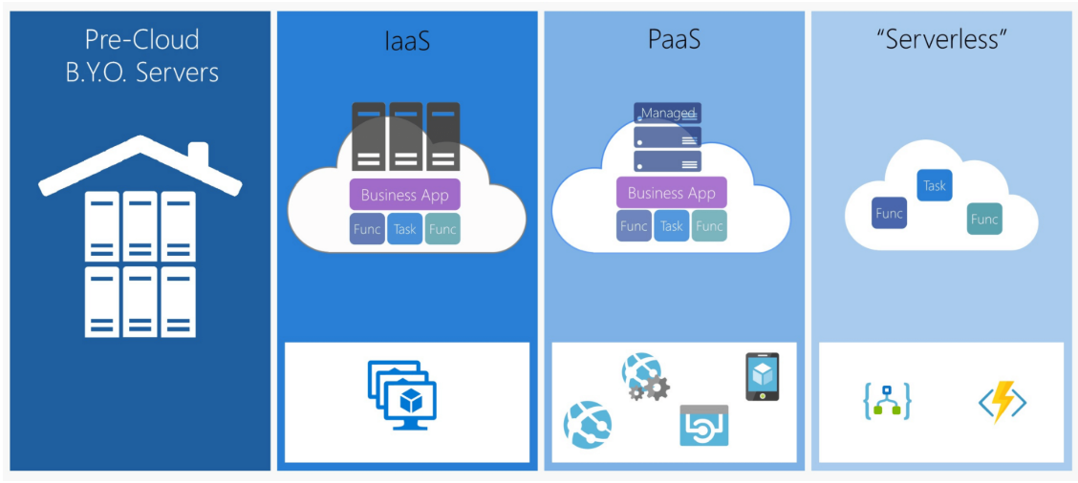
Notes:
Warum serverless?

Slide 6

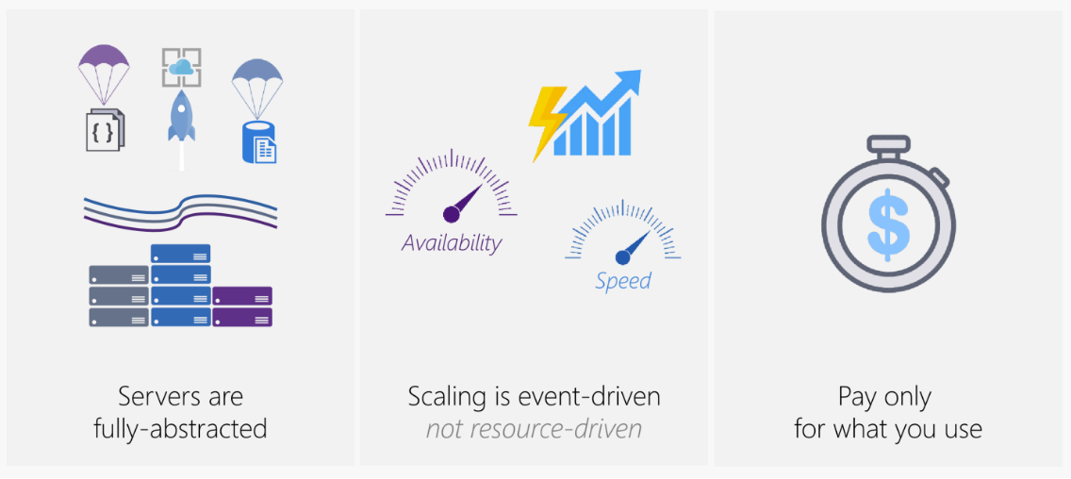
So, what really is Serverless?
Notes:
Warum serverless?

Slide 7
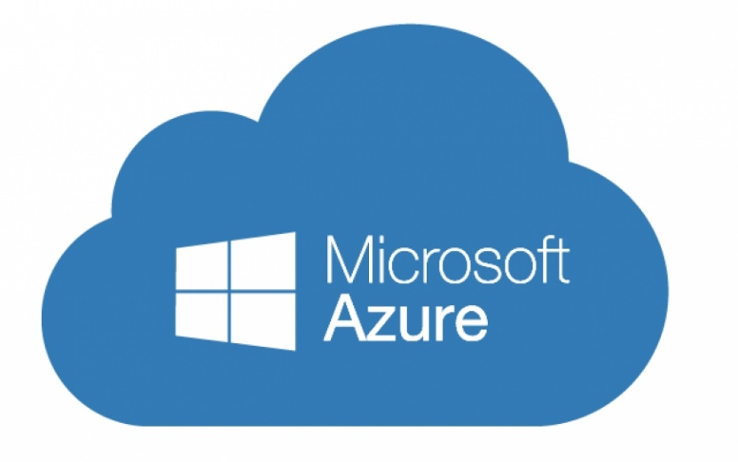

Azure Functions (FaaS)
Serverless compute service
Language of your choice
On demand scale
Micro billing $
Fully managed by azure
Processing data (Images, …)
Integrating systems
IOT solutions

Slide 8
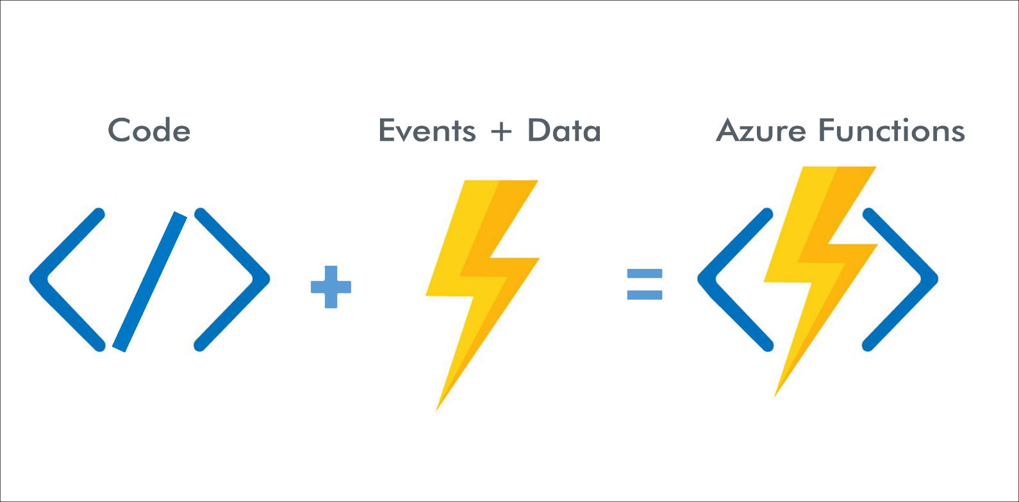
How Azure Functions Works

Slide 9
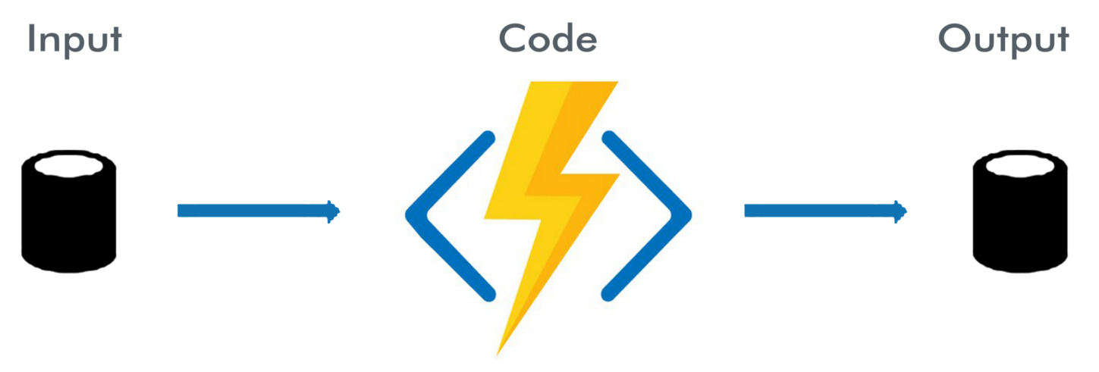
How Azure Functions Works

Slide 10
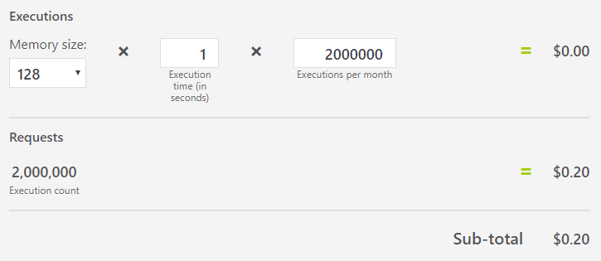
Azure functions Hosting
Consumption plan
Dynamics instances (scale out)
Pay only by running
Max running time up to 10 min
App Service plan
dedicated App Service plan
Always running
Long running time (more than 10 min)
Fix costs
No auto scale

Slide 11
Azure Functions triggers and bindings

Slide 12
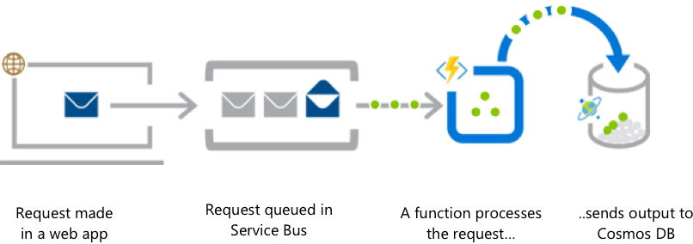
What you can do with Functions
Web application backends

Slide 13
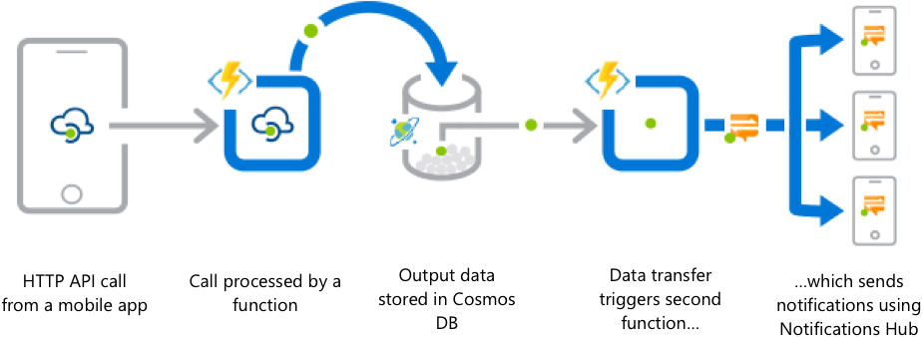
What you can do with Functions
Mobile application backends

Slide 14
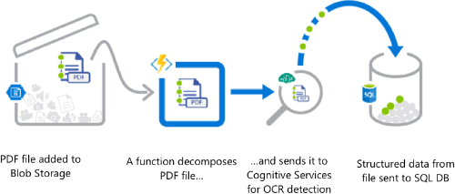
What you can do with Functions
Real-time file processing

Slide 15
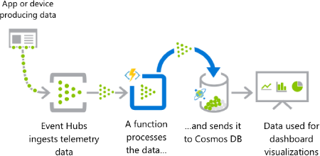
What you can do with Functions
Real-time stream processing

Slide 16
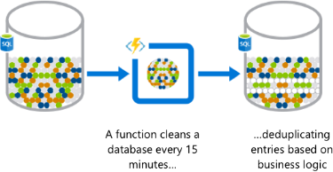
What you can do with Functions
Automation of scheduled tasks

Slide 17
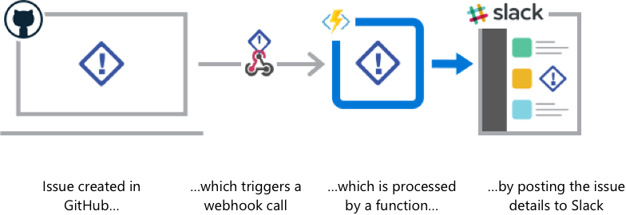
What you can do with Functions
Extending SaaS applications

Slide 18
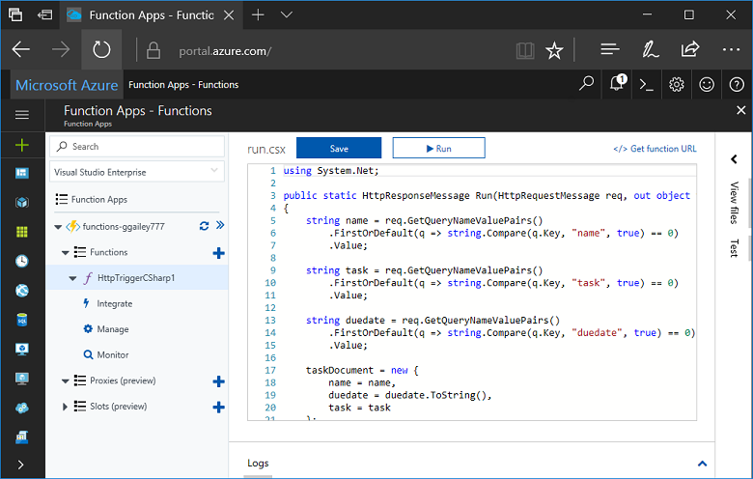
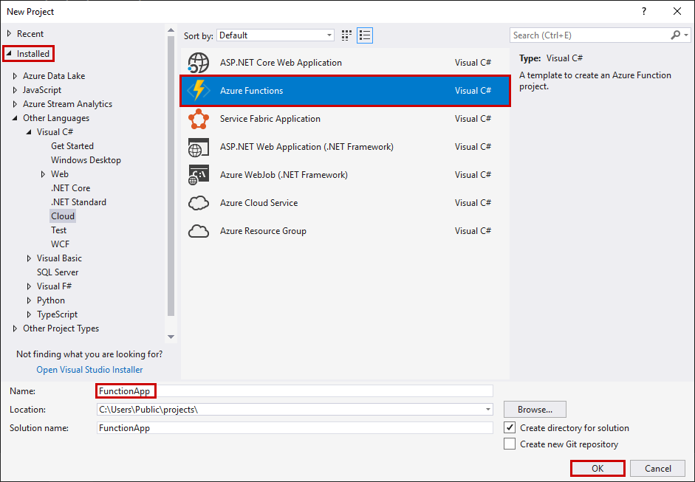
How to create a function app?
Azure portal
Visual Studio / code

Slide 19


Slide 20
Example Scenario

