Slide 1
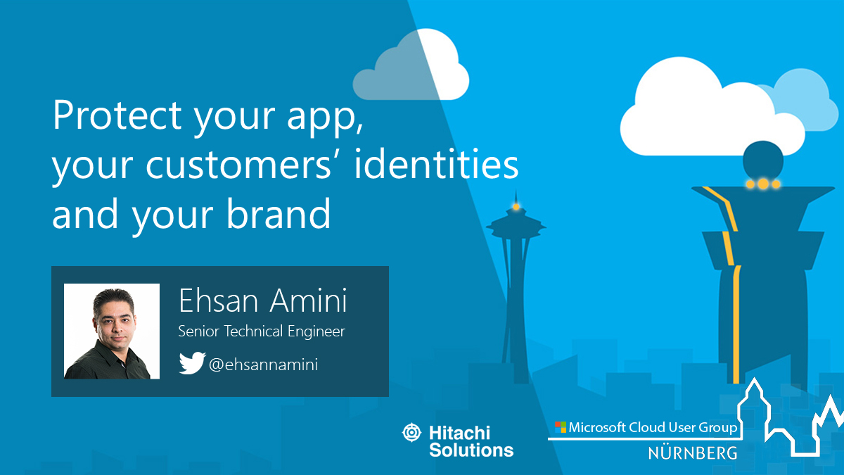

Slide 2



Ehsan Amini Senior Technical Engineer ehsan.amini@outlook.com
https://github.com/EhsanAminii
@ehsannamini

Slide 3

Nuremberg office Bayreuther Straße 1 90409 Nürnberg Deutschland
DE Telephone +49 (0)911 2778 80

Slide 4

Introduction
Why and When?
User experience customization
Demo
Q&A, Networking
Azure Active directory B2C as a service
Authentication protocols

Slide 5
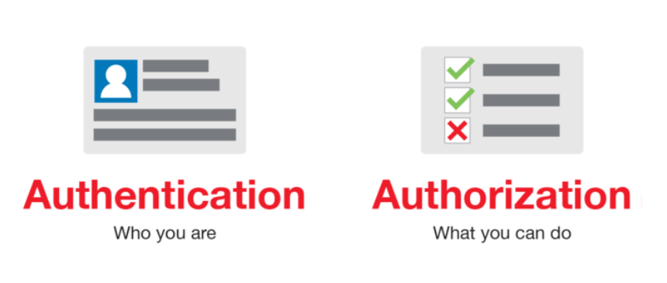
Authentication/ Authorization

Slide 6
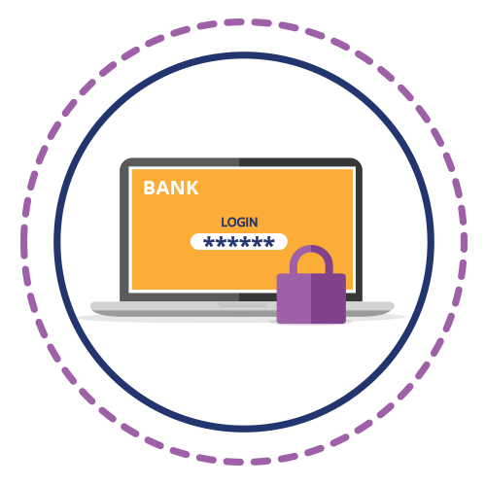
Evolution of Authentications
Basic
Digest
Form
Windows

Slide 7
Evolution of Authentications
Open ID
OAuth 2
Oauth1

Slide 8
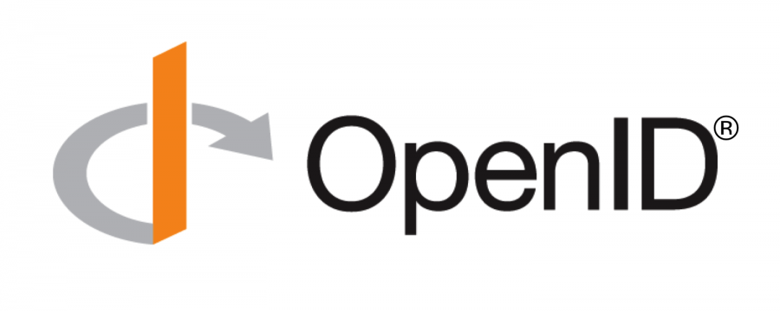
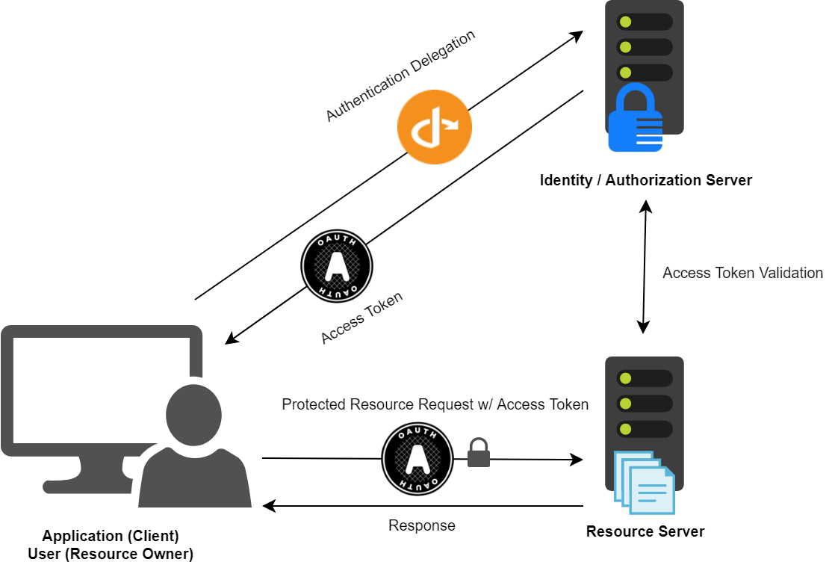
Connect and OAuth
Notes:
OpenID Connect 1.0 is a simple identity layer on top of the OAuth 2.0 protocol. It allows Clients to verify the identity of the End-User based on the authentication performed by an Authorization Server, as well as to obtain basic profile information about the End-User in an interoperable and REST-like manner.

Slide 9

Azure Active directory B2C
Notes:
In Azure Active Directory B2C (Azure AD B2C), a tenant represents your organization and is a directory of users. Each Azure AD B2C tenant is distinct and separate from other Azure AD B2C tenants. An Azure AD B2C tenant is different than an Azure Active Directory tenant, which you may already have.

Slide 10
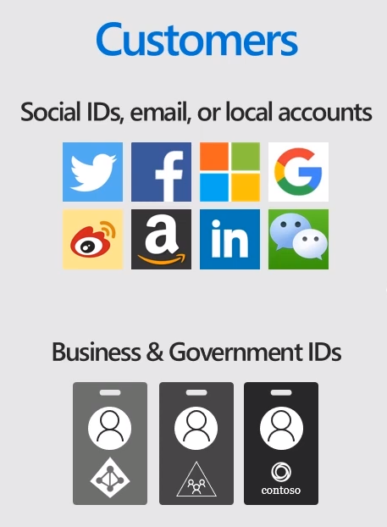
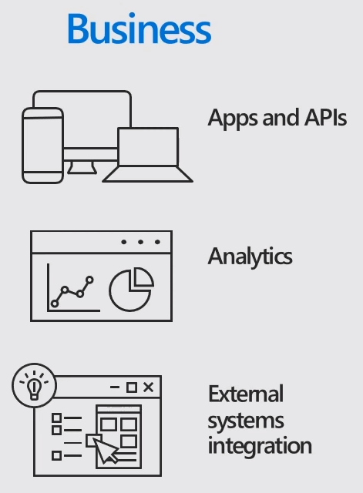
Identity as a Service (IDaaS)
Cloud-based central Authentication Solution
Extends Azure AD
Connecting all public-facing apps, APIs or modern applications
Using Social identity, Enterprise identity or local account
Customized and branded
Capture user profile and analytic information
Notes:
White labeled authentication solutions -> enable business, government and other organizations -> to provide their customer, citizens or consumers => to access public facing web and mobile application using the identity their already have.
Social identity, enterprise identity or local account.
Branded and customized

Slide 11
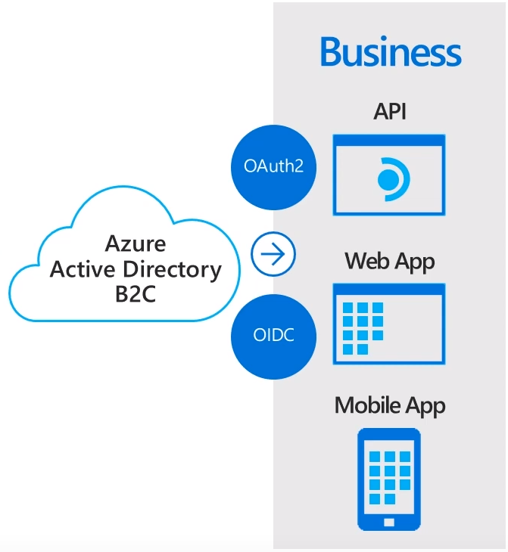
Identity as a Service (IDaaS)
Provide Single sign on for any API, web and mobile application
Provide Safety and scalability
Use standard base authentication protocols (Open Id connect, Oauth2 or SAML)
Support for multiple identity providers
Notes:
Many of the tokens issued by Azure AD B2C via the OpenID Connect 1.0 and OAuth 2.0 protocols are implemented with the JSON Web Token (JWT) format. JWT is a compact token format that is especially apt for REST-based development. JWT use is growing, and products supporting the format are increasingly common in the industry.
JSON Web Token (JWT): http://tools.ietf.org/html/rfc7519

Slide 12
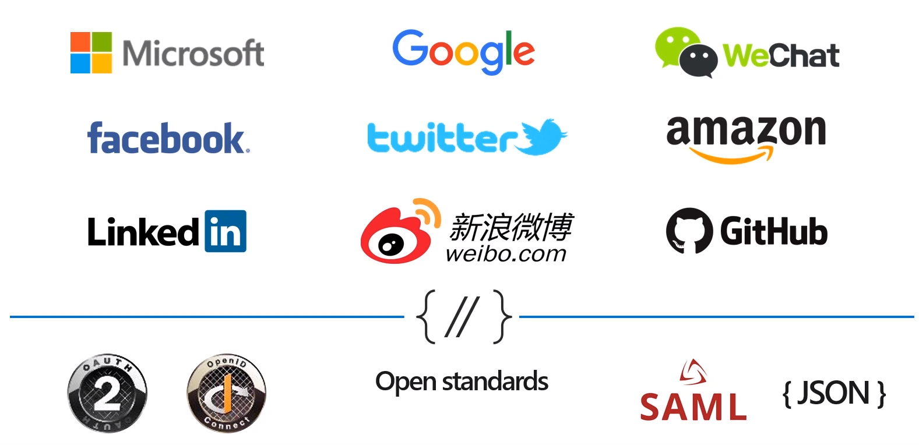
Multiple identity providers
Notes:
Out of the box support to integrate many third-party identity providers
Social identities
Developer accounts from GitHub
Any other external identity provider which support standard protocols

Slide 13
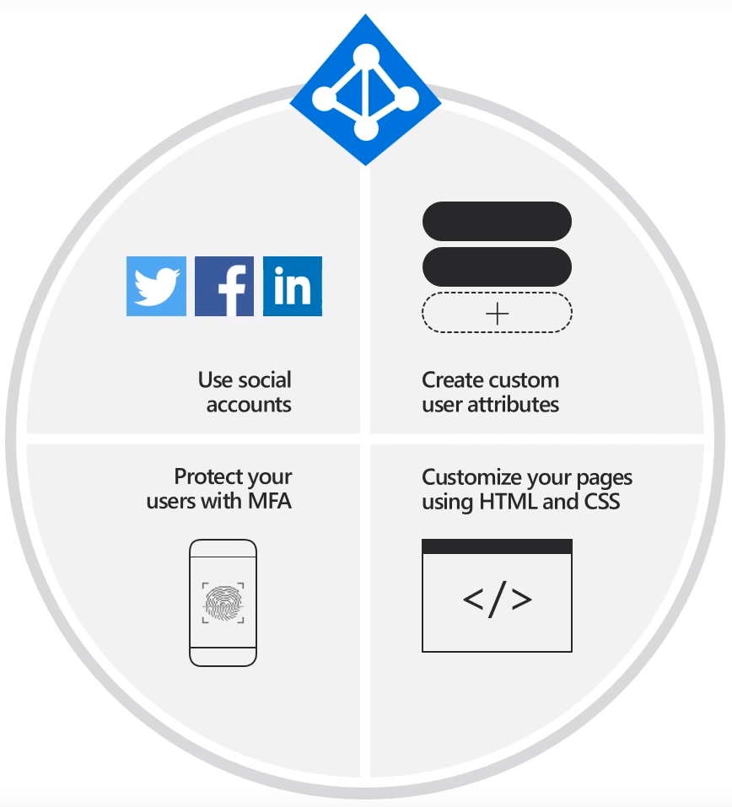
Build your solution your way
Sign-in any user, any identity provider, social or email, consumer and enterprise
Customize each pixel, your brand, your HTML and CSS
Use built-in, self-service, user journeys
Scale to 100s of million of users, enterprise ready, secure, cost effective
Notes:
B2C is also extremely customizable solution which fit easy to any customer facing application
Customize every page to Look and feel like your application

Slide 14
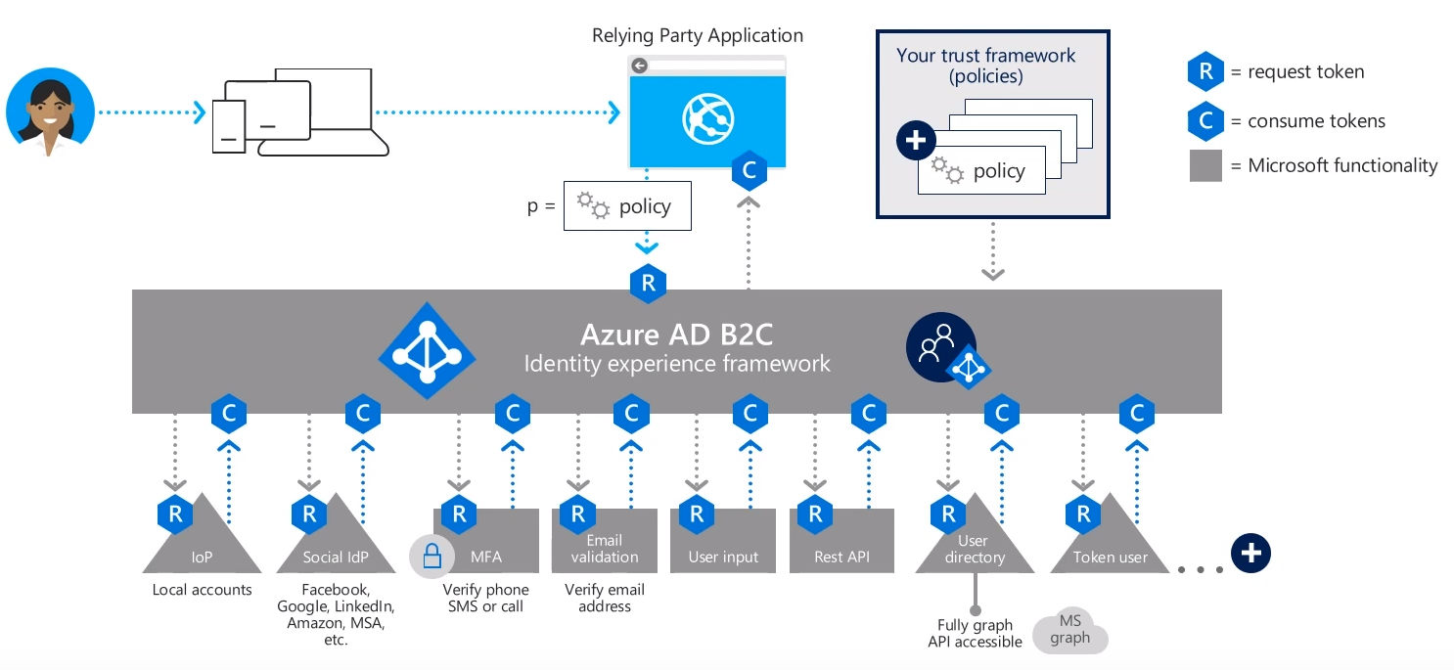
Cloud-secure identity and data orchestration/ custom rules
Notes:
The power of Azure AD B2C lies on Identity experience framework
Powerful orchestration engine ->used to build any authentication, user registration, profile editing or account recovery experience
Build complicated user journey using combination any kind of steps like federation authentication with other identity providers , Multifactor authentication, gather user data from different resources.
Creating custom policies

Slide 15
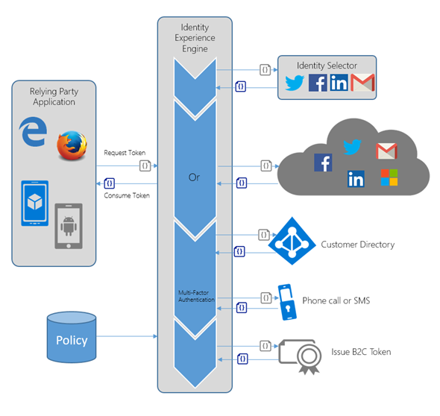
Authentication with Azure AD B2C
Notes:
A set of requirements that enables one application to talk with another application

Slide 16
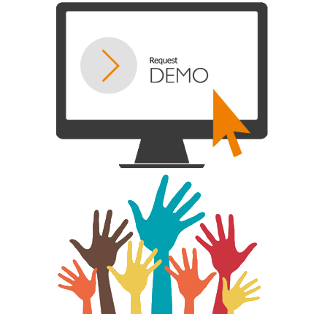

Slide 17
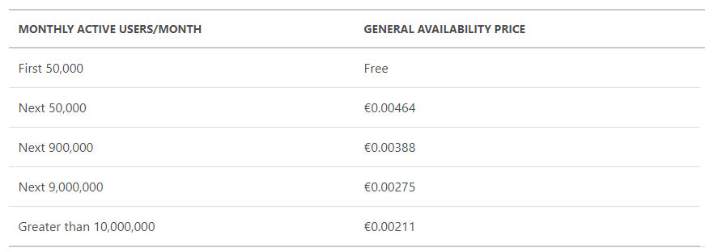
Azure Active Directory B2C pricing
(50,000 MAUs x €0 (Free tier)) + (50,000 MAUs x €0.0047) = €231.908
Guaranteed 99.9% uptime
Notes:
Azure Active Directory B2C is priced on a Monthly Active User (MAU) basis, helping customers to reduce costs and plan ahead with confidence.

Slide 18


