Slide 1


Serverless Microservices Architecture in practice
27.02.2020

Slide 2






Ehsan Amini Senior Technical Engineer ehsan.amini@outlook.com
https://github.com/EhsanAminii
@ehsannamini

Slide 3

Introduction
Microservice Architecture
Why?
Serverless microservices?
Best practices
Monolithic Architecture

Slide 4
Before cloud
What hardware should be installed?
How is physical access to the machine secured?
Should there be redundant power?
Where are storage backups sent?

Slide 5
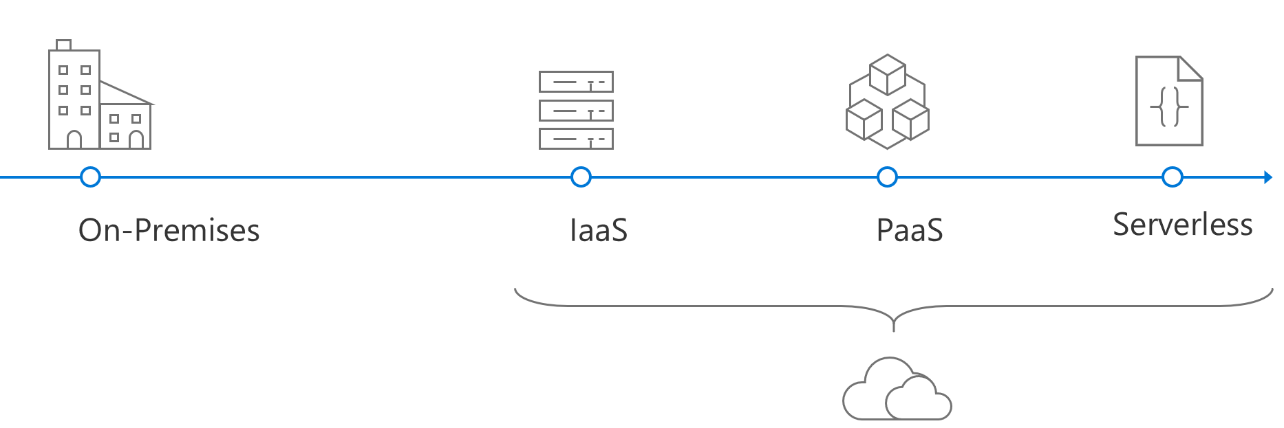
Evolution of cloud platforms
Notes:
The computing world has changed forever with the advent of the cloud. Cloud gives developers access to infrastructure instantly, cheaply, and at nearly infinite scales. The agility of cloud and high availability and constant agility demands of modern business have strained monolithic architectures and resulted in the rise of microservices-based applications.

Slide 6
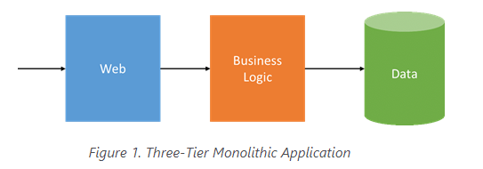
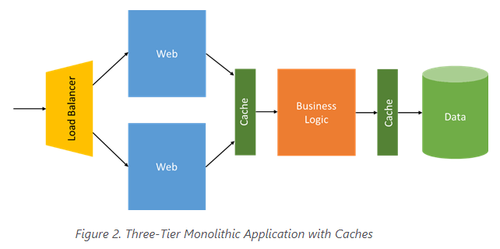
Monolithic Architecture
All components are co located within a single unit
single runtime instance of the application
Suitable Solutions for small Application
Difficult to scale services independently
Complex to develop and manage deployments
Slows releases and new feature implementation.
Tied to a single technology stack
Data schema updates can be increasingly difficult.
Notes:
For decades, the cost, time, and complexity of provisioning new hardware, whether physical or virtual, has strongly influenced application development.

Slide 7


Microservice
is an approach to developing a single application as a suite of small services, each running in its own process and communicating with lightweight mechanisms, often an HTTP resource API. These services are built around business capabilities and independently deployable by fully automated deployment machinery. There is a bare minimum of centralized management of these services, which may be written in different programming languages and use different data storage technologies.

Slide 8
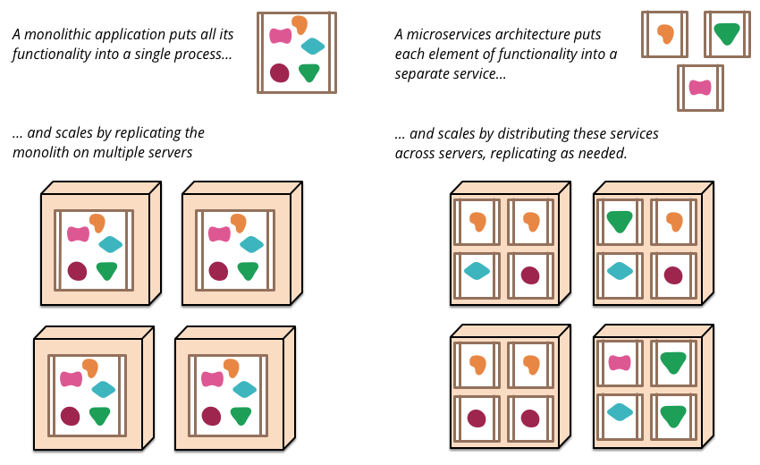
Monoliths and Microservices

Slide 9
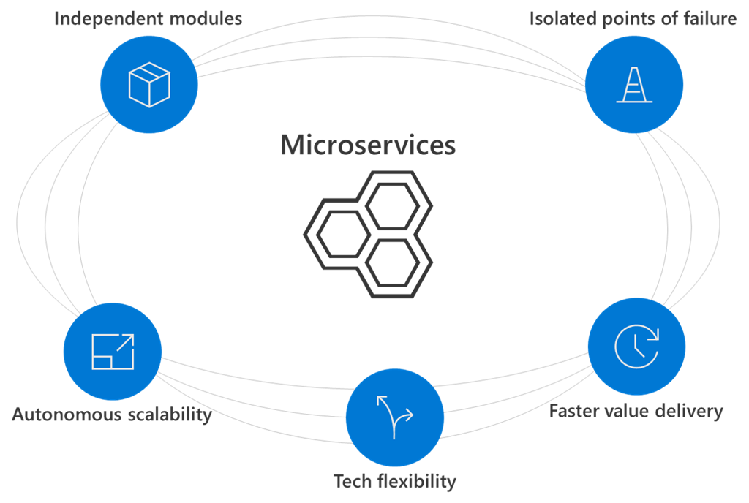
Microservice Architecture Benefits

Slide 10

Challenges
Complexity
Development and testing
Network congestion and latency
Data consistency
Management
Monitoring

Slide 11
When choose a microservices architecture?
Large applications that require a high release velocity
Complex applications that need to be highly scalable
Applications with rich domains or many subdomains
An organization that consists of small development teams

Slide 12
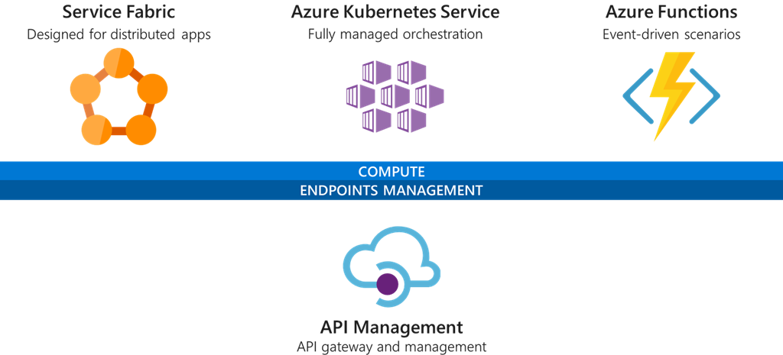
Microsoft Microservices patterns

Slide 13
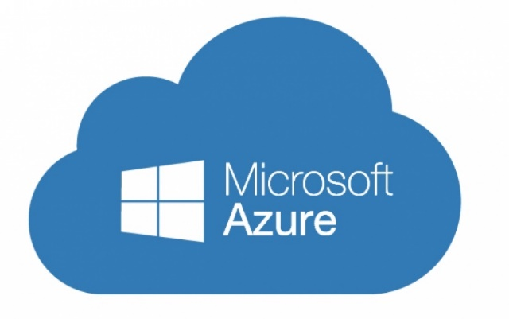

Azure Functions (FaaS)
Serverless compute service
Language of your choice
On demand scale
Micro billing $
Fully managed by azure
Processing data (Images, …)
Integrating systems
IOT solutions

Slide 14
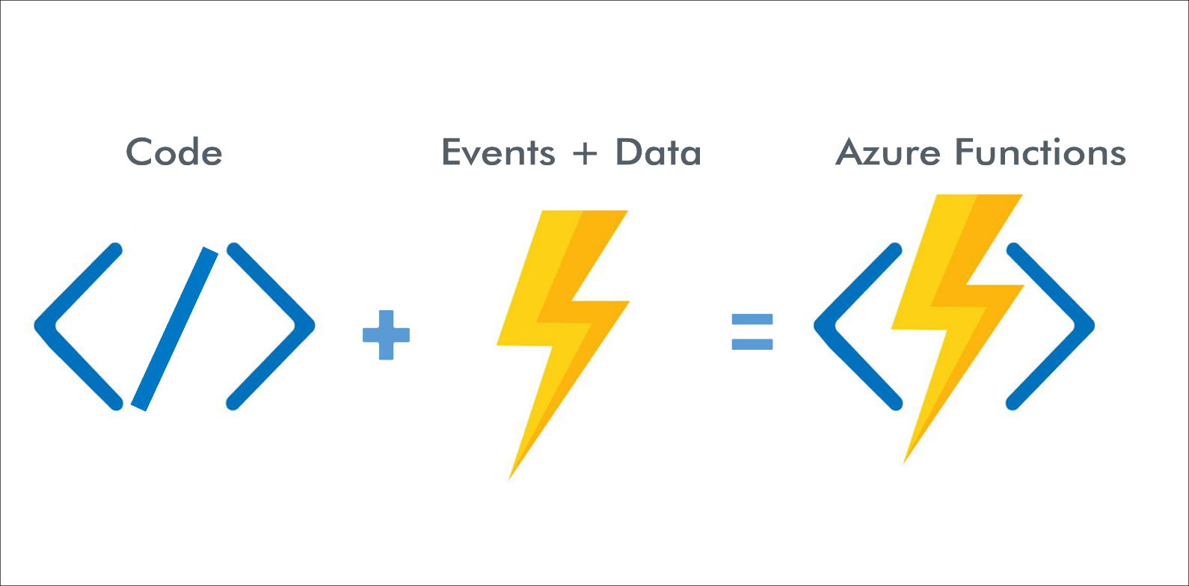
How Azure Functions Works?

Slide 15
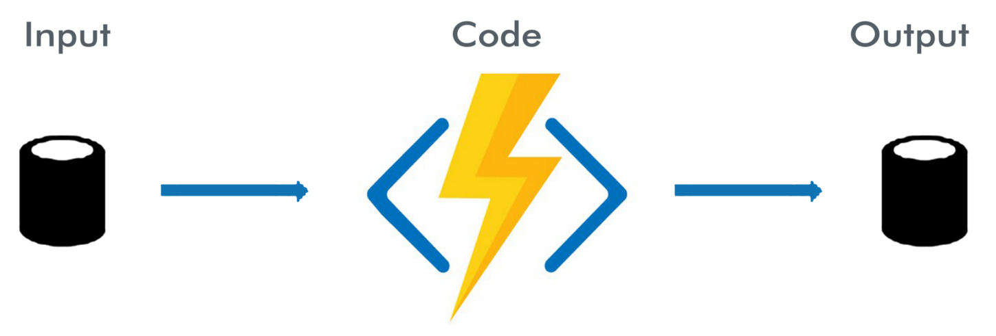
How Azure Functions Works?

Slide 16
Why FaaS as the center of microservices?
Problem of traditional microservices
Event-driven solution
Scaling of compute resources
Operations dependency
Pay per hosting nodes
Services discovery and managing services integration
Automatic scaling based on workload
No infrastructure management
Pay per execution
Event-based programming model (trigger + binding)
Notes:
A set of requirements that enables one application to talk with another application

Slide 17
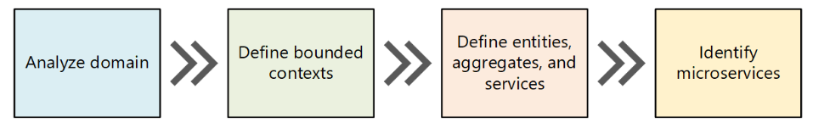
Domain-driven design (DDD) a way to a set of well-designed microservices.
Notes:
Microservices should be designed around business capabilities.
In addition, they should have loose coupling and high functional cohesion.
Microservices are loosely coupled if you can change one service without requiring other services to be updated at the same time

Slide 18
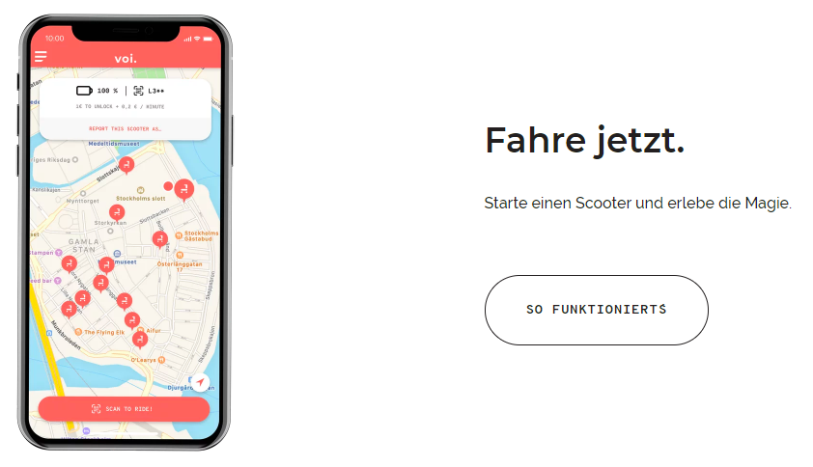

E-Scooter App
Notes:
For example, perhaps you want to access all Twitter tweets that mention the #epicodus hashtag.

Slide 19
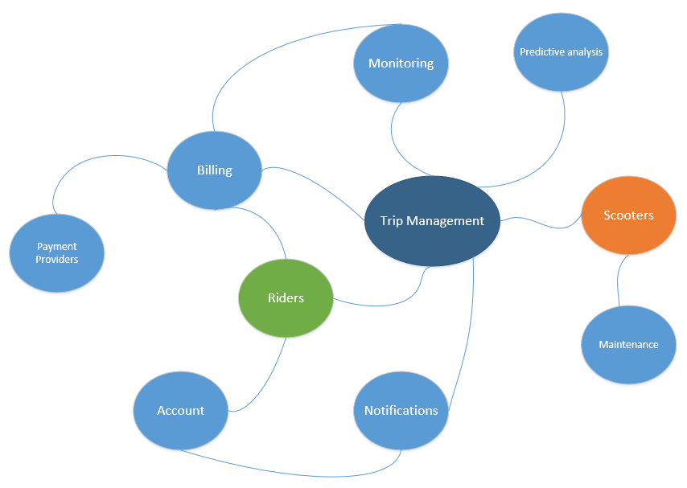
Analyzing Domain
Notes:
Microservices should be designed around business capabilities.
In addition, they should have loose coupling and high functional cohesion.
Microservices are loosely coupled if you can change one service without requiring other services to be updated at the same time

Slide 20
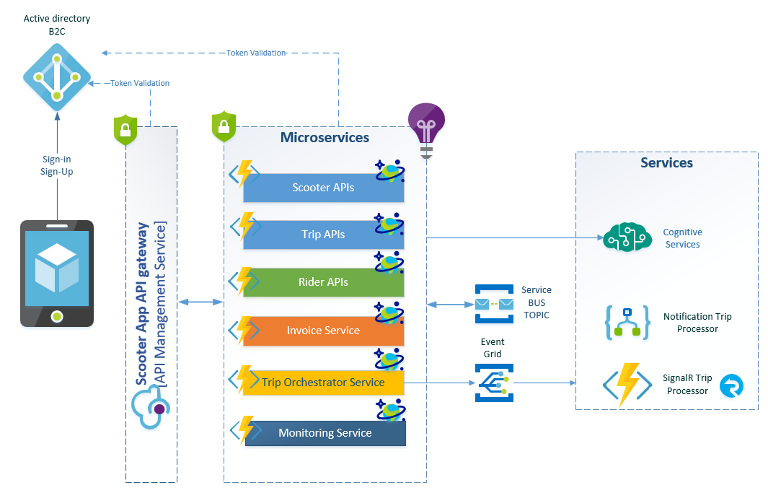

Slide 21


Slide 22


