Slide 1
Detecting Thread Communication Patterns in OpenMP Applications
Ehsan Amiryousefi
Supervisor: Dr. Ali Jannesari
Notes:
Add a photo instead of the text in the white area

Slide 2
Why Temporal Information in Communication Pattern is Necessary?
Thread mapping
To have less communication overhead
Based on the extracted communication
patterns
Thread synchronization
To have better performance
By reducing energy consumption
Threads
Core 1
Core 2
Core 3
Core 4
L1 Cache
L1 Cache
L1 Cache
L1 Cache
L2 Cache
L2 Cache
L3 Cache
Main Memory
Core 1
Core 3
Waiting
Waiting
Waiting
Time
Time
Notes:
Add photos

Slide 3
Outline
Introduction
OpenMP
DiscoPoP
State of the Art
Objectives
Approach
Evaluation

Slide 4

OpenMP
A shared-memory application programming interface (API)
User-friendly
Portable
Often used in SMP architectures
Not a new programming language
Notation that can be added to a sequential program in Fortran, C, or C++
Enables applications to benefit from shared-memory parallel architectures—often with minimal modification to the code
Notes:
Refer to OpenMp book page 8-10
Add photo

Slide 5
Outline
Introduction
OpenMP
DiscoPoP
State of the Art
Objectives
Approach
Evaluation

Slide 6
DiscoPoP (Discovery of Potential Parallelism)
Source Code
Source Code
Source Code
Dynamically profiles data dependences in
Sequential programs
Programs parallelized with Pthread library
Provides
Control flow analysis
Analysis of loop dependences
Identification of parallel tasks
Detection of parallel patterns
Data dependences that prevent parallelization
Conversion to IR
Static & Dynamic Analysis
Parallelism Discovery & Parallel Pattern
Detection
Ranking
Ranked Parallel opportunities
Notes:
Refine the photo font size and colors

Slide 7
Outline
Introduction
State of the Art
Profiling and instrumentation
Thread Mapping
Objectives
Approach
Evaluation

Slide 8
Communication Pattern Detection in Pthread Applications
Using DiscoPoP dependence profiler for detecting RaW dependences among threads
Use dynamic and static analysis for extracting multiple/nested communication matrices, for each hotspot
Notes:
Refine the photo font size and colors

Slide 9
Communication Pattern Detection in Pthread Applications
Defines the structure of communication between threads/cores
Could be represented as in 3 forms:
Weighted Graph
Communication Matrix
Image Representation
Notes:
Refine the photo font size and colors

Slide 10
OPARI OpenMP Pragma And Region Instrumenter
Instrumenter from the KOJAK/SCALASCA toolset [FZ Juelich]
For performance analysis of OpenMp applications
Supports Fortan, C, C++ programs
Used by many performance anlysis tools
E.g., TAU, ompP, KOJAK, Scalasca, VampirTrace
Source-to-source instrumenter for OpenMP
Adds calls according to the POMP specification
Generates region descriptors
E.g., POMP_Parallel_enter, POMP_Parallel_exit
Design and Prototype of a Performance Tool Interface for OpenMP. By Bernd Mohr et al
Volume 23 Issue 1, August 2002 Pages 105-128
Notes:
POMP: proposed openmp profiling tool

Slide 11
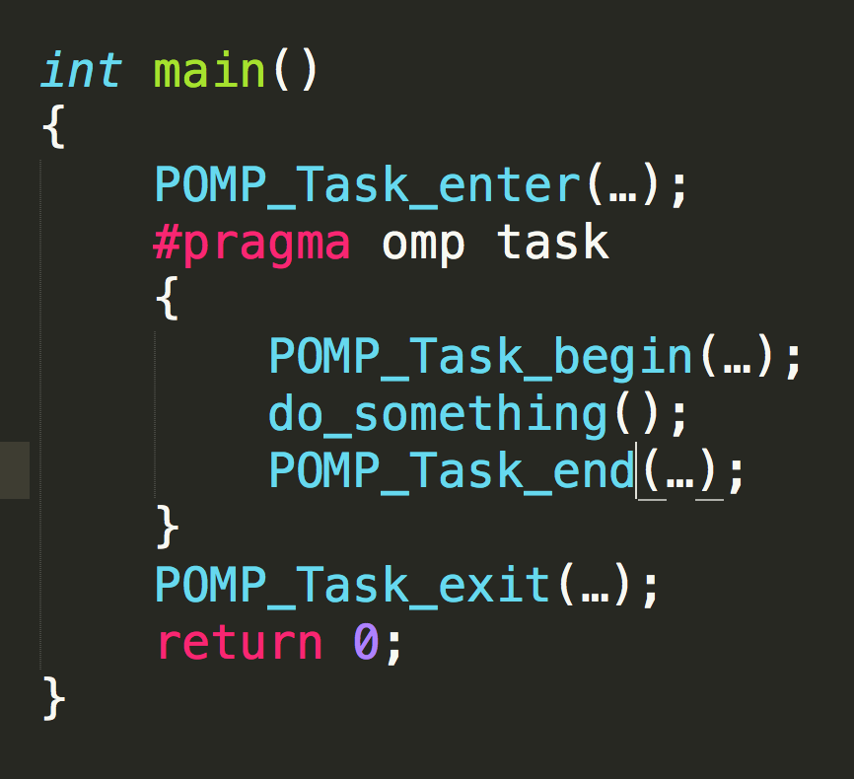
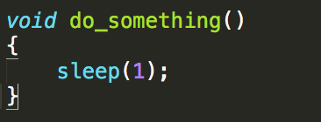
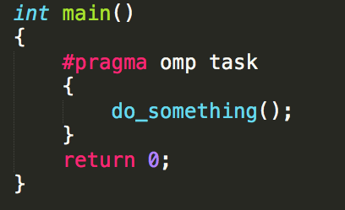
OPARI OpenMP Pragma And Region Instrumenter
E.g.,
Region Descriptor
-File name, line number,…
Original Source Code
Instrumented Source Code

Slide 12
Rogue Wave ThreadSpotter
Analyzes an application’s interaction with the cache and the memory subsystems
Suggests ways to restructure the code to make more effective use of the cache memory based on
Memory bandwidth
Memory Latency
Data Locality
Thread communication/ interaction
http://www.paratools.com/threadspotter
ftp://ftp.paratools.com/threadspotter/documentation/ParaTools_TS_tutorial.pdf
Notes:
ThreadSpotter will help you understand and improve the runtime performance of your applications by identifying areas where the program is using processor cache memory, and in some cases suggests ways to restructure the code to make more effective use of the cache memory.
Memory bandwidth: Limitations of memory bus
Memory Latency: The regularity of the application’s memory accesses affect the efficiency of hardware prefetcher(Higher cache misses)
Data Locality: Caches filled with the unused data causing high cache miss rates

Slide 13
Rogue Wave ThreadSpotter
Helps to pinpoint where the program could be made to run faster
Enhancing the application memory access regularity
Enhancing spatial locality
Enhancing temporal locality
Hide memory access
http://www.paratools.com/threadspotter
ftp://ftp.paratools.com/threadspotter/documentation/ParaTools_TS_tutorial.pdf
Notes:
Memory Hiding:memory access time is 'hidden' by executing other instructions whilst waiting for the memory access
Enhancing the application memory access regularity
To help hardware prefetcher
Enhancing spatial locality
To help minimize the amount of unused data transferred between memory and cache
Minimize the amount of cache space occupied by unused data
Enhancing temporal locality
By suggesting ways to reuse data while it remains in the cache
Hide memory access
By adding prefetch instructions

Slide 14
Thread Mapping
Large impact on the application’s performance and energy consumption
Different Approaches
Locality-based mapping
Mapping threads that frequently communicate with each other to processing units that are closer to each other in memory hierarchy
Balanced-based mapping
Mapping threads to the cores which have lower load in terms of assigned threads
Combined apporach
Use both lolcality and balance parameters to map the threads to different cores
Diener M., et al. (2015) Locality and Balance for Communication-Aware Thread Mapping in Multicore Systems. Euro-Par 2015

Slide 15
Thread Mapping Policies
OS: The mapping performed by the operating system
Compact: Neighboring threads are placed close to each other in the memory hierarchy ,a round-robin scheduling of threads to PUs
Scatter: Represents the opposite of Compact
Locality: Mapping threads that communicate frequently close to each other in the memory hierarchy
Distance: Represents the opposite of Locality, placing threads that communicate far apart in the memory hierarchy
Diener M., et al. (2015) Locality and Balance for Communication-Aware Thread Mapping in Multicore Systems. Euro-Par 2015
Notes:
OS: The mapping performed by the operating system
Compact: Performs a round-robin scheduling of threads to PUs
Neighboring threads are placed close to each other in the memory hierarchy
Scatter: Represents the opposite of Compact
Neighboring threads are placed far from each other in the hierarchy
Locality: Mapping threads that communicate frequently close to each other in the memory hierarchy
Different algorithms e.g., Matrices
Distance: Represents the opposite of Locality, placing threads that communicate far apart in the memory hierarchy

Slide 16
Thread Mapping Policies
Balance: Mapping threads to PUs with lowest amount of communications mapped to it
Balance Locality: Maps threads that communicate frequently to close PUs whose amounts of communication are lower than the average amount of communication per PU
First maps based on locality
Then keeps a similar amount of communication for each cache memory for each memory level
Diener M., et al. (2015) Locality and Balance for Communication-Aware Thread Mapping in Multicore Systems. Euro-Par 2015

Slide 17
Outline
Introduction
State of the Art
Objectives
Approach
Evaluation

Slide 18
Objectives
Extend DiscoPoP
OpenMP support (Data dependence)
Communication pattern detection (Threads communication)
Adding temporal information to communication patterns
Find a use-case
Thread mapping
Thread synchronization

Slide 19
Outline
Introduction
State of the Art
Objectives
Approach
Instrumentation
Profiling
Challenge
Proposed Solution
Evaluation

Slide 20

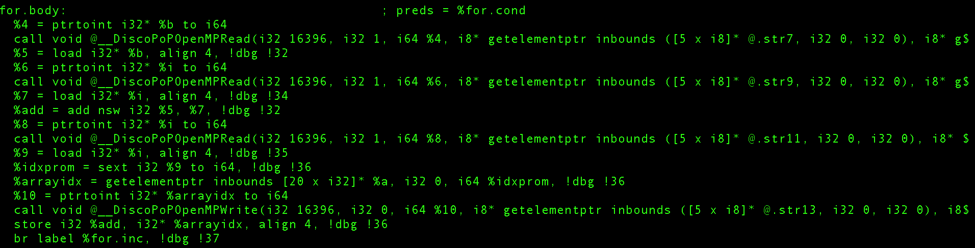
Instrumentation
Injection of customized function calls to intermediate code
At LLVM IR level
Before Load/Store instructions

Slide 21
Outline
Introduction
Objectives
Approach
Instrumentation
Profiling
Challenge
Proposed Solution
Evaluation
Summary

Slide 22
Profiling
Collection of the required data communication information
Time-stamp
Size of the data
Region information
Source Code
(To be analyzed)
Instrumentation Library
Instrumentation
Instrumented Source Code
Linker & Compiler
Executable
Notes:
Change the color of photo

Slide 23
Outline
Introduction
State of the Art
Objectives
Approach
Instrumentation
Profiling and data collection
Challenge
Solution
Evaluation

Slide 24
Challenge
Runtime and memory overhead
Highly frequent communications
Size of extracted information becomes bigger during profiling
Thread 1
Core 1
Thread 2
Core 2
Thread 3
Core 3
Threads
Core 1
Core 2
Core 3
Core 4
L1 Cache
L1 Cache
L1 Cache
L1 Cache
L2 Cache
L2 Cache
L3 Cache
Main Memory
Time
Notes:
Add photos

Slide 25
Outline
Introduction
Objectives
Approach
Instrumentation
Profiling
Challenge
Proposed Solution
Evaluation
Summary

Slide 26
Proposed Solution
Time series generation at run-time using regression analysis
Tentatively applicable
Example
Comm(t)=2t
Profiling at certain time frames
Profile
Profile
Profile
Time
0
2
4
6
8
10
Notes:
Add photos

Slide 27
Outline
Introduction
State of the Art
Objectives
Approach
Evaluation
Correctness and Efficiency

Slide 28
Correctness and Efficiency
Correctness assertion of the instrumented code by comparing the outputs
Efficiency
Using synchronization primitives to find thread’s communication
Trade-off between losing some data communication information and reducing overhead
Original Source Code
Instrumented Source Code
Execution
Execution
Output
Equality Assertion
Output
Notes:
Add photos

Slide 29
Work Plan
Implement OpenMp LLVM Passes (Synch. /Mem. access)
Applying use case of
Thread Mapping
Writing the thesis
+
Buffer
Month
1
2
3
4
5
6
Add Temporal information and extract time series
Extract results and benchmarking
Notes:
Add photos

Slide 30
Thanks
Thank you for your attention ☺
Questions?

