Slide 1

Weather API data analysis
Muhammad Ehsan Mohsin

Slide 2
Weather API
Weather API provide weather data using different APIs Complete list can be found here https://www.weatherapi.com/api-explorer.aspx
Some important
Forecast API
Current
History etc.
I have used Forecast API in our project with following inputs
PostCode :: EN6 1SR
Hours =1

Slide 3
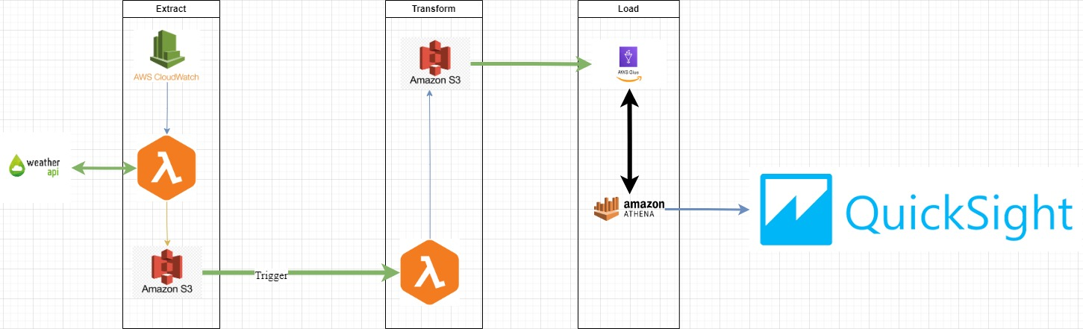
Data Pipeline (Diagram)

Slide 4
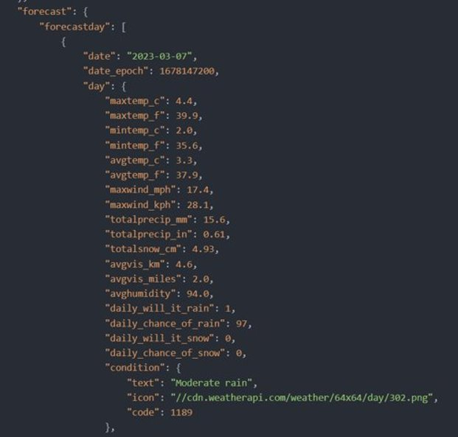

Slide 5
Extract
Lambda function used for this purpose is :- https://eu-north-1.console.aws.amazon.com/lambda/home?region=eu-north-1#/functions/weatherAPI_read?tab=code
S3 bucket folder for extraction is :-
https://s3.console.aws.amazon.com/s3/buckets/mohsinbucket1?region=eu-north-1&prefix=Toprocess/&showversions=false

Slide 6
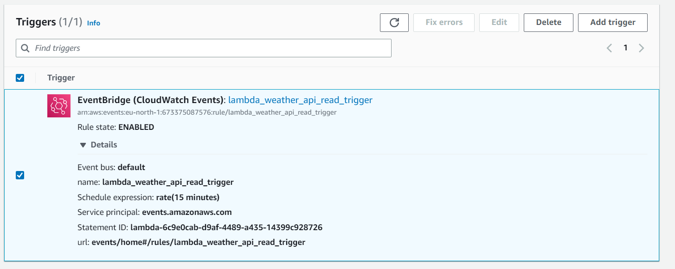
Trigger from cloud watch for extract

Slide 7
Transform
Lambda function used for this purpose is :- https://eu-north-1.console.aws.amazon.com/lambda/home?region=eu-north-1#/functions/weather_api_transform?tab=code
S3 bucket folder for transformed data is :-
https://s3.console.aws.amazon.com/s3/buckets/mohsinbucket1?region=eu-north-1&prefix=transformedv2/wind_data/&showversions=false
https://s3.console.aws.amazon.com/s3/buckets/mohsinbucket1?region=eu-north-1&prefix=transformedv2/heat_data/&showversions=false

Slide 8
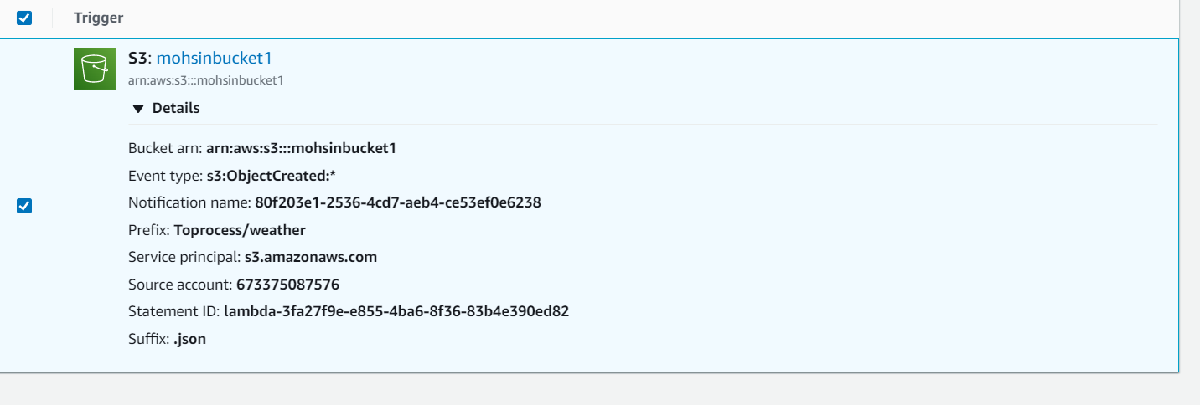
Trigger for transform start

Slide 9
Load
AWS Glue crawler is used to load data in AWS data catalog https://eu-north-1.console.aws.amazon.com/glue/home?region=eu-north-1#/v2/data-catalog/crawlers/view/wind_data_fetch
Data tables loaded are Wind_data and Heat_data corresposnding resultant folders of tranformation :-
Wind_data | Heat data
Col0: time | Col0:time
Col1: Wind speed (kph) | Col1: Wind chill
Col2: Wind direction in Degrees | Col2: Heat Index
Col3: Temperature | Col3: Feels Like temperature

Slide 10
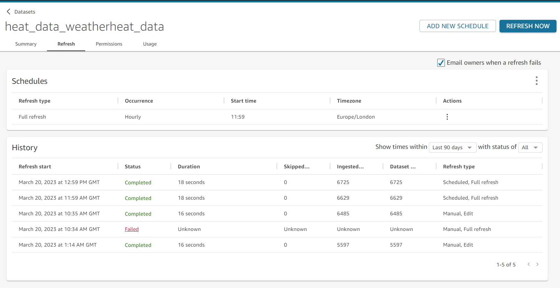
Visualization refresh schedule

Slide 11
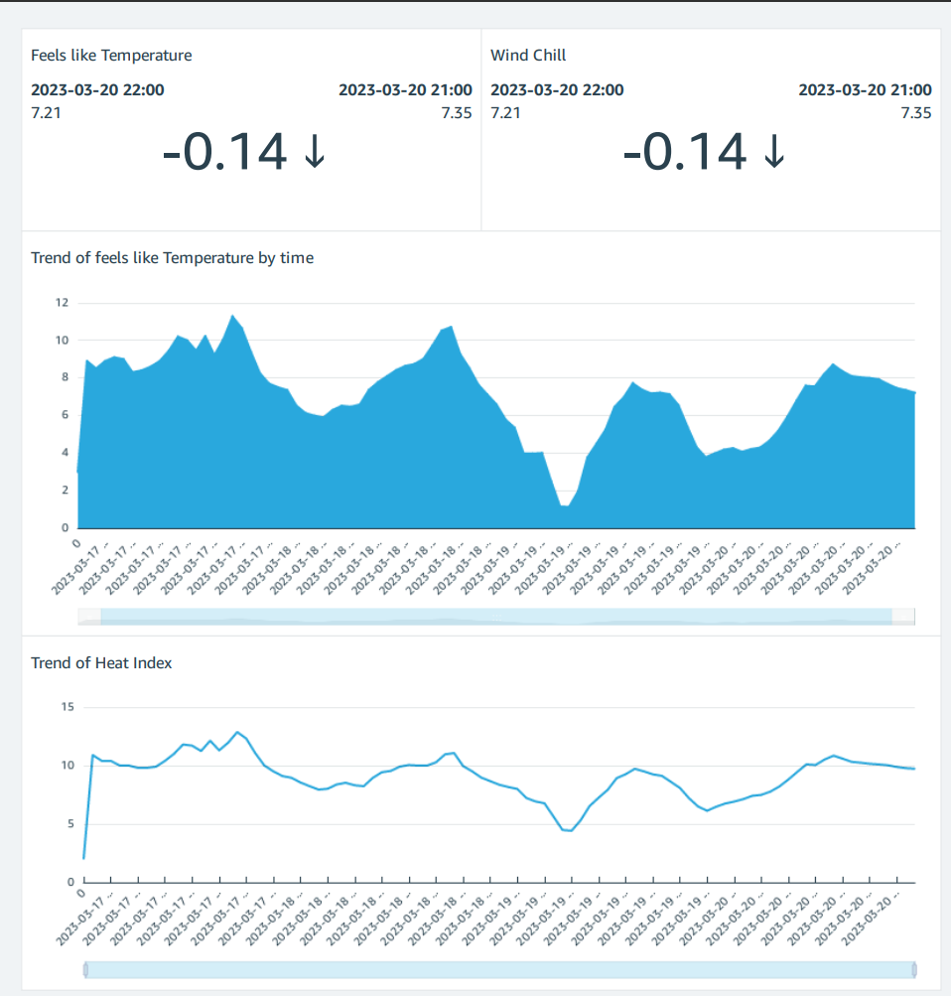
Heat analysis

Slide 12
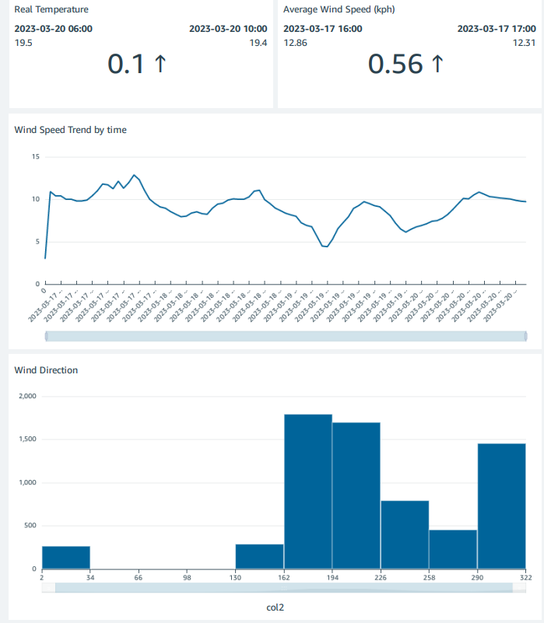
Wind analysis

