Slide 1
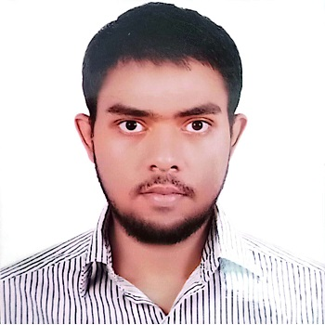



Ehsanul Karim
Undergraduate Student (CSE)
ehsanul.karim.talha@gmail.com
+8801521558848
Magnolia, Road 25, Block 4, Pallabi, Mirpur-12, Dhaka, Bangladesh.
About Me
Experienced in web development and competitive programming, I also have excellence in academics, communicative ability at all levels, and successfully organizing events.
Experience
Remotask
(Quality Assurance)
Feb 2024 – Present
Tectonics
(Administrative officer)
Jan 2022 - Present
Education
Undergraduate
Department of Computer Science and Engineering, (CSE)
Khulna University of Engineering & Technology, (KUET)
From 2019 – present
Higher Secondary Certificate
Government Science College
Passing Year: 2019
Secondary School Certificate
Government Science College Attached High School
Passing Year: 2017
Awards
Dean’s Award
(EEE Faculty)
For academic excellence.
GPA: 3.98 (1st Year)
GPA: 3.92 (2nd Year)
Intra KUET Programming Contest
2022: 10th Position
2023: 7th Position
Skills
Computer Language Proficiency
C++,
Java,
R language,
Django, PHP,
Assembly Language,
MySQL,
Java-script,
HTML, CSS,
Swift,
Python
(pandas, numpy,
Matplotlib).
Language
Software Proficiency
Bangla (Colloquial)
English
Codeblocks,
Visual Studio,
Android Studio,
EMU8086,
Netbeans, ASP.net,
Cisco packet Tracer,
MS Word,
MS PowerPoint.

Slide 2
Interest
Projects
Web Development
Competitive Programming
Machine Learning
Computer Vision
Deep Learning
Natural Language Processing
Criminal Identification System (CIS)
(System Development project)
AI-driven online platform for combines Django backend, HTML/CSS/JS frontend, and Resnet50 CNN for charge sheet automation and suspect identification.
Football Today
(Web Development Project)
A dynamic football club management website features a stunning frontend (HTML/CSS/JS) and a robust ASP.net backend.
Cardiac Recorder
(Software development project)
An Android app, developed collaboratively with Git, manages regular cardiac blood pressure updates.
Football Tournament Management
(Database Project)
The project utilizes an Oracle SQL Plus 21c database and follows with many simple and complex queries.
Soccer Bot
(Peripheral Project)
A hardware project consisting of two Bluetooth-controlled cars and a sonar-based football field capable of identifying goals and corners.
Football Manager
(Java application for PC)
A football club management PC application built with NetBeans.
Hobbies
Reading Books and Comics
Traveling
Practicing musical instruments

