Slide 1


Slide 2
Evolutionary computation Ehsan Lak Reza Kazazi
In the Name of God

Slide 3
Evaluation of Differential Evolution and K-means
Algorithms on Medical Diagnosis

Slide 4
Introduction
Clustering:
Grouping data based on similarity.
Applications: medical diagnosis, marketing, data mining.
Algorithms:
K-means: Traditional and simple, but has limitations.
DE (Differential Evolution): Evolutionary algorithm for finding
optimal clusters.
Notes:
خوشه بندی: گروه بندی داده ها بر اساس شباهت کاربردها: تشخیص پزشکی، بازاریابی، داده کاوی. الگوریتم ها: K-means: سنتی و ساده است، اما محدودیت هایی دارد. DE (تکامل دیفرانسیل): الگوریتم تکاملی برای یافتن خوشه های بهینه

Slide 5
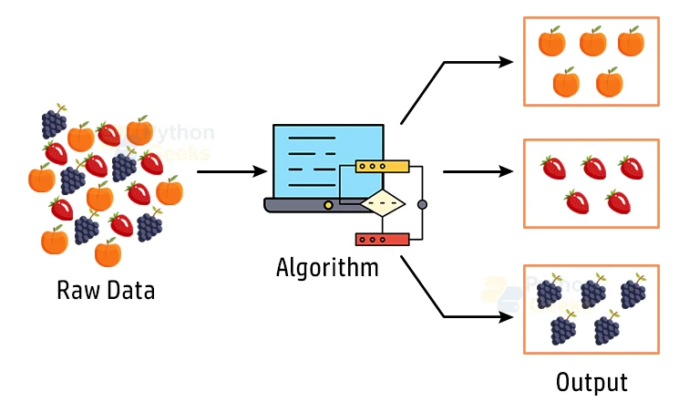

Slide 6
Objective
Compare the performance of K-means and DE algorithms in clustering medical
Datasets.
Evaluate clustering accuracy using the Purity metric.
Notes:
مقایسه عملکرد الگوریتم های K-means و DE در خوشه بندی پزشکی مجموعه داده ها دقت خوشه بندی را با استفاده از متریک Purity ارزیابی کنید.

Slide 7
Datasets Used
Three datasets from UCI Machine Learning Repository
01
02
03
Features include: age,blood pressure, blood sugar, and other
Heart:Heart disease diagnosis
Liver:Liver disorder detection
Pima:Diabetes diagnosis

Slide 8
Algorithms
K-means:
Simple and fast.
Sensitive to initialization.
May get stuck in local optima.
DE (Differential Evolution):
Inspired by natural evolution.
Resistant to noise.
Finds global optima.

Slide 9
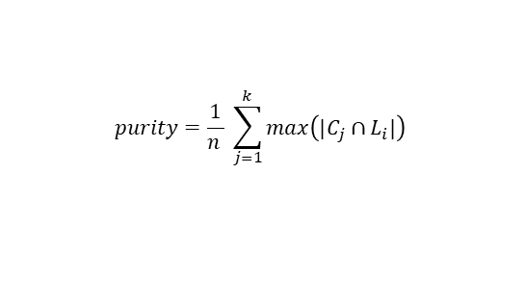
$$purity=\frac{1}{n } \sum_{j=1}^{k}{max\left(|C_{j}∩L_{i}|\right)}$$
Evaluation Metric (Purity)
Definition:
Percentage of data points correctly assigned to clusters.
Formula:
Purpose: To measure the quality of clustering.

Slide 10
Comparison Results
Liver dataset:
Heart dataset:
Pima dataset:
K-means: 86.7%
DE: 92.17%
K-means: 66.0%
DE: 66.82%
K-means: 57.9%
DE: 96.0%
• Conclusion: DE performed better, especially on noisy datasets.

Slide 11
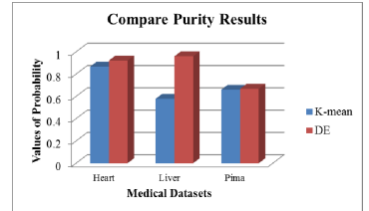

Slide 12
Conclusion
DE has higher accuracy compared to K-means.
DE is more suitable for complex datasets.
K-means is faster and simpler but less accurate in sensitive cases.

Slide 13
Feature Work
Combine DE with other algorithms.
Improve DE’s speed for large datasets.
Apply DE to more precise medical applications.
Notes:
DE را برای کاربردهای پزشکی دقیق تر اعمال کنید.

Slide 14
Thank you for Watching

