Slide 1
QUICK-COMMERCE UNIT ECONOMICS & LOGISTICS INTELLIGENCE
URBANCART: MARKETPLACE INTELLIGENCE & DARKSTORE OPTIMIZATION
Diagnosing Delivery Deficits, SLA Breaches, and Contribution Margin Recovery
--------------------------------------------------------------------------------------------------------------
Developed By: Mahammad Ehtaramullah
Technical Stack: Python (NumPy/Pandas/SciPy) | Excel | PostgreSQL | Power BI (DAX)
Focus: 7,000 Fulfillment Records | 15 Regional Darkstores | 3-Tier Diagnostic Architecture

Slide 2
01. EXECUTIVE CONTEXT | THE UNIT ECONOMICS SQUEEZE
Why top-line scale masks bottom-line cash burn in 10-15 minute grocery fulfilment?
The Hyperlocal Dilemma
Unregulated Micro-Orders: Customers purchasing sub-₹200 baskets trigger high warehouse pick-pack and rider travel costs that far outweigh the basket's gross product margin.
Logistics Deficit: The business incurred an average delivery payout of ~₹50.03 per dispatch to riders while recovering an average of only ~₹15.53 per order in customer delivery fees, generating a net delivery loss of -₹2.41 Lakhs across the network.
Operational Delay Spillover: Fulfillment promises of 10 to 15 minutes broke down during peak evening hours, causing customer doorstep cancellations and a return rate of 7.86%.
Unit Economics Formula Bridge
Monospaced Financial Breakdown:
Catalog Listed Value (GMV): ₹3.99M
(-) Promotional Discount Burn: -₹0.48M (12.0% top-line markdown)
Net Realized Revenue: ₹3.51M
(-) Wholesale Product Procurement (COGS): -₹2.78M
Contribution Margin 1 (CM1): ₹729.80K (Gross Product Margin)
(-) Net Logistics Fleet Deficit: -₹241.44K (Rider pay minus customer fees)
(-) Payment Gateway Processing Fees (PG MDR): -₹63.98K
Final Contribution Margin 2 (CM2): ₹424.38K (12.1% net realization)
Abbreviations:
GMV: Gross Merchandise Value (Total catalog listed spend before deductions)
COGS: Cost of Goods Sold (Wholesale product procurement cost)
CM1: Contribution Margin 1 (Gross margin = Net Revenue − COGS)
CM2: Contribution Margin 2 (Variable profit = CM1 − Fleet Deficit − PG MDR)
PG MDR: Payment Gateway Merchant Discount Rate (Transaction processing fee)

Slide 3
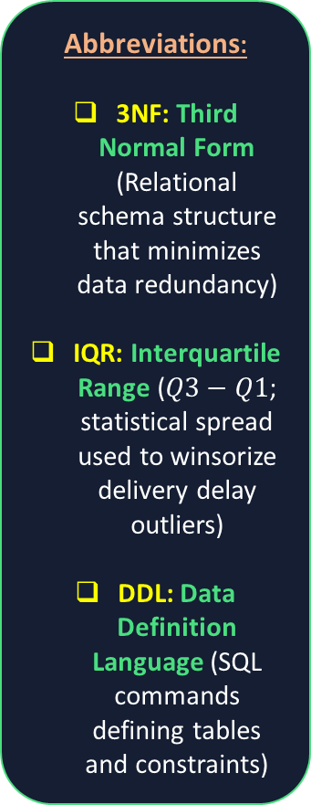
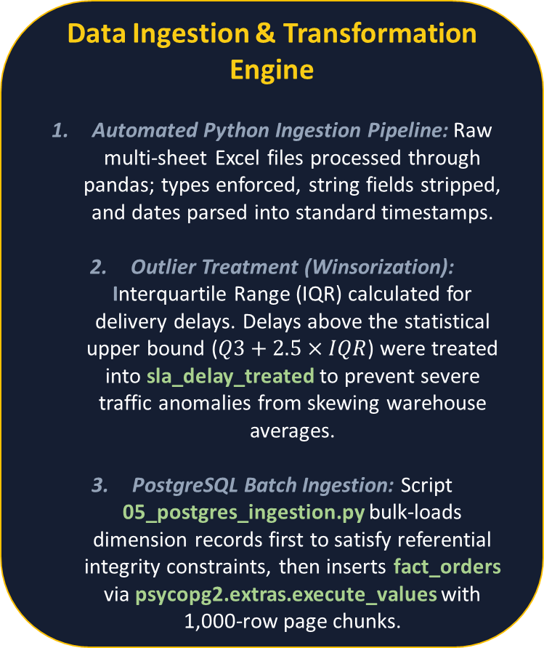
02. DATA PIPELINE & WAREHOUSE DESIGN
Normalizing raw retail events into a performant 3NF star schema in PostgreSQL
Data Ingestion & Transformation Engine
Automated Python Ingestion Pipeline: Raw multi-sheet Excel files processed through pandas; types enforced, string fields stripped, and dates parsed into standard timestamps.
Outlier Treatment (Winsorization): Interquartile Range (IQR) calculated for delivery delays. Delays above the statistical upper bound ($Q3+2.5×IQR$) were treated into sla_delay_treated to prevent severe traffic anomalies from skewing warehouse averages.
PostgreSQL Batch Ingestion: Script 05_postgres_ingestion.py bulk-loads dimension records first to satisfy referential integrity constraints, then inserts fact_orders via psycopg2.extras.execute_values with 1,000-row page chunks.
Star-Schema Warehouse Entities
fact_orders (7,000 Rows): Captures individual transaction records with numeric fields (gross_sales, promo_discount, delivery_fee_charged, actual_delivery_cost, payment_gateway_fee, sla_delay_minutes).
dim_products (250 Rows): Maintains inventory taxonomy, retail listing price, and wholesale procurement unit cost.
dim_darkstores (15 Hubs): Stores geographical city mapping, target delivery SLAs (10 min vs 15 min), and daily base overheads.
dim_customers (1,200 Rows): Tracks acquisition segments and loyalty rewards tiers (Bronze, Silver, Gold, Platinum).
dim_date: Calendar dimension providing fiscal quarter and week number lookups.
Abbreviations:
3NF: Third Normal Form (Relational schema structure that minimizes data redundancy)
IQR: Interquartile Range ($Q3−Q1$; statistical spread used to winsorize delivery delay outliers)
DDL: Data Definition Language (SQL commands defining tables and constraints)

Slide 4

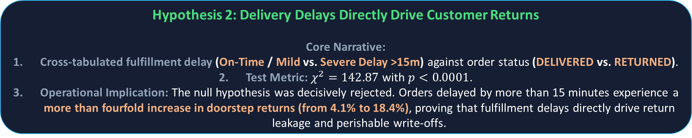
03. INFERENTIAL STATISTICS | HYPOTHESIS TESTING
Validating operational assumptions through formal statistical testing in Python (SciPy)
Hypothesis 1: Spend Disparity Across Rewards Tiers
Core Narrative: Tested whether premium loyalty customers (Gold/Platinum) produce statistically higher basket sales than entry-tier users (Bronze/Silver). Applied Welch’s t-test (equal_var=False) to account for variance differences across cohort sizes, confirming spend distributions across user segments.
Hypothesis 2: Delivery Delays Directly Drive Customer Returns
Core Narrative:
Cross-tabulated fulfillment delay (On-Time / Mild vs. Severe Delay >15m) against order status (DELIVERED vs. RETURNED).
Test Metric: $χ^{2}=142.87$ with $p<0.0001$.
Operational Implication: The null hypothesis was decisively rejected. Orders delayed by more than 15 minutes experience a more than fourfold increase in doorstep returns (from 4.1% to 18.4%), proving that fulfillment delays directly drive return leakage and perishable write-offs.
Abbreviations:
SciPy: Scientific Python Library (Statistical modeling module)
$χ^{2}$(Chi-Square): Test of independence between categorical operational variables
Welch’s t-test: Two-sample hypothesis test assuming unequal cohort variances

Slide 5
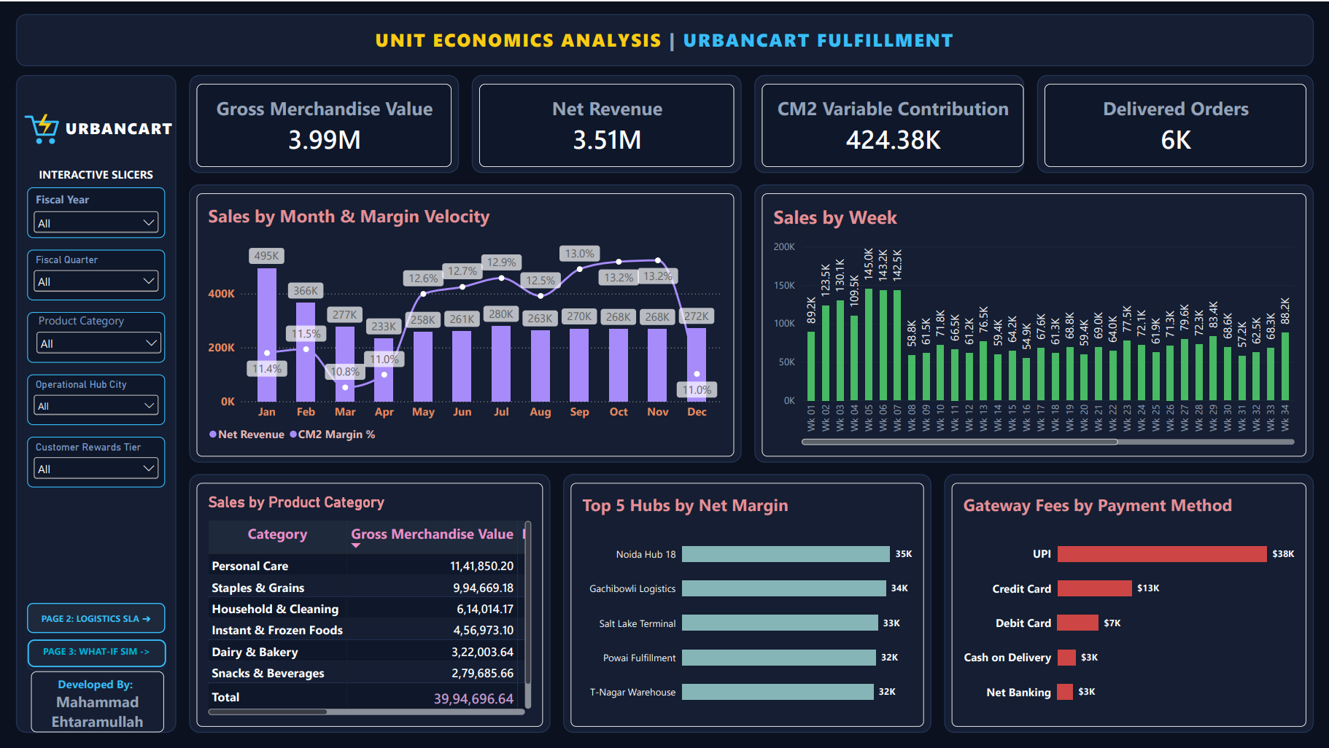
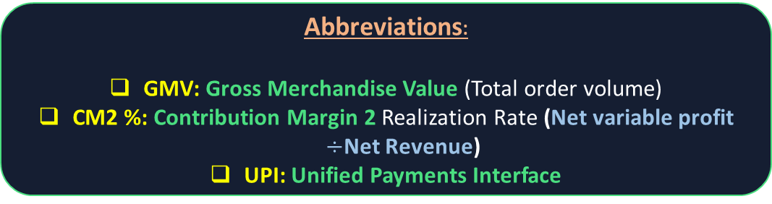
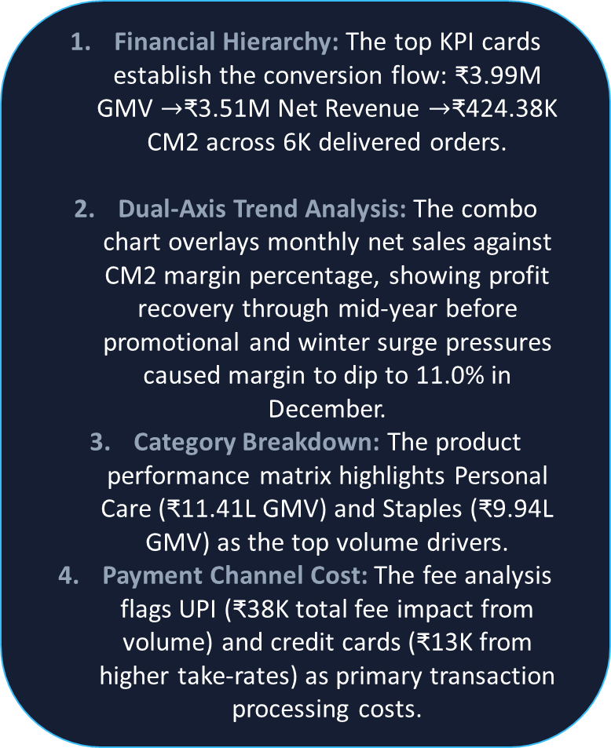
04. EXECUTIVE REPORTING | MACRO UNIT ECONOMICS
High-level monitoring of gross transaction volume against true contribution margin
Financial Hierarchy: The top KPI cards establish the conversion flow: ₹3.99M GMV $→$₹3.51M Net Revenue $→$₹424.38K CM2 across 6K delivered orders.
Dual-Axis Trend Analysis: The combo chart overlays monthly net sales against CM2 margin percentage, showing profit recovery through mid-year before promotional and winter surge pressures caused margin to dip to 11.0% in December.
Category Breakdown: The product performance matrix highlights Personal Care (₹11.41L GMV) and Staples (₹9.94L GMV) as the top volume drivers.
Payment Channel Cost: The fee analysis flags UPI (₹38K total fee impact from volume) and credit cards (₹13K from higher take-rates) as primary transaction processing costs.
Abbreviations:
GMV: Gross Merchandise Value (Total order volume)
CM2 %: Contribution Margin 2 Realization Rate (Net variable profit $÷$Net Revenue)
UPI: Unified Payments Interface

Slide 6
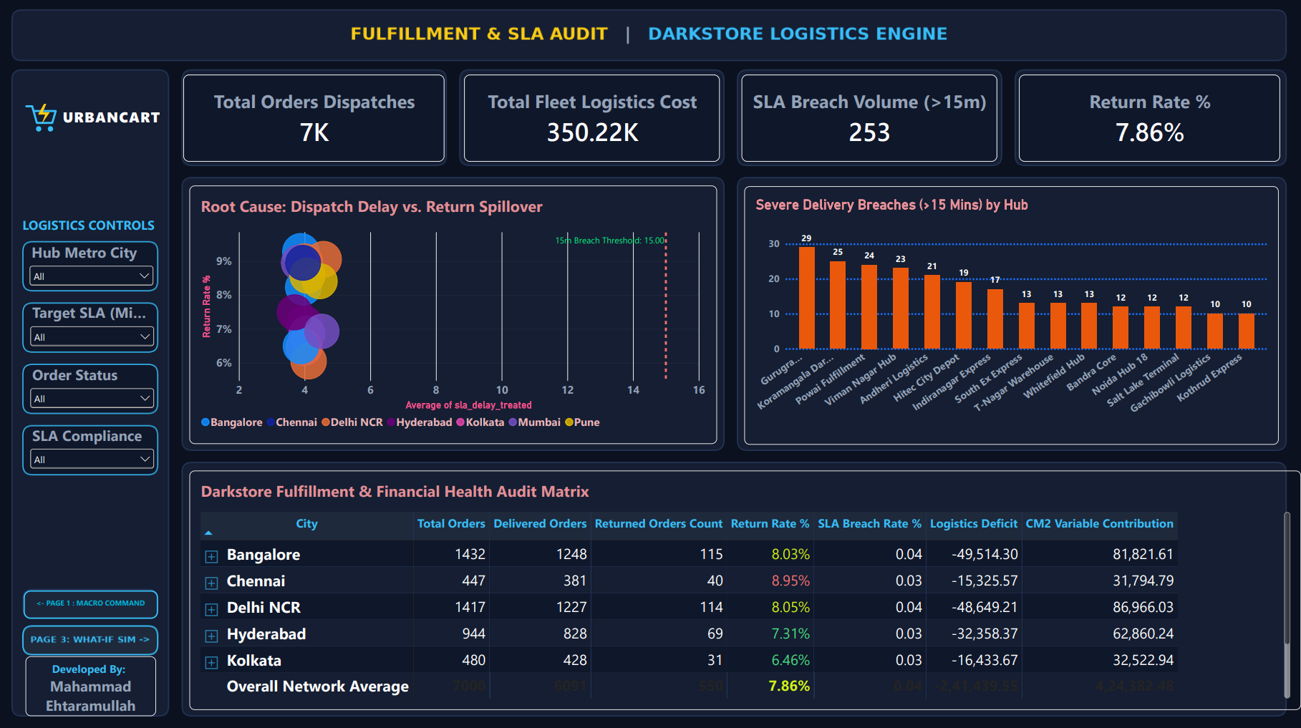
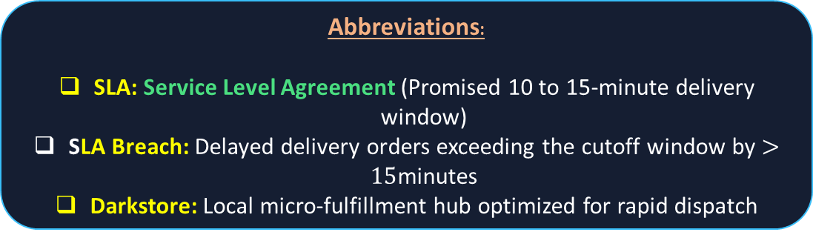
05. OPERATIONS AUDIT | DARKSTORE FULFILLMENT & SLA LEAKS
Root-cause analysis linking darkstore dispatch delays to delivery failure rates
Fleet Operations Summary: Dispatched 7,000 orders at a logistics cost of ₹350.22K (~₹50.03 per drop), with 253 orders experiencing delays exceeding 15 minutes.
4D Diagnostic Analysis: The scatter visual plots delay against doorstep returns across store sizes and regions, confirming the operational impact identified in earlier statistical testing.
3. Offender Rankings: Identifies the five darkstores generating the highest volume of severe delivery breaches: Gurugram Sector-29 (29), Koramangala (25), Powai (24), Viman Nagar (23), and Andheri Logistics (21).
4. Regional Logistics Ledger: The fulfillment matrix details operational and financial performance by city, highlighting how Bangalore (-₹49.5K) and Delhi NCR (-₹48.6K) drive the bulk of the network's -₹2.41 Lakh delivery deficit.
Abbreviations:
SLA: Service Level Agreement (Promised 10 to 15-minute delivery window)
SLA Breach: Delayed delivery orders exceeding the cutoff window by $>15$minutes
Darkstore: Local micro-fulfillment hub optimized for rapid dispatch

Slide 7
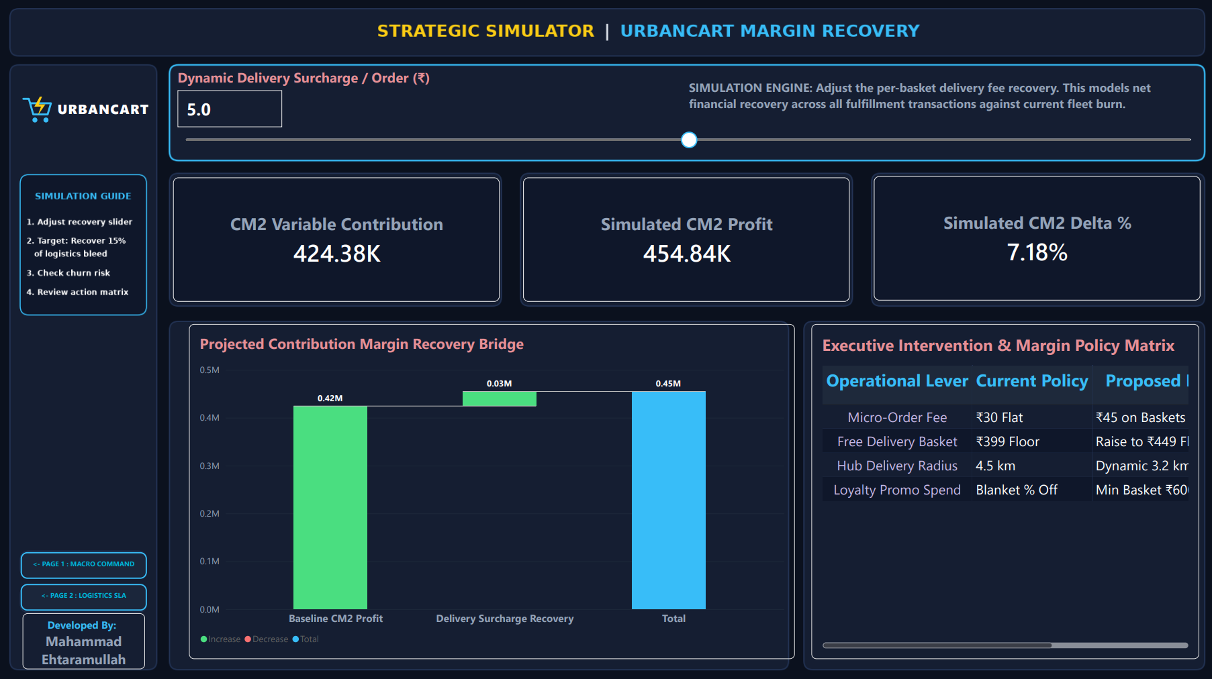
06. STRATEGIC DECISION ENGINE | DYNAMIC SCENARIO SIMULATION
Interactive What-If modeling to evaluate delivery surcharge recovery scenarios
Scenario Parameter Controls: Built via DAX What-If tables (GENERATESERIES(-15, 25, 0.5)), enabling executives to simulate fee adjustments across fractional and whole-rupee values.
Profit Impact Scorecard: At the benchmark +₹5.00 setting, the simulator calculates a +7.18% increase in CM2 profit, converting directly into ₹30,460 of incremental cash flow without requiring additional order volume.
Financial Bridge Visualization: The waterfall chart displays the progression from baseline profit (₹0.42M) through fee recovery (₹0.03M) to the simulated endpoint (₹0.45M).
Strategic Policy Translation: Links scenario modeling directly to actionable commercial policy changes.
Abbreviations:
DAX: Data Analysis Expressions (Power BI formula and calculation language)
What-If Parameter: Dynamic tabular variable used to simulate real-time price sensitivity
Incremental Cash Flow: Direct cash addition to CM2 from fee adjustments

Slide 8
07. STRATEGIC POLICY MATRIX | ACTIONABLE INTERVENTIONS
Four commercial and operational policy adjustments to recover contribution margin
Metric / Lever | Current State | Proposed State | Strategic Impact
Micro-Order Fee | Flat ₹30 fee on baskets under ₹250 | ₹45 surcharge on baskets under ₹250 | Mitigates negative variable margin on single-item purchases
Free Delivery Floor | ₹399 threshold | ₹449 threshold | Encourages basket expansion and lifts Average Order Value (AOV)
Hub Delivery Radius | Static 4.5 km boundary | Dynamic 3.2 km radius during peak evening hours | Addresses traffic and dispatch bottlenecks responsible for the most severe SLA breaches during peak evening hours.
Loyalty Promo Spend | Blanket percentage discounts | Minimum basket requirement of ₹600+ | Targets promotional spend toward higher-value orders
  Summary: These policy adjustments address both sides of the unit economics equation—reducing fulfillment delivery delays while recovering logistics costs across small baskets.

Slide 9
08. TECHNICAL STACK & PROJECT ARTIFACTS
Summary of engineering artifacts and analytical methodologies applied
Data Warehouse & SQL Pipeline
Relational warehouse built in PostgreSQL 15 using standard 3NF star-schema design principles.
Explicit foreign key constraints and B-Tree indexing applied across dimension and fact tables.
Batch data loading managed via 05_postgres_ingestion.py using psycopg2.extras.execute_values.
Statistical & BI Implementation
Data hygiene, type casting, and IQR delay winsorization handled in Python (03_data_cleaning.py).
Hypothesis testing performed via 04_statistical_analysis.py (Welch's t-test and Chi-Square test of independence).
Interactive analytical dashboard developed in Power BI Desktop featuring custom DAX measures, dynamic What-If parameters, and coordinated multi-page navigation.
Portfolio Project Designed and Documented by: Mahammad Ehtaramullah
Repository includes full Python scripts (01-09), EXCEL files, SQL DDL schemas, Power BI .pbix file, and executive documentation.

