Slide 1

ITP311
FUNDAMENTALS OF DATABASE SYSTEMS

Slide 2
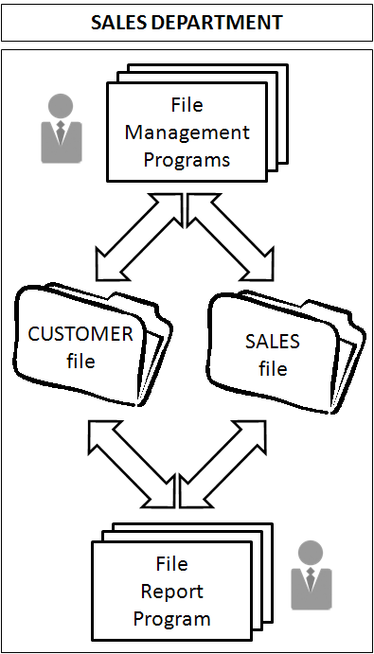
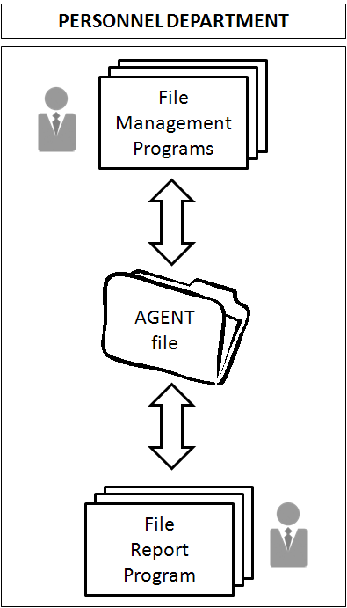
File Systems
Theory of Database Systems
🢩 File systems
are used by a manager of any small organization to track necessary data

Slide 3
File Systems
Theory of Database Systems
Disadvantages of a File System
o Lengthy development time
Difficulty of getting quick answers
Complex system administration
Lack of security and limited data sharing
Extensive programming

Slide 4
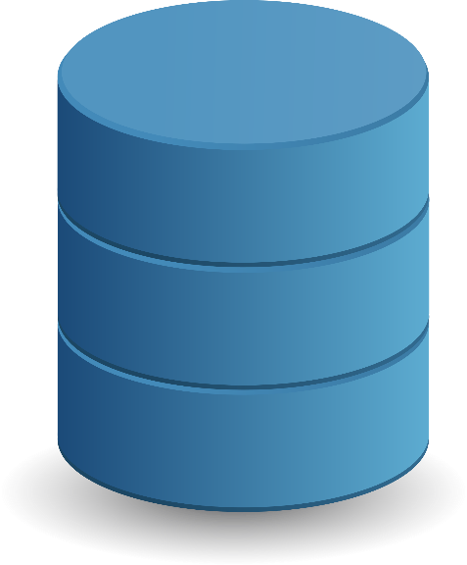
Database System
Theory of Database Systems
🢩 Database System
is a computerized system whose overall purpose is to maintain information and make that information available on demand
Examples:
Computerized record-keeping system
Electronic filing cabinet
Repository for a collection of computerized data files

Slide 5
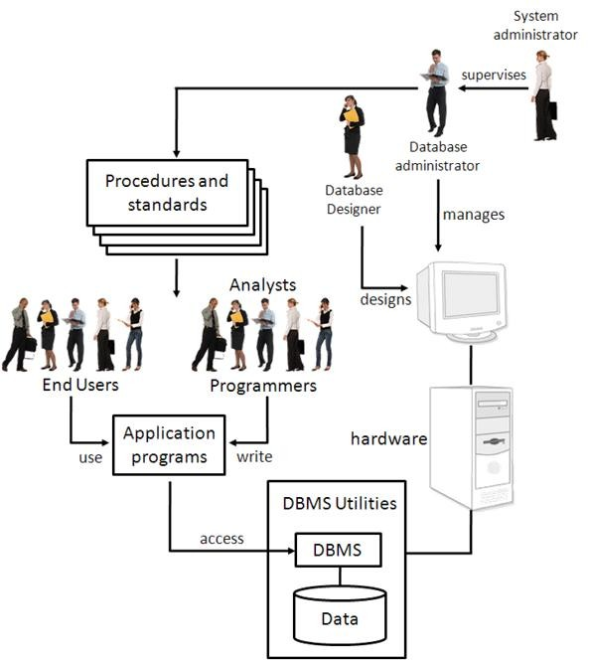
Database System
Theory of Database Systems

Slide 6
Database System
Theory of Database Systems
🢩 Five major parts of a Database
System
Hardware
Software
Operating Systems Software
DBMS Software
Application programs and utility software
People
Systems Administrators
Database Administrators
Database Designers
Systems Analysts and Programmers
End Users
Procedures
Data

Slide 7

Database
Theory of Database Systems
🢩 Database
is a shared, integrated computer structure that stores a collection of:
End-user data
raw facts of interest to the end user
Metadata
data about data through which the end-user data are integrated and managed

Slide 8

Database
Theory of Database Systems
🢩 Advantages
Reduced data redundancy
Data integrity
Data independence
Data security
Data consistency
Easier use of data
Less storage
🢩 Disadvantages
Complexity
Expense
Vulnerability
Size
Training costs
Compatibility
Locking in of technology
Lack of lower level control

Slide 9
Database Models
Theory of Database Systems
🢩 Database Model
is a collection of logical constructs used to represent the data structure and the data relationships found within the database
Categories:
Conceptual Model
focuses on the logical nature of the data representation
Example: Entity relationship (E-R) model
Implementation Model
places emphasis on how the data are represented in the database or how the data structures are implemented to represent what is modeled
Examples:
» Hierarchical database model
» Network database model
» Relational database model
» Object-oriented database model

Slide 10
Database Models
Theory of Database Systems
Basic building
Model
o Entity
blocks of a Database
– is anything about which data are to be collected and stored
Attribute
– is the characteristic of an entity
Relationship
describes entities
Types:
the association among
» One-to-many (1:*) relationship
» Many-to-many (*:*) relationship
» One-to-one (1:1) relationship
o Constraints
– is a restriction placed on the data

Slide 11
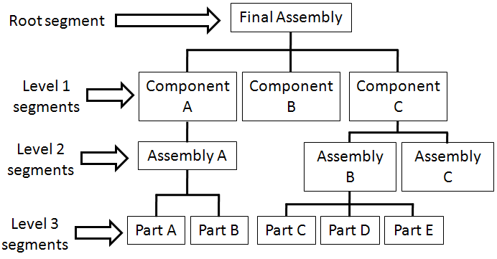
Database Models
Theory of Database Systems
🢩 Hierarchical Model
was developed in the 1960’s
is used to manage large amounts of data for complex manufacturing projects
has a basic logical structure represented
by an upside-down tree

Slide 12
Database Models
Theory of Database Systems
🢩 Network Model
was created to represent complex data
relationships, performance, standard
improve database and impose a database
was defined by the Conference on Data Systems Language (CODASYL)
Conference on Data Systems Language (CODASYL)
established database standards
created the Database Task Group (DBTG) in
the late 1960s
Database Task Group (DBTG)
was charged to create standard specifications for an environment that would facilitate database creation and data manipulation

Slide 13
Database Models
Theory of Database Systems
🢩 Relational Model
was introduced in 1970 by E.F. Codd of IBM
is collection of relations or two- dimensional tables having distinct names
student-number | name | course
89-11043 | Marian | BSIT
89-10043 | Jackie | BSCS
61-12345 | Jennelyn | BSCOE
23-10202 | Solenn | BSBA

Slide 14
Database Models
Theory of Database Systems
🢩 Entity relationship model
was introduced by Peter Chen in 1976
yields a graphical entities
representation of relationships in
and their
database structure
is usually
represented by an entity
relationship diagram
introduced the three types of relationships:
One-to-many (1:*) relationship
Many-to-many (*:*) relationship
One-to-one (1:1) relationship
is based on the following components:
Entity
Attributes
Relationship

Slide 15
Database Models
Theory of Database Systems
Entity relationships
o One-to-one
A₁
b₁
A₂
b₂
A₃
b₃
A₄
b₄
o One-to-many
A₁
b₁
A₂
b₂
A₃
b₃
b₄

Slide 16
Database Models
Theory of Database Systems
o Many-to-one
A₁
b₁
A₂
b₂
A₃
b₃
A₄
o Many-to-many
A₁
b₁
A₂
b₂
A₃
b₃
A₄
b₄

Slide 17
Database Models
Theory of Database Systems
🢩 Object-oriented model
stores both data and their relationships in a single structure known as an object
is based on the components such as:
Object
is an abstraction of a real-world entity
Attribute
describes the properties of an object
Class
is a collection of similar objects with shared attributes and methods
Class hierarchy
refers to the arrangement of classes
Inheritance
refers to the ability of an object within the class hierarchy to inherit the attributes and methods of the classes above it

Slide 18
Basic Data Modeling Concepts
Theory of Database Systems
🢩 Data model
is the relatively simple representation of a more complex real-world object
🢩 ANSI/SPARC
stands for American National Standard Institute/Standards Planning and Requirements Committee
defined three different data models based on their degree of abstraction:
Conceptual model
Internal model
External model

Slide 19
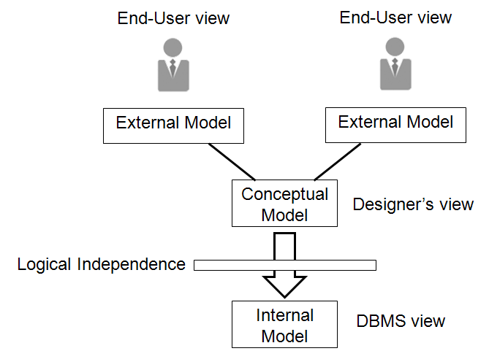
Basic Data Modeling Concepts
Theory of Database Systems

Slide 20
Database Management Systems
Theory of Database Systems
🢩 Database Management Systems
is a collection of programs that manages the database structure and controls access to the data stored in the database
Examples:
MS SQL
Oracle
DB2

Slide 21
Database Management Systems
Theory of Database Systems
🢩 Functions of a DBMS
Data dictionary management
Data storage management
Data transformation and presentation
Security management
Multiuser access control
Backup and recovery management
Data integrity management
Database access languages and application programming interfaces
Query language
Data Definition Language (DDL)
Data Manipulation Language (DML)
Database communication interfaces

Slide 22
Data Dictionary
Theory of Database Systems
🢩 Data Dictionary
is a centralized repository of information about data such as meaning, relationships to other data, origin, usage, and format
has two main types:
Integrated
standalone
can be classified as:
Active Data Dictionary
Passive Data Dictionary

