Slide 1

Visualizing NFL Data
Nicole Antkowiak
Emily Hurst
Victoria Munoz
Omar Bernal
Sviatoslav Piasta

Slide 2
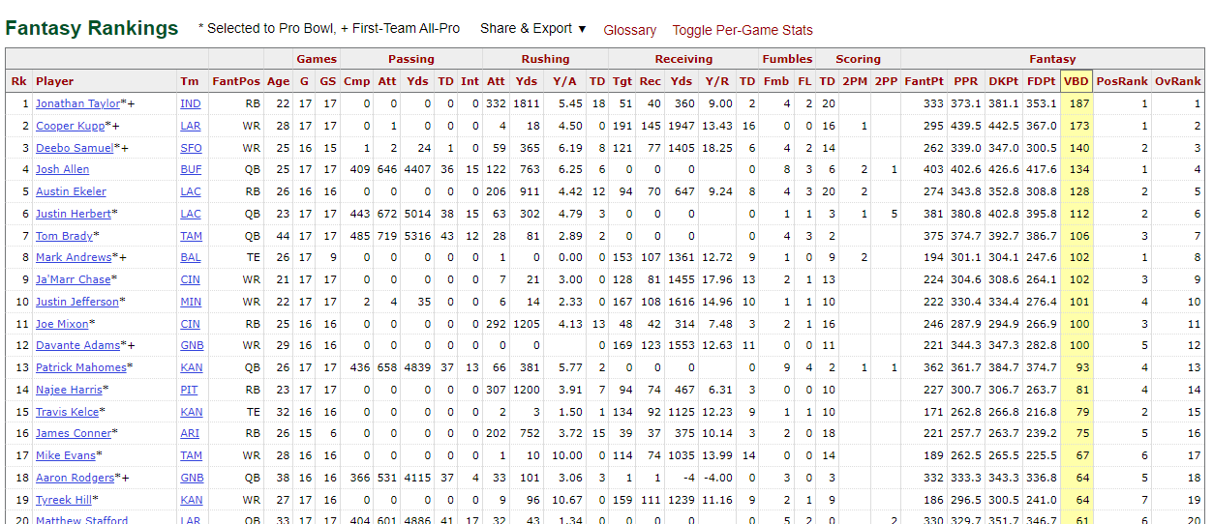
Data Set
Fantasy football points for 2021 year:

Slide 3
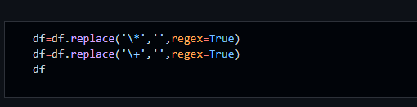
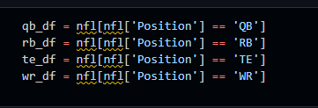
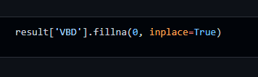
Data Cleaning
Replaced ‘*’ and ‘+’
Create DataFrames based on position
Dropped NA values with 0

Slide 4
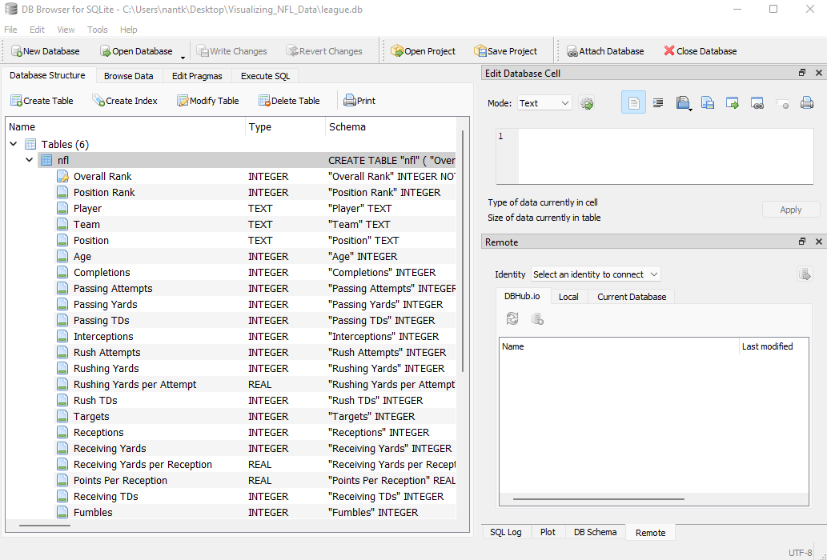
SQLite Database
Tables: nfl, qb, rb, te,and wr

Slide 5
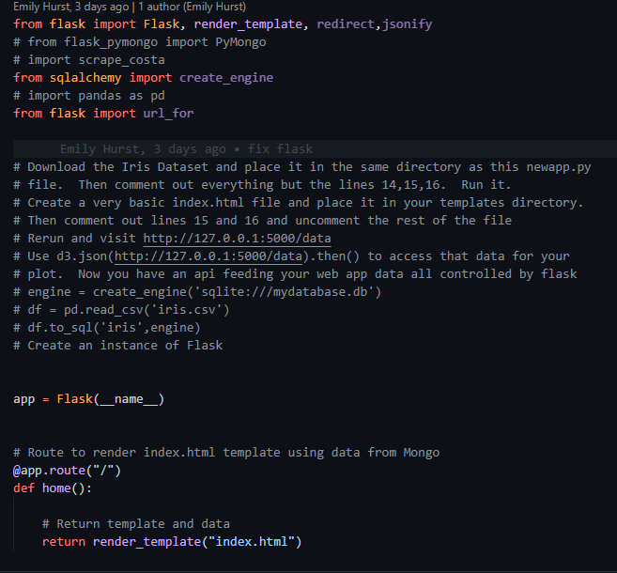
Flask App
Navigation bar needed to import url_for to allow the navigation bar to function.
Created routes for the rendering of the templates

Slide 6
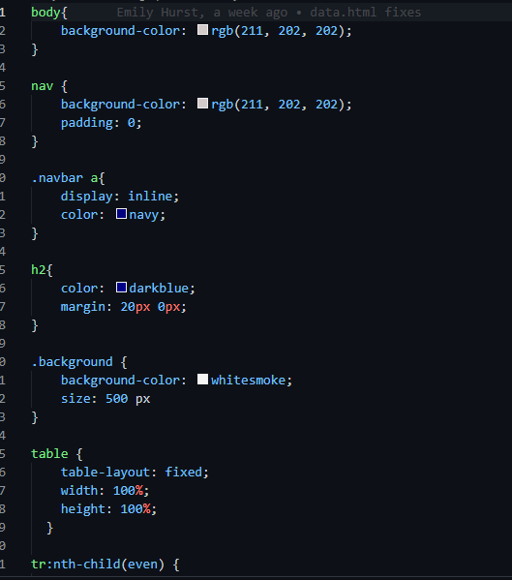
Styling Code

Slide 7
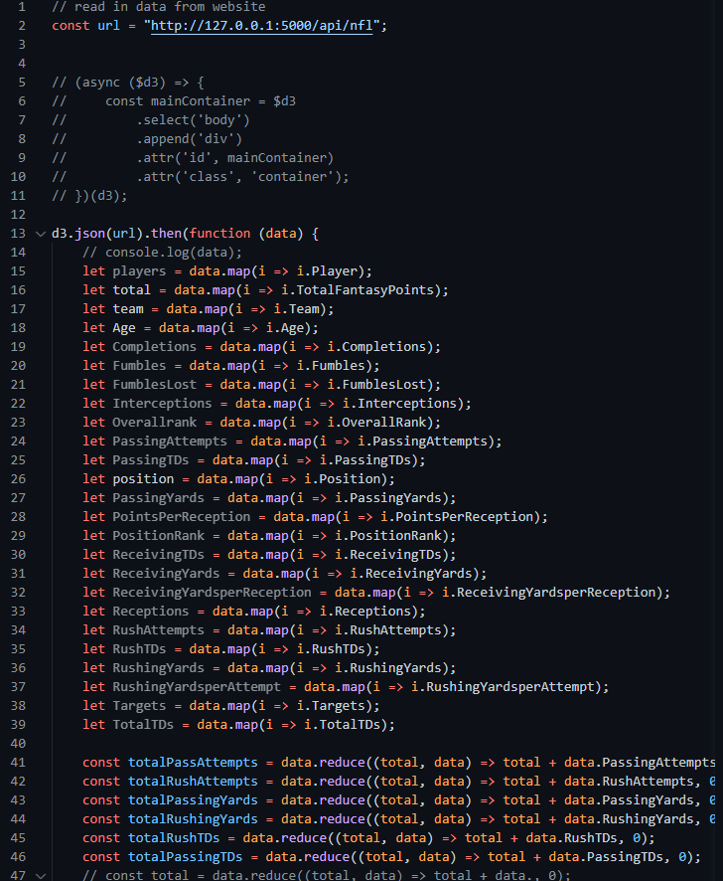
Logic.js Code

Slide 8
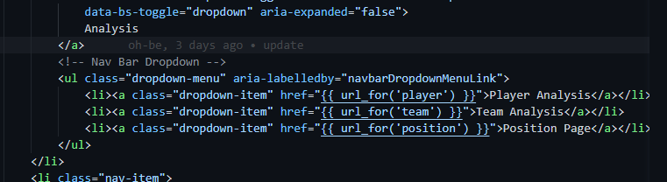
HTML
Code for navigation bar to allow for the drop down to select each HTML page.

Slide 9
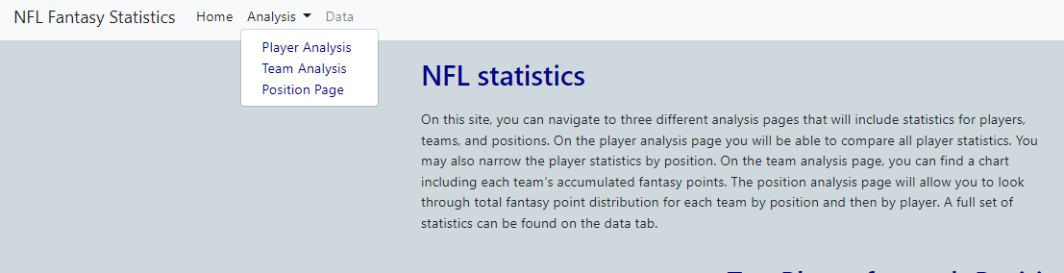
HTML Nav Bar
Dropdown menu for player, team, and position analysis tables
Link to home and data page

Slide 10
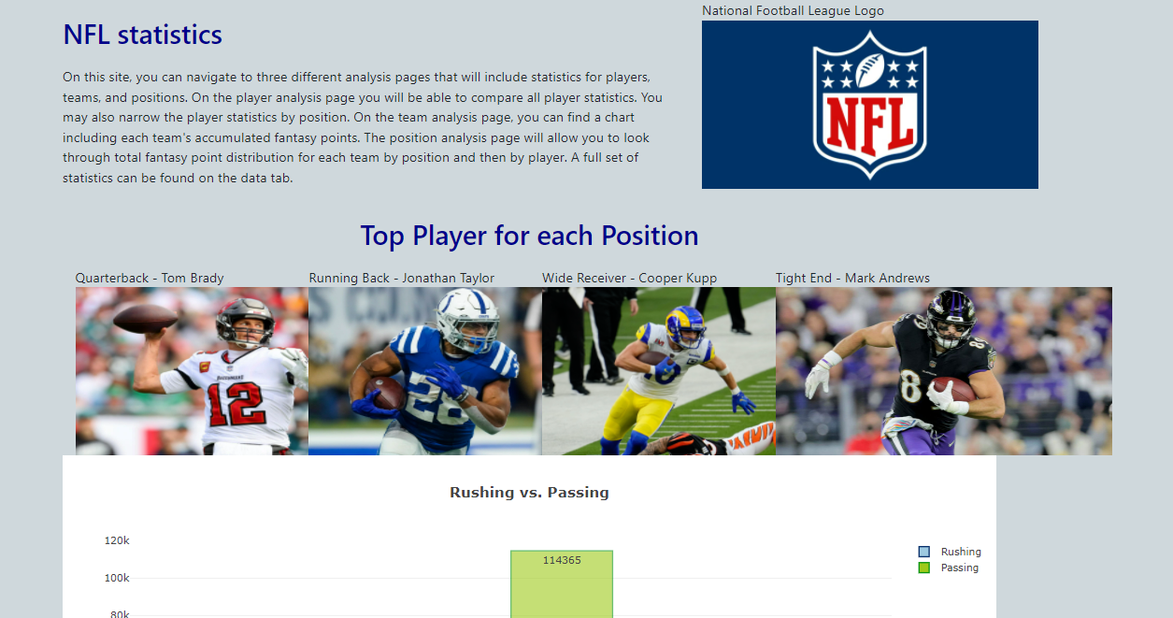
Final Visualization

Slide 11
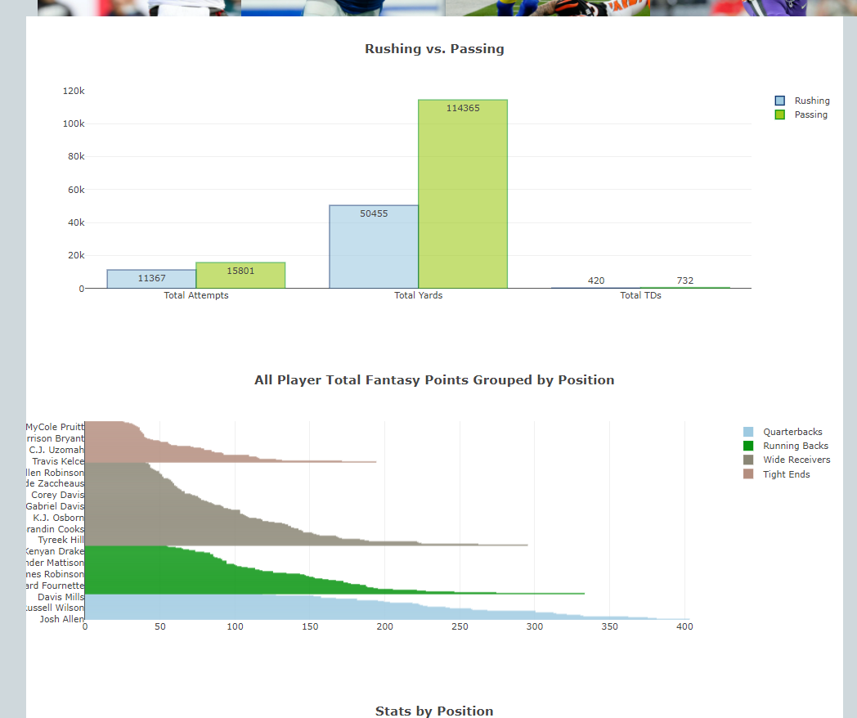
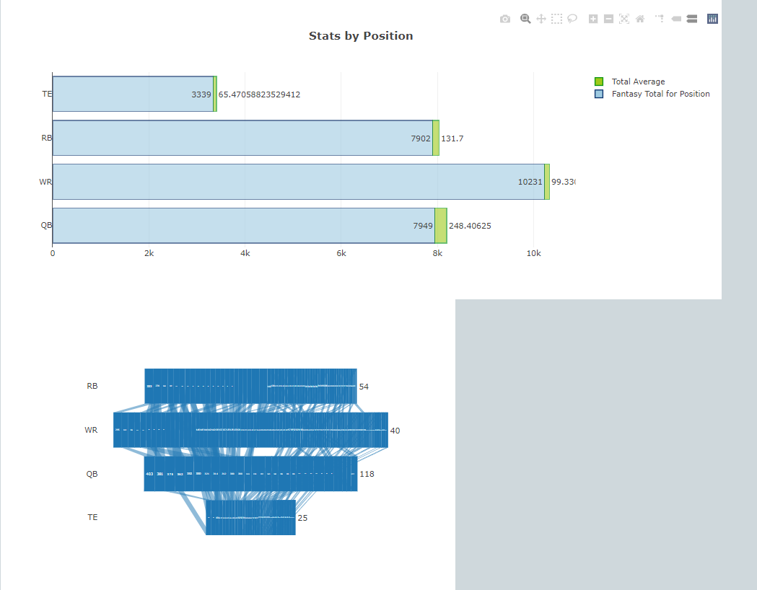
Final Visualizations
Plotly Charts

Slide 12
Final Visualizations
Chart.js
An easy way to include animated, interactive graphs on your website for free.

Slide 13
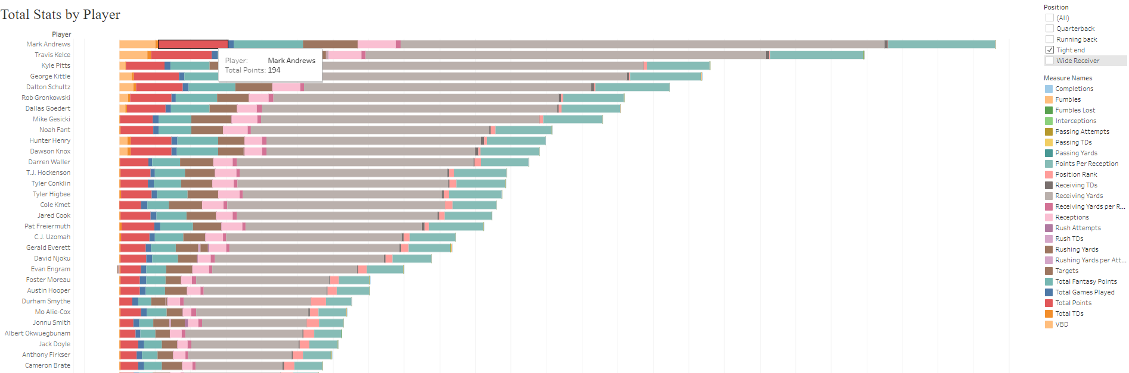
Tableau Visualizations - Players

Slide 14
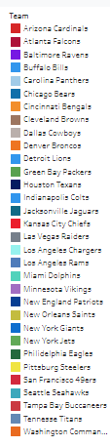
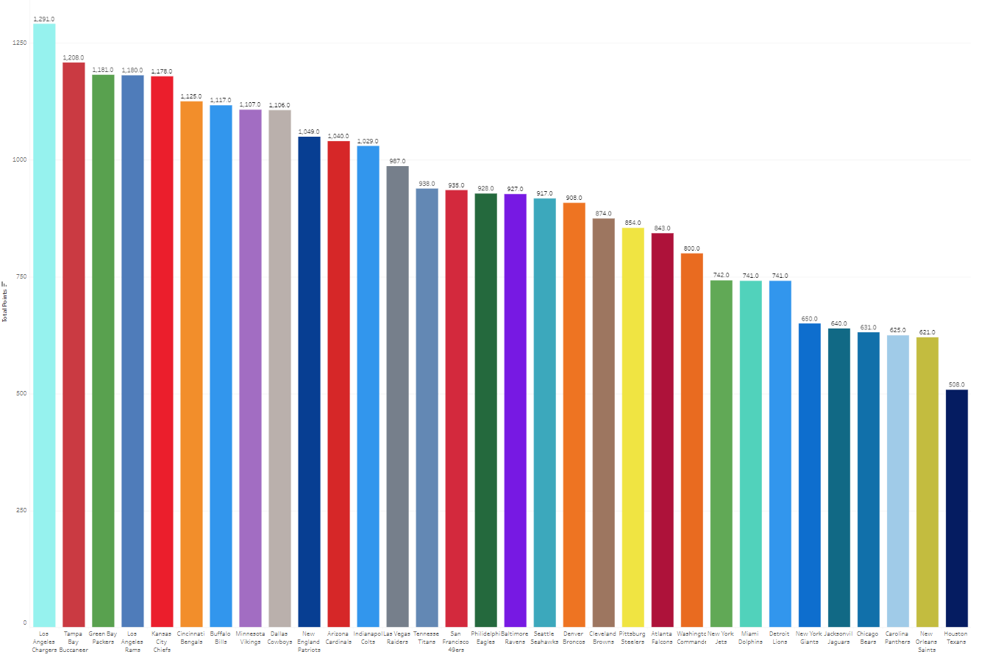
Tableau Visualizations - Team

Slide 15
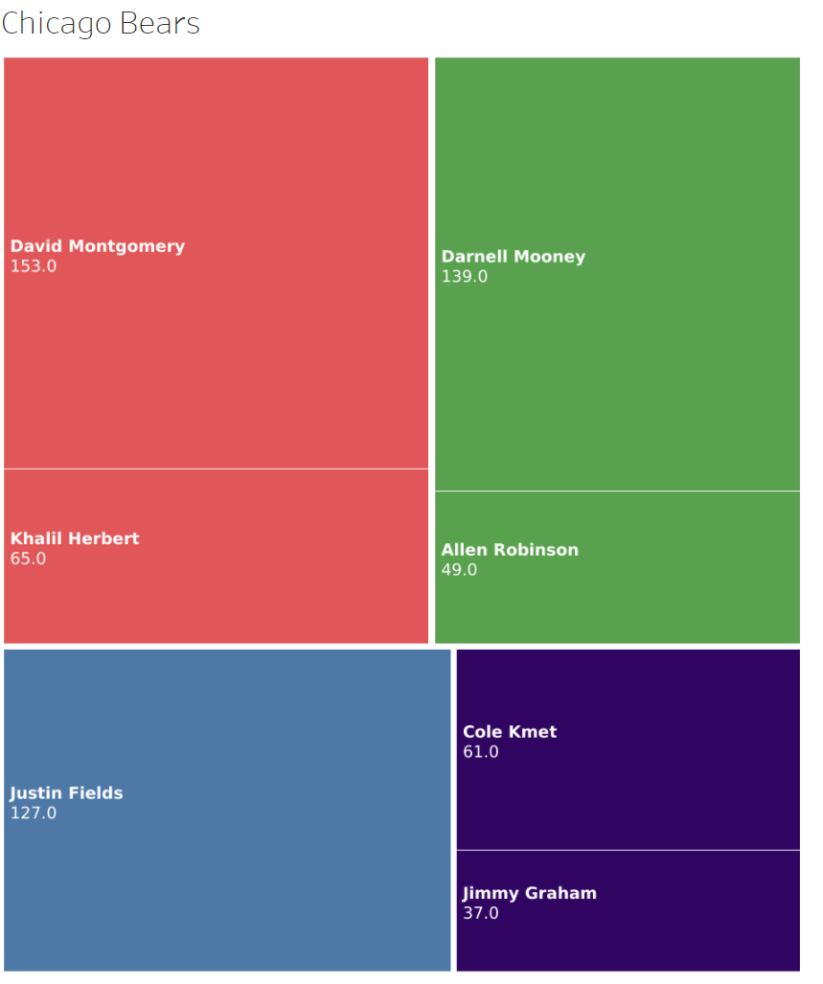
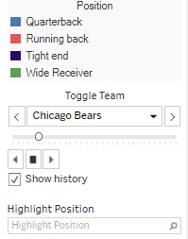
Tableau Visualizations - Position

