Slide 1
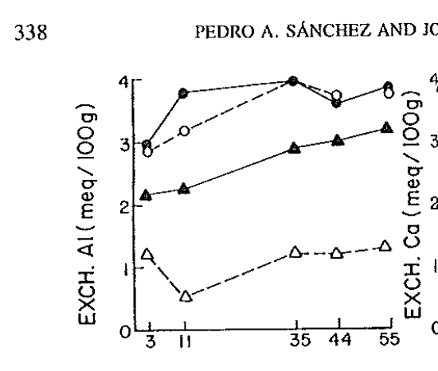
(3.2 - 2.1) / (52/12)
# [1] 0.25
The thin red lines have the same slope.
Sanchez and Salinas

Slide 2
(3.3 - 0.6) / 11 = 0.245
Cifu et al, 2004. Long-term effects of lime application on soil acidity and crop yields on a red soil in Central Zhejiang. Plant and Soil 265

