Slide 1


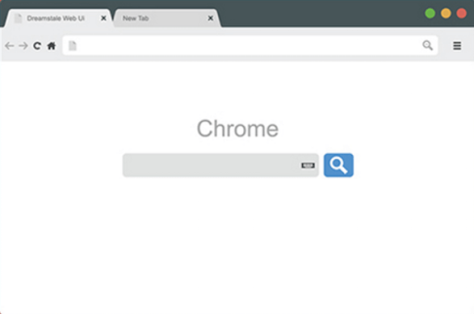



Liquid Content
Render
Visualizer
Cast to your TV

