Slide 1






Use this slide deck to produce Docs-ready UI screenshots. The steps below are based on Create screenshots for documentation (they’re an unofficial extension). The red & white callout style is widely used and matches the red color recommended for highlighting parts of an image. The black & yellow callout style provides higher contrast and matches the example screenshot in the Docs contributor guide. Choose the style that works best for your UI.
Save a copy of this deck with a title that matches the source material where you’re adding images, and then minimize the window.
Capture the UI element using your preferred screen capture app. Don’t capture the whole screen—focus on the UI element you need to illustrate.
Copy the screen capture to your clipboard, then switch back to PowerPoint.
Insert a blank new slide and paste the image from your clipboard.
Copy and paste the callouts you need from slide 1 onto the new slide.
To resize the callouts: First make sure they’re all selected but your pasted image isn’t. Then hold the SHIFT key and drag a corner dot of one of callouts.
Move each callout into place, using PowerPoint’s layout lines to help you align them.
After you’ve placed your callouts, press CTRL+A, then select Home > Drawing > Arrange > Group, and then press CTRL+C.
Open Paint 3D, and then on the welcome screen select Paste. (Or create a new file and paste your clipboard contents there.)
Save your image as a 2D PNG, and then insert it into your source material.
Save a copy of your modified slide deck to send along with your source material. That way the content developer can reuse it most effectively.
1
2
3
4
5
6
7
8
9
10
10
1
2
3
4
5
6
7
8
9

Slide 2
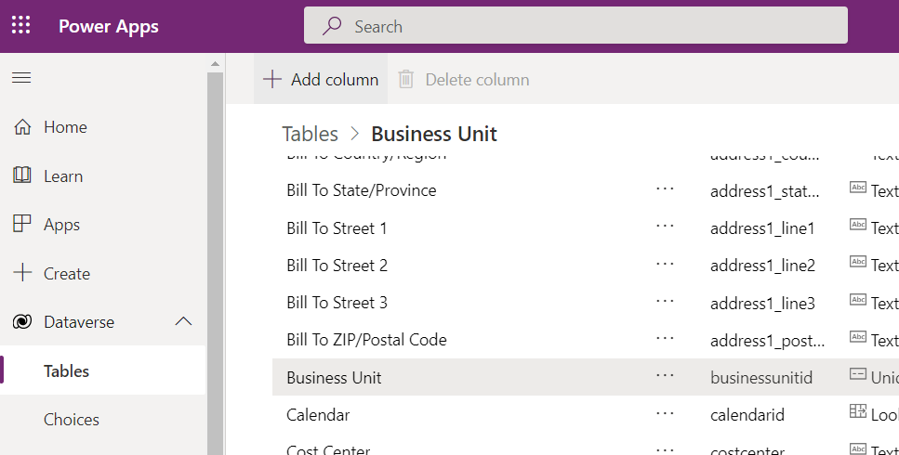
Last, select
+ Add column.
First, select
Dataverse > Tables.
Next, select the table to modify.

Slide 3
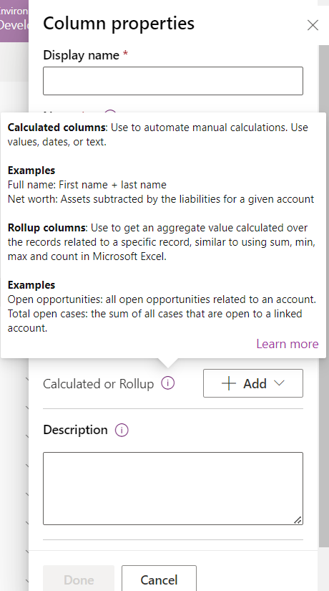
For a quick reminder of a property’s effect, select the info icon beside its name.

Slide 4
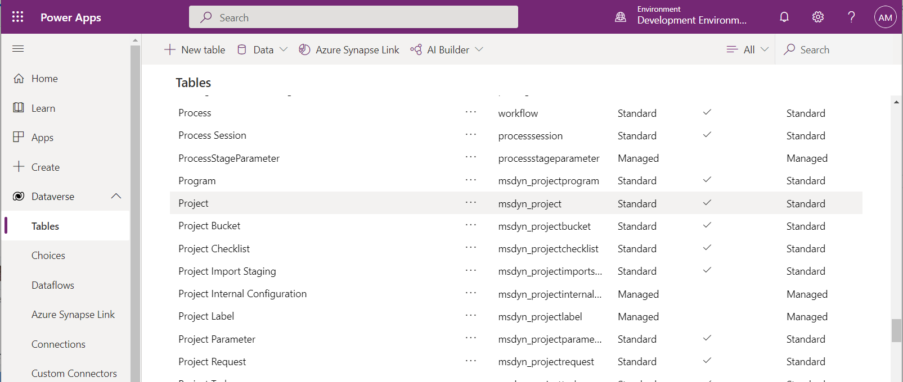
Make changes in your Development environment first, so you can ensure they work as expected before you deploy them in your Production environment.
Make sure that a table isn’t a Managed or System table before you try to make arbitrary changes to it.

Slide 5
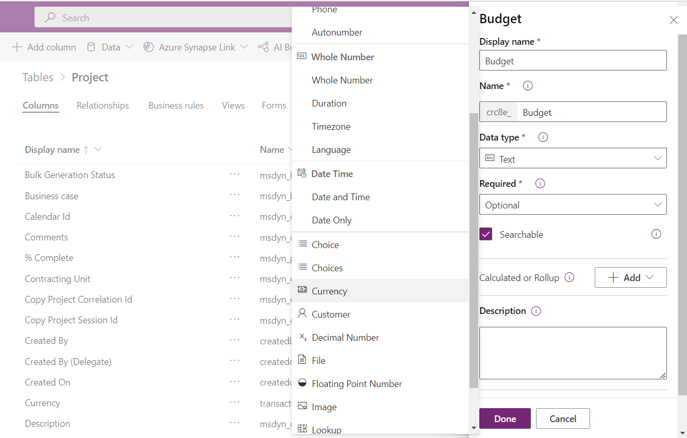
The Currency data type supports financial calculations.

Slide 6
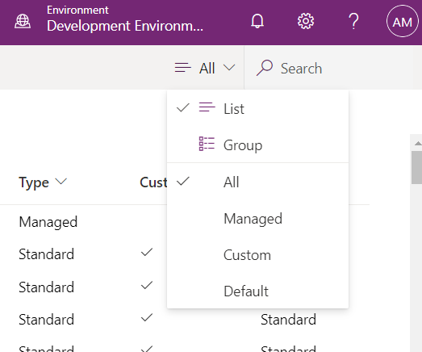

Slide 7
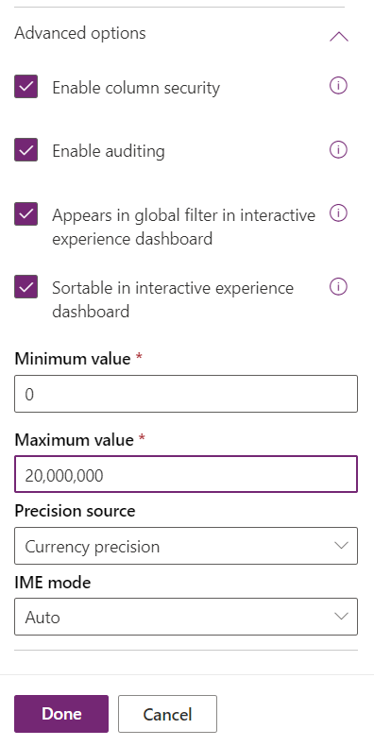
Enable column security to prevent unauthorized changes.
Enable auditing for data that needs periodic review.
Columns with high-level data make good filter/sort options on dashboards.
Adjust the Minimum value and Maximum value to make sure that the column data meets your needs.

Slide 8
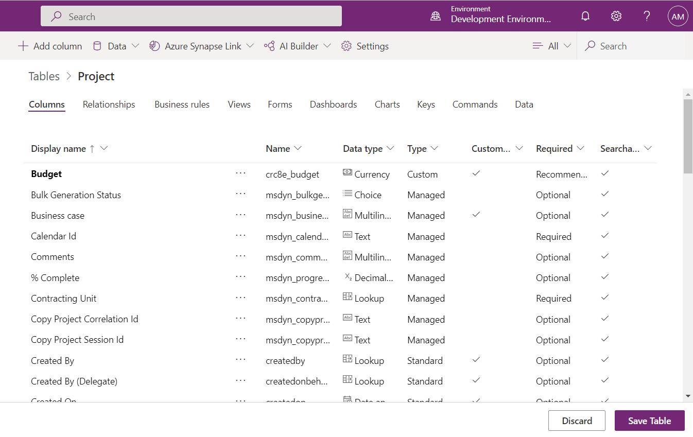

Slide 9
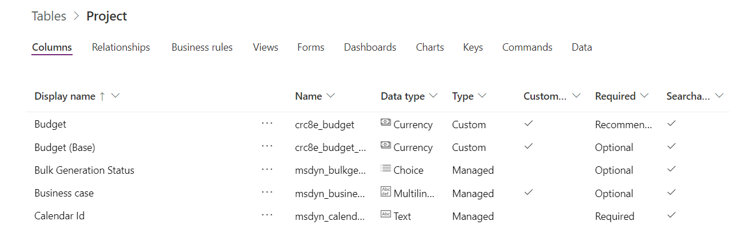
When you add a column with the Currency data type, Power Platform adds another column that holds the calculation of the value in the column you added, in terms of the base currency for your app.

Slide 10
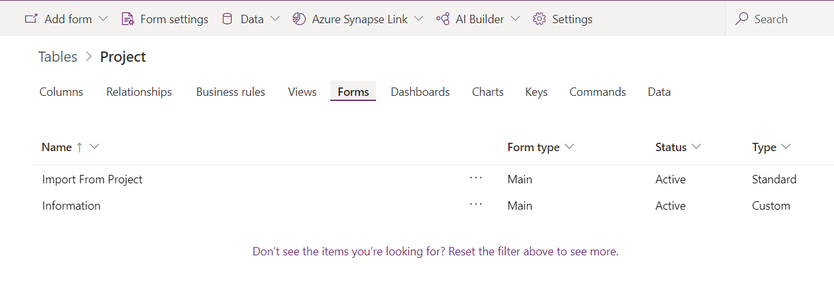
Switch to the Forms area after you add a custom column.
Select the form where you want to make the column available.

Slide 11
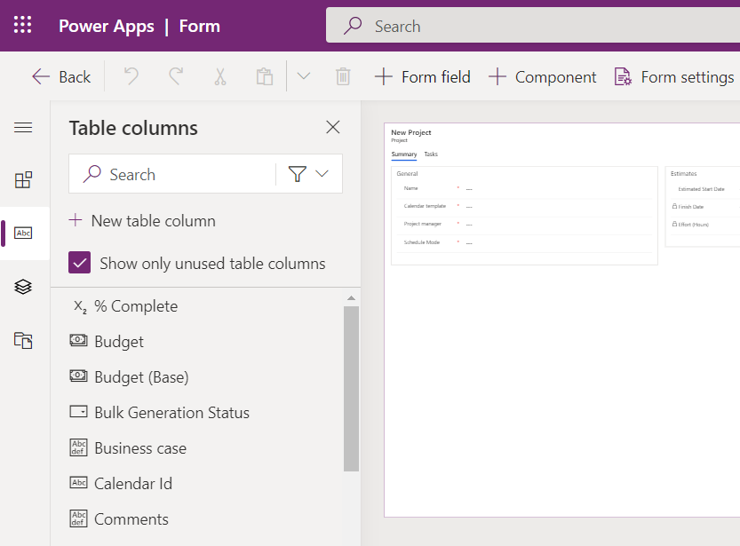
When you select + Form field, the Table columns pane opens.
By default, unused columns appear in the Table columns pane.

Slide 12
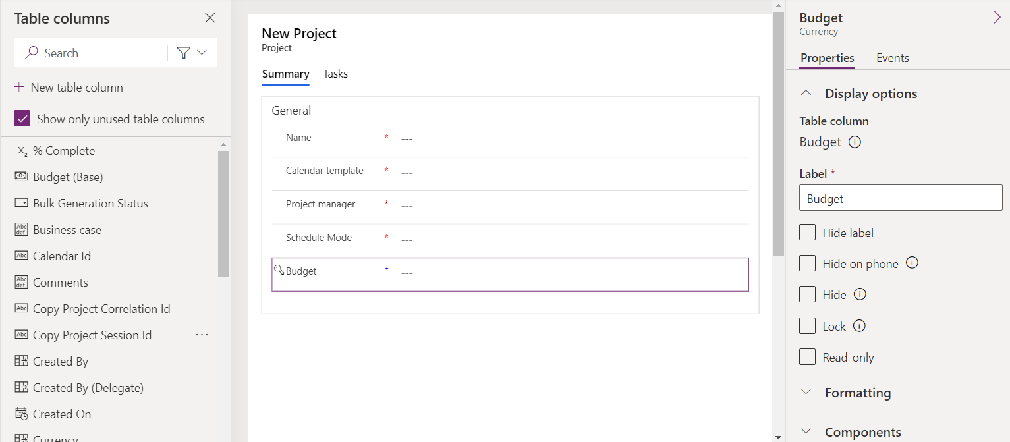
When you drag a field onto a form, it’s added to the General section unless you drop it somewhere else.

Slide 13
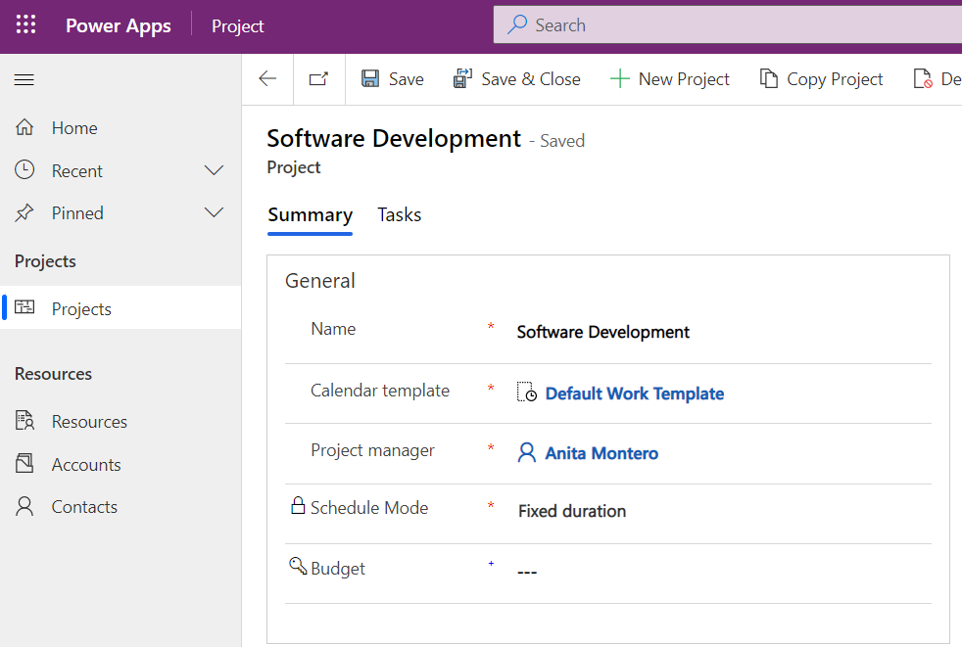
After you publish your changes, the new field appears in every project in the same environment.

Slide 14
Když přetáhnete pole do formuláře, přidá se do oddílu Obecné, pokud ho nepřesunete někam jinam.
由于"预算"列具有字段级安全性，因此对于没有所需安全角色的用户，该列处于锁定状态。

