Slide 1
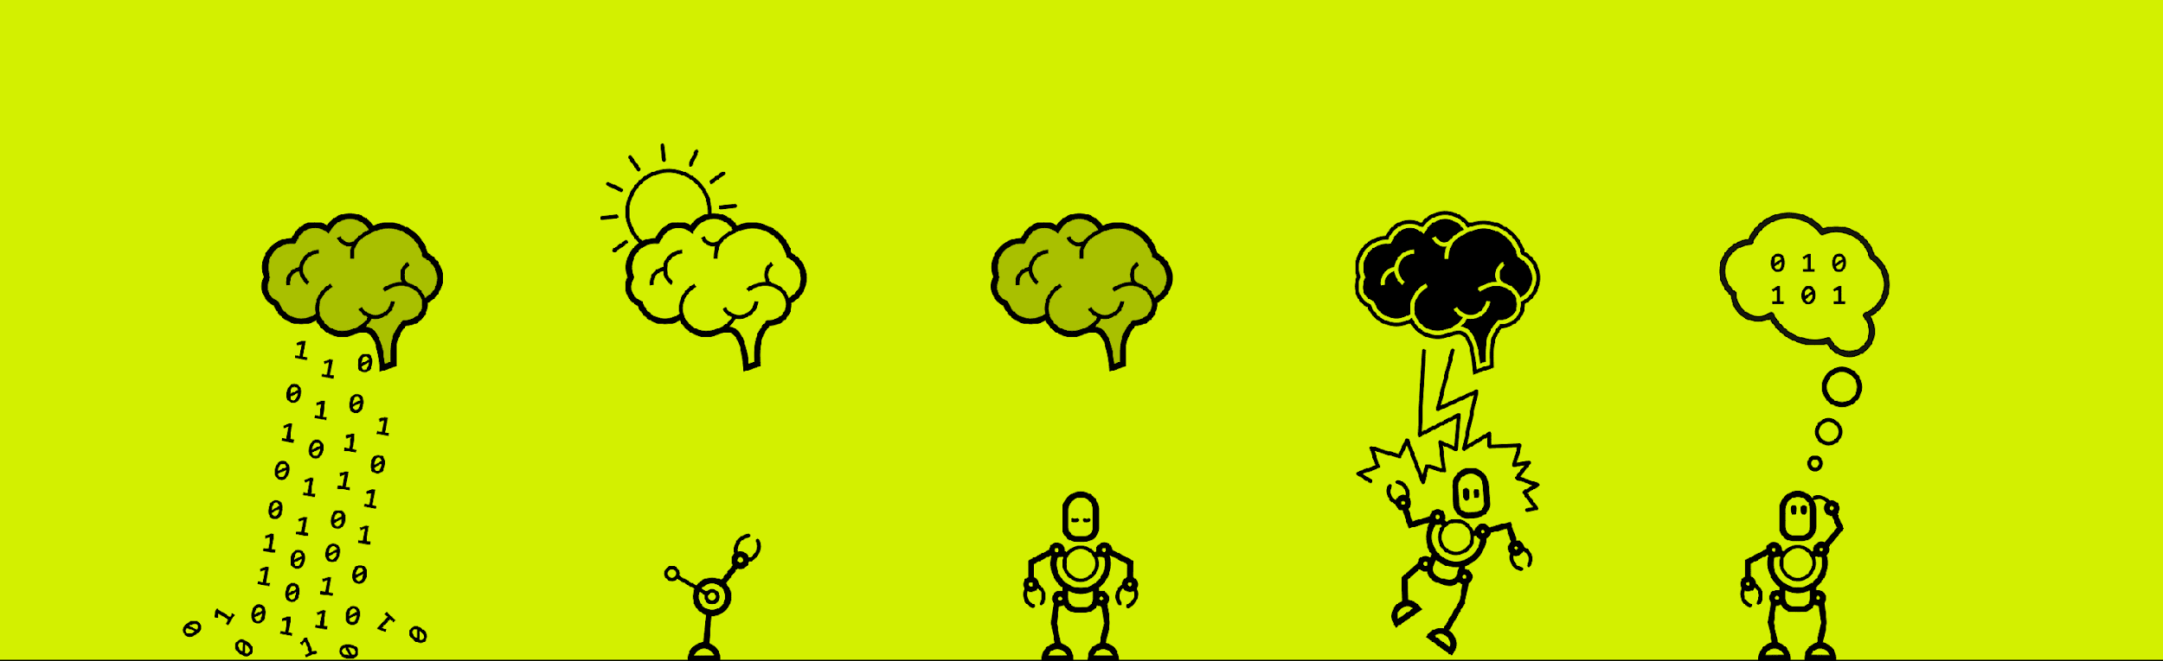


Slide 2

ECoG Hand Pose Data Analysis
Eidan Tzdaka
Konstantin Volzhenin
Antoine Prosper

Slide 3
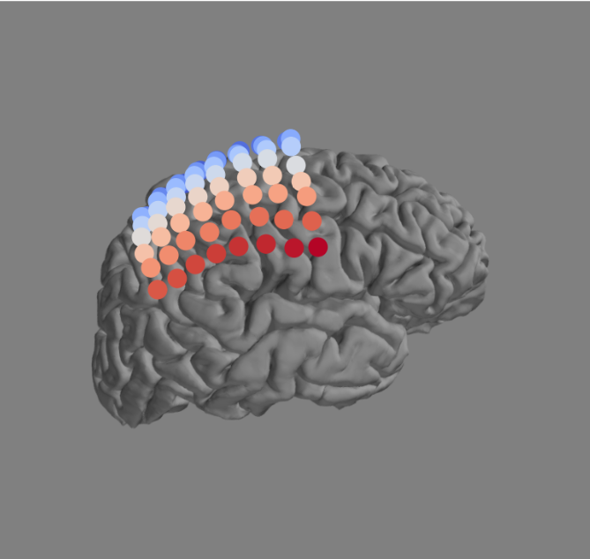
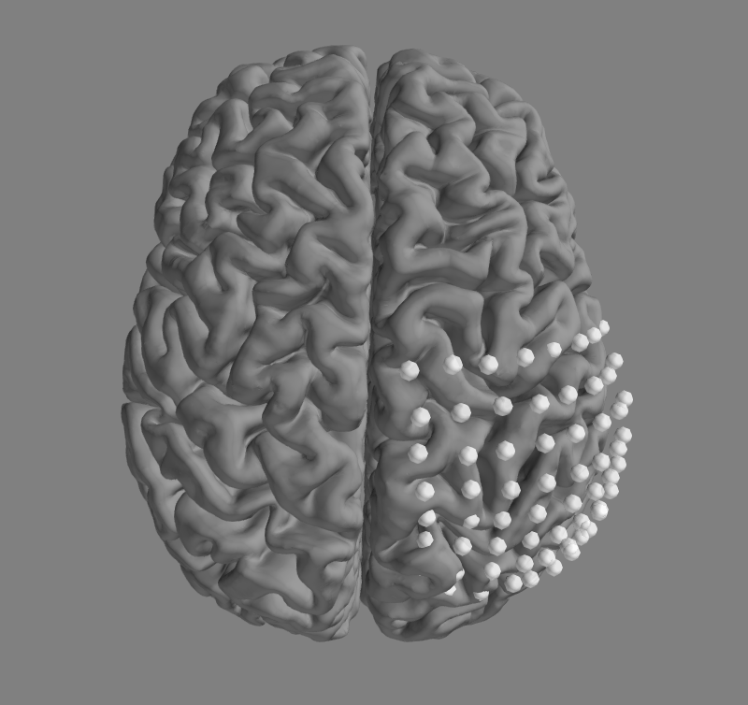
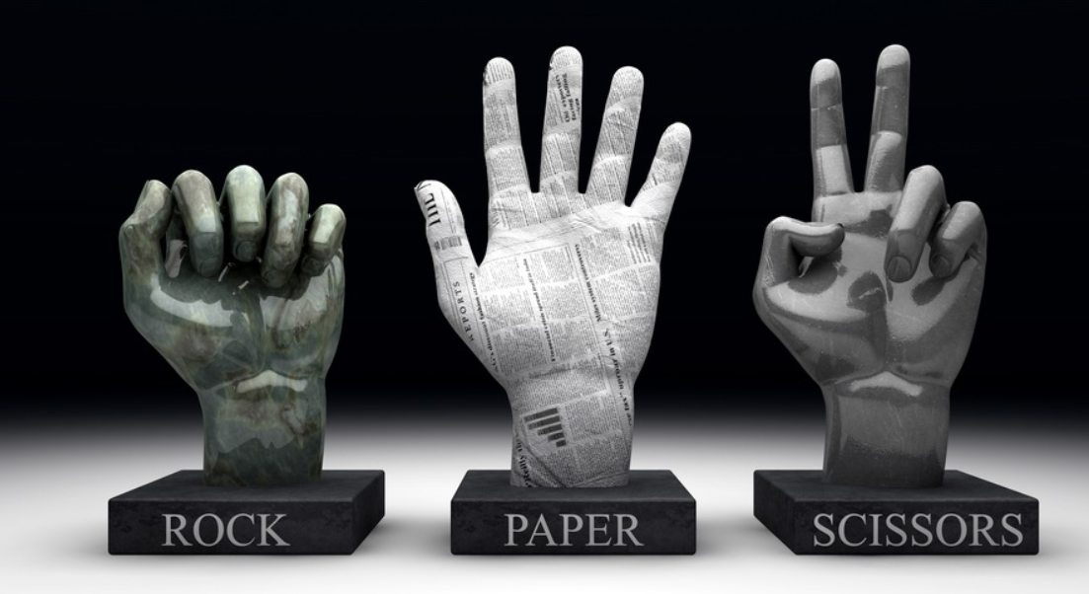
INTRODUCTION
ECoG data set of a Rock/Paper/Scissors training session.

Slide 4
IDEAS AND WORKING PROCESS
Hint:
Time-Variant Linear Discriminant
Analysis Improves Hand Gesture and
Finger Movement Decoding for
Invasive Brain-Computer Interfaces
CSP/PCA + LDA
A lot of trials and errors
Attempt to boost the accuracy
Brainstorm for different methods
Riemann space?

Slide 5
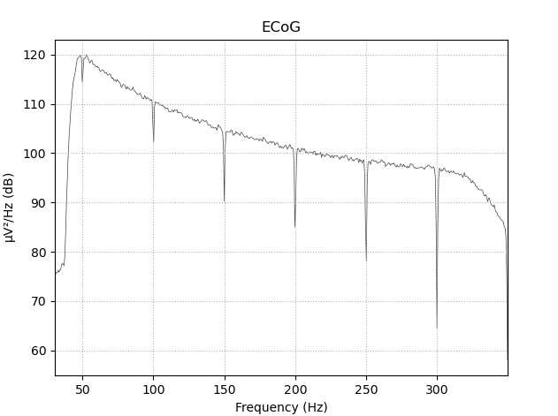
IMPLEMENTATION REALIZATION…
Preprocessing:
Re-referenced the data by the common average
Band-pass filter for high-gamma frequency band (50-300Hz)
Notch filter for power line frequency removal

Slide 6
Feature Reduction
Classification Algorithms
PCA - Find highest variance axes in the data to project dimensions with minimal loss of information
CSP - Signal decomposition using the Common Spatial Patterns with 4 CSP components
Covariance matrix - covariance matrix estimation for each given trial
LDA - You all know it, Don’t you?
MDM - Minimum Distance to Mean : Classification by nearest centroid in Riemann space using Riemann distance
Tangent Space logistic regression - project the Riemann space onto tangent (linear) space and use Euclidean distance
Notes:
We knew we needed feature reduction techniques based on the paper and the over fitting of LDA when too many dimensions are provided, so we looked at CSP and PCA to reduce the channel counts.
Then we made classifiers compete based

Slide 7
RESULTS
Method | CSP+LDA | PCA+LDA | Covariance matrices + MDM in Riemann space | Covariance matrices + Riemann Tangent Space logistic regression | Multi class LDA
Accuracy | 87% | 84% | 82% | 84% | 67%
Notes:
YOLO

Slide 8
REFLECTION…
What else could we have looked at?
TVLDA: Dynamic updating of the classifiers
Pay close attention to overfitting: performance dropped when trying to build 1-vs-1 classifiers -> overfitting is an issue with our implementation
Look at frequency bands other than Gamma to confirm the classifications.

Slide 9
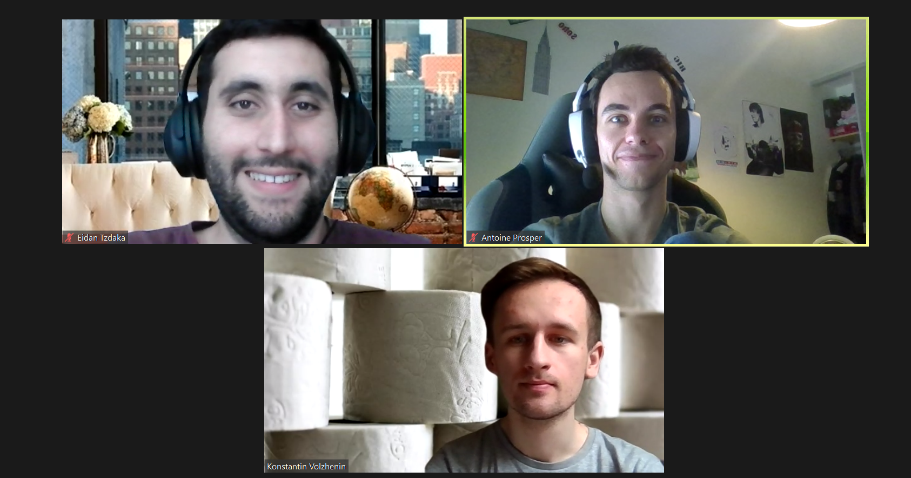
GROUP PICTURE

Slide 10
ECoG Hand Pose Data Analysis
Eidan Tzdaka
Konstantin Volzhenin
Antoine Prosper

