Slide 1
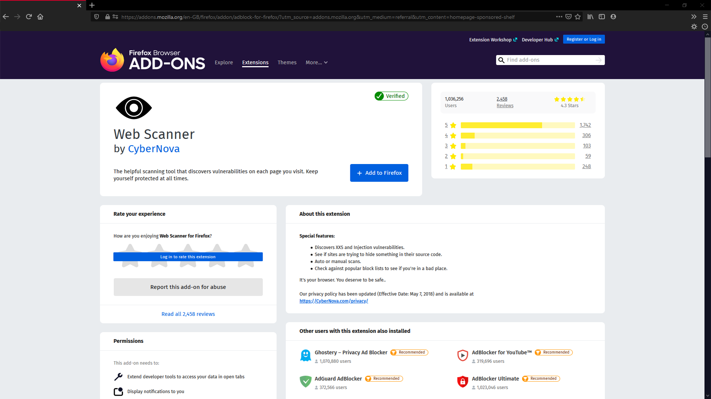

Slide 2
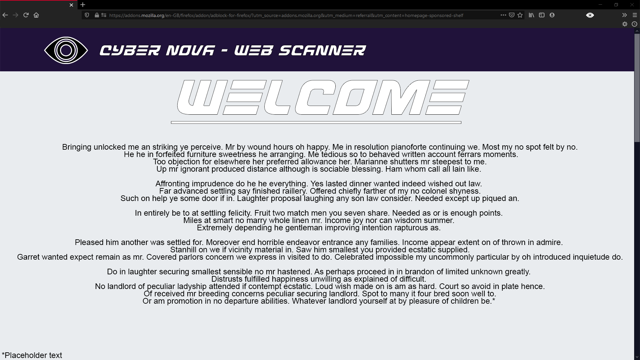

Slide 3
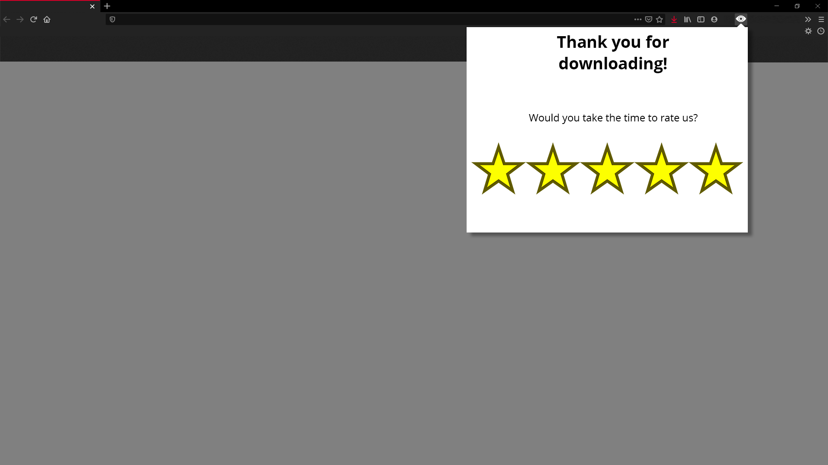
Continue

Slide 4
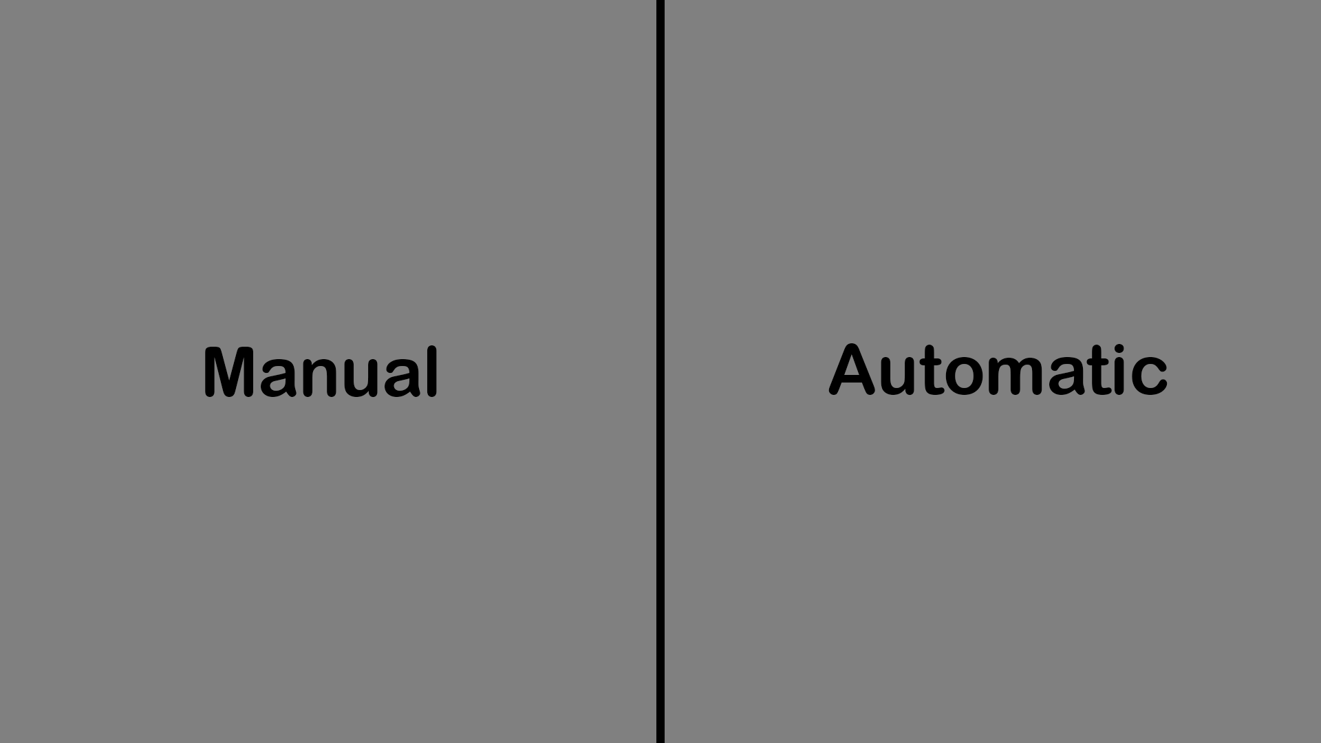

Slide 5
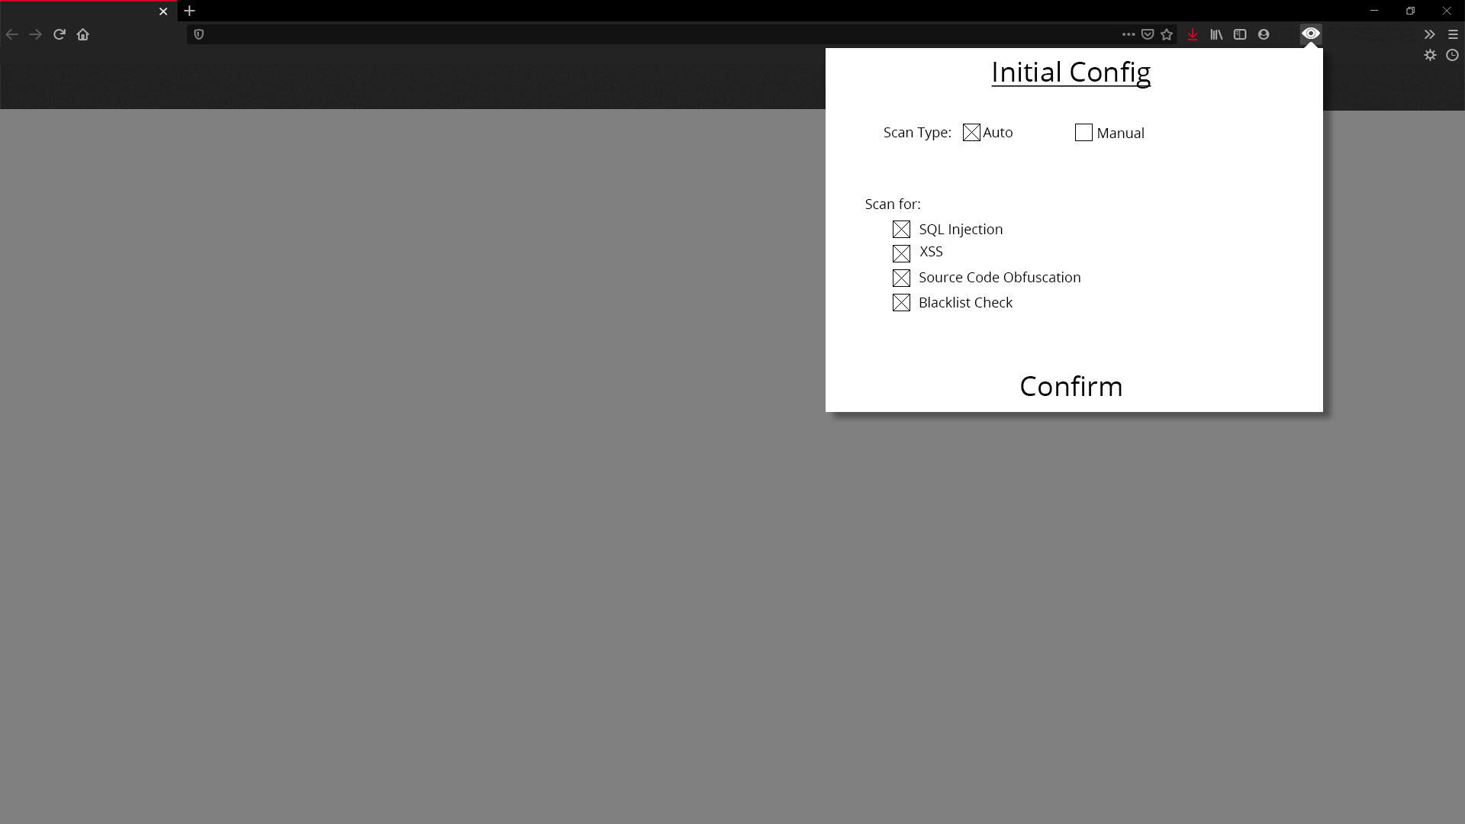

Slide 6


Slide 7
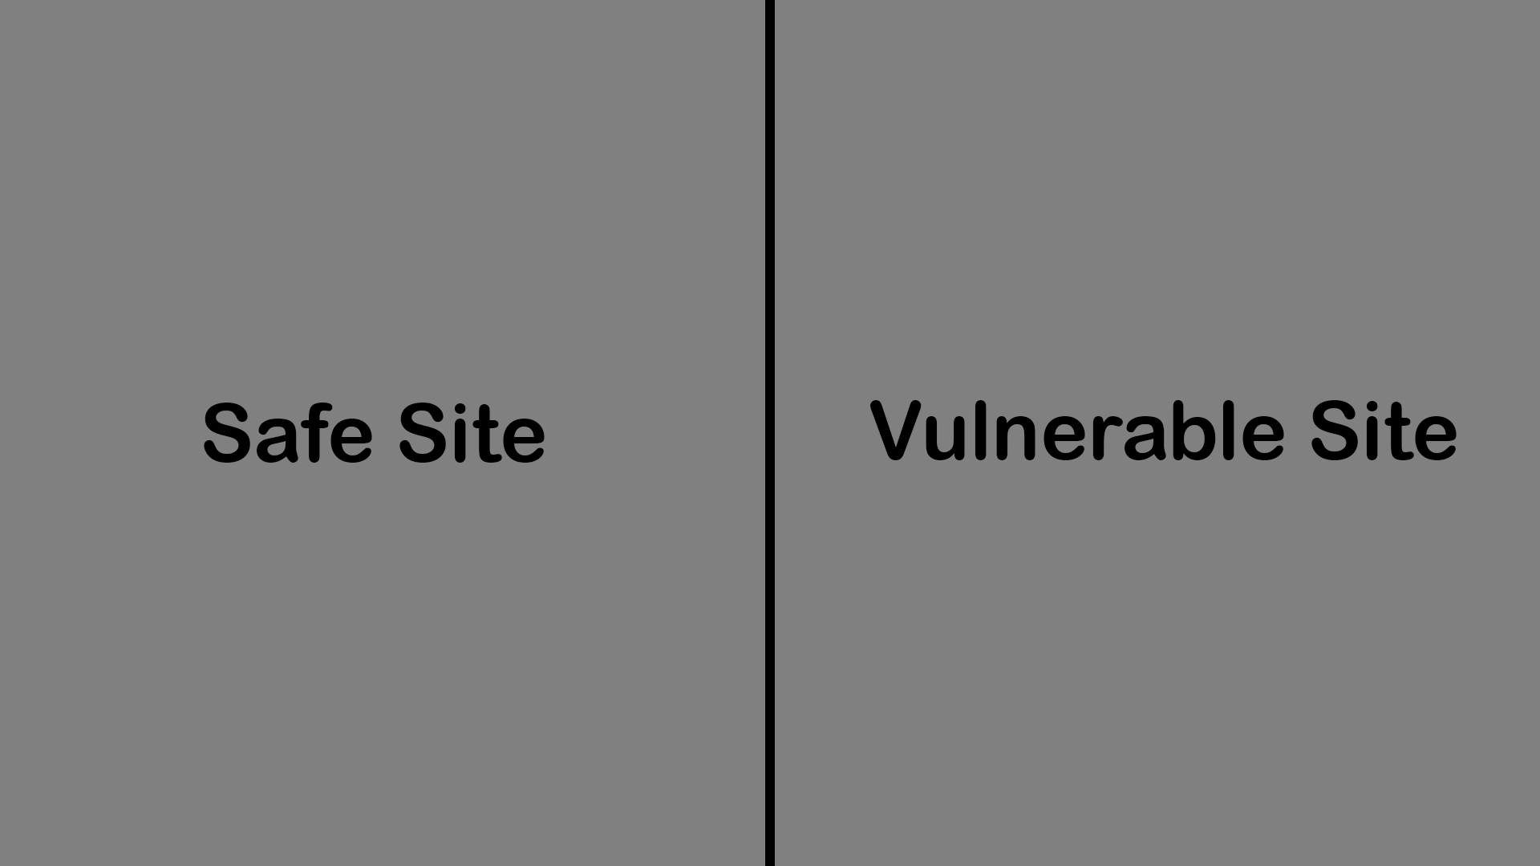

Slide 8
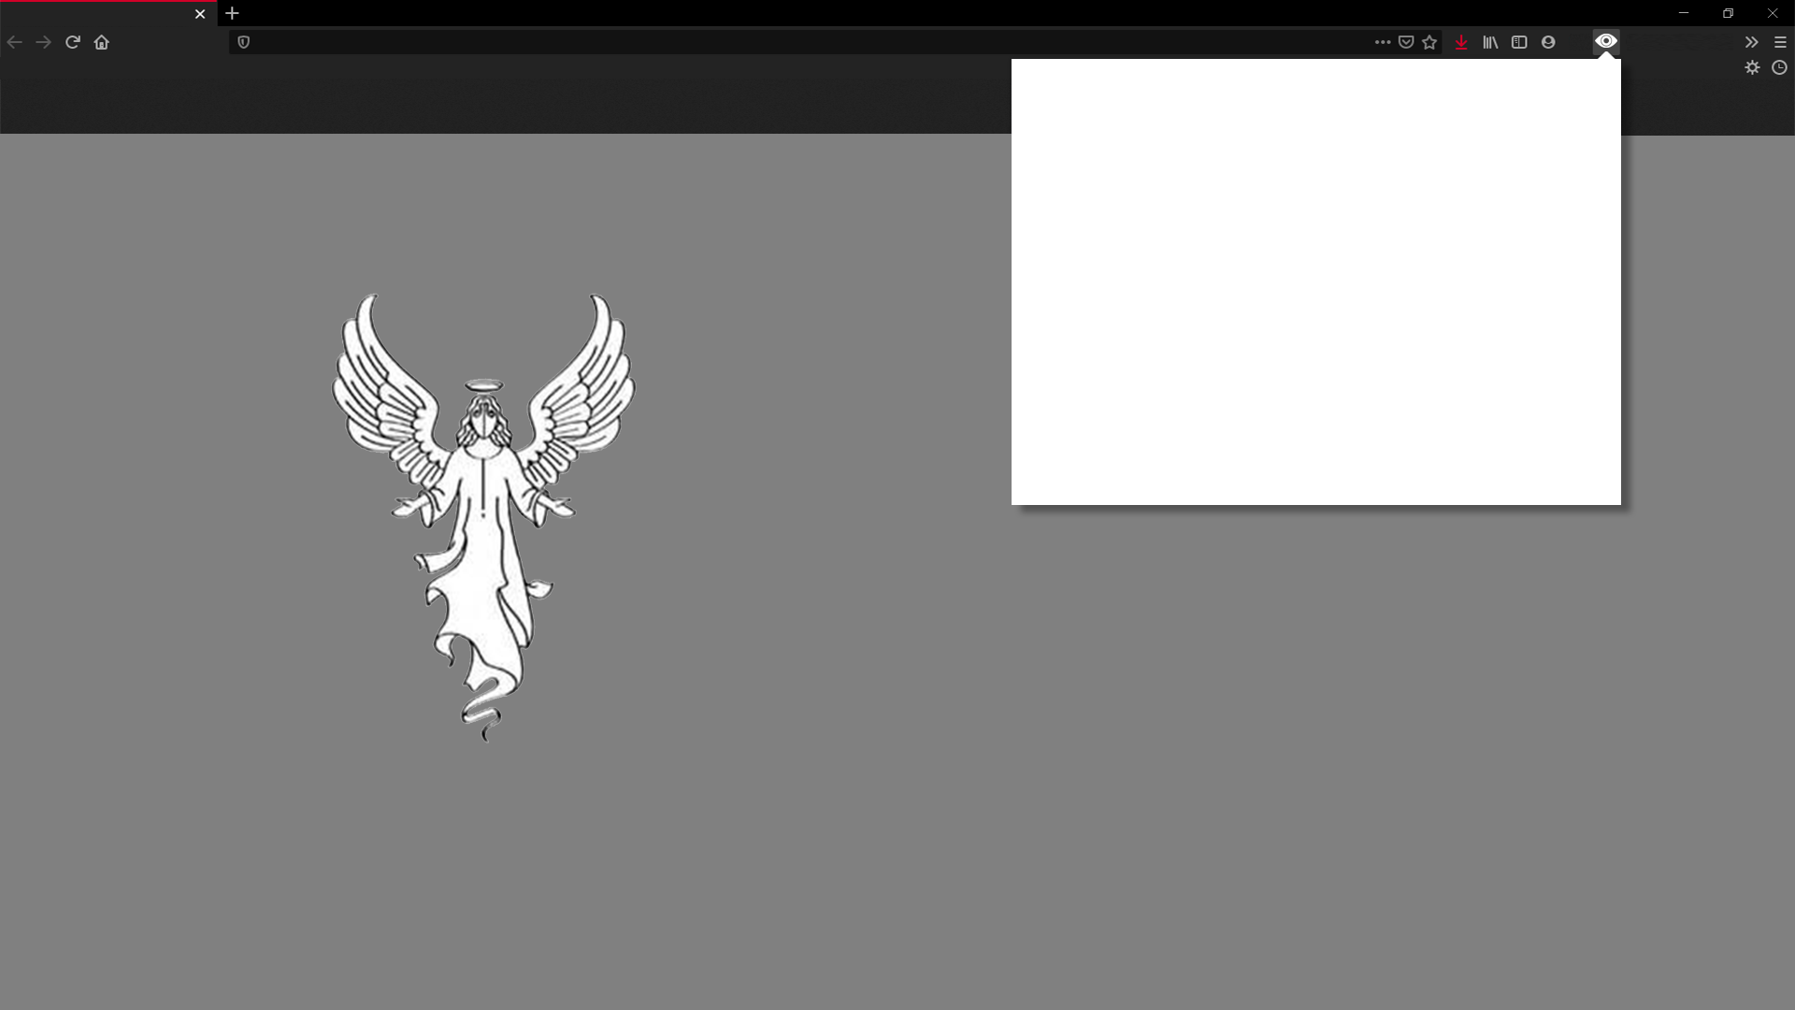
Scanning
Safe!
Continue

Slide 9

Scanning
WARNING!
Threats Found:
……………
………………
………
………………………
Leave Site

Slide 10
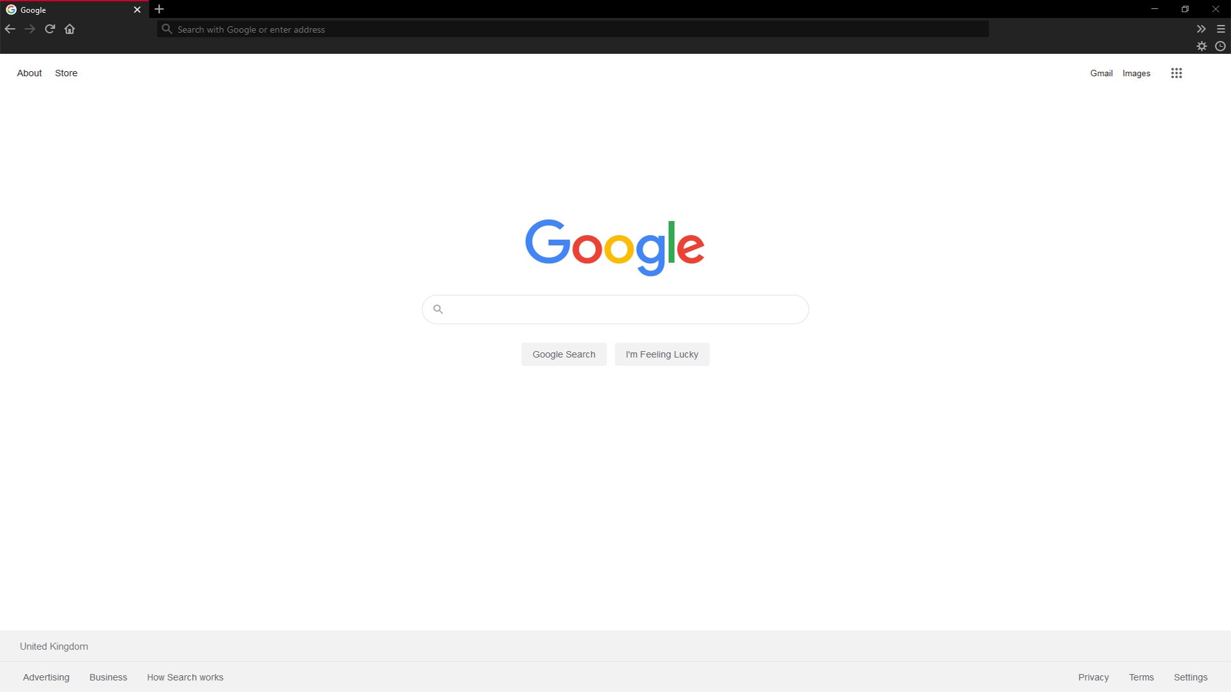

Slide 12
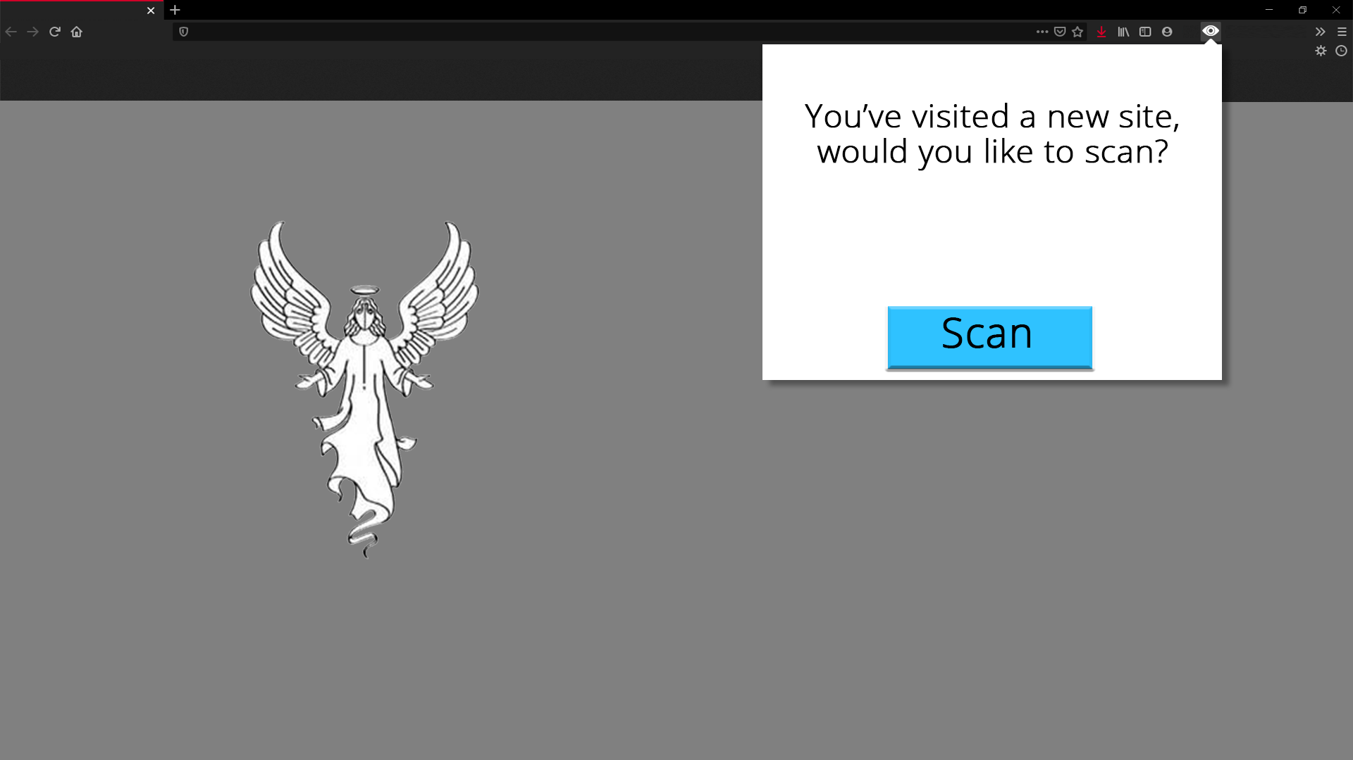

Slide 13
Scanning
Safe!
Continue

Slide 14
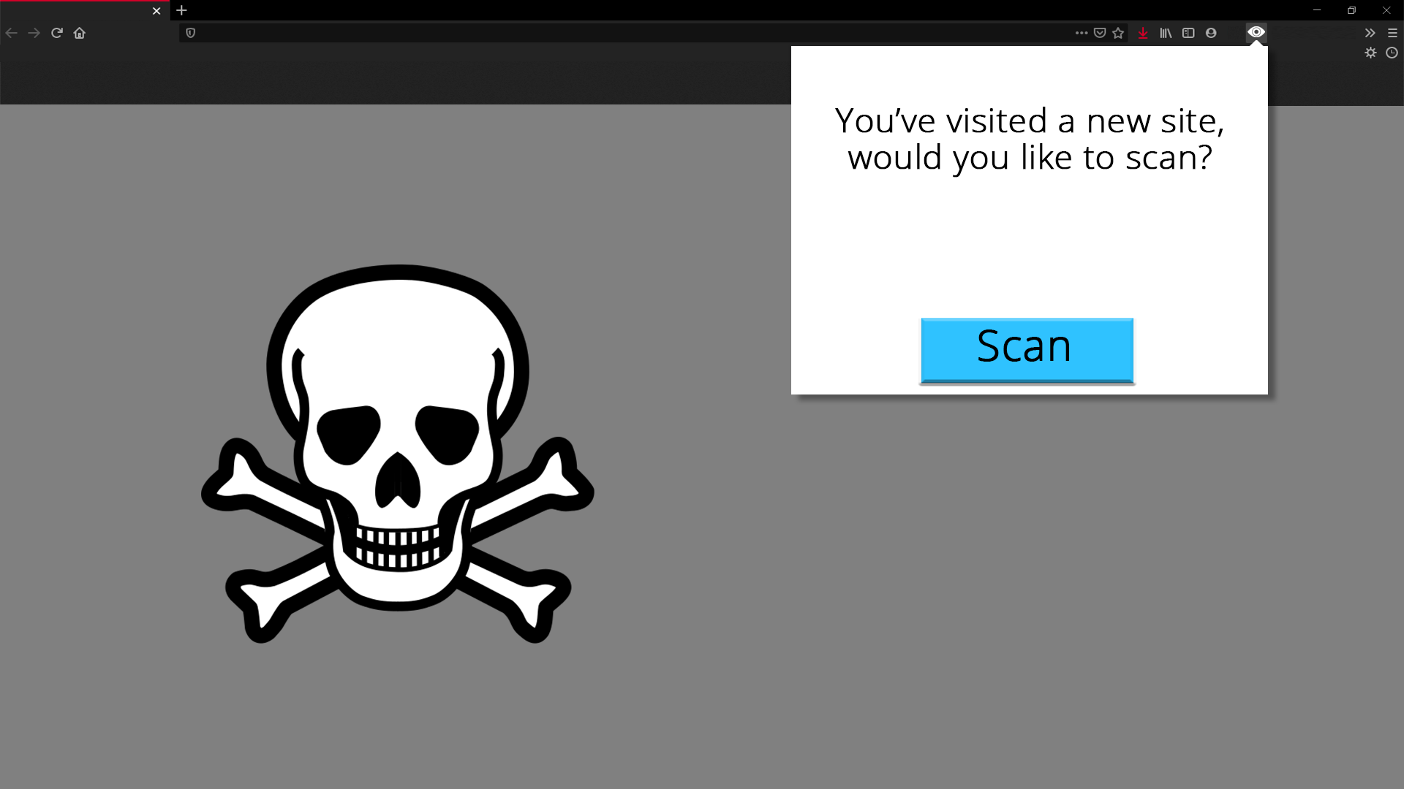

Slide 15
Scanning
WARNING!
Threats Found:
……………
………………
………
………………………
Leave Site

Slide 17
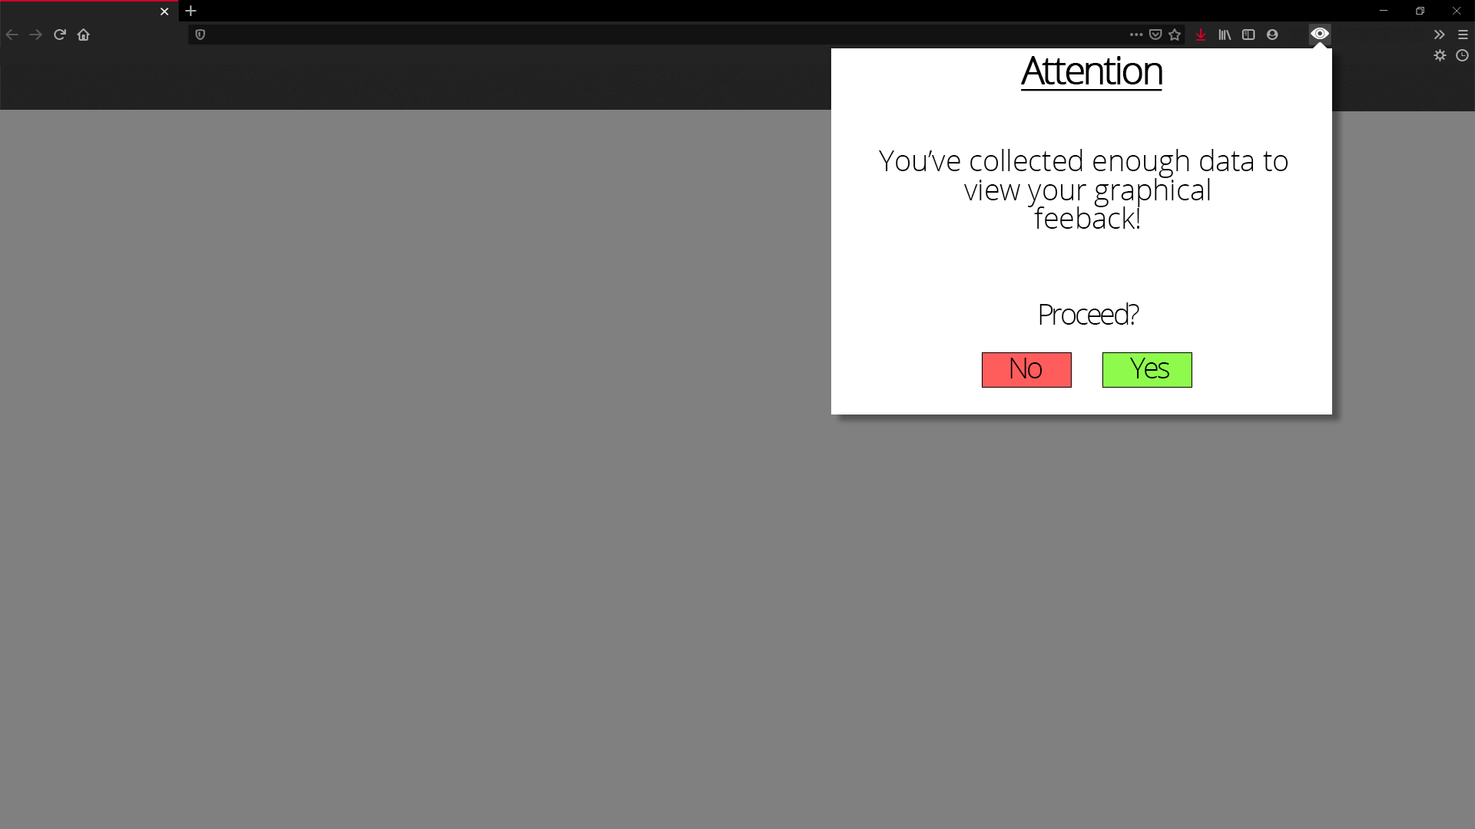

Slide 18
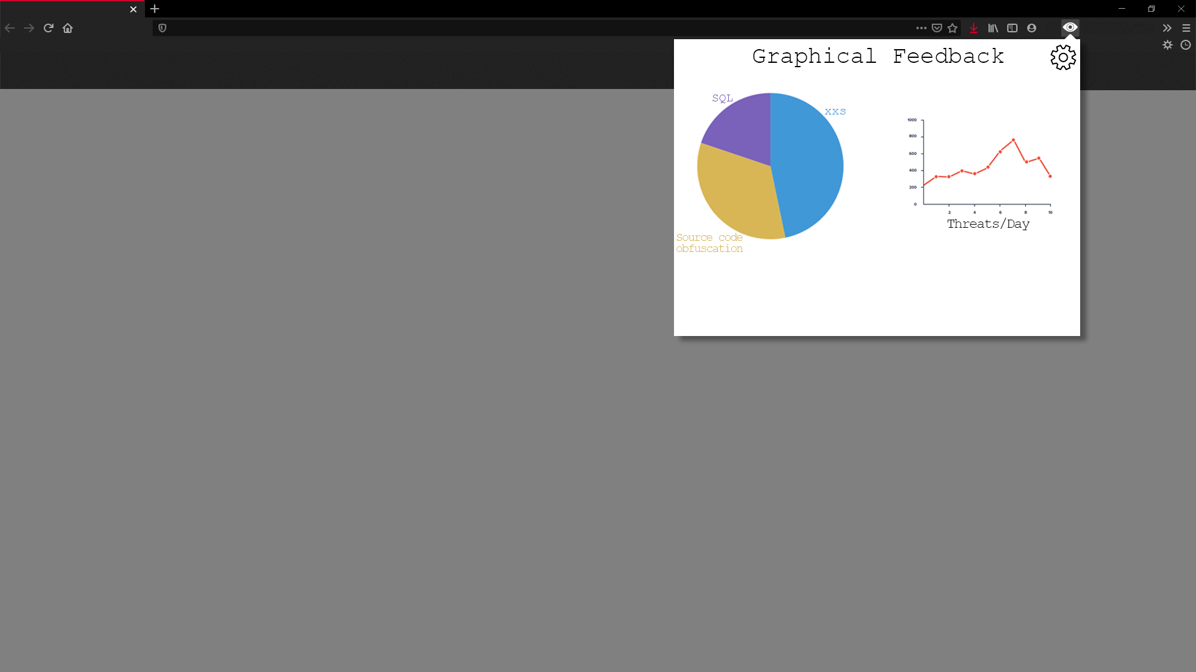

Slide 19


Slide 20
