Slide 1
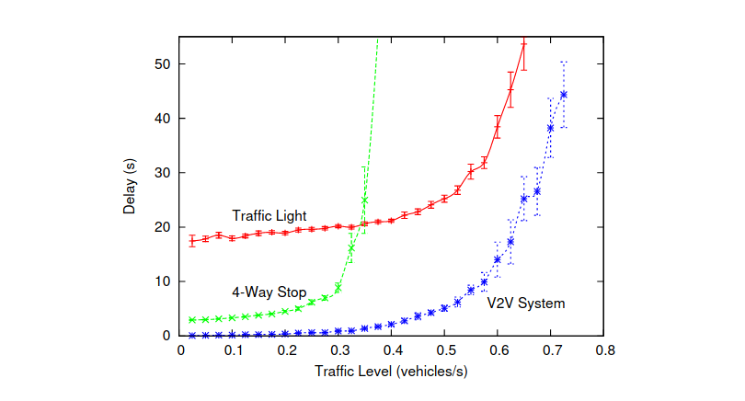
Replacing the Stop Sign: Unmanaged Intersection Control for Autonomous Vehicle, 2008
New system Peer to Peer
METHOD

Slide 2
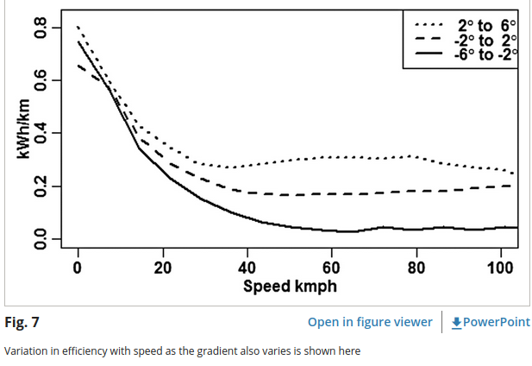
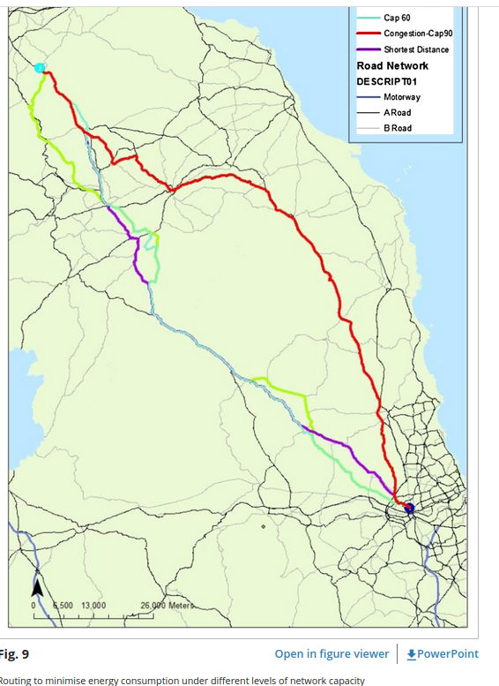
Routing systems to extend the driving range of electric vehicles, 2013
Elec vehicules routing
DATA

Slide 3
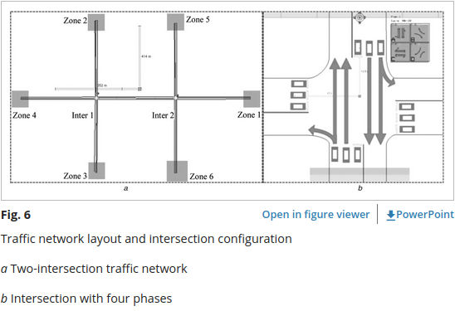
Vehicle-to-infrastructure communication-based adaptive traffic signal control, 2013
Vehicle acceleration & breaking profile
METHOD

Slide 4
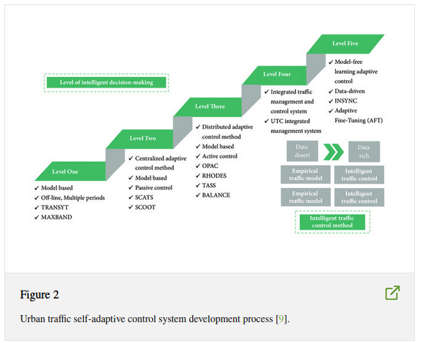
A Review of the Self-Adaptive Traffic Signal Control System Based on Future Traffic Environment, 2018
History
METHOD
REVIEW

Slide 5
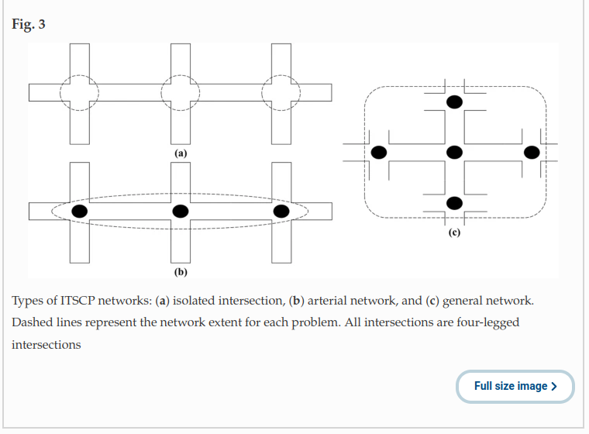
The traffic signal control problem for intersections: a review, 2020
ITSCP Problem
REVIEW

Slide 6
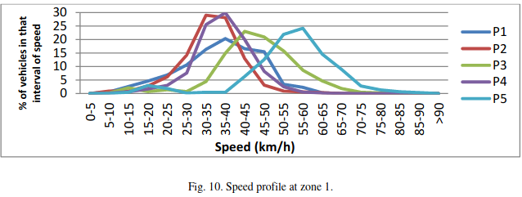
Traffic calming measures and their effect on the variation of speed, 2016
Measures impact on real speed
DATA

Slide 7
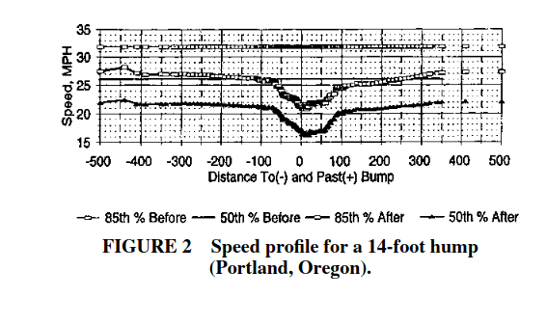
Impacts of Traffic Calming, 1999
Speed by measure
DATA

Slide 8
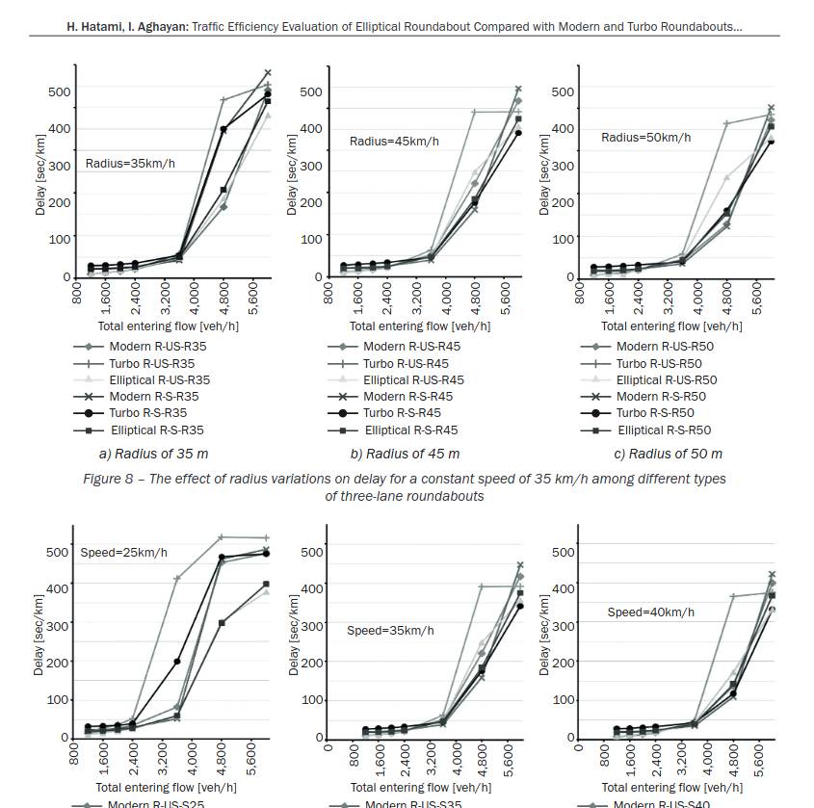
TRAFFIC EFFICIENCY EVALUATION OF ELLIPTICAL
ROUNDABOUT COMPARED WITH MODERN AND TURBO
ROUNDABOUTS CONSIDERING TRAFFIC SIGNAL CONTROL, 2016
Roudabouts comparison
DATA

Slide 9
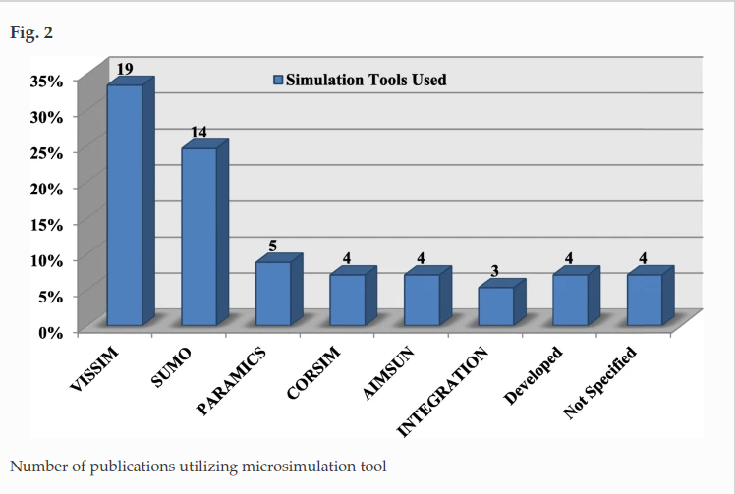
State-of-art review of traffic signal control methods: challenges and opportunities, 2020
Simulation tools
REVIEW

Slide 10
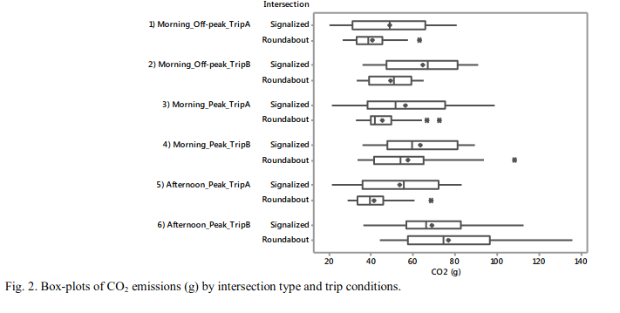
On-road measurement of CO2 vehicle emissions under alternative forms of intersection control, 2017
On-Field measurement
DATA
CENTRAL

Slide 11
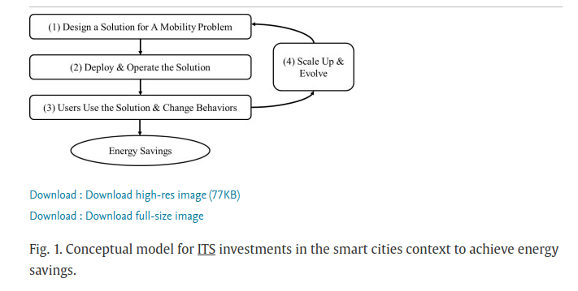
Achieving energy savings by intelligent transportation systems investments in the context of smart cities, 2017
REVIEW

Slide 12
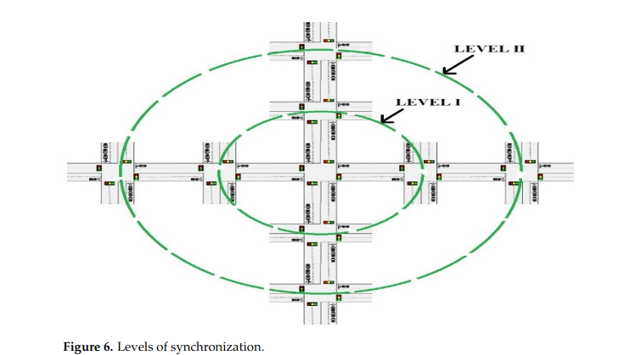
State-of-Art Review of Traffic Light Synchronization for
Intelligent Vehicles: Current Status, Challenges, and Emerging Trends, 2022
Synchro levels
REVIEW

Slide 13
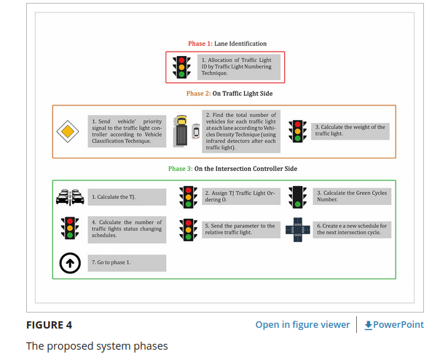
Novel system for road traffic optimisation in large cities, 2022
Synchro levels
METHOD

Slide 14
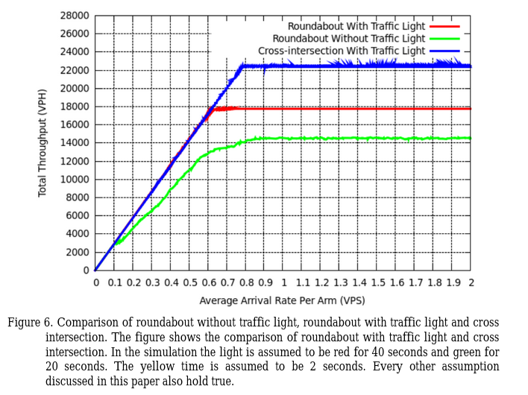
Efficiency of Roundabouts as Compared to Traffic Light Controlled Intersections in Urban Road Networks, 2013
Intersection comparison
DATA
CENTRAL

Slide 15
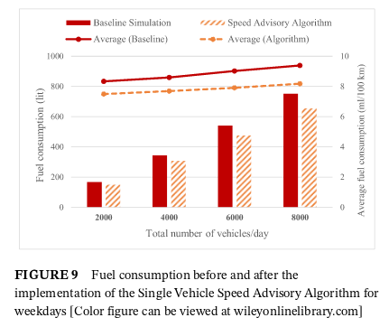
Traffic flow and emissions improvement via
Vehicle-to-vehicle and vehicle-to-infrastructure communication for an intelligent intersection, 2021
Synchro in SUMO
METHOD

Slide 16
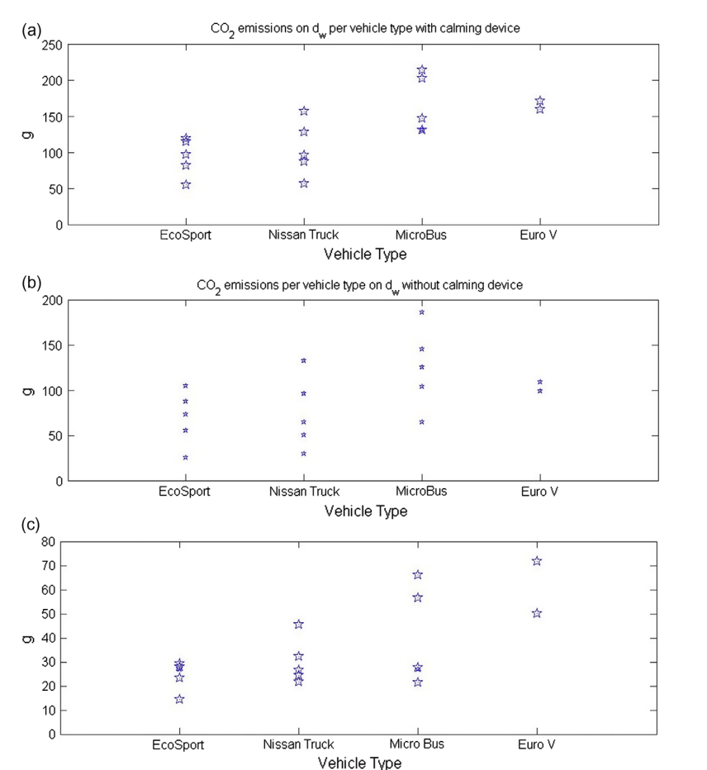
Economic-environmental analysis of trafﬁc-calming devices, 2015
Ghg (GES) emisions
DATA
CENTRAL

Slide 17
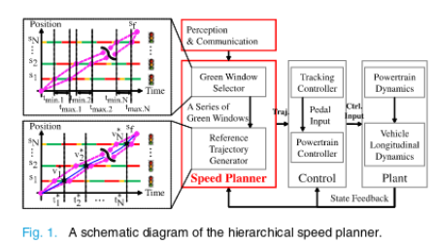
Leveraging Multiple Connected Traffic Light
Signals in an Energy-Efficient Speed Planner, 2021
Green Window
METHOD

Slide 18
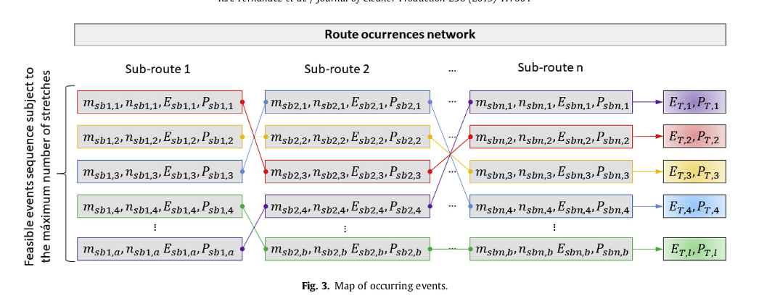
A probabilistic approach for determining the influence of urban trafic management policies on energy consumption and greenhouse gas emissions from a battery electric vehicle, 2019
Probabilistic approach
METHOD
CENTRAL ?

Slide 19
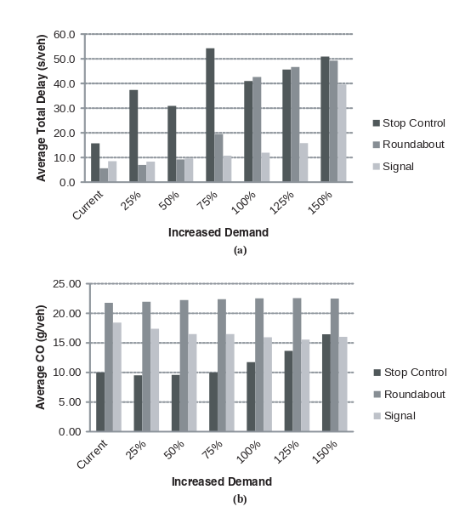
Energy and Environmental Assessment of High-Speed Roundabouts, 2009
Roudabouts
DATA
CENTRAL

Slide 20
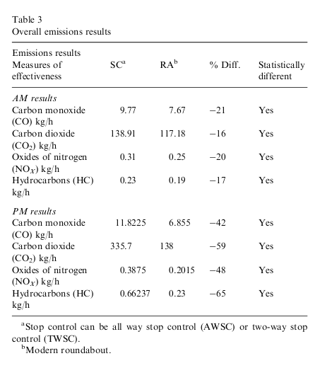
Environmental impact of modern roundabouts, 2007
Roudabouts
DATA

Slide 21
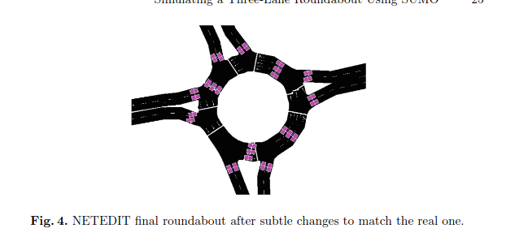
Simulating a Three-Lane Roundabout
Using SUMO, 2019
Simulation in SUMO
METHOD
SIMULATION

Slide 22
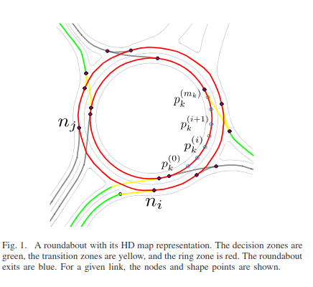
Roundabout Crossing With Interval Occupancy and Virtual Instances of Road Users, 2020
Roundabouts simulation
SIMULATION

Slide 23
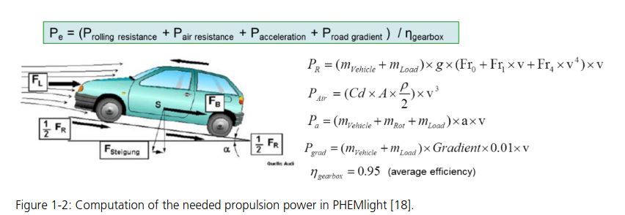
Second Generation of Pollutant Emission Models for
SUMO
SIMULATION
Sumo thermic cars
CENTRAL

Slide 24
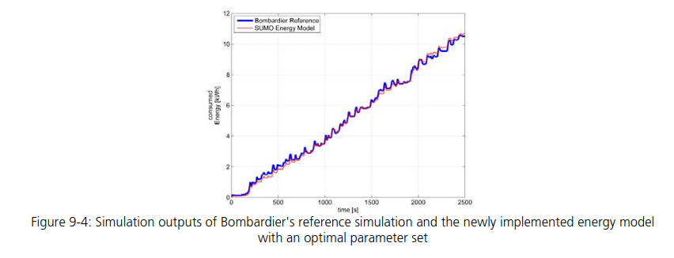
Implementation of an Energy Model and a Charging
Infrastructure in SUMO, 2013
SIMULATION
1st elec cars, outdated

Slide 25
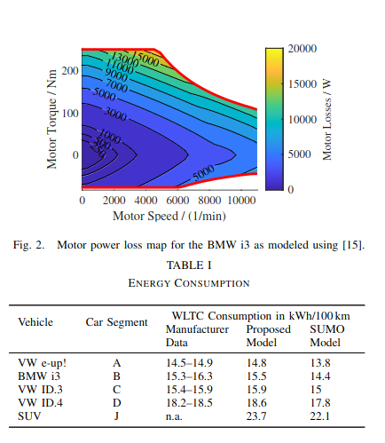
Accurate physics-based modeling of electric vehicle energy consumption in the SUMO traffic microsimulator, 2021
SIMULATION
2nd elec car model
CENTRAL

