Slide 1
Problem motivation
Anomaly detection

Slide 2
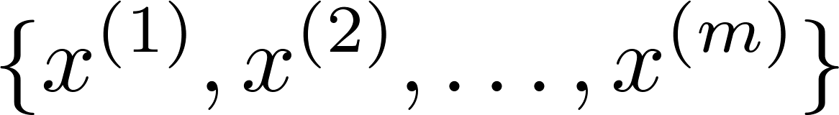





Anomaly detection example
Aircraft engine features:
= heat generated
= vibration intensity
…
Dataset:
New engine:
(vibration)
(heat)

Slide 3
Density estimation
Dataset:
Is anomalous?
(vibration)
(heat)

Slide 4


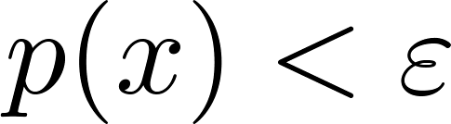


Anomaly detection example
Fraud detection:
= features of user ’s activities
Model from data.
Identify unusual users by checking which have
Manufacturing
Monitoring computers in a data center.
= features of machine
= memory use, = number of disk accesses/sec,
= CPU load, = CPU load/network traffic.
…

Slide 5
Gaussian distribution
Anomaly detection

Slide 6



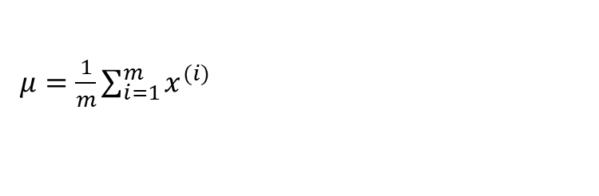
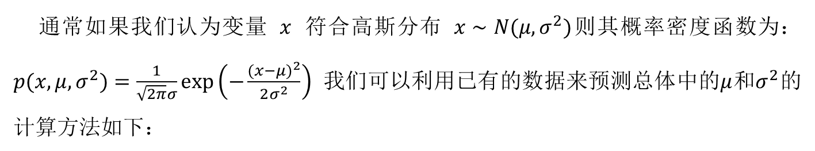

Gaussian (Normal) distribution
Say . If is a distributed Gaussian with mean , variance .
通常如果我们认为变量 $x$ 符合高斯分布 $x∼N(μ,σ^{2})$则其概率密度函数为： $p(x,μ,σ^{2})=\frac{1}{\sqrt{2π}σ}exp\left(−\frac{(x−μ)^{2}}{2σ^{2}}\right)$ 我们可以利用已有的数据来预测总体中的$μ$和$σ^{2}$的计算方法如下：
注：机器学习中对于方差我们通常只除以$m$而非统计学中的$(m−1)$。这里顺便提一下，在实际使用中，到底是选择使用$1/m$还是$1/(m−1)$其实区别很小，只要你有一个还算大的训练集，在机器学习领域大部分人更习惯使用$1/m$这个版本的公式。这两个版本的公式在理论特性和数学特性上稍有不同，但是在实际使用中，他们的区别甚小，几乎可以忽略不计。
$μ=\frac{1}{m}\sum_{i=1}^{m}{x^{(i)}}$
Notes:
Add dots

Slide 7
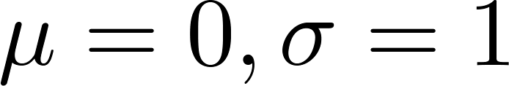

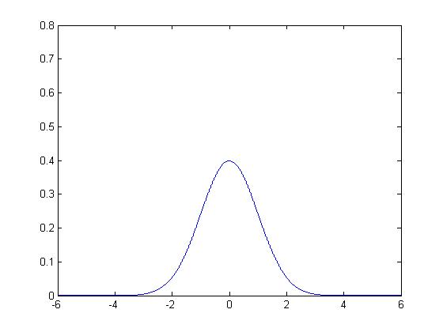
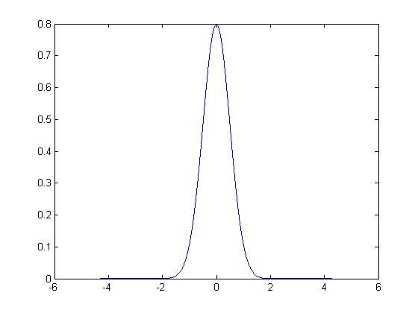
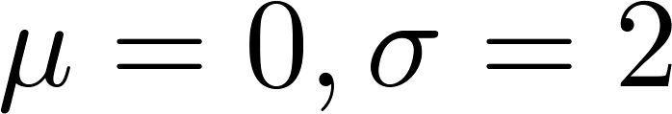

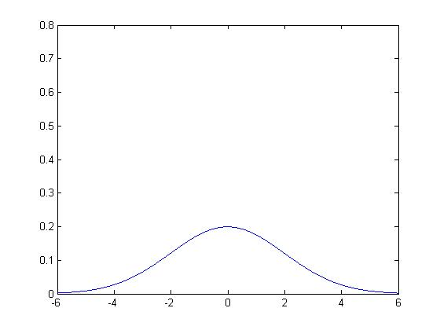
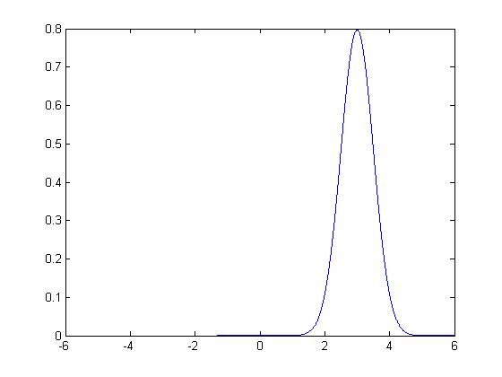
Gaussian distribution example

Slide 8
Algorithm
Anomaly detection

Slide 9
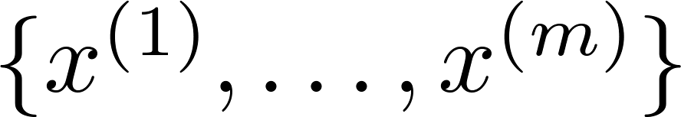

Density estimation
Training set:
Each example is
What is your idea?
Notes:
Change numbers to LATEX as well

Slide 10

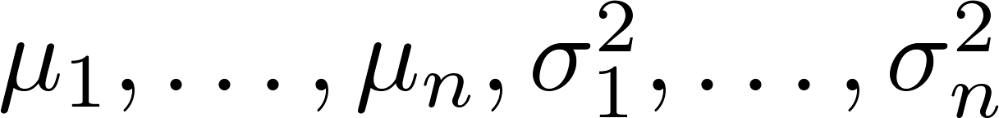
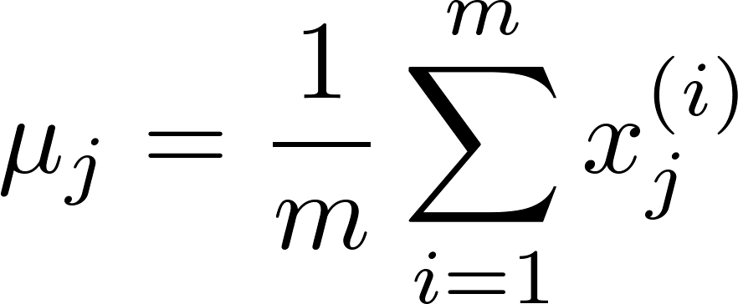
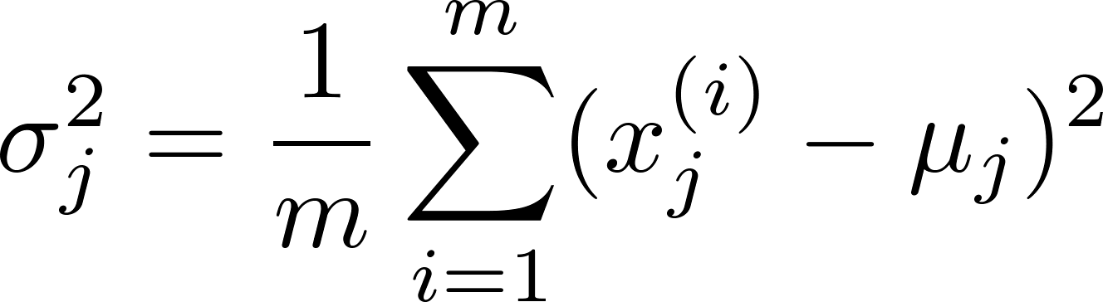

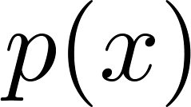
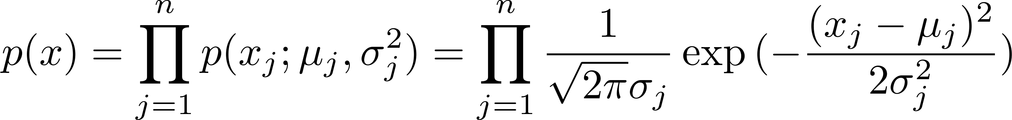
Anomaly detection algorithm
Choose features that you think might be indicative of anomalous examples.
Fit parameters
Given new example , compute :
Anomaly if
Notes:
Change numbers to LATEX as well

Slide 11
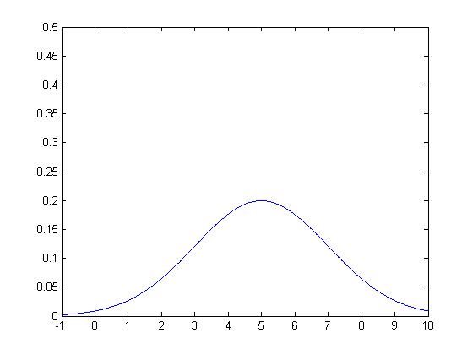
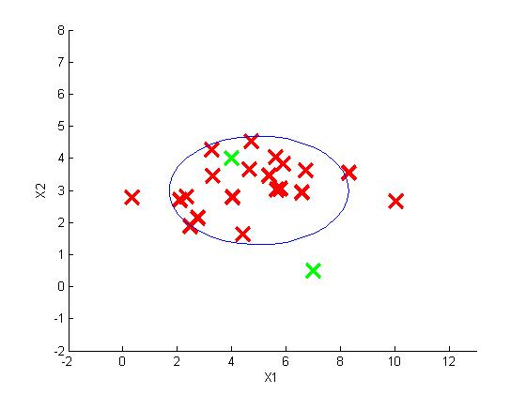
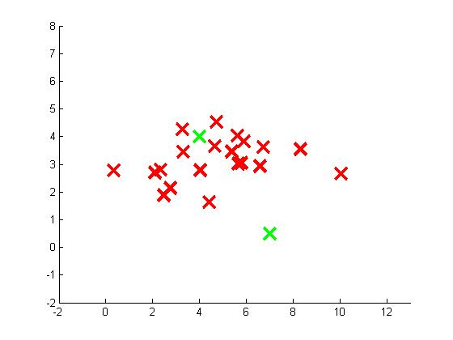
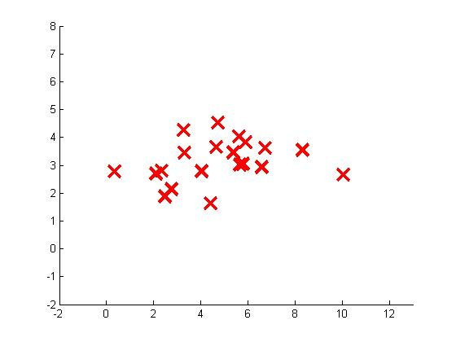
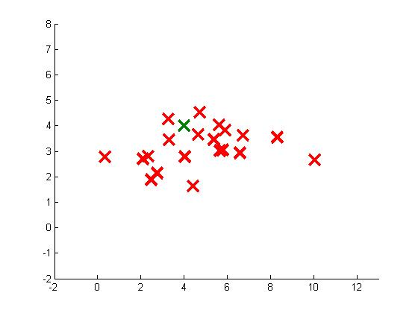

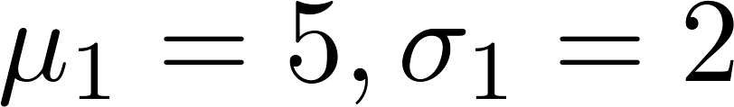


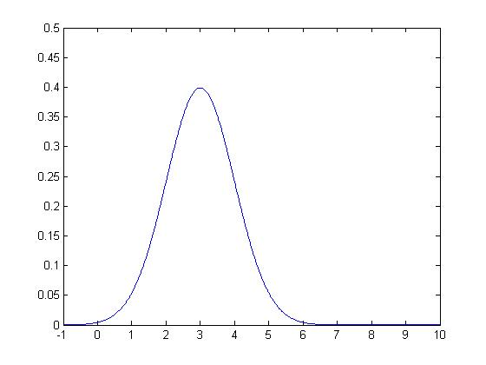
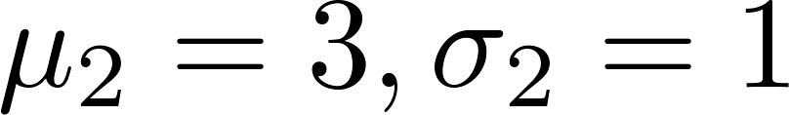
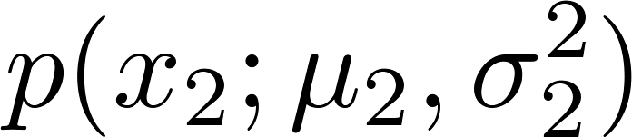
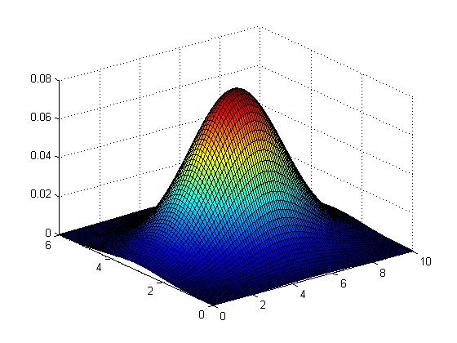

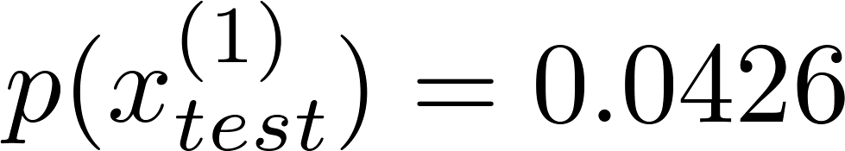
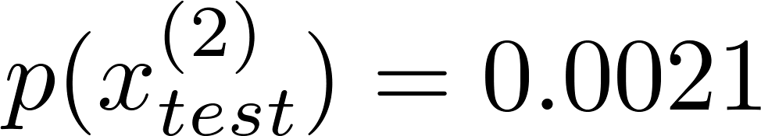
Anomaly detection example
Notes:
Add animation to block left graph

Slide 12
Developing and evaluating an anomaly detection system
Anomaly detection

Slide 13
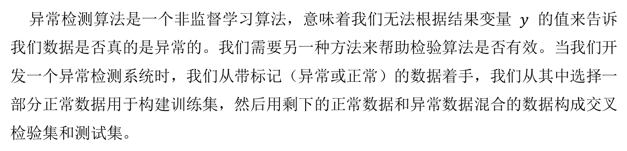
异常检测算法是一个非监督学习算法，意味着我们无法根据结果变量 $y$ 的值来告诉我们数据是否真的是异常的。我们需要另一种方法来帮助检验算法是否有效。当我们开发一个异常检测系统时，我们从带标记（异常或正常）的数据着手，我们从其中选择一部分正常数据用于构建训练集，然后用剩下的正常数据和异常数据混合的数据构成交叉检验集和测试集。
例如：我们有10000台正常引擎的数据，有20台异常引擎的数据。 我们这样分配数据：
6000台正常引擎的数据作为训练集
2000台正常引擎和10台异常引擎的数据作为交叉检验集
2000台正常引擎和10台异常引擎的数据作为测试集

Slide 14
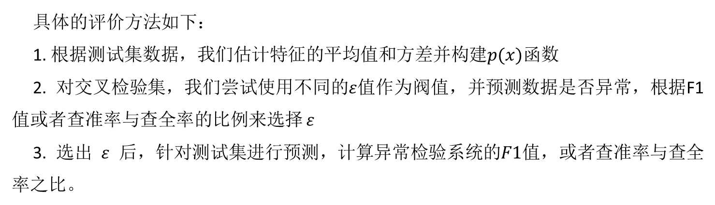
具体的评价方法如下：
1. 根据测试集数据，我们估计特征的平均值和方差并构建$p(x)$函数
2. 对交叉检验集，我们尝试使用不同的$ε$值作为阀值，并预测数据是否异常，根据F1值或者查准率与查全率的比例来选择 $ε$
3. 选出 $ε$ 后，针对测试集进行预测，计算异常检验系统的$F1$值，或者查准率与查全率之比。

Slide 15


Anomaly detection
vs.
Supervised learning
Very small number of positive examples ( ). (0-20 is common).
Large number of negative ( ) examples.
Many different “types” of anomalies. Hard for any algorithm to learn from positive examples what the anomalies look like; future anomalies may look nothing like any of the anomalous examples we’ve seen so far.
Large number of positive and negative examples.
Enough positive examples for algorithm to get a sense of what positive examples are like, future positive examples likely to be similar to ones in training set.
Notes:
Make points have 0 mean on x1 and x2

Slide 16
Anomaly detection
vs.
Supervised learning
Fraud detection
Manufacturing (e.g. aircraft engines)
Monitoring machines in a data center
Email spam classification
Weather prediction (sunny/rainy/etc).
Cancer classification
Notes:
Make points have 0 mean on x1 and x2

Slide 17
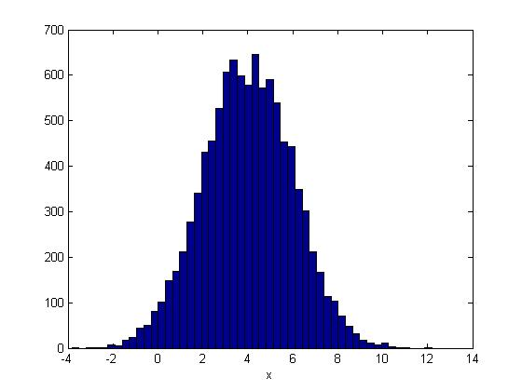
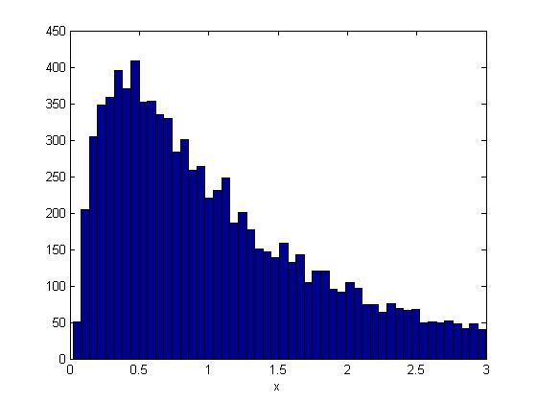
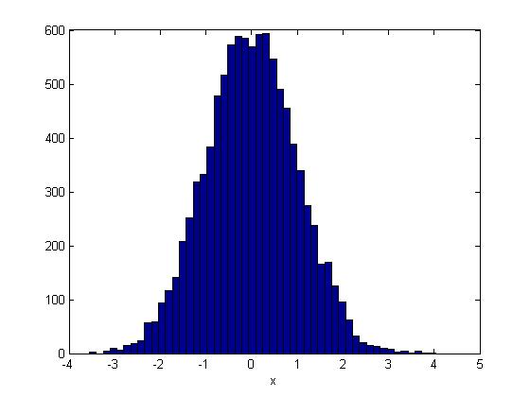
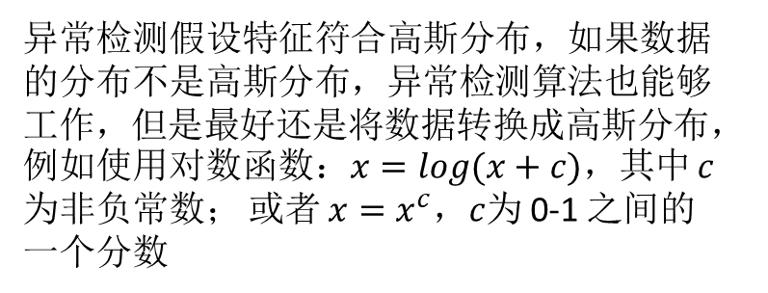
Non-gaussian features
异常检测假设特征符合高斯分布，如果数据的分布不是高斯分布，异常检测算法也能够工作，但是最好还是将数据转换成高斯分布，例如使用对数函数：$x=log(x+c)$，其中 $c$ 为非负常数； 或者 $x=x^{c}$，$c$为 0-1 之间的一个分数

Slide 18
Error analysis for anomaly detection
Want large for normal examples .
small for anomalous examples .
Most common problem:
is comparable (say, both large) for normal and anomalous examples

Slide 19


Monitoring computers in a data center
Choose features that might take on unusually large or small values in the event of an anomaly.
= memory use of computer
= number of disk accesses/sec
= CPU load
= network traffic

Slide 20
Multivariate Gaussian distribution
Anomaly detection

Slide 21
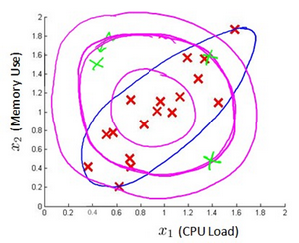
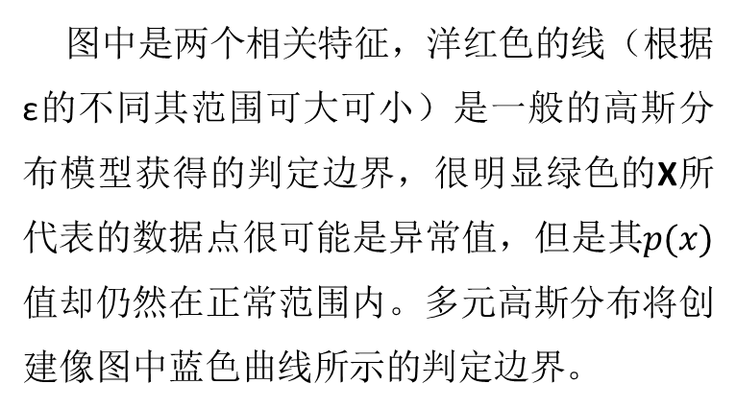
Motivating example: Monitoring machines in a data center
图中是两个相关特征，洋红色的线（根据ε的不同其范围可大可小）是一般的高斯分布模型获得的判定边界，很明显绿色的X所代表的数据点很可能是异常值，但是其$p(x)$值却仍然在正常范围内。多元高斯分布将创建像图中蓝色曲线所示的判定边界。

Slide 22
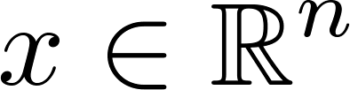
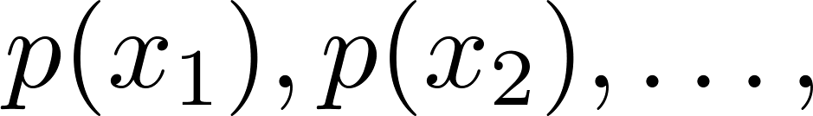
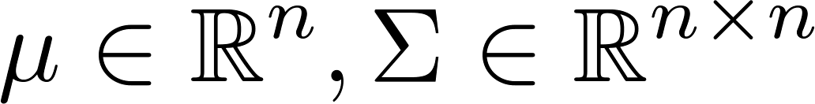
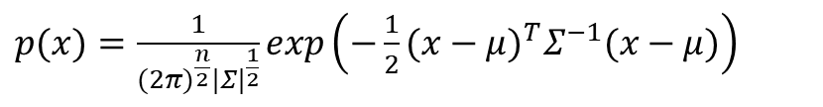

Multivariate Gaussian (Normal) distribution
. Don’t model etc. separately. Model all in one go.
Parameters: (covariance matrix)
$$μ=\frac{1}{m}\sum_{i=1}^{m}{x^{\left(i\right)}}$$
$p(x)=\frac{1}{(2π)^{\frac{n}{2}}|Σ|^{\frac{1}{2}}}exp\left(−\frac{1}{2}(x−μ)^{T}Σ^{−1}(x−μ)\right)$

Slide 23
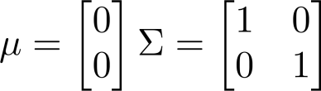
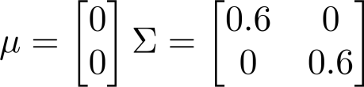
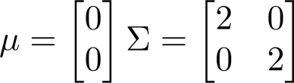
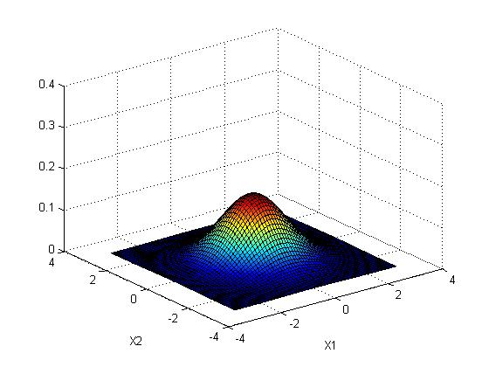
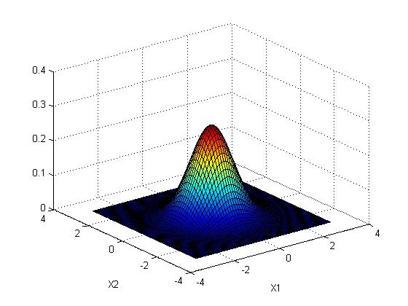
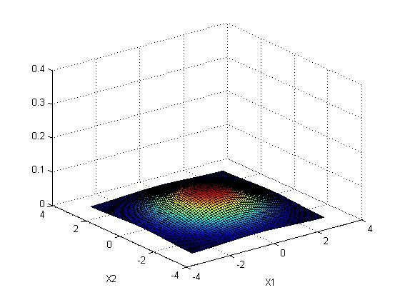


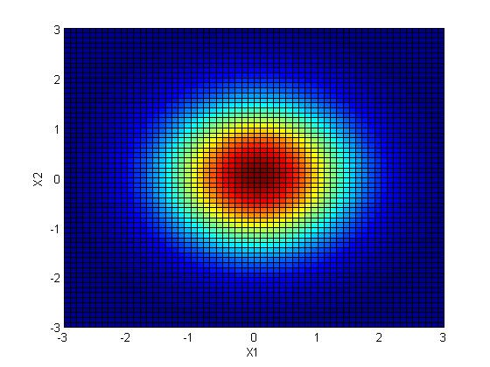
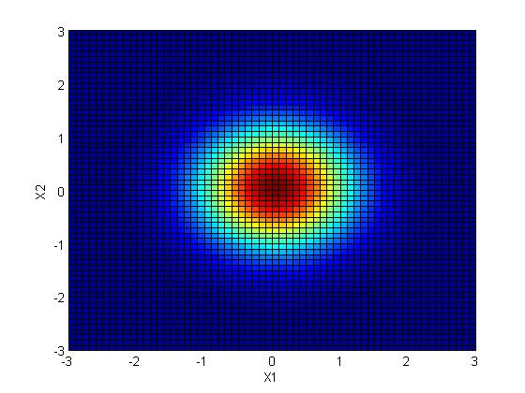

Multivariate Gaussian (Normal) examples

Slide 24






Multivariate Gaussian (Normal) examples

Slide 25






Multivariate Gaussian (Normal) examples

Slide 26







Multivariate Gaussian (Normal) examples

Slide 27






Multivariate Gaussian (Normal) examples

Slide 28






Multivariate Gaussian (Normal) examples

Slide 29







Multivariate Gaussian (Normal) distribution
Parameters
Parameter fitting:
Given training set

Slide 30


Anomaly detection with the multivariate Gaussian
1. Fit model by setting
2. Given a new example , compute
Flag an anomaly if

Slide 31





Relationship to original model
Original model:
Corresponds to multivariate Gaussian

Slide 32

Notes:
Make points have 0 mean on x1 and x2

