Slide 1
Problem formulation
Recommender Systems

Slide 2





Example: Predicting movie ratings
User rates movies using one to five stars
Movie | Alice (1) | Bob (2) | Carol (3) | Dave (4)
Love at last | 5 | 5 | 0 | 0
Romance forever | 5 | ？ | ？ | 0
Cute puppies of love | ？ | 4 | 0 | ？
Nonstop car chases | 0 | 0 | 5 | 4
Swords vs. karate | 0 | 0 | 5 | 4
= no. users
= no. movies
= 1 if user has rated movie
= rating given by user to movie (defined only if
)

Slide 3
Content-based recommendations
Recommender Systems

Slide 4
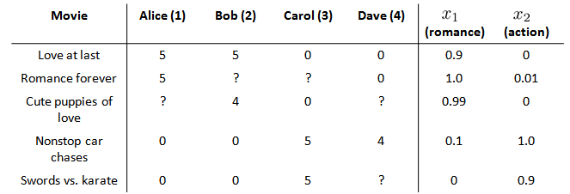
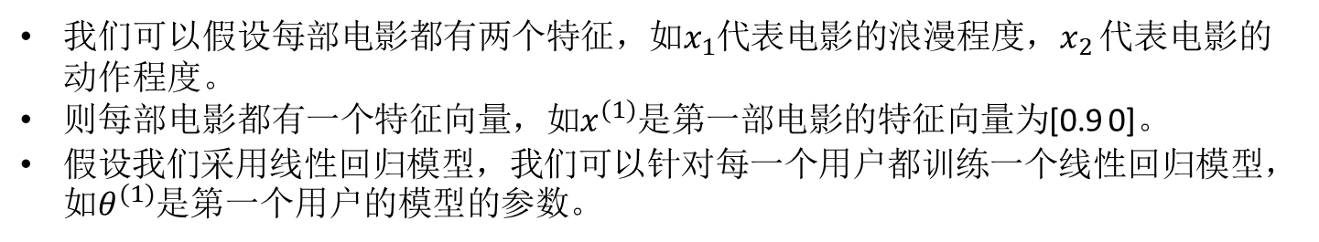
我们可以假设每部电影都有两个特征，如$x_{1}$代表电影的浪漫程度，$x_{2}$ 代表电影的动作程度。
则每部电影都有一个特征向量，如$x^{(1)}$是第一部电影的特征向量为[0.9 0]。
假设我们采用线性回归模型，我们可以针对每一个用户都训练一个线性回归模型，如$θ^{(1)}$是第一个用户的模型的参数。
Notes:
Add dots

Slide 5
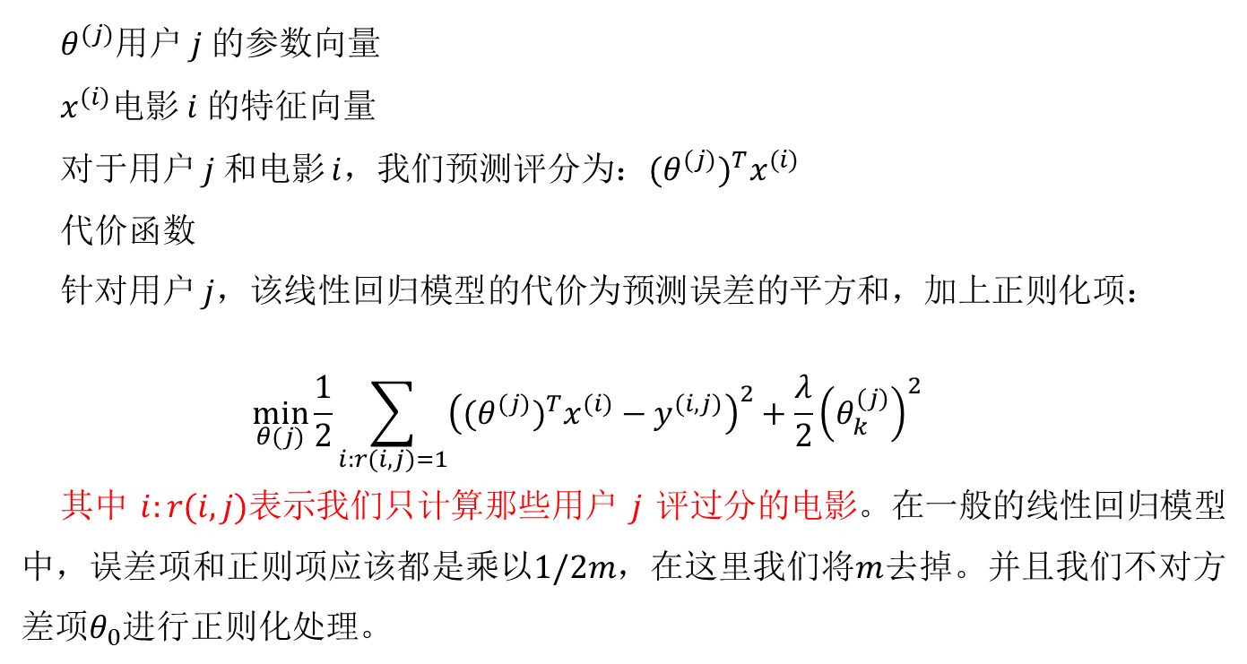
$θ^{(j)}$用户 $j$ 的参数向量
$x^{(i)}$电影 $i$ 的特征向量
对于用户 $j$ 和电影 $i$，我们预测评分为：$(θ^{(j)})^{T}x^{(i)}$
代价函数
针对用户 $j$，该线性回归模型的代价为预测误差的平方和，加上正则化项：
$$\min_{θ(j)}\frac{1}{2}\sum_{i:r(i,j)=1}{{\left((θ^{(j)})^{T}x^{(i)}−y^{(i,j)}\right)}^{2}}+\frac{λ}{2}{\left(θ_{k}^{(j)}\right)}^{2}$$
其中 $i:r(i,j)$表示我们只计算那些用户 $j$ 评过分的电影。在一般的线性回归模型中，误差项和正则项应该都是乘以$1/2m$，在这里我们将$m$去掉。并且我们不对方差项$θ_{0}$进行正则化处理。
Notes:
Add dots

Slide 6
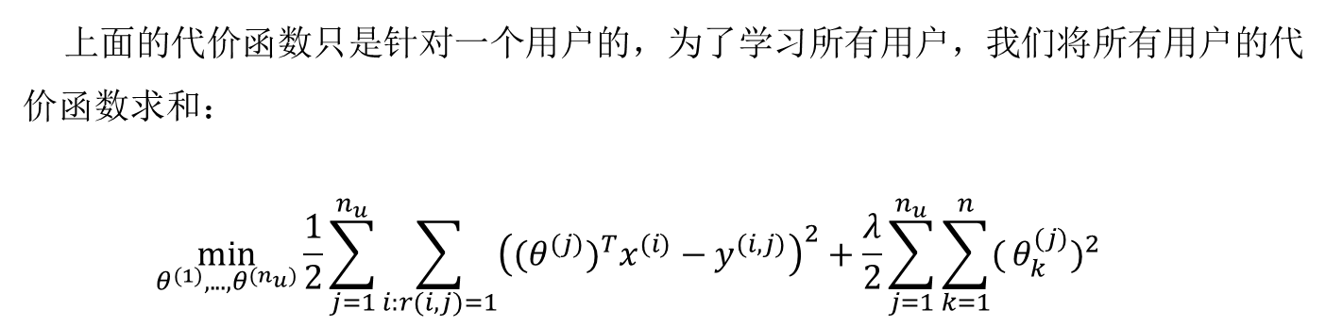
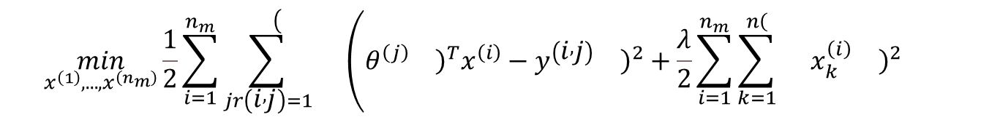
上面的代价函数只是针对一个用户的，为了学习所有用户，我们将所有用户的代价函数求和：
$$\min_{θ^{(1)},...,θ^{(n_{u})}}\frac{1}{2}\sum_{j=1}^{n_{u}}{\sum_{i:r(i,j)=1}{{\left((θ^{(j)})^{T}x^{(i)}−y^{(i,j)}\right)}^{2}}}+\frac{λ}{2}\sum_{j=1}^{n_{u}}{\sum_{k=1}^{n}{(}}θ_{k}^{(j)})^{2}$$
基于内容的推荐系统中，对于每一部电影，我们都掌握了可用的特征，使用这些特征训练出了每一个用户的参数。相反地，如果我们拥有用户的参数，我们可以学习得出电影的特征。
$$\min_{x^{\left(1\right)},...,x^{\left(n_{m}\right)}}\frac{1}{2}\sum_{i=1}^{n_{m}}{\sum_{jr\left(i , j\right)=1}^{\left.\left.\right.\right(}{}}\left(θ^{\left(j\right)}{\left.\right)}^{T}x^{\left(i\right)}−y^{\left(i , j\right)}{\left.\right)}^{2}+\frac{λ}{2}\sum_{i=1}^{n_{m}}{\sum_{k=1}^{\left.\left.n\right.\right(}{}}x_{k}^{\left(i\right)}{\left.\right)}^{2} \right.$$
Notes:
Add dots

Slide 7
Recommender Systems
Collaborative filtering

Slide 8


Problem motivation
Movie | Alice (1) | Bob (2) | Carol (3) | Dave (4) | (romance) | (action)
Love at last | 5 | 5 | 0 | 0 | 0.9 | 0
Romance forever | 5 | ? | ? | 0 | 1.0 | 0.01
Cute puppies of love | ? | 4 | 0 | ? | 0.99 | 0
Nonstop car chases | 0 | 0 | 5 | 4 | 0.1 | 1.0
Swords vs. karate | 0 | 0 | 5 | ? | 0 | 0.9
Notes:
Change numbers to LATEX as well

Slide 9
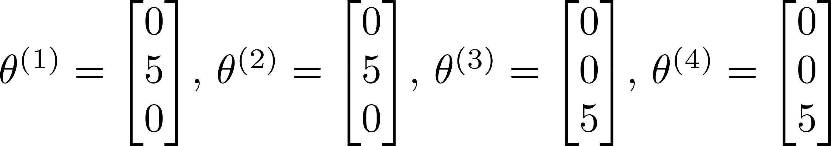
Problem motivation
Movie | Alice (1) | Bob (2) | Carol (3) | Dave (4) | (romance) | (action)
Love at last | 5 | 5 | 0 | 0 | ? | ?
Romance forever | 5 | ? | ? | 0 | ? | ?
Cute puppies of love | ? | 4 | 0 | ? | ? | ?
Nonstop car chases | 0 | 0 | 5 | 4 | ? | ?
Swords vs. karate | 0 | 0 | 5 | ? | ? | ?
Notes:
Change numbers to LATEX as well

Slide 10
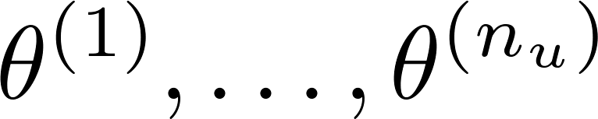

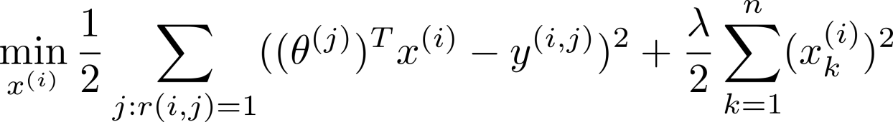
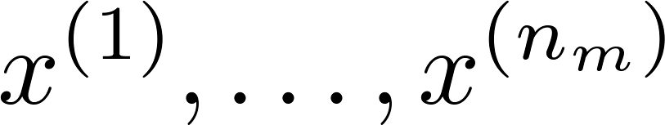
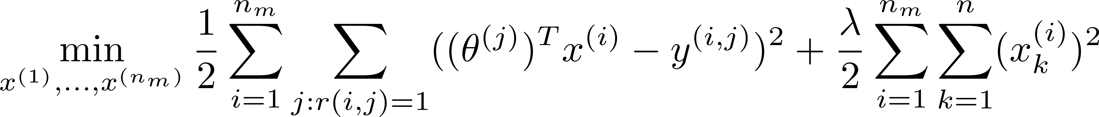
Optimization algorithm
Given , to learn :
Given , to learn :

Slide 11
Collaborative filtering
Given (and movie ratings),
can estimate
Given ,
can estimate

Slide 12
Recommender Systems
Collaborative filtering algorithm

Slide 13
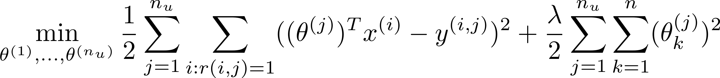

Collaborative filtering optimization objective
Given , estimate :
Given , estimate :
Minimizing and simultaneously:

Slide 14
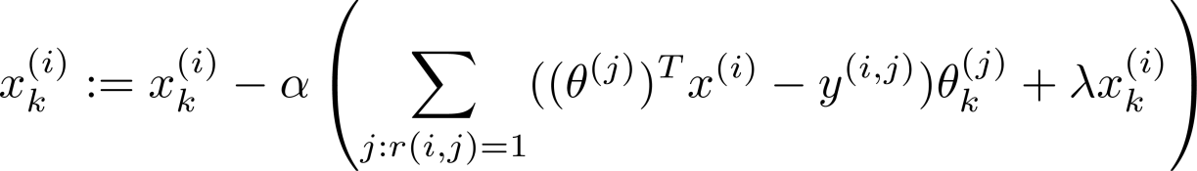
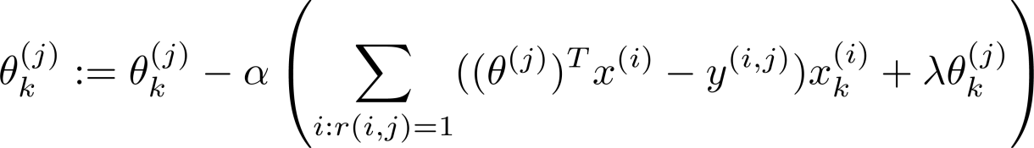

Collaborative filtering algorithm
Initialize to small random values.
Minimize using gradient descent (or an advanced optimization algorithm). E.g. for every :
For a user with parameters and a movie with (learned) features , predict a star rating of .

Slide 15
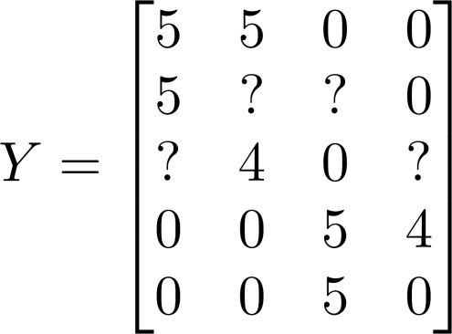
Collaborative filtering
Movie | Alice (1) | Bob (2) | Carol (3) | Dave (4)
Love at last | 5 | 5 | 0 | 0
Romance forever | 5 | ? | ? | 0
Cute puppies of love | ? | 4 | 0 | ?
Nonstop car chases | 0 | 0 | 5 | 4
Swords vs. karate | 0 | 0 | 5 | ?
Notes:
Make points have 0 mean on x1 and x2

Slide 16
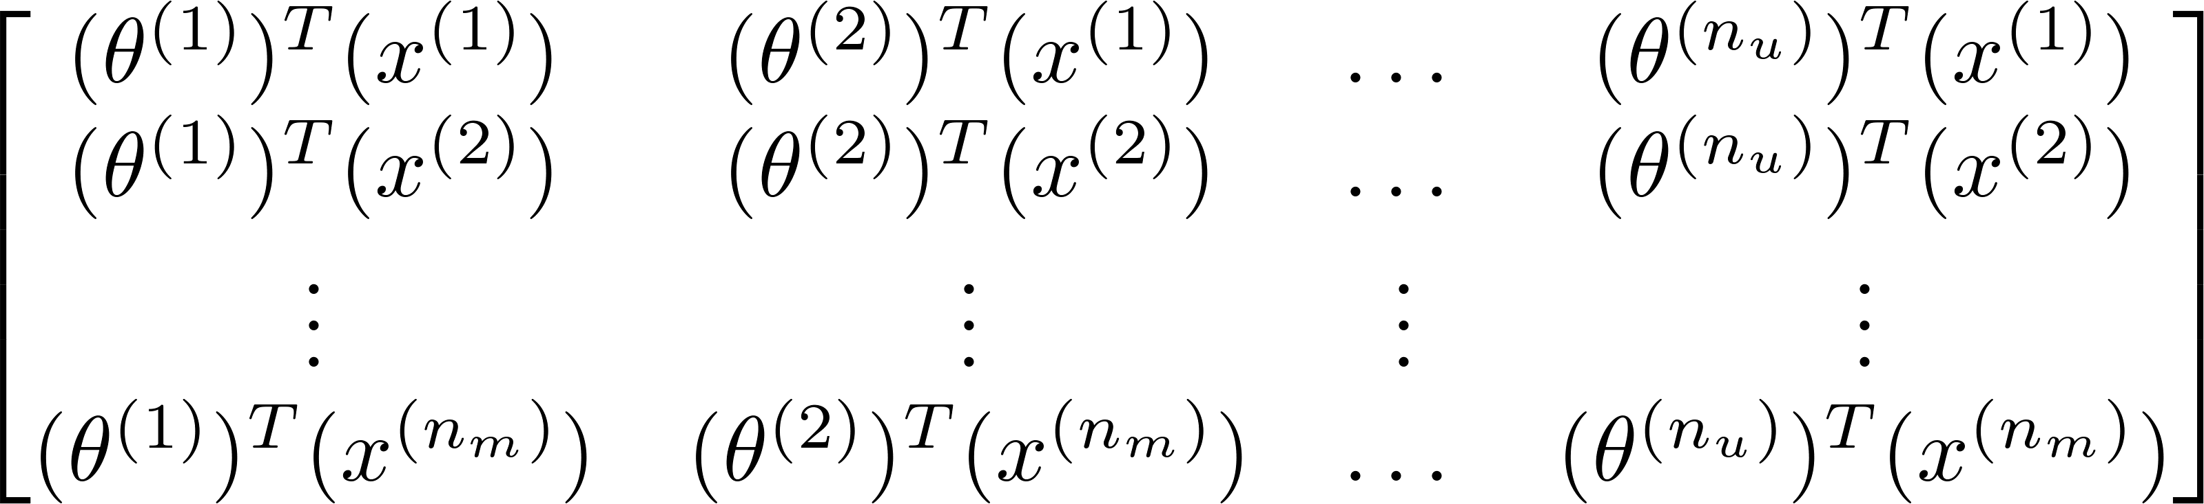
Collaborative filtering
Predicted ratings:
Notes:
Make points have 0 mean on x1 and x2

Slide 17
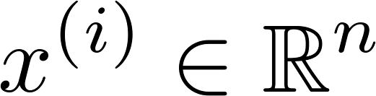

Finding related movies
For each product , we learn a feature vector .
How to find movies related to movie ?
5 most similar movies to movie :
Find the 5 movies with the smallest .
Notes:
Make points have 0 mean on x1 and x2

