Slide 1
模型表示 Model Presentation
单变量线性回归
Linear regression with one variable

Slide 2
Housing Prices
(Portland, OR)
Price
(in 1000s of dollars)
Size (feet²)
Supervised Learning
Given the “right answer” for each example in the data.
Regression Problem
Predict real-valued output

Slide 3
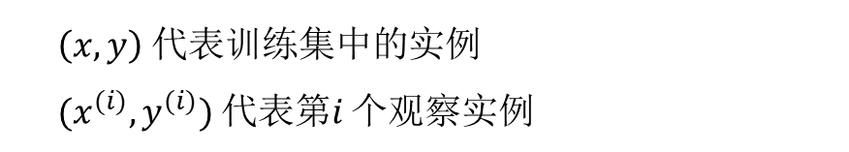
Training set of
housing prices
(Portland, OR)
Size in feet² (x) | Price ($) in 1000's (y)
2104 | 460
1416 | 232
1534 | 315
852 | 178
… | …
Notation:
m = Number of training examples
x’s = “input” variable / features
y’s = “output” variable / “target” variable
$\left(x,y\right)$ 代表训练集中的实例
$(x^{(i)},y^{(i)})$ 代表第$i$ 个观察实例

Slide 4
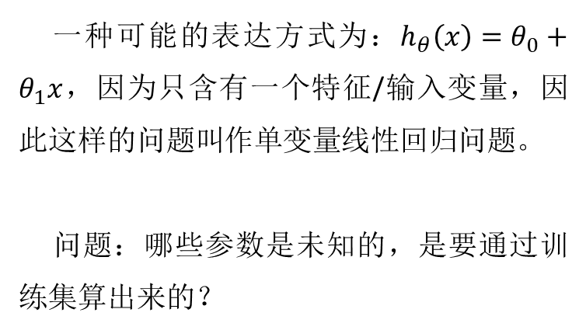
一种可能的表达方式为：$h_{θ}\left(x\right)=θ_{0}+θ_{1}x$，因为只含有一个特征/输入变量，因此这样的问题叫作单变量线性回归问题。
问题：哪些参数是未知的，是要通过训练集算出来的？
Training Set
Learning Algorithm
Size of house
h
Estimated price

Slide 5
代价函数 Cost function
单变量线性回归
Linear regression with one variable

Slide 6
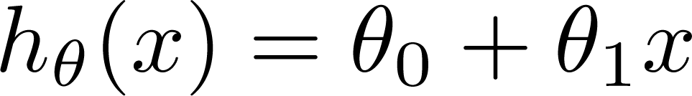

Training Set
Size in feet² (x) | Price ($) in 1000's (y)
2104 | 460
1416 | 232
1534 | 315
852 | 178
… | …
Hypothesis:
‘s: Parameters
How to choose ‘s ?

Slide 7
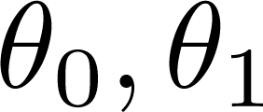
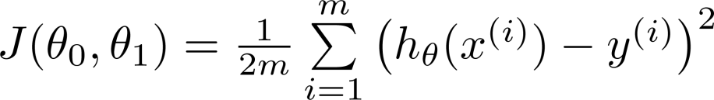


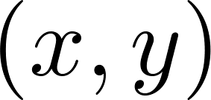
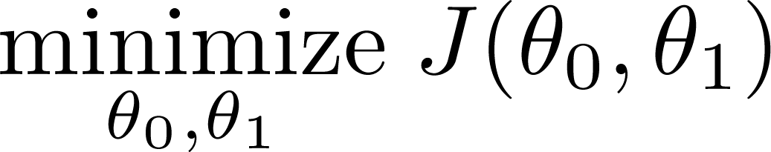
Hypothesis:
y
Parameters:
x
Cost Function:
Idea: Choose so that is close to for our training examples
Goal:

Slide 8






(for fixed , this is a function of x)
(function of the parameter )
y
x

Slide 9

(for fixed , this is a function of x)
(function of the parameter )
y
x

Slide 10

(for fixed , this is a function of x)
(function of the parameter )
y
x

Slide 11
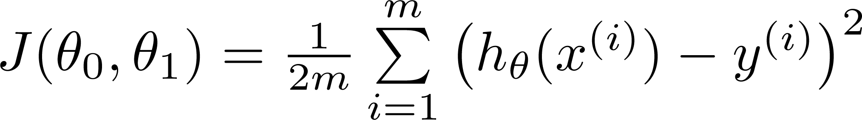
Hypothesis:
Parameters:
Cost Function:
Goal:

Slide 12
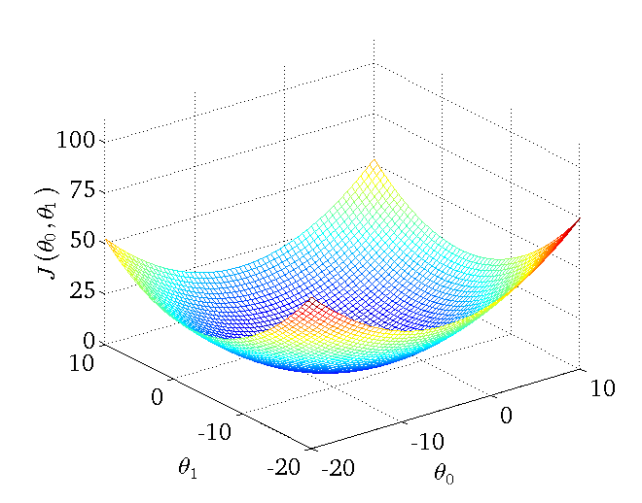

Slide 13
梯度下降 Gradient descent
单变量线性回归
Linear regression with one variable

Slide 14
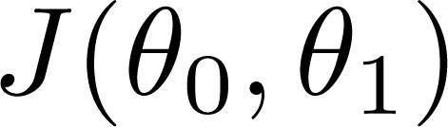
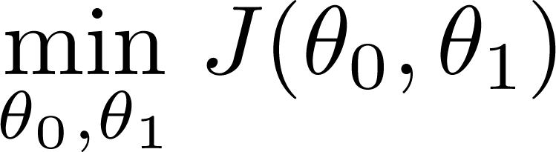
Have some function
Want
Outline:
Start with some
Keep changing to reduce until we hopefully end up at a minimum

Slide 15
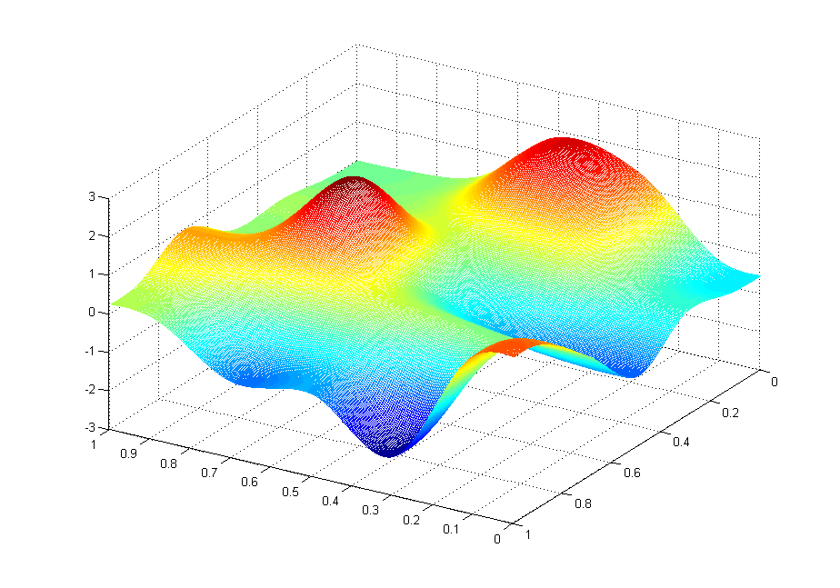
J(θ₀,θ₁)
θ₁
θ₀

Slide 16
J(θ₀,θ₁)
θ₁
θ₀
这意味着什么？

Slide 17
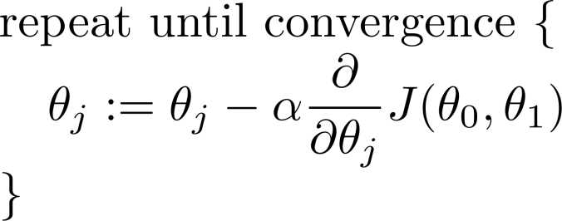
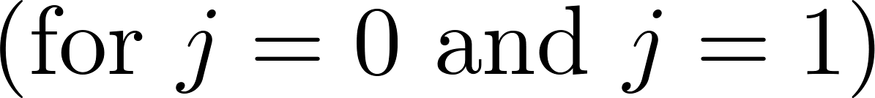
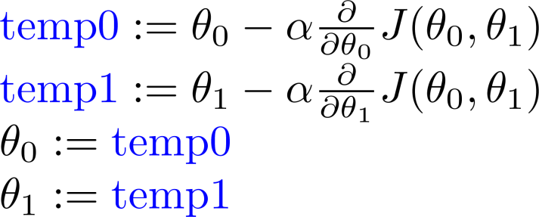
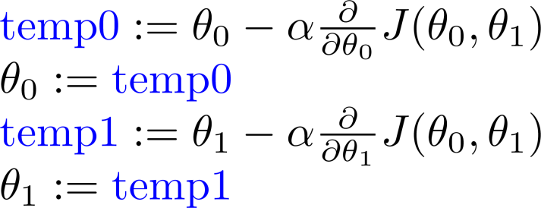
Gradient descent algorithm
Correct: Simultaneous update
Incorrect:

Slide 18

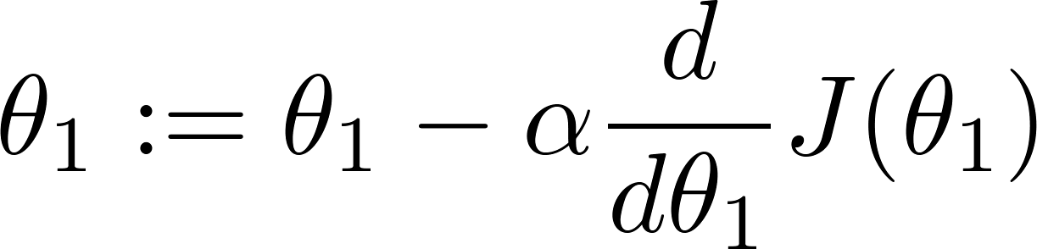
at local optima
Current value of

Slide 19
Gradient descent can converge to a local minimum, even with the learning rate α fixed.
As we approach a local minimum, gradient descent will automatically take smaller steps. So, no need to decrease α over time.

Slide 20
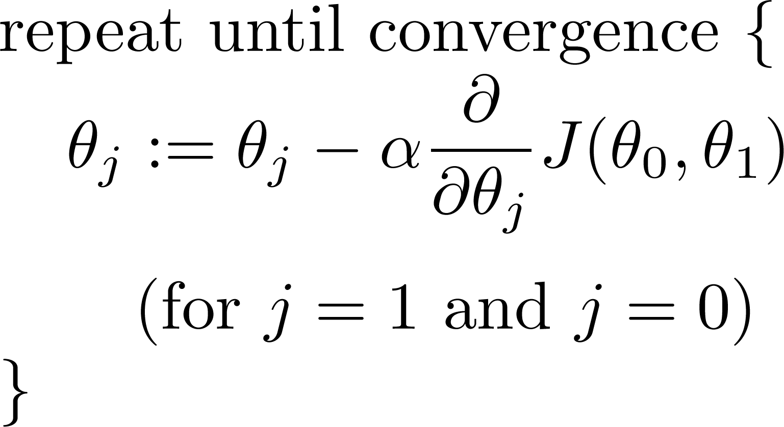
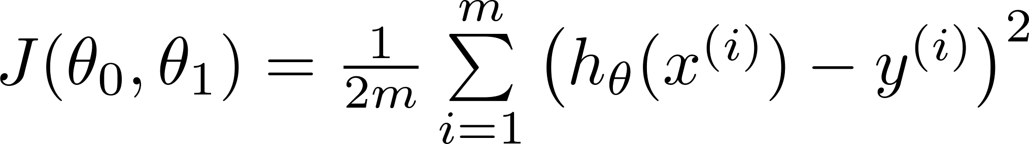
Gradient descent algorithm
Linear Regression Model

Slide 21
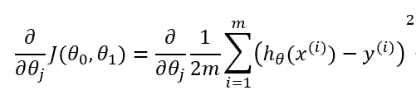


重点内容，务必理解其中的含义。

Slide 22
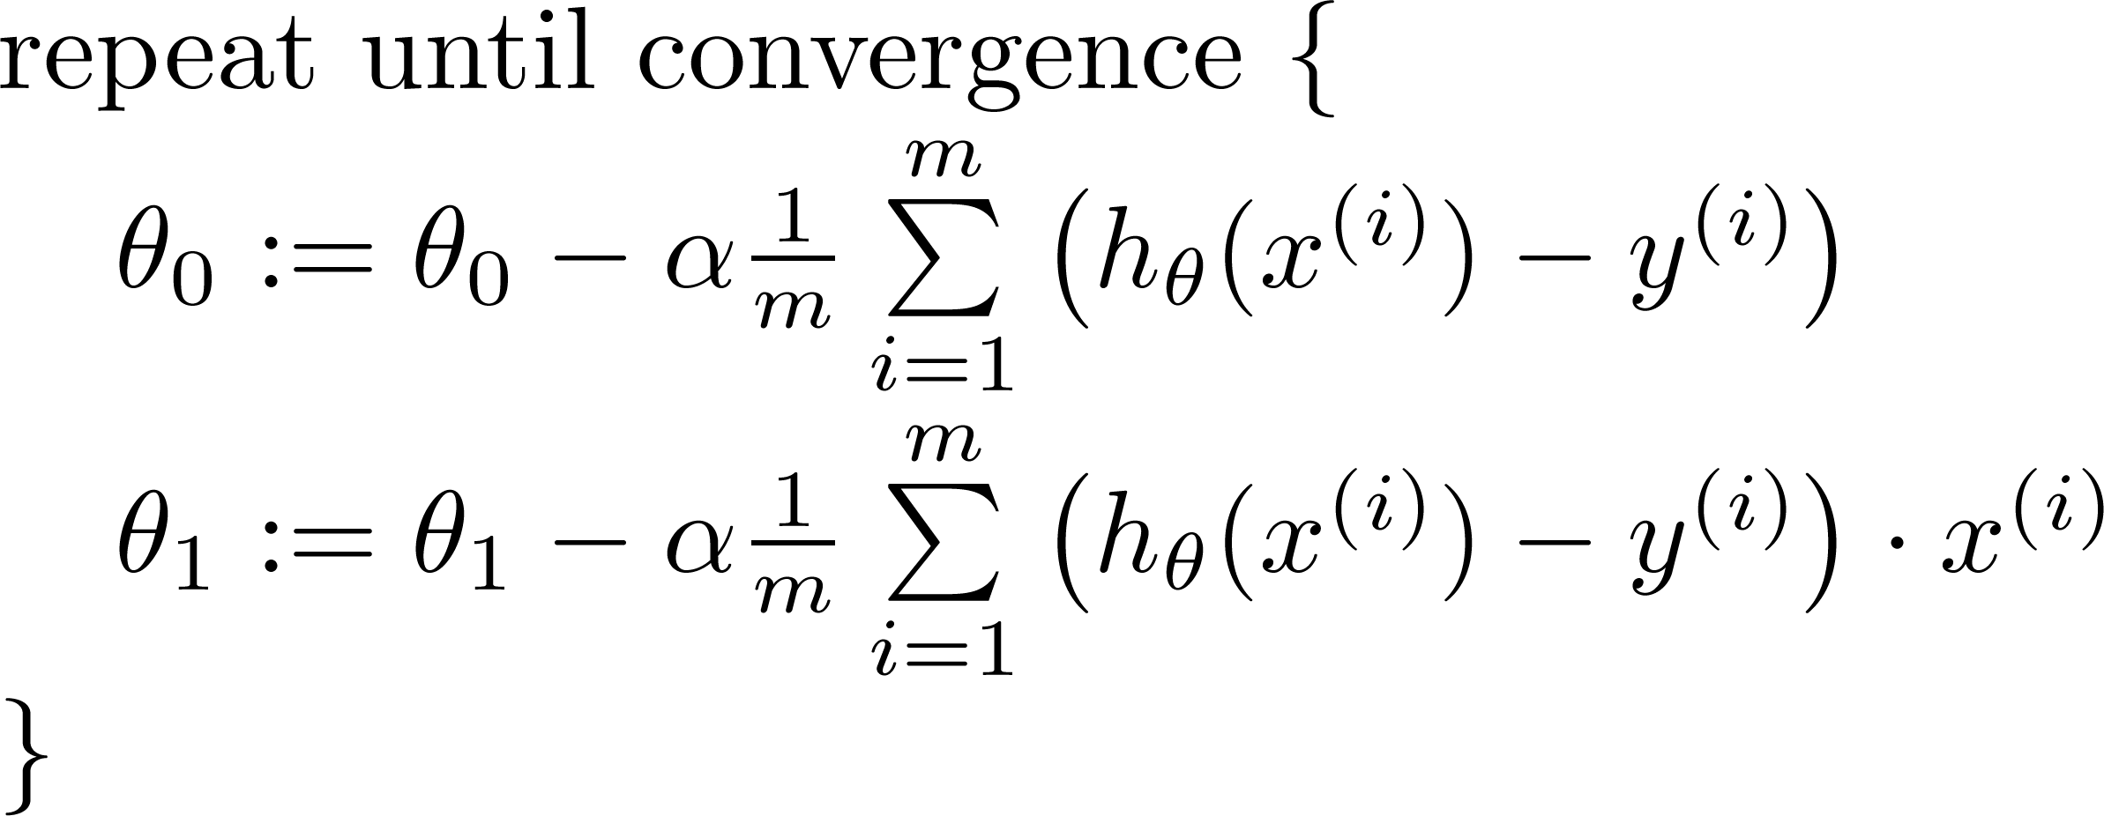

Gradient descent algorithm
update
and
simultaneously

Slide 23
J(θ₀,θ₁)
θ₁
θ₀

Slide 24
J(θ₀,θ₁)
θ₁
θ₀

Slide 26


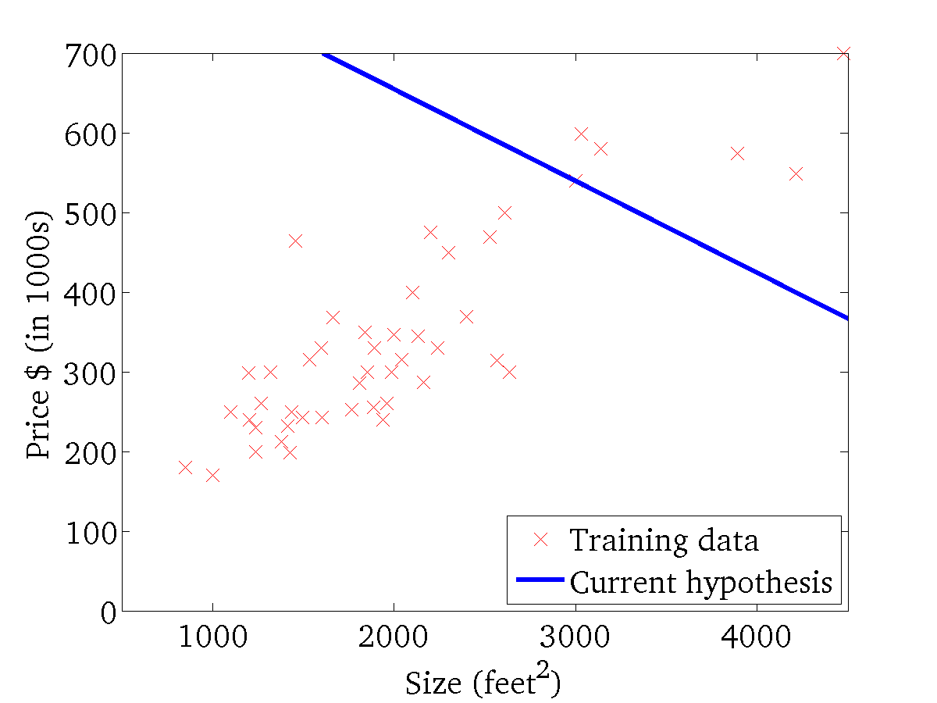
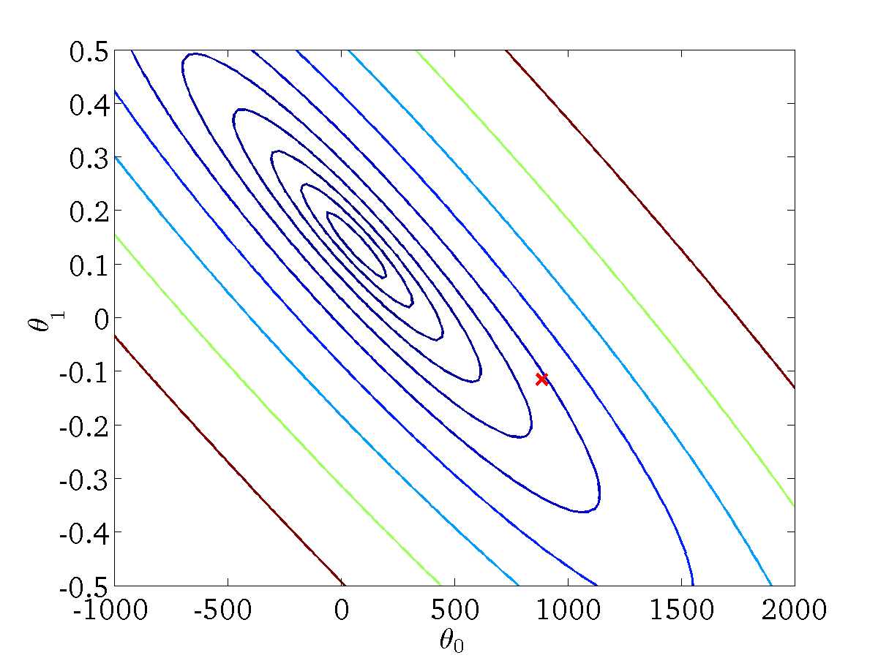
(for fixed , this is a function of x)
(function of the parameters )

Slide 27
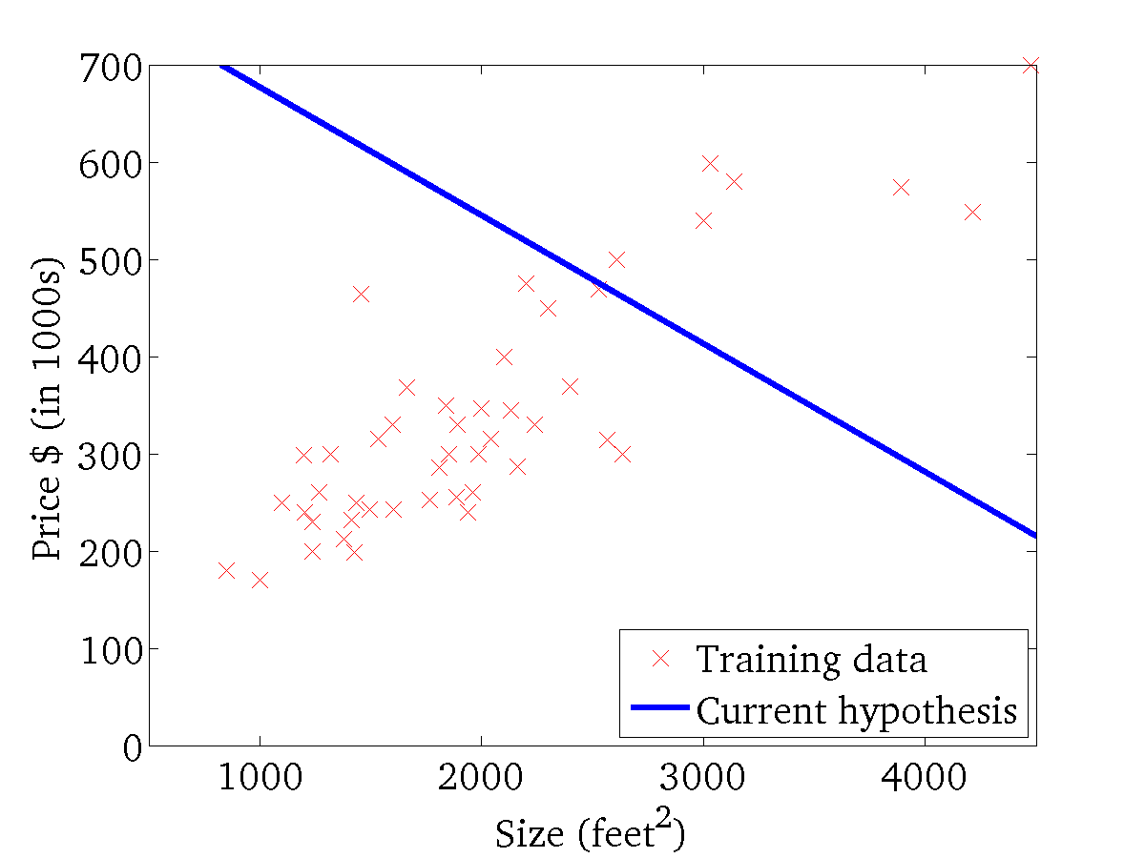

(for fixed , this is a function of x)
(function of the parameters )

Slide 28
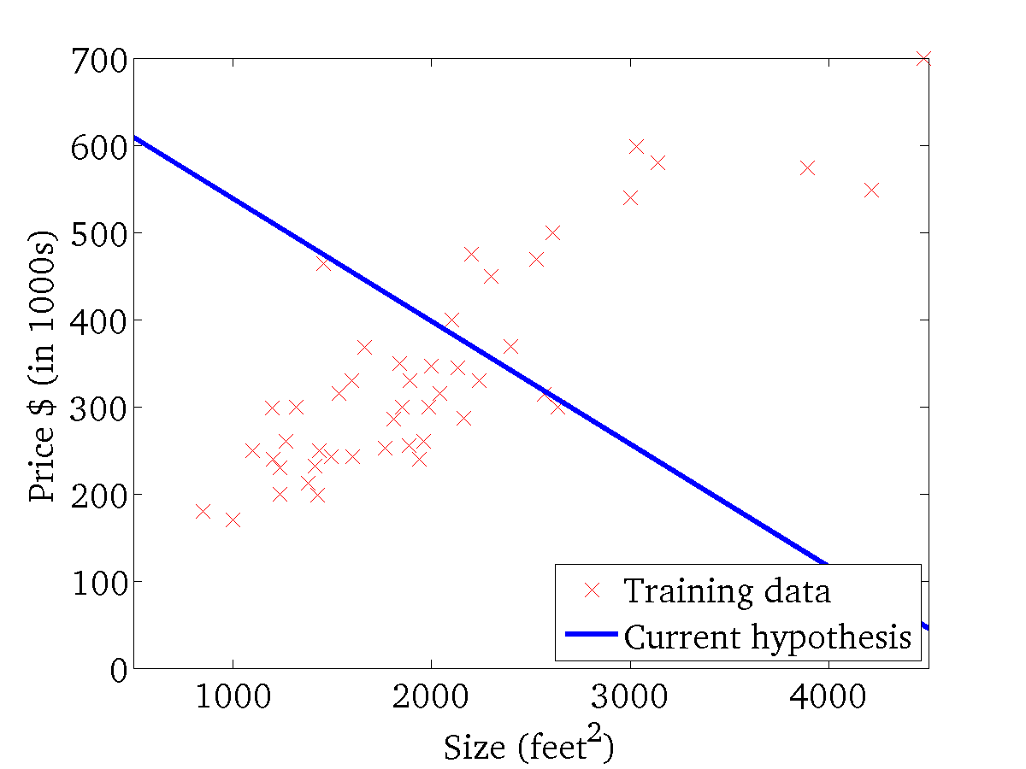
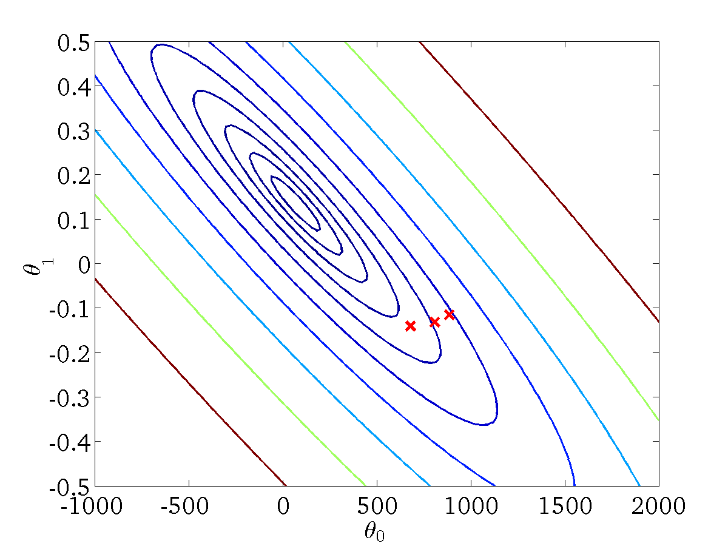
(for fixed , this is a function of x)
(function of the parameters )

Slide 29
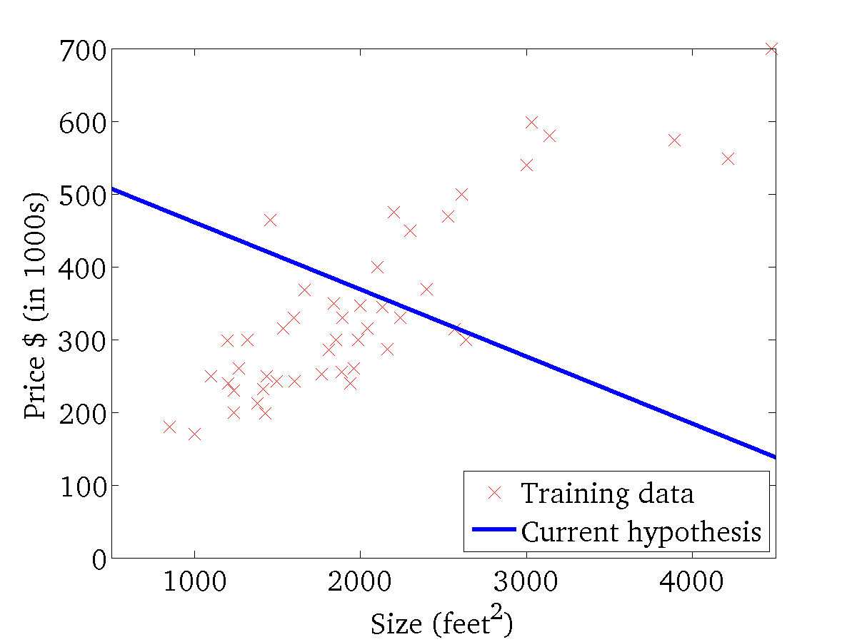

(for fixed , this is a function of x)
(function of the parameters )

Slide 30
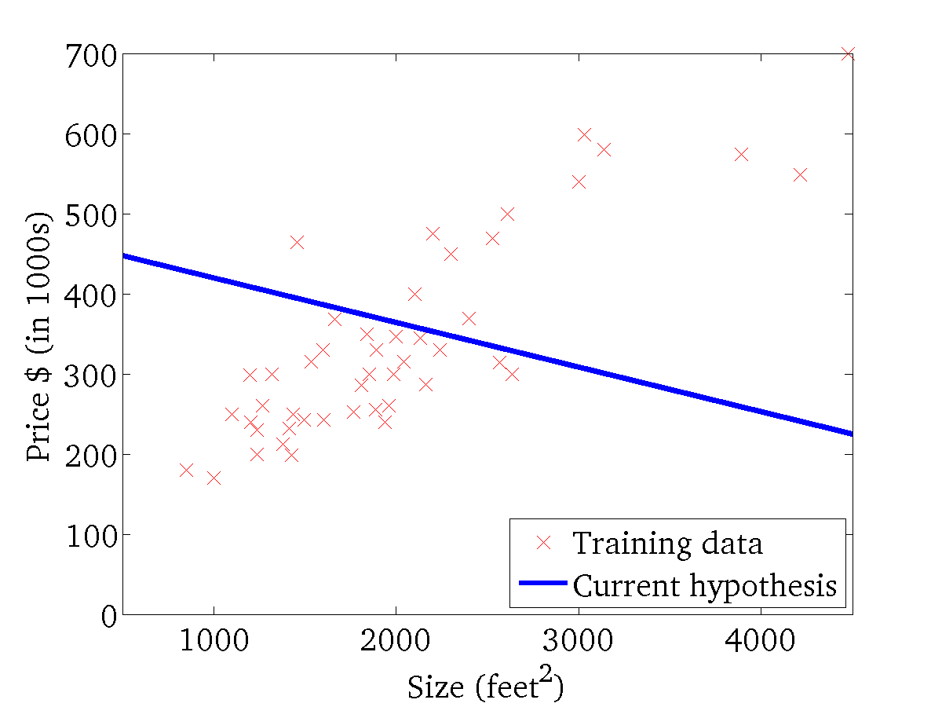
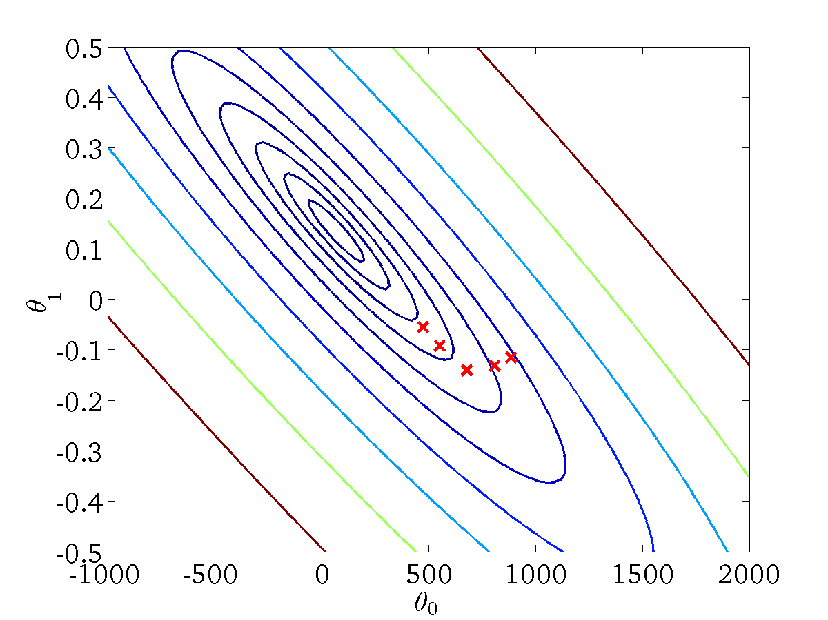
(for fixed , this is a function of x)
(function of the parameters )

Slide 31
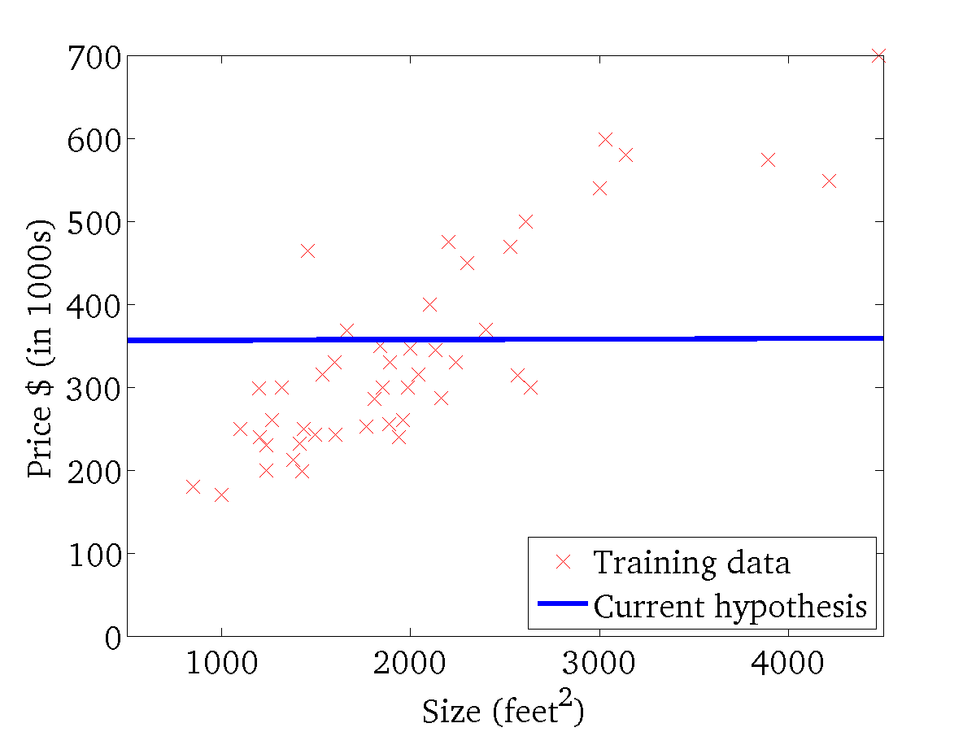

(for fixed , this is a function of x)
(function of the parameters )

Slide 32
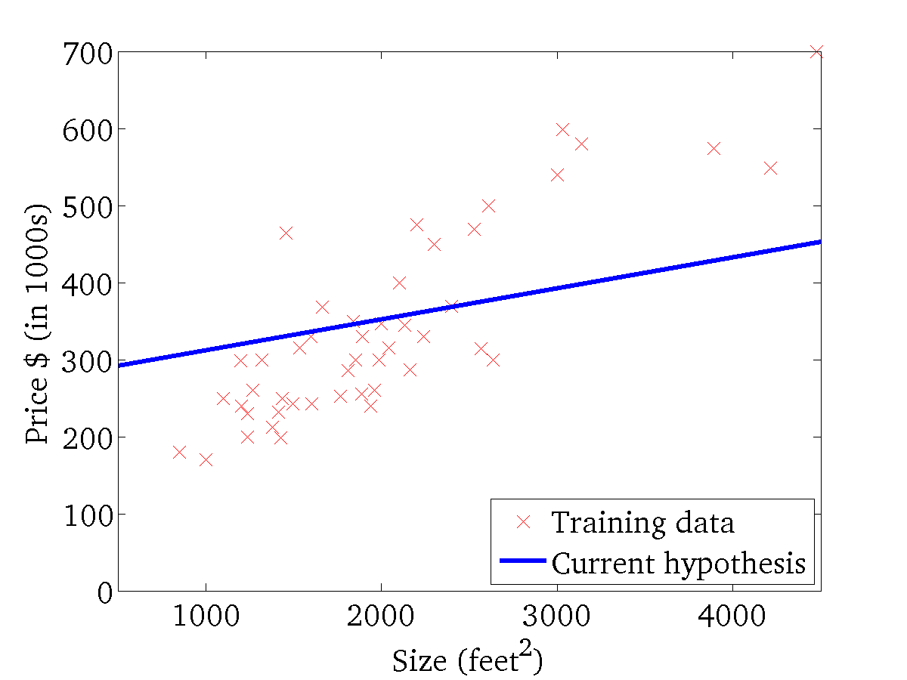

(for fixed , this is a function of x)
(function of the parameters )

Slide 33
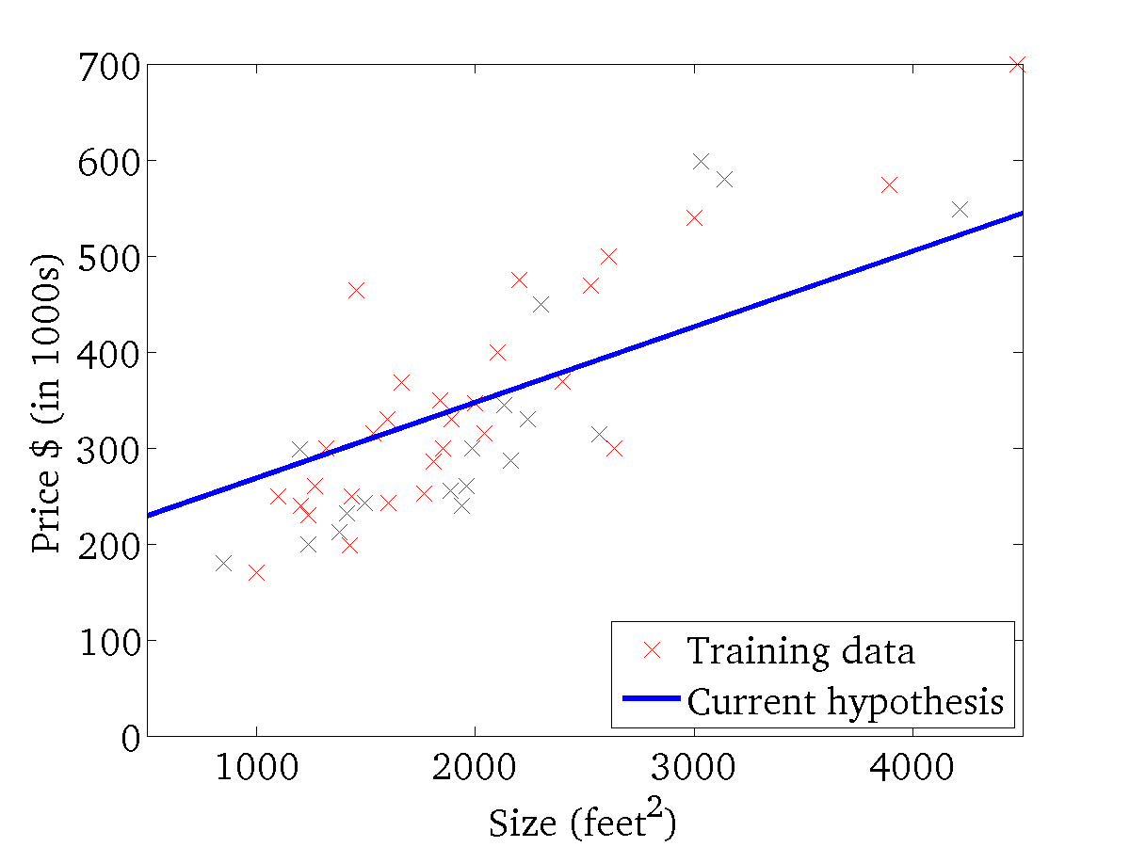
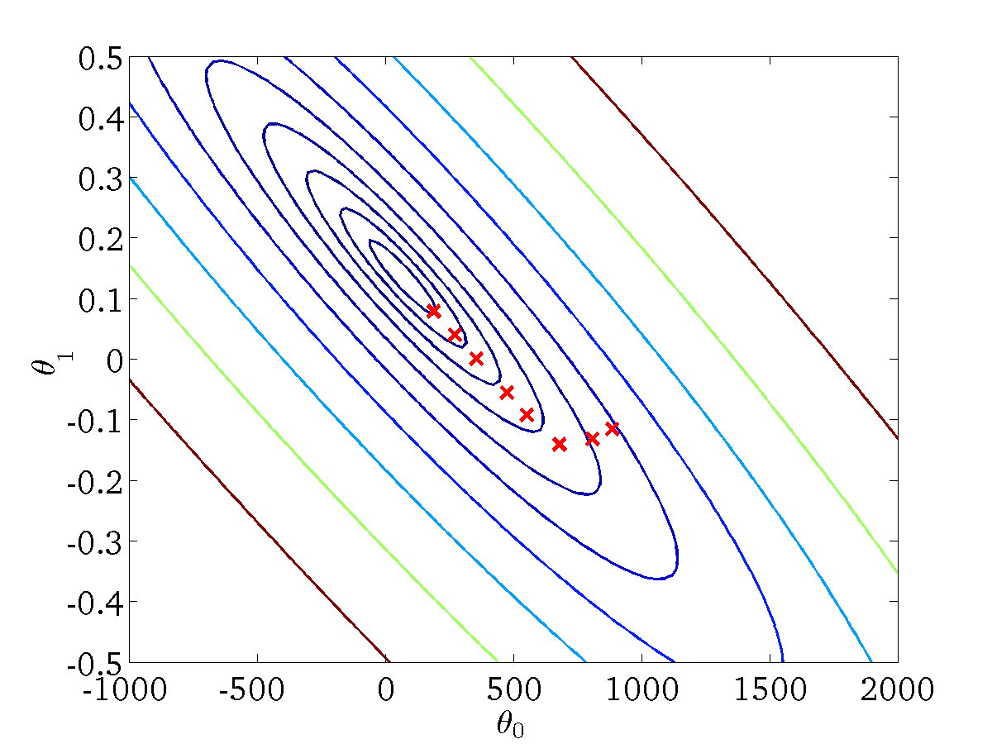
(for fixed , this is a function of x)
(function of the parameters )

Slide 34
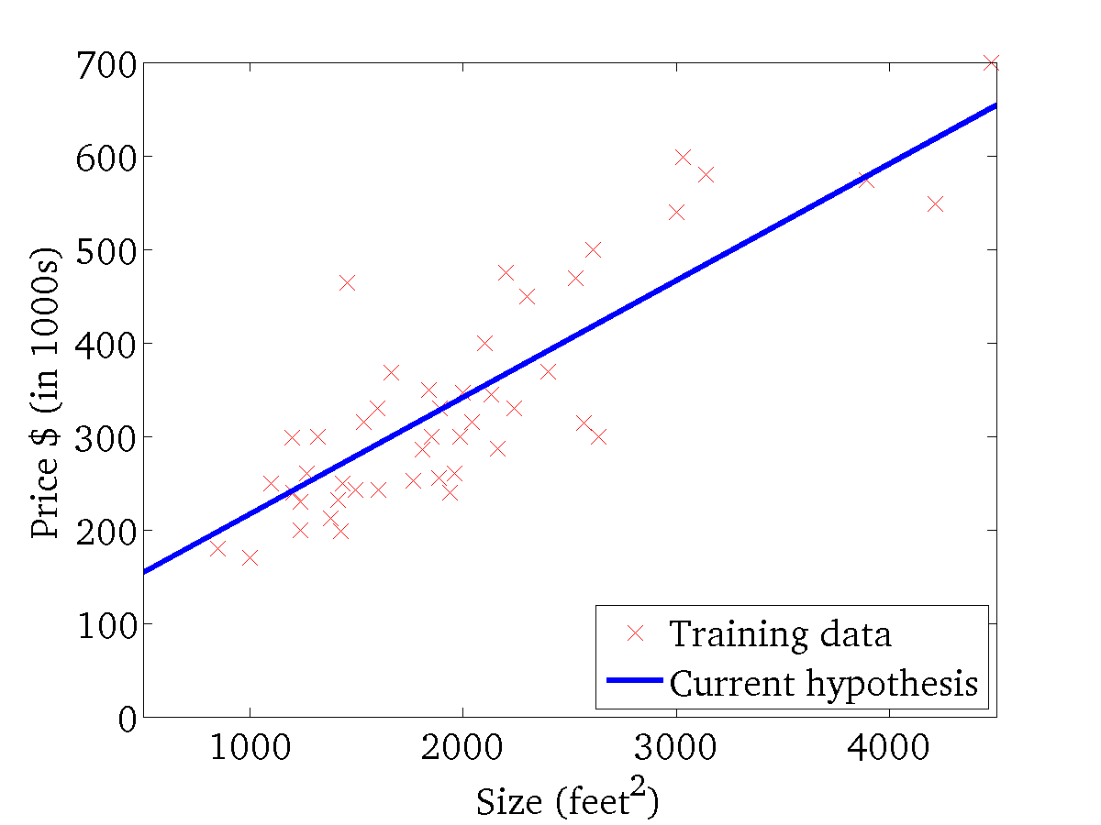

(for fixed , this is a function of x)
(function of the parameters )

Slide 35
“Batch” Gradient Descent
“Batch”: Each step of gradient descent uses all the training examples.
随机梯度下降法（Stochastic Gradient Descent）
小批量梯度下降法（Mini-batch Gradient Descent）

