Slide 1
机器学习基础
杨兴华
办公地点：基础楼223房间
邮箱：yangxh@bjfu.edu.cn

Slide 2
课程介绍
专业选修课
理论课 40学时
实验课 8学时
课程目的
掌握机器学习基本概念，理论和算法模型。
针对特定实际工程问题能够运用所学搭建模型和编程。
勤于思考，善于表达。

Slide 3
课程介绍
引言 (Introduction, Supervise and Unsupervised Learning)
单变量线性回归 (Linear Regression with One Variable)
多变量线性回归 (Linear Regression with Multiple Variables)
逻辑回归 (Logistic Regression)
正则化 (Regularization)
神经网络 (Neural Networks)
模型误差分析 (Model Error Analysis)
支持向量机 (Support Vector Machines)
聚类 (Clustering)
降维 (Dimensionality Reduction)
异常检测和推荐系统 (Anomaly Detection and Recommender Systems)

Slide 4
课程介绍
成绩评价：
期末成绩：百分制，半开卷，允许携带一张A4纸记录，占总成绩50%；
平时成绩：百分制，占总成绩的50%，（1）两次编程，两次作业，各25分；（2）课堂表现，100分；（3）满分截止。

Slide 5
机器学习基础——引言
什么是机器学习(What is Machine Learning)
监督学习(Supervise Learning)
非监督学习(Unsupervised Learning)
关于图灵测试的思考

Slide 6
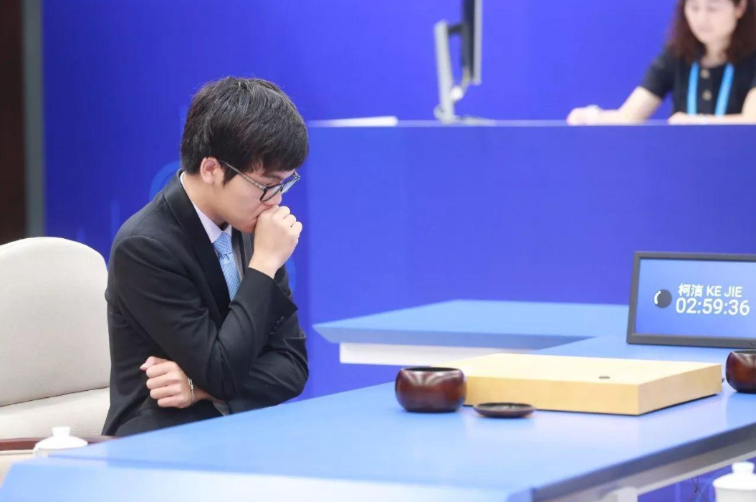
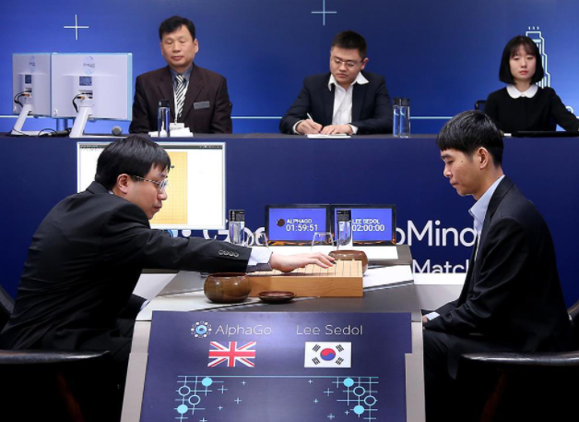
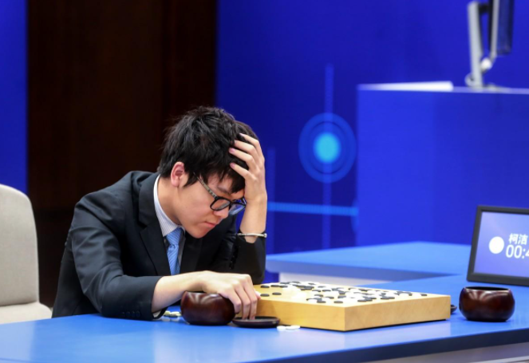
什么是机器学习(What is Machine Learning)
蒙特卡洛决策树

Slide 7
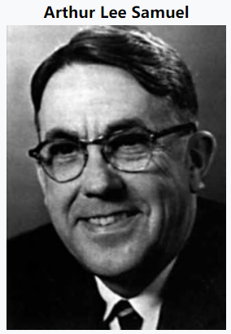
Arthur Samuel (1959). Machine Learning: Field of study that gives computers the ability to learn without being explicitly programmed.
1952 年，IBM 的 Arthur Samuel（被誉为“机器学习之父”）设计了一款可以学习的西洋跳棋程序。它能通过观察棋子的走位来构建新的模型，并用其提高自己的下棋技巧。Samuel 和这个程序进行多场对弈后发现，随着时间的推移 程序的棋艺变得越来越好。Samuel 用这个程序推翻了以往“机器无法超越人类，不能像人一样写代码和学习”这一传统认识。而他对“机器学习”的定义是：
不需要确定性编程就可以赋予机器某项技能的研究领域。

Slide 8
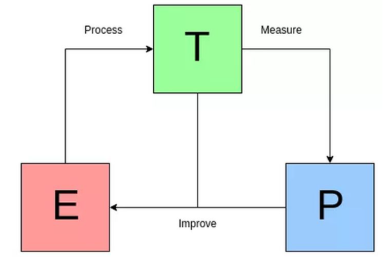
Tom Mitchell (1998) : A computer program is said to learn from experience E with respect to some task T and some performance measure P, if its performance on T, as measured by P, improves with experience E.
对于某类任务 T 和性能度量 P，如果一个计算机程序在 T 上以 P 衡量的性能随着经验 E 而自我完善，那么我们称这个计算机程序在从经验 E 中学习。

Slide 9
“A computer program is said to learn from experience E with respect to some task T and some performance measure P, if its performance on T, as measured by P, improves with experience E.”
Suppose your email program watches which emails you do or do not mark as spam, and based on that learns how to better filter spam. What is the task T in this setting？And also P and E？
Classifying emails as spam or not spam.
Watching you label emails as spam or not spam.
The number (or fraction) of emails correctly classified as spam/not spam.
None of the above—this is not a machine learning problem.

Slide 10
Housing price prediction
Price ($)
in 1000’s
Size in feet²
Supervised Learning
“right answers” given
Regression: Predict continuous valued output (price)

Slide 11
Breast cancer (malignant, benign)
Classification
Discrete valued output (0 or 1)
1(Y)
Malignant?
0(N)
Tumor Size

Slide 12
Supervised Learning
x₂
x₁

Slide 13
You’re running a company, and you want to develop learning algorithms to address each of two problems.
Problem 1: You have a large inventory of identical items. You want to predict how many of these items will sell over the next 3 months.
Problem 2: You’d like software to examine individual customer accounts, and for each account decide if it has been hacked/compromised.
Should you treat these as classification or as regression problems?
Treat both as classification problems.
Treat problem 1 as a classification problem, problem 2 as a regression problem.
Treat problem 1 as a regression problem, problem 2 as a classification problem.
Treat both as regression problems.

Slide 14
非监督学习
Unsupervised Learning
x₂
x₁

Slide 15

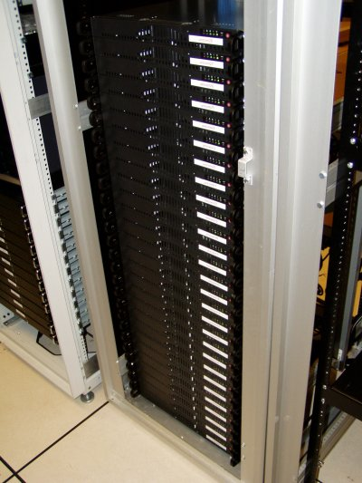
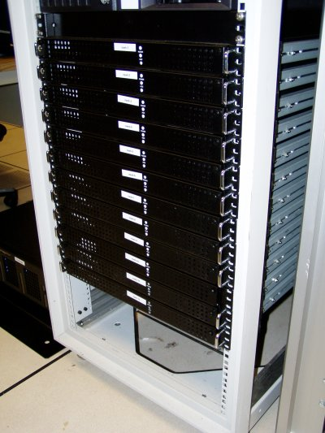

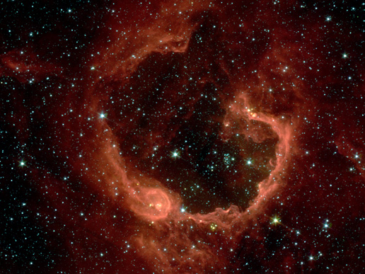
Organize computing clusters
Social network analysis
Image credit: NASA/JPL-Caltech/E. Churchwell (Univ. of Wisconsin, Madison)
Market segmentation
Astronomical data analysis
Notes:
Astronomical data analysis image obtained from NASA website.
http://www.nasa.gov/multimedia/imagegallery/image_feature_874.html
RCW 79 is seen in the southern Milky Way, 17,200 light-years from Earth in the constellation Centaurus. The bubble is 70-light years in diameter, and probably took about one million years to form from the radiation and winds of hot young stars. The balloon of gas and dust is an example of stimulated star formation. Such stars are born when the hot bubble expands into the interstellar gas and dust around it. RCW 79 has spawned at least two groups of new stars along the edge of the large bubble. Some are visible inside the small bubble in the lower left corner. Another group of baby stars appears near the opening at the top. NASA's Spitzer Space Telescope easily detects infrared light from the dust particles in RCW 79. The young stars within RCW79 radiate ultraviolet light that excites molecules of dust within the bubble. This causes the dust grains to emit infrared light that is detected by Spitzer and seen here as the extended red features. Image credit: NASA/JPL-Caltech/E. Churchwell (Univ. of Wisconsin, Madison)
--------------------
From NASA use guidelines:
http://www.nasa.gov/multimedia/guidelines/index.html
Using NASA Imagery and Linking to NASA Web Sites 10.13.05 Still Images, Audio Files and Video
NASA still images, audio files and video generally are not copyrighted. You may use NASA imagery, video and audio material for educational or informational purposes, including photo collections, textbooks, public exhibits and Internet Web pages. This general permission extends to personal Web pages.
This general permission does not extend to use of the NASA insignia logo (the blue "meatball" insignia), the retired NASA logotype (the red "worm" logo) and the NASA seal. These images may not be used by persons who are not NASA employees or on products (including Web pages) that are not NASA sponsored.
If the NASA material is to be used for commercial purposes, especially including advertisements, it must not explicitly or implicitly convey NASA's endorsement of commercial goods or services. If a NASA image includes an identifiable person, using the image for commercial purposes may infringe that person's right of privacy or publicity, and permission should be obtained from the person. Any questions regarding application of any NASA image or emblem should be directed to:
Photo Department NASA Headquarters 300 E St. SW Washington, DC 20546 Tel: (202)358-1900 Fax: (202)358-4333
Linking to NASA Web Sites
NASA Web sites are not copyrighted, and may be linked to from other Web sites, including individuals' personal Web sites, without explicit permission from NASA. However, such links may not explicitly or implicitly convey NASA's endorsement of commercial goods or services.
NASA images may be used as graphic "hot links" to NASA Web sites, provided they are used within the guidelines above. This permission does not extend to use of the NASA insignia, the retired NASA logotype or the NASA seal.
Restrictions
Please be advised that:
1) NASA does not endorse or sponsor any commercial product, service, or activity.
2) The use of the NASA name, initials, any NASA emblems (including the NASA insignia, the NASA logo and the NASA seal) which would express or imply such endorsement or sponsorship is strictly prohibited.
3) Use of the NASA name or initials as an identifying symbol by organizations other than NASA (such as on foods, packaging, containers, signs, or any promotional material) is prohibited.
4) NASA does permit the use of the NASA logo and insignia on novelty and souvenir-type items. However, such items may be sold and manufactured only after a proposal has been submitted to and approved by a Visual Identity representative from the Public Outreach Division (Phone: 202/358-1750) in accordance with 14 CFR (Code of Federal Regulations) Part 1221. Permission is granted on a nonexclusive basis as it is not NASA's policy to grant exclusive rights to use any of the agency identities.
5) No approval for use is authorized by NASA when the use can be construed as an endorsement by NASA of a product, service or activity.
6) NASA emblems should be reproduced only from original reproduction proofs, transparencies, or computer files available from NASA Headquarters. Please be advised that approval must be granted by a Visual Identity representative from the Public Outreach Division ( Tel: 202/358-1750) before any reproduction materials can be obtained.

Slide 16

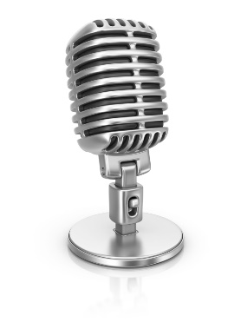

Cocktail party problem
“鸡尾酒会问题”（cocktail party problem）是在计算机语音识别领域的一个问题，当前语音识别技术已经可以以较高精度识别一个人所讲的话，但是当说话的人数为两人或者多人时，语音识别率就会极大的降低，这一难题被称为鸡尾酒会问题。
该问题描述的是给定混合信号，如何分离出鸡尾酒会中同时说话的每个人的独立信号。当有N个信号源时，通常假设观察信号也有N个（例如N个麦克风或者录音机）。该假设意味着混合矩阵是个方阵，即J = D，其中D是输入数据的维数，J是系统模型的维数。
Speaker #1
Microphone #1
Speaker #2
Microphone #2
[W,s,v] = svd((repmat(sum(x.*x,1),size(x,1),1).*x)*x');

Slide 17
Of the following examples, which would you address using an unsupervised learning algorithm? (Check all that apply.)
Given email labeled as spam/not spam, learn a spam filter.
Given a set of news articles found on the web, group them into set of articles about the same story.
Given a database of customer data, automatically discover market segments and group customers into different market segments.
Given a dataset of patients diagnosed as either having diabetes or not, learn to classify new patients as having diabetes or not.

Slide 18
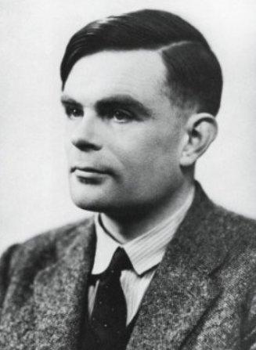
关于图灵测试的思考
1936年，哲学家阿尔弗雷德·艾耶尔思考心灵哲学问题：我们怎么知道其他人曾有同样的体验。在《语言，真理与逻辑》中，艾尔提出有意识的人类及无意识的机器之间的区别。
图灵测试（The Turing test）由图灵发明，指测试者与被测试者（一个人和一台机器）隔开的情况下，通过一些装置（如键盘）向被测试者随意提问。进行多次测试后，如果机器让平均每个参与者做出超过30%的误判，那么这台机器就通过了测试，并被认为具有人类智能。
图灵
Notes:
Astronomical data analysis image obtained from NASA website.
http://www.nasa.gov/multimedia/imagegallery/image_feature_874.html
RCW 79 is seen in the southern Milky Way, 17,200 light-years from Earth in the constellation Centaurus. The bubble is 70-light years in diameter, and probably took about one million years to form from the radiation and winds of hot young stars. The balloon of gas and dust is an example of stimulated star formation. Such stars are born when the hot bubble expands into the interstellar gas and dust around it. RCW 79 has spawned at least two groups of new stars along the edge of the large bubble. Some are visible inside the small bubble in the lower left corner. Another group of baby stars appears near the opening at the top. NASA's Spitzer Space Telescope easily detects infrared light from the dust particles in RCW 79. The young stars within RCW79 radiate ultraviolet light that excites molecules of dust within the bubble. This causes the dust grains to emit infrared light that is detected by Spitzer and seen here as the extended red features. Image credit: NASA/JPL-Caltech/E. Churchwell (Univ. of Wisconsin, Madison)
--------------------
From NASA use guidelines:
http://www.nasa.gov/multimedia/guidelines/index.html
Using NASA Imagery and Linking to NASA Web Sites 10.13.05 Still Images, Audio Files and Video
NASA still images, audio files and video generally are not copyrighted. You may use NASA imagery, video and audio material for educational or informational purposes, including photo collections, textbooks, public exhibits and Internet Web pages. This general permission extends to personal Web pages.
This general permission does not extend to use of the NASA insignia logo (the blue "meatball" insignia), the retired NASA logotype (the red "worm" logo) and the NASA seal. These images may not be used by persons who are not NASA employees or on products (including Web pages) that are not NASA sponsored.
If the NASA material is to be used for commercial purposes, especially including advertisements, it must not explicitly or implicitly convey NASA's endorsement of commercial goods or services. If a NASA image includes an identifiable person, using the image for commercial purposes may infringe that person's right of privacy or publicity, and permission should be obtained from the person. Any questions regarding application of any NASA image or emblem should be directed to:
Photo Department NASA Headquarters 300 E St. SW Washington, DC 20546 Tel: (202)358-1900 Fax: (202)358-4333
Linking to NASA Web Sites
NASA Web sites are not copyrighted, and may be linked to from other Web sites, including individuals' personal Web sites, without explicit permission from NASA. However, such links may not explicitly or implicitly convey NASA's endorsement of commercial goods or services.
NASA images may be used as graphic "hot links" to NASA Web sites, provided they are used within the guidelines above. This permission does not extend to use of the NASA insignia, the retired NASA logotype or the NASA seal.
Restrictions
Please be advised that:
1) NASA does not endorse or sponsor any commercial product, service, or activity.
2) The use of the NASA name, initials, any NASA emblems (including the NASA insignia, the NASA logo and the NASA seal) which would express or imply such endorsement or sponsorship is strictly prohibited.
3) Use of the NASA name or initials as an identifying symbol by organizations other than NASA (such as on foods, packaging, containers, signs, or any promotional material) is prohibited.
4) NASA does permit the use of the NASA logo and insignia on novelty and souvenir-type items. However, such items may be sold and manufactured only after a proposal has been submitted to and approved by a Visual Identity representative from the Public Outreach Division (Phone: 202/358-1750) in accordance with 14 CFR (Code of Federal Regulations) Part 1221. Permission is granted on a nonexclusive basis as it is not NASA's policy to grant exclusive rights to use any of the agency identities.
5) No approval for use is authorized by NASA when the use can be construed as an endorsement by NASA of a product, service or activity.
6) NASA emblems should be reproduced only from original reproduction proofs, transparencies, or computer files available from NASA Headquarters. Please be advised that approval must be granted by a Visual Identity representative from the Public Outreach Division ( Tel: 202/358-1750) before any reproduction materials can be obtained.

