Slide 1
线性代数回顾
Linear Algebra review

Slide 2
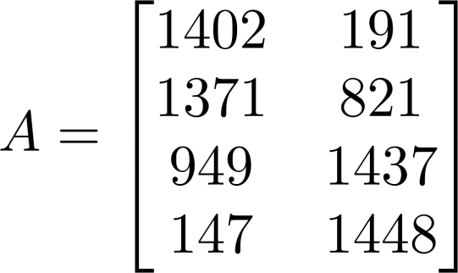
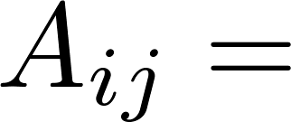



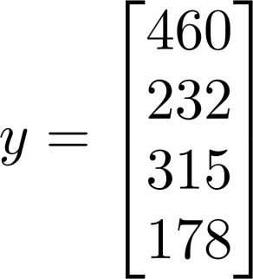
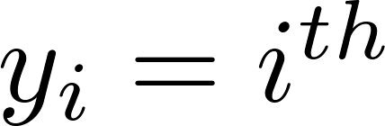
Matrix Elements (entries of matrix)
“ , entry” in the row, column.
Vector: An n x 1 matrix.
element

Slide 3
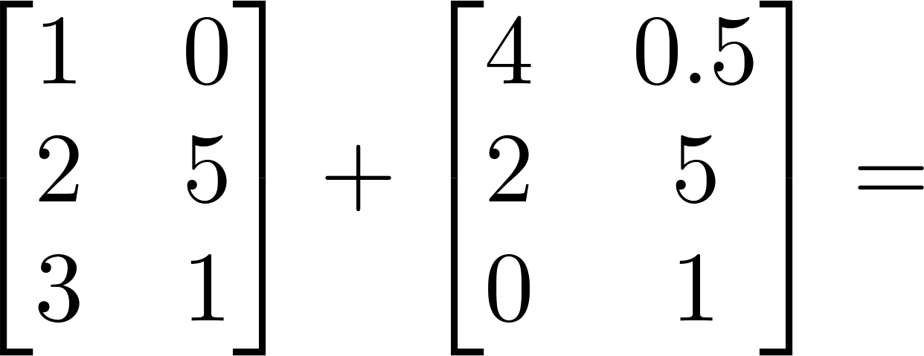
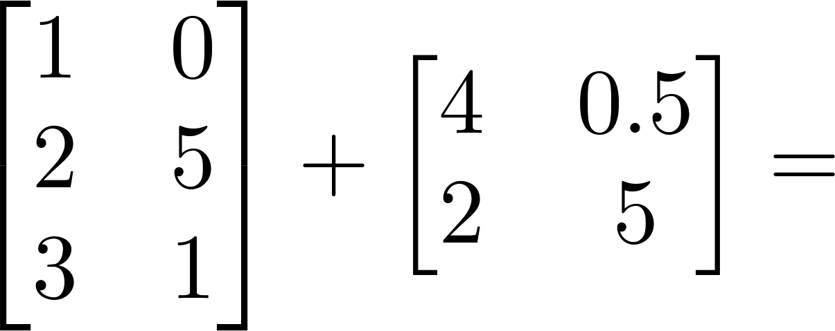
Matrix Addition

Slide 4
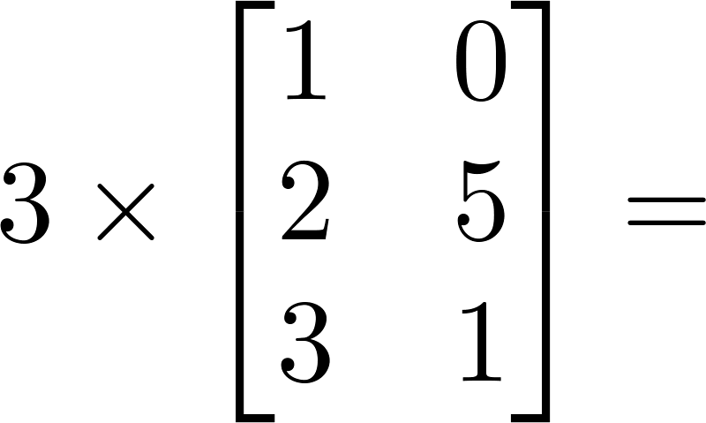
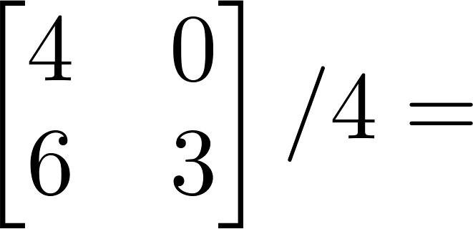
Scalar Multiplication

Slide 5
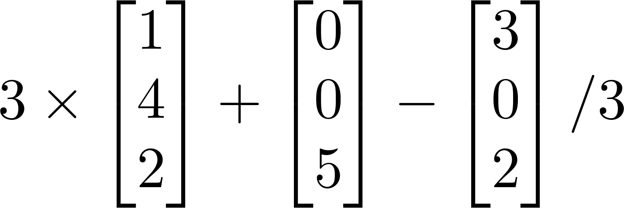
Combination of Operands

Slide 6
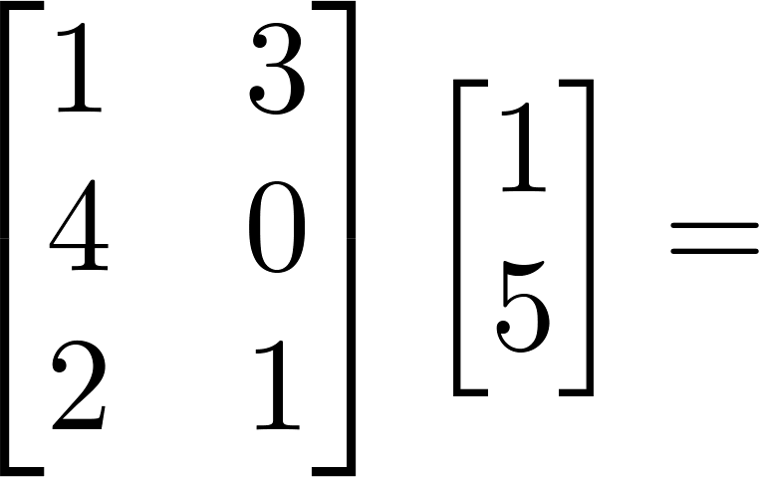
Matrix——Vector Multiplication

Slide 7
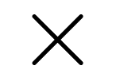
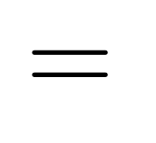



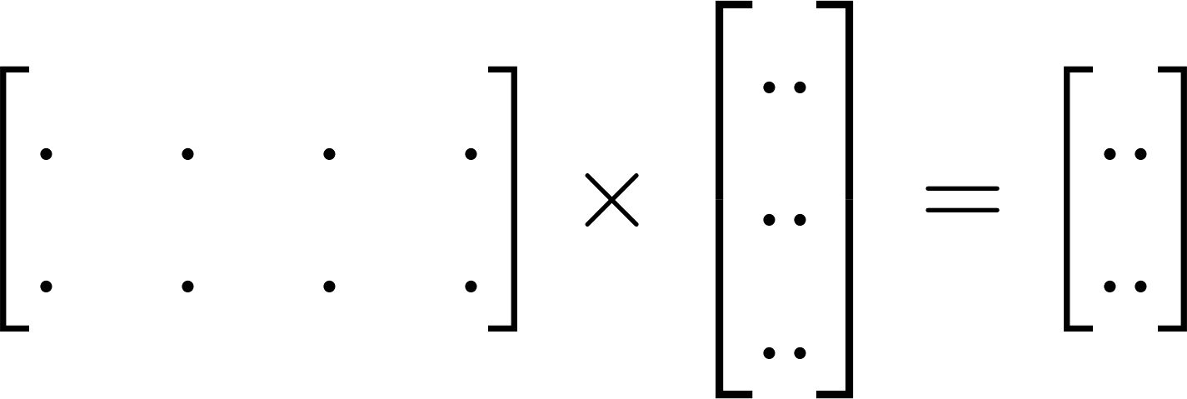

Details:
m x n matrix
(m rows,
n columns)
n x 1 matrix
(n-dimensional
vector)
m-dimensional vector
To get , multiply ’s row with elements of vector , and add them up.

Slide 8
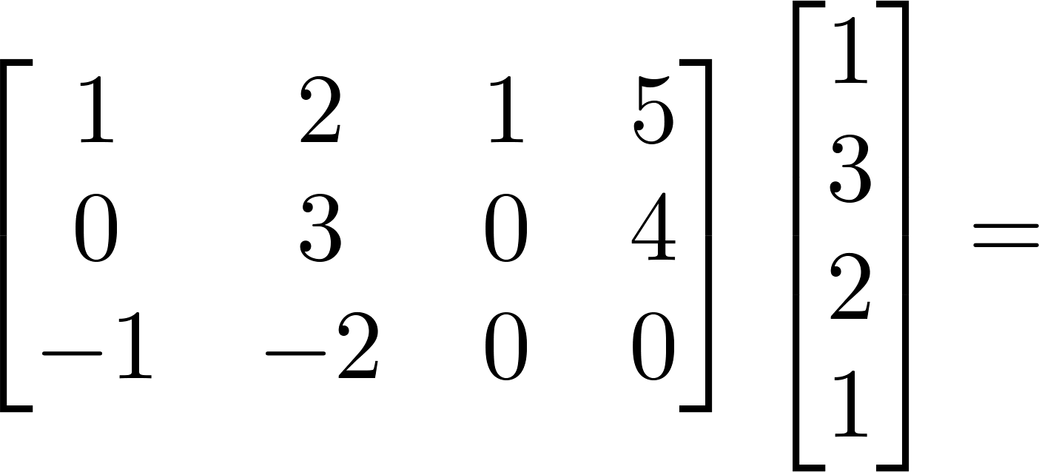
Example

Slide 9
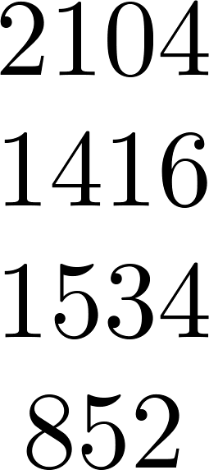
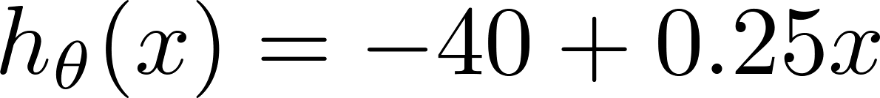
House sizes:

Slide 10
House sizes:

Slide 11
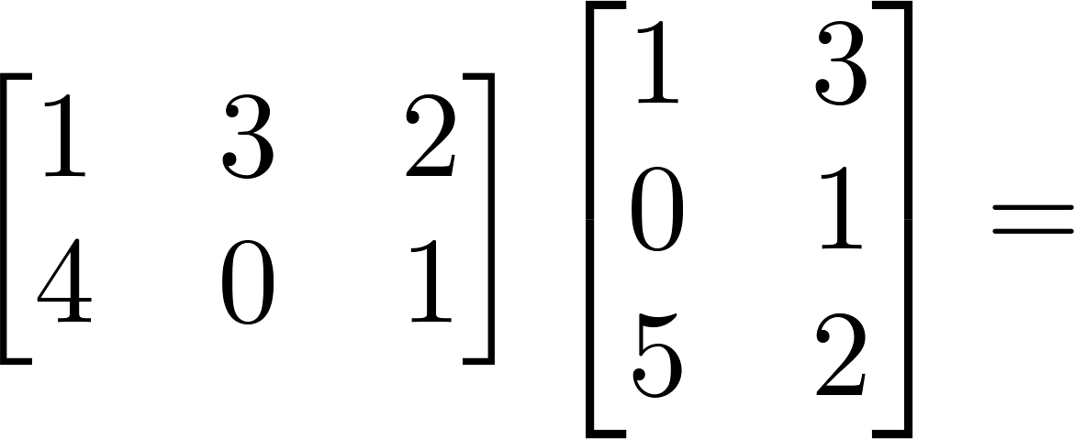
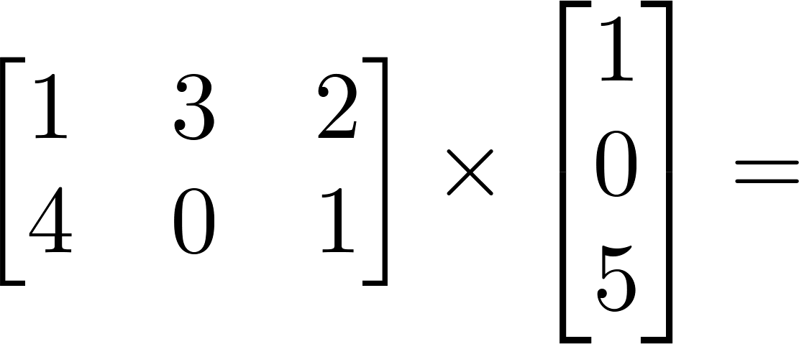
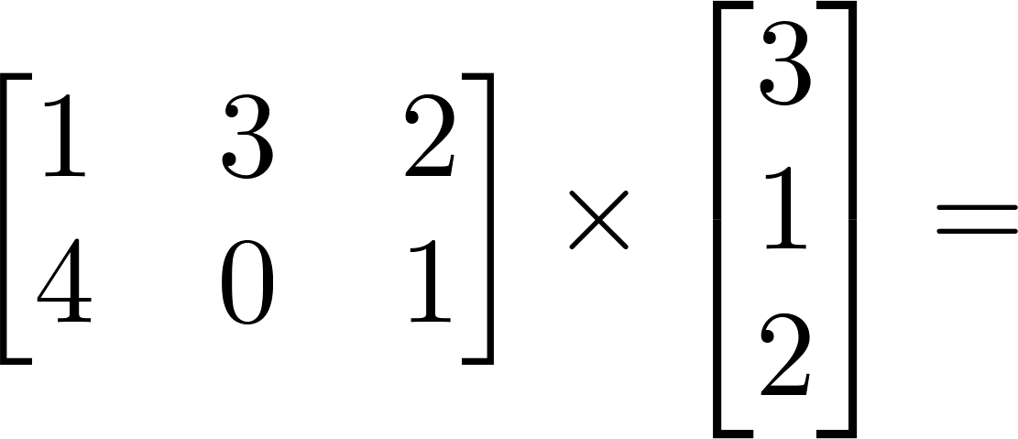
Matrix-Matrix Example

Slide 12
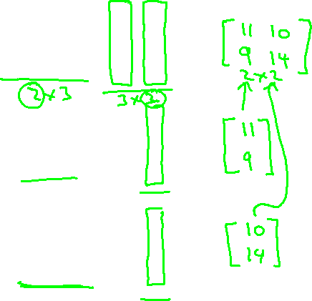
Matrix-Matrix Example

Slide 13





Details:
m x n matrix
(m rows,
n columns)
n x o matrix
(n rows,
o columns)
m x o
matrix
The column of the matrix is obtained by multiplying
with the column of . (for = 1,2,…,o)

Slide 14
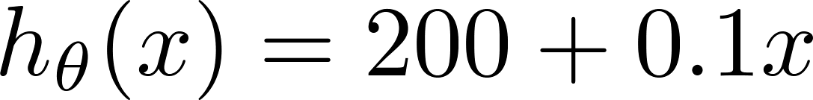
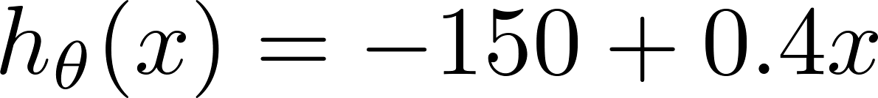
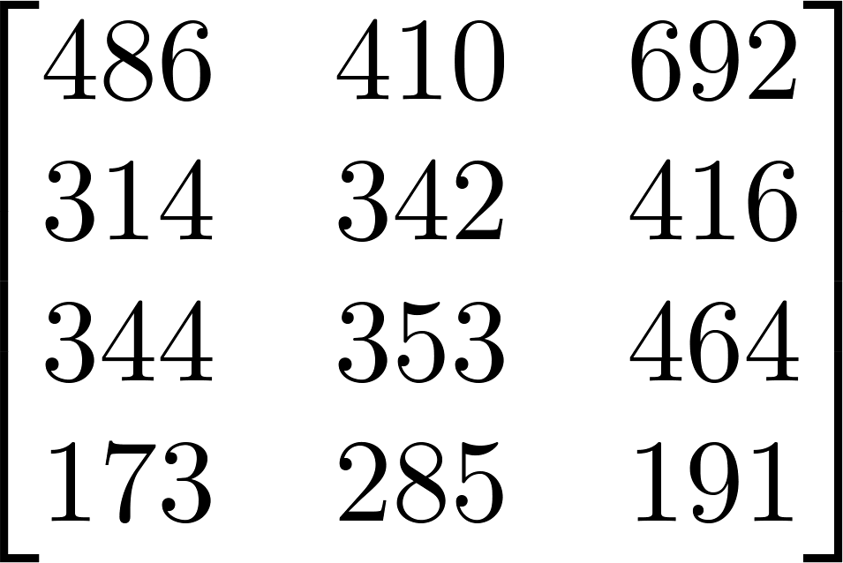
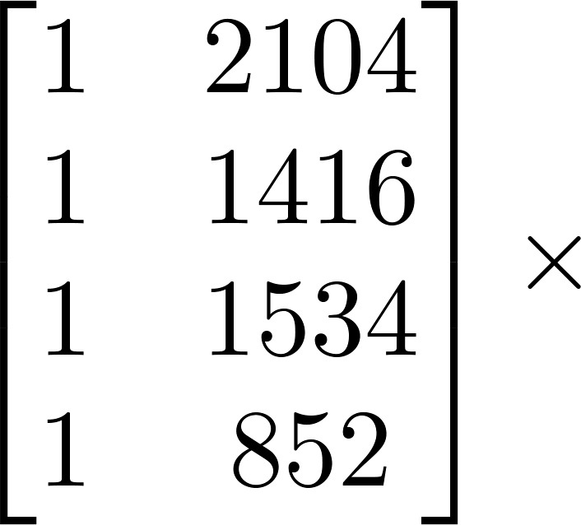
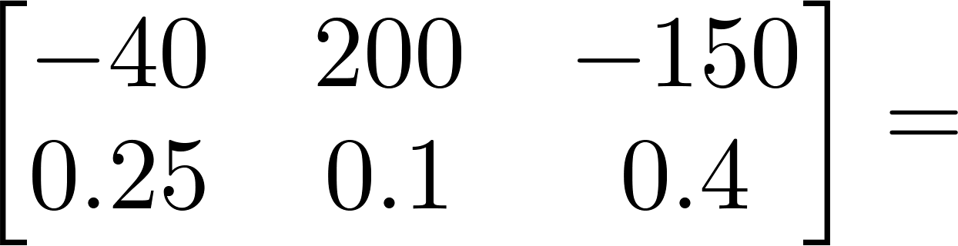
House sizes:
Have 3 competing hypotheses:
1.
2.
3.
Matrix
Matrix

Slide 15

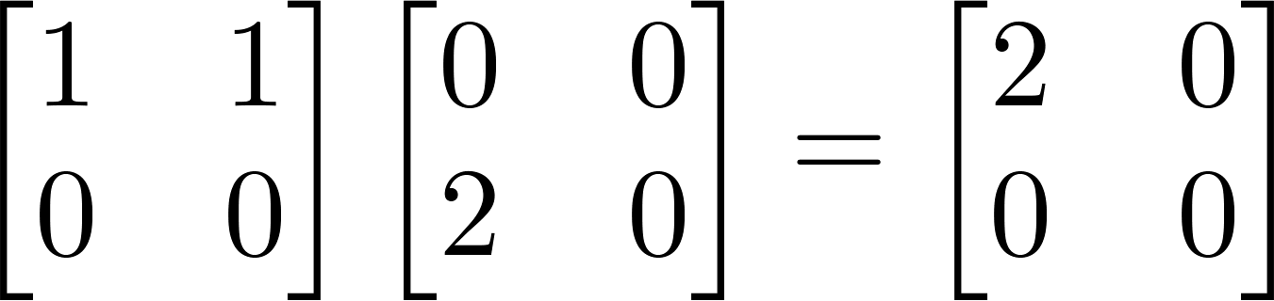
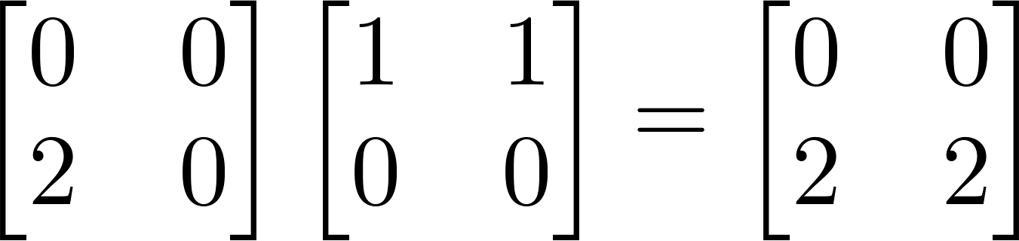
Let and be matrices. Then in general,
(not commutative.)
E.g.

Slide 16

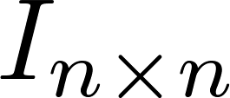
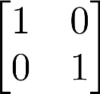
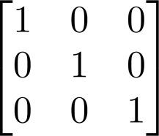
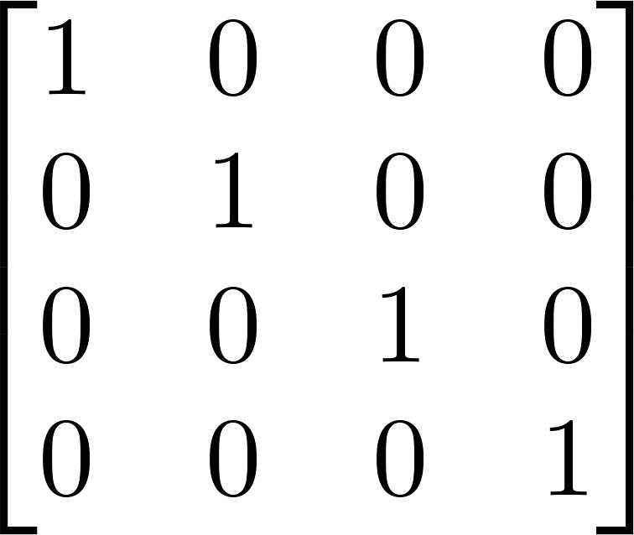
Identity Matrix
Denoted (or ).
Examples of identity matrices:
2 x 2
3 x 3
4 x 4
For any matrix ,
Matrix inverse:
If A is an m x m matrix, and if it has an inverse,

Slide 17
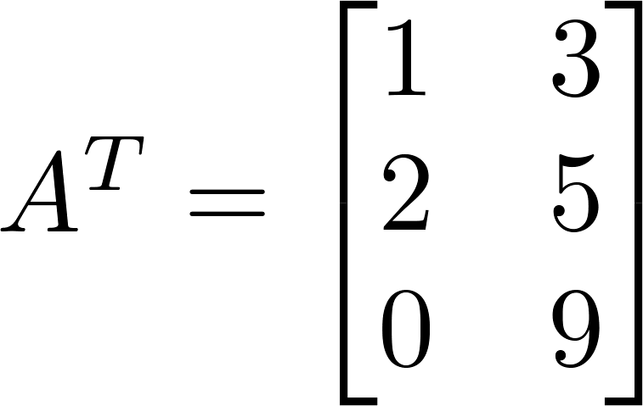
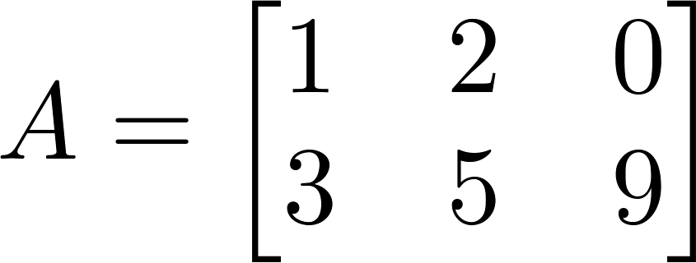

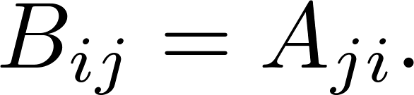
Matrix Transpose
Example:
Let be an m x n matrix, and let
Then is an n x m matrix, and

