Slide 1
多维特征 Multiple features
多变量线性回归
Linear Regression with multiple variables

Slide 2


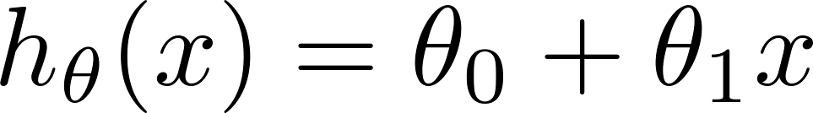
Multiple features (variables).
Size (feet²) | Price ($1000)
2104 | 460
1416 | 232
1534 | 315
852 | 178
… | …

Slide 3
Multiple features (variables).
Size (feet²) | Number of bedrooms | Number of floors | Age of home (years) | Price ($1000)
2104 | 5 | 1 | 45 | 460
1416 | 3 | 2 | 40 | 232
1534 | 3 | 2 | 30 | 315
852 | 2 | 1 | 36 | 178
… | … | … | … | …

Slide 4



Multiple features (variables).
Size (feet²) | Number of bedrooms | Number of floors | Age of home (years) | Price ($1000)
2104 | 5 | 1 | 45 | 460
1416 | 3 | 2 | 40 | 232
1534 | 3 | 2 | 30 | 315
852 | 2 | 1 | 36 | 178
… | … | … | … | …
Notation:
= number of features
= input (features) of training example.
= value of feature in training example.
Notes:
Pop-up Quiz

Slide 5
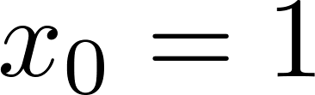
Hypothesis:
Previously:
For convenience of notation, define .
Multivariate linear regression.

Slide 6
多变量的梯度下降 Gradient descent for multiple variables
多变量线性回归
Linear Regression with multiple variables

Slide 7
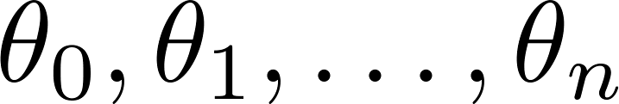
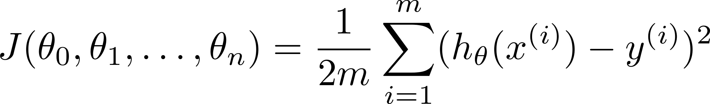

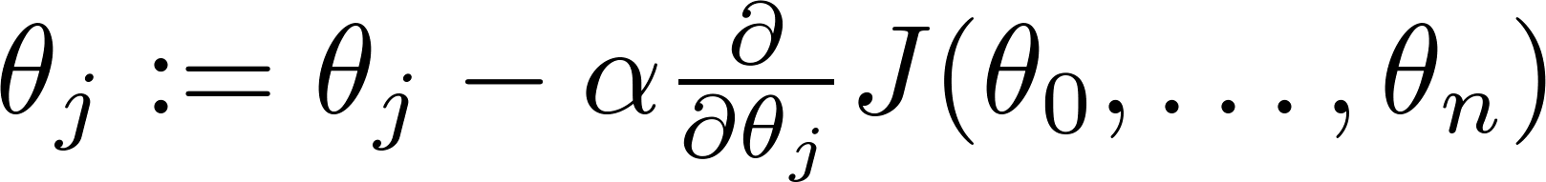

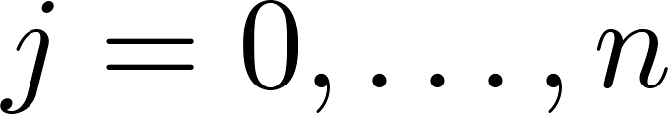
Hypothesis:
Parameters:
几维度？
Cost function:
Gradient descent:
Repeat
(simultaneously update for every )

Slide 8

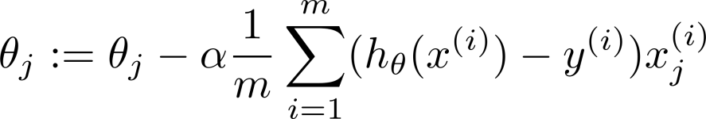
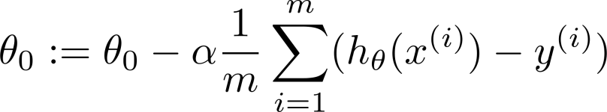



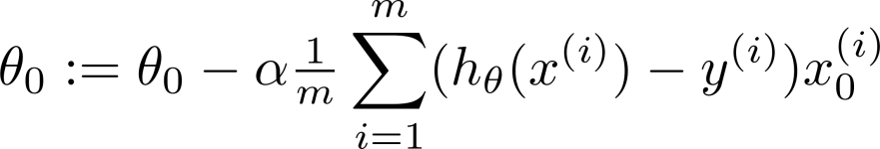
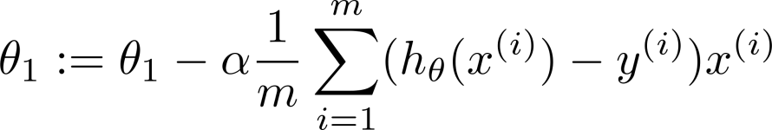
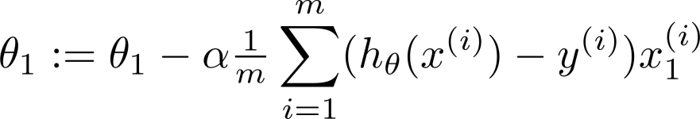

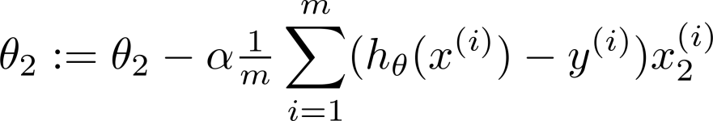
New algorithm :
Gradient Descent
Repeat
Previously (n=1):
Repeat
(simultaneously update for
)
(simultaneously update )

Slide 9
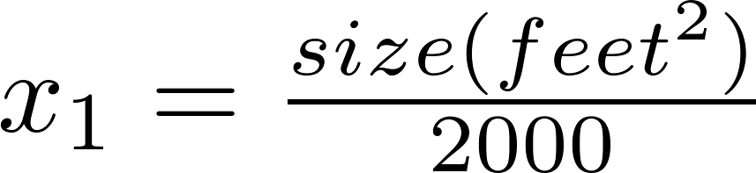


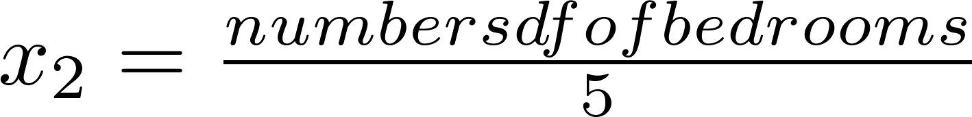
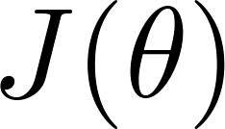


Feature Scaling
Idea: Make sure features are on a similar scale.
E.g. = size (0-2000 feet²)
= number of bedrooms (1-5)
size (feet²)
number of bedrooms

Slide 10
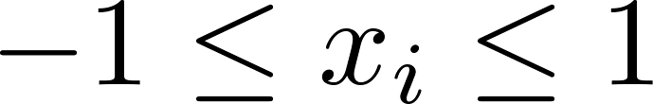
Feature Scaling
Get every feature into approximately a range.
在我们面对多维特征问题的时候，我们要保证这些特征都具有相近的尺度，这将帮助梯度下降算法更快地收敛。

Slide 11



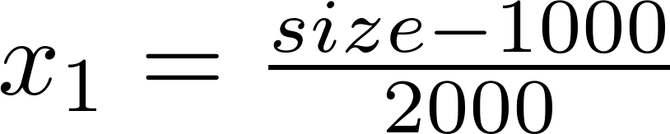
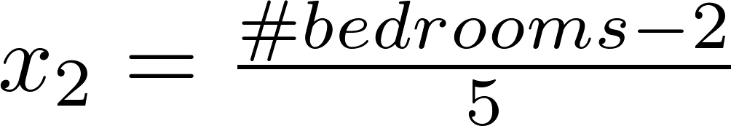
Mean normalization
Replace with to make features have approximately zero mean (Do not apply to ).
E.g.

Slide 12
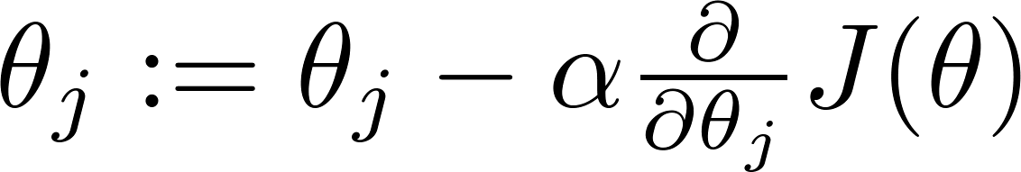

Learning Rate
Gradient descent
“Debugging”: How to make sure gradient descent is working correctly.
How to choose learning rate .

Slide 13
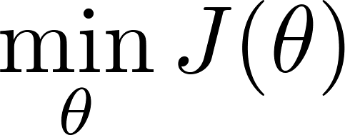
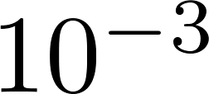
Making sure gradient descent is working correctly.
Example automatic convergence test:
Declare convergence if decreases by less than in one iteration.
No. of iterations

Slide 14

Making sure gradient descent is working correctly.
Gradient descent not working.
Use smaller .
No. of iterations
No. of iterations
No. of iterations
For sufficiently small , should decrease on every iteration.
But if is too small, gradient descent can be slow to converge.

Slide 15
Summary:
If is too small: slow convergence.
If is too large: may not decrease on every iteration; may not converge.
To choose , try

Slide 16
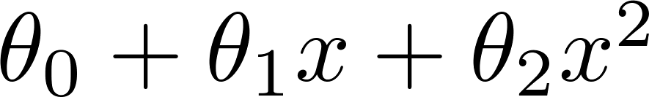
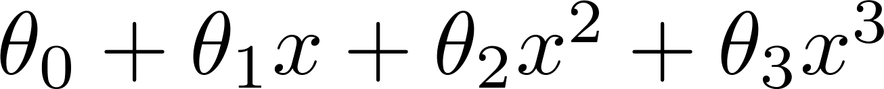
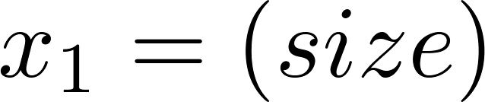
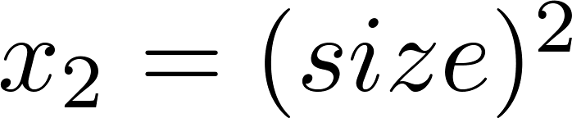
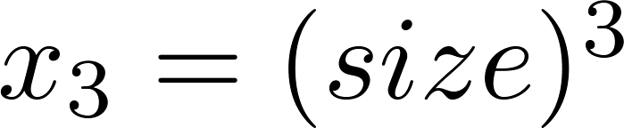
Polynomial regression
Price
(y)
Size (x)

Slide 17
Choice of features
Price
(y)
Size (x)

Slide 18
正规方程 Normal equation
多变量线性回归
Linear Regression with multiple variables

Slide 19

Gradient Descent
Normal equation: Method to solve for
analytically.

Slide 20

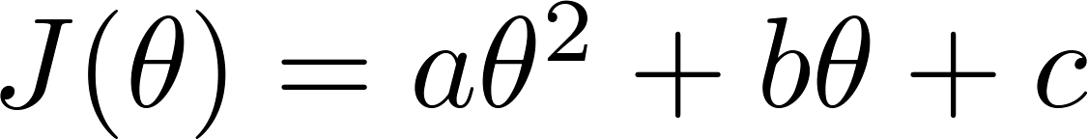

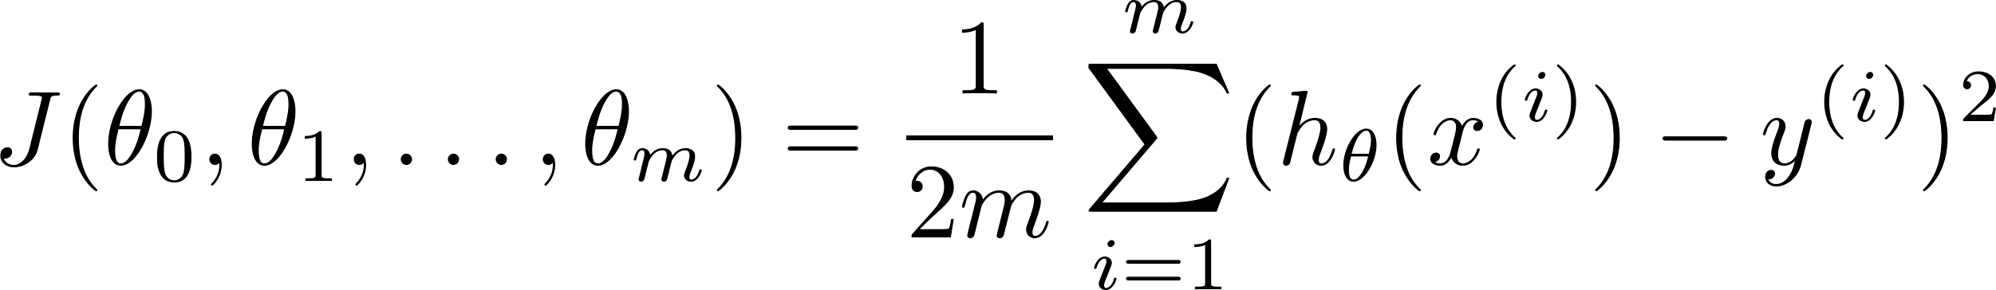
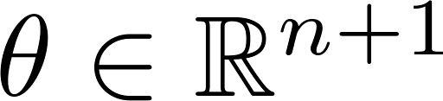
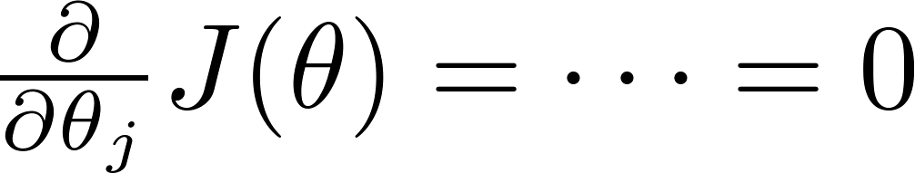

Intuition: If 1D
(for every )
Solve for

Slide 21






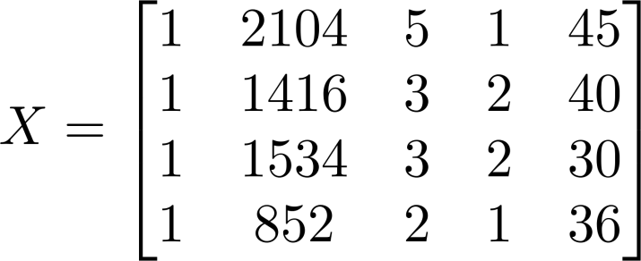
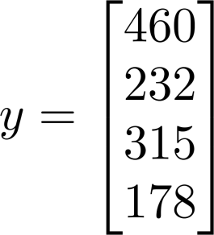
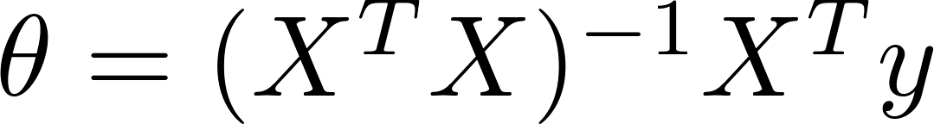
Examples:
 | Size (feet²) | Number of bedrooms | Number of floors | Age of home (years) | Price ($1000)
1 | 2104 | 5 | 1 | 45 | 460
1 | 1416 | 3 | 2 | 40 | 232
1 | 1534 | 3 | 2 | 30 | 315
1 | 852 | 2 | 1 | 36 | 178
Size (feet²) | Number of bedrooms | Number of floors | Age of home (years) | Price ($1000)
2104 | 5 | 1 | 45 | 460
1416 | 3 | 2 | 40 | 232
1534 | 3 | 2 | 30 | 315
852 | 2 | 1 | 36 | 178
Notes:
Pop-up Quiz

Slide 22

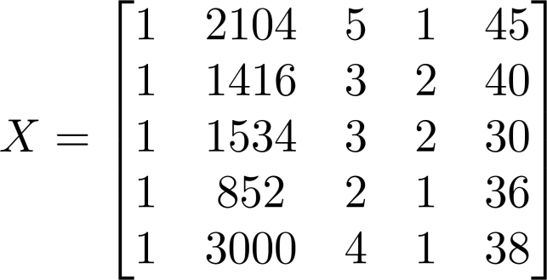
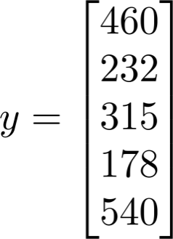
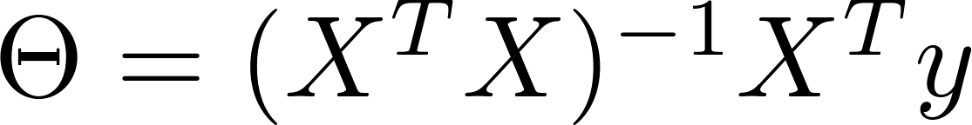
Examples:
 | Size (feet²) | Number of bedrooms | Number of floors | Age of home (years) | Price ($1000)
1 | 2104 | 5 | 1 | 45 | 460
1 | 1416 | 3 | 2 | 40 | 232
1 | 1534 | 3 | 2 | 30 | 315
1 | 852 | 2 | 1 | 36 | 178
1
Size (feet²) | Number of bedrooms | Number of floors | Age of home (years) | Price ($1000)
2104 | 5 | 1 | 45 | 460
1416 | 3 | 2 | 40 | 232
1534 | 3 | 2 | 30 | 315
852 | 2 | 1 | 36 | 178
3000 | 4 | 1 | 38 | 540
Notes:
Pop-up Quiz

Slide 23
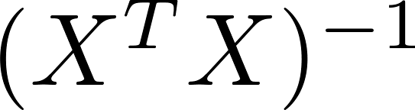

is inverse of matrix .
Octave:
pinv(X’*X)*X’*y

Slide 24


training examples, features.
Gradient Descent
Normal Equation
Need to choose .
Needs many iterations.
No need to choose .
Don’t need to iterate.
Works well even when is large.
Need to compute
Slow if is very large.

Slide 25
Normal equation
What if is non-invertible? (singular/ degenerate)
Octave:
pinv(X’*X)*X’*y

Slide 26


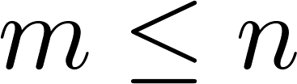
What if is non-invertible?
Redundant features (linearly dependent).
E.g. size in feet²
size in m²
Too many features (e.g. ).
Delete some features, or use regularization.

