Slide 1
Motivation I: Data Compression
Dimensionality Reduction

Slide 2


Data Compression
Reduce data from
2D to 1D
(inches)
(cm)

Slide 3
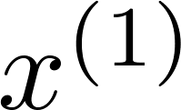
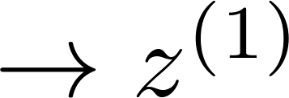
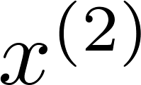
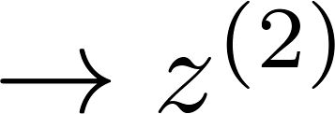
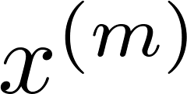
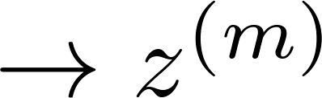

Data Compression
Reduce data from
2D to 1D
(inches)
(cm)
Notes:
Add more unique colors (3-4)

Slide 4
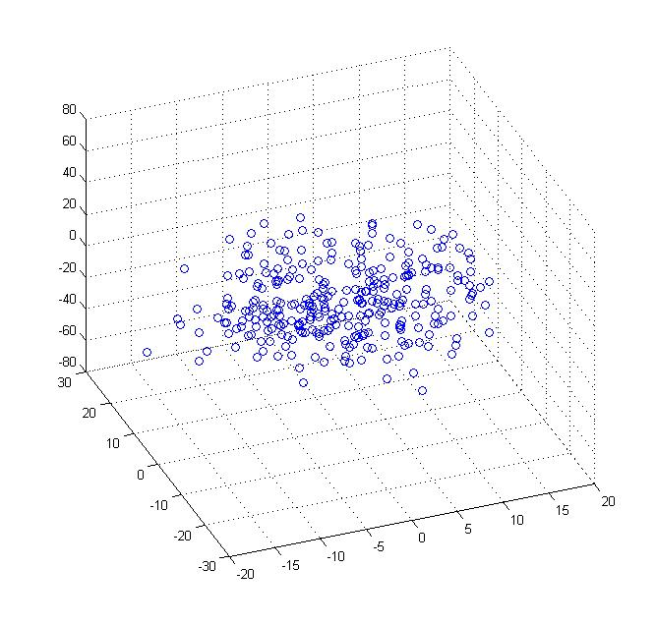
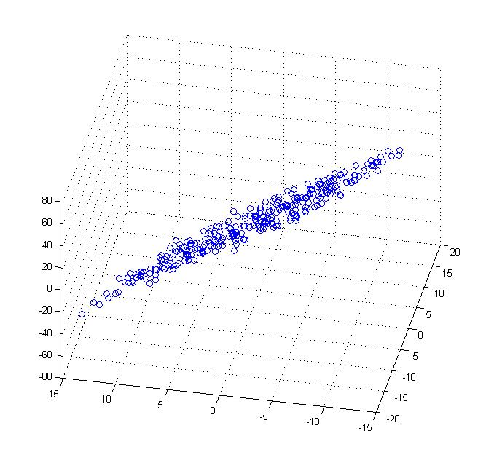
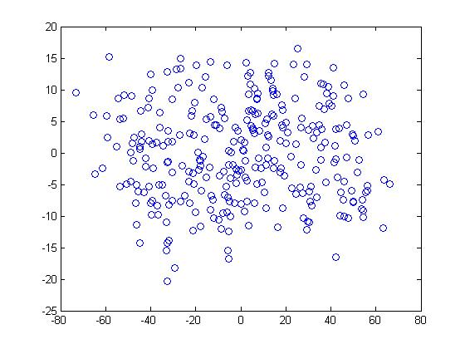


Data Compression
Reduce data from 3D to 2D
Notes:
Pca3d2d in lecture-slides/assets/pca/
Label axes

Slide 5
Motivation II: Data Visualization
Dimensionality Reduction

Slide 6
Data Visualization
Country | GDP (trillions of US$) | Per capita GDP (thousands of intl. $) | Human Develop-ment Index | Life expectancy | Poverty Index (Gini as percentage) | Mean household income (thousands of US$) | …
Canada | 1.577 | 39.17 | 0.908 | 80.7 | 32.6 | 67.293 | …
China | 5.878 | 7.54 | 0.687 | 73 | 46.9 | 10.22 | …
India | 1.632 | 3.41 | 0.547 | 64.7 | 36.8 | 0.735 | …
Russia | 1.48 | 19.84 | 0.755 | 65.5 | 39.9 | 0.72 | …
Singapore | 0.223 | 56.69 | 0.866 | 80 | 42.5 | 67.1 | …
USA | 14.527 | 46.86 | 0.91 | 78.3 | 40.8 | 84.3 | …
… | … | … | … | … | … | …
[resources from en.wikipedia.org]
Notes:
Add dots

Slide 7
Data Visualization
Country
Canada | 1.6 | 1.2
China | 1.7 | 0.3
India | 1.6 | 0.2
Russia | 1.4 | 0.5
Singapore | 0.5 | 1.7
USA | 2 | 1.5
… | … | …

Slide 8
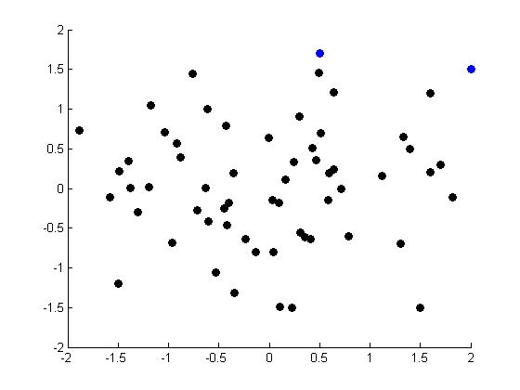
Data Visualization
Notes:
Make points look uncorrelated
US, Singapore in blue

Slide 9
Principal Component Analysis problem formulation PCA（主成分分析）
Dimensionality Reduction

Slide 10
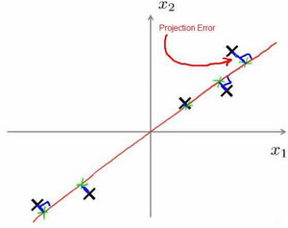
Principal Component Analysis (PCA) problem formulation
在PCA中，我们要做的是找到一个方向向量（Vector direction），当我们把所有的数据都投射到该向量上时，我们希望投射平均均方误差能尽可能地小。方向向量是一个经过原点的向量，而投射误差是从特征向量向该方向向量作垂线的长度。
Notes:
Change numbers to LATEX as well

Slide 11
PCA is not linear regression
Notes:
Add animation to block left graph

Slide 12
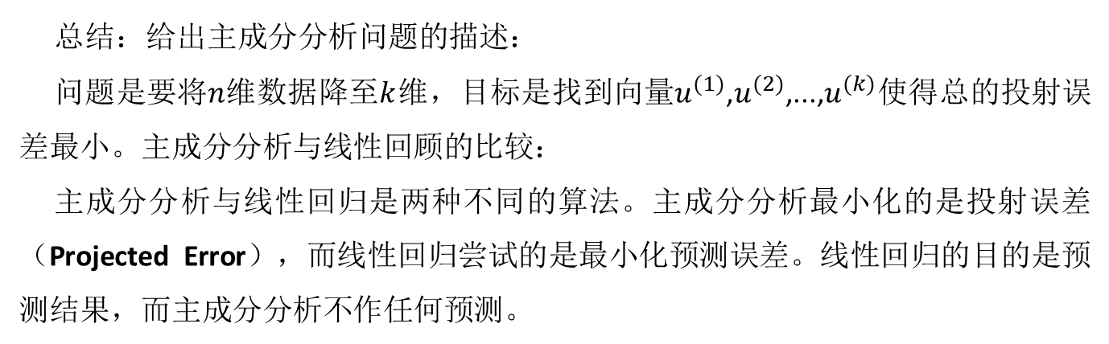
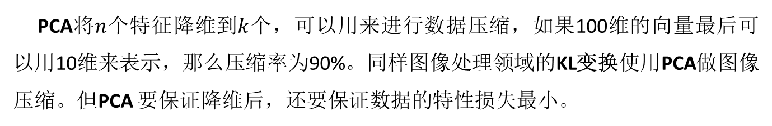
PCA is not linear regression
总结：给出主成分分析问题的描述：
问题是要将$n$维数据降至$k$维，目标是找到向量$u^{(1)}$,$u^{(2)}$,...,$u^{(k)}$使得总的投射误差最小。主成分分析与线性回顾的比较：
主成分分析与线性回归是两种不同的算法。主成分分析最小化的是投射误差（Projected Error），而线性回归尝试的是最小化预测误差。线性回归的目的是预测结果，而主成分分析不作任何预测。
PCA将$n$个特征降维到$k$个，可以用来进行数据压缩，如果100维的向量最后可以用10维来表示，那么压缩率为90%。同样图像处理领域的KL变换使用PCA做图像压缩。但PCA 要保证降维后，还要保证数据的特性损失最小。
Notes:
Add animation to block left graph

Slide 13
PCA is not linear regression
PCA技术的一大好处是对数据进行降维的处理。我们可以对新求出的“主元”向量的重要性进行排序，根据需要取前面最重要的部分，将后面的维数省去，可以达到降维从而简化模型或是对数据进行压缩的效果。同时最大程度的保持了原有数据的信息。
PCA技术的一个很大的优点是，它是完全无参数限制的。在PCA的计算过程中完全不需要人为的设定参数或是根据任何经验模型对计算进行干预，最后的结果只与数据相关，与用户是独立的。
Notes:
Add animation to block left graph

Slide 14
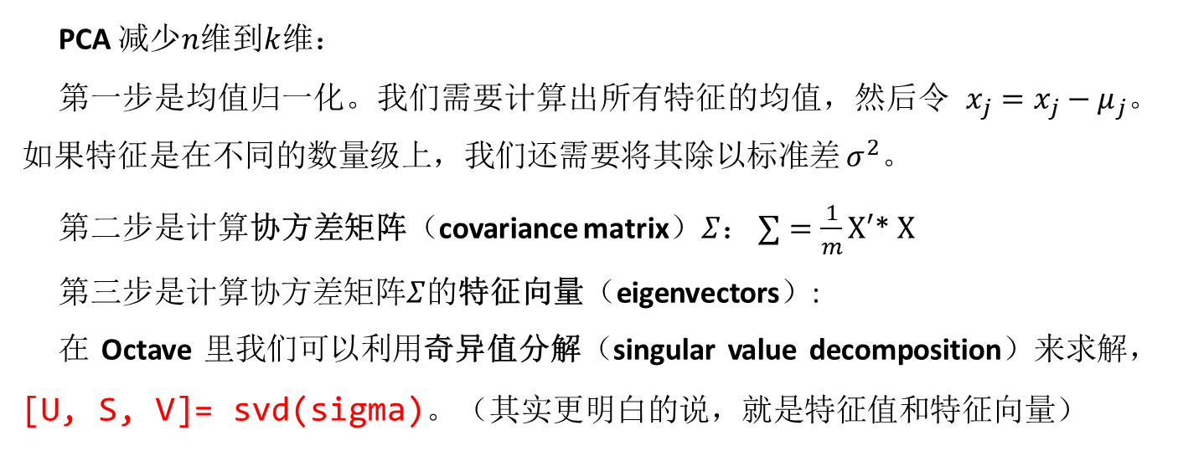
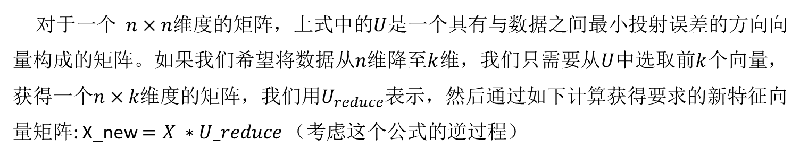
PCA 减少$n$维到$k$维：
第一步是均值归一化。我们需要计算出所有特征的均值，然后令 $x_{j}=x_{j}−μ_{j}$。如果特征是在不同的数量级上，我们还需要将其除以标准差 $σ^{2}$。
第二步是计算协方差矩阵（covariance matrix）$Σ$： $∑=\frac{1}{m}X′$* $X$
第三步是计算协方差矩阵$Σ$的特征向量（eigenvectors）:
在 Octave 里我们可以利用奇异值分解（singular value decomposition）来求解，[U, S, V]= svd(sigma)。（其实更明白的说，就是特征值和特征向量）
对于一个 $n×n$维度的矩阵，上式中的$U$是一个具有与数据之间最小投射误差的方向向量构成的矩阵。如果我们希望将数据从$n$维降至$k$维，我们只需要从$U$中选取前$k$个向量，获得一个$n×k$维度的矩阵，我们用$U_{reduce}$表示，然后通过如下计算获得要求的新特征向量矩阵: X_new $=X ∗U_reduce$（考虑这个公式的逆过程）
Notes:
Replace as previous; change spacing to fill page

Slide 15
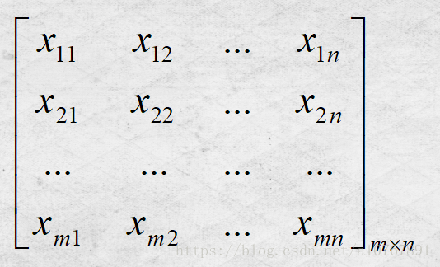
1、输入样本矩阵，大小：m*n。每一行为一个n维样本，共m个，如下图：
X=
取第一行为例，它的下标含义是 行表示样本序号，列表示样本维度。
Notes:
Replace as previous; change spacing to fill page

Slide 16
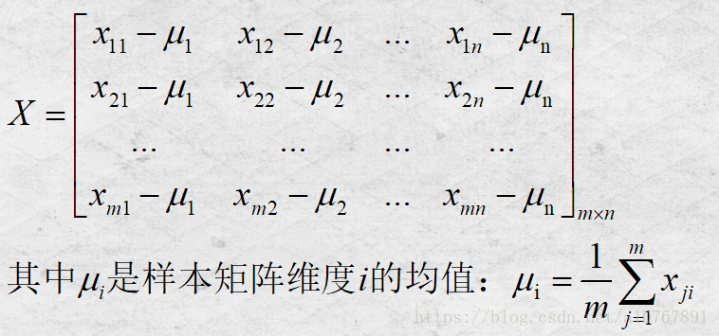
2、对样本矩阵进行中心化(取均值)；
Notes:
Replace as previous; change spacing to fill page

Slide 17
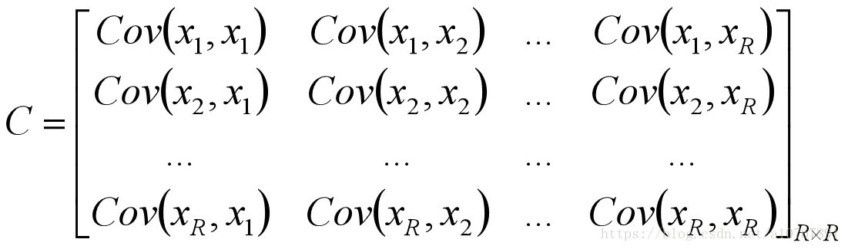
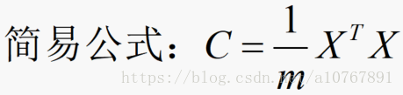
3、计算样本的协方差矩阵；
Notes:
Replace as previous; change spacing to fill page

Slide 18
Choosing the number of principal components
Dimensionality Reduction

Slide 19

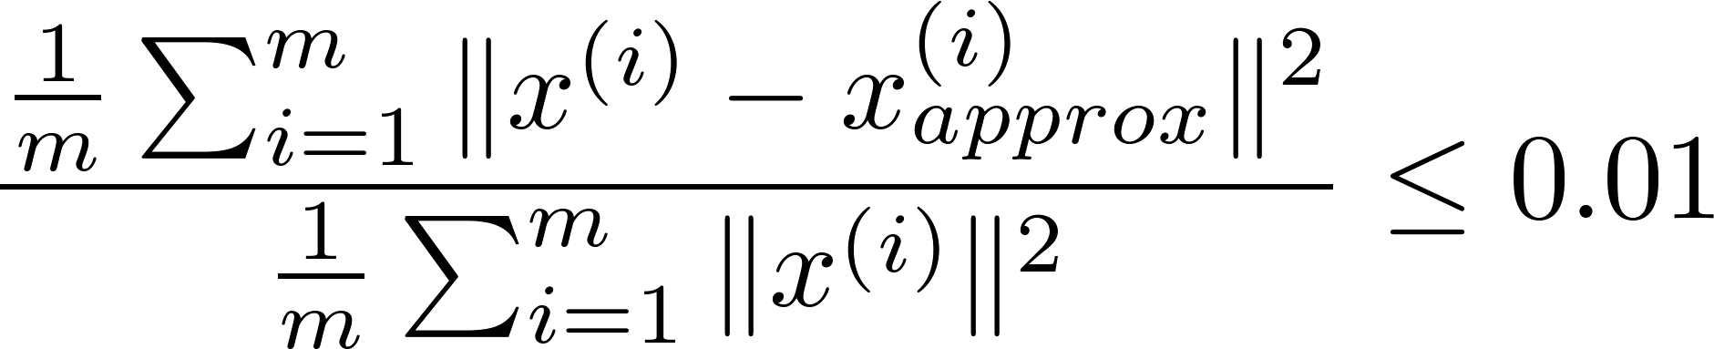
Choosing (number of principal components)
Average squared projection error:
Total variation in the data:
Typically, choose to be smallest value so that
“99% of variance is retained”
(1%)

Slide 20

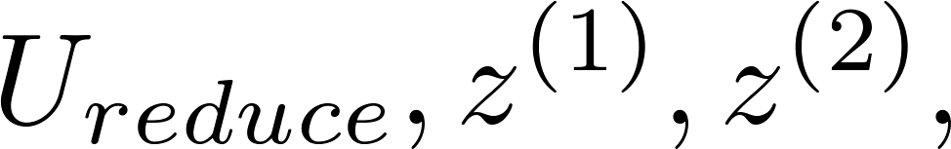

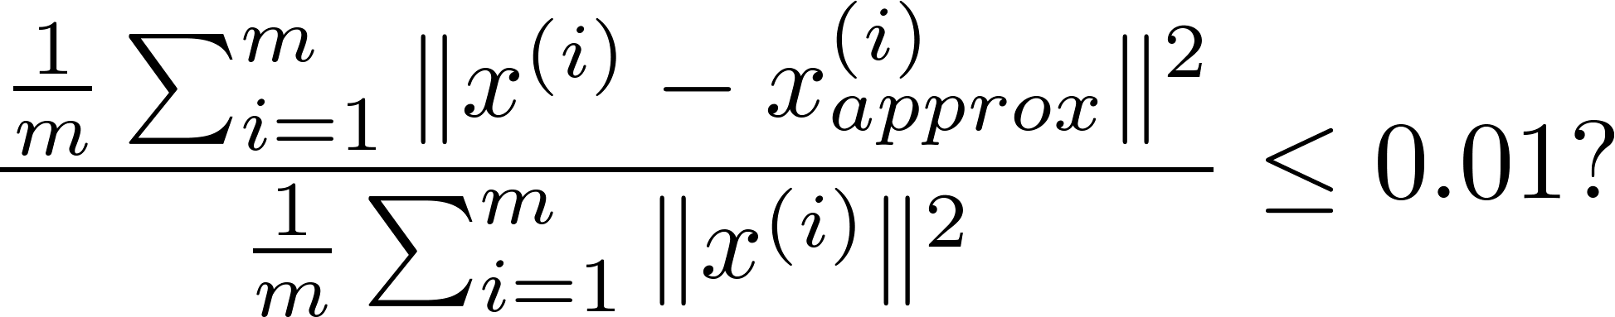
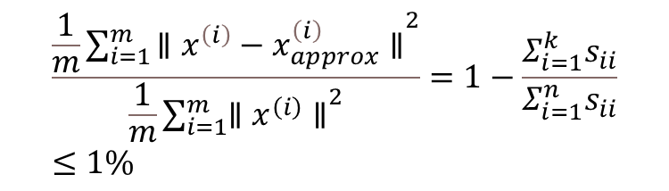
Choosing (number of principal components)
Algorithm:
Try PCA with
Compute
Check if
[U,S,V] = svd(Sigma)
$$\frac{\frac{1}{m}\sum_{i=1}^{m}{{\left.∥x^{\left(i\right)}−x_{approx}^{\left(i\right)}∥\right.}^{2}}}{\frac{1}{m}\sum_{i=1}^{m}{{\left.∥x^{\left(i\right)}∥\right.}^{2}}}=1−\frac{Σ_{i=1}^{k}s_{ii}}{Σ_{i=1}^{n}s_{ii}}≤1\%$$

Slide 21
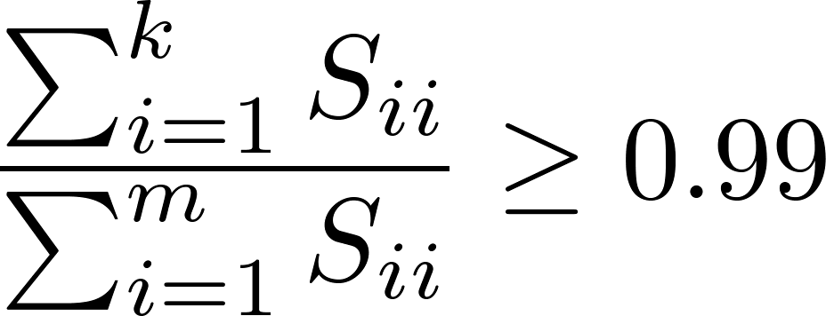
Choosing (number of principal components)
[U,S,V] = svd(Sigma)
Pick smallest value of for which
(99% of variance retained)

Slide 22
Advice for applying PCA
Dimensionality Reduction

Slide 23

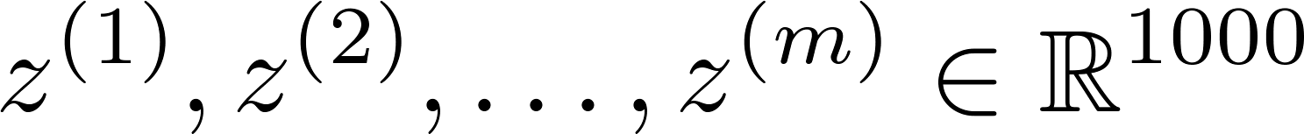
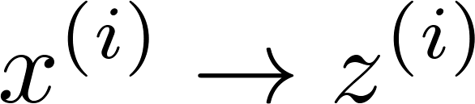
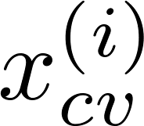
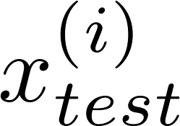
Supervised learning speedup
Extract inputs:
Unlabeled dataset:
New training set:
Note: Mapping should be defined by running PCA only on the training set. This mapping can be applied as well to the examples and in the cross validation and test sets.

Slide 24
Application of PCA
Compression
Reduce memory/disk needed to store data
Speed up learning algorithm(question)
Visualization

Slide 25
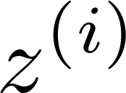
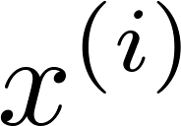

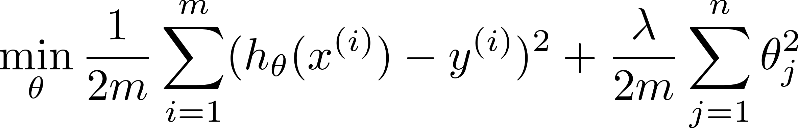
Bad use of PCA: To prevent overfitting
Use instead of to reduce the number of features to
Thus, fewer features, less likely to overfit.
This might work OK, but isn’t a good way to address overfitting. Use regularization instead.

Slide 26





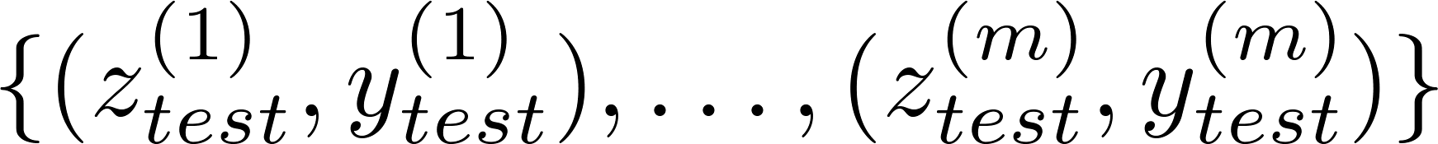
PCA is sometimes used where it shouldn’t be
Design of ML system:
Get training set
Run PCA to reduce in dimension to get
Train logistic regression on
Test on test set: Map to . Run on
How about doing the whole thing without using PCA?
Before implementing PCA, first try running whatever you want to do with the original/raw data . Only if that doesn’t do what you want, then implement PCA and consider using .

