Slide 1
Unsupervised learning introduction
Clustering

Slide 2


Supervised learning
Training set:

Slide 3
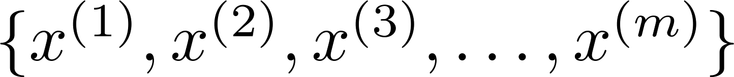
Unsupervised learning
Training set:

Slide 4


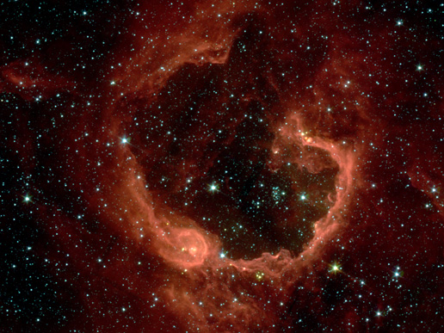
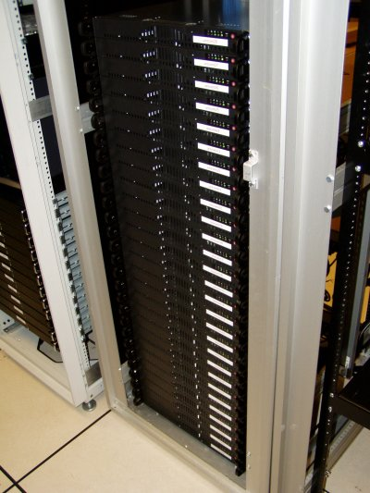
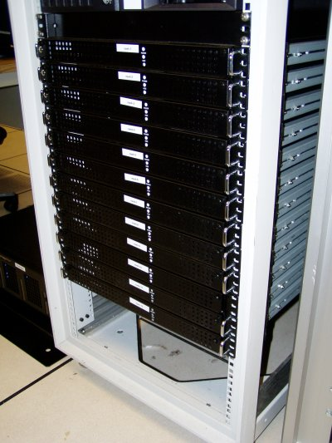
Applications of clustering
Market segmentation
Social network analysis
Image credit: NASA/JPL-Caltech/E. Churchwell (Univ. of Wisconsin, Madison)
Organize computing clusters
Astronomical data analysis
Notes:
Swap: market seg and organize clusters

Slide 5
K-means algorithm
Clustering

Slide 6
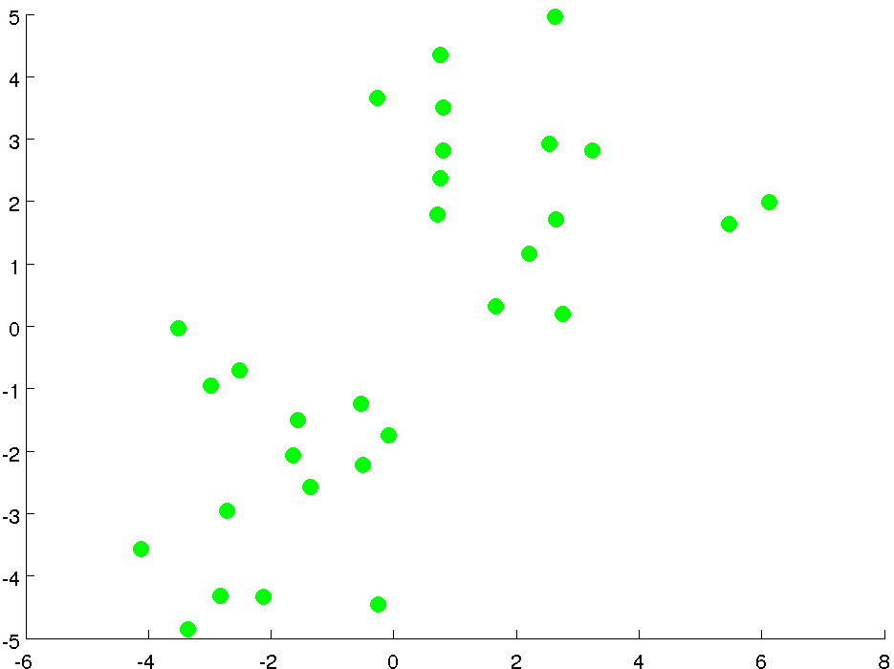

Slide 7
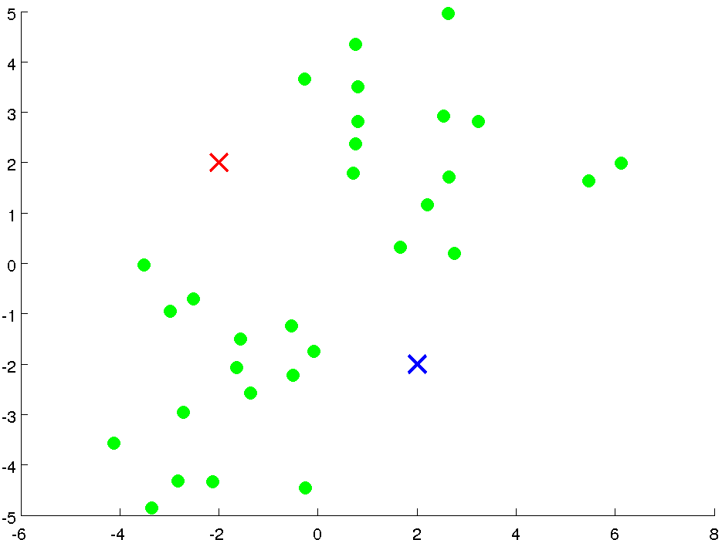

Slide 8
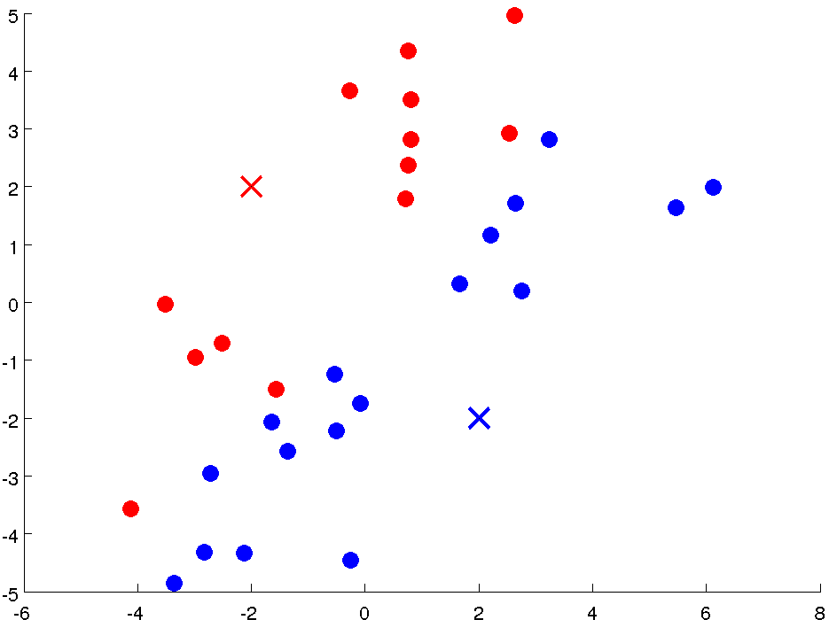

Slide 9
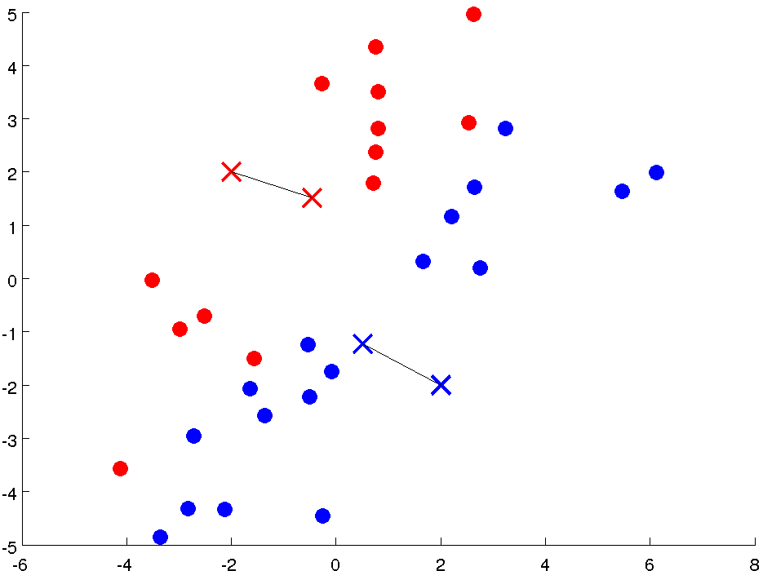

Slide 10
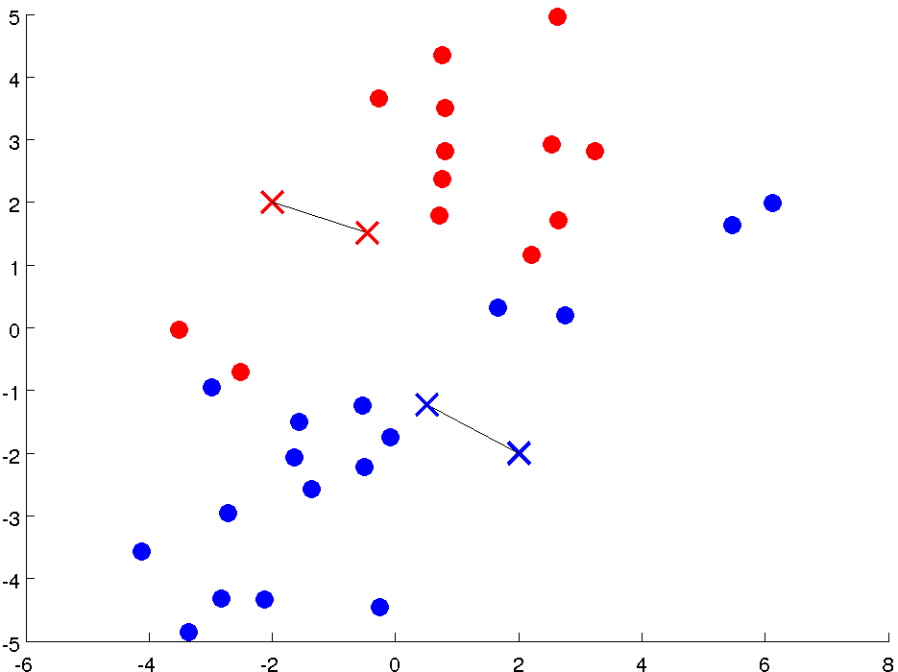

Slide 11
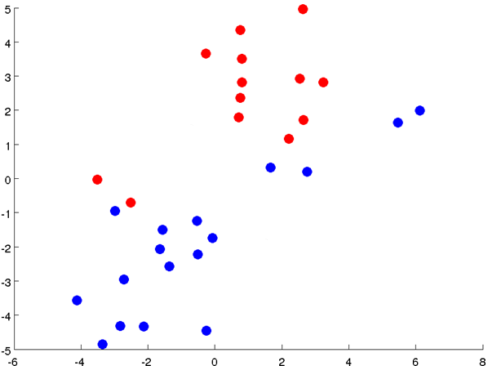

Slide 12
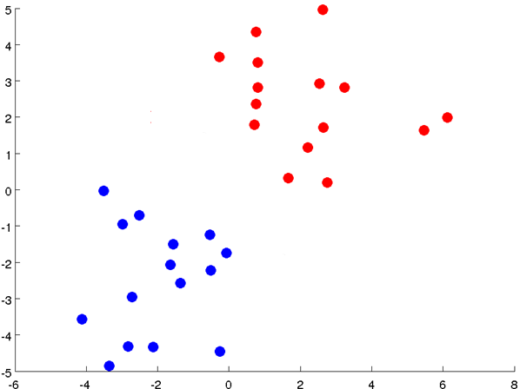

Slide 13
Notes:
Get rid of the legacy points

Slide 14
Notes:
Get rid of the legacy points

Slide 15

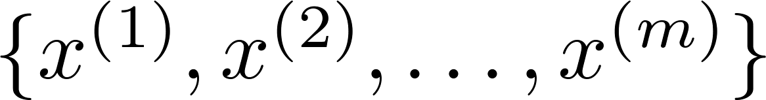
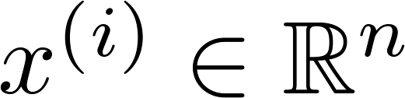
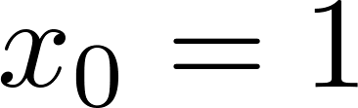
K-means algorithm
Input:
(number of clusters)
Training set
(drop convention)

Slide 16

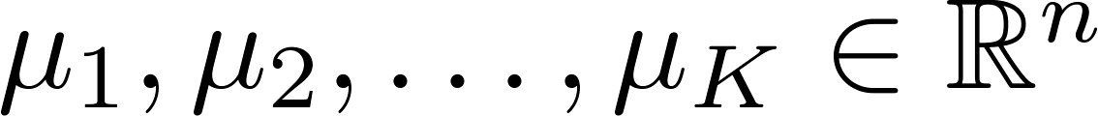
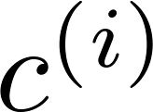
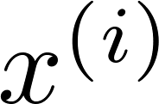

K-means algorithm
Randomly initialize cluster centroids
Repeat {
for = 1 to
:= index (from 1 to ) of cluster centroid
closest to
for = 1 to
:= average (mean) of points assigned to cluster
}
Notes:
Replace with normal text, size with LATEX fonts

Slide 17
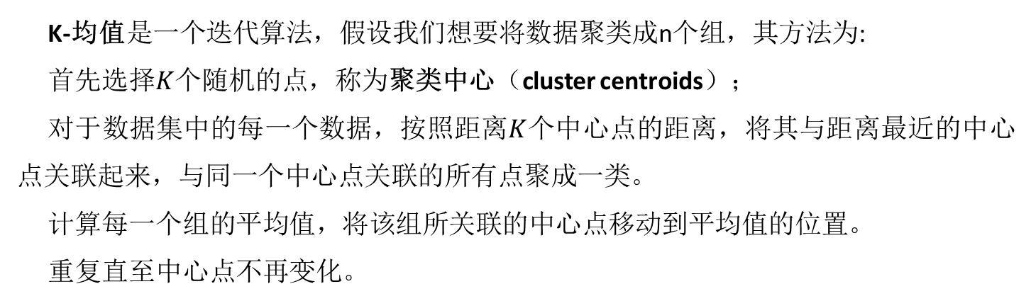
K-means algorithm
K-均值是一个迭代算法，假设我们想要将数据聚类成n个组，其方法为:
首先选择$K$个随机的点，称为聚类中心（cluster centroids）；
对于数据集中的每一个数据，按照距离$K$个中心点的距离，将其与距离最近的中心点关联起来，与同一个中心点关联的所有点聚成一类。
计算每一个组的平均值，将该组所关联的中心点移动到平均值的位置。
重复直至中心点不再变化。
Notes:
Replace with normal text, size with LATEX fonts

Slide 18
K-means for non-separated clusters
T-shirt sizing
Weight
Height

Slide 19
Optimization objective
Clustering

Slide 20

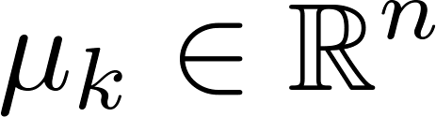
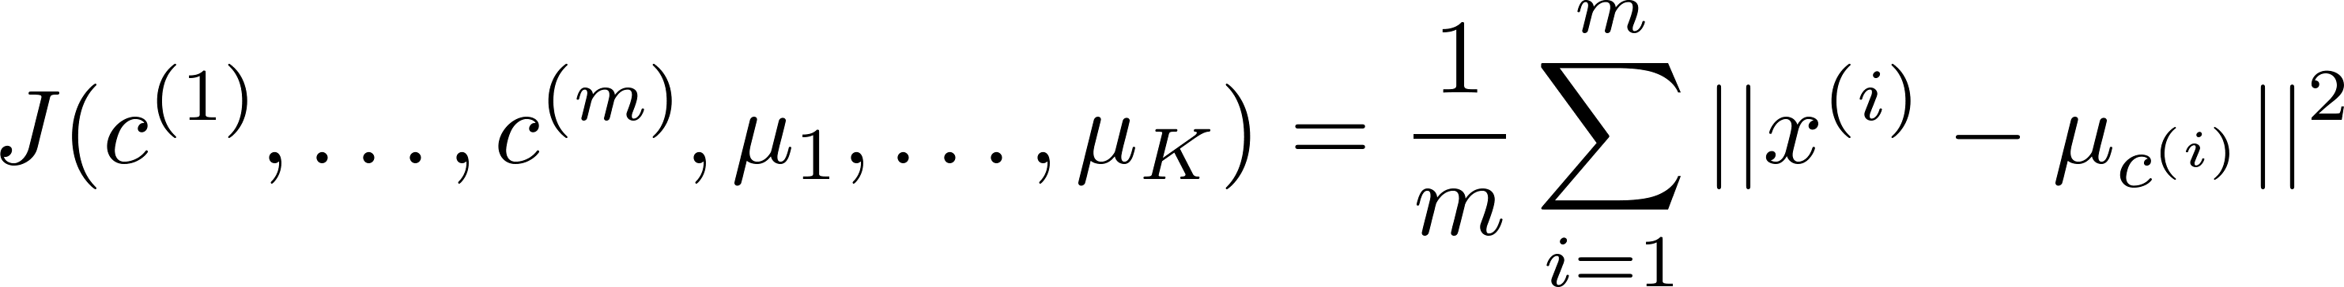
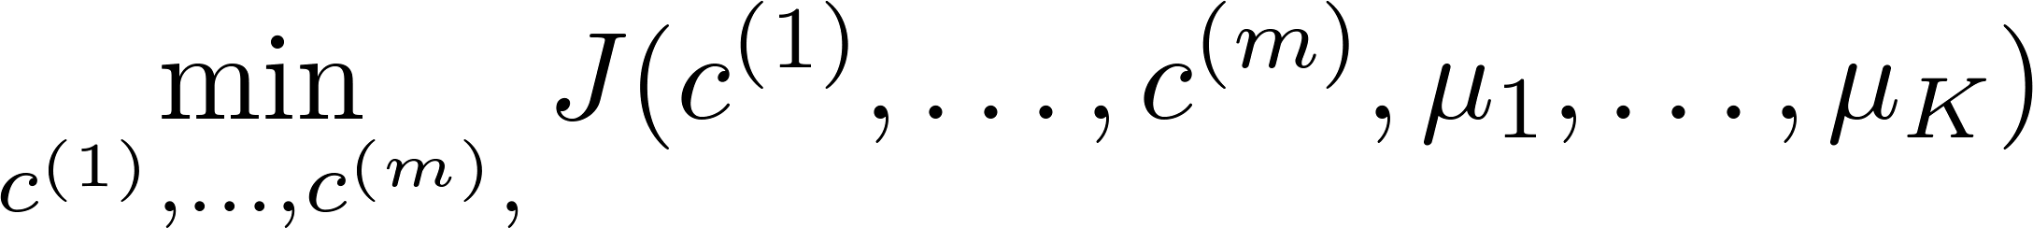

K-means optimization objective
= index of cluster (1,2,…, ) to which example is currently assigned
= cluster centroid ( )
Optimization objective:
Notes:
Change numbers to LATEX as well

Slide 21


K-means algorithm
Randomly initialize cluster centroids
Repeat {
for = 1 to
:= index (from 1 to ) of cluster centroid
closest to
for = 1 to
:= average (mean) of points assigned to cluster
}
Notes:
Replace as previous; change spacing to fill page

Slide 22

Random initialization
Should have
Randomly pick training
examples.
Set equal to these
examples.
Notes:
LATEX font

Slide 23
Local optima

Slide 24
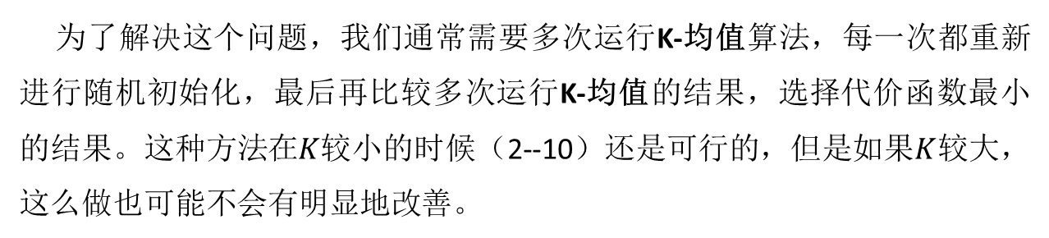
K-均值的一个问题在于，它有可能会停留在一个局部最小值处，而这取决于初始化的情况。
为了解决这个问题，我们通常需要多次运行K-均值算法，每一次都重新进行随机初始化，最后再比较多次运行K-均值的结果，选择代价函数最小的结果。这种方法在$K$较小的时候（2--10）还是可行的，但是如果$K$较大，这么做也可能不会有明显地改善。

Slide 25
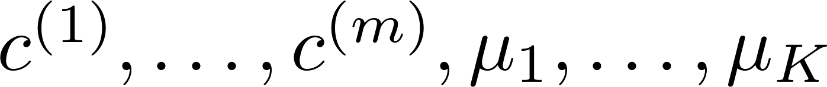
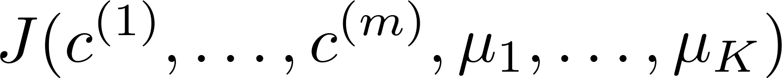
Random initialization
For i = 1 to 100 {
Randomly initialize K-means.
Run K-means. Get .
Compute cost function (distortion)
}
Pick clustering that gave lowest cost

Slide 26
Choosing the number of clusters
Clustering

Slide 27
What is the right value of K?

Slide 28

Choosing the value of K
Elbow method（ “肘部法则” ）:
Cost function
Cost function
(no. of clusters)
(no. of clusters)

Slide 29
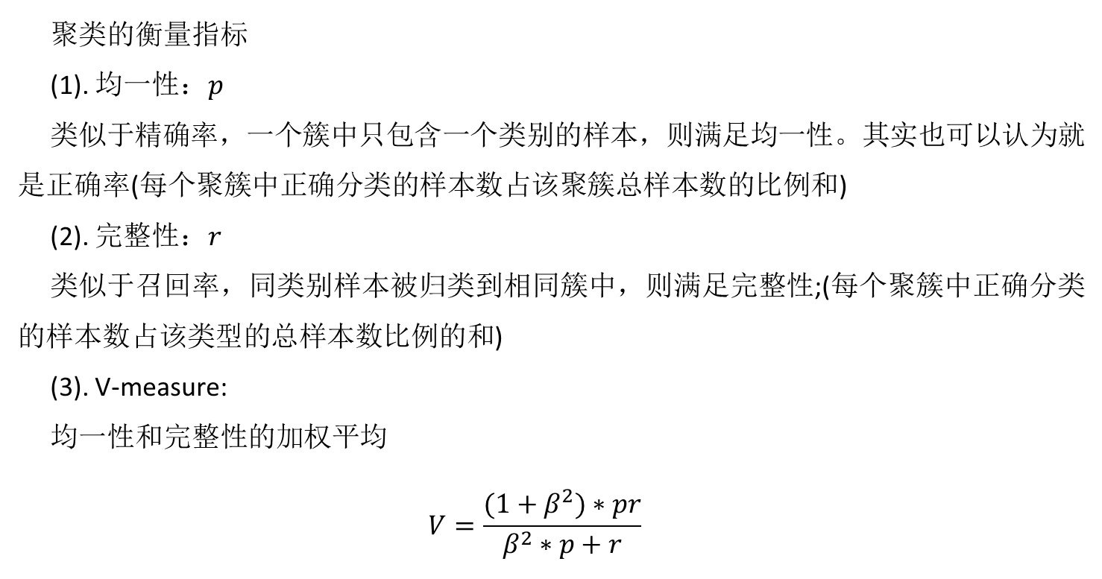
聚类的衡量指标
(1). 均一性：$p$
类似于精确率，一个簇中只包含一个类别的样本，则满足均一性。其实也可以认为就是正确率(每个聚簇中正确分类的样本数占该聚簇总样本数的比例和)
(2). 完整性：$r$
类似于召回率，同类别样本被归类到相同簇中，则满足完整性;(每个聚簇中正确分类的样本数占该类型的总样本数比例的和)
(3). V-measure:
均一性和完整性的加权平均
$$V=\frac{(1+β^{2})∗pr}{β^{2}∗p+r}$$

Slide 30
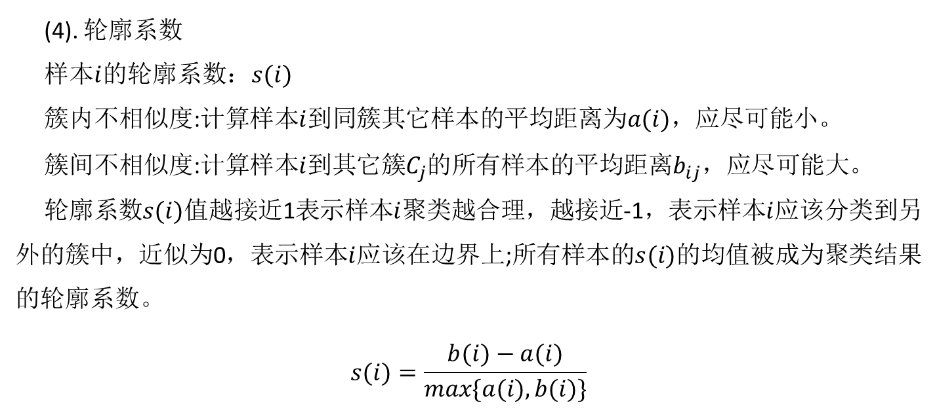
(4). 轮廓系数
样本$i$的轮廓系数：$s(i)$
簇内不相似度:计算样本$i$到同簇其它样本的平均距离为$a(i)$，应尽可能小。
簇间不相似度:计算样本$i$到其它簇$C_{j}$的所有样本的平均距离$b_{ij}$，应尽可能大。
轮廓系数$s(i)$值越接近1表示样本$i$聚类越合理，越接近-1，表示样本$i$应该分类到另外的簇中，近似为0，表示样本$i$应该在边界上;所有样本的$s(i)$的均值被成为聚类结果的轮廓系数。
$$s(i)=\frac{b(i)−a(i)}{max\{a(i),b(i)\}}$$

