Slide 1
过拟合问题 The problem of overfitting
正则化
Regularization

Slide 2
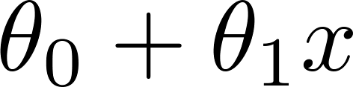
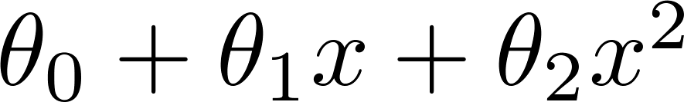
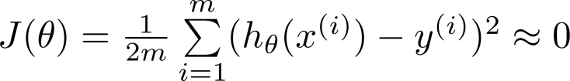
Example: Linear regression (housing prices)
Price
Price
Price
Size
Size
Size
Overfitting: If we have too many features, the learned hypothesis may fit the training set very well ( ), but fail to generalize to new examples (predict prices on new examples).

Slide 3
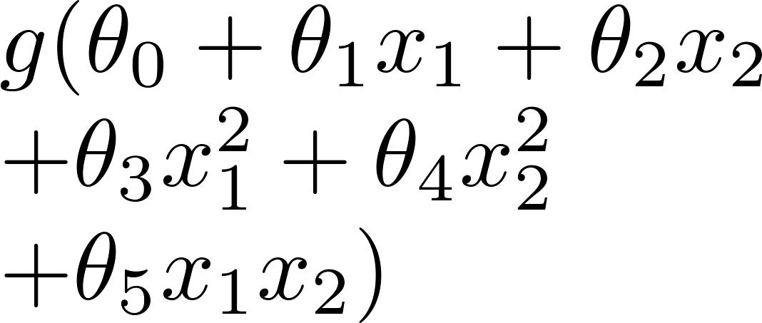
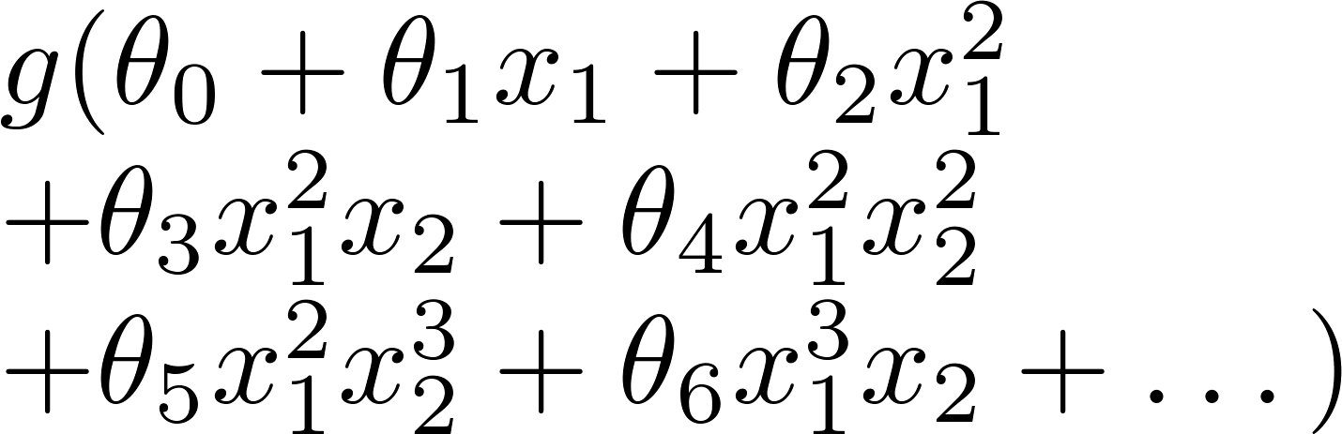
Example: Logistic regression
x₂
x₂
x₂
x₁
x₁
x₁
( = sigmoid function)

Slide 4


Addressing overfitting:
Options:
Reduce number of features.
Manually select which features to keep.
Model selection algorithm (later in course).
Regularization.
Keep all the features, but reduce magnitude/values of parameters .
Works well when we have a lot of features, each of which contributes a bit to predicting .

Slide 5


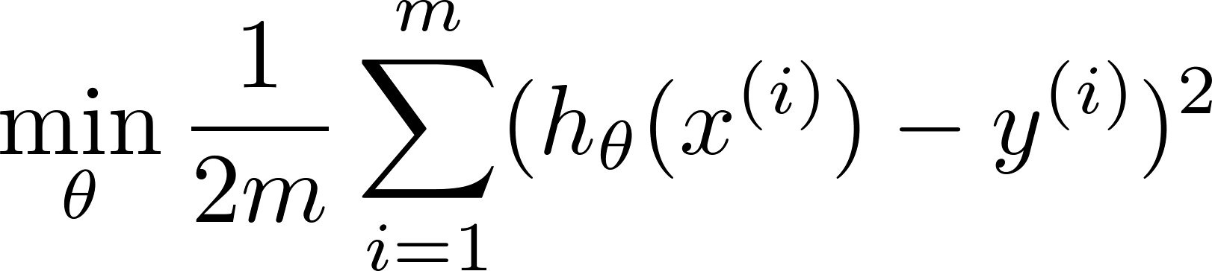

Intuition
Price
Price
Size of house
Size of house
Suppose we penalize and make , really small.

Slide 6
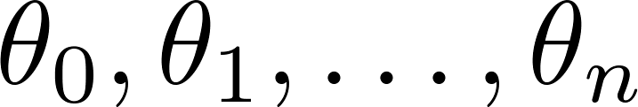
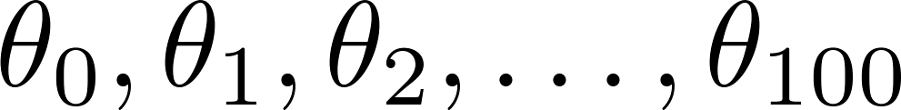

Regularization.
Small values for parameters
“Simpler” hypothesis
Less prone to overfitting
Housing:
Features:
Parameters:
$λ$又称为正则化参数（Regularization Parameter）

Slide 7

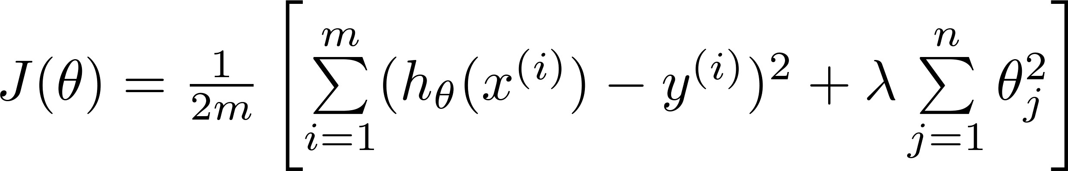

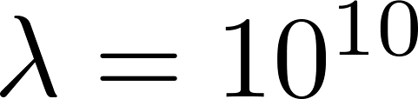
In regularized linear regression, we choose to minimize
What if is set to an extremely large value (perhaps for too large for our problem, say )?
Algorithm works fine; setting to be very large can’t hurt it
Algortihm fails to eliminate overfitting.
Algorithm results in underfitting. (Fails to fit even training data well).
Gradient descent will fail to converge.

Slide 8
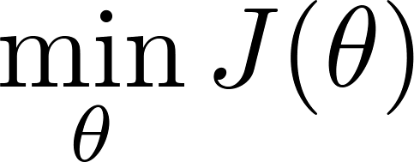
Regularized linear regression

Slide 9

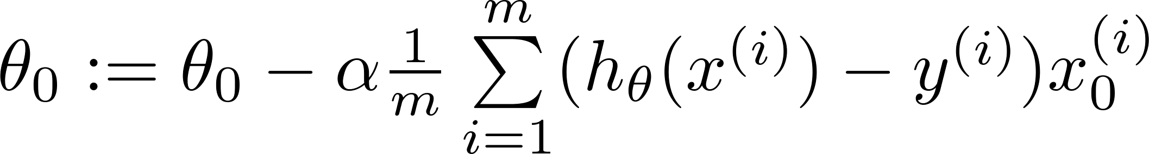


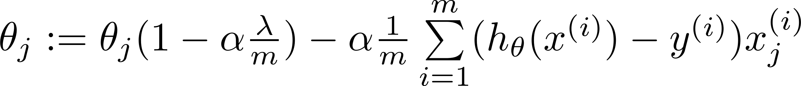
Gradient descent
Repeat
$θ_{j}:=θ_{j}−a[\frac{1}{m}\sum_{i=1}^{m}{\left(h_{θ}\left(x^{\left(i\right)}\right)−y^{\left(i\right)}\right)x_{j}^{\left(i\right)}}+\frac{λ}{m}θ_{j}]$

Slide 10
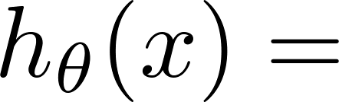
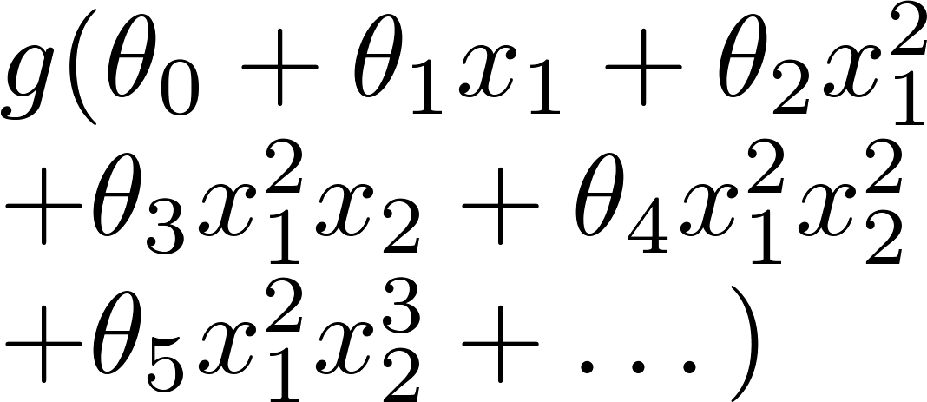
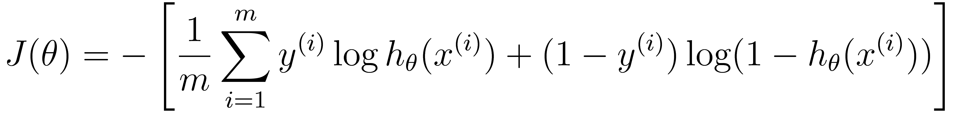
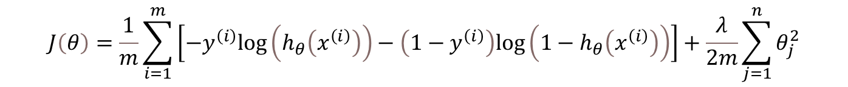
Regularized logistic regression.
x₂
x₁
Cost function:
$$J\left(θ\right)=\frac{1}{m}\sum_{i=1}^{m}{\left[−y^{\left(i\right)}log\left(h_{θ}\left(x^{\left(i\right)}\right)\right)−\left(1−y^{\left(i\right)}\right)log\left(1−h_{θ}\left(x^{\left(i\right)}\right)\right)\right]}+\frac{λ}{2m}\sum_{j=1}^{n}{θ_{j}^{2}}$$

Slide 11


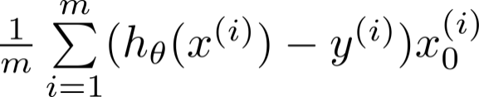

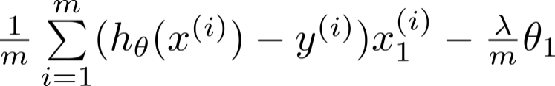

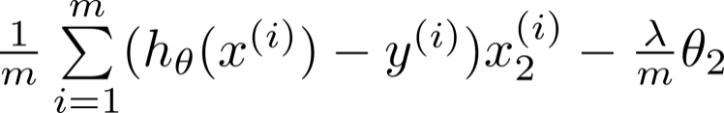

Advanced optimization
function [jVal, gradient] = costFunction(theta)
code to compute
jVal = [ ];
code to compute
gradient(1) = [ ];
code to compute
gradient(2) = [ ];
code to compute
gradient(3) = [ ];
code to compute
gradient(n+1) = [ ];

